Slide 1
Neutrino Oscillations
By: Justin Lara

Slide 2
Neutron mass eigenstates
Neutrinos have different states ( muon, tao, electron)
Oscillation between these states
Oscillation as it passes through time and space
In and out of phase

Slide 3
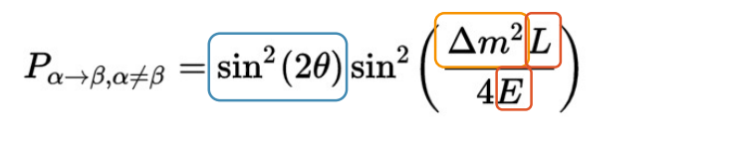
Probability of getting generations of neutrinos
We don't have a real way of defining what a neutrino will oscillate to
Based off our mixing angles
Probability of going from one neutrino to another (only 2 neutrinos assumed)
L/E is important for when you will see oscillations or survival of a certain neutrino state

Slide 4
Discrepancies
Matching data from the expected
Neutrino mass
Sterile neutrino
Imposes other ideas
More leptons

Slide 5
Main Problems
Normalising the third row within the mixing matrix
Like a basis for a vector space
Help to make more precise probability calculations
Maybe a four by four matrix?

Slide 6
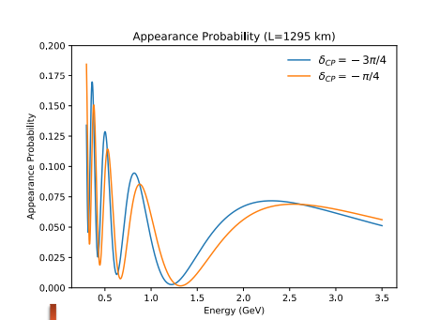
What do these oscillations tell us
In the three neutrino model the term delta cp term is used as a suppressive effect
If delta cp is 0 or π cp is not violated
Long baseline experiments test this

