Slide 1


Cancer Treatment with Nuclear Medicine
By: Anthony Montalvo
Internship: Brookhaven National Lab NuSTEAM
Institution: University of Texas Rio Grande Valley (UTRGV)

Slide 2
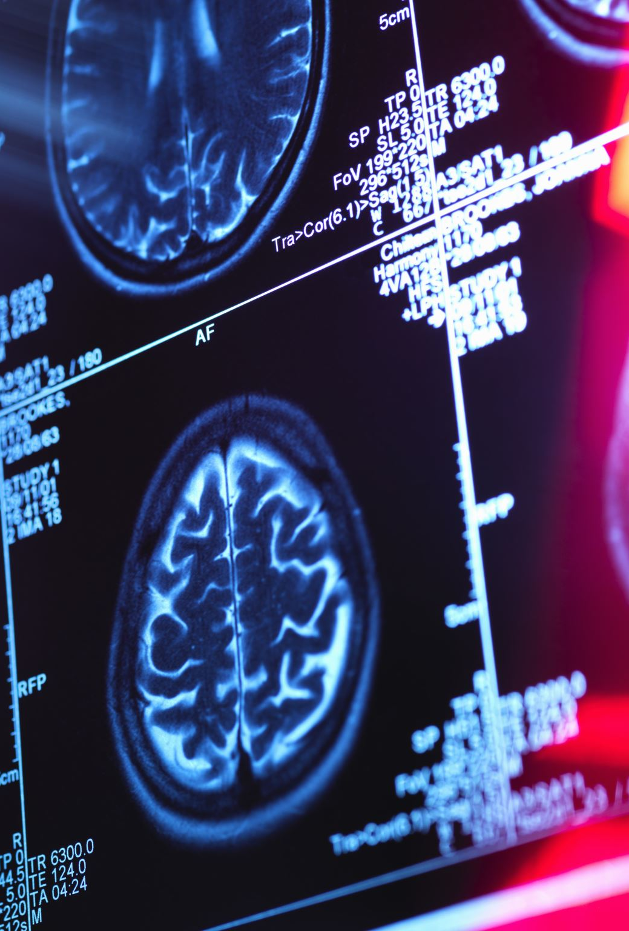
Introduction to Medical Physics
Medical physics is a field that applies the principles of physics to medicine, specifically in the diagnosis and treatment of diseases like cancer. It plays a critical role in imaging technologies such as PET, CT, and MRI, as well as in therapeutic tools like radiation therapy.
These applications rely on precise calculations, understanding of radiation, and advanced instrumentation to target and treat cancer safely and effectively.

Slide 3
Nuclear Medicine Technologies
Nuclear medicine is a branch of medical physics that uses small amounts of radioactive material to diagnose, manage, and treat cancer and other diseases. By using radiopharmaceutical compounds that combine radioactive isotopes with molecules targeting specific tissues, physicians can deliver highly focused radiation to tumors or visualize physiological processes at the molecular level.
This process is closely tied to particle physics because the detection of radiation relies on subatomic interactions and detector technologies that were originally developed for particle research. The same are applied to imaging and planning radiation therapy in nuclear medicine.

Slide 4
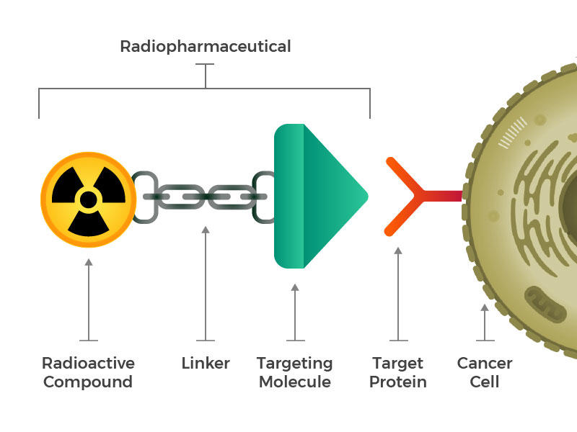
Radiopharmaceuticals in Use
Radiopharmaceuticals are drugs that contain a small amount of radioactive material and are usually given by injection. They travel through the body and release radiation from inside to help create images or treat disease.
They are specially designed compounds that carry radioactive atoms to specific parts of the body, usually cancer cells. For example, iodine-131 is used to treat thyroid cancer, while lutetium-177 and yttrium-90 (eh-tree-um) are used for tumors in the liver or neuroendocrine system.
These treatments work by attaching the radioactive isotope to a molecule that binds to cancer cells, allowing radiation to kill the tumor with minimal impact on healthy tissue.

Slide 5
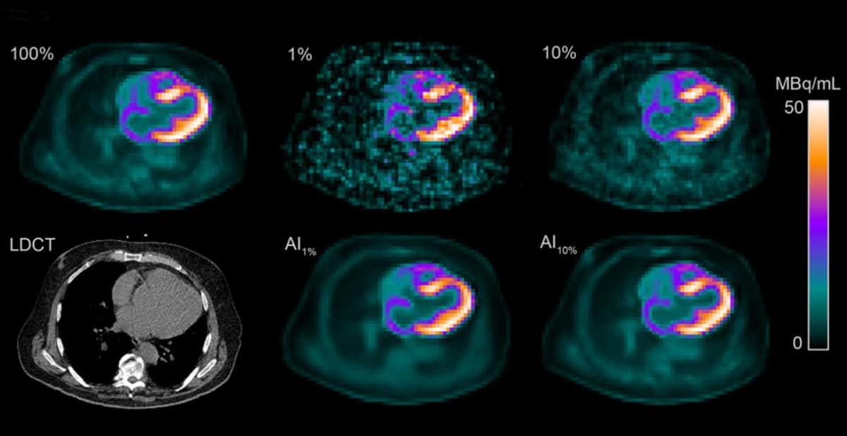
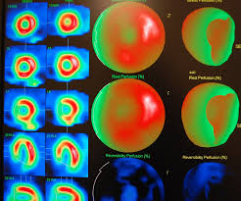
Diagnostic Imaging Techniques
PET (Positron Emission Tomography) and SPECT (Single Photon Emission Computed Tomography) are advanced imaging tools used in nuclear medicine.
PET uses tracers like fluorine-18 that emit positrons, which interact with electrons to create gamma rays that form an image.
SPECT uses gamma-emitting tracers such as technetium-99m, rotating around the patient to build 3D images.
These scans allow doctors to visualize tumors, assess organ function, and evaluate how well treatments are working.

Slide 6
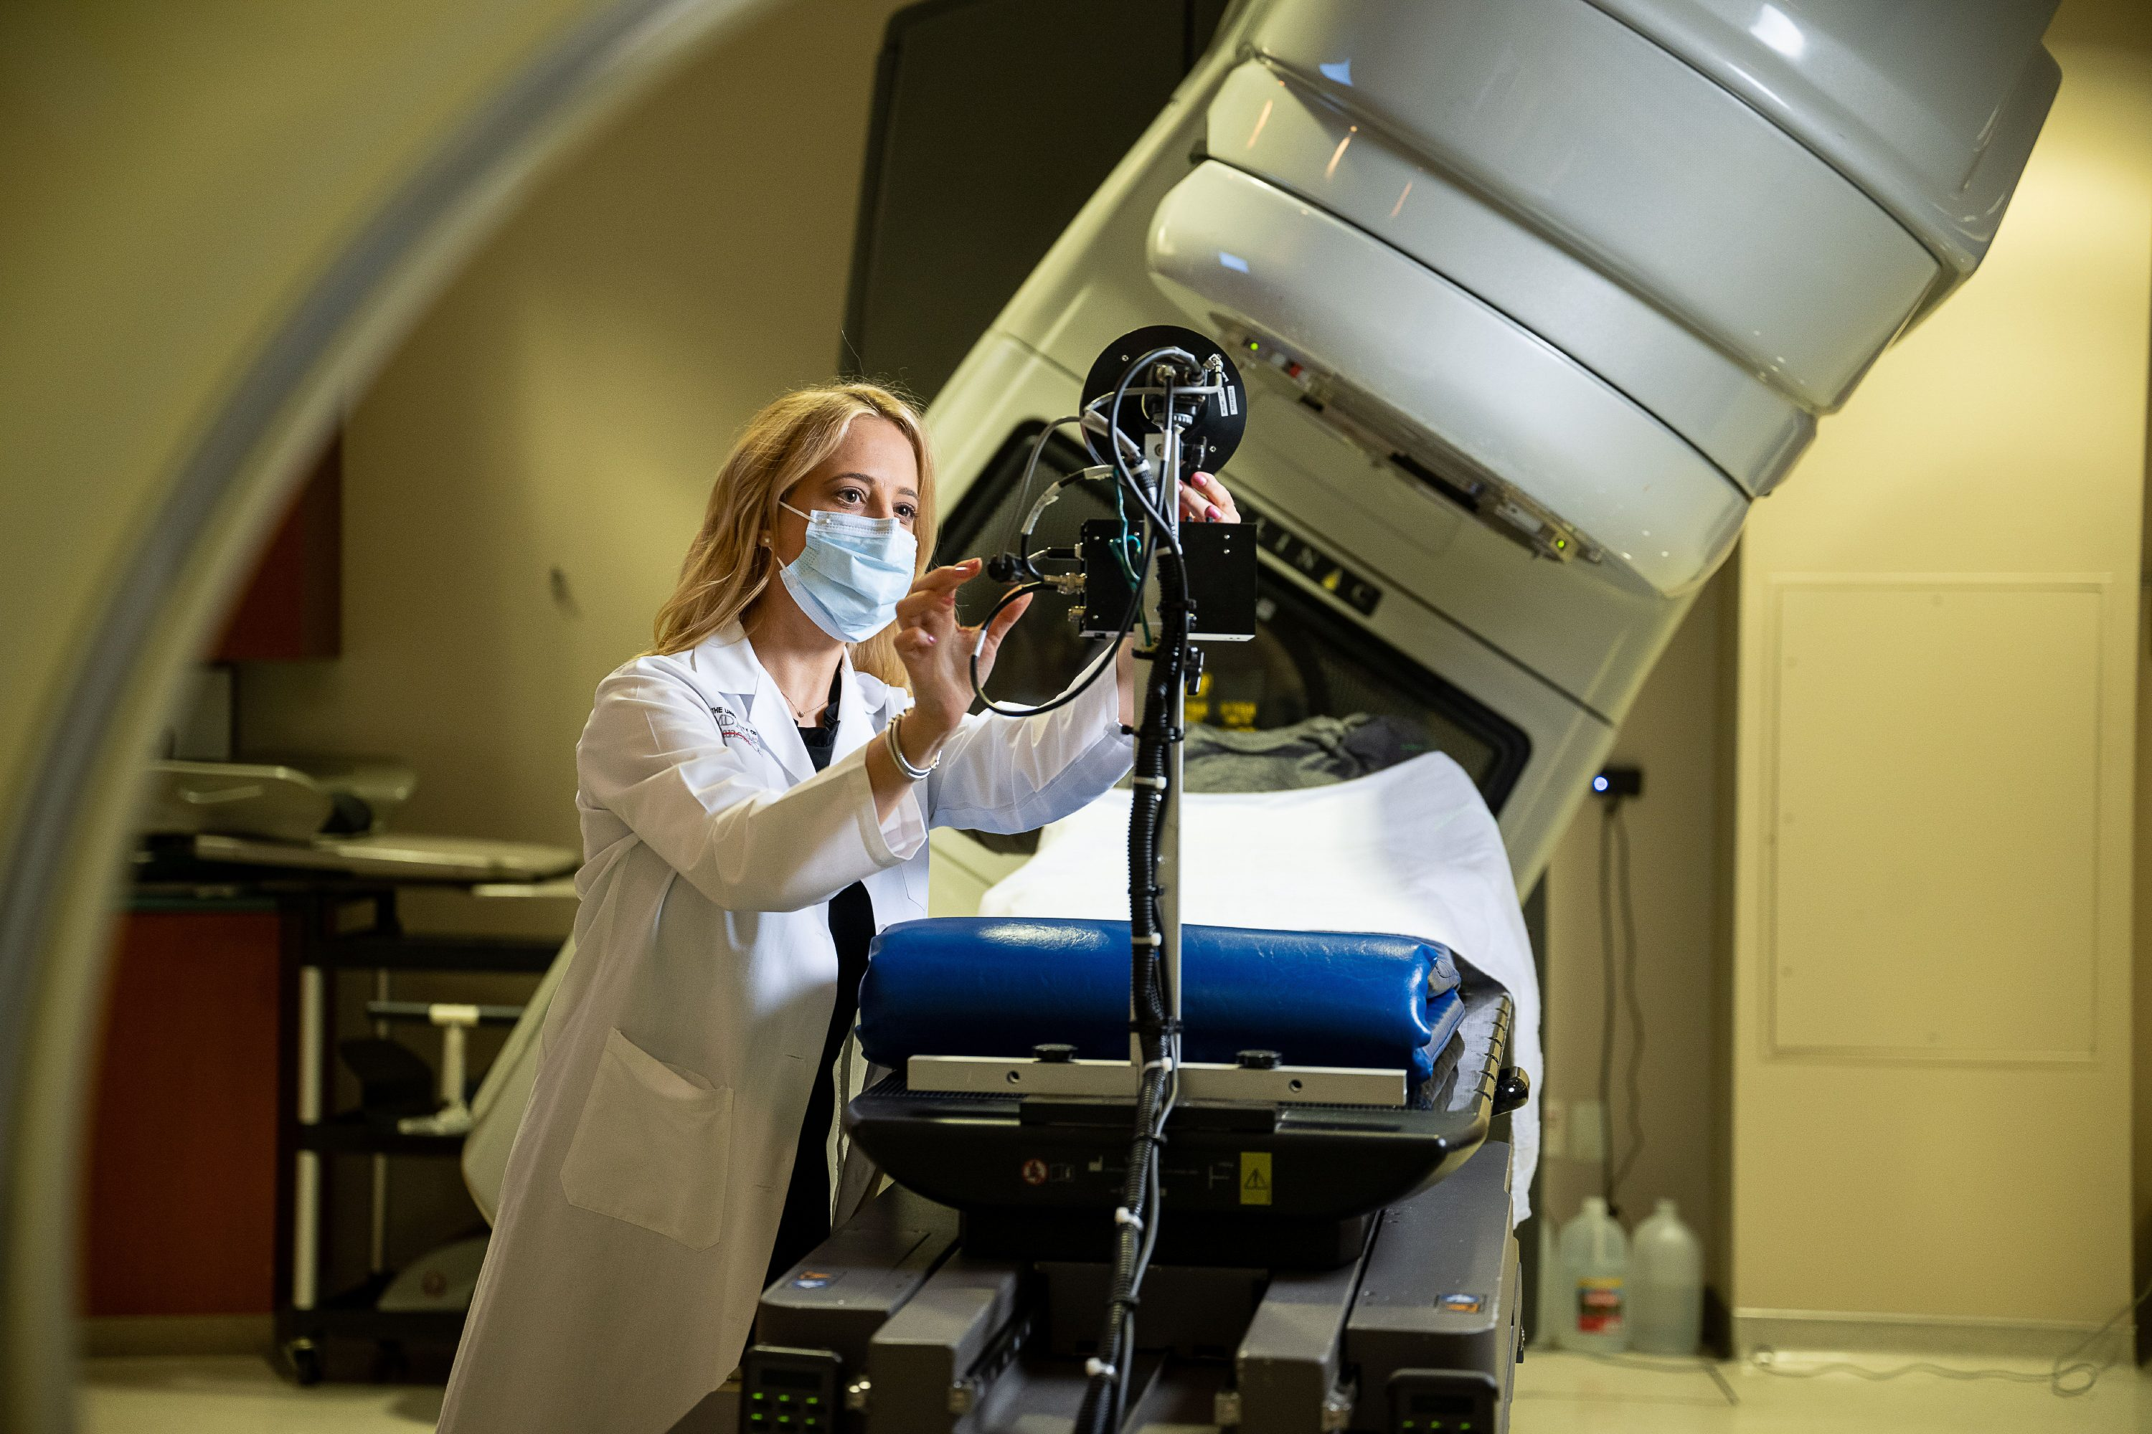
External Beam Radiation Therapy
External Beam Radiation Therapy (EBRT) delivers radiation from a machine outside the body directly to the tumor. A device called a linear accelerator (LINAC) is used to generate high-energy X-rays or protons/electrons.
Medical physicists plan the treatment using imaging software to calculate how much radiation the tumor should receive and from which angles. This approach is noninvasive and typically administered over several weeks.

Slide 7
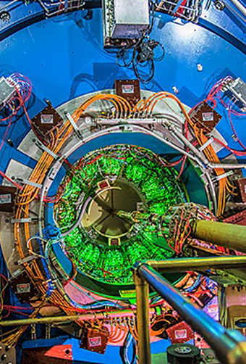
Connecting Particle Physics to Medical Imaging
The STAR detector is designed to track particles from heavy ion collisions at RHIC (Relativistic Heavy Ion Collider). It uses a Time Projection Chamber (TPC) to capture the tiny trails that charged particles leave as they pass through gas inside the detector. An electric field moves the electrons from those trails to sensors at the end of the chamber, where the data is processed to reconstruct the 3D paths of the particles.
PET scans work similar in medicine. A small amount of radioactive material, called a radiotracer, is injected into the body, and when it emits gamma rays, detectors pick them up to create detailed images of organs or tissues.

Slide 8
Cited sources
Dr. Zoomie. (2023, June 21). How do sodium iodide (scintillation) detectors work?. Nevada Technical Associates, Inc. |. https://www.ntanet.net/how-do-sodium-iodide-scintillation-detectors-work
Fresno State. (n.d.). College of Science and Mathematics. Biomedical Physics Program. https://csm.fresnostate.edu/medicalphysics/program/jobs.html
Mayo Clinic College of Medicine and Science. (n.d.). Medical physicist - explore healthcare careers - mayo clinic college of medicine & science. https://college.mayo.edu/academics/explore-health-care-careers/careers-a-z/medical-physicist/
MD Anderson Cancer Center. (n.d.). Imaging physics. MD Anderson Cancer Center. https://www.mdanderson.org/research/departments-labs-institutes/departments-divisions/imaging-physics.html
NCI Staff. (2020, October 26). Radiopharmaceuticals emerging as new cancer therapy. Radiopharmaceuticals Emerging as New Cancer Therapy - NCI. https://www.cancer.gov/news-events/cancer-currents-blog/2020/radiopharmaceuticals-cancer-radiation-therapy
University, W. S. (n.d.). What is medical physics?. Medical Physics. https://medicalphysics.med.wayne.edu/faq-students

