Slide 1
Pressurized Water Fission Reactors and Beta Decay
Mike Clemens

Slide 2
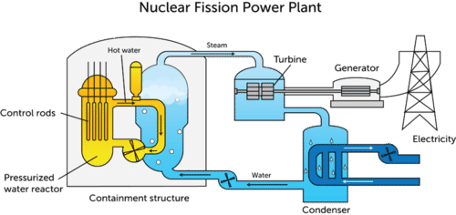

Slide 3
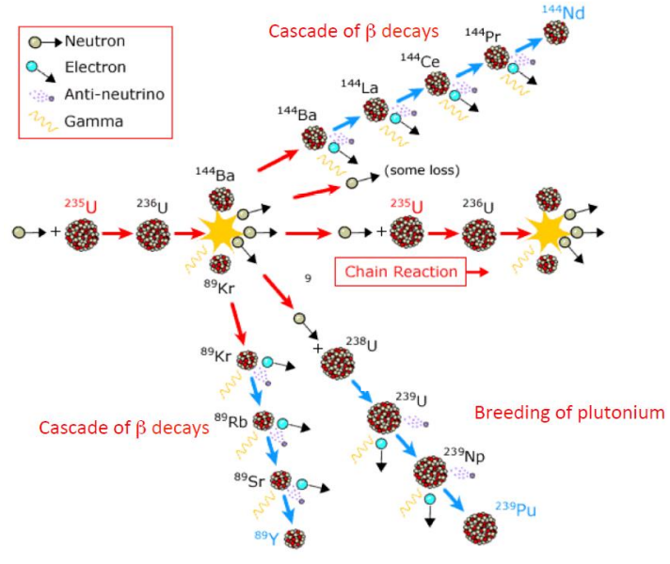

Slide 4
Beta Decay
Occurs in ~97% of all known unstable isotopes
β⁻ decay emits an electron and an anti-neutrino
  Changes the mass number, but not the element
β⁺ decay emits a positron and a neutrino
  Changes the element

Slide 5
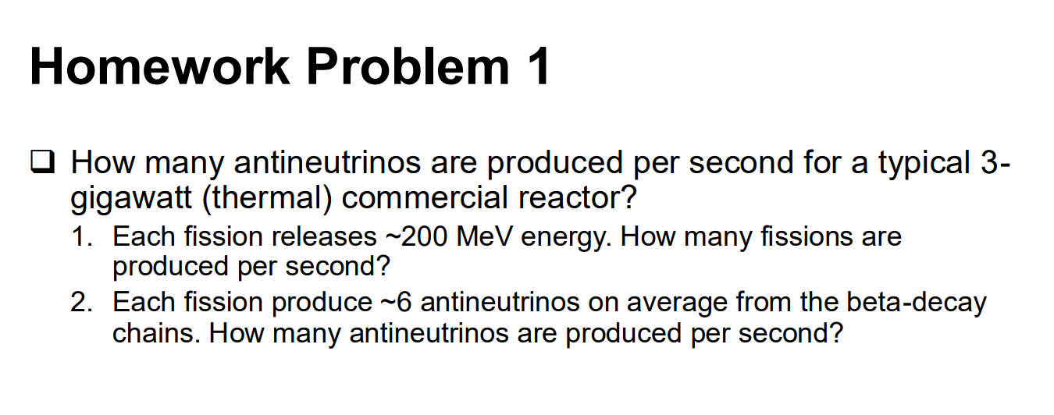

Slide 6
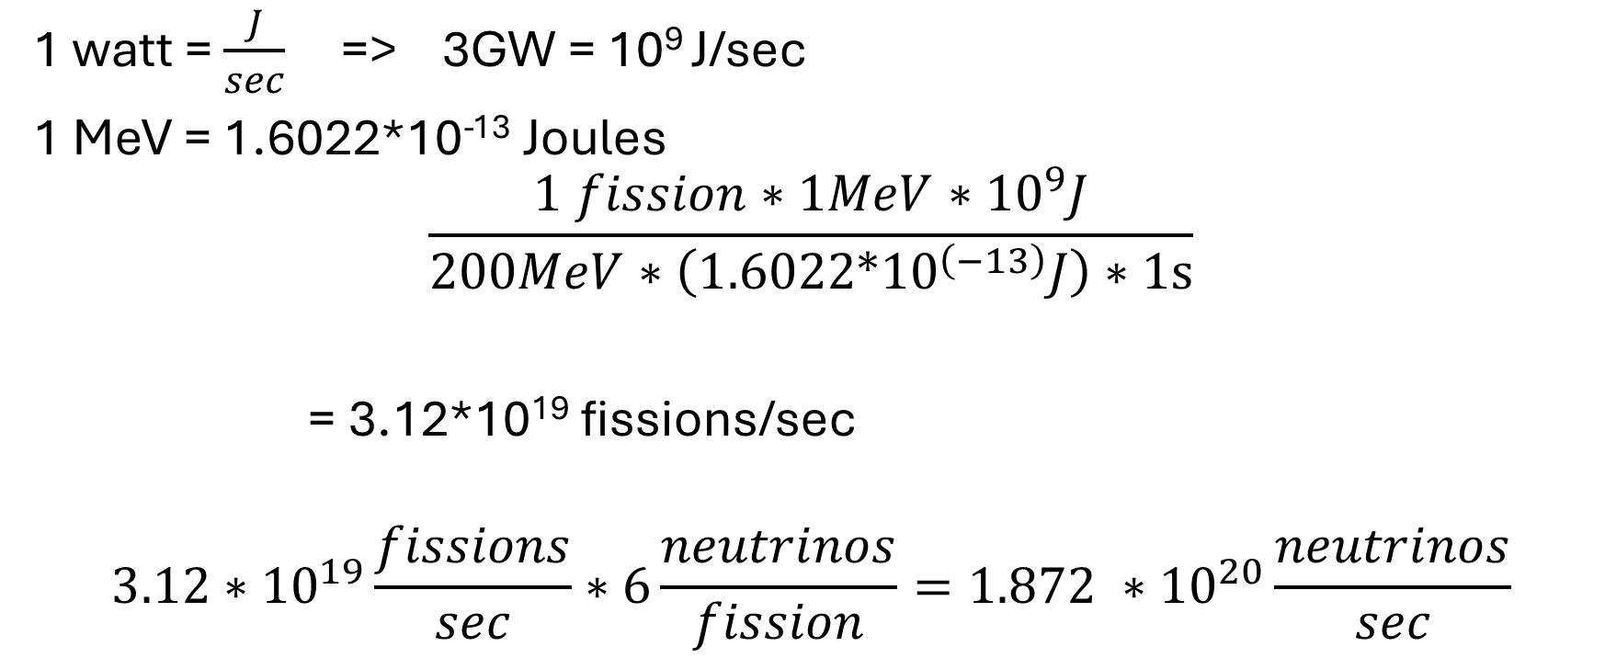
Homework Answer?
1 watt = $\frac{J}{sec}$ => 3GW = 10⁹ J/sec
1 MeV = 1.6022*10⁻¹³ Joules
$$\frac{1 fission∗1MeV∗{10}^{9}J}{200MeV∗\left(1.6022*{10}^{\left(−13\right)}J\right)∗1s}$$
= 3.12*10¹⁹ fissions/sec
$$3.12∗{10}^{19}\frac{fissions}{sec}∗6\frac{neutrinos}{fission}=1.872 ∗{10}^{20}\frac{neutrinos}{sec}$$

