Slide 1
Tachyons
Rafael Estrada
UH
Brookhaven

Slide 2


Background

Slide 3
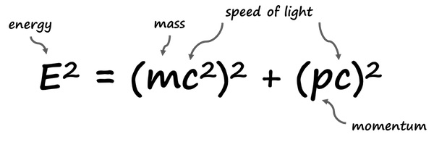
background
This is relativistic mass-energy relation established by Einstein.
RHS is energy, middle is rest-mass relation, and LHS is momentum relation.

Slide 4
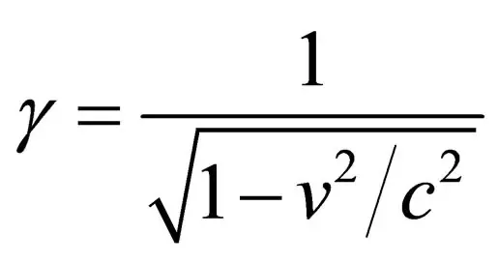
Gamma/Lorentz factor
This is responsible for:
Time dilation.
Length Contraction.
Note V cannot equal C***
If so, we divide by zero.
Note mathematically, there is nothing wrong with letting V go greater than C***

Slide 5

With some manipulations we arrive at:
Here E is total energy.
Gamma is Lorentz factor.
M is rest-mass.
C is speed of light.

Slide 6
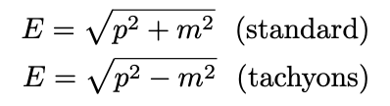
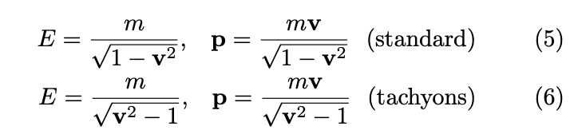
Rules made let’s break them.
Here we avoid imaginary mass.
Keep Lorenz invariance.

Slide 7
Ok math done, now where are they?
This is the hard part about them.
They might not even exist in our universe.
Notice how much we are limited by an energy problem here with the accelerators.
Then there’s a problem with dividing by zero and getting over that hump.

