Slide 1
Announcement:
Schedule for this afternoon:
  11:00am sPHENIX Lab Tour (Rachid Nouicer, room 2-211)
  1:30pm tour of SDCC (Meet lobby in front of Large Seminar Room at 1:20pm, we walk to 725)
NuSteam 7/9/2025

Slide 2
DAQ / Trigger
Jeff Landgraf
Overview of the collider and experiment
Overview of my experience of the operations of a Collider experiment
Trigger (how do we select what to readout)
DAQ how do we read out the data
How do we monitor and track the data we readout
The next generation (Electron Ion Collider / ePIC streaming DAQ)
NuSteam 7/9/2025

Slide 3
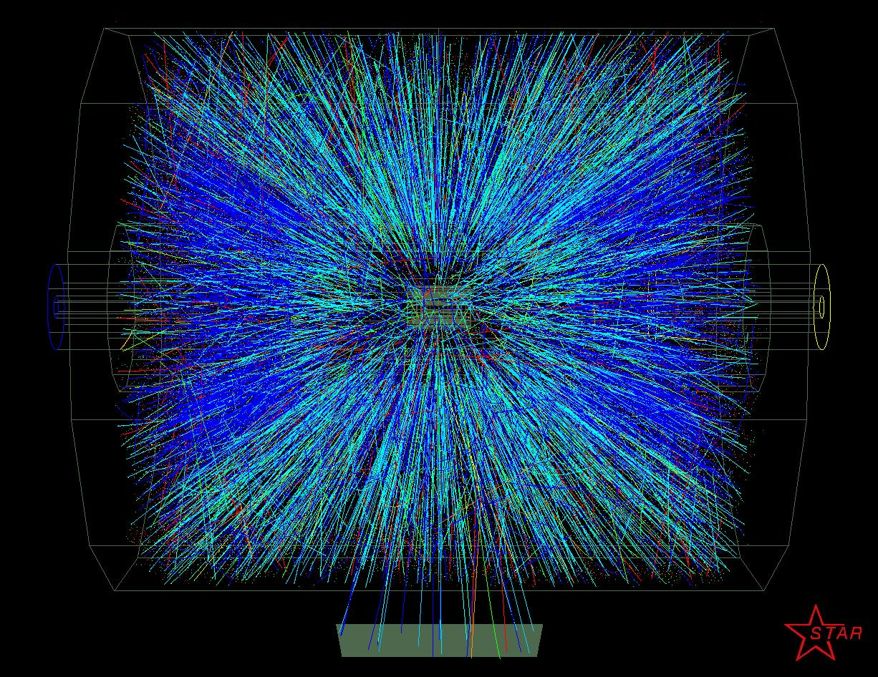
200 GeV Central Au-Au STAR event

Slide 4
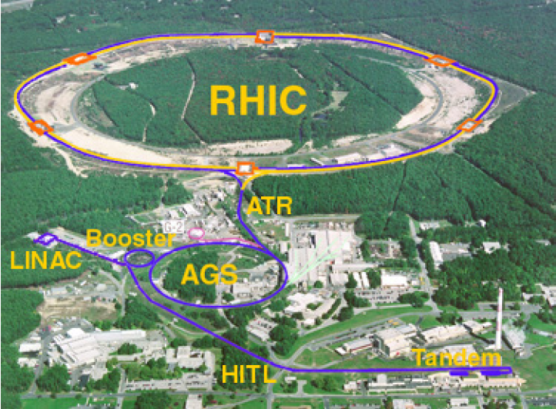
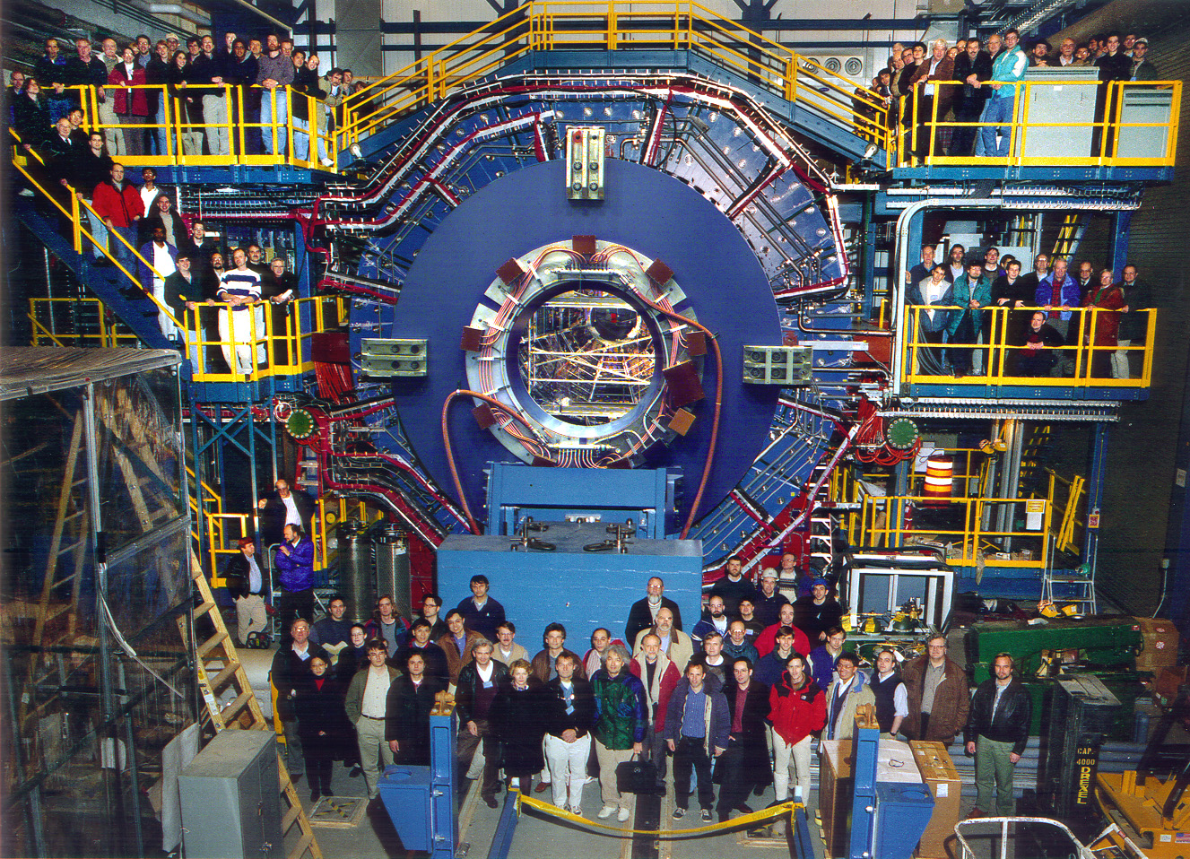
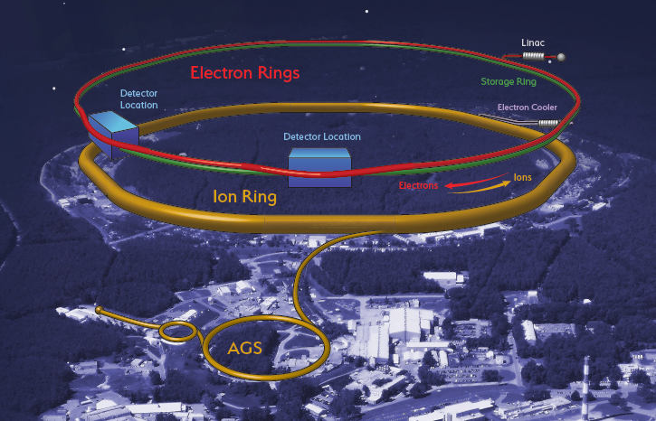
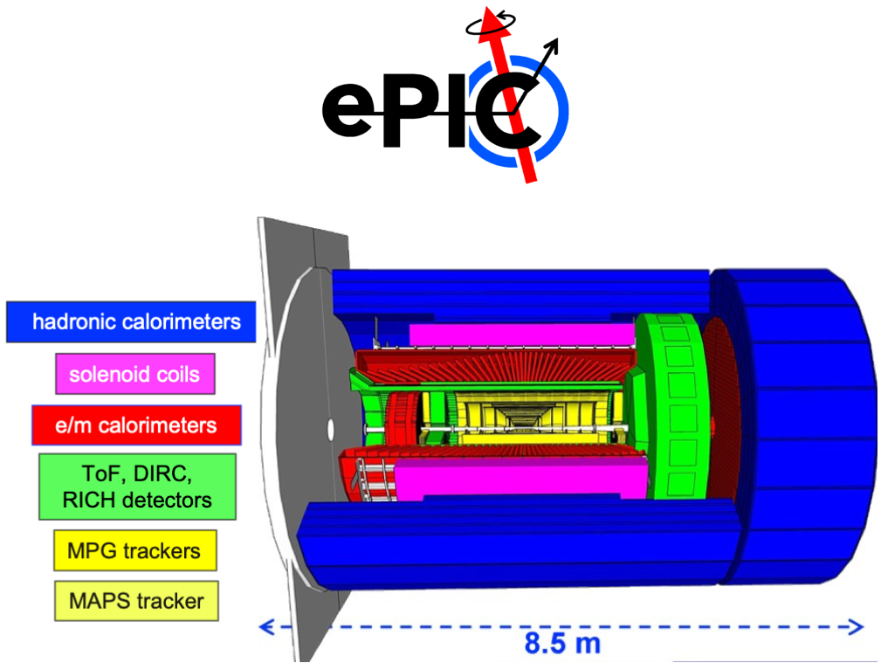
2000-2025
STAR
2030-
EIC

Slide 5
PR video’s from Athena:
PR Video | https://youtu.be/dnxF1-ILT-w
Low / High Q2 DIS | https://youtu.be/dXojLFQqbv0
DVCS | https://youtu.be/WKcZOZhmBLw
Upsilon Photoproduction (dielectron channel | https://youtu.be/9gevqYkSJEY
Upsilon Photoproduction (dimuon channel) | https://youtu.be/ZQn8r_Qdrzk

Slide 6
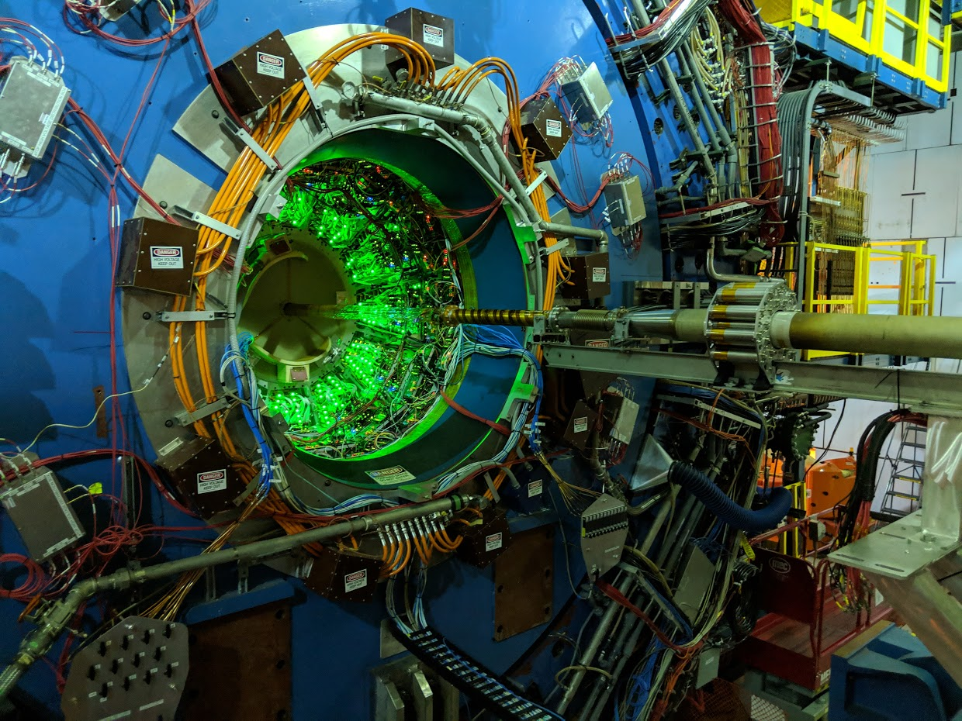
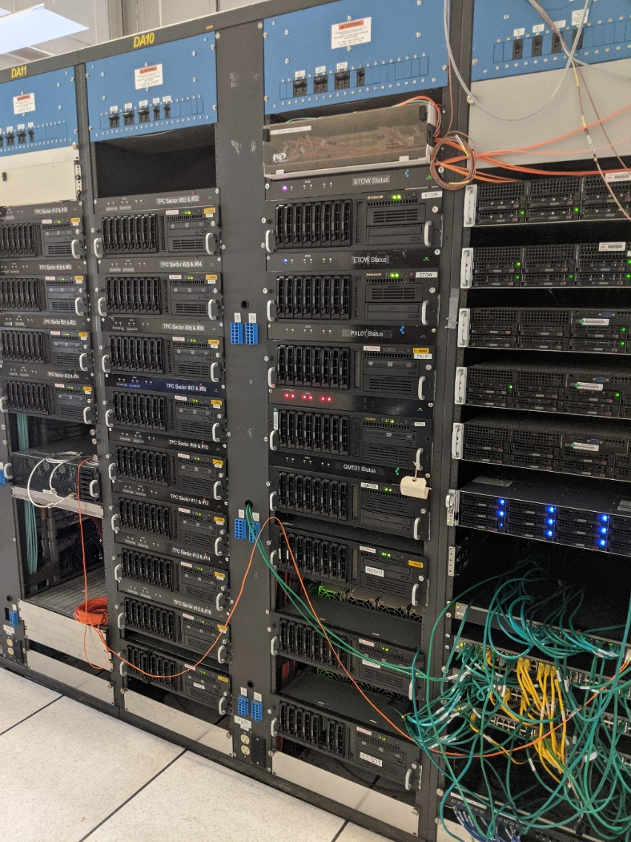
The STAR
Collaboration at RHIC
STAR is:
753 collaborators
70 institutions / 14 countries
RHIC collides protons, gold
and anything in between.
Maximum energy:
200 GeV / nucleon
500 GeV for protons
Heavy Ion & Polarized Proton
Programs

Slide 7
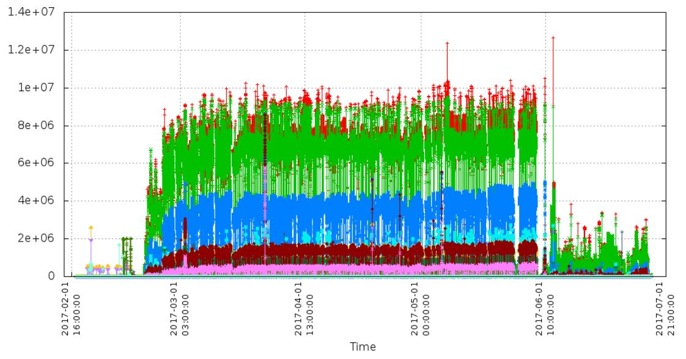
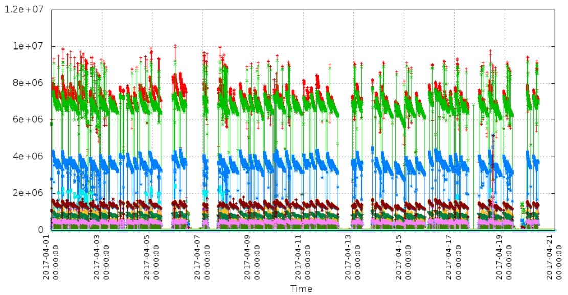
2017 RHIC run
proton/proton 500GeV
Au / Au
54 GeV
- RHIC Runs 5-6
Months / Year
- 2-3 Species / Year
- Running Conditions
Vary by species!
- Often exponential
Decay during fill
- Maintenance Shift
Every 2 weeks
- Machine Development
- Beam Experiments

Slide 8
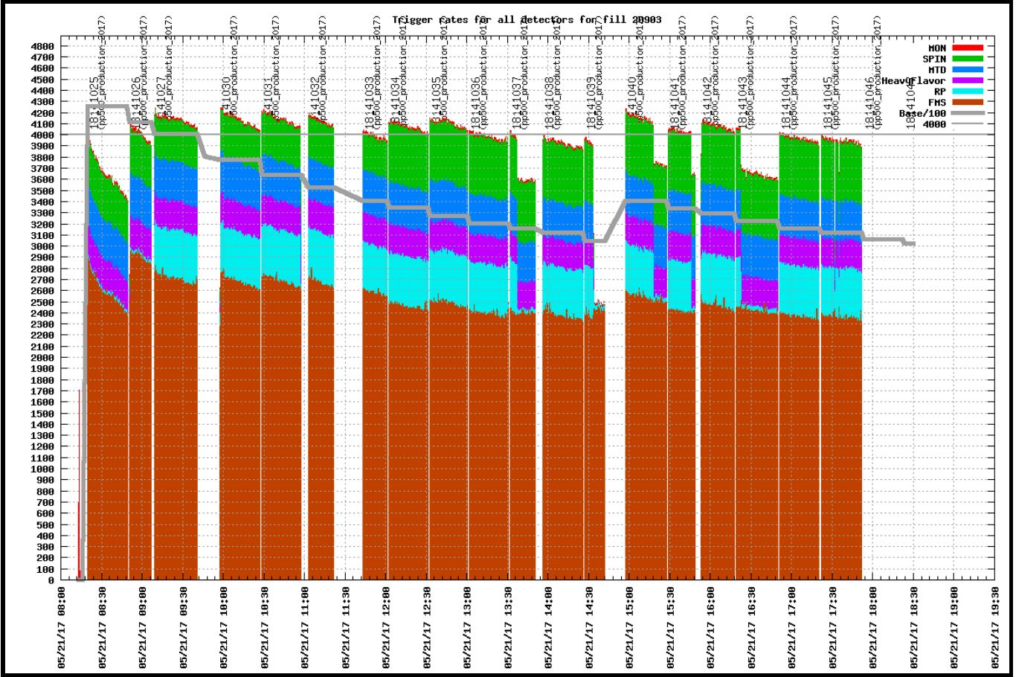
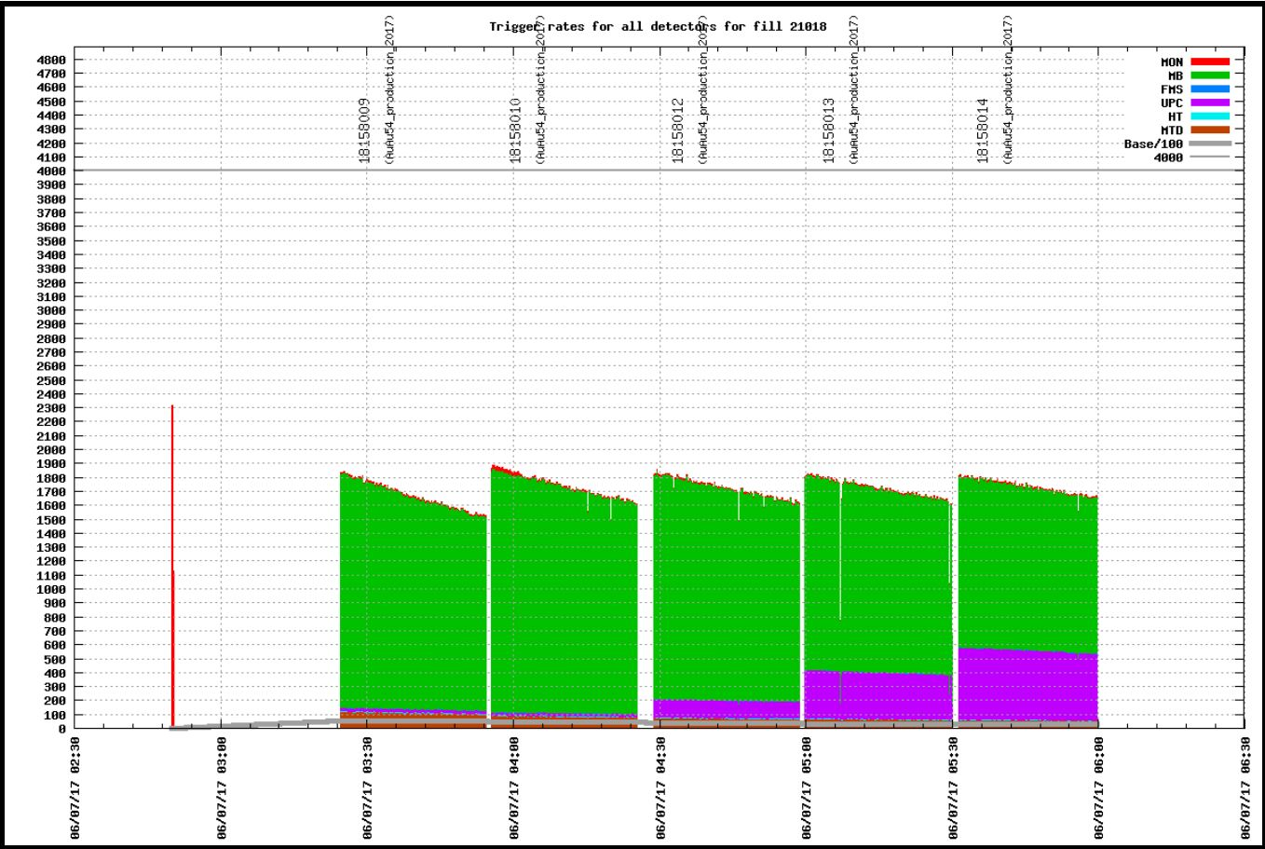
Proton / Proton 500GeV
- Long Fills
- High Rates
- Complex Trigger
- Radiation Issues
* Detector Failures
* Detector Omission
Au / Au 54GeV
- Short Fills
- Lowish Rates
- Simple Trigger
- Few failures

Slide 9
Types of Tasks
Roles:
  STAR: 25+ years as DAQ/trigger expert, part of operations management team
  “Control account manager” of DAQ for ePIC project
  Convener of DAQ Working Group for ePIC collaboration
Operations Tasks for STAR while running:
  Daily meetings
    Current status/problems
    Tracking progress towards long term goals (modifying configuration of detector, suggesting/reacting to modifications to collider running mode)
  Monitoring / debugging (~100 computers, thousands of channels of custom electronics) --> daily failures…
STAR tasks while shut down (up through 2024):
  Detector upgrades
  Software upgrades
  Hardware upgrades
ePIC tasks:
  Many meetings
  Specification documents
  Defining Cost / Schedule / activities
  Organizing tests (timing / performance / radiation effects)
  Analyzing simulation data (to define data volume requirements)
  Conferences - giving talks, listening to talks
  Reviews – present the status of the design and prototypes

Slide 10
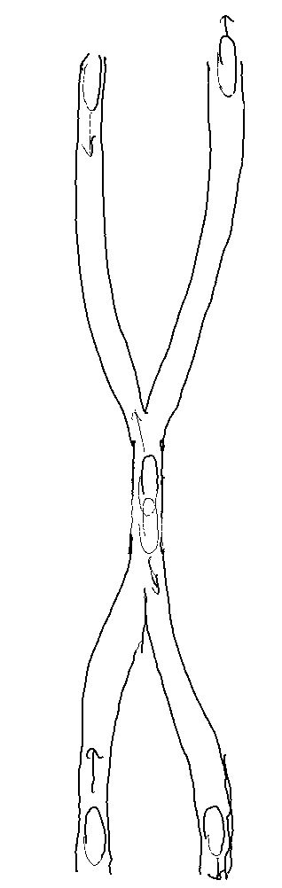
Bunches:
* The ions / protons travel in bunches (~10^11 particles per bunch)
* The bunches arrive at STAR every 109ns (9.3MHz)
* The trigger and detector electronics are driven by this RHIC clock.
* The bunches tend to be fairly long. The width of the vertex distribution
can be from ~20cm to 1m depending on the running conditions.
* There is a gap of unfilled bunches in each ring.
* During polarized proton running the bunches have different polarization which
means we must track the luminosity bunch by bunch.

Slide 11
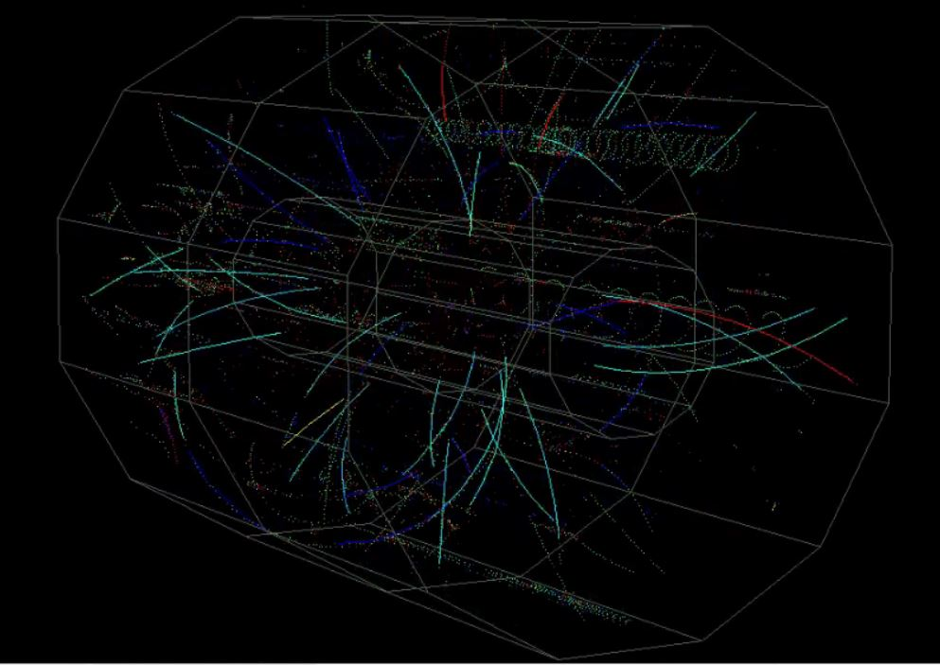
Time Scales:
Original Conception Of
STAR Trigger:
L0 decides within ~1.7us
L1 can abort during the
drift of the TPC (40us)
L2 can abort during the
Readout of the TPC
(originally up 10ms)
L3 can abort before
Building events (1Hz)
STAR Physics << 1ps
Time for particles to exit STAR ~ 10ns
Time between bunch crossings ~ 109ns
Average Time between collisions ~ (1us – 200us)
TPC Drift Time ~ 40us
Time to read out event (TPC) ~ 300us
Time to flush event out of system ~ 1s
Time to flush event out of event buffer ~ 1day

Slide 12
The Trigger Detectors:
Trigger detectors are capable of reading out every bunch crossing!
- Some read out all of their data each bunch crossing (ZDC, BBC, EPD, VPD…)
- Others read out a useful portion of their data each bunch crossing (EMC’s, TOF)

Slide 13
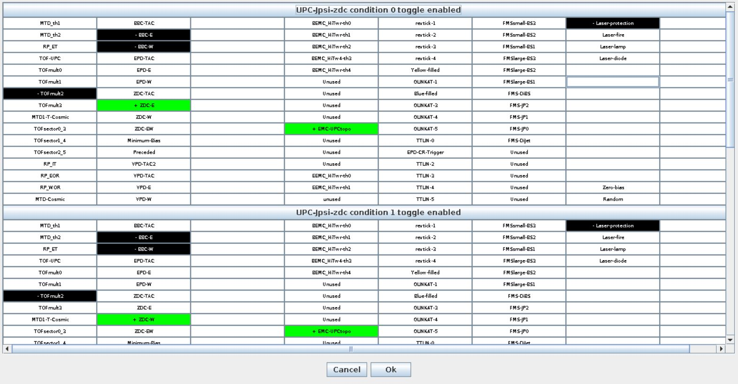
The Brains of the L0 Trigger (Trigger Control Unit):
TCU
128 Input Bits From
Trigger Detectors
20 bits to the DAQ detectors
(+16 bits specifying
which detectors)
16 Busy Signals
From Detectors

Slide 14
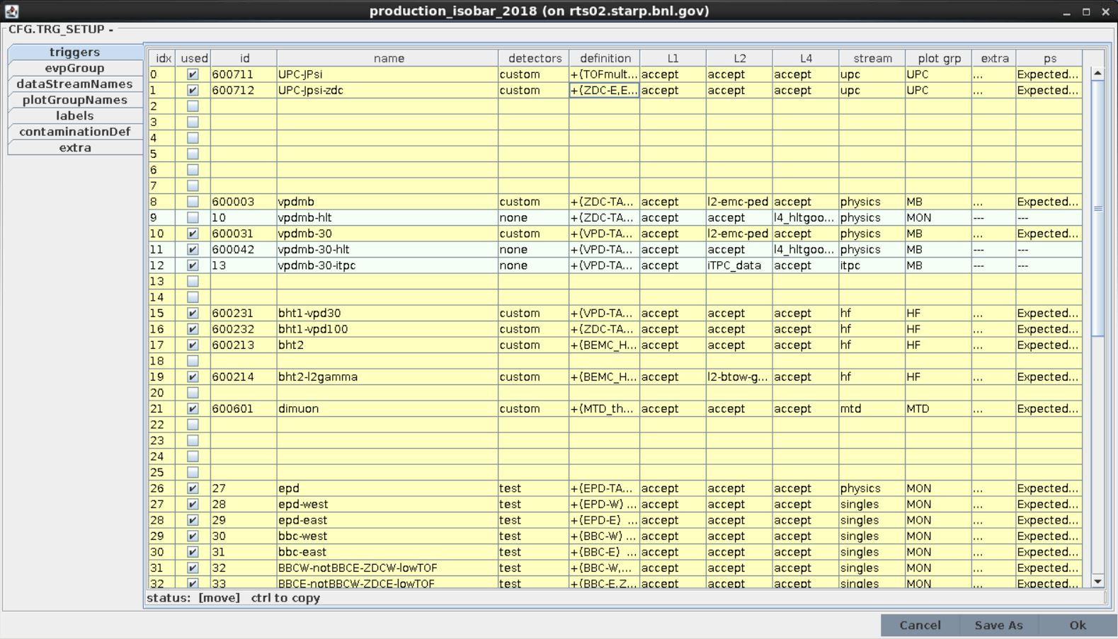
The Configuration File:
- The TCU supports up to 64 independent triggers running at the same time
- The concept of a trigger in STAR requires that ALL of the conditions L0 / L1 / L2 and HLT
be fully specified.
- Rates are specified by a single prescale for every run, but that prescale can be specified by a program.

Slide 15
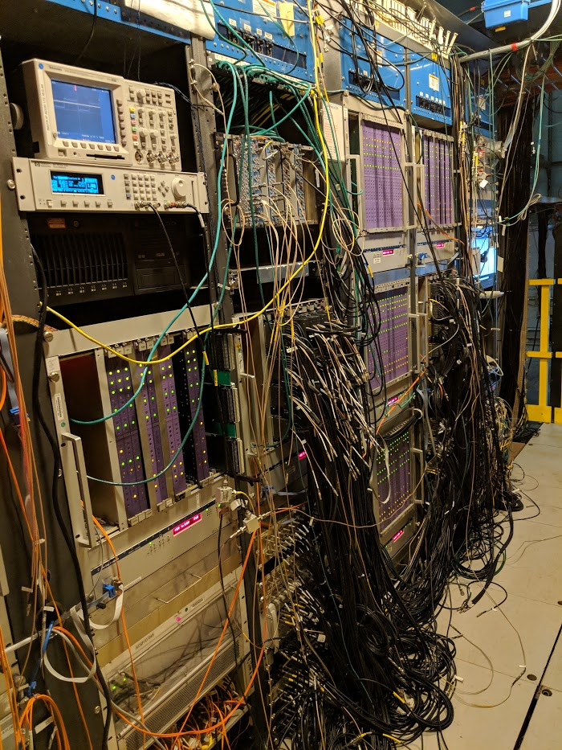
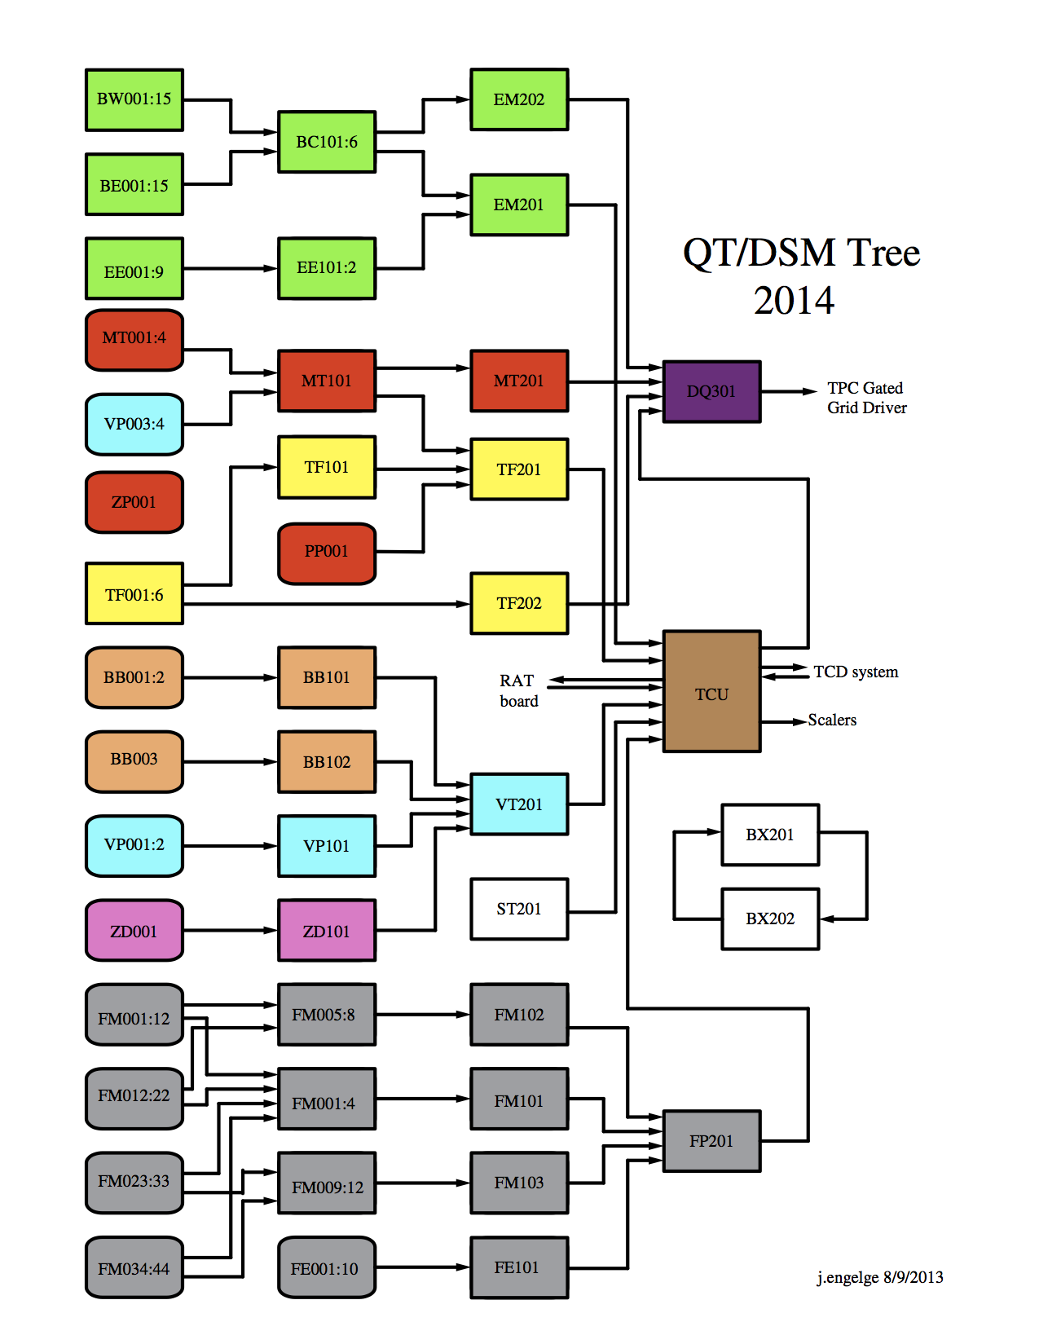
Getting The 128 Bits
To the TCU (The DSM / QT Tree):

Slide 16
Getting The 128 Bits
To the TCU (The DSM / QT Tree):
- DSM are programmable FPGA based boards with
128 inputs bits and 32 bits outputs.
- The QT have a similar role, but can handle some
analog input data.
- They receive the data directly from the electronics
Of the various trigger detectors.
- They are arranged in 3 layers, and the boards
within a layer have no information from
the other boards in the same layer.
- They can have different code running each time
A run is configured, so we have a protocol
To group the firmware with along with appropriate
Labels in the run control software.
- The DSM crates are connected to a computer
called L2 using a custom network called STP.
L2 gathers the data from all of the DMS/QT boards
And ships it to DAQ.

Slide 17
After the TCU decides to trigger an event:
TCU
TCD
Detectors
TCD
Detectors
TCD
Detectors
TCD
Detectors
20 Bits
Trigger Info
TCD
Detectors
TCD
Detectors
20 Bits
Trigger Info
16 Bits
Which TCD
The Trigger Info is:
12 Bits Token. A unique identifier for the event until
the all of it’s components can be assembled.
4 Bits Trigger command (laser / pulser / configuration evt/ physics)
4 Bits DAQ command (read raw)
*** The detectors have no information as to what trigger fired!

Slide 18
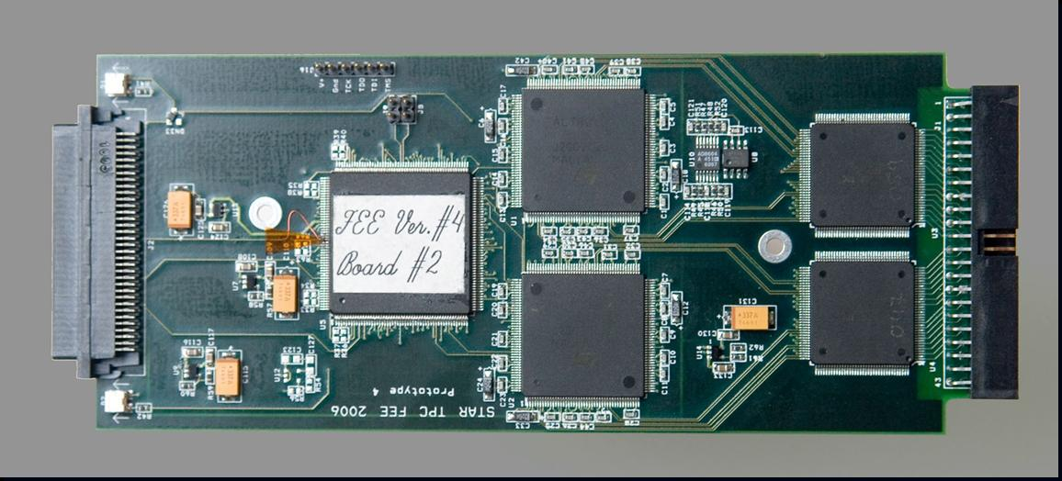
Not So Random Detector Example (TPX – the outer part of the TPC):
- 96 RDO’s contain a fiber back to
TPX DET computer.
- 18 FEE’s / RDO
- Black Event ~50MB
- The fee’s use ALICE’s ALTRO chip
* digitization
* pedestal subtraction
* tail cancellation
* zero suppression
- Electronics alone reduces event
Size to about 2-12MB
- 36 TPX DET computers perform
2 dimensional cluster finding to
Reduce data volume down to
.25 – 2 MB/event.

Slide 19
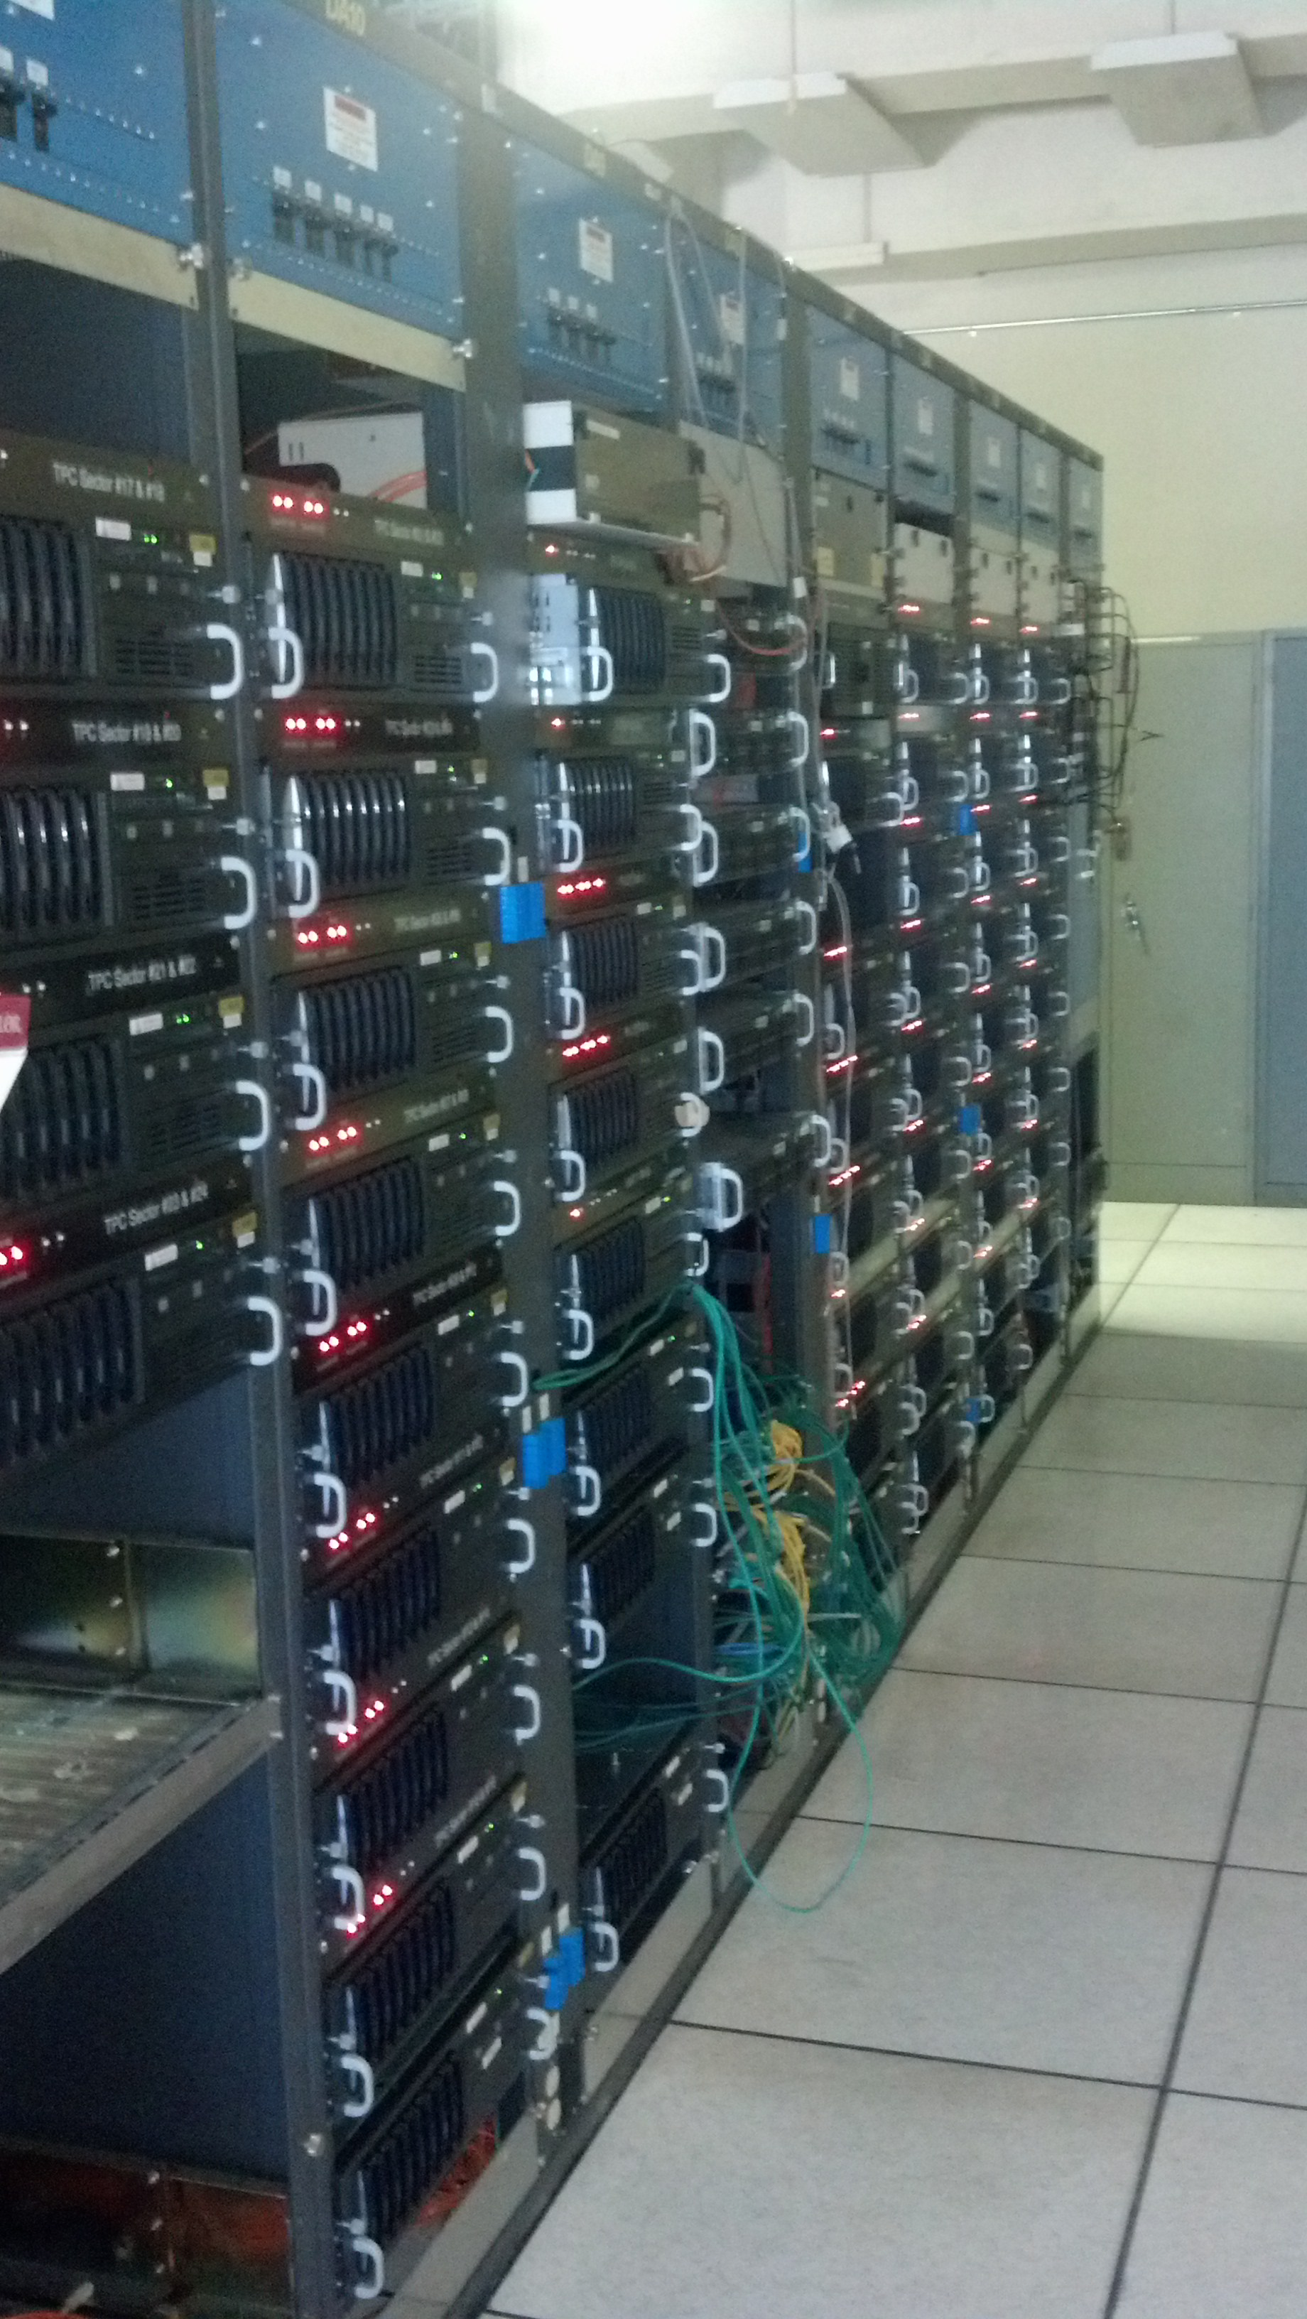
The Event Building Network:
* The computers that receive the data from
The detector fibers are called DETS. There
Are roughly 75 DET computers.
* The event builders consists of 14
computers. Each containing 10-24 TB
of buffer disk.
* The event building network is a hybrid of
Gb and 10Gb ethernet. The Event Builders
and HLT computers are on 10Gb ports.
The DETS use Gb ethernet, though the
Switches have 10Gb uploads to the event
Builders
* The HLT trigger is on
A separate 10Gb network along with the
Event Builders. The EVBs send fully
Assembled events to HLT, and receive
An appropriate trigger decision.
* The aggregate bandwidth of the system
Is about 4000MB / second.
* Completed events are shipped to a tape robot system called HPSS.

Slide 20
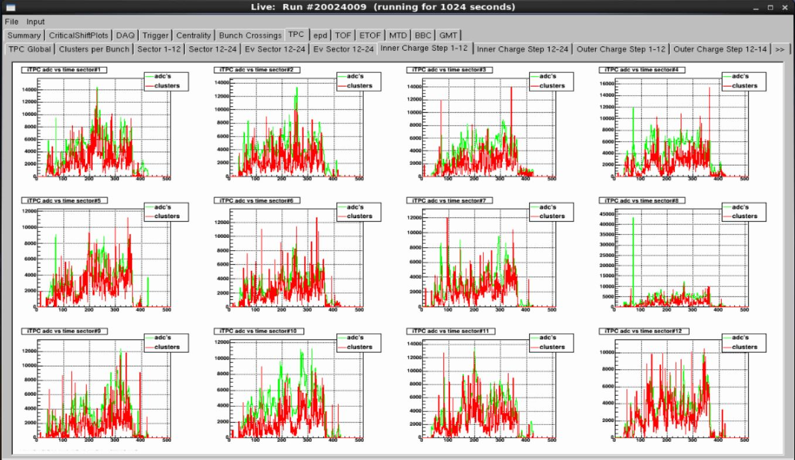
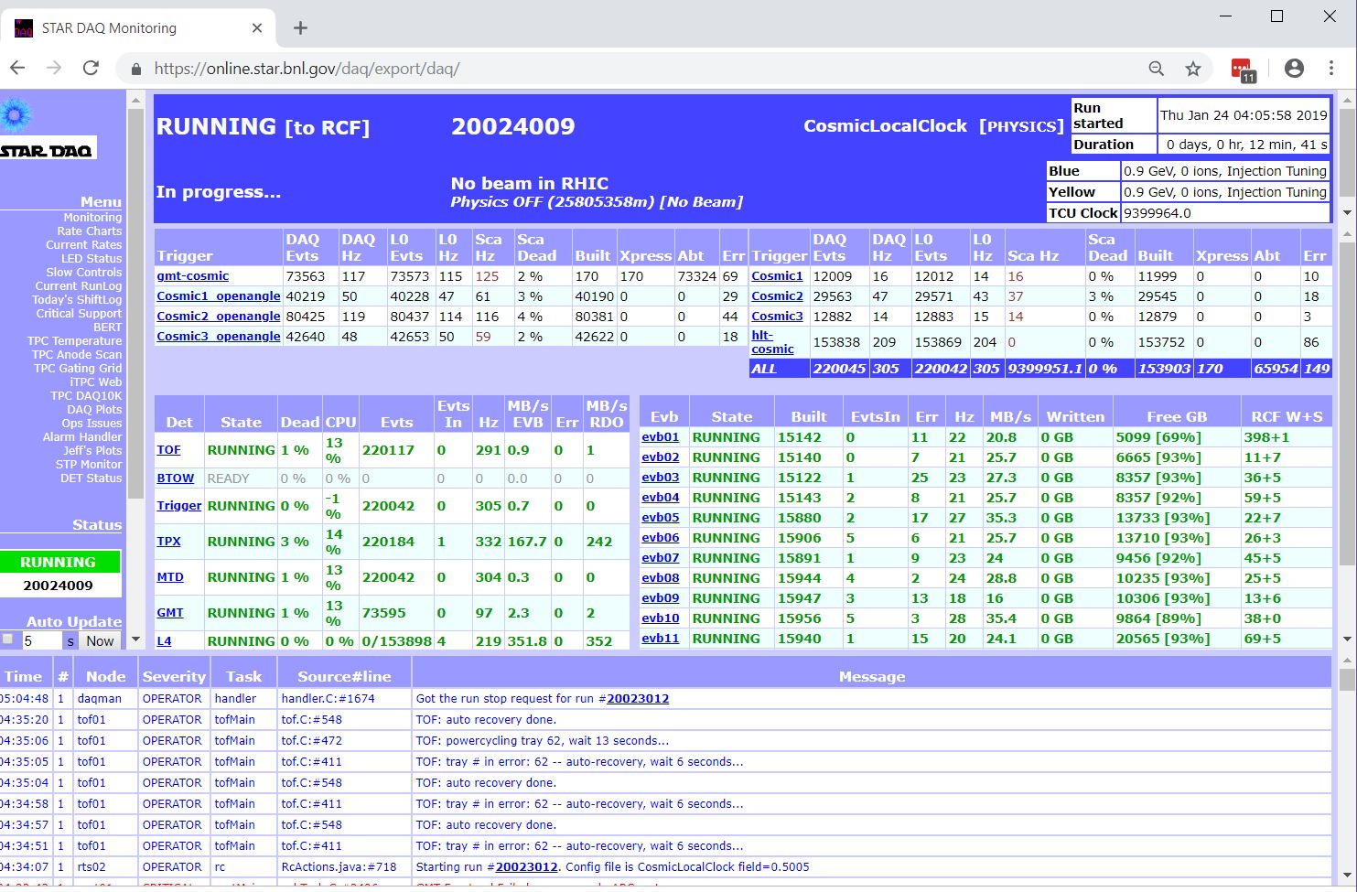
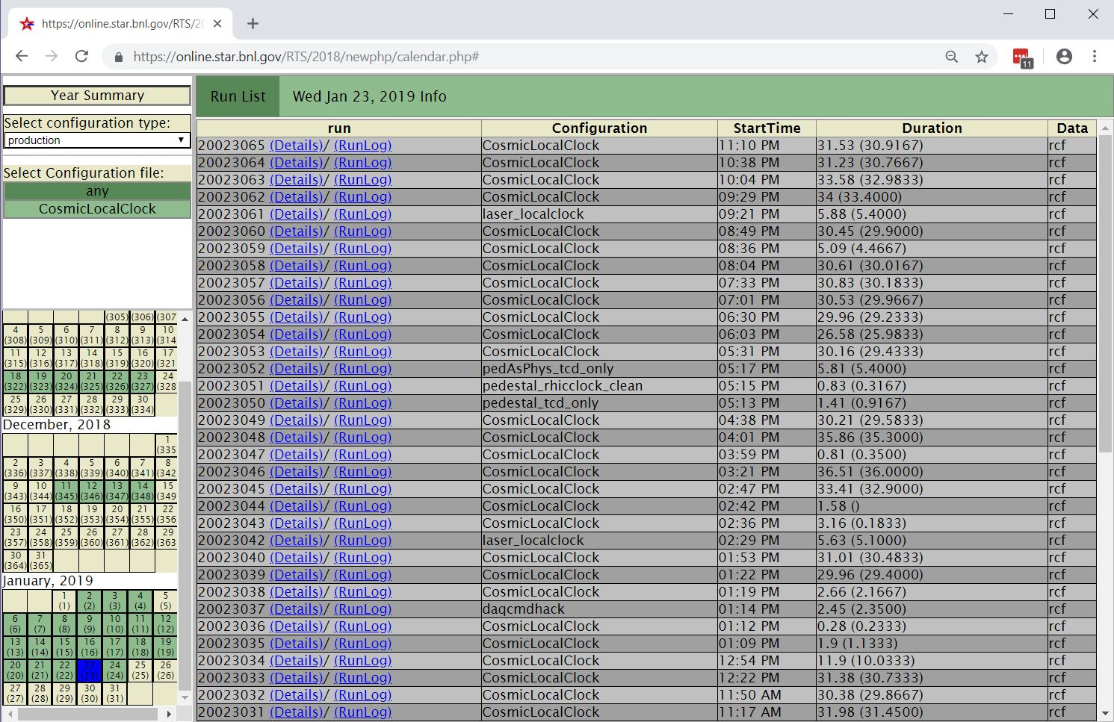
Monitoring / QA / Databases:

Slide 21
Full (Color Coded) Trigger/DAQ Data Flow:
Trigger
Detectors
DSM/QT
TCU
TCD
Detector
FEE/RDO
DSM CPU
L0 CPU
TCD CPU
DETS
L2 CPU
Run Control
User Interface
EVBs
Monitoring
(Web Pages)
Run Control
Handler
L2
Jevp Plots
(Web Pages)
Event Pool
Monitoring
Server
L4
L2 QA
(Web Pages)
L4 Event
Pool
Logging
Server
L4 EVB
Run Log
(Web Pages)
L2 QA
RCF
Database
Server(s)
L3 Event
Display

Slide 22
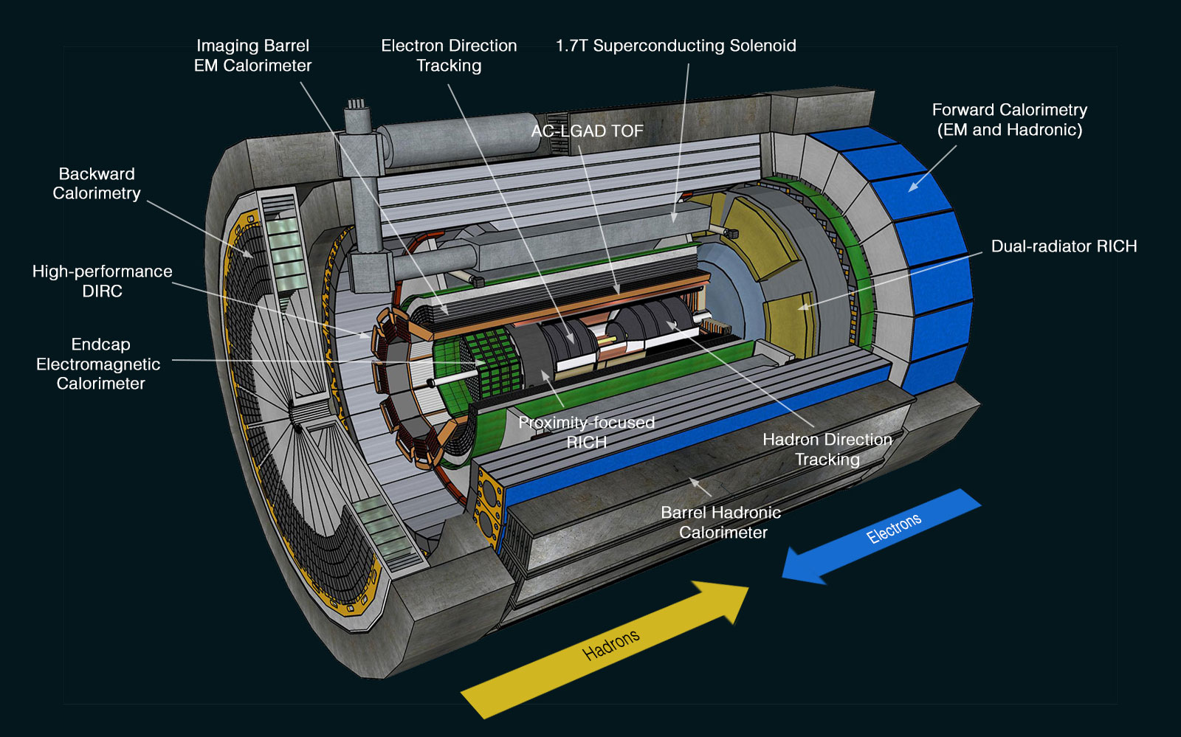
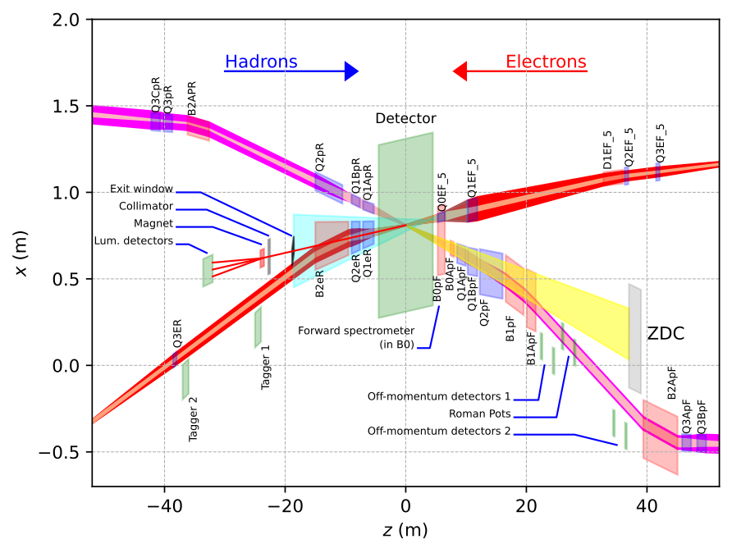
The Future of DAQ at the EIC Detector (2030)
~30 Detectors
Spread over +/- 40 meters
(13 bunch crossings @ C)
Many technologies, but effort has been made to make use of possible synergy…

Slide 23
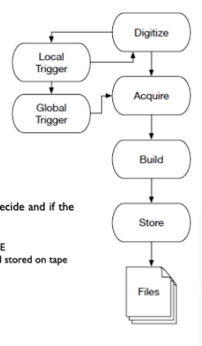
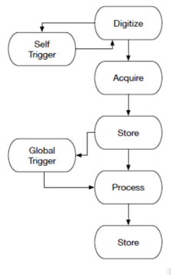
ePIC Streaming Readout
Streaming Readout (SRO)
Features of ePIC SRO
No global trigger
  No custom trigger electronics
  Zero-suppress early (ASICs)
Hits identified by time stamp rather than by event
Flexibility in event selection
  Can be performed with all channels available
  Can be performed in CPU, FPGA, or GPU
Cons
  SRO has greater sensitivity to noise and background
Triggered DAQ
(Marco Battaglieri INFN)

Slide 24
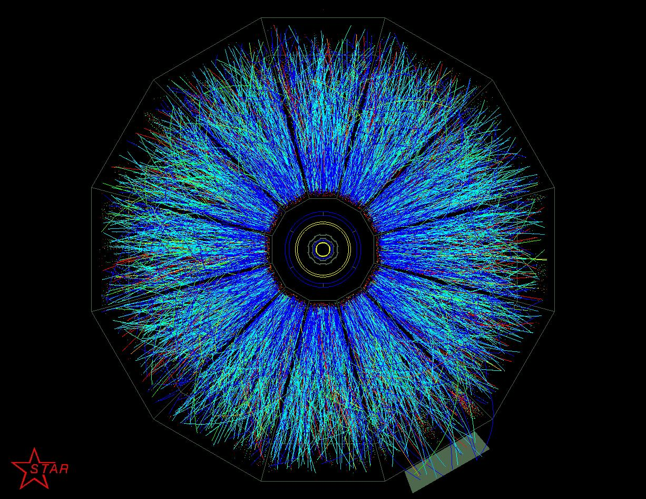
Questions?

