Slide 1
First thoughts for machining the inner surface of the End Ring
TK Hemmick

Slide 2
Ground Rules
We need to hold the end ring very securely.
We need to make the cutting very gentle:
  You can do most anything if you have a rather secure apparatus and make the work out of many steps with a small cut at each step.
  However, a “novel” cut needs an experienced hand is required to “feel” the process.
We need to be rather precise not so much accurate.
  We must wear away the inner surface in a series of small steps.
  Small steps require PRECISION (each pass moves out a tiny bit in radius).
  Our target is enough to make a “glue gap” and so we don’t need much accuracy.

Slide 3
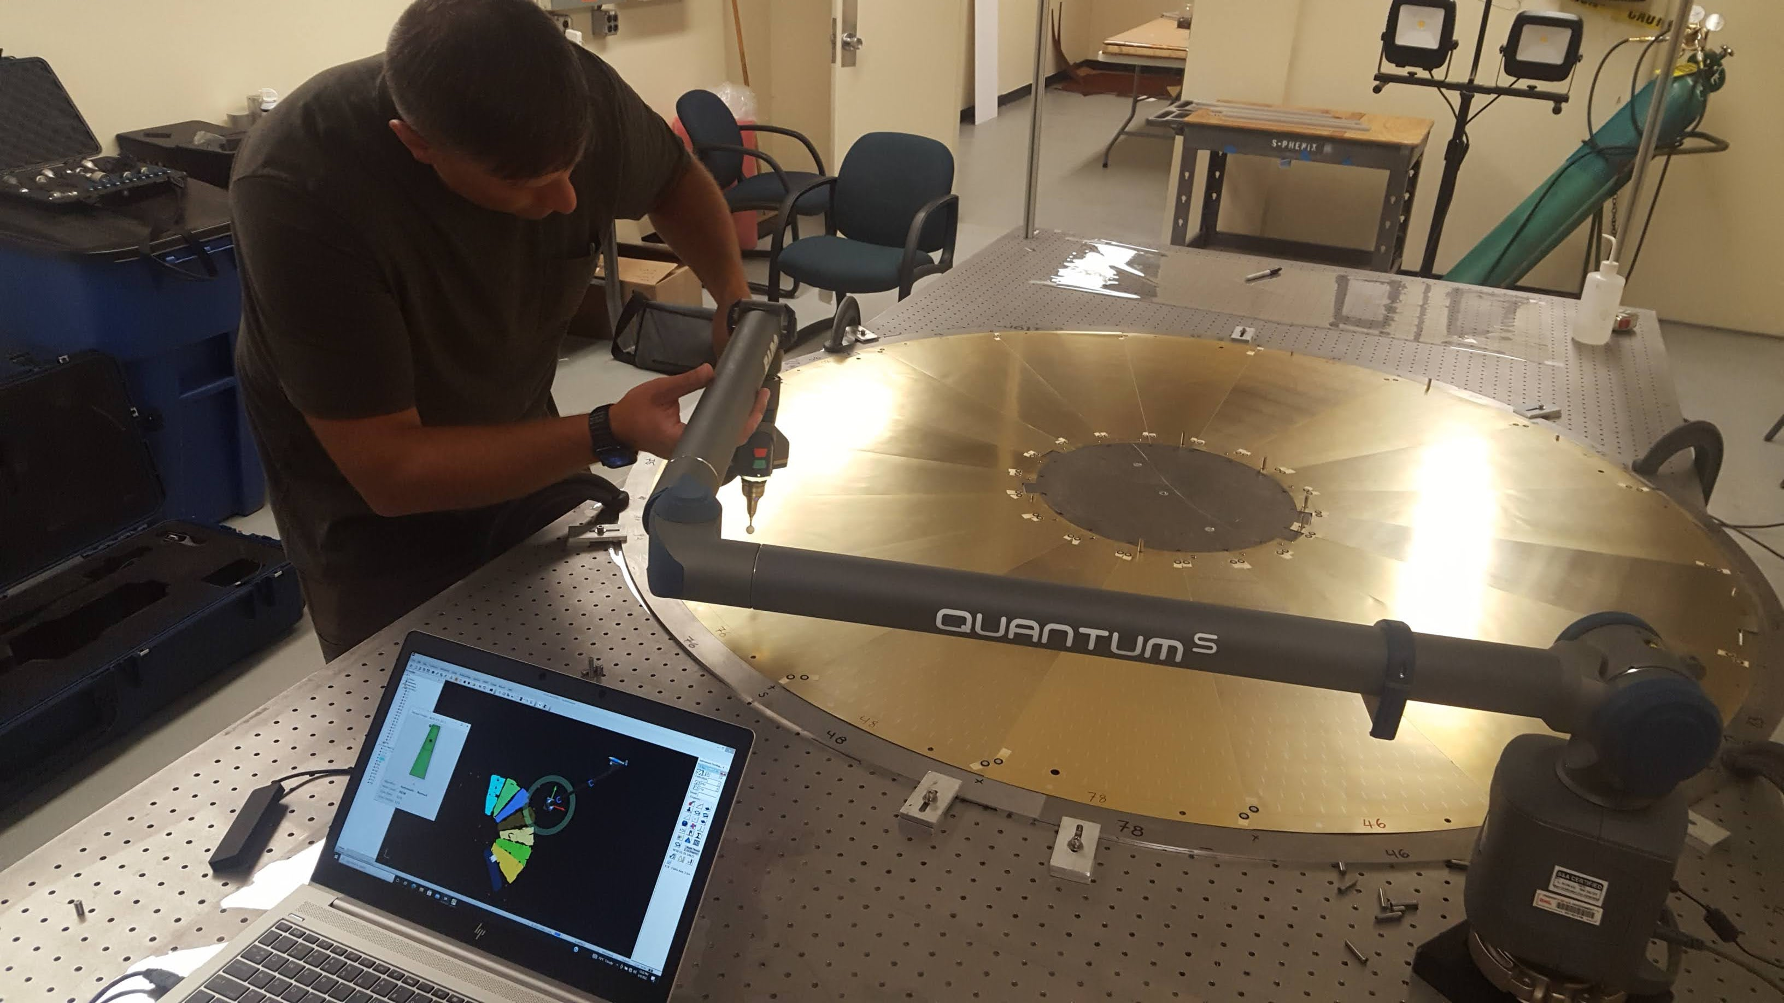
Need Optical Table & BNL Survey group
Sometimes survey means “Where is it?”
Other times survey means “Put it where I need it.”
We have an optical table at SBU:
  4’ x 10’ (extra long)
  ¼-20 holes on 1” spacing.
Proposal: BNL Survey team places the end ring concentric with a “post”.

Slide 4
Cartoonish - 1
tool
Post
Rotating arm (Reasonably stiff)
spc
spc
spc
ER
ER
Post is reasonably strong
  I recommend brass cylinder with a blind tapped hole in the bottom).
Rotating arm is BEEF (e.g. Al C-channel with the flanges up).
  NOTE: Brass and Al make a moderately low friction joint.
  Brass/Bronze is lower friction, but steel is a pain in the butt 😂
Spc are a slippery material (nylon, PTFE, etc) uniform thickness.
  Bought at equal thickness is good enough.
Tool is moved radially using a “bought thingy” (there are many).

Slide 5
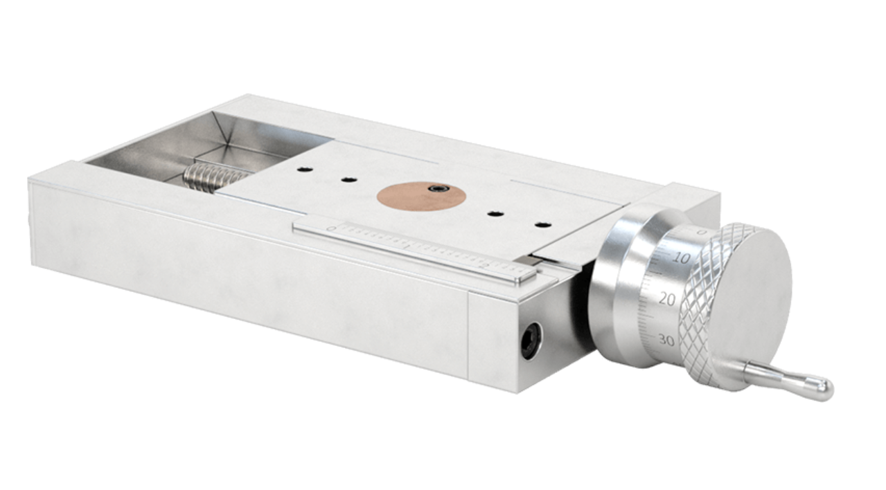
Cartoonish - 2
Small mods to Positioner:
  Offset slot; way to hold tool
Long tool must be fat.
GENTLE tiny cuts.
  Grinding minimizes vertical kick.
  Still requires experienced hands.
Hold Downs
Tool Positioner (one option)
Survey Group:
Places post (TIGHT)
Precise end ring placement
NOTE: Not to scale…conceptual only

Slide 6
Extraneous Considerations
Grinding a composite material = dust.
  Need to wear some form of mask.
  Vacuuming during cut might be difficult:
    Geometry (hard to get to the bit).
    Noise (good communication is essential during tricky operations).
  Maybe put some clear curtains on each side – C-channel

