Slide 1
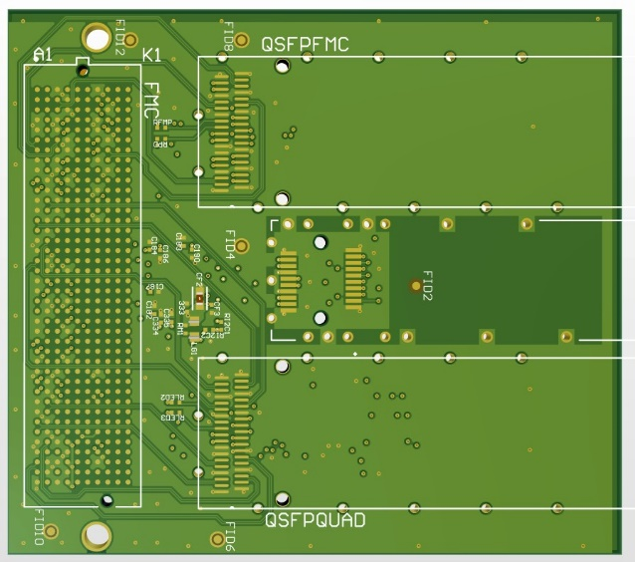
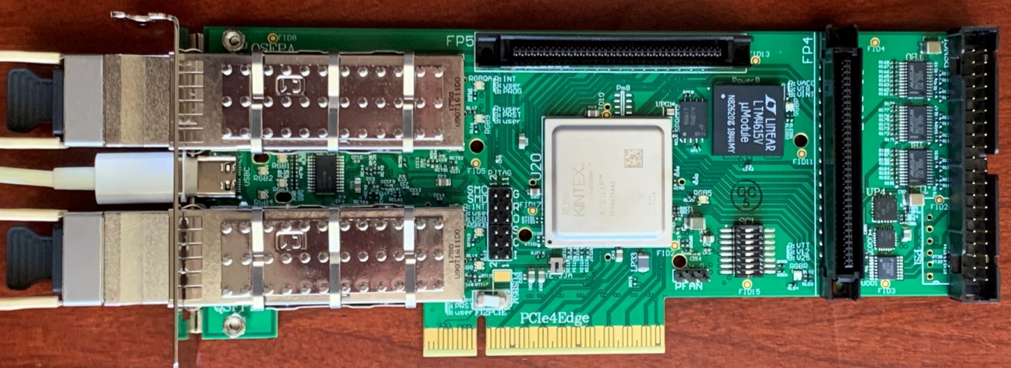
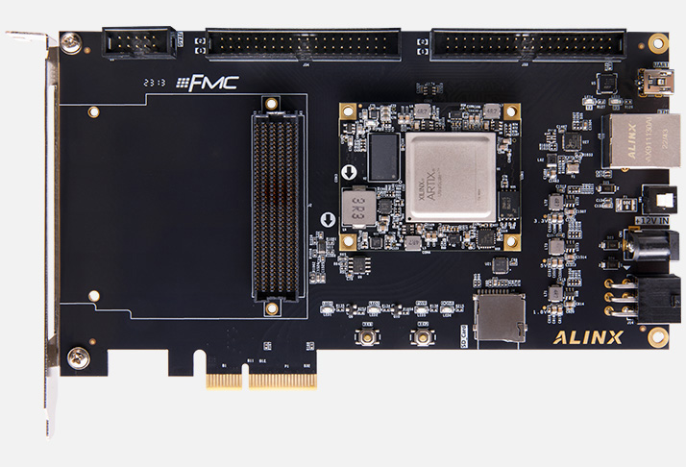
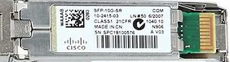

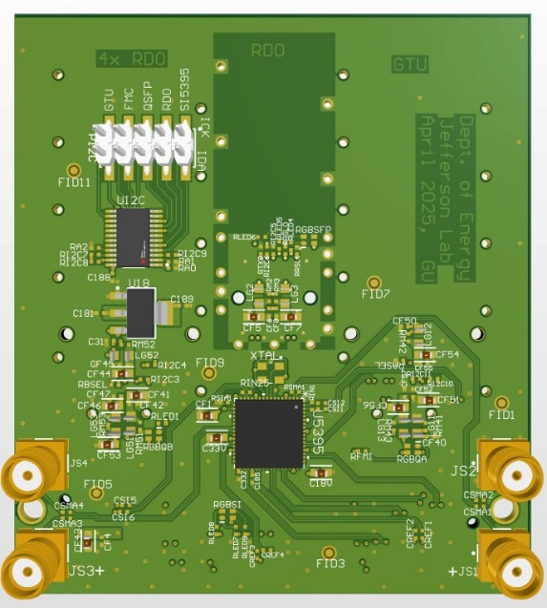
1. The ePIC designs
2. FMC/(Q)SFP adaptor
With this FMC adaptor (ready to be manufactured), the Axau15P can be GTU, DAM, or RDO.
Platform For DAQ software development
Platform for firmware development
Mini-daq for detector/FEB/ASIC test
Mini_DAQ, functionally includes GTU, DAM, and RDO

Slide 2
3. (Q)SFP connection details
4. (max) system setup
QSFP: 4x DAM ←→ RDO
SFP: 1x DAM ←→ RDO
QSFP: 1x GTU ←→ DAM
One GTU
Two DAM
Ten RDO
DAM
Regular ‘DAM’:
Four pieces are being ordered.
Expected delivery: one month.
Master-mode ‘DAM’: built in GTU

