Slide 1
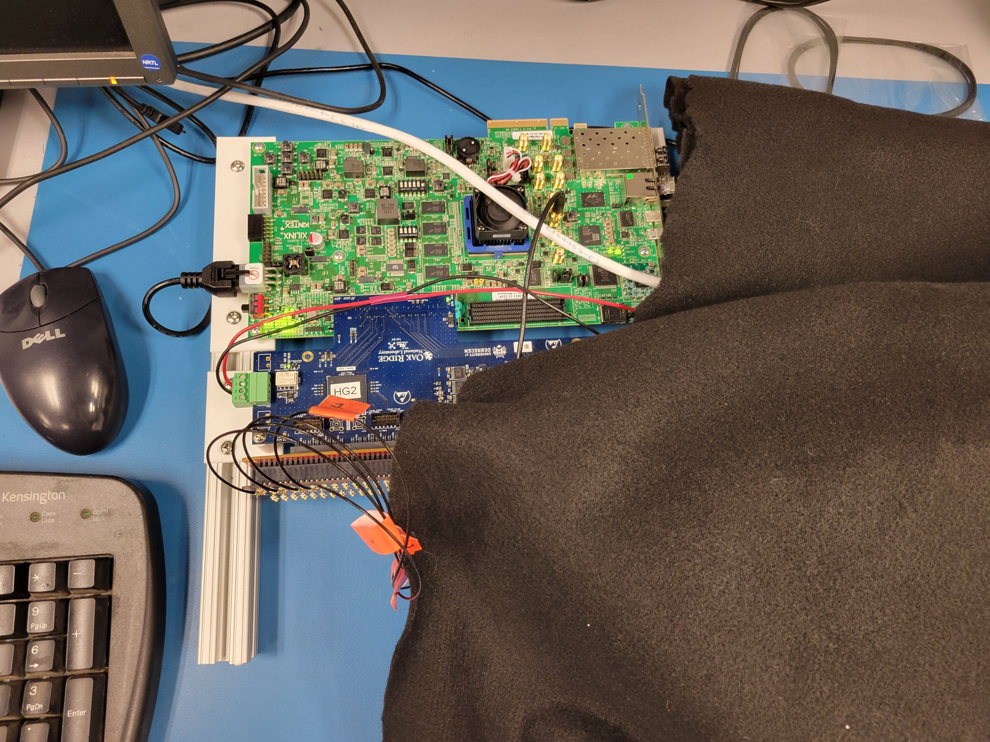
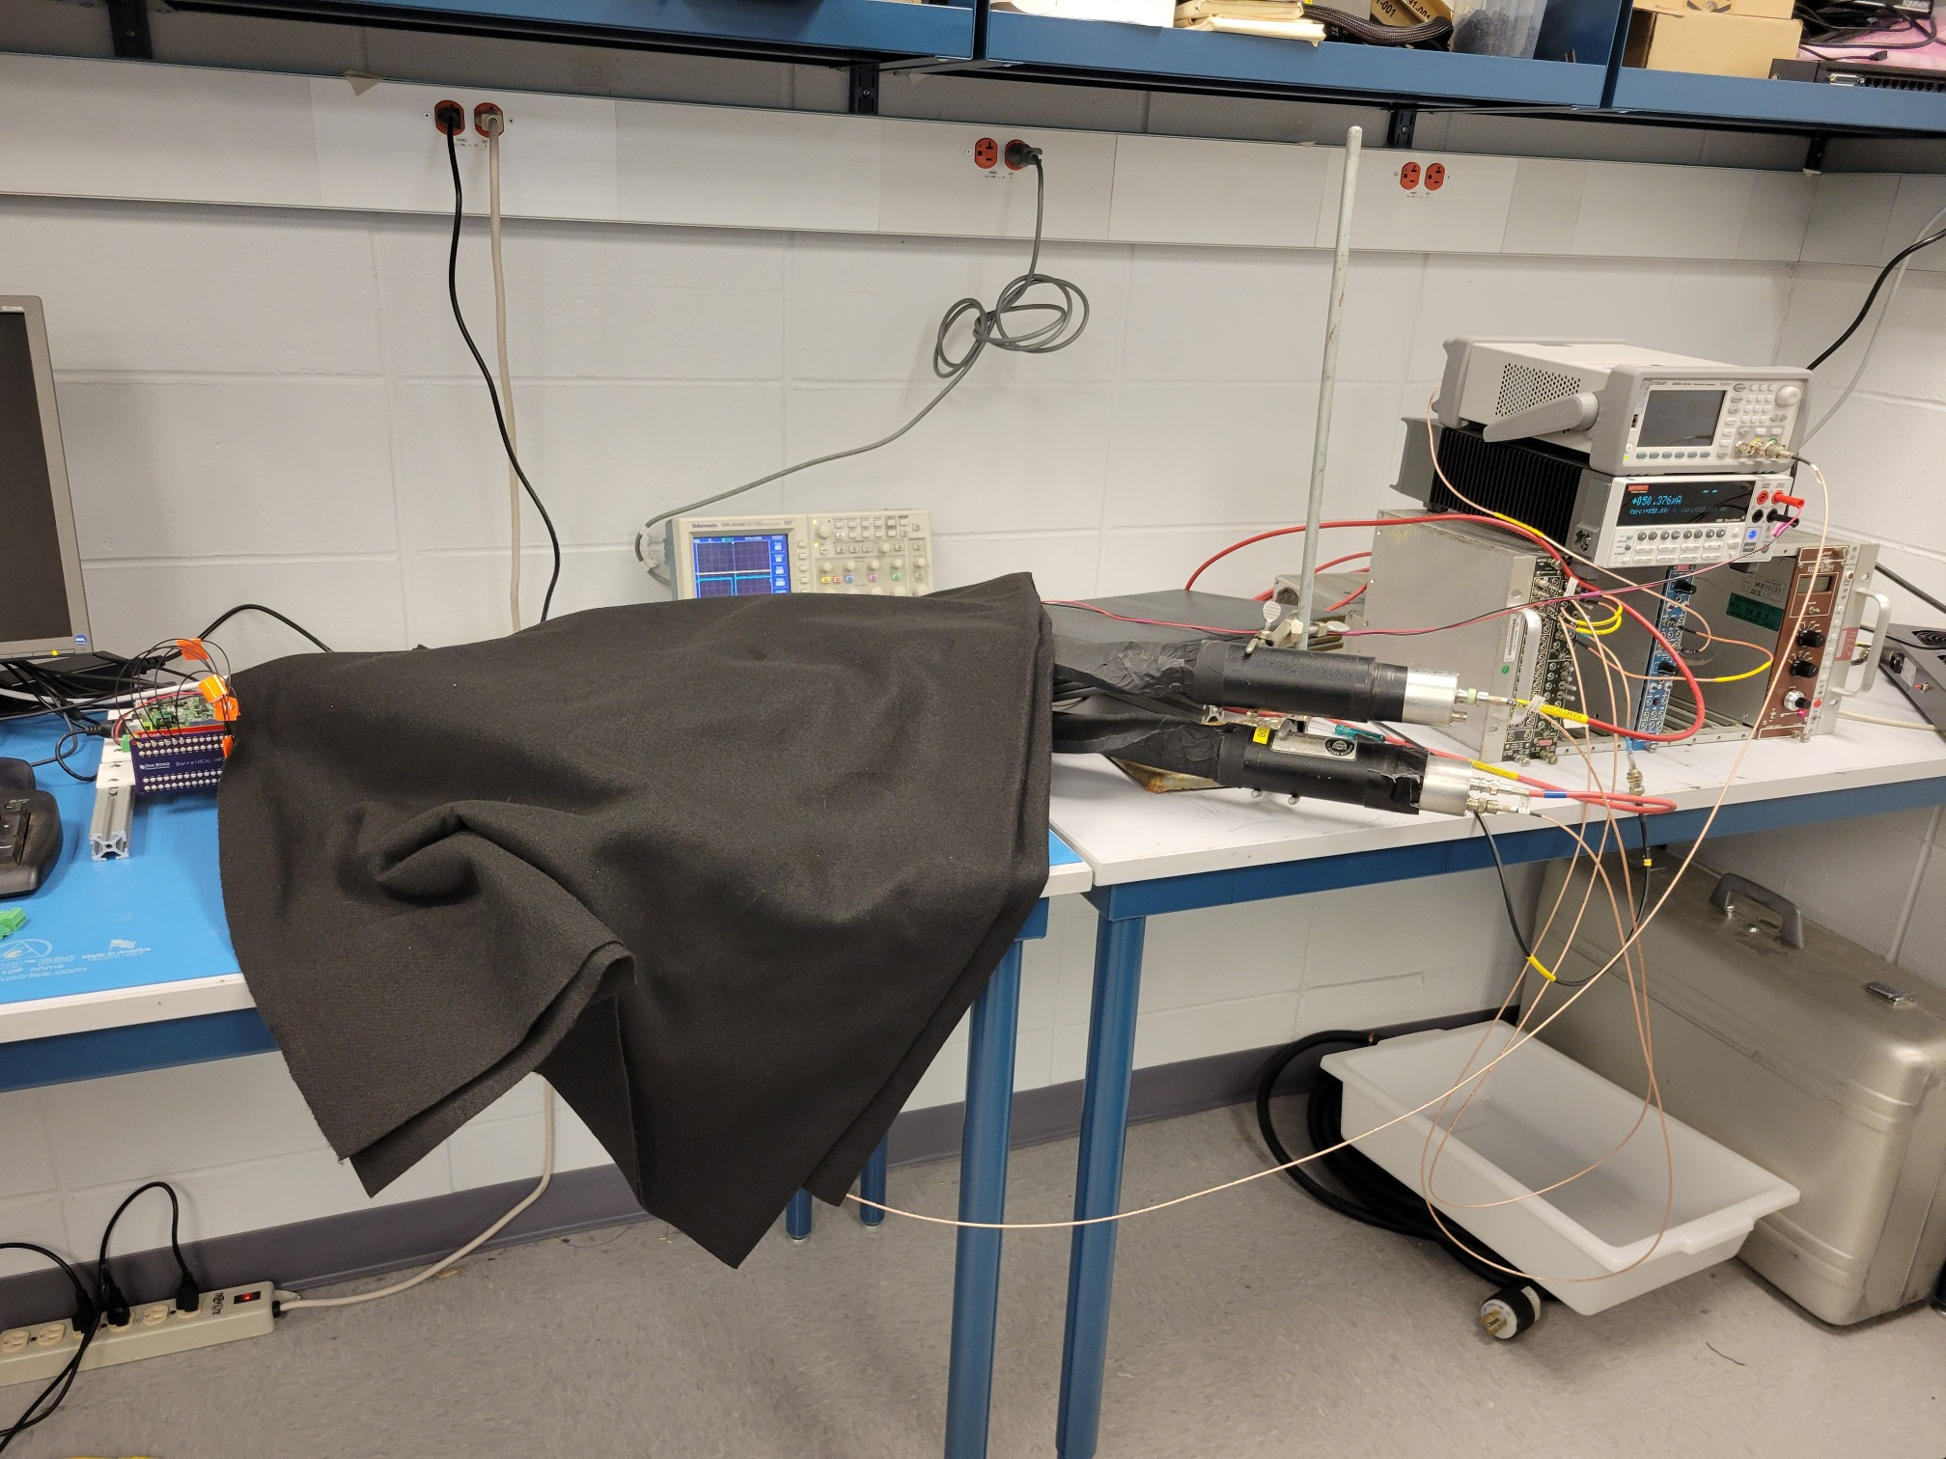
ROC readout in RCDAQ
Of course that was my personal main goal that I hoped to get out of Norbert’s visit
And thanks to Norbert’s help, done
RCDAQ plugin is in place
I made an “ePIC” fork of what is known as the Event Libraries that give you access to the standard APIs to access the data
In there is a decoder for the “H2GCROC3” hitformat (typically, each supported device has a dedicated decoder that presents the data in a small number of standard APIs)
Yesterday I took cosmics data with RCDAQ for about an hour

Slide 2
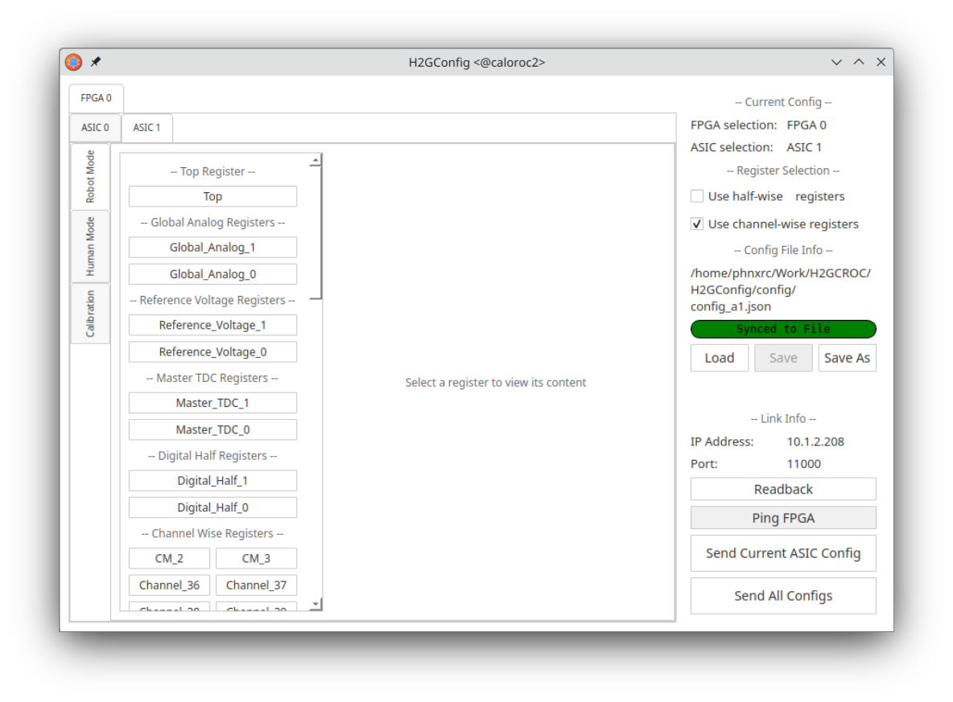
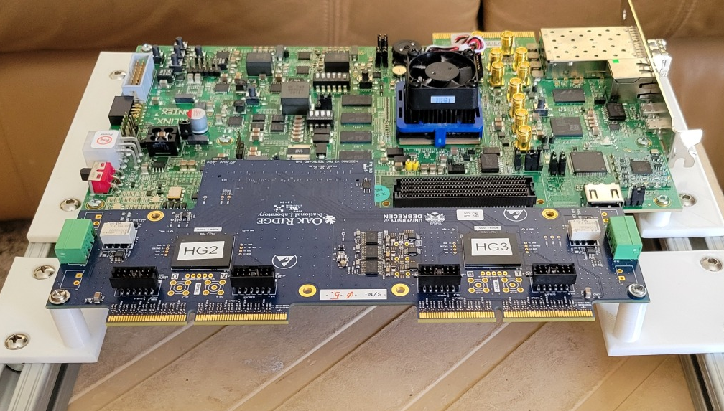
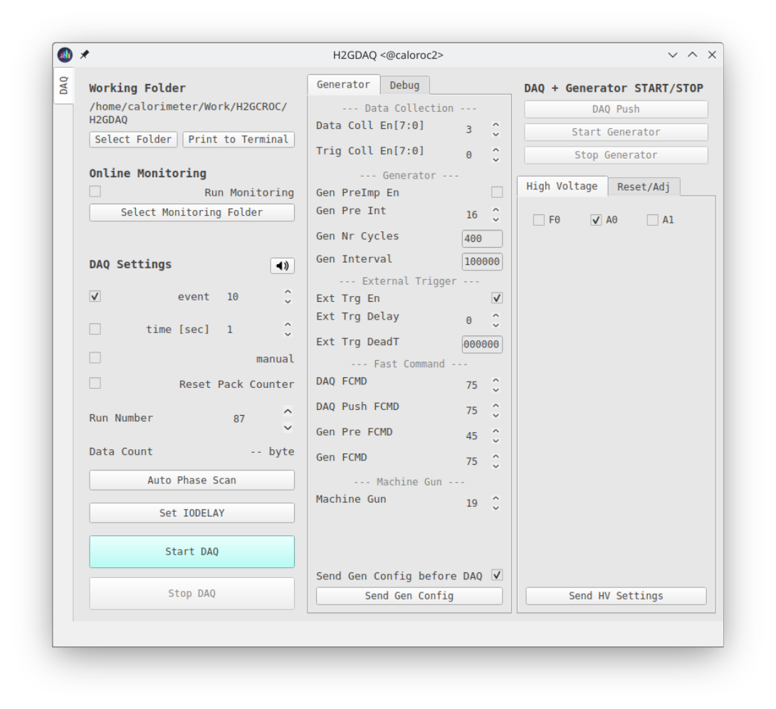
Front-end configuration vs RCDAQ configuration
Like many other devices with a vast configuration space (here: some 3000 parameters, most with reasonable defaults), the configuration of the front-end and the readout are two distinct tasks
The front-end is getting configured with two GUI-based processes (H2GConfig for the ASICs, H2GDAQ for the FPGA portion), and set up just the way we want it
RCDAQ is almost fully oblivious to the particulars of the front-end configuration, it reads whatever comes its way
It really only needs to know the IP address from which the data are coming; it also issues “start” and “stop” commands to the front-end to start or stop the flow of data – that’s all.
The standalone configuration process
The plan is to support command based “canned” configs – GUIs are nice but can also be tedious.

Slide 3
The RCDAQ Plugin and configuration
I made a standard script like the one that I presented the other week, not much new for y’all here
(and yes, I left out a “c” in “librcdaqplugin_h2gcro3.so” library name ☺ - will be fixed
$ more rcdaq_roc.sh
#! /bin/sh
# we need the $0 as absolute path b/c we pass it on to a "file" device further down
MYSELF=$(readlink -f $0)
# we figure out if a server is already running
if ! rcdaq_client daq_status > /dev/null 2>&1 ; then
echo "No rcdaq_server running, starting... log goes to $HOME/rcdaq.log"
rcdaq_server > $HOME/rcdaq.log 2>&1 &
sleep 2
fi
# we add this file to the begin-run event
rcdaq_client create_device device_file 9 900 "$MYSELF"
#rcdaq_client load $ONLINE_MAIN/lib/librcdaqplugin_h2gcro3.so
rcdaq_client load librcdaqplugin_h2gcro3.so
rcdaq_client create_device device_h2gcroc3 1 12001 10.1.2.208 1 128
This is all that the plugin needs to know

Slide 4
The RCDAQ Plugin at work
This is how the configured RCDAQ looks like
$ daq_status -ll
caloroc2 - Stopped
Filerule: /home/phnxrc/data/junk/junk_ROC-%08d-%04d.evt
Logging enabled
Number of buffers/write threads: 2 Buffersize: 64MB
compression disabled level: 0
MD5 calculation enabled
have a trigger object
Buffer Sizes: 65536 KB adaptive buffering: 15 s
Web control Port: 8899
Elog: not defined
-- defined Run Types:
cosmics - /home/phnxrc/data/cosmics/cosmics_ROC-%08d-%04d.evt
junk - /home/phnxrc/data/junk/junk_ROC-%08d-%04d.evt
List of loaded Plugins:
- H2GCROC3 Plugin, provides -
- device_h2gcroc3 (evttype, subid, IP addr, trigger, nr_packets) - readout an H2GCROC3
$ daq_list_readlist
File Device Event Type: 9 Subevent id: 900 reading from /home/phnxrc/ROC/new ROC firmware/rcdaq_roc.sh
H2GCROC3 Device Event Type: 1 Subevent id: 12001 IP: 10.1.2.208 nr_packets: 128 trigger

Slide 5
Analysis with pmonitor
The device generates a packet with hitformat 301 (mnemonic “IDH2GCROC3”)
Remember these numbers are a simple enumeration, and numbers are plentiful
The data access APIs are exactly like those for any waveform sampler we support (CAEN V7142, DRS4, the sPHENIX digitizers, the (sPHENIX) Sampa (== ePIC’s Salsa) chips…).
If p is a pointer to the packet object from that device:
There are many more interfaces to ask the packet all kinds of other questions, but those are the most-often used ones here
$ dlist /home/phnxrc/data/cosmics/cosmics_ROC-00000012-0000.evt
Packet 12001 7304 -1 (sPHENIX Packet) 301 (IDH2GCROC3)
p->iValue(0,"SAMPLES") tells you how many samples are present
p->iValue(0,”CHANNELS") tells you how many channels that device has (here:144)
p->iValue(c,s) gives you sample s from channel c (there are faster interfaces available)

Slide 6
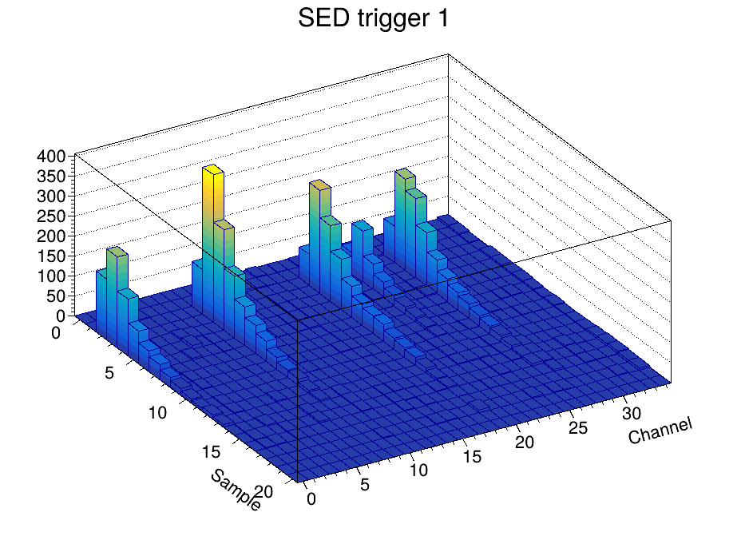
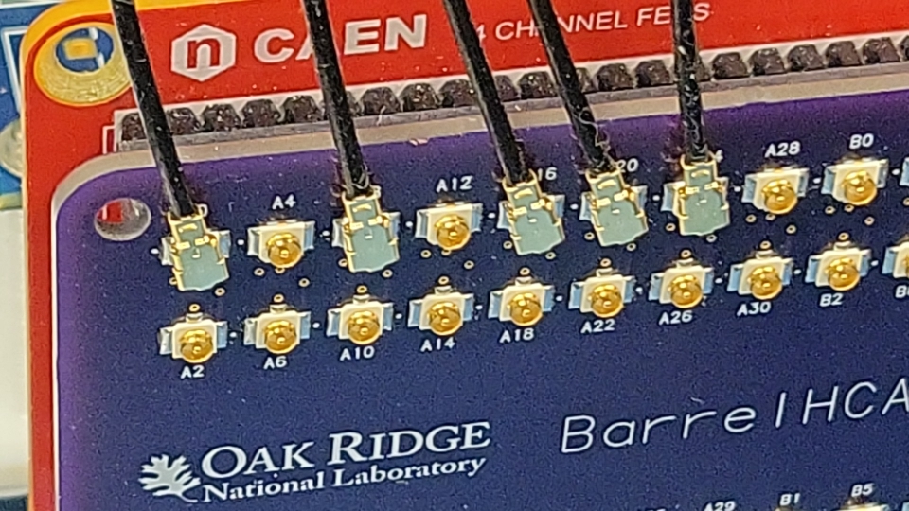
The “mlp standard plot”
Whenever I have data from a waveform sampler (that is, a device with a number of channels, and each channel provides a waveform) I make a Lego plot with Channel vs Sample, with z the sample value:
We see what we expect: Signals from 5 tiles, and with the right channel numbers
The waveforms are baseline-corrected. And we saw the first of those plots from online monitoring yesterday!
Connected channels

Slide 7
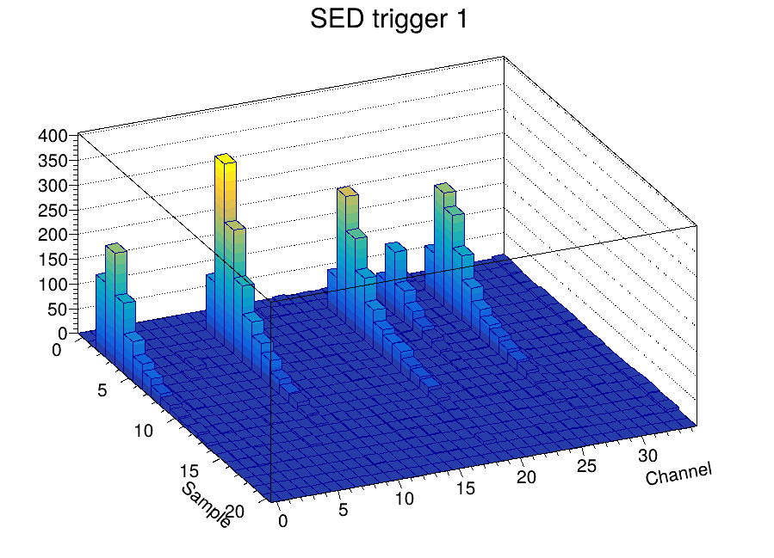
Some eye-candy…
I made a quick movie of the response from ~150 triggers.
We have some empty events, and (b/c the trigger paddles are larger than the tiles), a number of events where the triggered-on cosmic misses the tiles.
But still nice to watch…

