Slide 1
Differentiable Beam Simulation Codes
Chenran Xu
2025-10-27, 4th AI4EIC Workshop

Slide 2
Why do we need differentiable simulation codes?
Differentiable simulation codes enable the computation of derivatives of simulation outcomes with respect to user-defined input parameters.
Various applications for particle accelerators
Design stage
Efficient high-dimensional (multi-objective) optimization
Safe and fast online tuning and control
System identification
Phase space reconstruction
Virtual accelerator
Operation

Slide 3

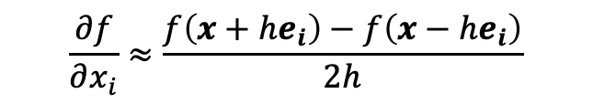
Gradient calculation is not new in physics
Analytic derivatives are exact, but only applicable for limited expressions
Numerical differentiation such as finite difference, scales poorly with input dimensions
Existing simulation codes were not written with computation graphs in mind, and they do not account for AI/ML applications
Automatic differentiation (AD) provides explicit and efficient gradient calculation by applying chain rule to the computation
$$\frac{∂f}{∂x_{i}}≈\frac{f\left(x+he_{i}\right)−f\left(x−he_{i}\right)}{2h}$$
$f:R^{n}→R$,
O(n)
Forward mode AD
(Tangent mode)
Reverse mode AD
(Adjoint mode)

Slide 4
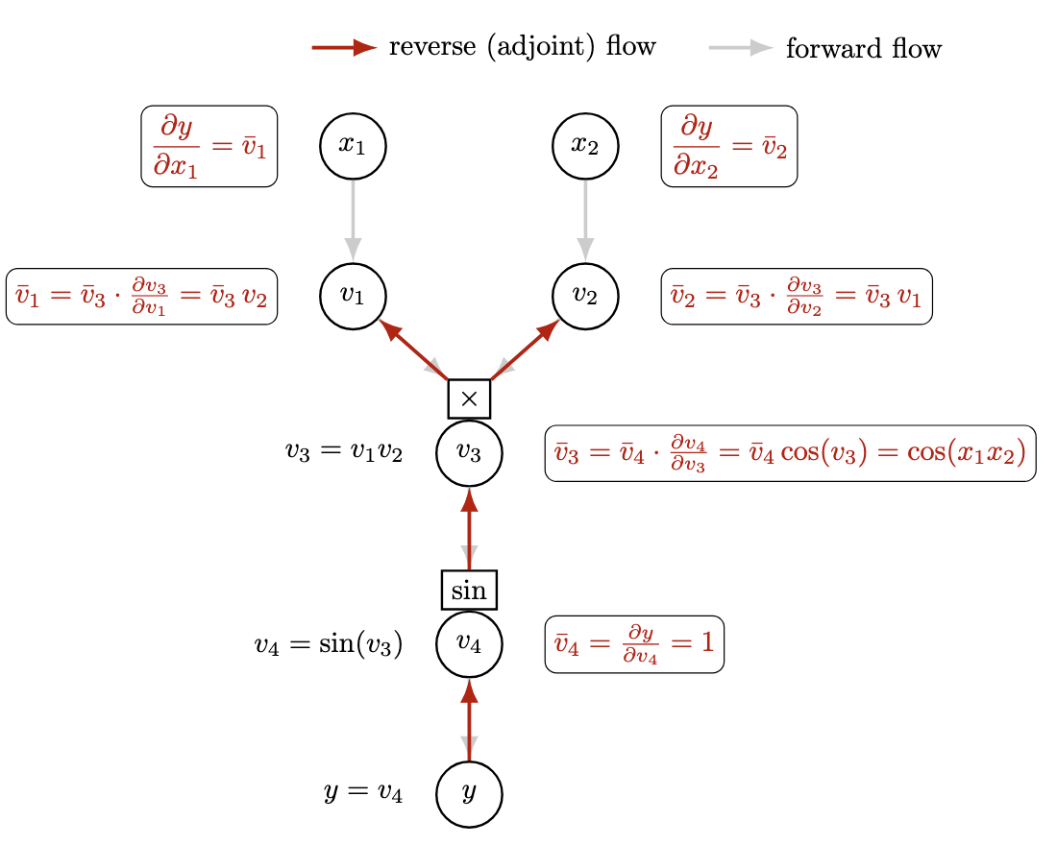
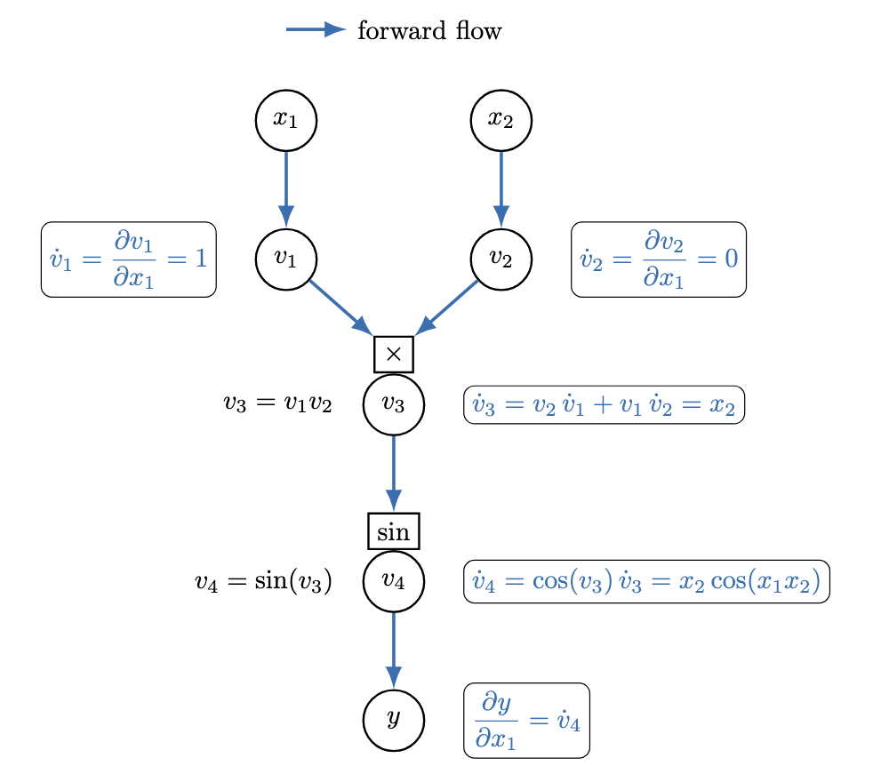

Automatic Differentiation
Example: $y=\sin\left(x_{1}x_{2}\right)$
Forward Mode
Propagates the directional derivatives (tangents) alongside the intermediate values when moving forward through the computation graph
Reverse Mode
Propagates the adjoint values from the output to the input variables, after evaluating the function

Slide 5




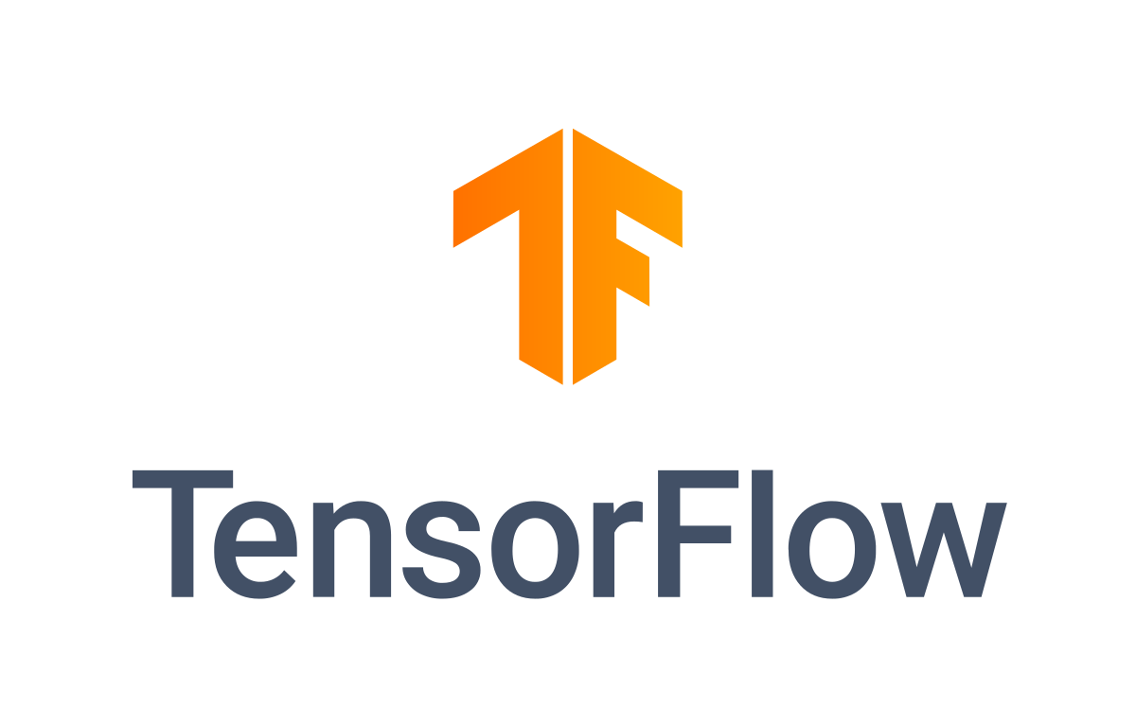
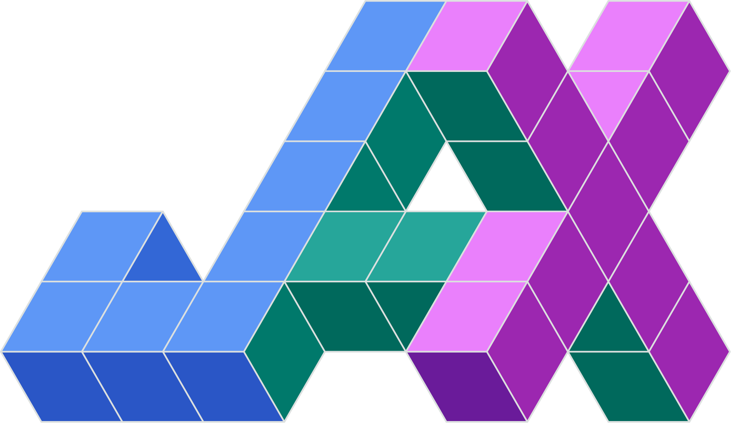
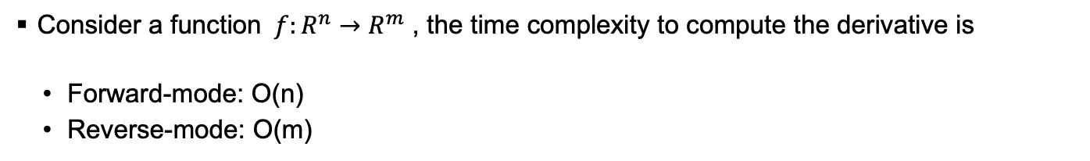
Automatic Differentiation
Consider a function $f:R^{n}→R^{m}$ , the time complexity to compute the derivative is
Forward-mode: O(n)
Reverse-mode: O(m)
* Computation is parallelizable
Example cases
Input n >> Output m: neural network training, design optimization, parameter fitting
Input n << Output m: sensitivity analysis, time series/trajectory generation
Many libraries and programming languages now have AD supports
Enzyme-AD

Slide 6
Differentiable Simulation Codes in Accelerator Physics

Slide 7
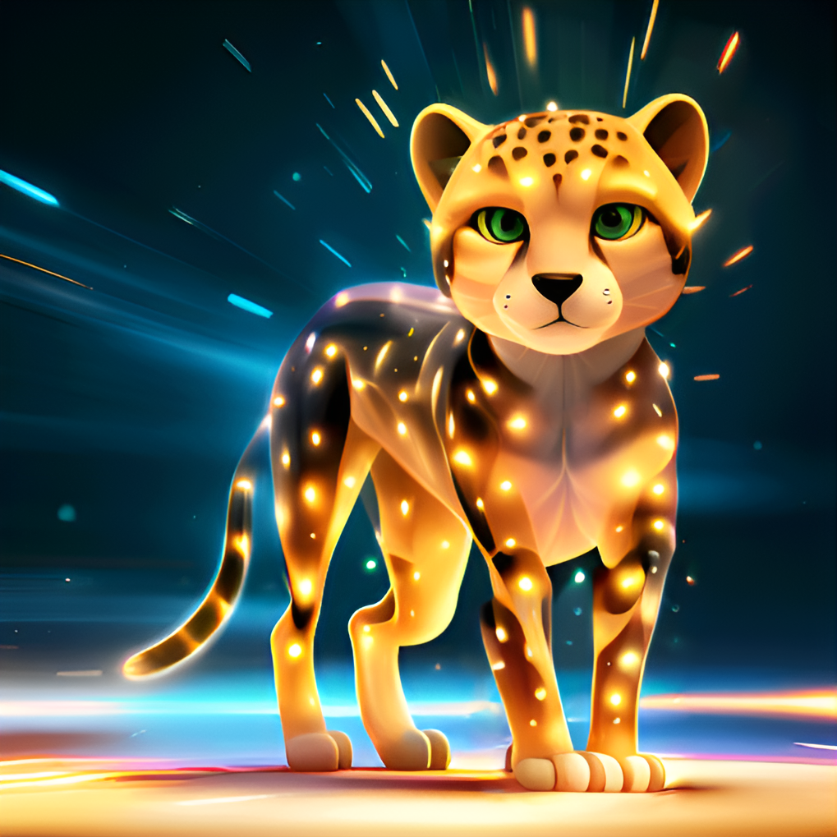
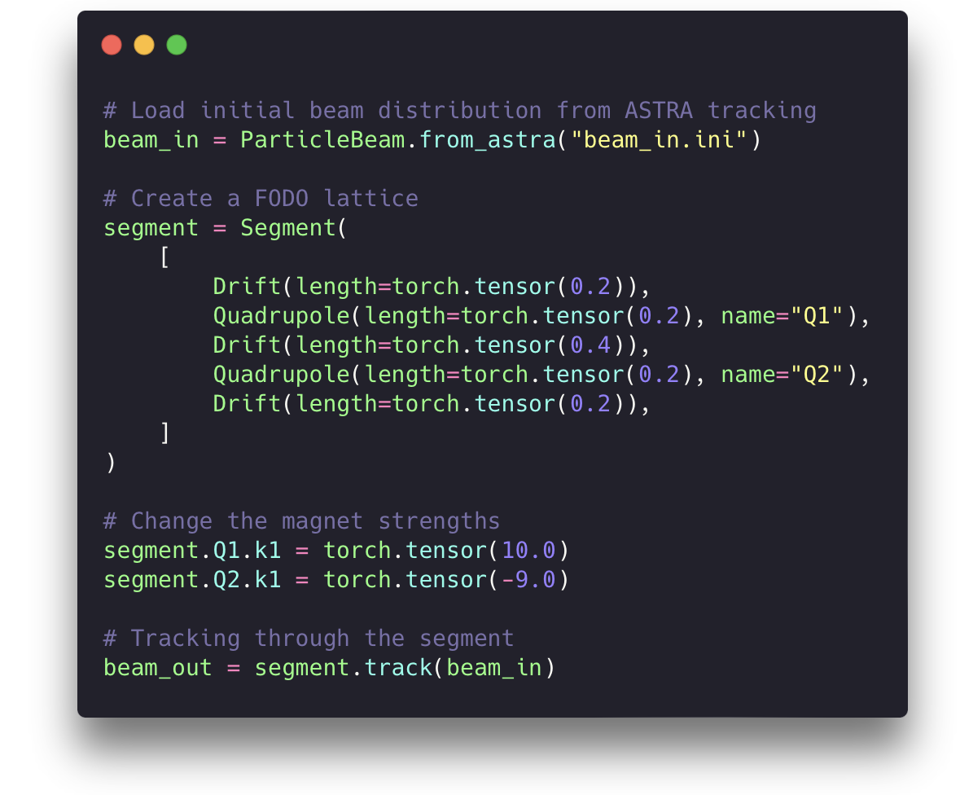
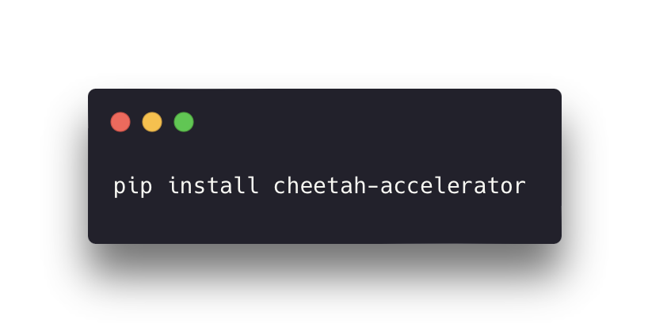
Cheetah
A PyTorch-based high-speed beam simulation code to support ML applications ^{[1]}
Full GPU supports and seamless integration of ML models built in PyTorch
Open-source: https://github.com/desy-ml/cheetah
Modular design, easy to use and extend
Merged tracking routines from bmad-x^{[2]}
[1] J. Kaiser, C. Xu et al. PRAB 2024
[2] J.P Gonzalez-Aguilera et al. IPAC2023

Slide 8
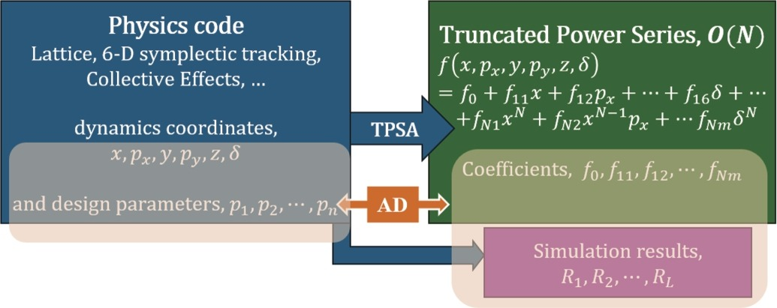
JuTrack
A Julia package for auto-differentiable accelerator modeling and particle tracking
6D symplectic tracking
Supports more collective effects like space-charge, wakefield, and beam-beam interaction
Open-source: https://github.com/MSU-Beam-Dynamics/JuTrack.jl
J. Wan et al, J. CPC 2025

Slide 9

SciBmad (Bmad-Julia)
A new high-performance, polymorphic, and differentiable accelerator physics simulation ecosystem in Julia.
Open source: https://github.com/bmad-sim/SciBmad.jl
Inspired by the Bmad ecosystem, highly modularized packages
BeamTracking.jl : differentiable charged particle tracking
GTPSA.jl: high-order auto-diff using the GTPSA library
Beamlines.jl
AtomicAndPhysicalConstants.jl
NonlinearNormalForm.jl
D. Sagan et al, IPAC 2024

Slide 10
All the codes are under active development
 | Cheetah | JuTrack | SciBmad
Programming Language | Python | Julia | Julia
JIT Compilation | ✅ | ✅ | ✅
Reverse mode AD | ✅ | ✅ Enzyme | ✅ ReverseDiff.jl
Forward mode AD | ✅ experimental in PyTorch | ✅ TPSA + Enzyme | ✅ ForwardDiff.jl, GTPSA.jl
There are also other auto-differentiable beam simulation codes that do not consider AI/ML applications: COSY-Infinity, MAD-NG, …

Slide 11
Applications of Differentiable Simulations

Slide 12
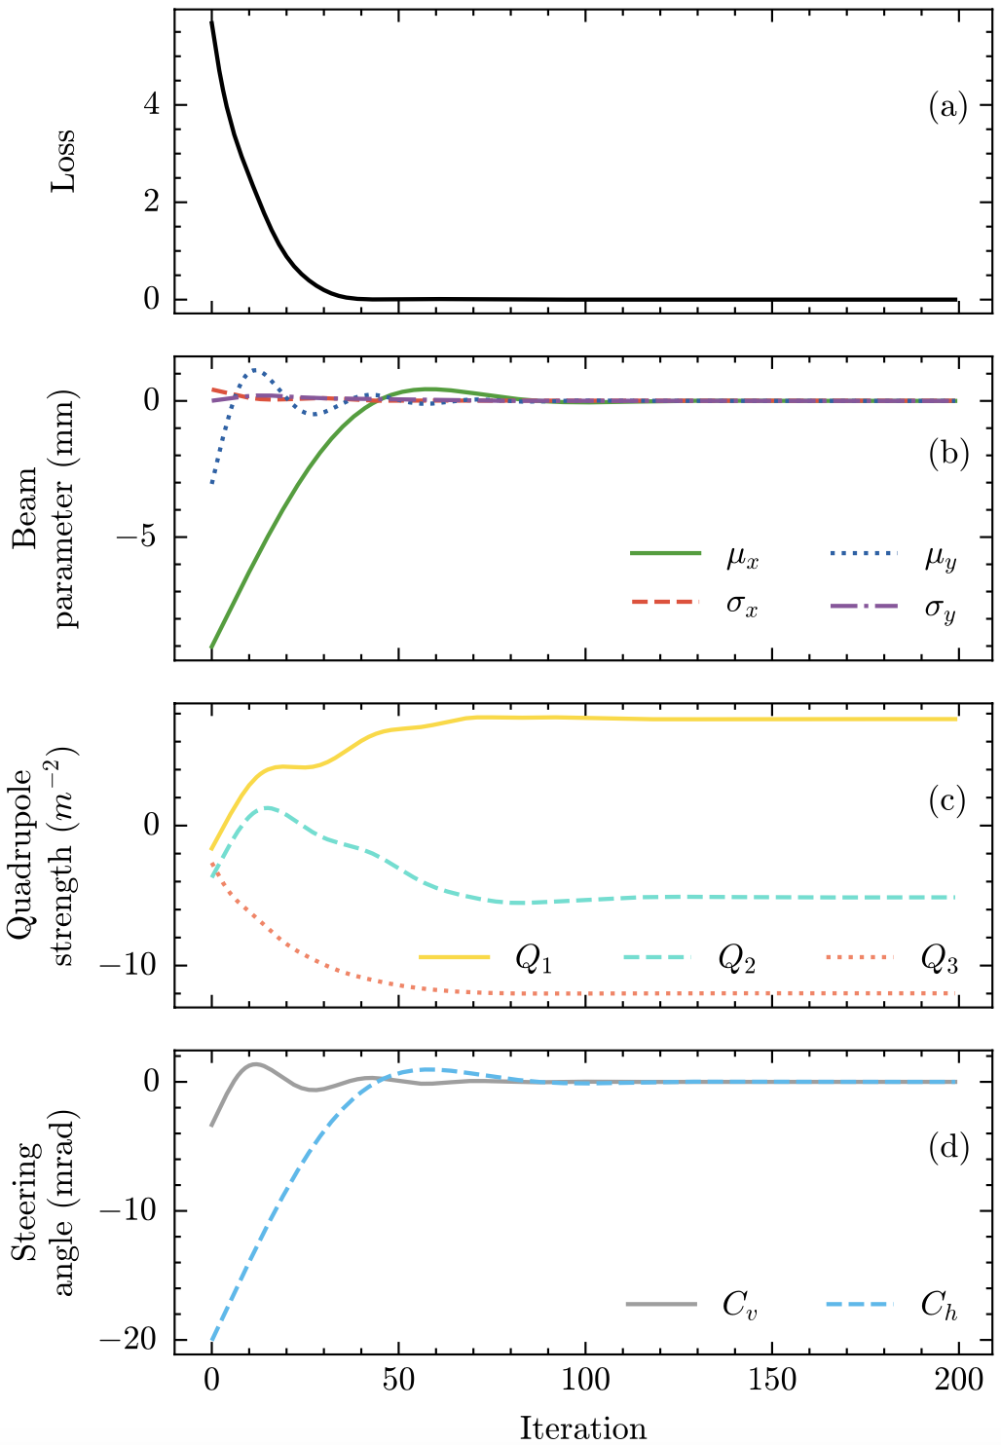
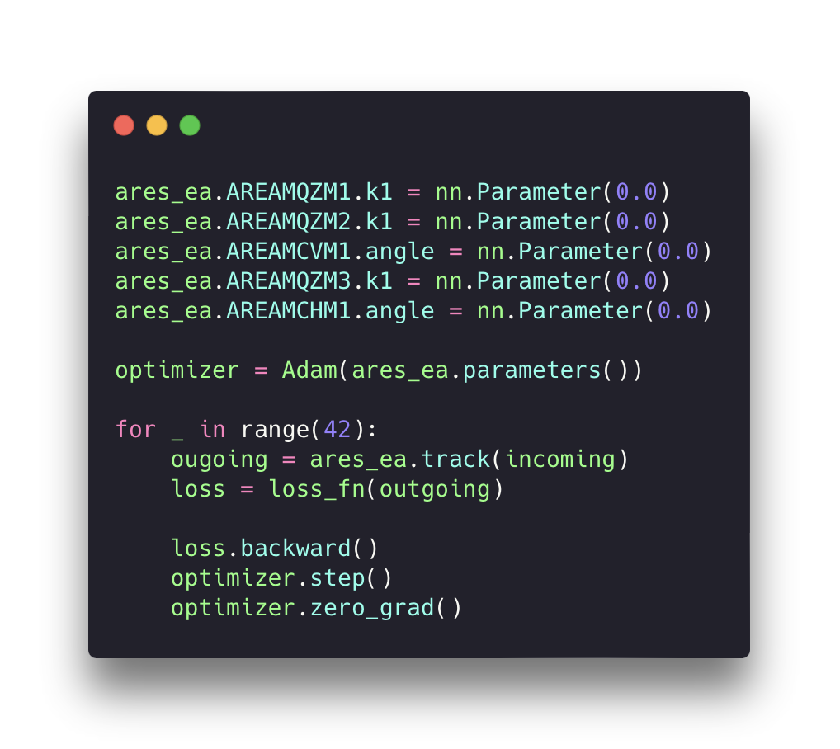
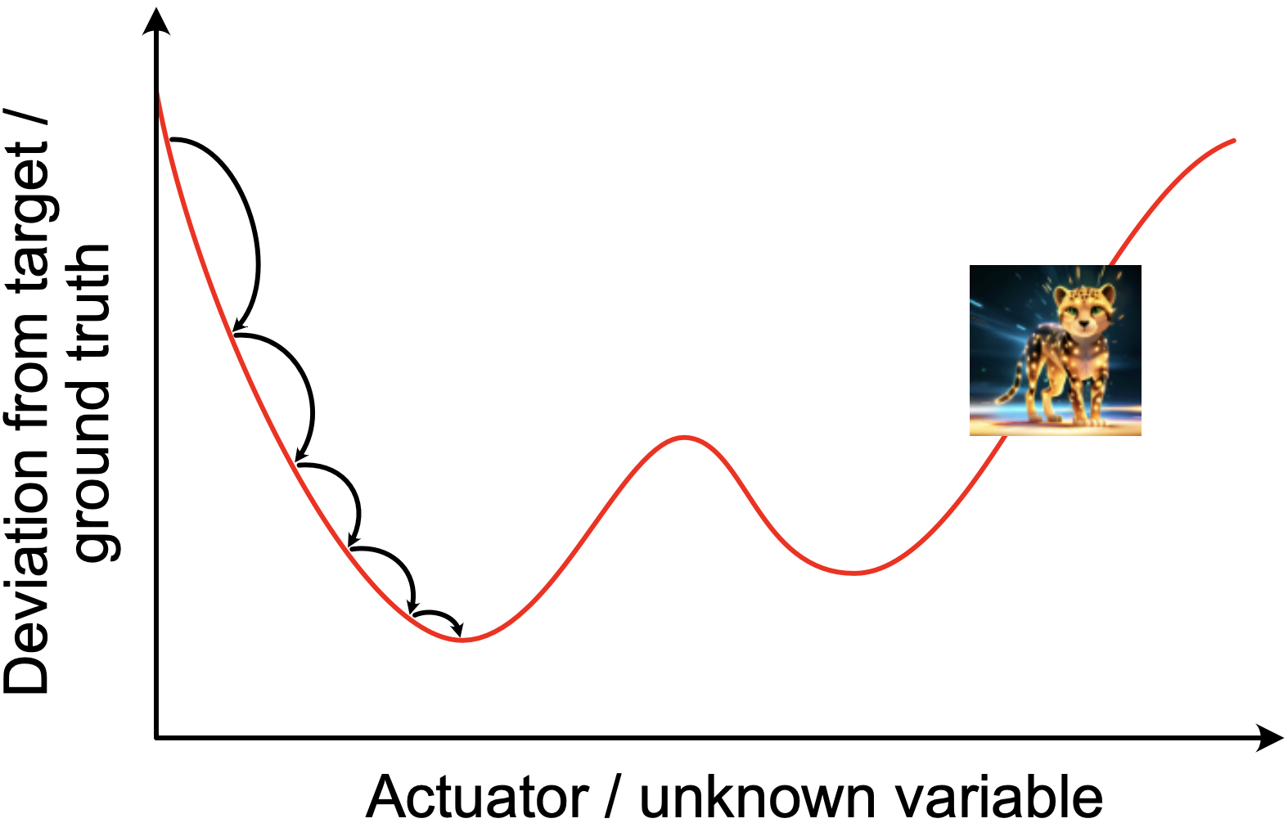
Gradient-based Tuning
Transverse beam tuning at ARES
Tune magnet settings or lattice parameters using the gradient of the beam dynamics model computed through automatic differentiation.
Seamless integration with PyTorch tools tuning neural networks.
Becomes very useful for high-dimensional tuning tasks (e.g. neural network training).

Slide 13
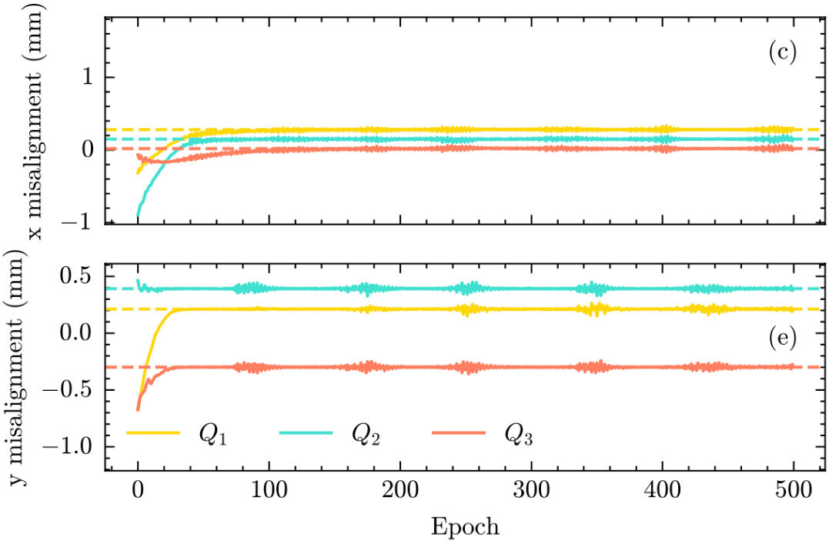
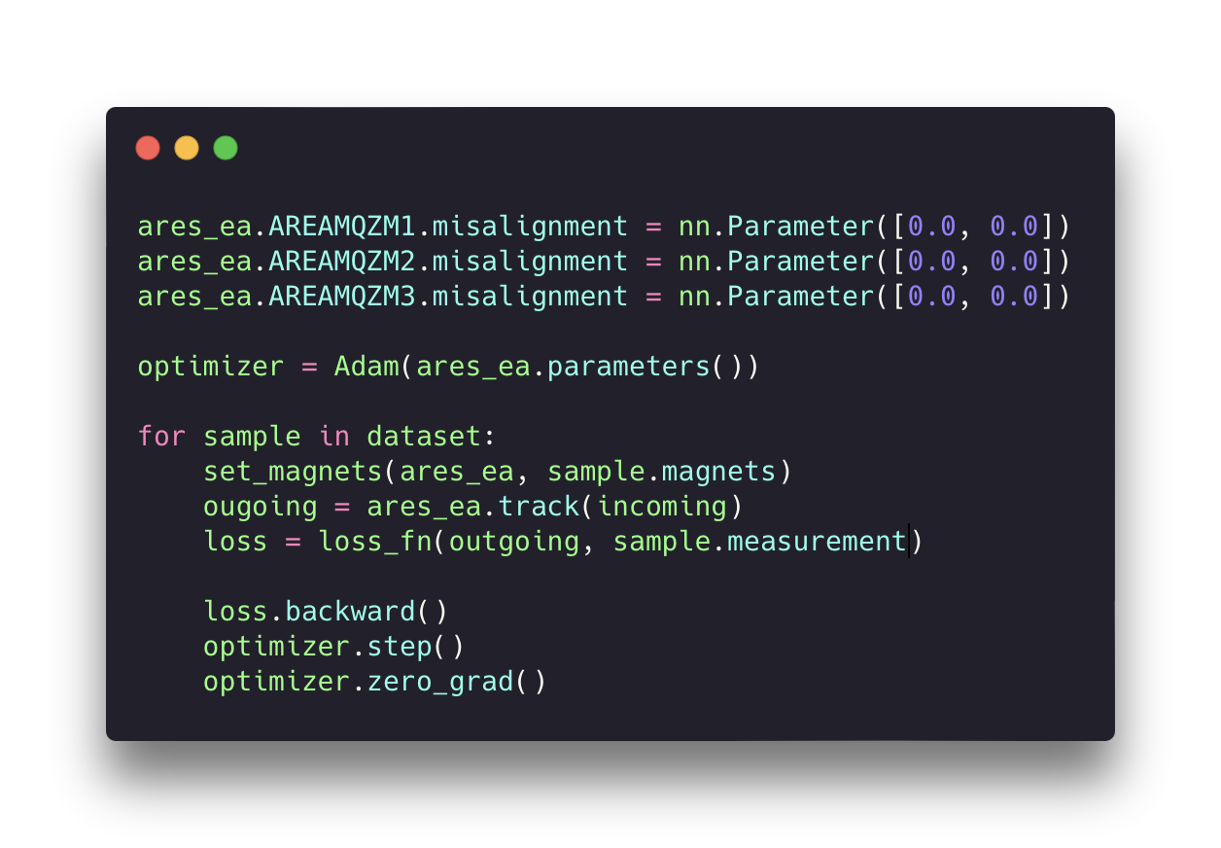
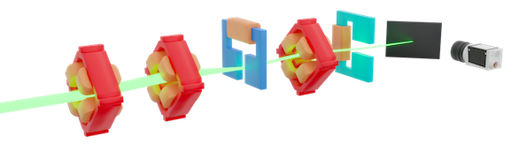
Gradient-based System Identification
Quadrupole misalignments fitting
Determine hidden system properties using the gradient of the beam dynamics model computed through automatic differentiation.
Notes:
ARES EA example … parasitic data

Slide 14
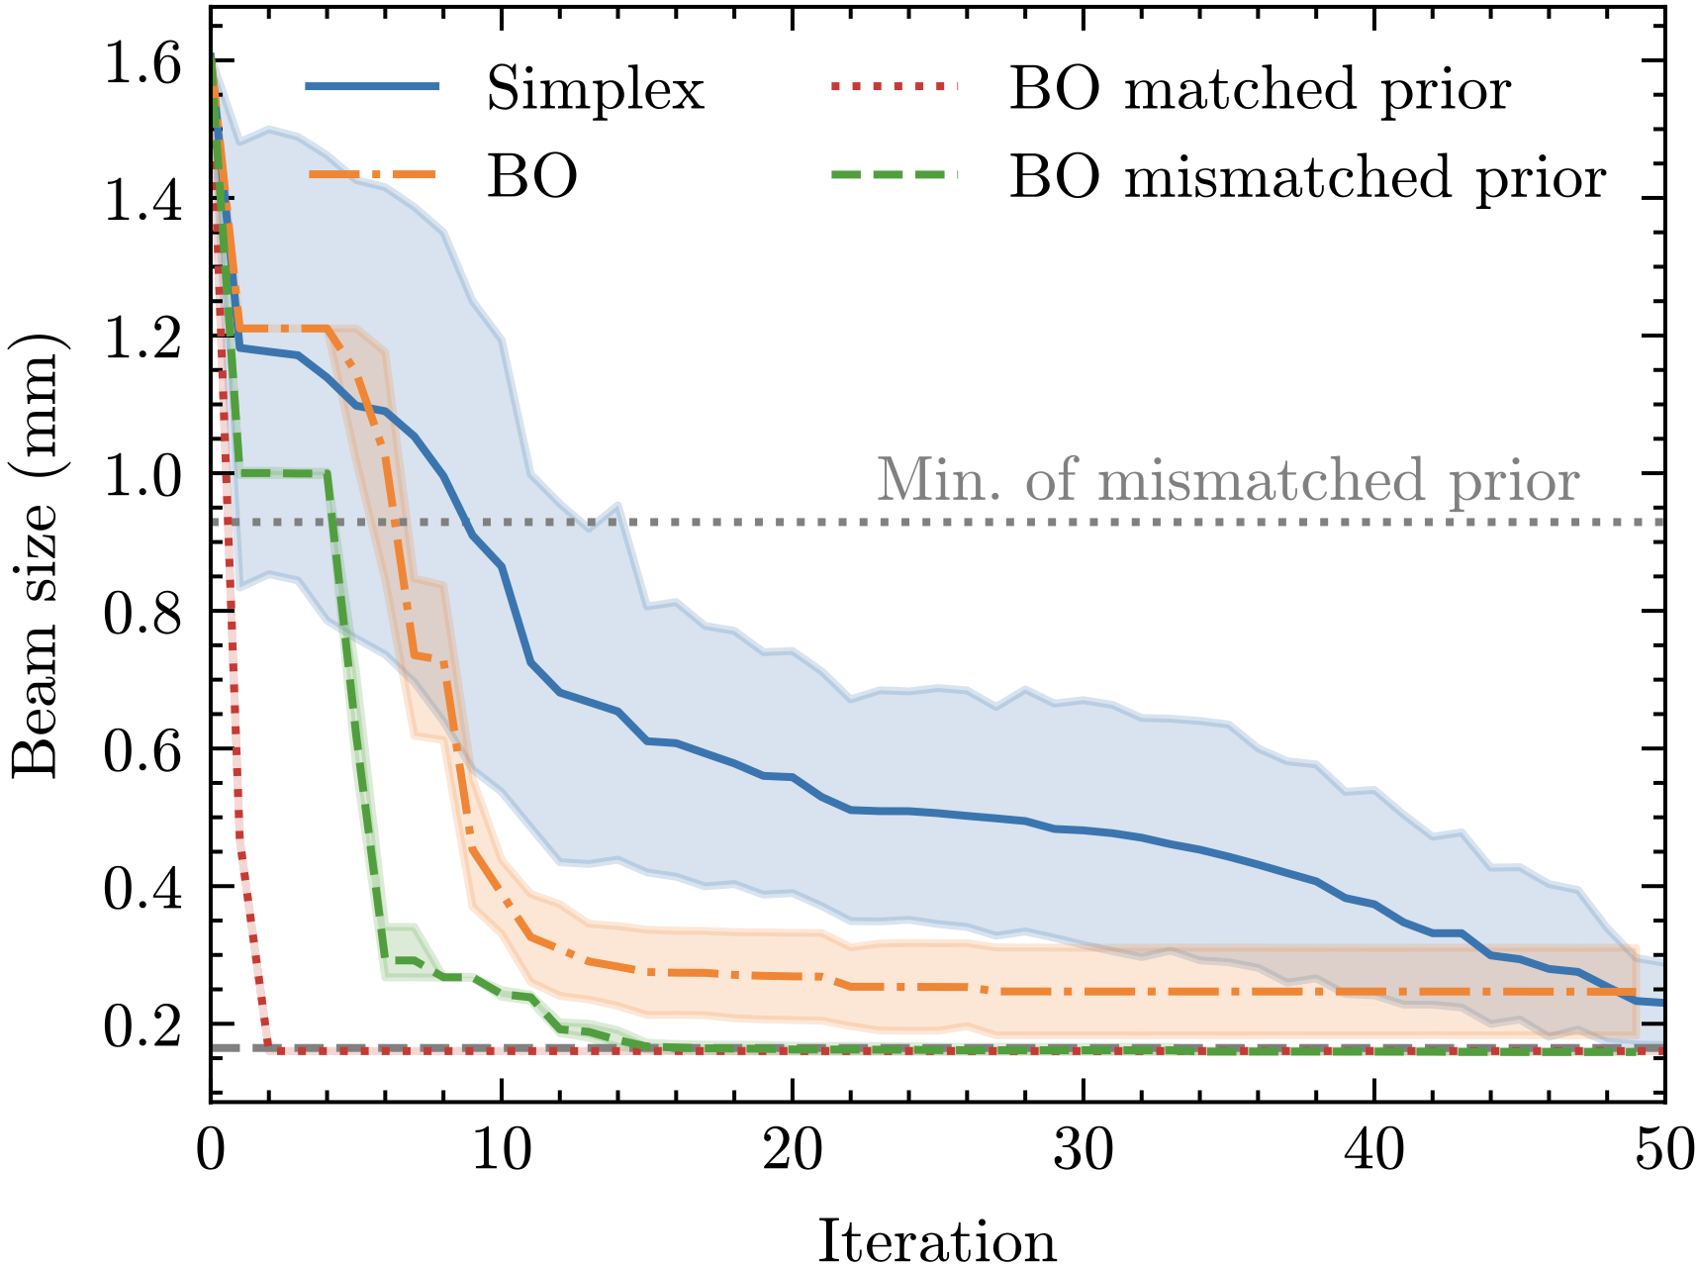
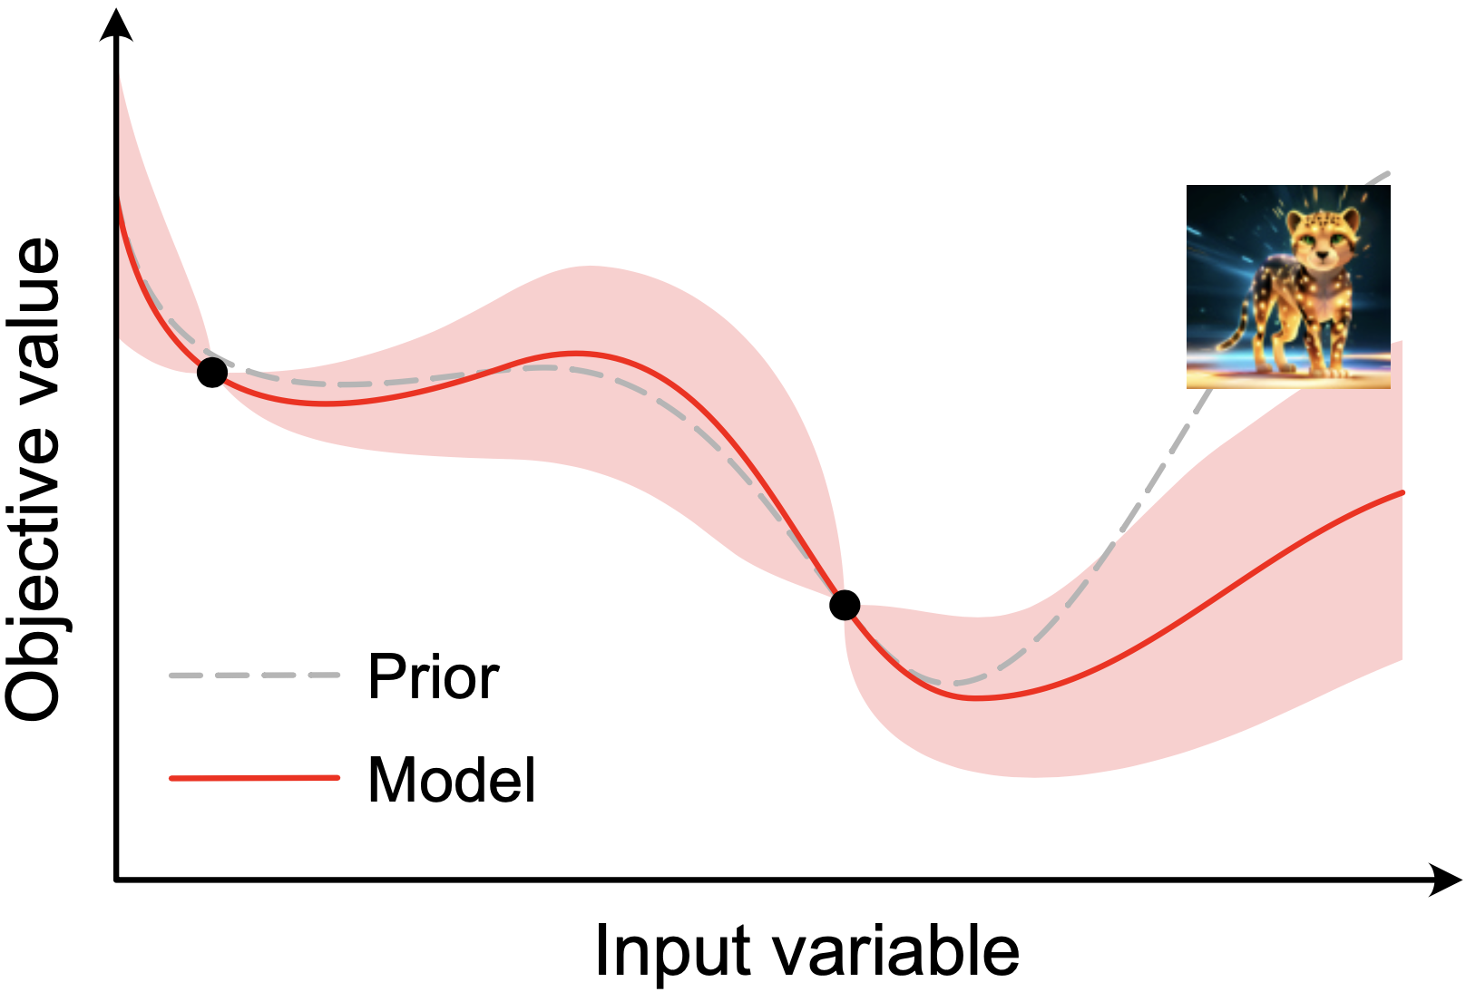
Physics-based Prior Mean for Bayesian Optimization
Combine Cheetah with BO
A physics-informed prior can help improve the performance of BO by preventing over-exploitation.
Differentiability allows efficient acquisition function optimization using gradient descent methods in modern BO packages like BoTorch.
Can be used in combination with gradient-based system identification to overcome model inaccuracies.
FODO cell beam focusing example

Slide 15
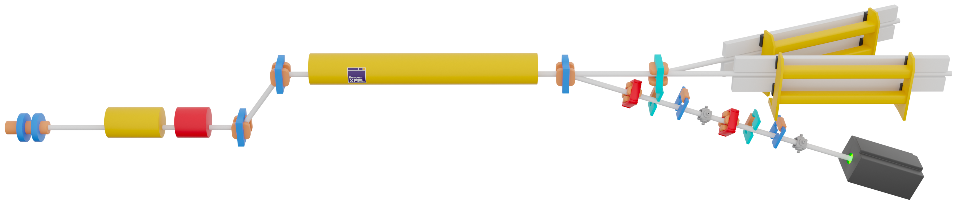

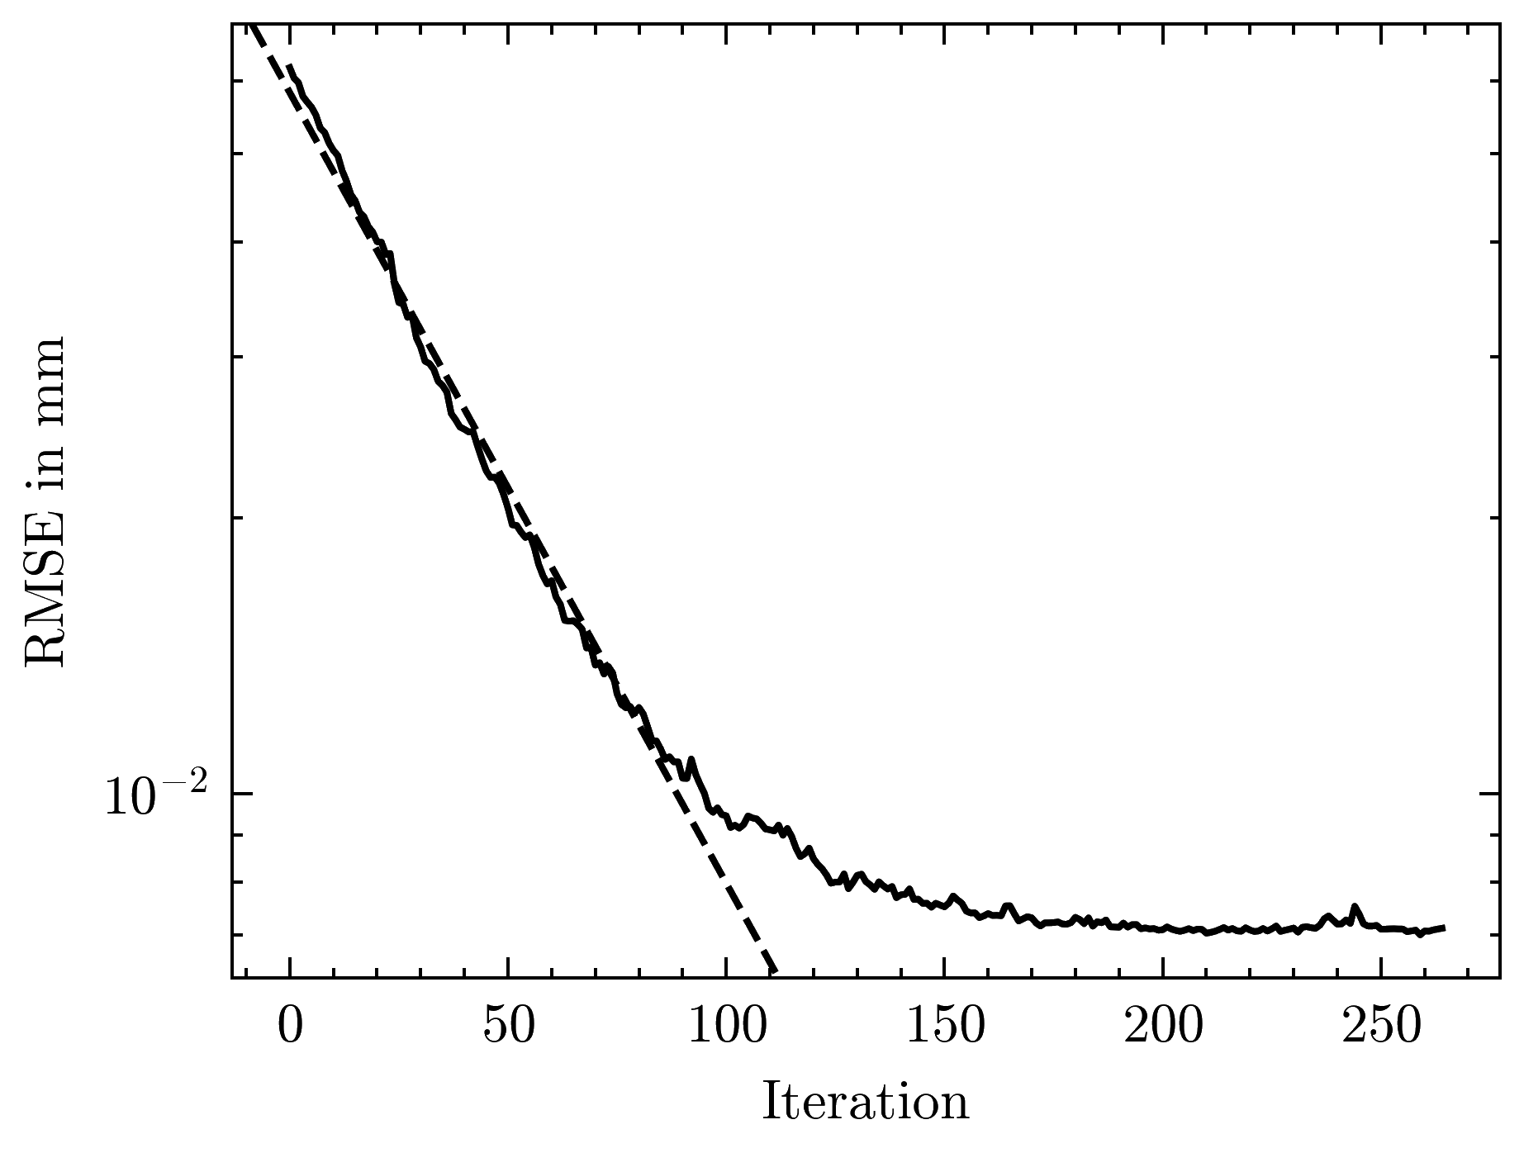
Data-Driven Feedback Optimization
European-XFEL Electron Beam Dump
Find optimal settings for 12 corrector magnets and compensate for continuous drift, using readings from 10 BPMS
Initial sensitivity from Cheetah model, refine with Kalman filter
Random excitation signal
Model-based
Data-driven
Plant
Plant
u_{k}
y_{k}
u_{k}
y_{k}
Optimizer
Optimizer
Filter
Courtesy: Christian Hespe
C. Hespe et al, Automatisierungstechnik 2025

Slide 16
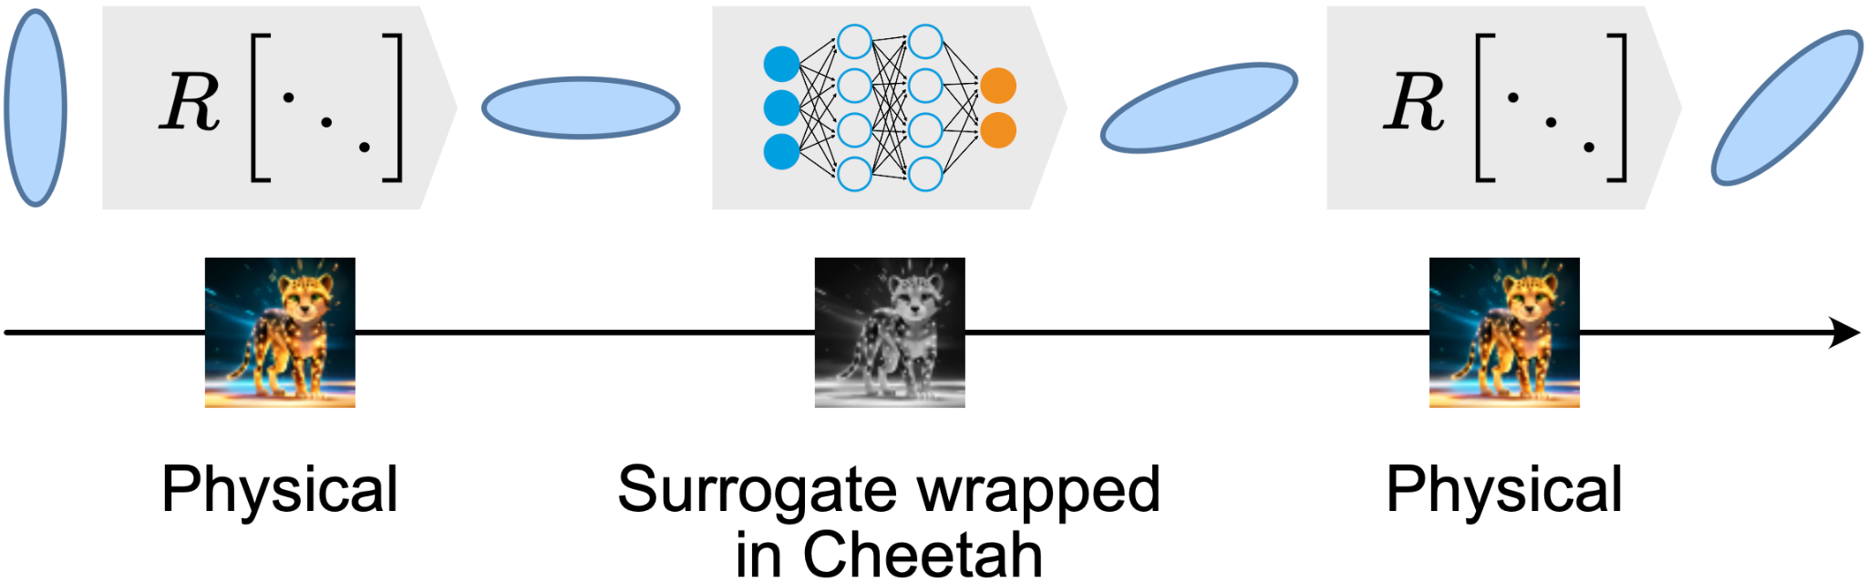
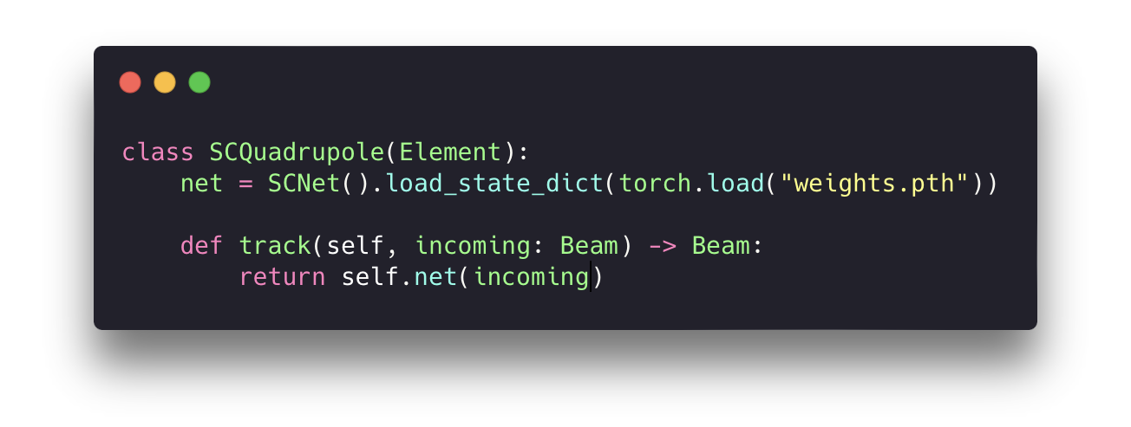
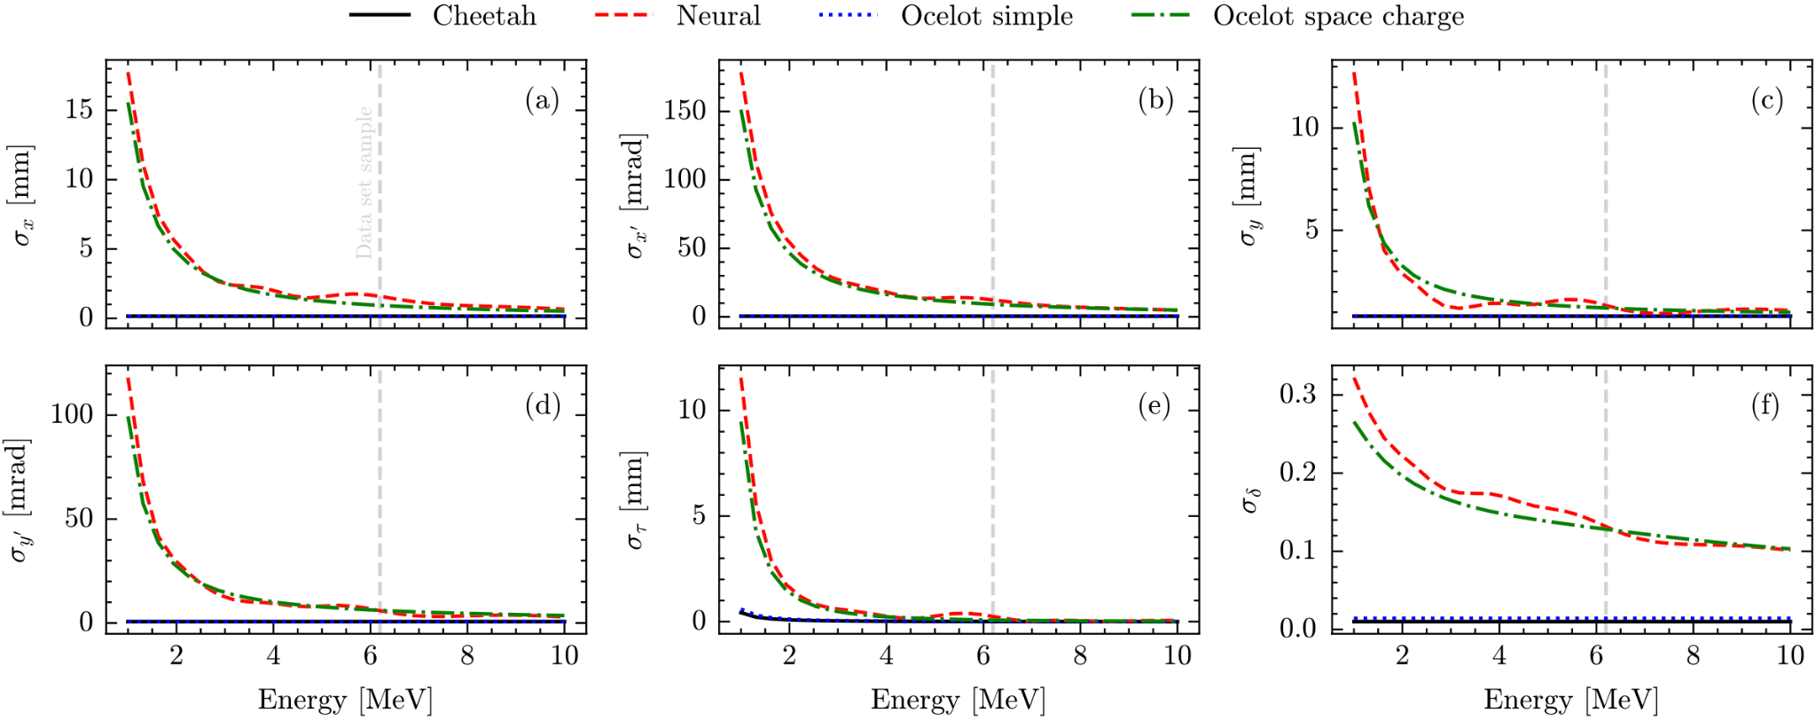
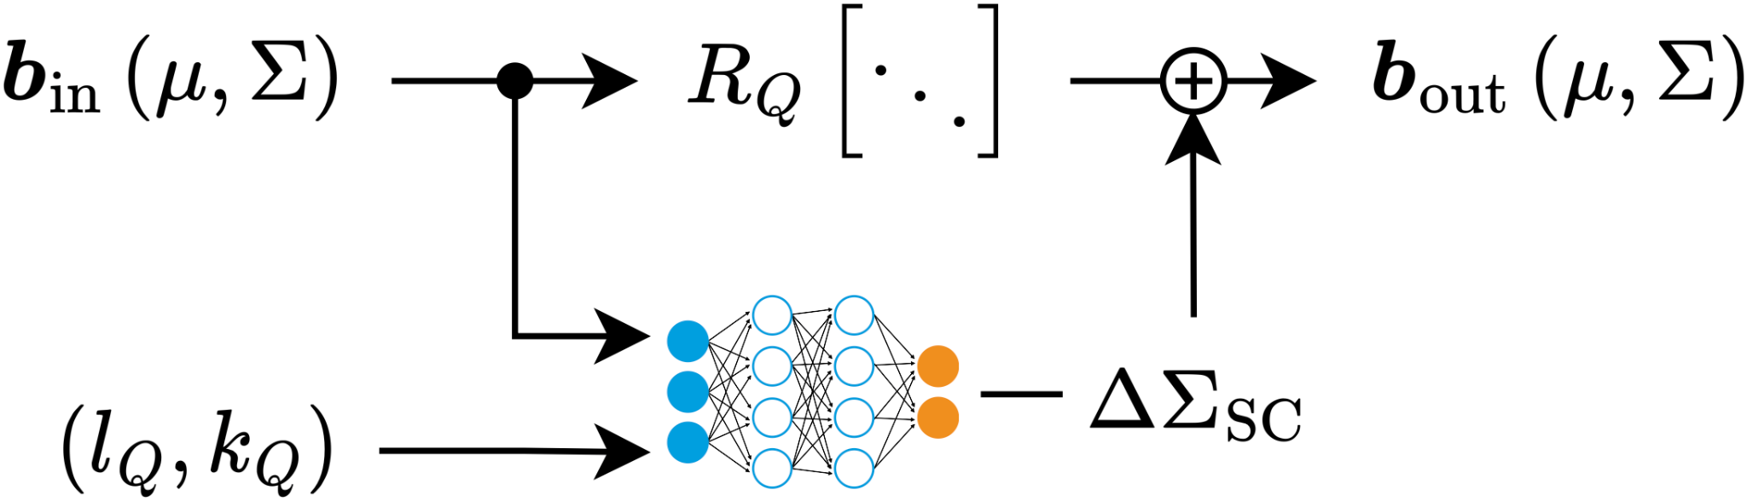
Integrate Modular Neural Network Surrogate Models
Increasing simulation fidelity with surrogate models
Replace/augment Cheetah elements with neural network surrogates trained on high-fidelity simulations or real data.
Neural networks implemented in PyTorch are effectively native to Cheetah. Easy integration & preserved differentiability.

Slide 17



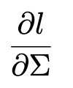
Beam Sigma Matrix Measurement in Transport Lines
Measurement of 5x5 beam matrix in Booster-to-Storage Ring (BTS) Line at APS
Predicted transverse beam profile before (white) and after (red) fitting
Scan quadrupole magnets and observe the beam image on a downstream diagnostic screen, in a transport line with dispersion.
Track the beam in Cheetah, minimize the error between predicted and measured beam distributions
particle tracking
Loss function
auto-differentiation
C. Xu et al. NAPAC2025

Slide 18
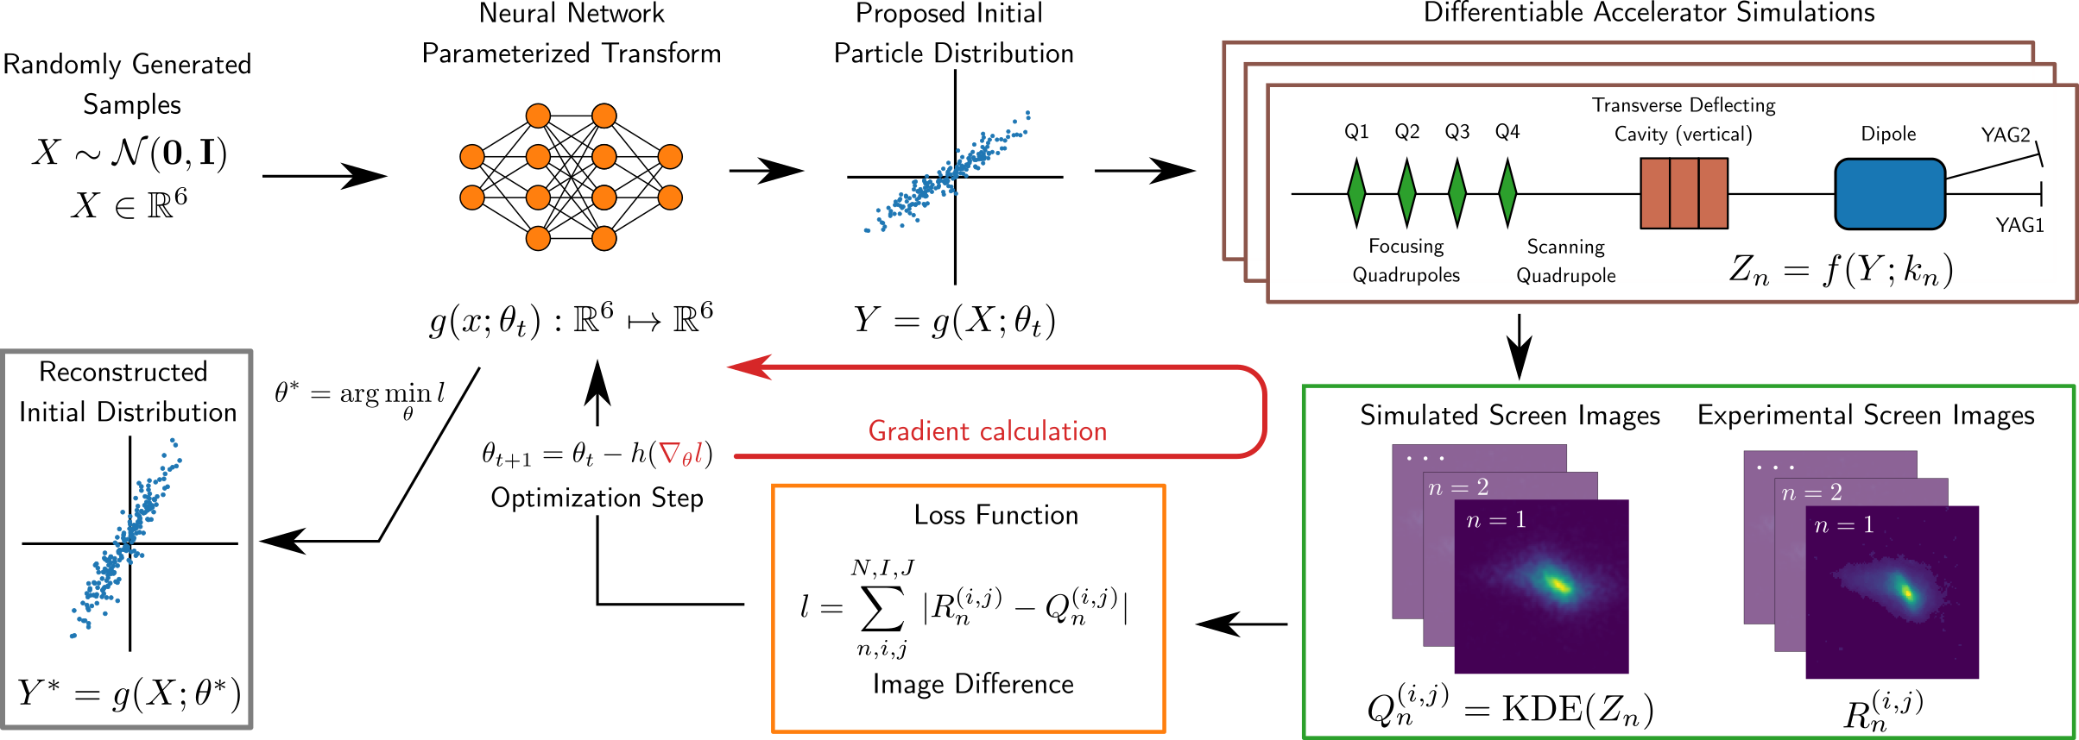
Generative Phase Space Reconstruction (GPSR)
Sample efficient reconstruction for up to 6D phase spaces
Package available at: https://github.com/roussel-ryan/gpsr
R. Roussel et al. 2023, PRL.130.145001
R. Roussel et al. 2025, PRAB.27.094601
Courtesy: Ryan Roussel

Slide 19
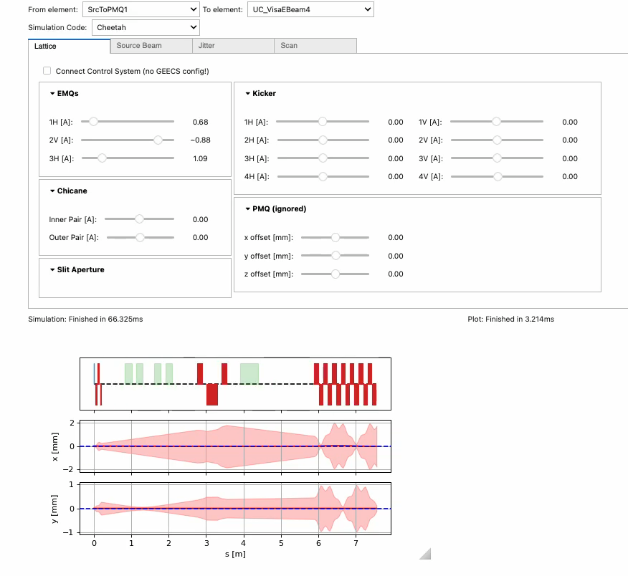
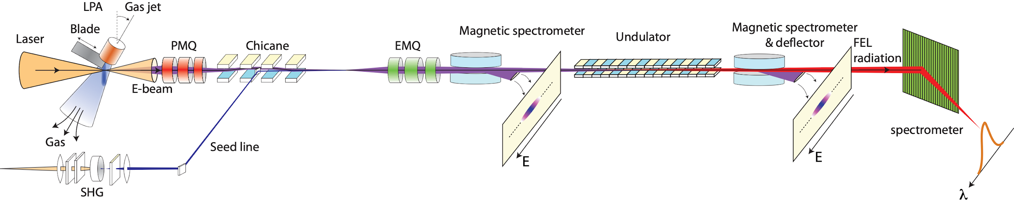
Efforts Towards Building a Digital Twin at LBNL (BELLA): Interactive Beam Dynamics Simulations
Beam dynamics simulations of the BELLA HTU beamline using ImpactX or Cheetah take < 1s enabling interactive use in the control room
LBNL team has built an interactive interface to explore accelerator behavior in simulations.
The interface can connect to the control system and read control parameters in real-time, and update simulations accordingly.
Effort funded by an LBNL LDRD. The code is soon to be released on https://github.com/BLAST-AI-ML
Courtesy: Remi Lehe

Slide 20
Conclusion
Differentiable simulation codes in accelerator physics are still at their early stages.
The packages are under active development, with new features continuously emerging.
First applications already demonstrate the effectiveness of differentiable codes.
Joint development effort and community collaboration will be the key to enable new applications throughout the lifecycle of a particle accelerator.

Slide 21
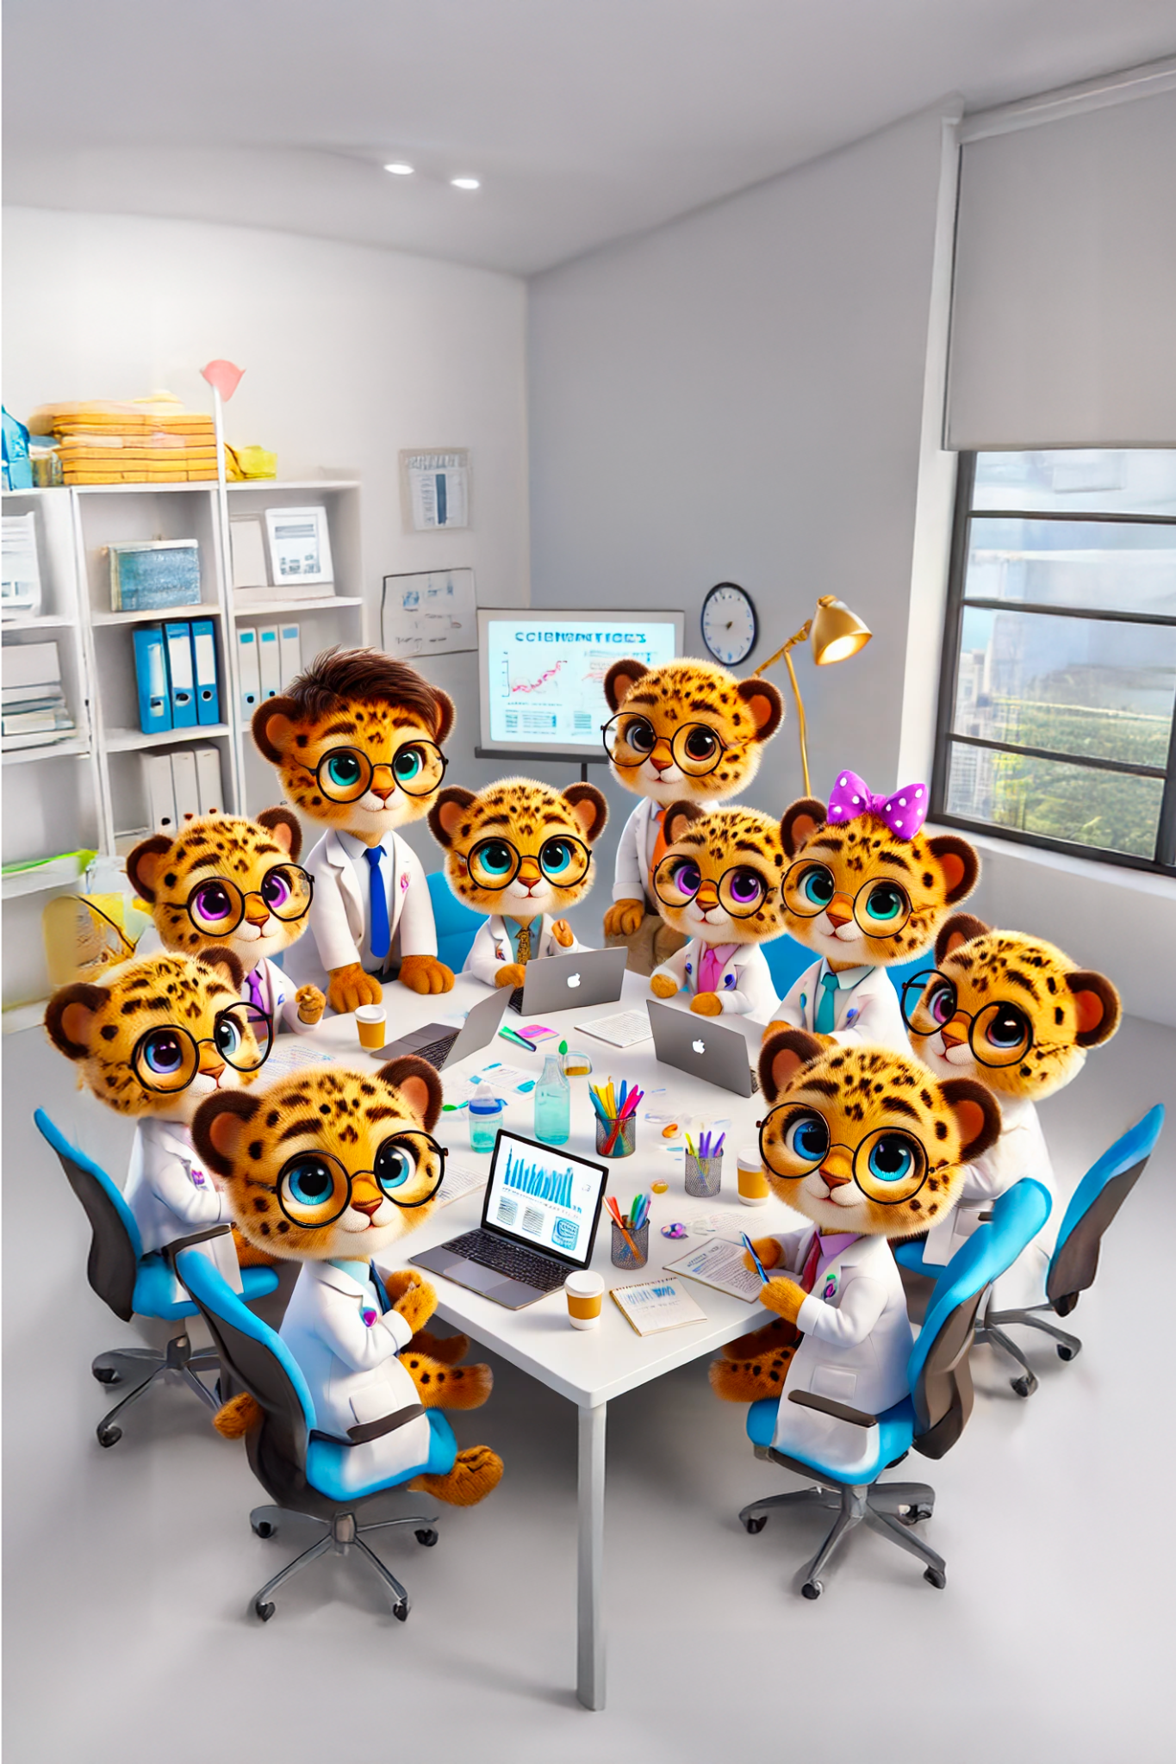
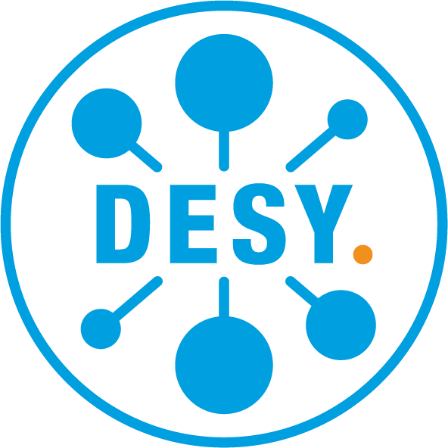




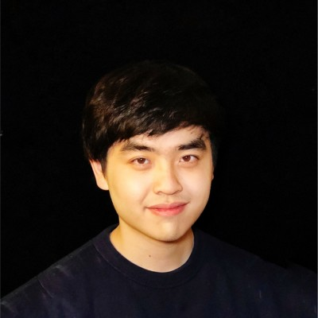

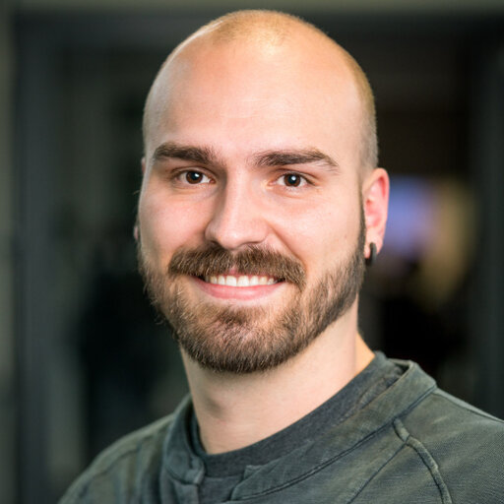

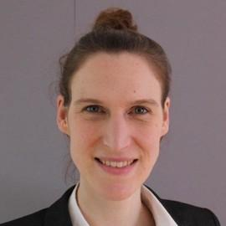







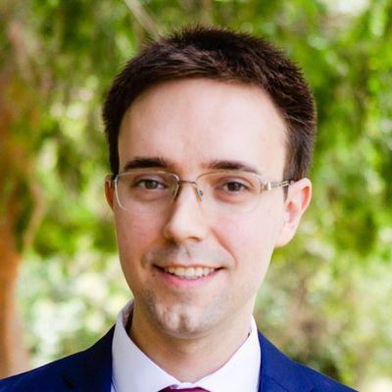

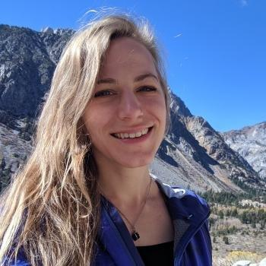
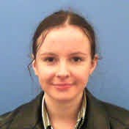

Acknowledgement
Cheetah Collaboration
Jan Kaiser
Christian Hespe
Chenran Xu
Grégoire Charleux
Axel Huebl
Annika Eichler
A. Santamaría García
Remi Lehe
J. P. Gonzalez-Aguilera
Ryan Roussel
Daniel Ratner
Auralee Edelen
Jenny Morgan
Zihan Zhu
The work to develop Cheetah has in part been funded by the IVF project InternLabs-0011 (HIR3X) and the Initiative and Networking Fund by the Helmholtz Association (Autonomous Accelerator, ZT-I-PF-5-6). Further, we gratefully acknowledge funding by the EuXFEL R&D project "RP-513: Learning Based Methods". This work is also supported by the U.S. Department of Energy, Office of Science under Contract No. DE-AC02-76SF00515, the Center for Bright Beams, NSF Award No. PHY-1549132, and the U.S. DOE Office of Science-Basic Energy Sciences, under Contract No. DE-AC02-06CH11357. In addition, we acknowledge support from DESY (Hamburg, Germany) and KIT (Karlsruhe, Germany), members of the Helmholtz Association HGF as well as from the Hamburg Open Online University (HOOU) and the Science and Technology Facilities Council (UK).
Notes:
Weekly meetings for development coordination.
Very active work to towards taking advantage for novel applications and making Cheetah even better for v0.7 release.

Slide 22
Backup Slides

Slide 23
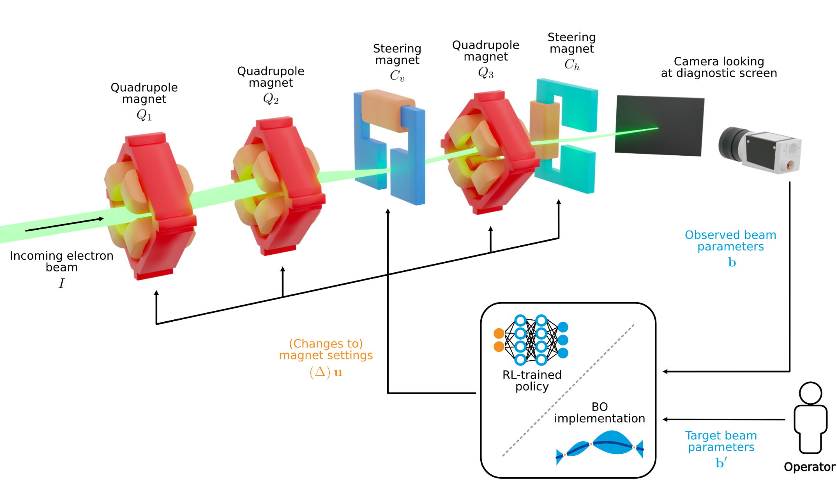

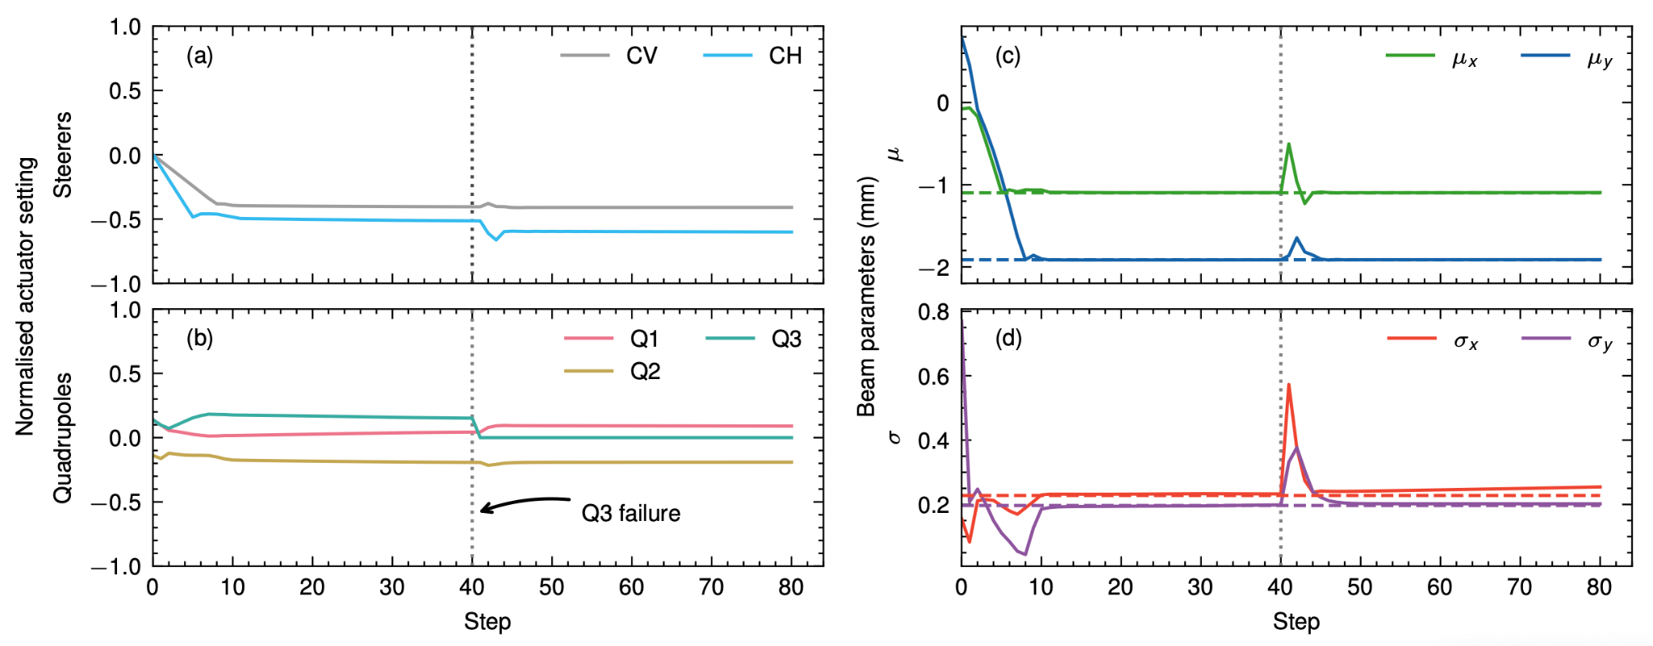
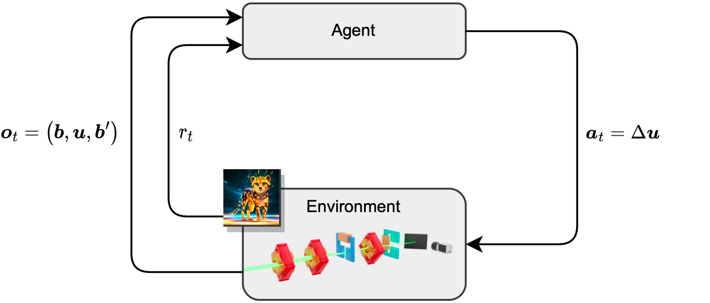
Training Reinforcement Learning Controllers
Transverse beam tuning at ARES
Train a NN policy to tune transverse beam parameters on a diagnostic screen using five magnets (3 quads, 2 dipoles).
Training time ca. 1 hour with Cheetah, equivalent of 3 years on the real machine, training would take 11 days with Ocelot. More efficient training possible with gradient- based RL.
The RL-trained optimization algorithm is deployed to the real-world with zero-shot learning thanks to domain randomization
RLO in ARES EA (including feedback)
J. Kaiser, C. Xu et al. Sci. Rep 2025

