Slide 1

Use of AI/ML for higher brightness and higher polarization of hadron beams
AI / ML proposal supported by DOE
Eiad Hamwi
On behalf of the AI/ML for more polarization collaboration
PI: Georg Hoffstaetter de Torquat
BNL, Cornell, JLab, SLAC, Stony Brook, RPI
AI4EIC October 27th, 2025
Notes:
Add other institutions, Stony Brook, SLAC, RPI, JLab

Slide 2
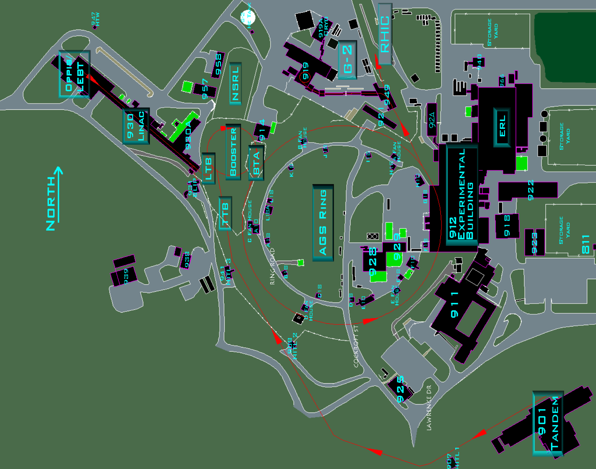
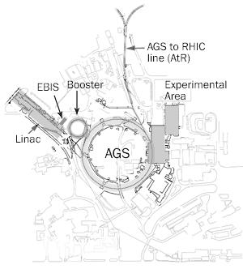
RHIC Injector Complex
OPPIS
LEBT
Linac
HEBT
LtB
Booster
BtA
AGS
AtR
RHIC/HSR
* BNL CADOPS

Slide 3
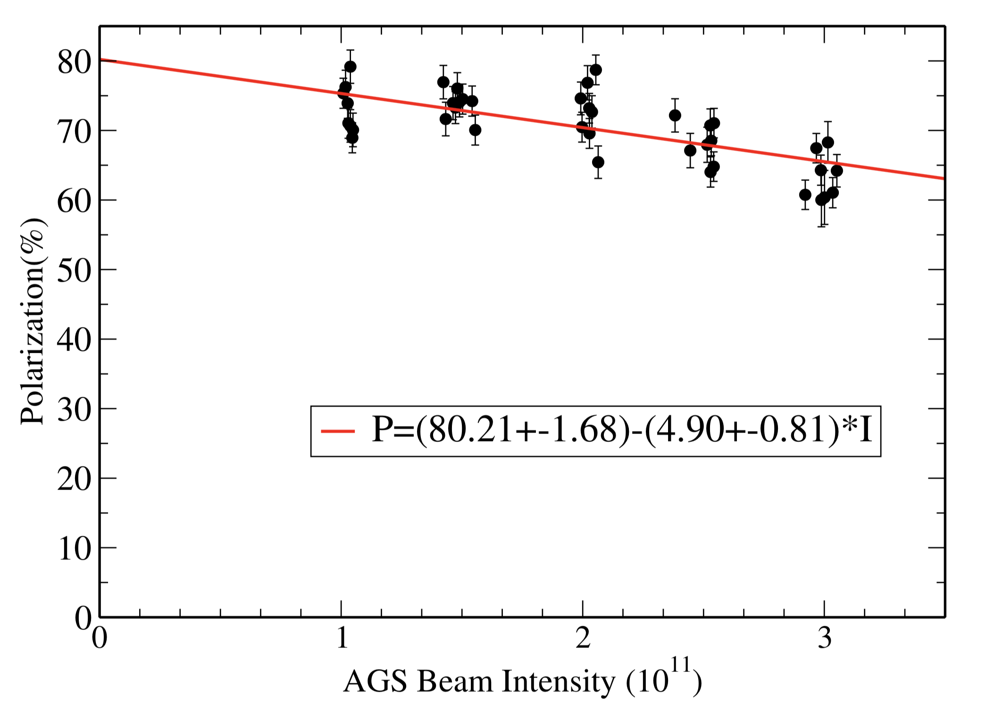
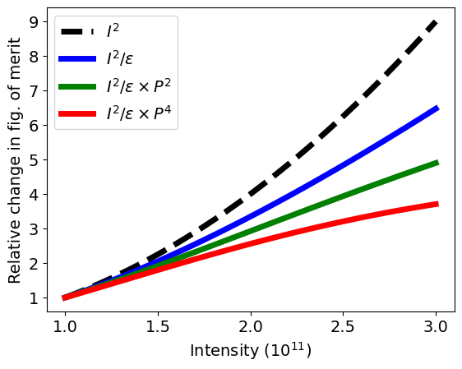
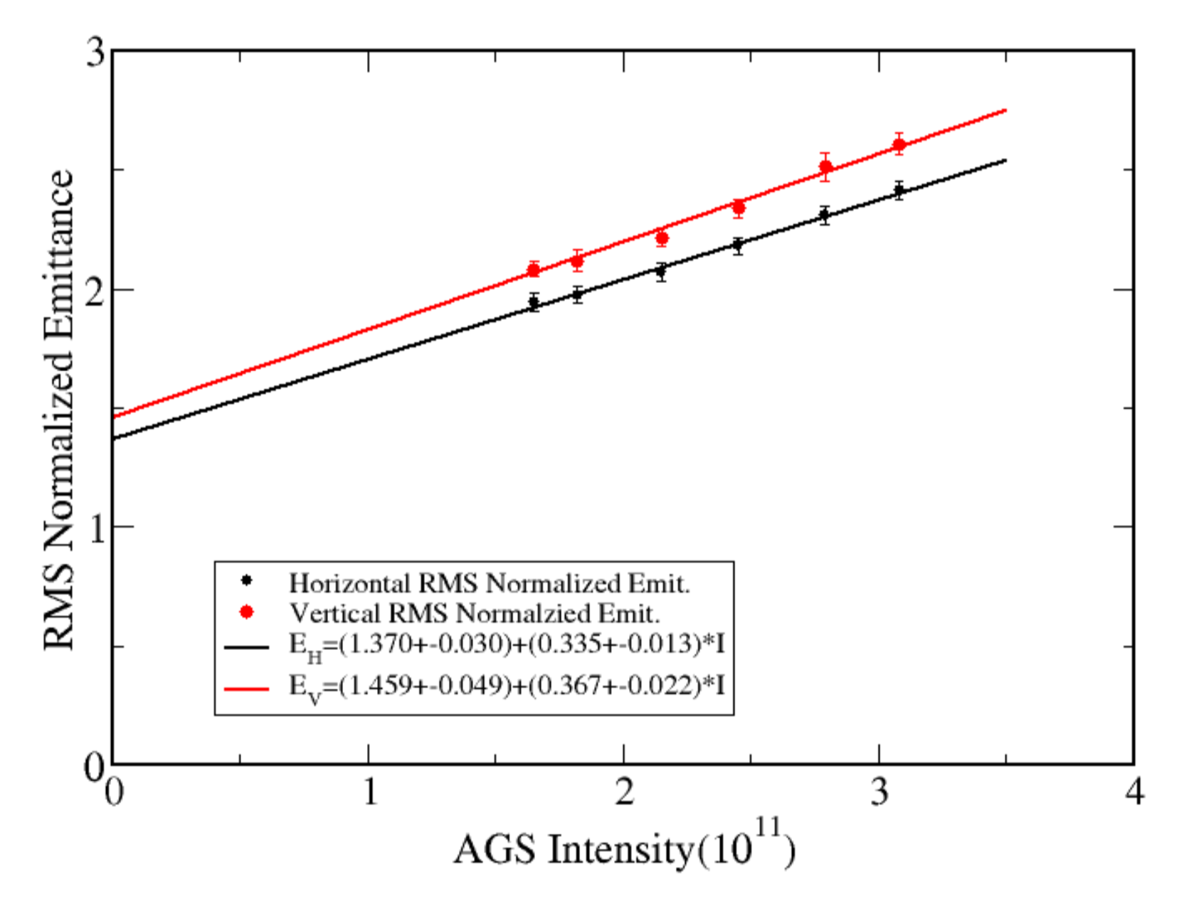
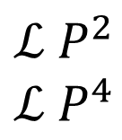
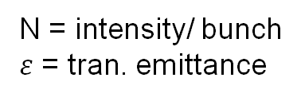


Polarized collider performance
AGS extraction
Collider luminosity, $ℒ$
Pol vs Intensity
$$ℒ∝\frac{N^{2}}{ε}$$
N = intensity/ bunch
$ε$ = tran. emittance
Polarized beam collider FOM
Polarized collider figure of merit (for polarization P):
$$ℒ P^{2}$$
$$ℒ P^{4}$$
transverse spin
FOM =
longitudinal spin
Emittance vs Intensity
Since both emittance and polarization degrade with intensity figure of merit decreases rapidly
FOM dependence on intensity closer to linear in N than quadratic.
Impact of intensity increase on FOM given emittance and polarization dependence at AGS extraction

Slide 4
RHIC Polarized Beam Complex
 | Max Energy [GeV] | Pol. At Max Energy [%] | Polarimeter
Source+Linac | 1.1 | 84-85
Booster | 2.5 | ~80-84
AGS | 23.8 | 65-70 | p-Carbon
RHIC | 255 | 58-60 | P-Carbon avg*
2 Siberian Snakes/ring
Spin flipper
Absolute Polarimeter (H jet)
RHIC pC Polarimeters
PHENIX
* Includes both ramp loss and store decay
STAR
Spin Rotators
(longitudinal polarization)
Spin Rotators
(longitudinal polarization)
LINAC
BOOSTER
Pol. H⁻ Source
Helical Partial
Siberian Snake
 | Absolute Ramp Polarization Loss (Run 17, full run avg)
AGS | 17 %
RHIC | 8 %
200 MeV Polarimeter
AGS
AGS Polarimeter
Strong AGS Snake
Courtesy
Vincent Schoefer

Slide 5
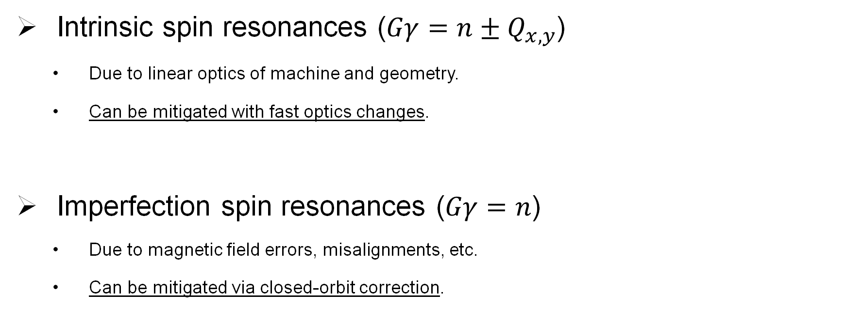
Main Depolarization Mechanisms
Intrinsic spin resonances ($Gγ=n±Q_{x,y}$)
  Due to linear optics of machine and geometry.
  Can be mitigated with fast optics changes.
Imperfection spin resonances ($Gγ=n$)
  Due to magnetic field errors, misalignments, etc.
  Can be mitigated via closed-orbit correction.

Slide 6
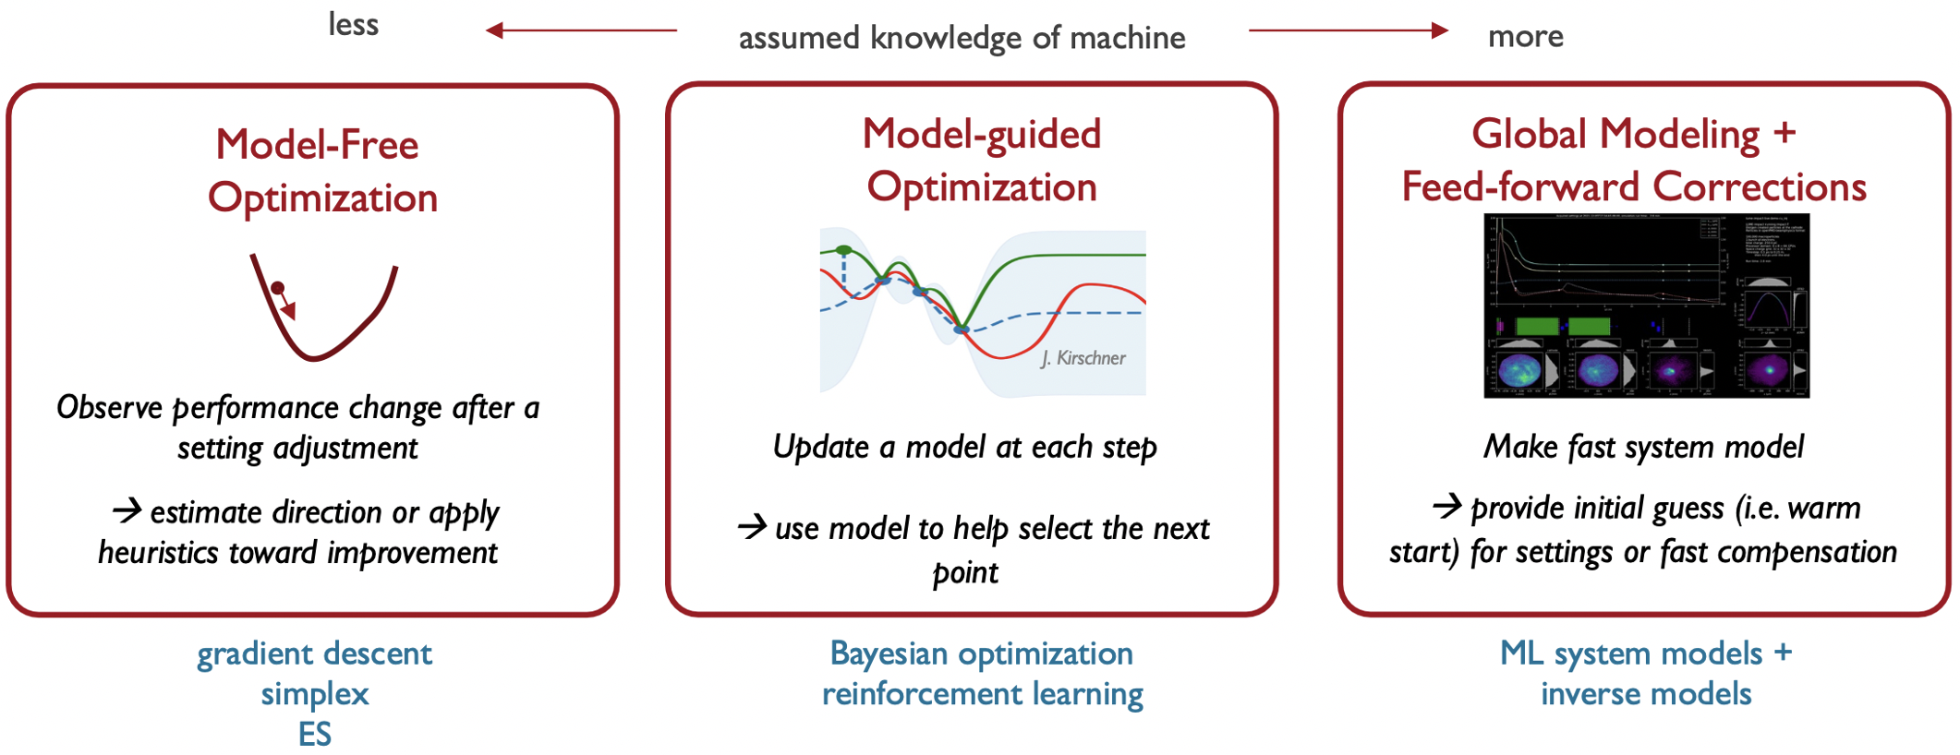
Spectrum of optimization
Courtesy Auralee Edelen

Slide 7
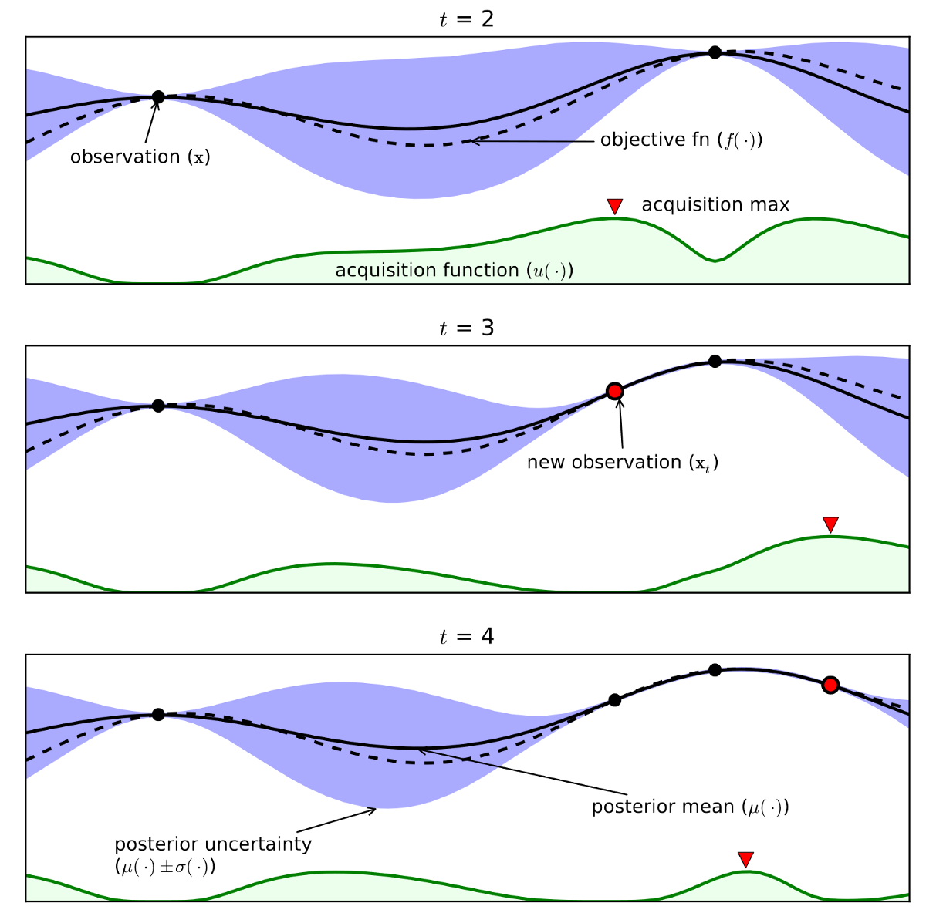
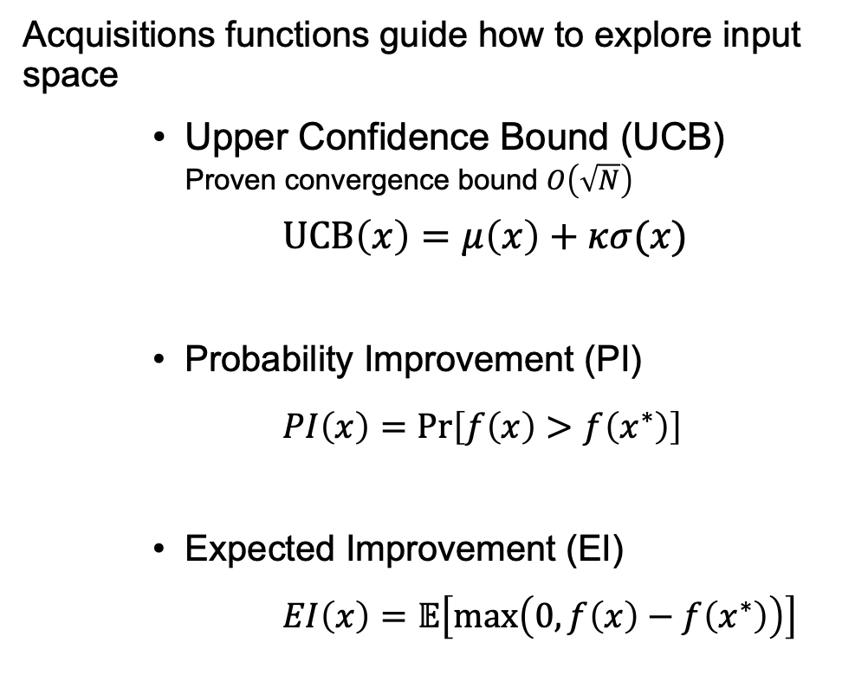
Bayesian optimization
[Image by R. Chandradevan on Medium]
Acquisitions functions guide how to explore input space
    Upper Confidence Bound (UCB)
    Proven convergence bound $O\left(\sqrt{N}\right)$
    $UCB\left(x\right)=μ\left(x\right)+κσ(x)$
    Probability Improvement (PI)
  $PI\left(x\right)=Pr\left[f\left(x\right)>f\left(x^{∗}\right)\right]$
    Expected Improvement (EI)
    $EI\left(x\right)=𝔼\left[\max\left(0,f\left(x\right)−f\left(x^{∗}\right)\right)\right]$

Slide 8
Why is Bayesian Optimization suitable?
Insensitive to local minima (important for nonlinear processes)
Efficient sample usage (data is expensive)
Does not require gradient information (data is expensive)
Physics-informed through kernel function and prior mean

Slide 9
Physics-informed Bayesian Optimization
Surrogate model
  Default: Gaussian processes (GP)
  Fast: Decision trees / Bayesian NN
Mean and uncertainty
  Predictive mean
    Default: constant
    Physically informed NN: Simulated / measured data
  Uncertainty
    Default: Radial basis functions for GP
    Physically informed: RBF fitted parameters (noise, weight, center)
    Trust region weighting

Slide 10
When to use Reinforcement Learning?
Optimal parameters change over time (i.e. drift).
  RL is a continuous control algorithm, not a one-time optimization.
High-dimensional parameter space.
Cheap function evaluation (fast model / very large data available).

Slide 11
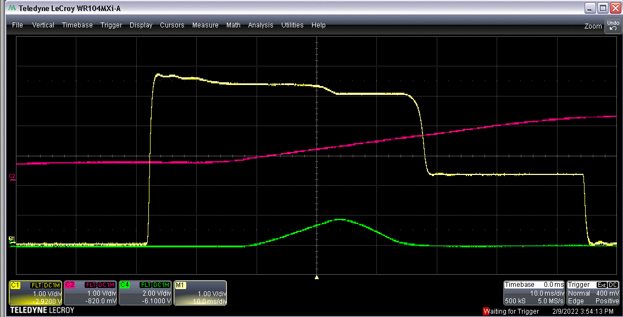
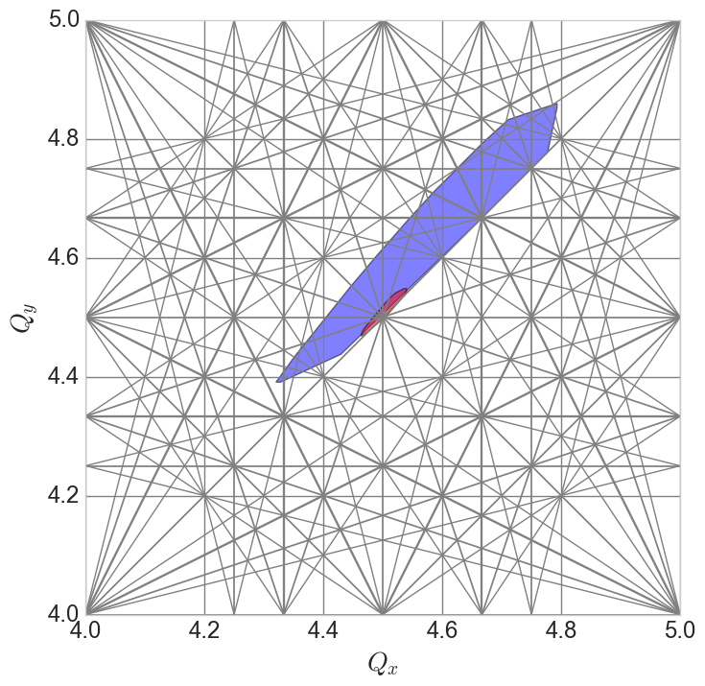
Booster injection
Intensity
Main mag
Many “knobs”
  Linac to Booster trajectory/optics matching
  Optimization of time on foil
  Linac RF phases affect capture and acceleration efficiencies
  Booster RF capture rate affects longitudinal emittance (and transverse, via space charge)
  Booster orbit and optics affect foil scattering, matching and intensity transmission.
  Betatron ‘stop band’ correctors for intensity, emittance preservation.
Difficult instrumentation
  WCM, BPMs don’t work until after capture
  No transverse profile monitor in Booster
    Scraping efficiency as proxy
    Measurable in the extraction line via multiwire
Difficult model
  Linac to Booster longitudinal effects
  Space charge
  Stripping foil
Injection
V scrape
Extraction
Capture
H scrape
Space charge tune spreads
Capture/Early acc
Injection

Slide 12
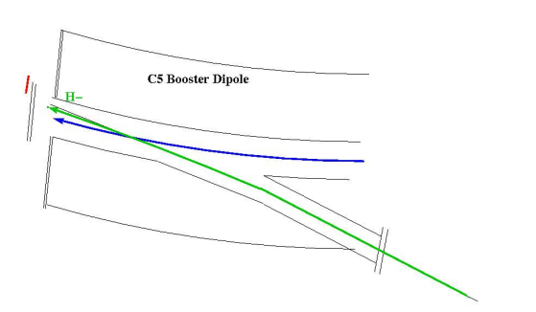
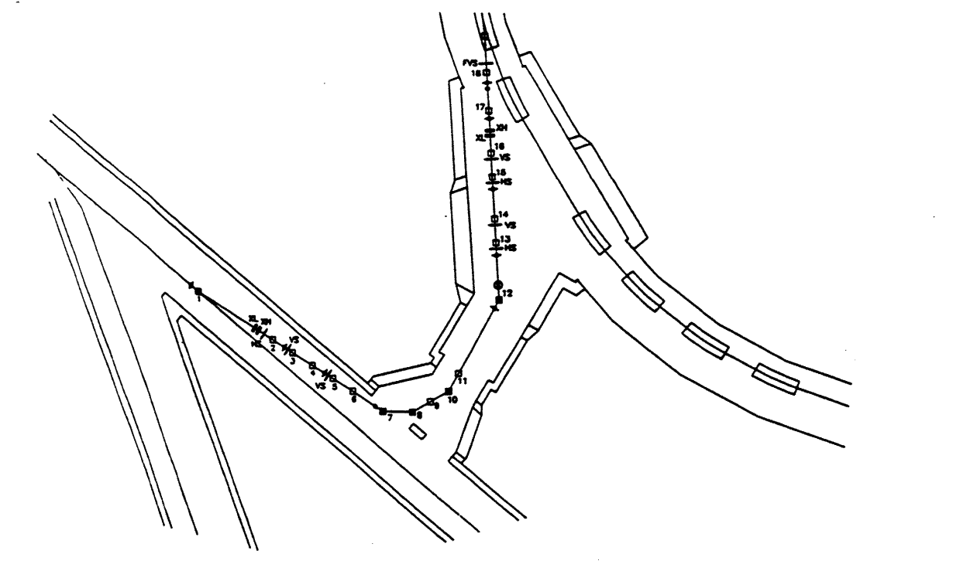
Booster injection
200µs H⁻ pulse injected from Linac
  126° bends
Booster capture
  Entrance through dipole yoke
  Stripping foil converts to p
  Captured into 3 RF buckets
  Beam scraping for emittance control
Booster
LINAC

Slide 13
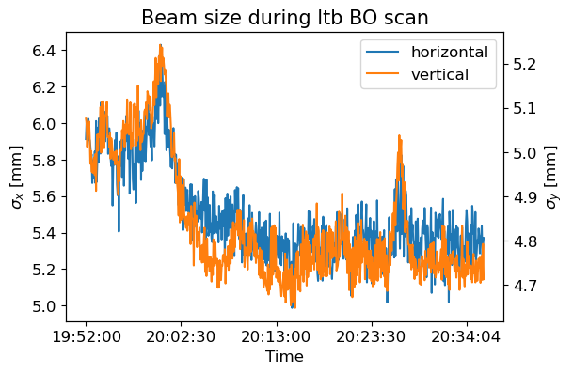
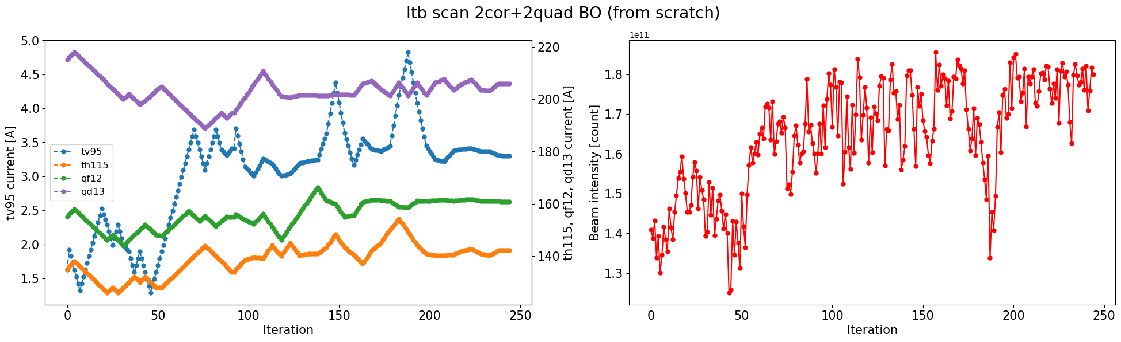
LtB optimization: 2 correctors + 2 quadrupoles
Controls: Power supply currents of two correctors and two quadrupoles at the end of the LtB line
Beam size decrease in both planes in the BtA line in correspondence with intensity increase

Slide 14
AGS injection
3-bunch train kicked out of AGS Booster in 1 turn
  Fast kicker at F3
  0.14 µs rise / 2.25 µs flat-top
  ~0.8 µs/rev @ 2.5GeV
Bunch train injected via septum inflector
  Closed-orbit injection bump via BLW
  Fast kicker at A5
  0.12 µs rise / 0.60 µs flat-top
  ~3 µs/rev @ 2.5GeV
4 Booster cycles (per Booster supercycle) fill 1 AGS cycle
AGS
Booster

Slide 15
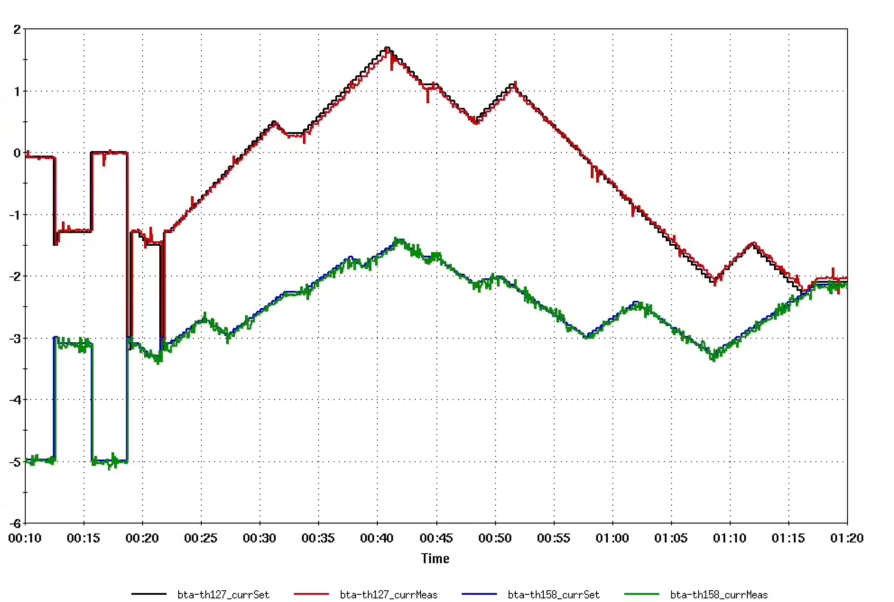
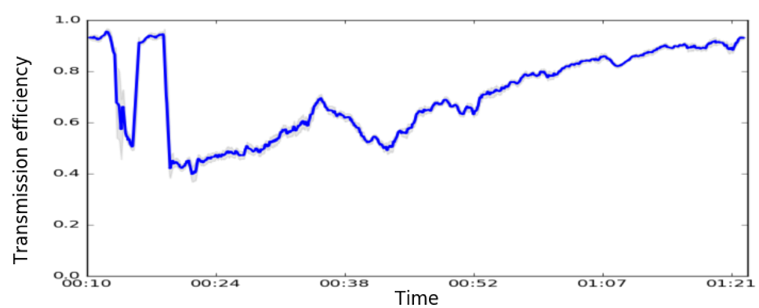
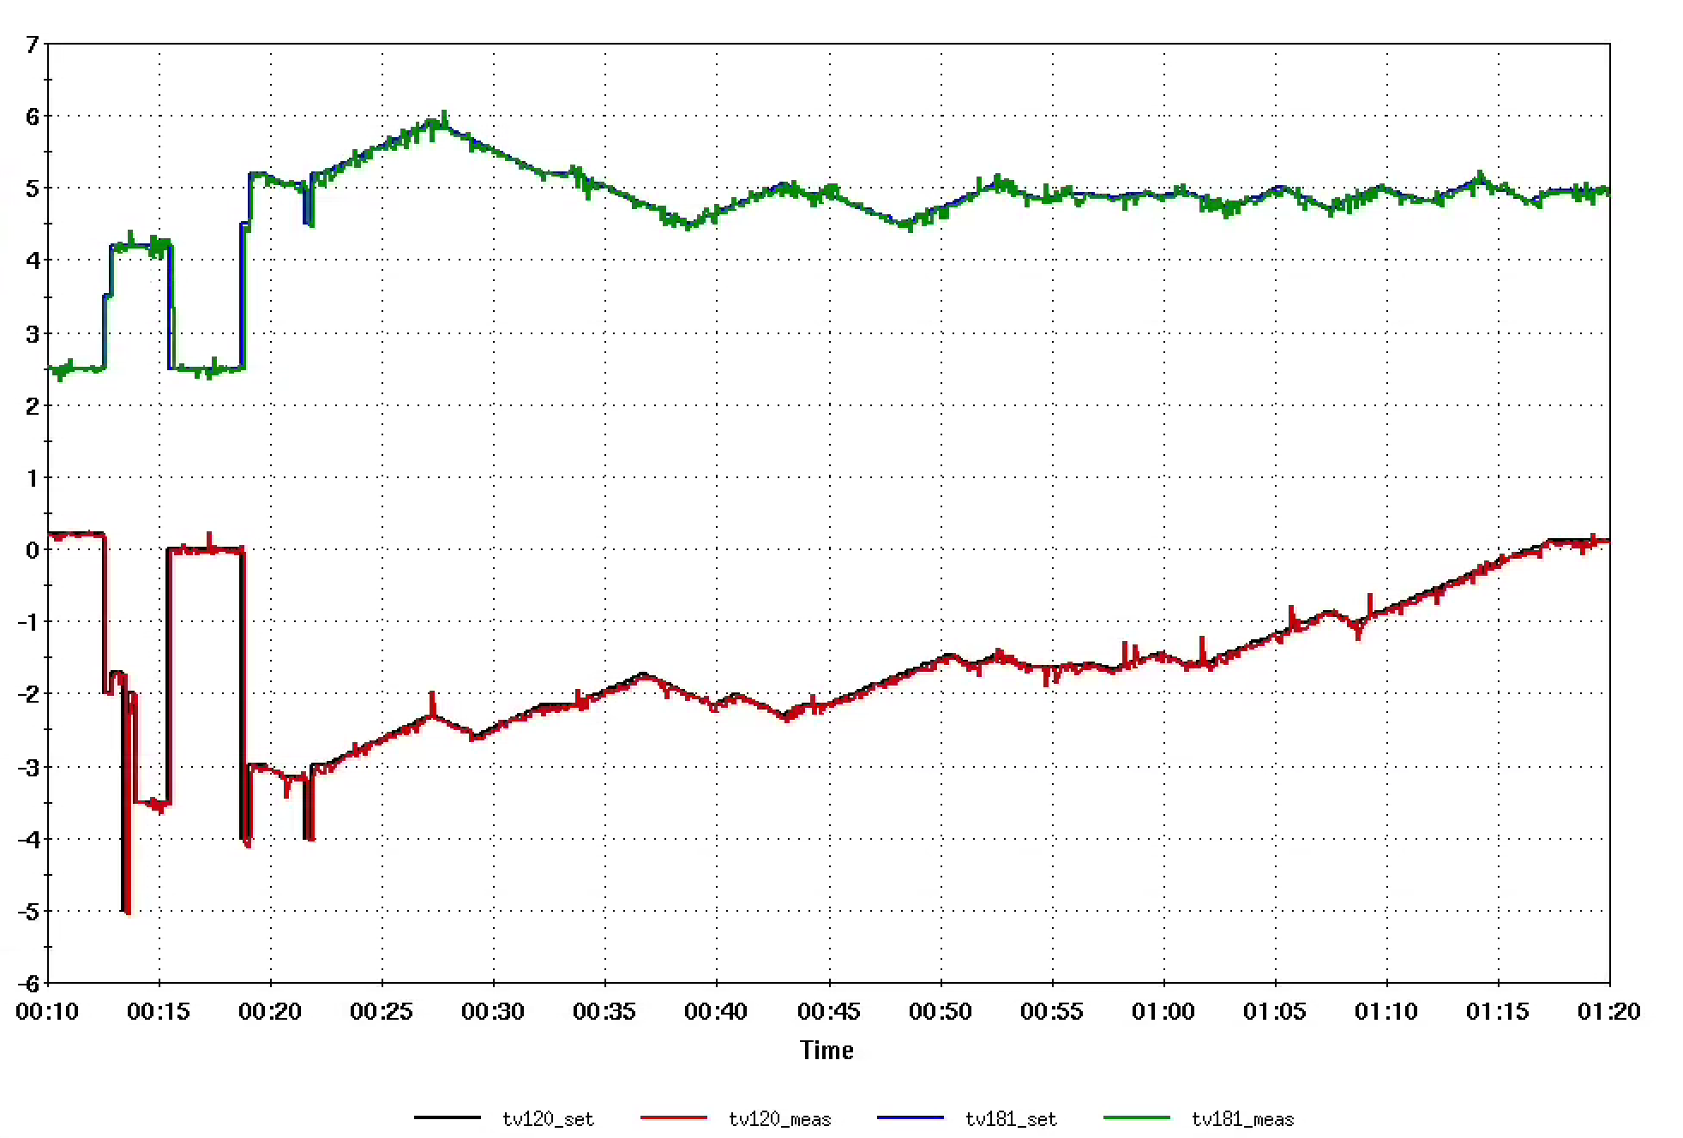
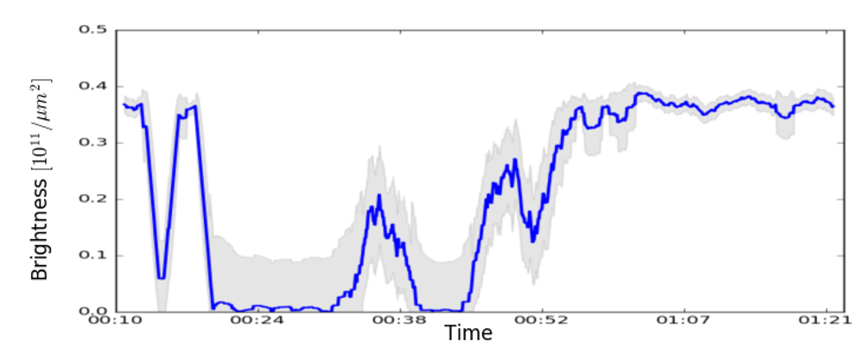
BtA optimization: 4 correctors
Spoilage test
Steering (2HC + 2VC)
  IPM signal possible
  Averaged 3 cycles
  1+ hrs

Slide 16
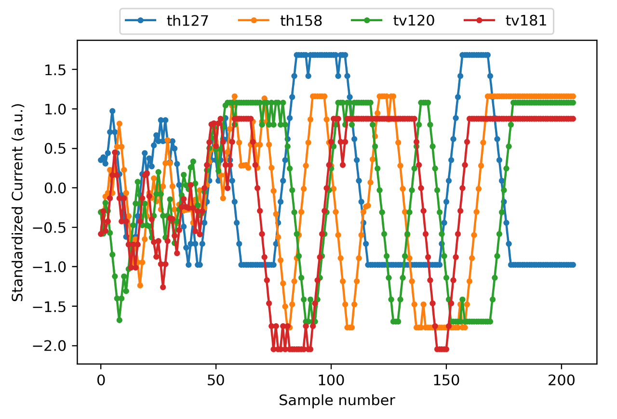
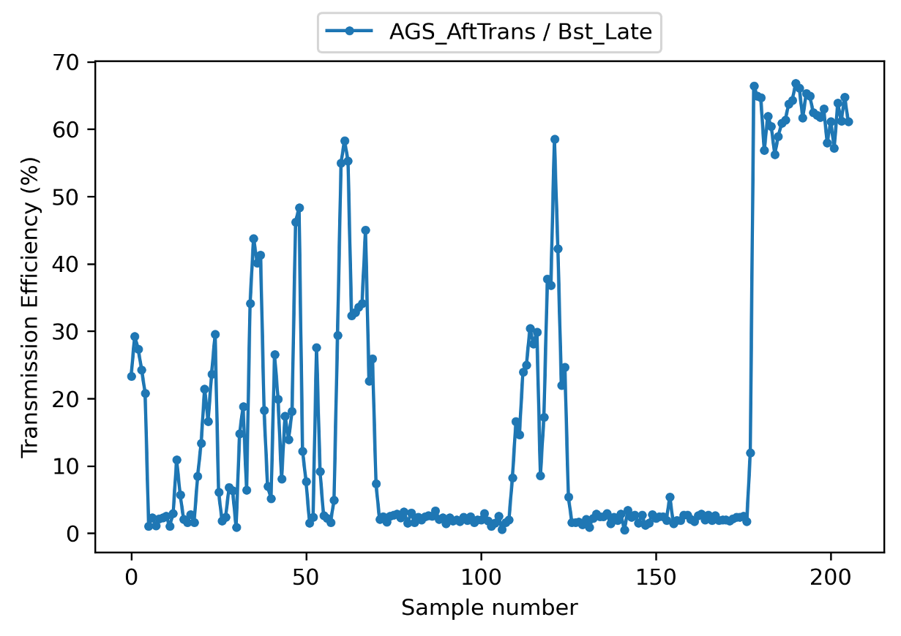
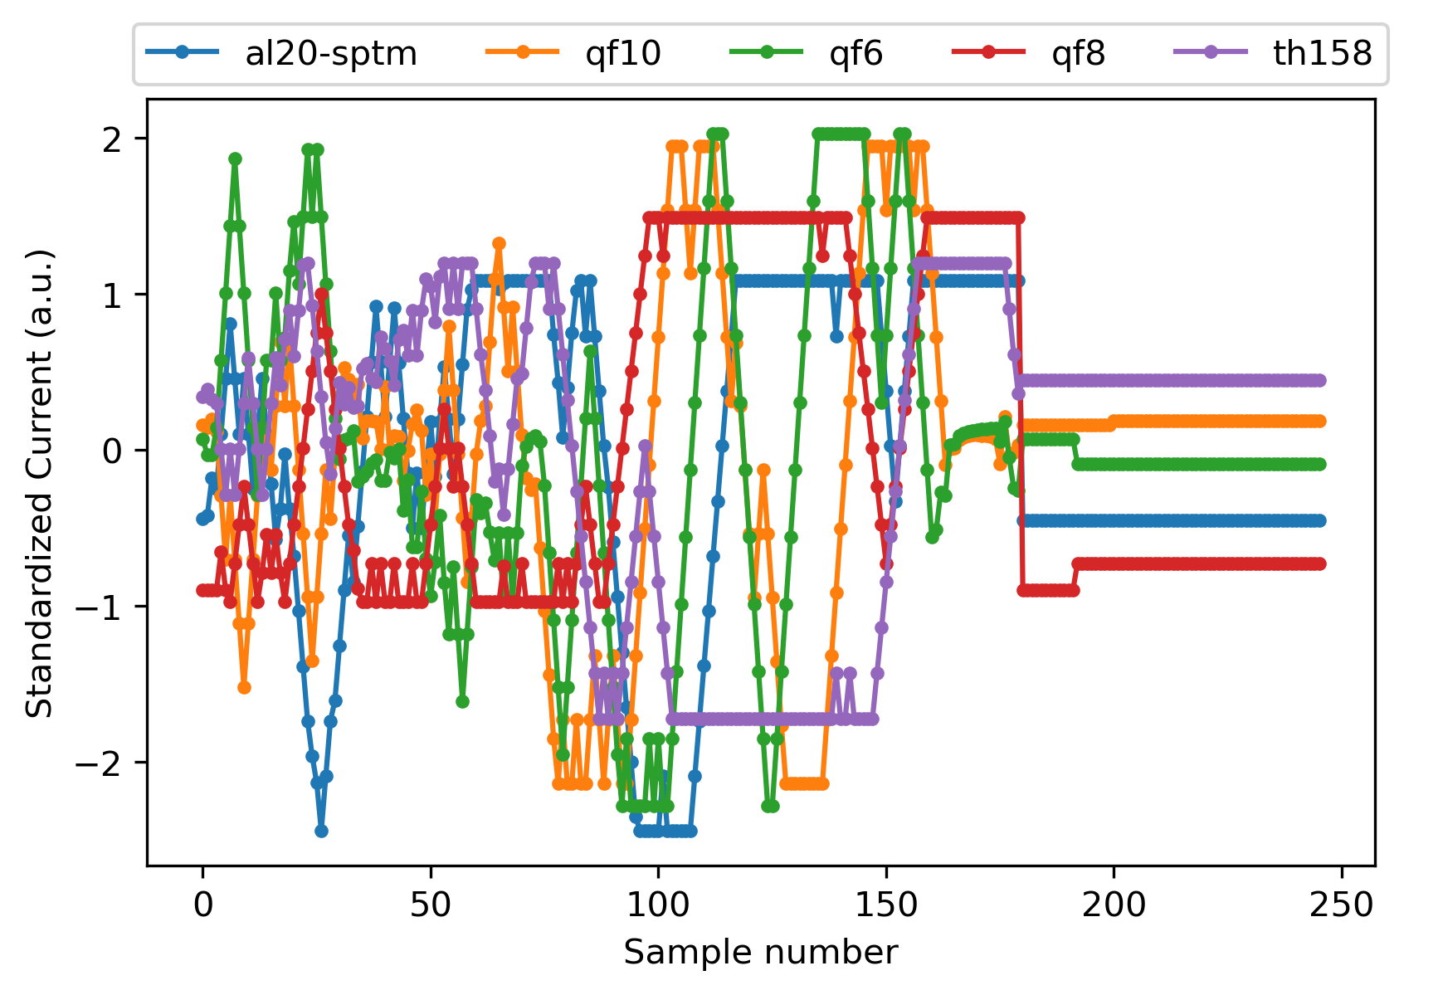
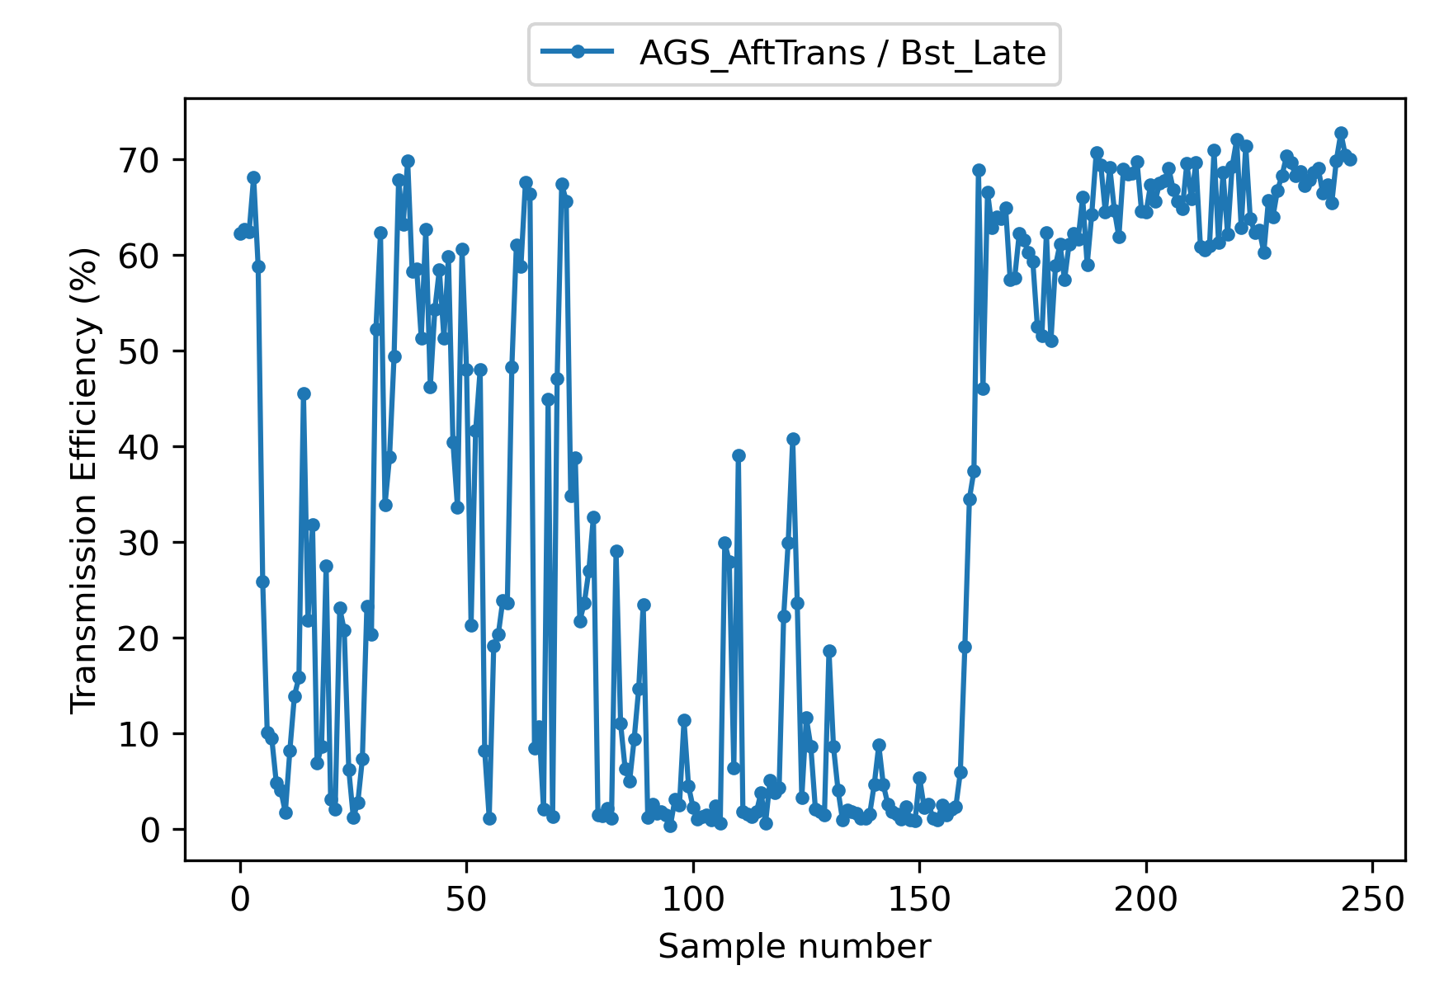
BtA optimization: 4 correctors + 3 quads
Spoilage test
Steering (2HC + 2VC)
  No IPM signal
  No averaging
  ~20 mins
Shaping (3QF + 2HC)
  No IPM signal
  No averaging
  ~25 mins

Slide 17
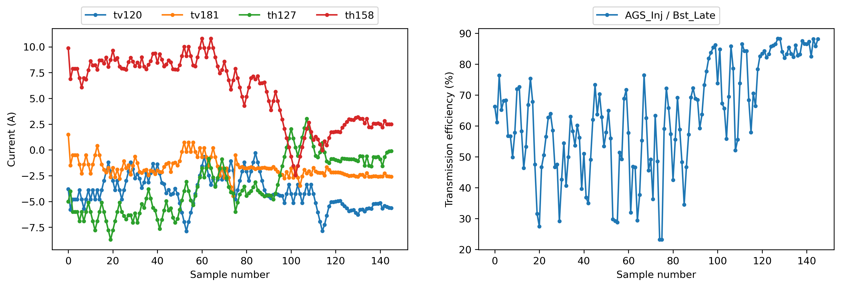
BtA optimization: 4 correctors
In-production test
Steering (2HC + 2VC)
  No IPM signal
  No averaging
  ~15 mins

Slide 18
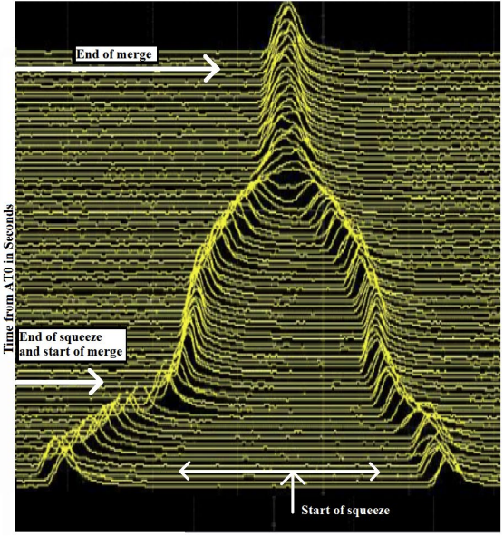
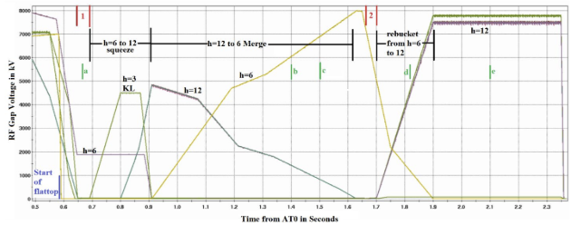
AGS Bunch Merging
To reduce the space-charge forces, the beam bunches are proposed to be split into two smaller bunches in the Booster and merged back in the AGS.
The typical RF gymnasiums to achieve bunch merge involves tuning of 2 harmonic groups
h=12 to 6 Merge
h=6
h=12

Slide 19
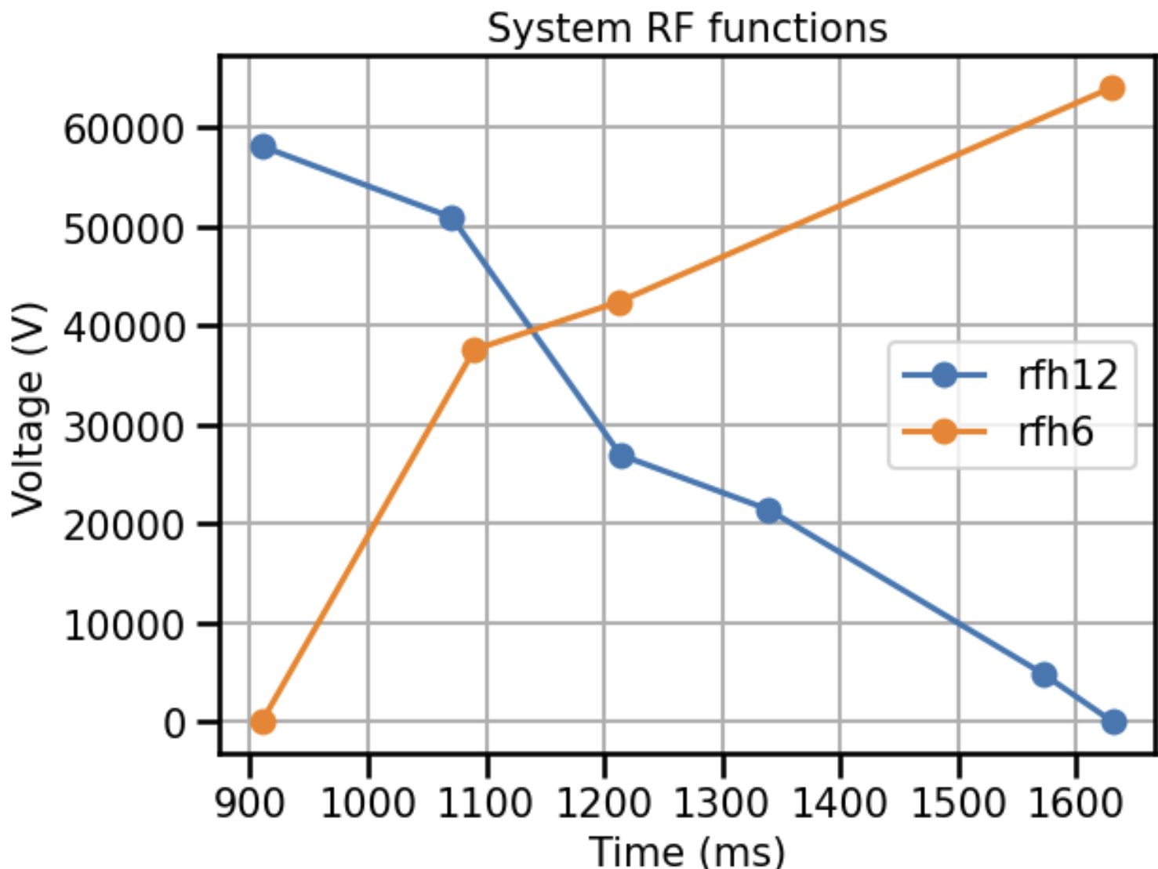
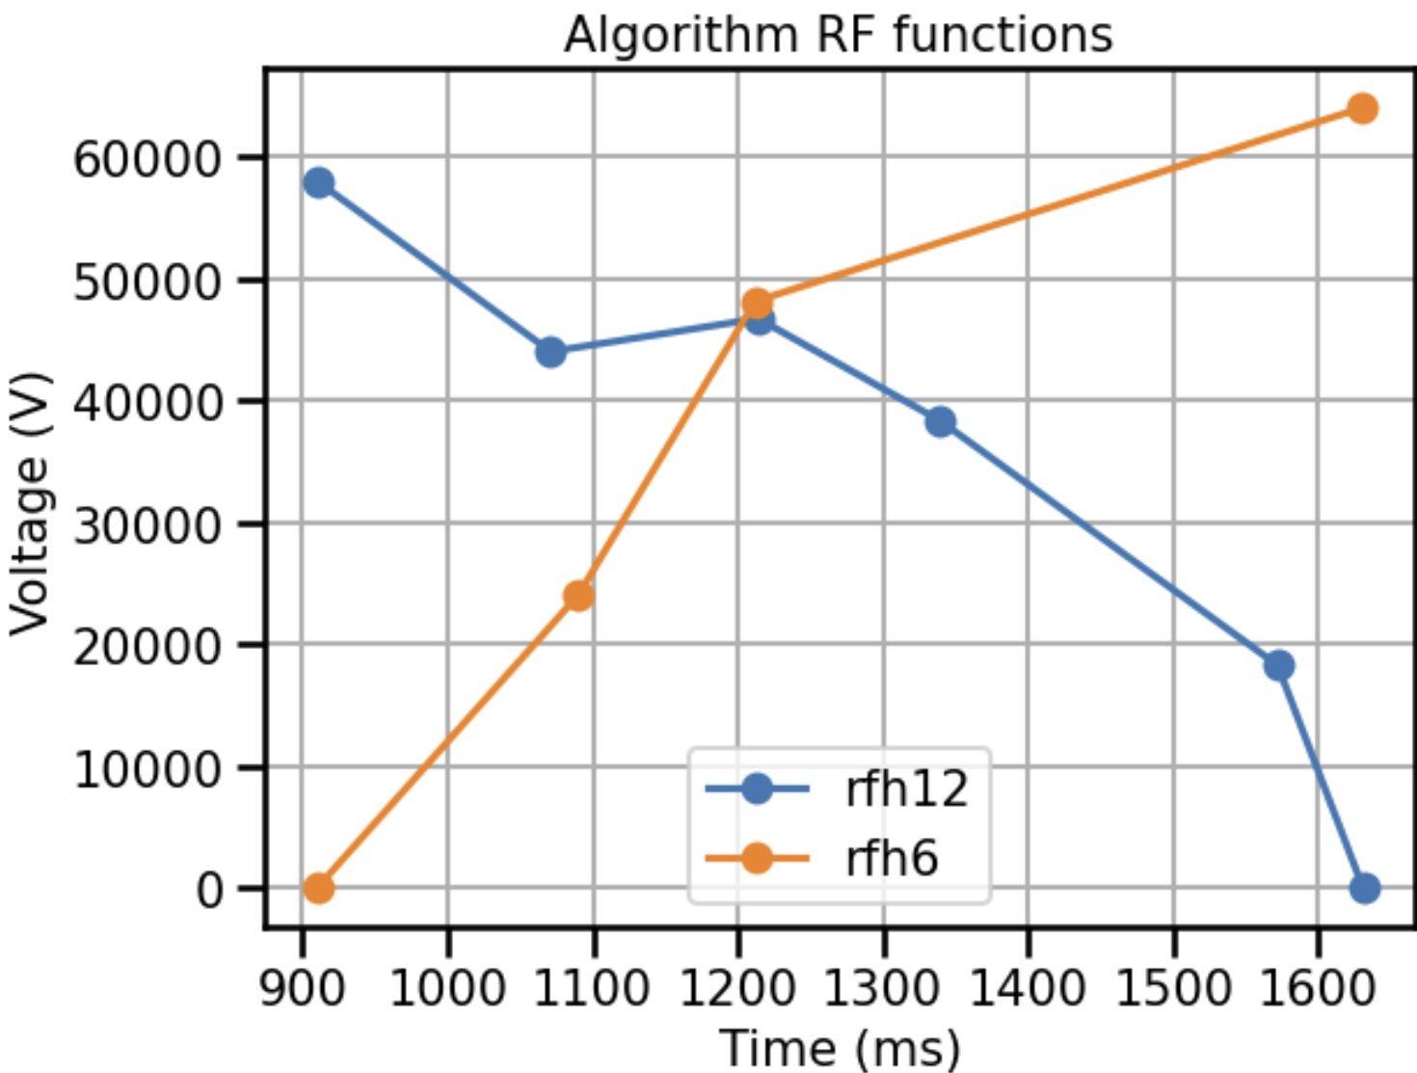
Bunch Merge RL Setup
Method: Reinforcement Learning, Soft Actor Critic (SAC).
Pre-training on a Julia simulator.
Agent actions: 6 RF voltages.
State: Bunch length, bunch length variations.

Slide 20
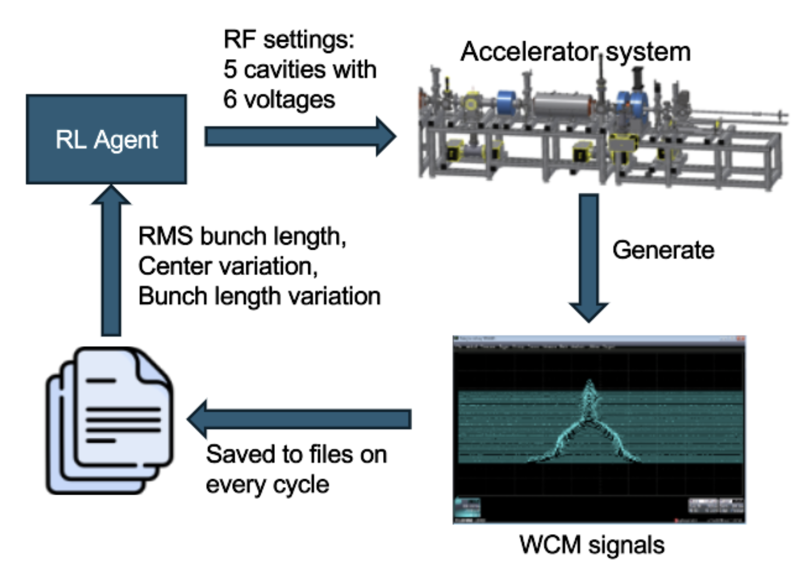
Bunch Merge RL Workflow
Agent reads previous RF voltages and bunch merge metrics (state)
Agent suggests RF voltage changes (action)
Controls update RF voltages
Controls stores WCM signals in a file
Bunch merge metrics are computed (reward)

Slide 21
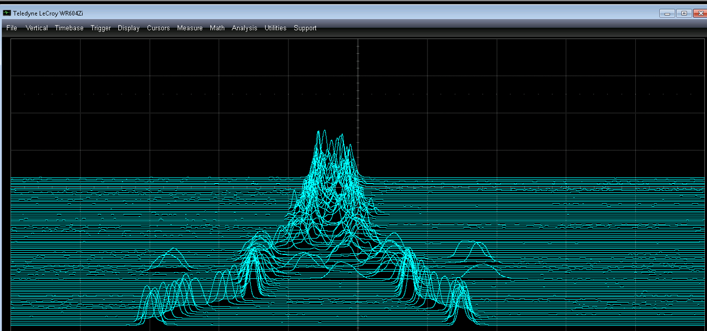
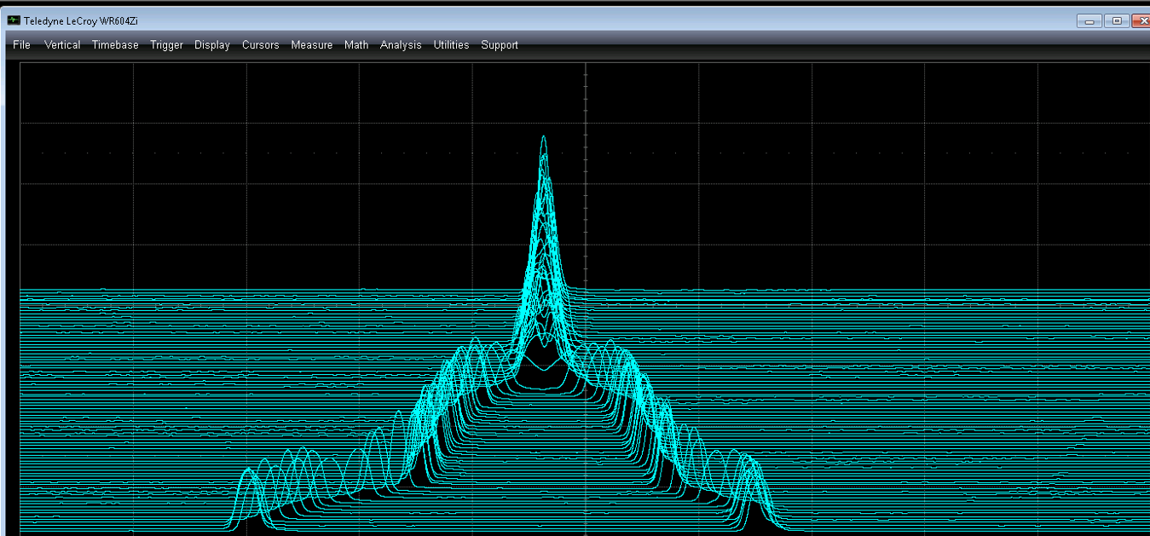
Bunch Merge RL Results
We first intentionally spoil the merging process to test.
We can see that the RL agent can quickly find the optimal RF settings for a stable merge.
Initial merge
RL corrected merge

Slide 22

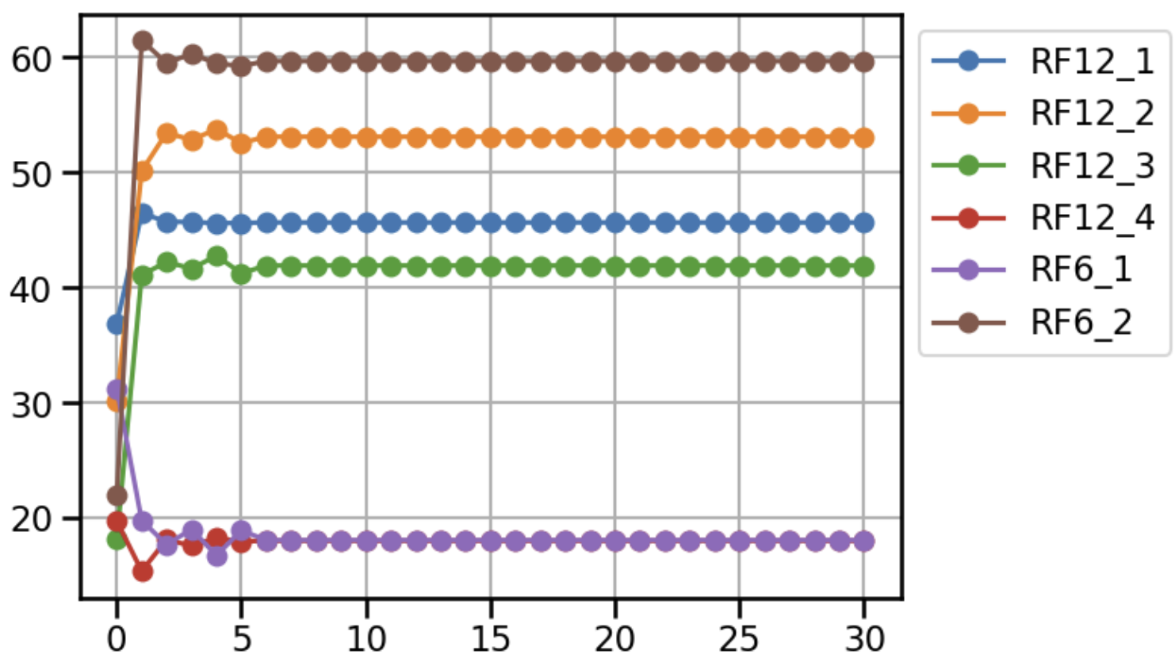
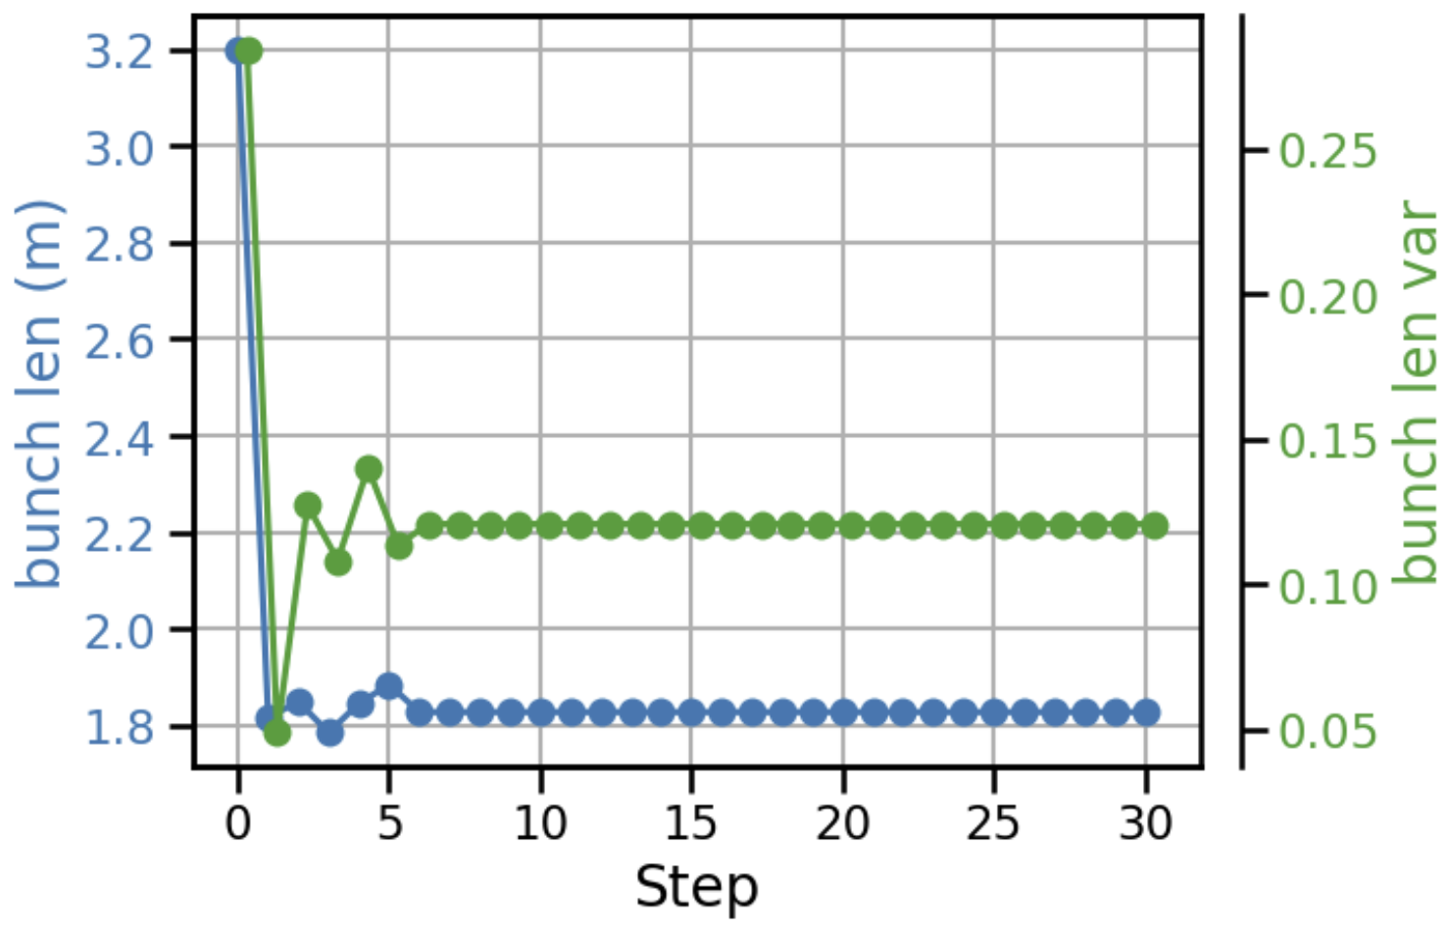
Bunch Merge RL Results
The RL agent was able to locate the optimal solution in one step and maintain them.
Both the bunch length and bunch variations were optimized effectively.

Slide 23
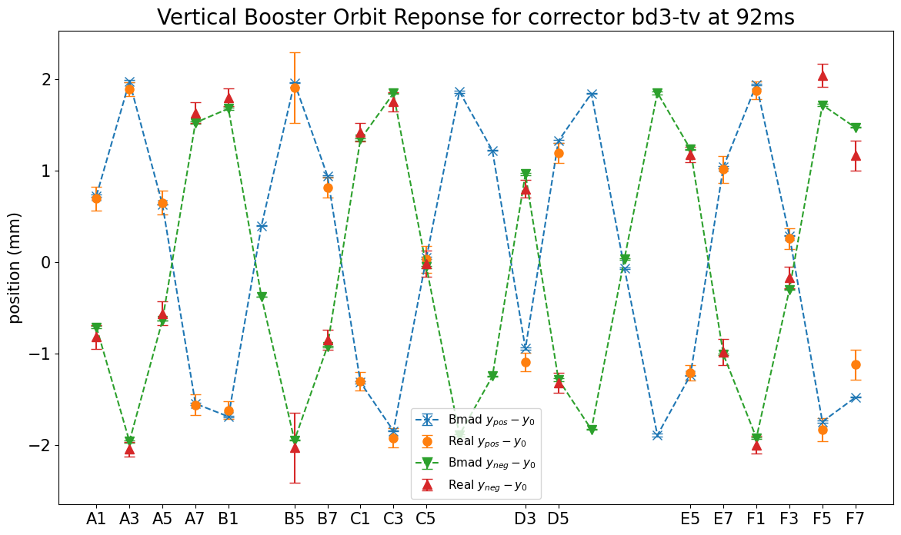
Orbit response data in AGS Booster
Orbit response data can be used to find and quantify unknown parameters (e.g., power supply scaling factors, magnet misalignment etc.) in real accelerators
There is reasonable agreement between AGS Booster data and Bmad model. But could be improved.

Slide 24
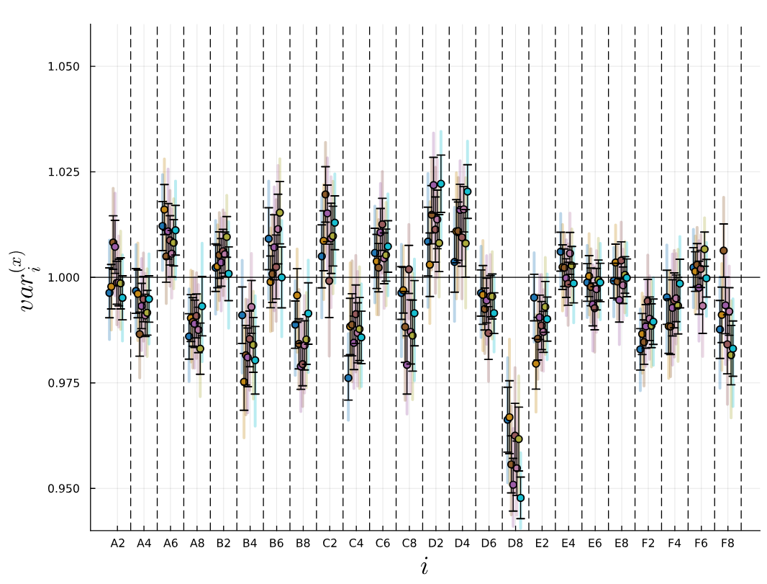
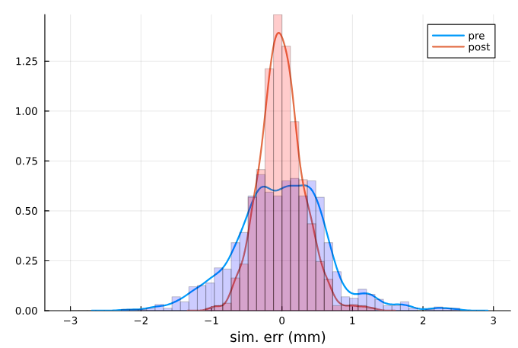
Booster ORM:
Uncertainty quantification through Bayesian inference
Xi-squared/DF = 1.3
Inference on quad families
  2D parameter space
  Focusing/defocusing strengths
  Inconsistent results
Inference on individual quadrupoles
  48D parameter space
  HMC sampling
  Reduced model errors > found likely culprit
See Christopher Kelly’s talk

Slide 25

SciBmad
SciBmad
A new…
Modular
High performance
CPU/GPU compatible
Differentiable/polymorphic
Fully-featured
…accelerator physics simulation ecosystem usable from Python or Julia
Beamlines.jl
Fast, differentiable, advanced accelerator lattice definitions
GTPSA.jl
Fast high-order differentiation using the GTPSA library
NonlinearNormalForm.jl
Parametric map-based perturbation theory including spin and radiation
BeamTracking.jl
CPU/GPU compatible, polymorphic integrators
AtomicAndPhysicalConstants.jl
Physical and particle constants library.
Implemented as a modular toolkit for rapid development of higher-level programs

Slide 26
Future work
Automating RL bunch merge and testing against drifting parameters
Deploying injection BO apps through Badger GUI (Xopt)
Injection optimization using measured prior means
Bayesian inference of absolute transfer line orbits using multiwires
Digital twins

Slide 27
Summary
Bayesian optimization of Booster injection
Bayesian optimization of AGS injection
Reinforcement learning (SAC) control of AGS bunch merge
Bayesian inference for uncertainty quantification of Booster quad errors

Slide 28
Dominant Participants
BNL: Kevin Brown, Yuan Gao, Lucy Lin, Vincent Schoefer, Levente Hajdu,
Nathan Urban, Christopher Kelley
Cornell: Georg Hoffstaetter, Eiad Hamwi, David Sagan, Matt Signorelli
SLAC: Auralee Edelen, Ryan Roussell
JLAB: Malachi Schram, Armen Kasparian
RPI: Yinan Wang
Radiasoft: Jon Edelen, Chris Hall, Nathan Cook

Slide 29
Thank you and Questions?

Slide 30
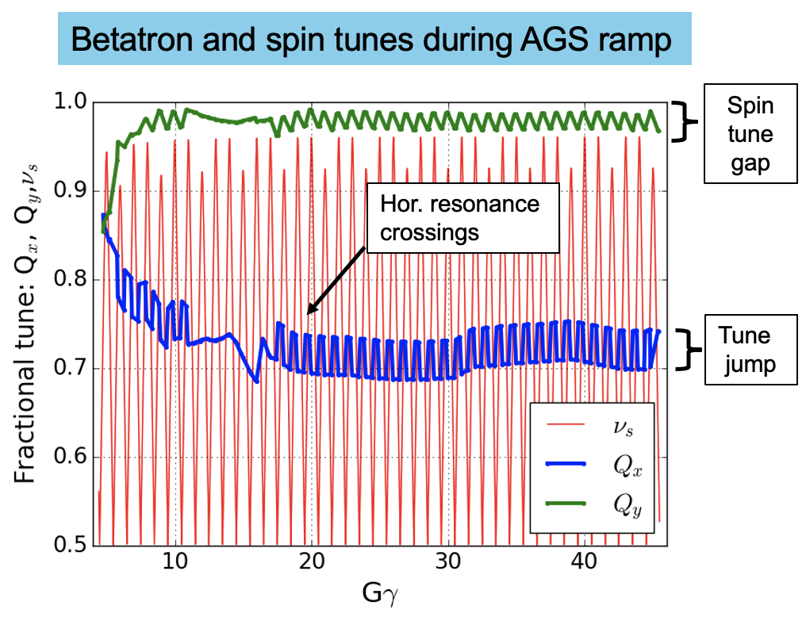
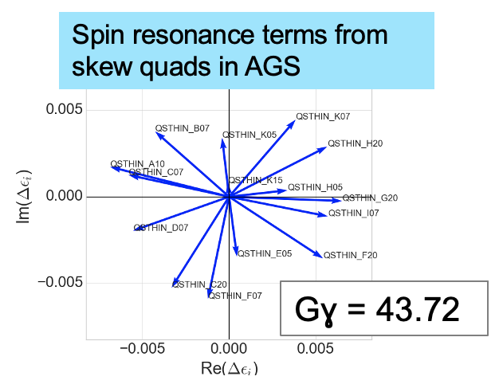
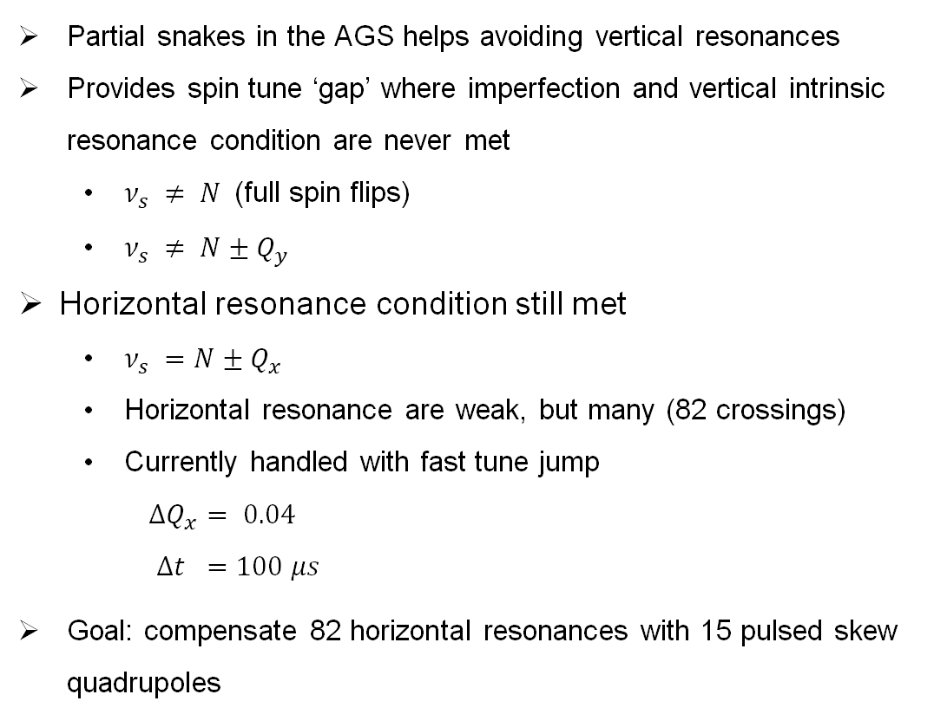
AGS skew quads
Partial snakes in the AGS helps avoiding vertical resonances
Provides spin tune ‘gap’ where imperfection and vertical intrinsic resonance condition are never met
  $ν_{s} ≠ N$(full spin flips)
  $ν_{s} ≠ N±Q_{y}$
Horizontal resonance condition still met
  $ν_{s} =N±Q_{x}$
  Horizontal resonance are weak, but many (82 crossings)
  Currently handled with fast tune jump
  $ΔQ_{x}= 0.04$
  $Δt =100 μs$
Goal: compensate 82 horizontal resonances with 15 pulsed skew quadrupoles

Slide 31
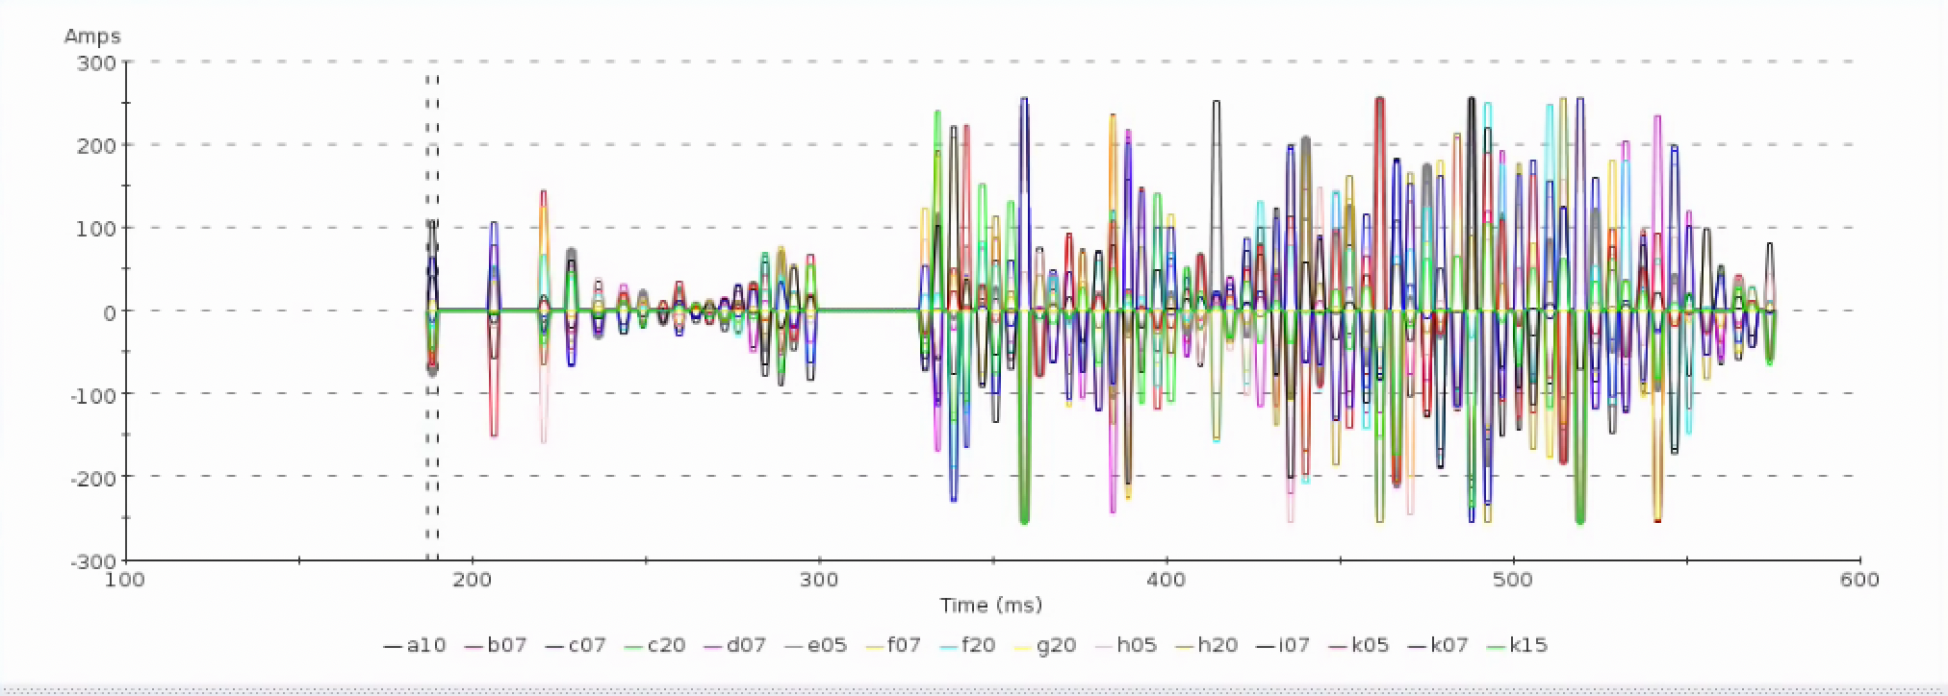
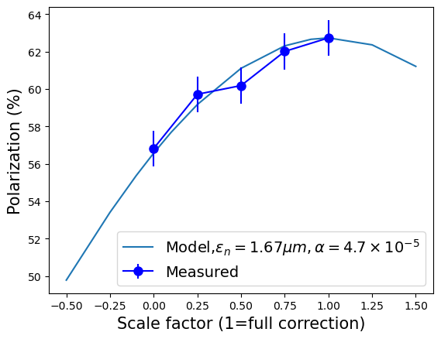
AGS Spin Resonance Correction Skew Quadrupoles
Skew quad current pulses
Skew quad current pulses
15 knobs, 82 different resonances
  Expected effect is 15-20% gain in polarization
  A +/-2% measurement takes 5-10 minutes
Run 24: Observation of polarization gain factor (+15%) during acceleration (better than existing tune jump +12%)
Further improvements (enabling more pulses, +5-10% gain):
  Addressing model inaccuracies at low energy
  Iteration on orbit centering
  Possible optimizations based on ML methods:
    Reinforcement learning model
    Bayesian optimization of specific resonances
    Bayesian optimization through systematic effects (rolls)
Correction amplitude scan
Partial correction
Zero correction

Slide 32
Publications
ML/AI efforts at BNL/CAD
B. Huang, C. González-Zacarías, S. Sosa Güitrón, A. Aslam, S. G. Biedron, K. Brown, T. Bolin, Artificial Intelligence-Assisted Design and Virtual Diagnostic for the Initial Condition of a Storage-Ring-Based Quantum Information System, IEEE Access, Volume 10, 2022, pp.14350-14358
Y. Gao, W. Lin, K. A. Brown, X. Gu, G. H. Hoffstaetter, J. Morris, and S. Seletskiy, Bayesian optimization experiment for trajectory alignment at the low energy RHIC electron cooling system, Phys. Rev. Accel. Beams 25, 014601 – Published 7 January 2022
Y. Gao, J. Chen, T. Robertazzi, and K. A. Brown, Reinforcement learning based schemes to manage client activities in large distributed control systems, Phys. Rev. Accel. Beams 22, 014601 – Published 2 January 2019
W. Lin, M. A. Sampson, Y.C. Jing, K. Shih, G. H. Hoffstaetter, J. A. Crittenden, Simulation Studies and Machine Learning Applications at the Coherent Electron Cooling Experiment at RHIC, IPAC2022, Bangkok, Thailand
Y. Gao, K. A. Brown, X. Gu, J. Morris, S. Seletskiy, W. Lin, G. H. Hoffstaetter, J. A. Crittenden, Experiment Of Bayesian Optimization For Trajectory Alignment At Low Energy RHIC Electron Cooler, IPAC2022, Bangkok, Thailand
Y. Gao, K. A. Brown, P. Dyer, S. Seletskiy, H. Zhao, Applying Machine Learning to Optimization of Cooling Rate at Low Energy RHIC Electron Cooler, IPAC2021, Campinas, SP, Brazil
Polarized proton beams at BNL
K. Zeno, An overview of Booster and AGS Polarized Proton Operations during Run 17, BNL-114742-2017-TECH (10/2017)
K. Zeno, Run 16 Tandem gold performance in the injectors and possible improvement with AGS type 6:3:1 bunch merge in the Booster, C-A/AP/576, (10/2016)
V. H. Ranjbar, Approximations for crossing two nearby spin resonances, Phys. Rev. ST-AB 18, 014001 (2015)
Y. Dutheil, L. Ahrens, H. Huang, F. Méot, A. Poblaguev, V. Schoefer, K. Yip, Energy Calibration and Tune Jumps Efficiency in the PP APS, in Proc. PAC2014, Dresden/Germany (2014)
V. H. Ranjbar, M. Bai, H. Huang, A. Marusic, M. Minty, V. Ptitsyn, Experimental Effects of Orbit on Polarization Loss in RHIC, Proc. IPAC2012, New Orleans/LA (2012)
V. Schoefer, L. Ahrens, K.A. Brown, J.W. Glenn, H. Huang, Optics Error Measurements in the AGS for Polarized Proton Operation, Proc. PAC2011, New York/NY (2011)
V. Schoefer, Using betatron coupling to suppress horizontal intrinsic spin resonances driven by partial snakes, Phys. Rev. AB 24, 031001 (2021)
V. Schoefer, AGS Horizontal Resonance Compensation Overview, Presentation at BNL (2022)

