Slide 1
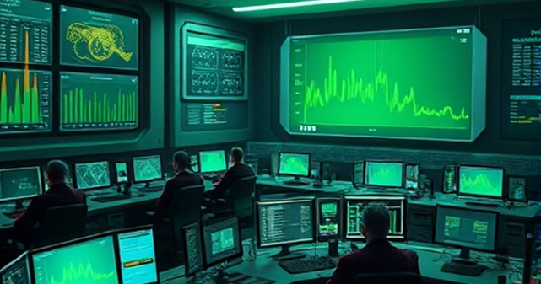
Framework for the Development of Virtual Accelerator Models for Machine Learning Applications
October 27, 2025
Adwaith ravichandran
Brahim mustapha
Postdoctoral Appointee
Argonne National Laboratory
Accelerator Physicist
Argonne National Laboratory

Slide 2
outline
ATLAS AI/ML Interface – Current online capabilities
Virtual Accelerator Aim – Offline experiments, train operators, support online tuning
Virtual Model Requirements – Mimics the machine in all aspects
Virtual Model Development – Example: ATLAS PI-Booster beamline
Virtual Accelerator Application – Example: Offline MHB experiment prior to online test
Potential Application to the EIC: Common techniques that can be transferred

Slide 3
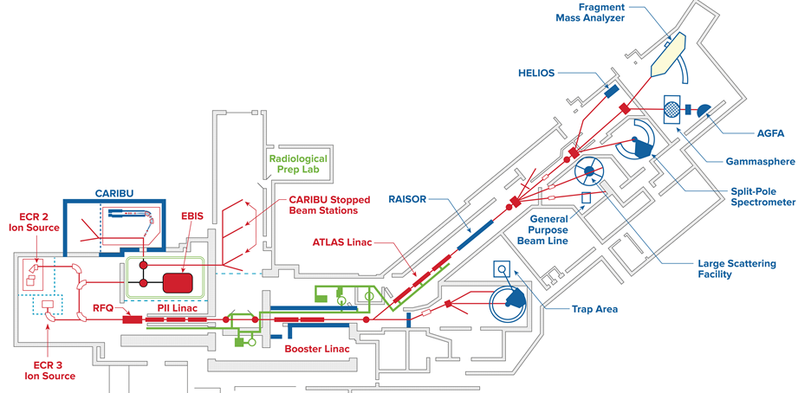
ATLAS: Argonne tandem linear accelerator system
World’s first superconducting accelerator for ion beams
Ion beams ranging from hydrogen to uranium
Energies as high as 10 MeV/u for the heaviest ions
National User Facility serving ~ 400 users per year
Switch ion beam every 3-4 days requiring rapid tuning
ATLAS EXIT-PRE TARGET BEAMLINE
PII-BOOSTER BEAMLINE

Slide 4
The atlas ai-ML Dashboard interface

Slide 5
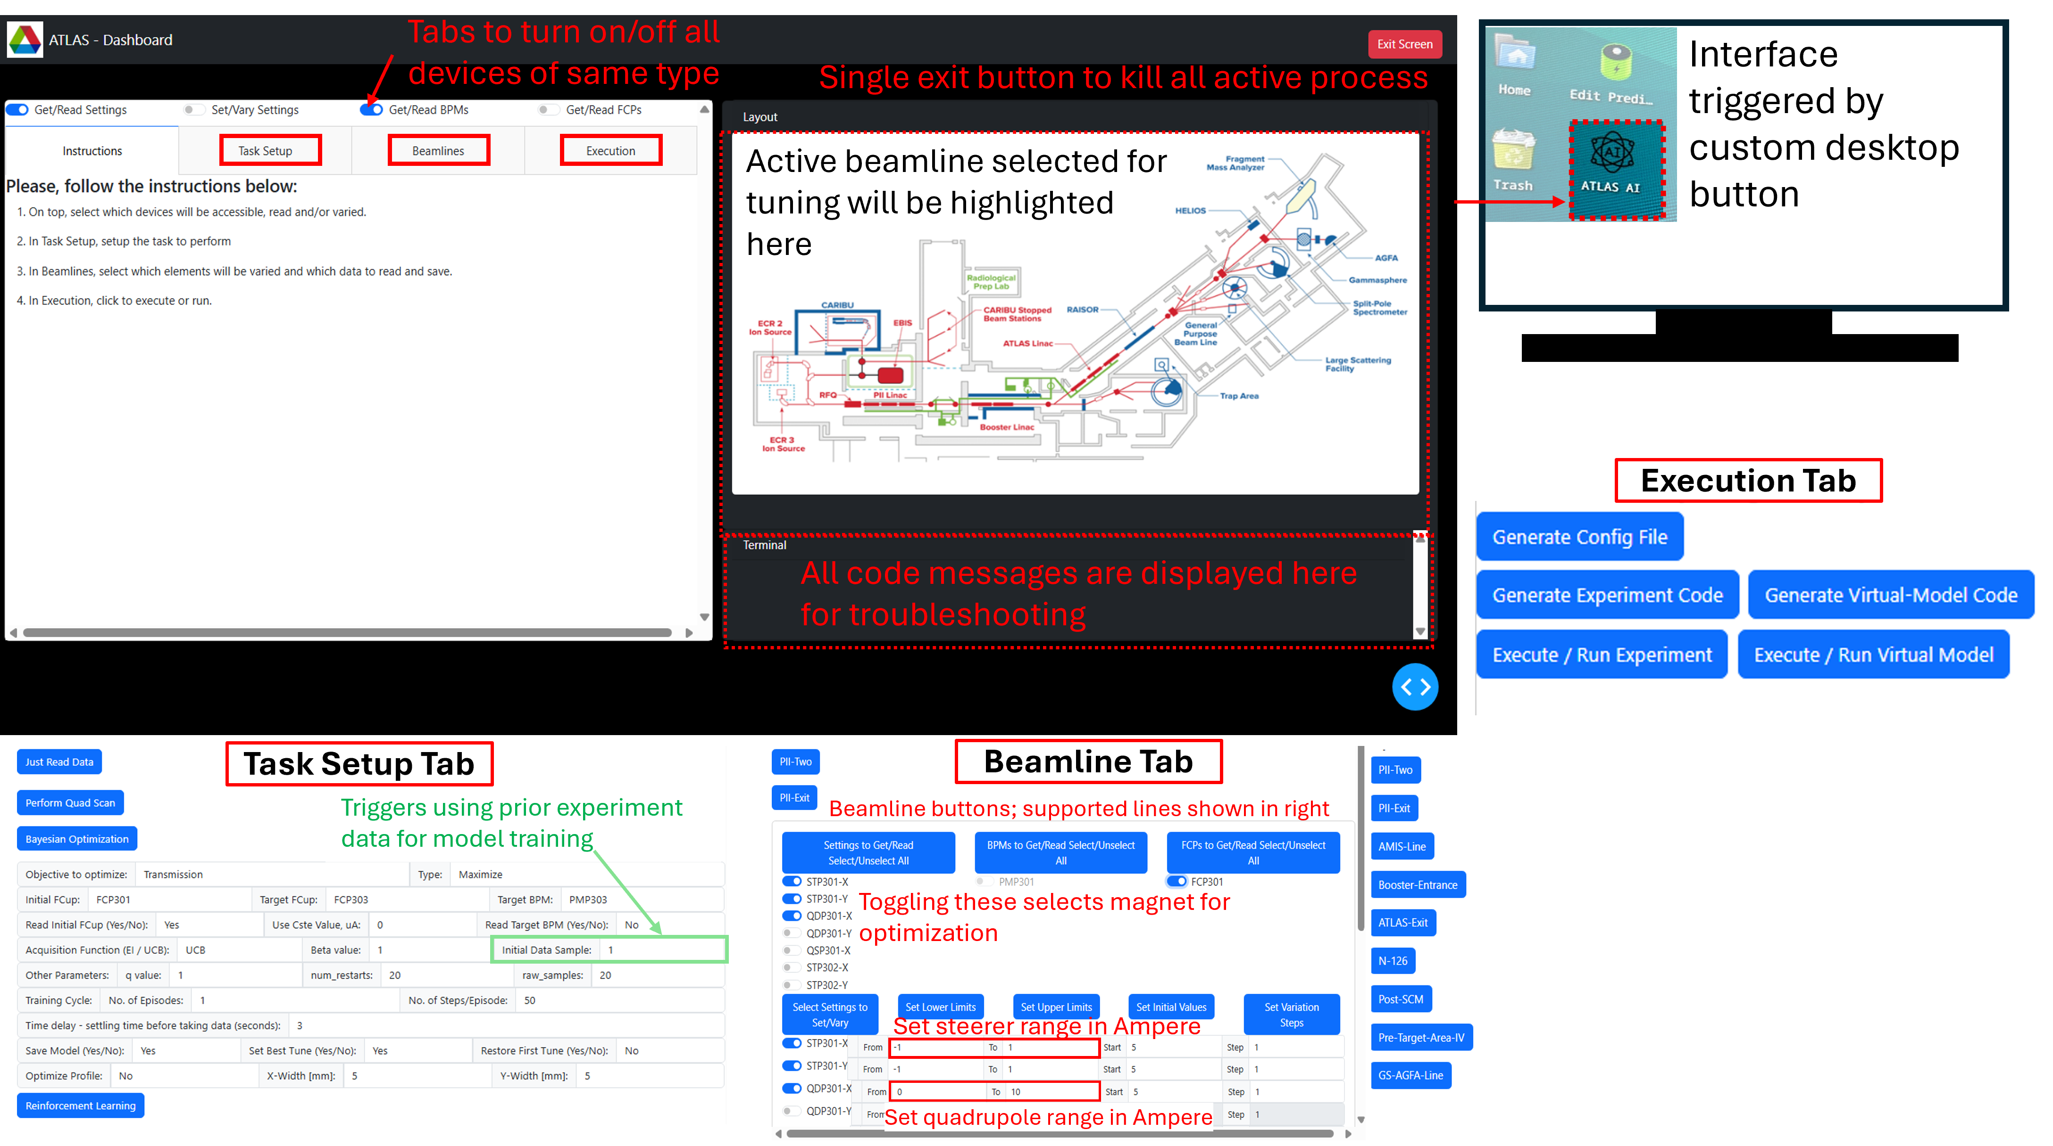
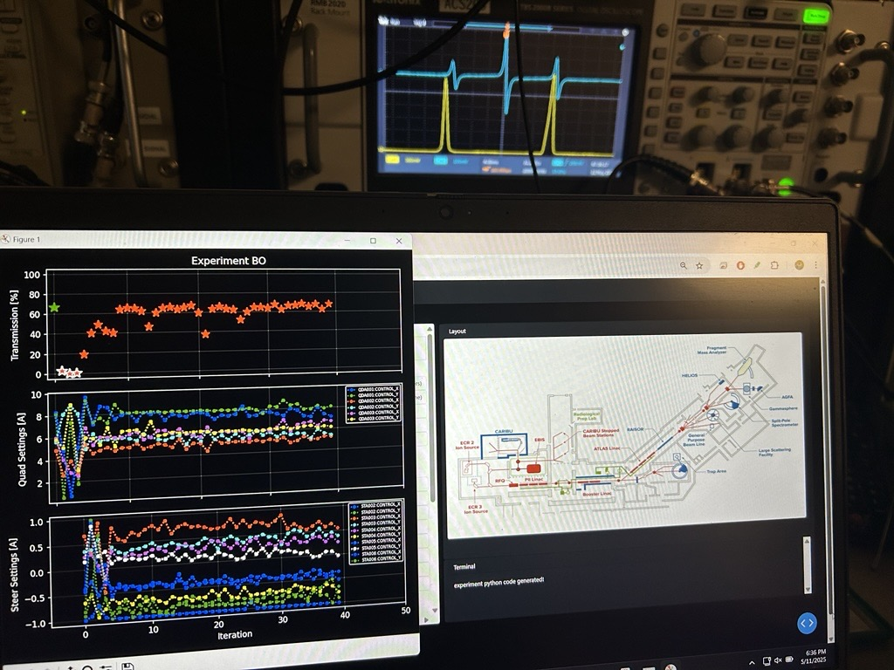
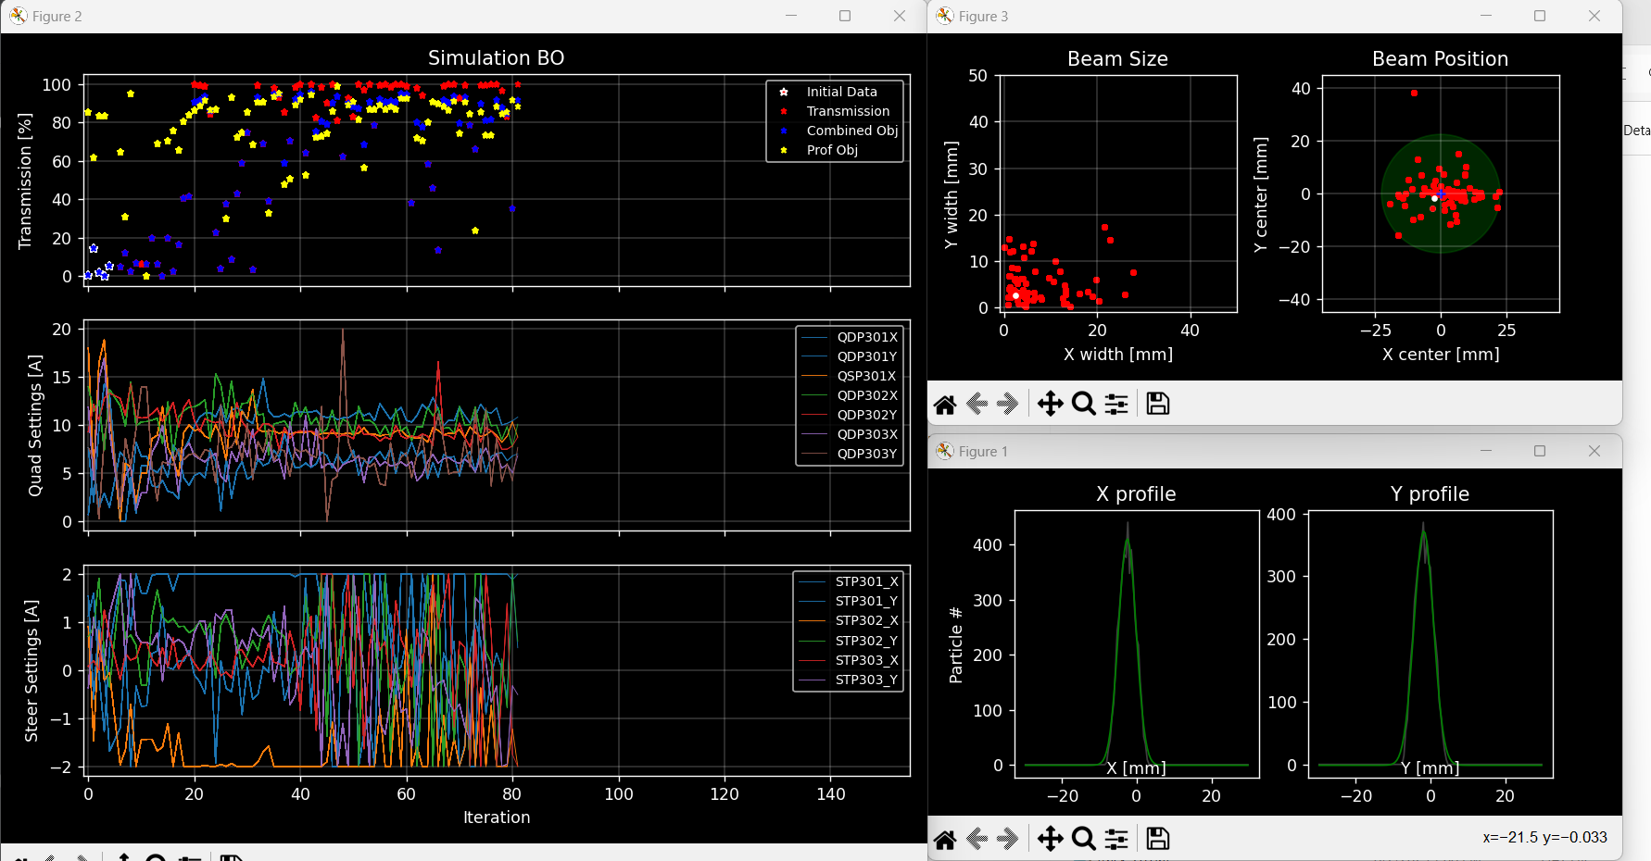
ATLAS AI/ML Interface:
ATLAS AI-ML Interface [Dash module backend] used for Online accelerator interfacing
The Dash Interface is being used for online beam tuning and optimization, by expert operators
Virtual Accelerator with TRACK simulation added, Common input controls & output visualization

Slide 6
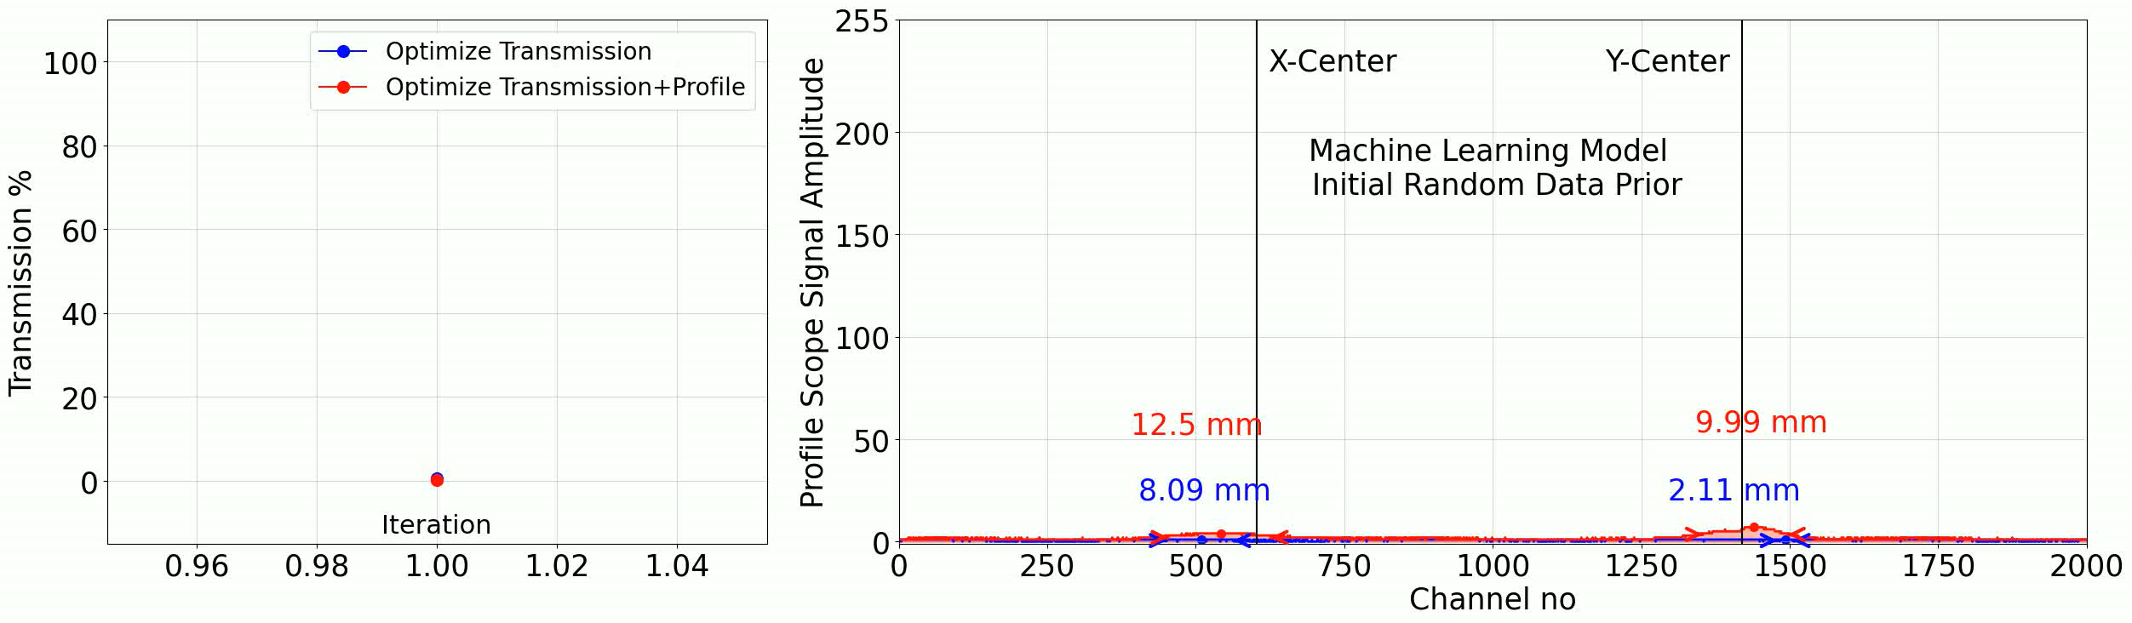
Example - Online optimization of both beam transmission and profiles
This video shows comparison between 2 online experimental tests performed with and without profile width optimization in addition to transmission
When profile information is considered, higher transmission is achieved quicker

Slide 7
virtual accelerator framework & development

Slide 8
Virtual accelerator Requirements:
Accurate 3D physical representation using operationally validated beam dynamics software (TRACK in our case)
Match real machine behavior; Same control, diagnostics/observables experience for user:
Statistical simulated particle profiles match profile monitor reading
Statistical simulated particle timing/energy match silicon barrier detector spectra
Same control channel names, operating range/units
Compatible backend calibration for beamline elements:
Quadrupole Magnetic field → Control current
Radio frequency quadrupole Chassis voltage → Inter-vane voltage
Steering magnet bending angle → Control current [using beam rigidity-based scaling]
Cavity Field level → Control
Model extended, reused, adapted for many configurations, components, future designs

Slide 9
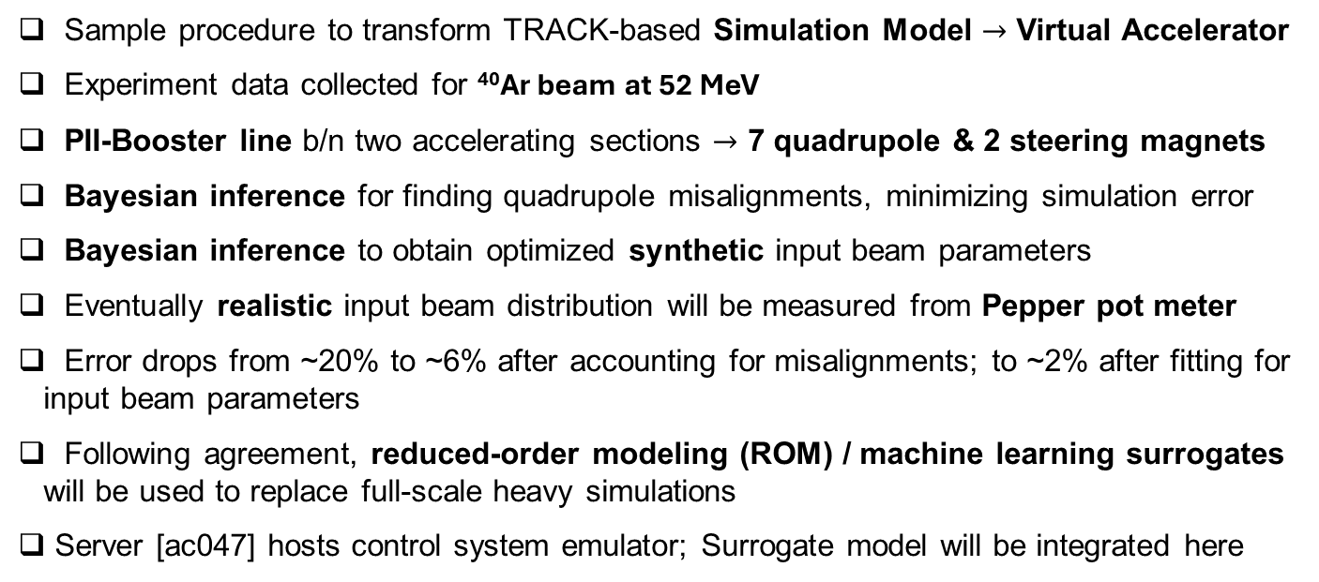
Virtual accelerator Development:
Sample procedure to transform TRACK-based Simulation Model $→$ Virtual Accelerator
Experiment data collected for ⁴⁰Ar beam at 52 MeV
PII-Booster line b/n two accelerating sections $→$ 7 quadrupole & 2 steering magnets
Bayesian inference for finding quadrupole misalignments, minimizing simulation error
Bayesian inference to obtain optimized synthetic input beam parameters
Eventually realistic input beam distribution will be measured from Pepper pot meter
Error drops from ~20% to ~6% after accounting for misalignments; to ~2% after fitting for input beam parameters
Following agreement, reduced-order modeling (ROM) / machine learning surrogates will be used to replace full-scale heavy simulations
Server [ac047] hosts control system emulator; Surrogate model will be integrated here

Slide 10
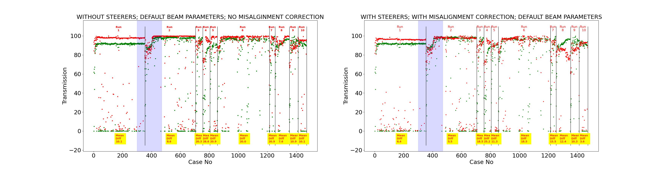
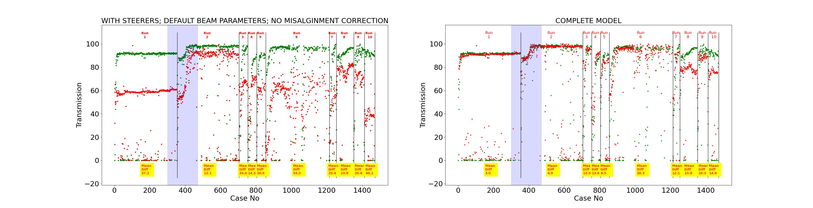
Error minimization btw model & experiment

Slide 11
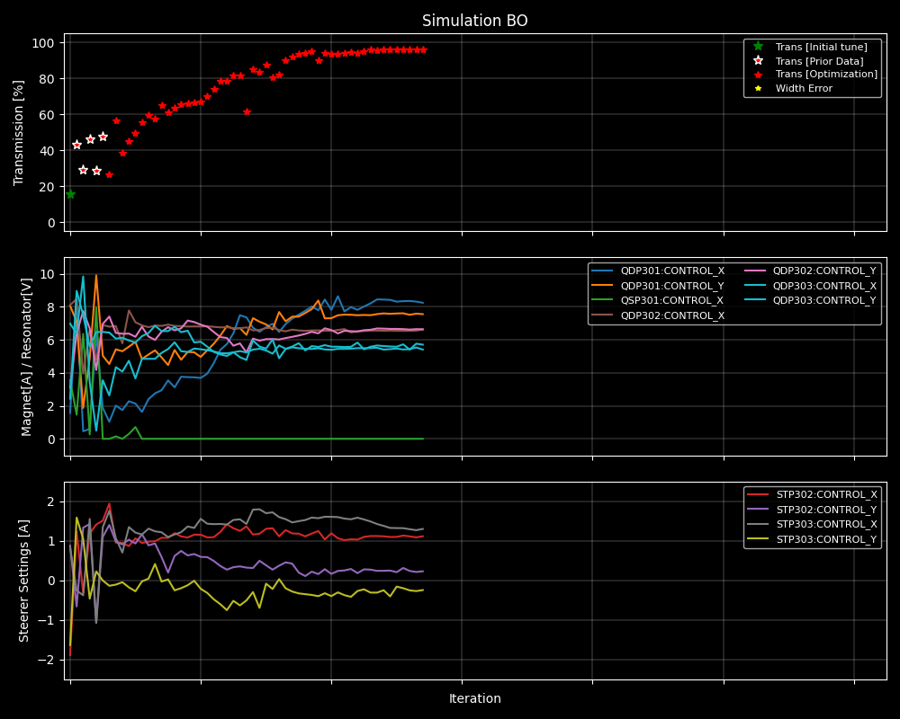
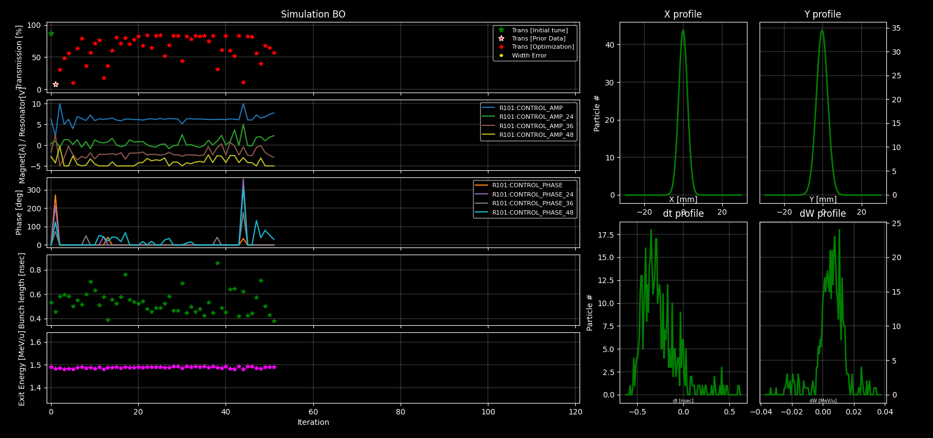
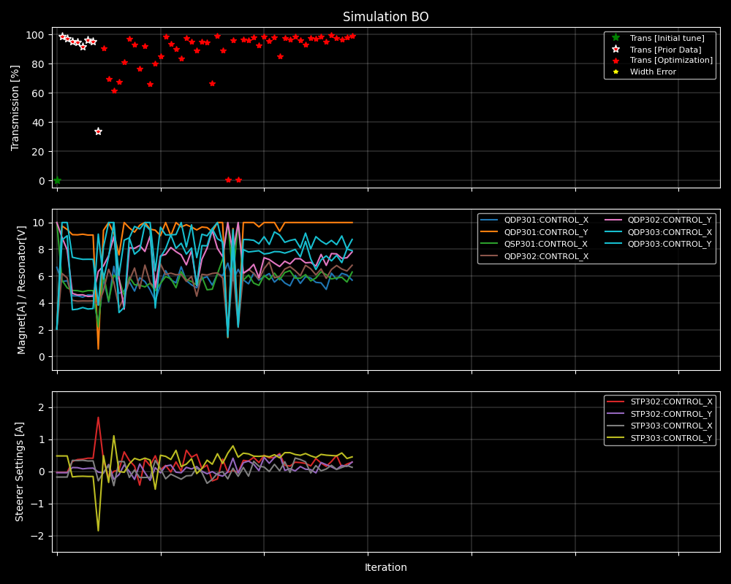
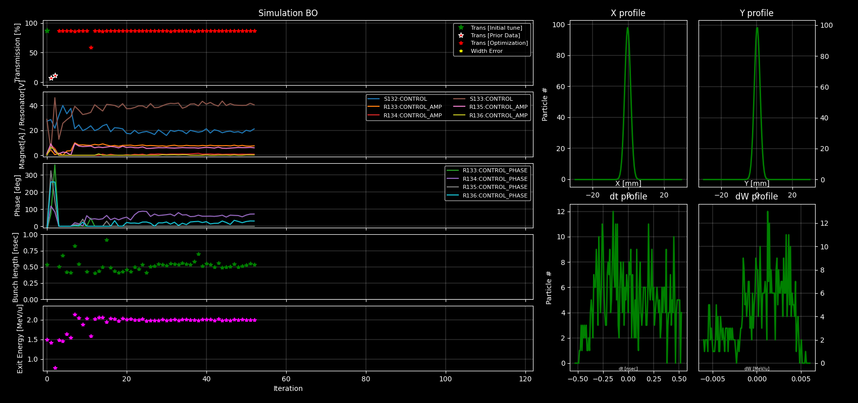
Virtual accelerator Applications
Profile optimization without prior experiment data
Bunch length optimization
Newly proposed experimental methods can be tested in virtual model
Input settings for Quadrupole, Steering magnets, Resonators, Solenoids & Multi harmonic bunchers can be changed
Output observables like beam profile, beam current, bunch length and exit energy measured
Profile optimization with prior experiment data
Energy Change using Resonators

Slide 12
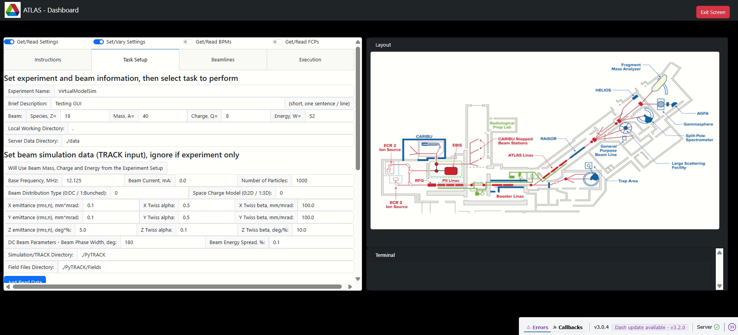
Virtual accelerator Demonstration [PROFILE OPT]:

Slide 13

Virtual accelerator Demonstration [mhb OPT]:

Slide 14
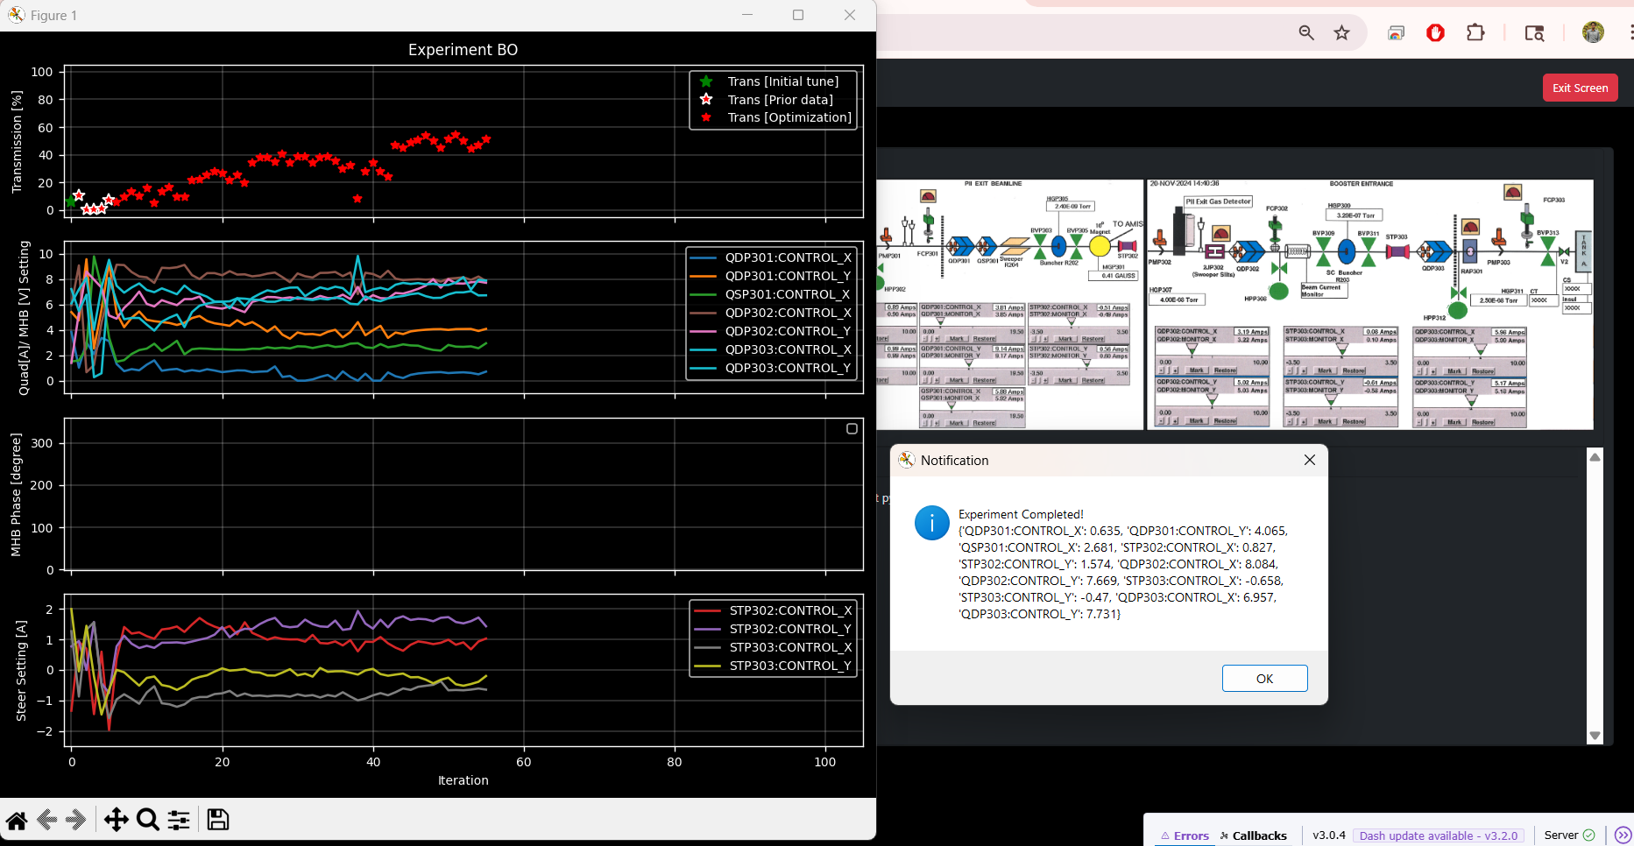
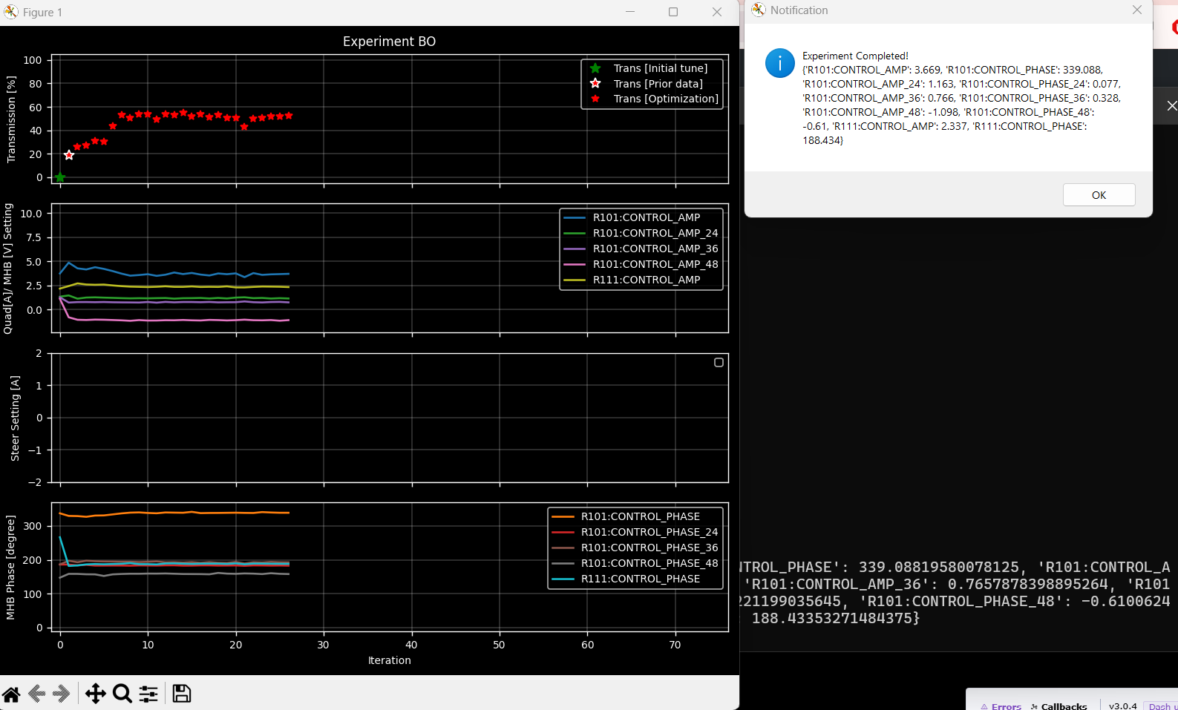
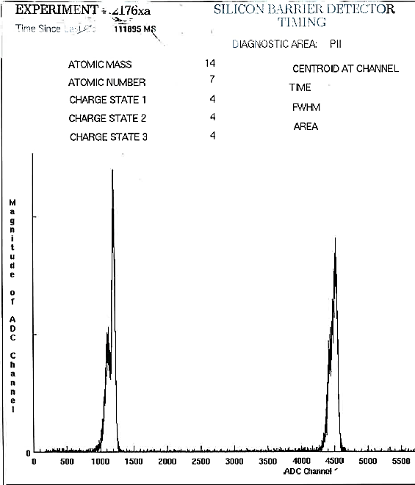
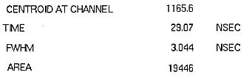
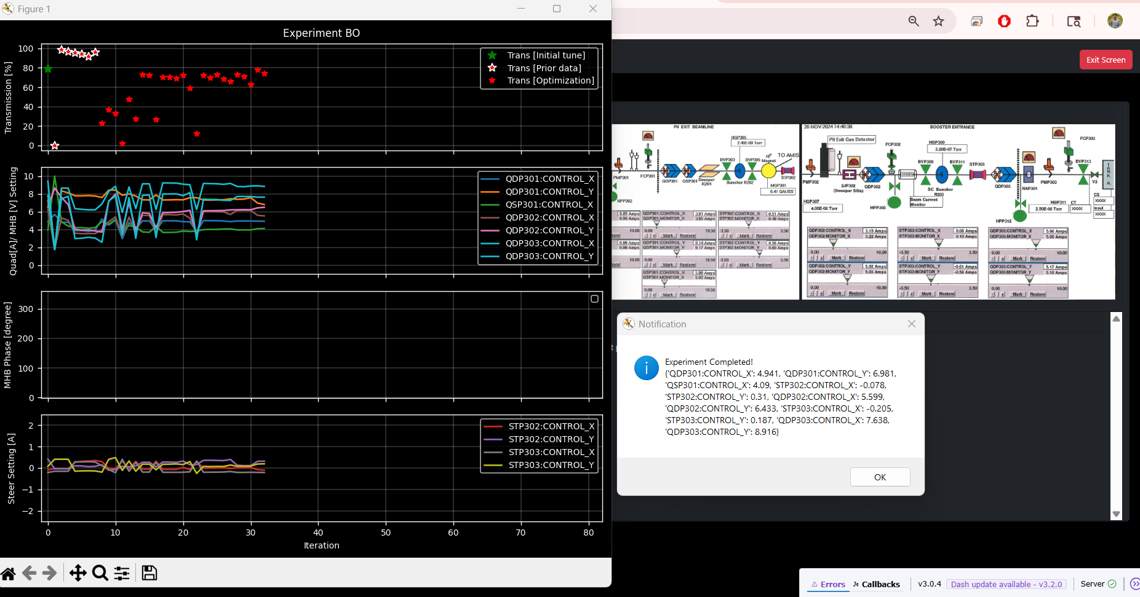
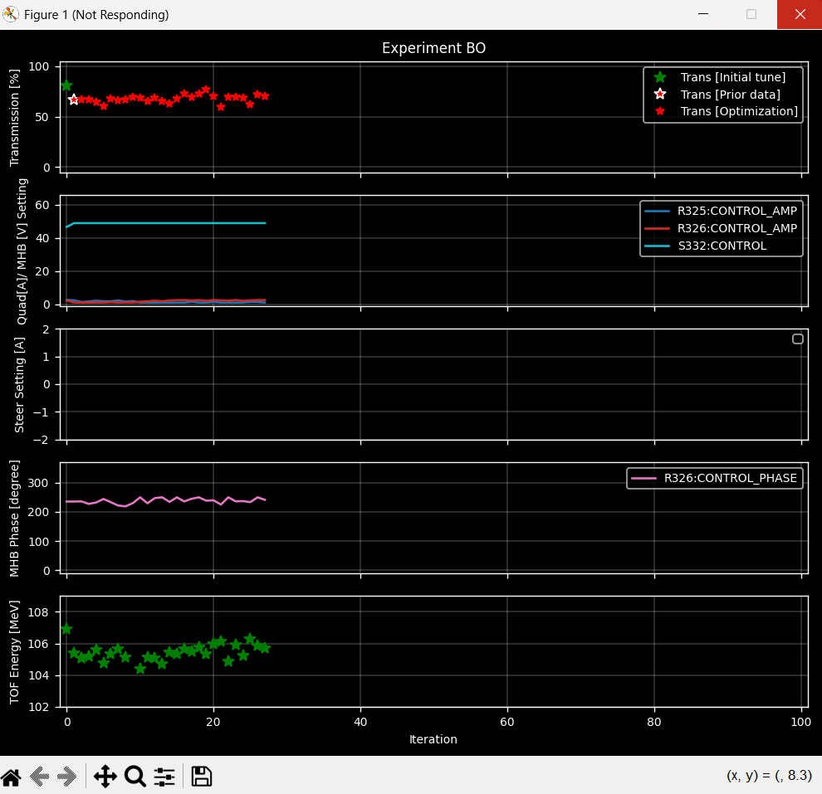
Experimental tests
Same interface used to repeat virtual model tests in real machine
Experimental observables for objective function: > Faraday cup [beam current/transmission]; > Time of Flight measurement [beam energy]; > Silicon barrier detector [bunch length]
Each test ends with optimized element settings corresponding to optimal objective
These are compared with virtual model recommendations
Optimizing for Transmission
Optimizing for bunch length [fine tuning]
Optimizing Transmission using prior experiment data
Optimizing for fixed beam energy [fine tuning]
Resonator/Solenoid
control voltage [V]
Resonator
phase [deg]

Slide 15
Summary of progress & highlights
The ATLAS AI-ML Dashboard Interface is fully developed and currently being used for online beam tuning and optimization by expert operators, working on full deployment…
Developed Virtual Accelerator models for different sections of the ATLAS linac based on beam simulations using TRACK code
Model predictability was significantly improved through fine-tuning by adding misalignment and steering effects as well as initial beam parameters inferred from data
For PII-to-Booster beamline, the difference in beam transmission between experiment and simulation reduced from ~46% down to ~16% after adding steering, down to 6% after including misalignments, and down to ~2% after including initial beam parameters
Using the described model tuning procedure, a highly accurate virtual model is now at the core of the ATLAS AI-ML Dashboard Interface, model already being used for experimental preparations
Future work
Developing a surrogate to the full TRACK simulation model for speed
Deploying the virtual accelerator online, bidirectional data flow Virtual ↔ Physical
Developing virtual models for other sections of the linac

Slide 17
Back up / Additional slides

