Slide 1

Machine Learning Approaches to Improved Ion Profile Monitor Measurements
Chris Hall* (RadiaSoft)
*chall@radiasoft.net
October 27, 2025
Artificial Intelligence for the Electron Ion Collider (AI4EIC)
This work is supported by the Department of Energy, Office of Science,
Office of Nuclear Physics award number DE SC-0024287 under Contract # 2023-BNL-AD060-FUND
Collaborators: BNL, Cornell, JLAB, SLAC, RPI
Boulder, Colorado USA | radiasoft.net

Slide 2
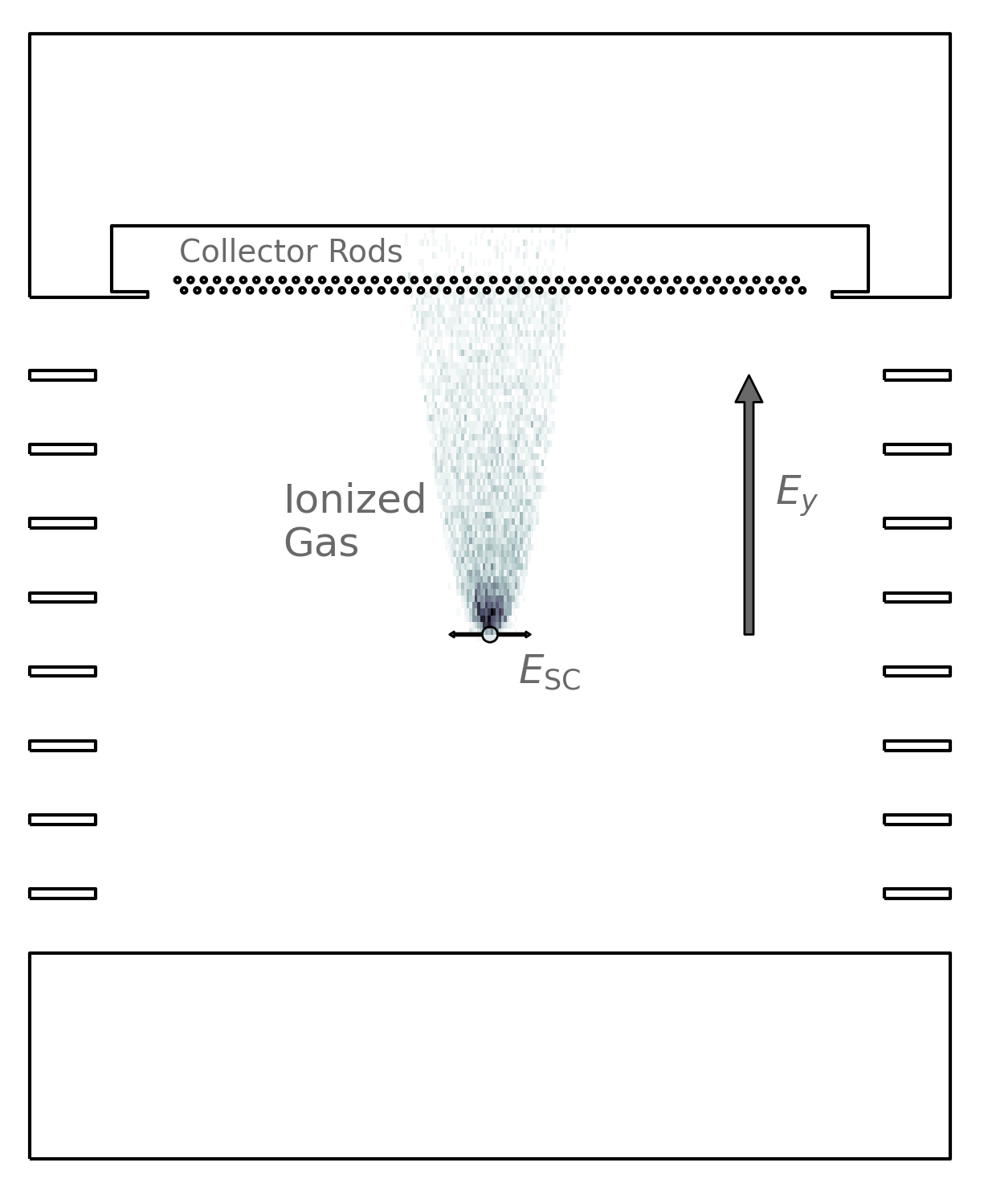
Ion Profile Monitors
Non-destructive measurement of transverse bunch size
Operation:
  Passing beam ionizes background gas
  Ions are collected, their profile provides information on the beam distribution
  Space charge from the bunch will spread the observed profile out relative to the true distribution
If the Twiss β and dispersion are known at the IPM then emittance can be calculated

Slide 3
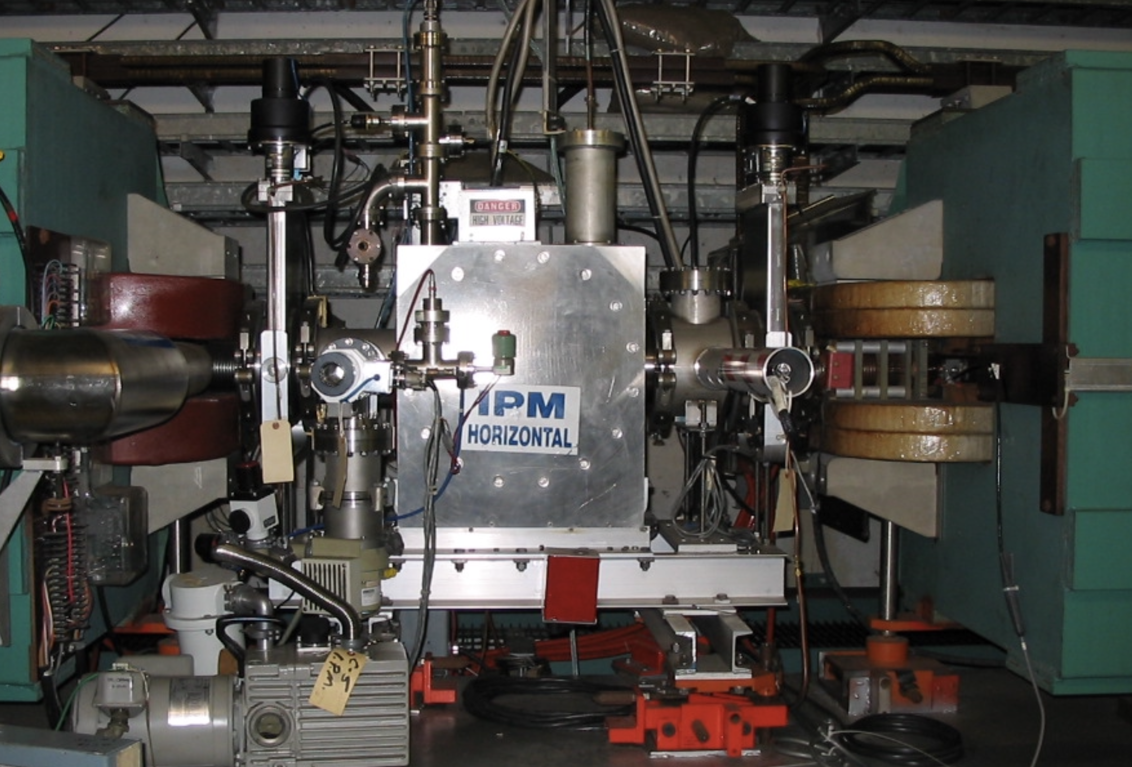
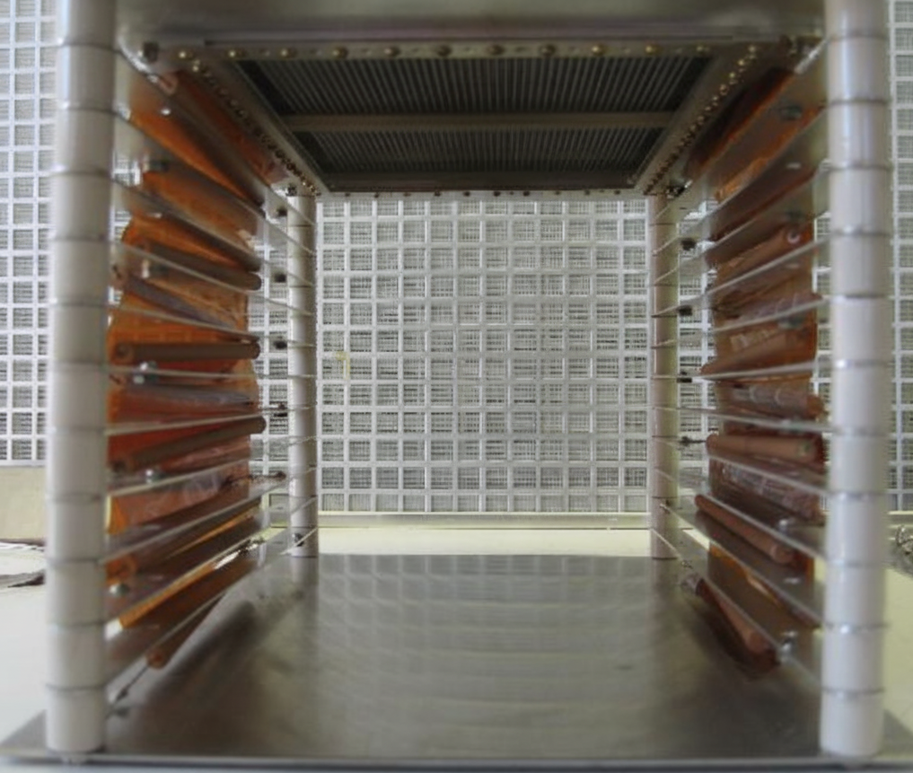
AGS Ion IPM Studies
Ion IPM are the main emittance measurement tool in the AGS
Electron gathering IPMs are also present
  Measurements less sensitive to intensity
  Faster collection
  But not run constantly
Want to improve both measurement accuracy and reliability
Test ML-based approaches to correct emittance measurements

Slide 4
Measurement Distortion Factors
Measured emittance is a function of a range of bunch parameters
  Intensity
  Transverse aspect ratio
  Position in the IPM
Properties of the IPM
  Field uniformity
  Collected ion species
Empirical and simplified model-based correction are available, but lack broad applicability

Slide 5
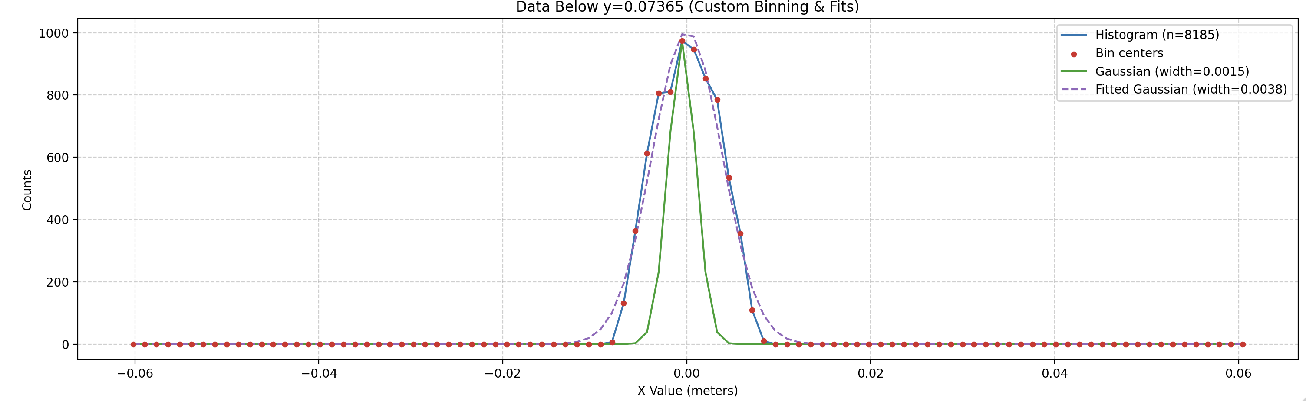
IPM Simulations
Built using the code Warp, a multi-species, three-dimensional particle-in-cell (PIC) application specializing in the simulation of intense beams of charged particles
Provides
  Field solve
  Embedded boundaries
    Electric field of the collector assembly
    Accurate particle scraping on collector wires
  Monte Carlo ionization models

Slide 6
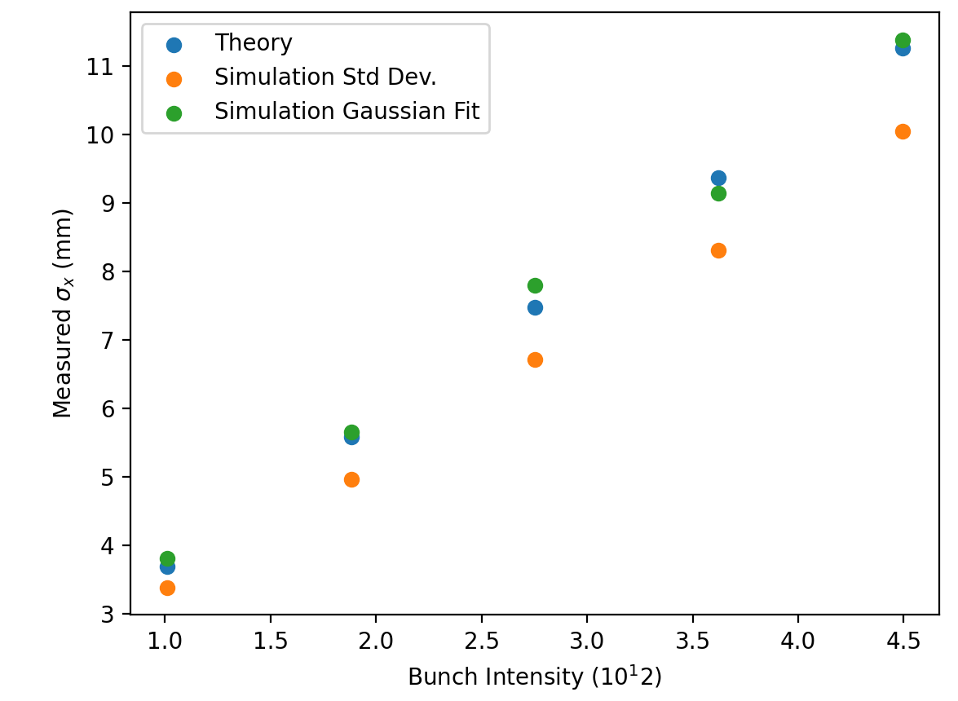
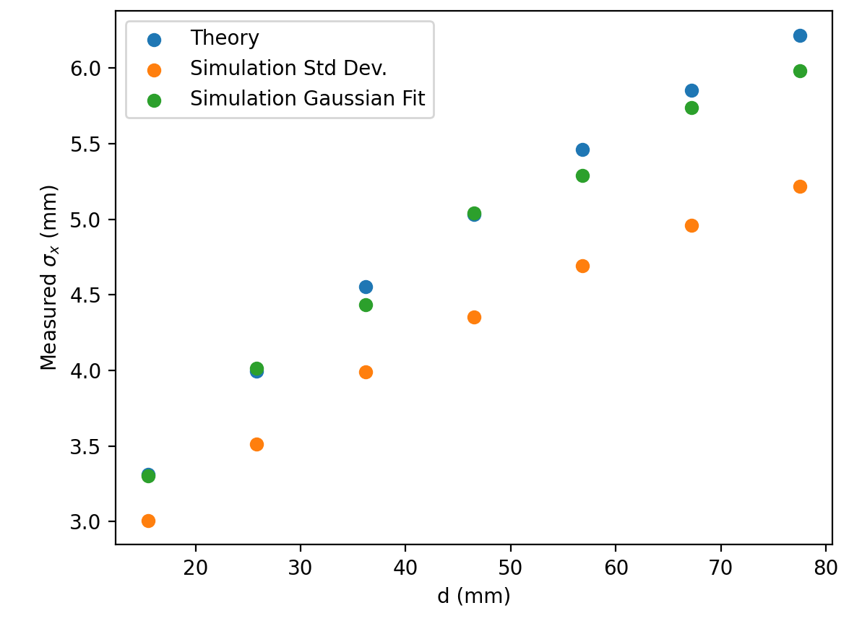
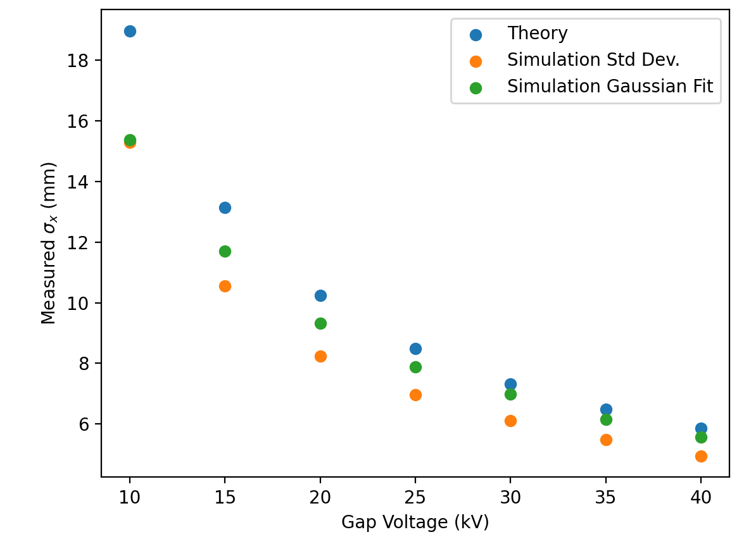
IPM Simulations
Theory* assumes:
Condition is violated for small gap voltages
Characteristic times to extract from the bunch core due to:
Space charge:
External field:
*V. Shiltsev. "Space-charge effects in ionization beam profile monitors." NIM A: 986 (2021): 164744.

Slide 7
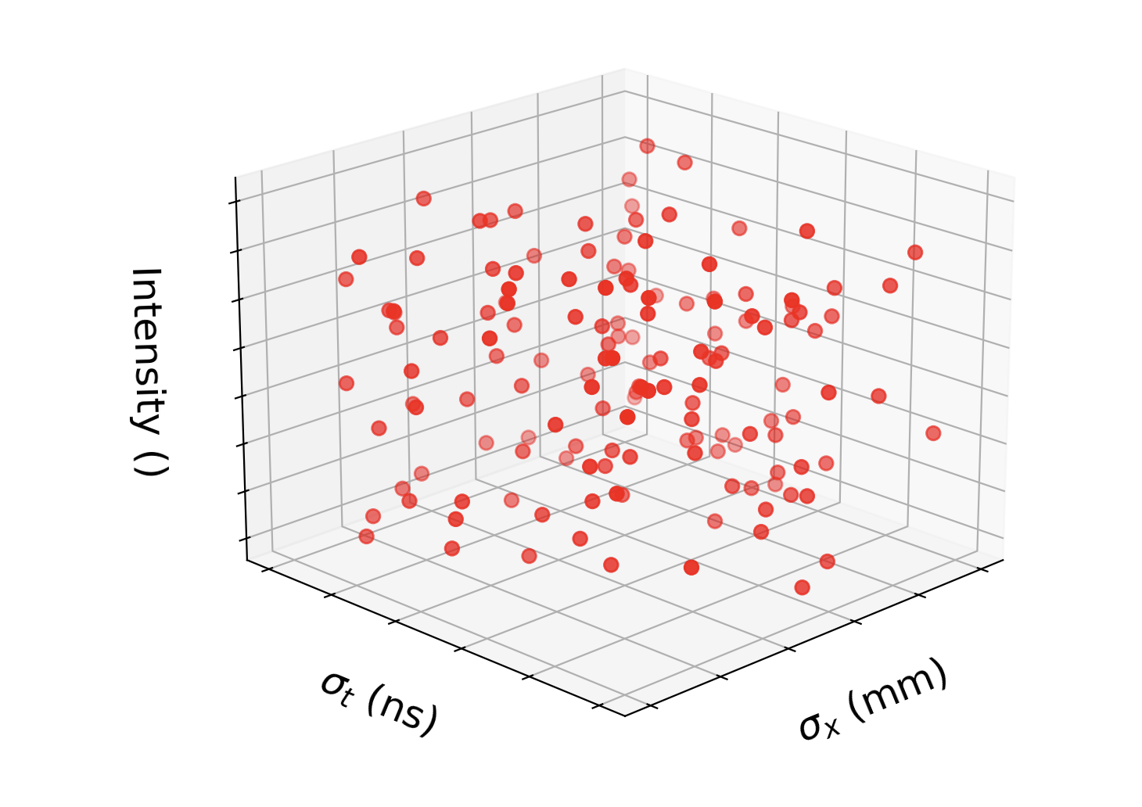
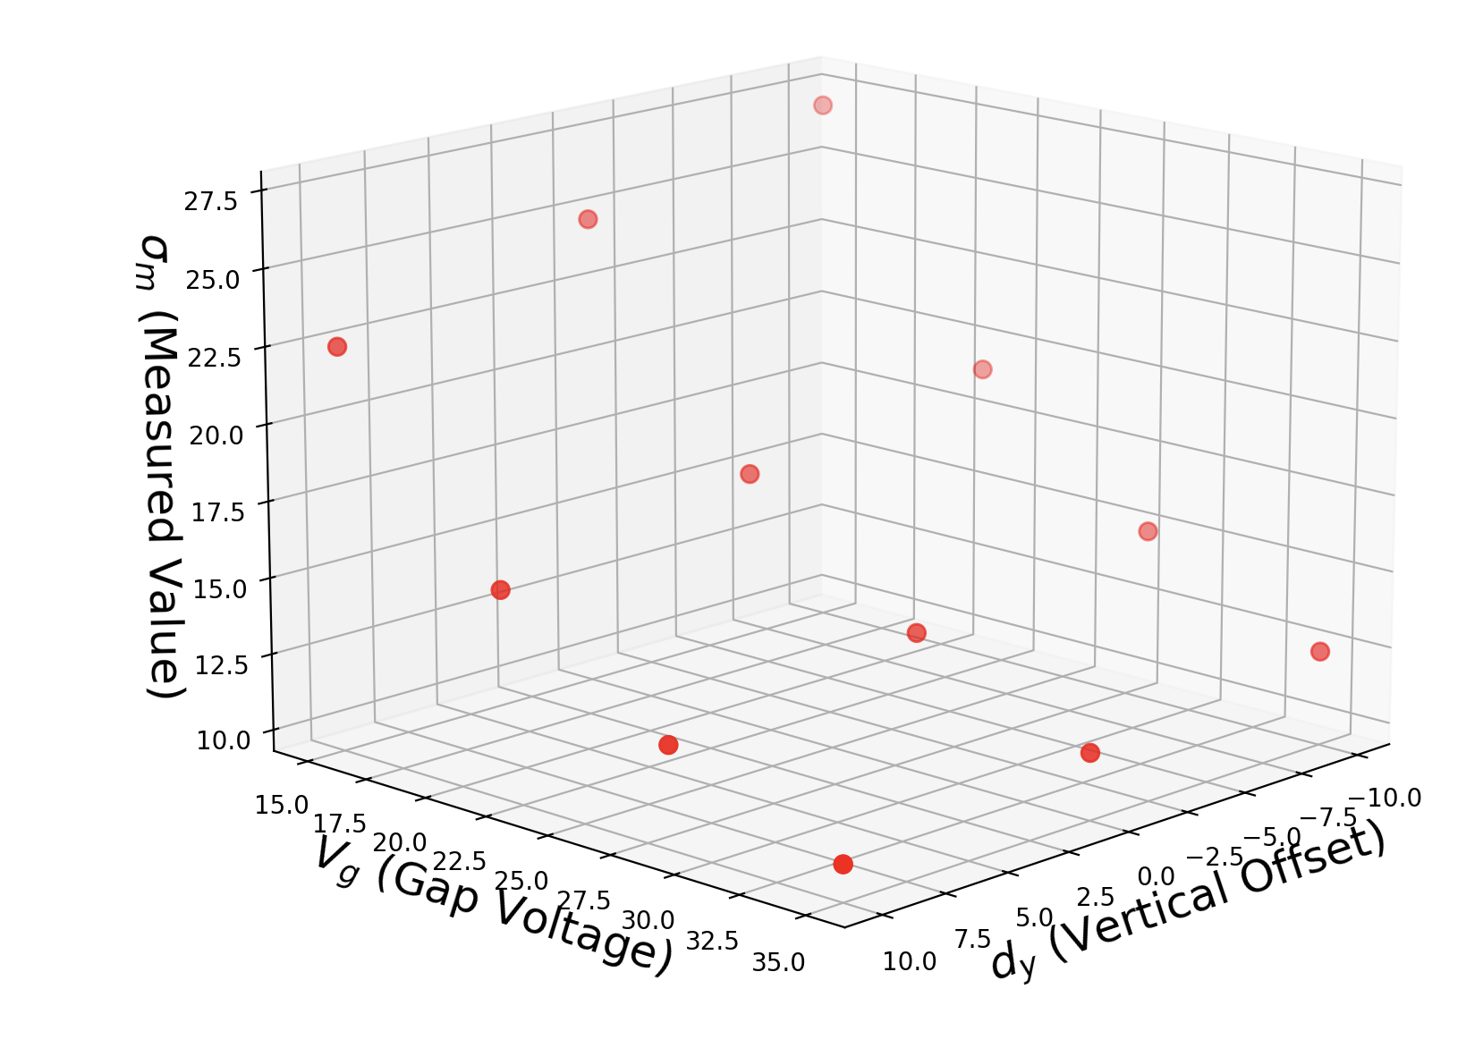
Training a Model from Simulations
Simulation dataset with Latin hypercube sampling of:
  Beam size (x & y)
  Number of protons in bunch
  Bunch length
Fixed values for:
  Collection species: N2
  Circulating beam energy: 10 GeV
  Bunch spacing: 200 ns
For each parameterization of the beam run scan over
  Collector voltage
  Vertical offset of bunch centroid from collector
Train models to predict true beam size from scan – without direct knowledge of other beam parameters

Slide 8
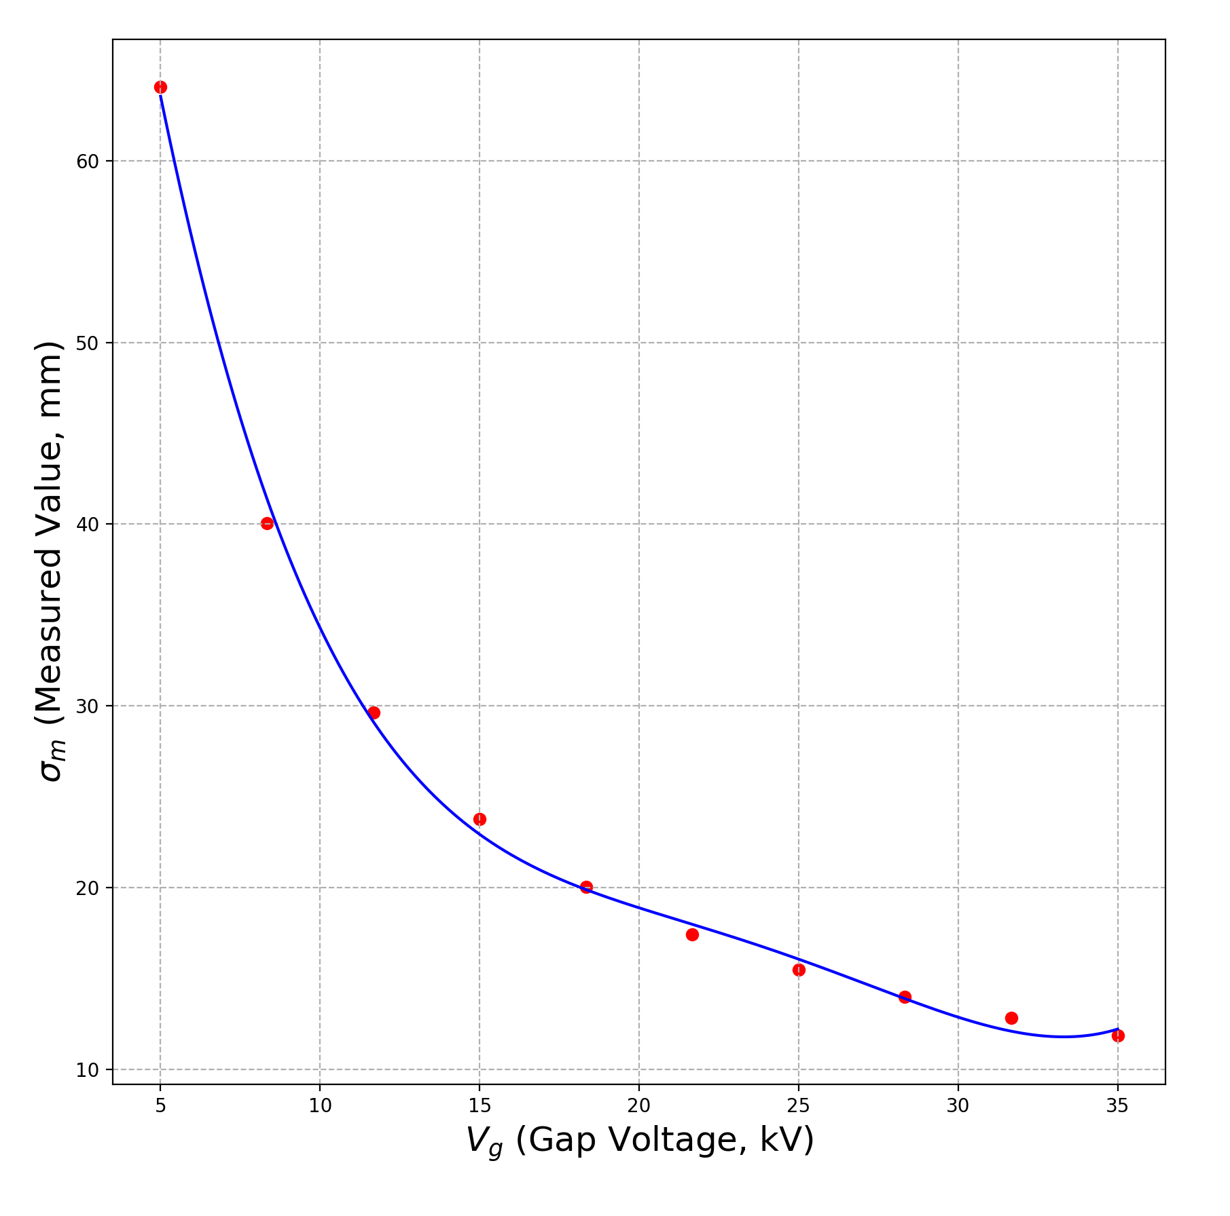
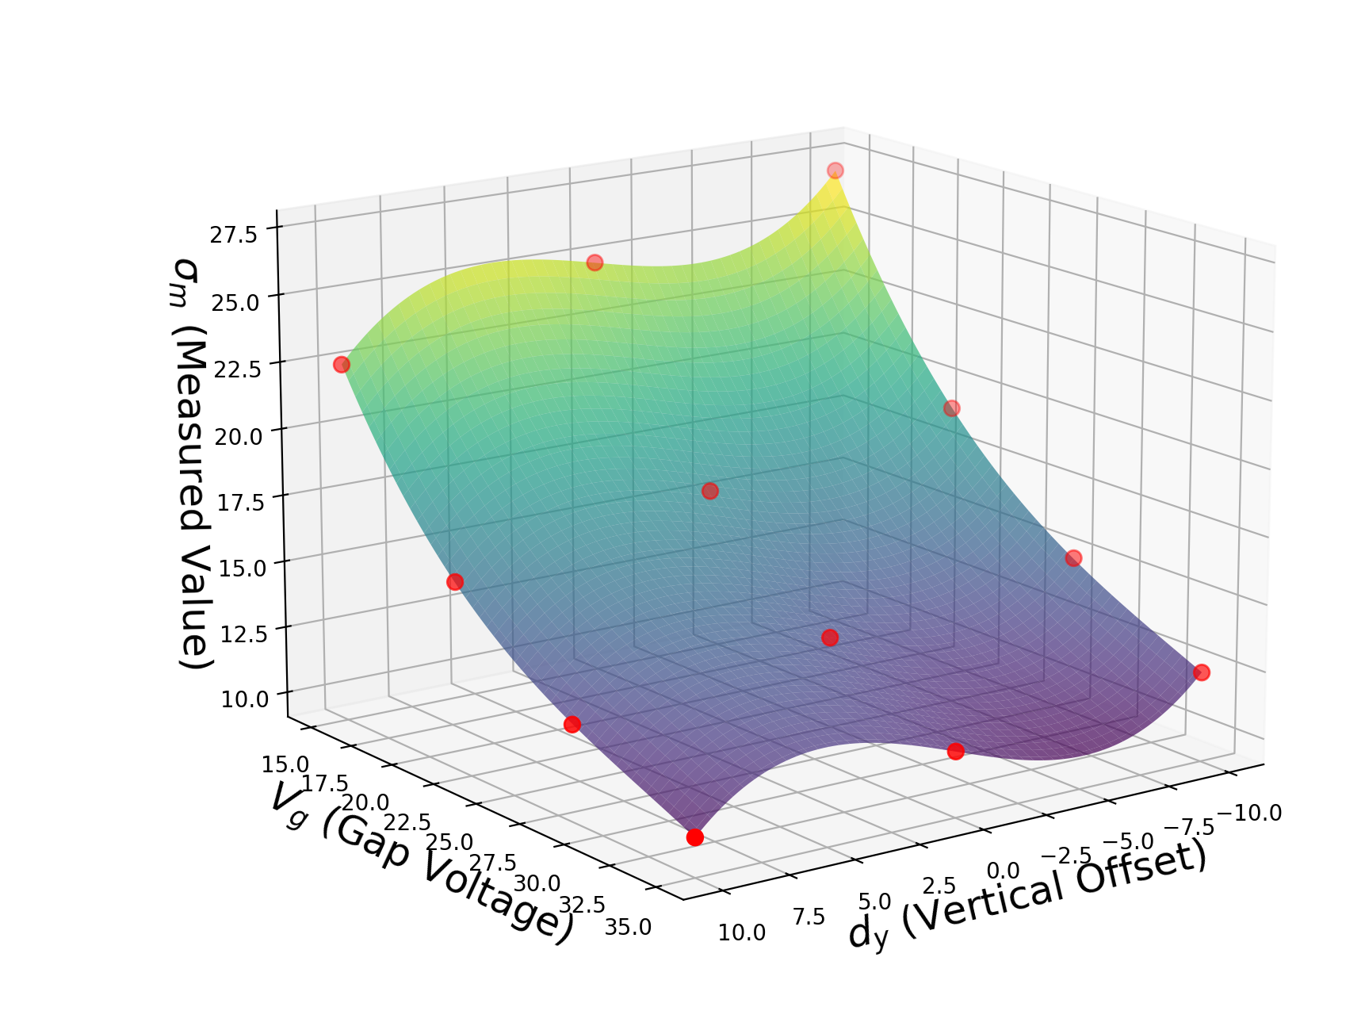
Measurement Types
Voltage-fit: A 4th order polynomial is fit to a voltage scan of 12 points. The polynomial coefficients are used as inputs to the regressor.
Surface-fit: A 4th order polynomial surface is fit to the scan data. The polynomial coefficients are used as inputs to the regressor.
Point-by-point: The regressor models are trained using the individual data points from the scan, plus intensity. Intended as a reference case.

Slide 9
Model Evaluation
Compares 3 model methods for each measurement approach
“Gaussian noise” case adds in errors to the measured beam size sampled from a Gaussian
GP is always the clear best performer
Using the surface-fit offers some benefit, over voltage-fit, for noisy measurements
  Slightly more involved, need to kick the beam

Slide 10
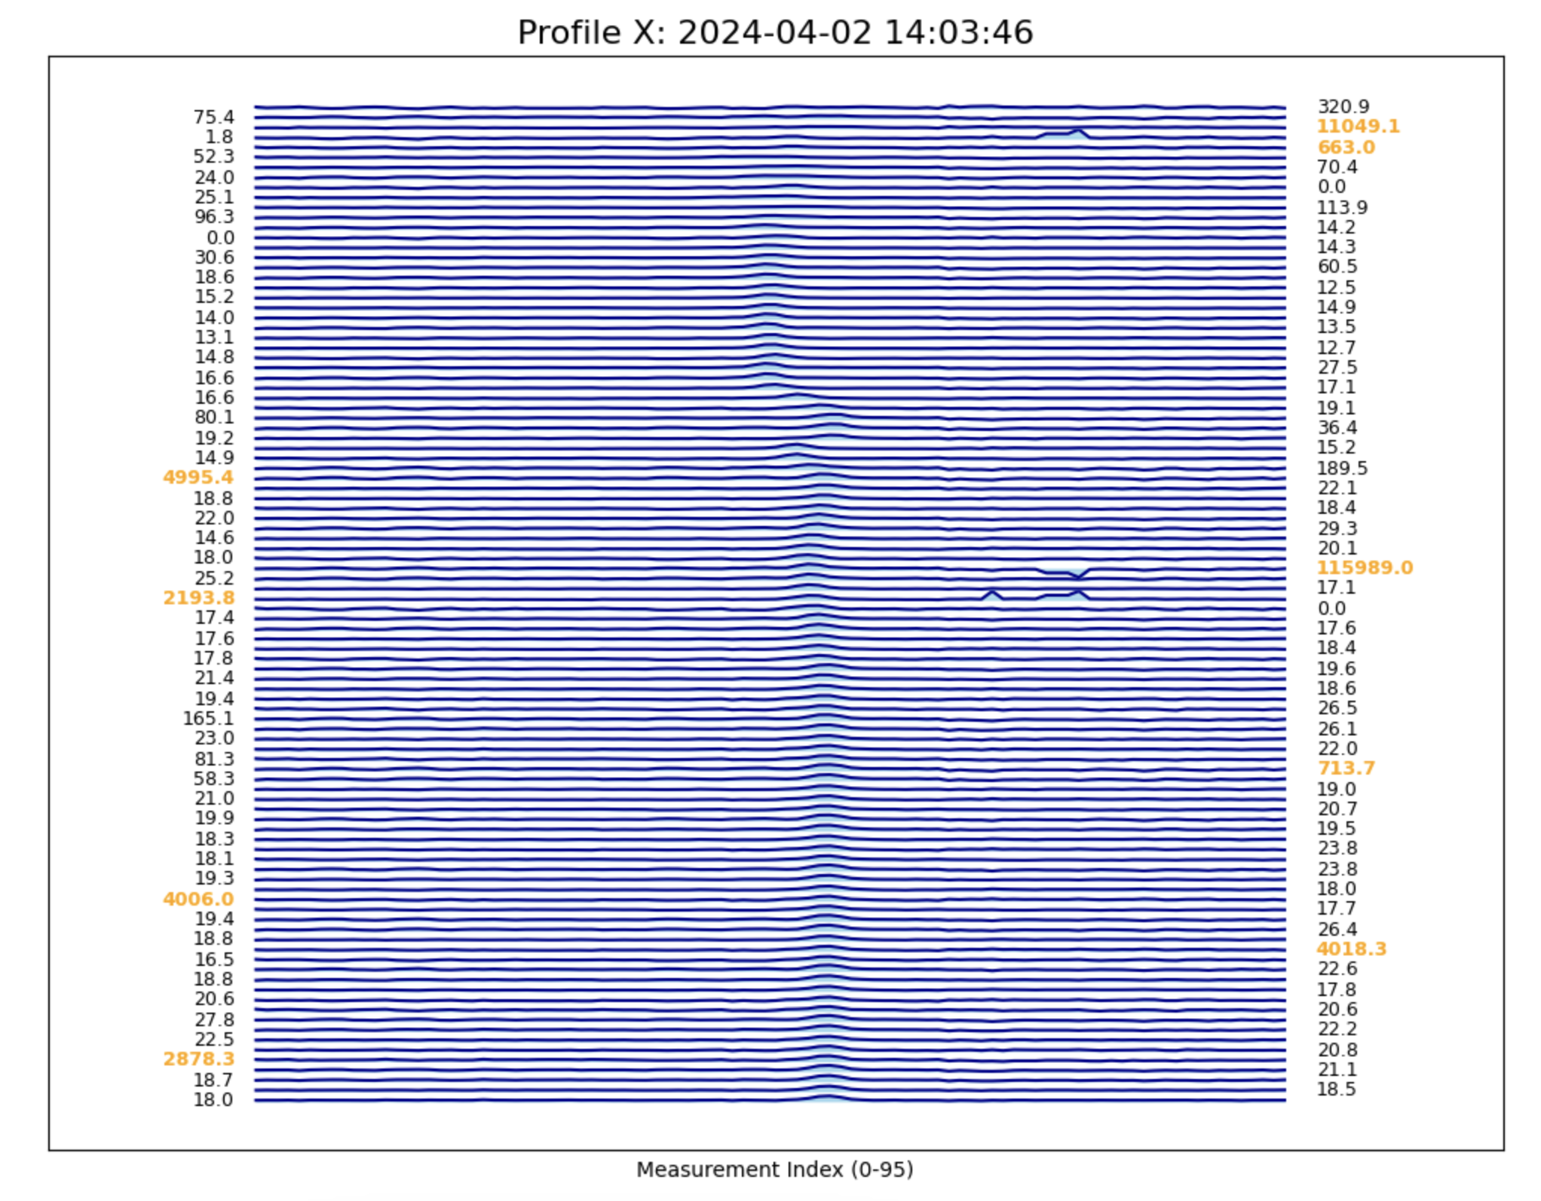
Measurement Reliability Challenges
Bunch properties can change significantly over one cycle in the AGS
Fitting routines are sensitive to variable noise structures in the data
Places limits on the degree to which the IPM measurements could be integrated into automated routines
Makes use of historical IPM data for ML tasks more challenging
But, there are significant quantities of data to work with

Slide 11
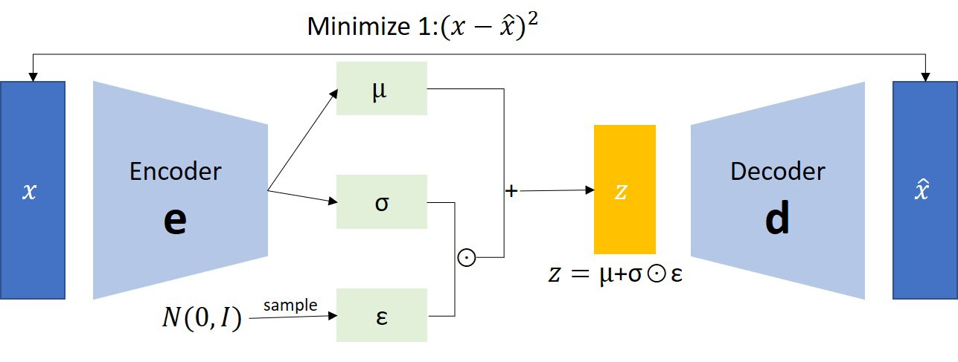
IPM Profile Measurement Denoising
VAEs can be very effective at removing random noise while preserving the main signal*
A variational autoencoder is trained to reproduce input profiles
1D convolutional networks used for the encoder and decoder
*Henderson, M., et al. Journal of Instrumentation 19.11 (2024): P11015.

Slide 12
Denoising VAE Results
Denoising enables the fitting routine to converge in cases that previously failed
The VAE is prone to hallucinating signals from pure-noise profiles

Slide 13
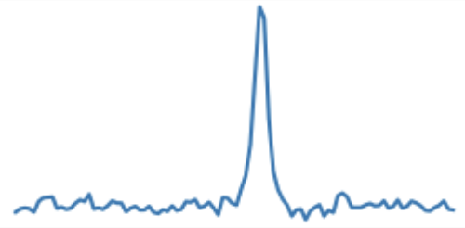
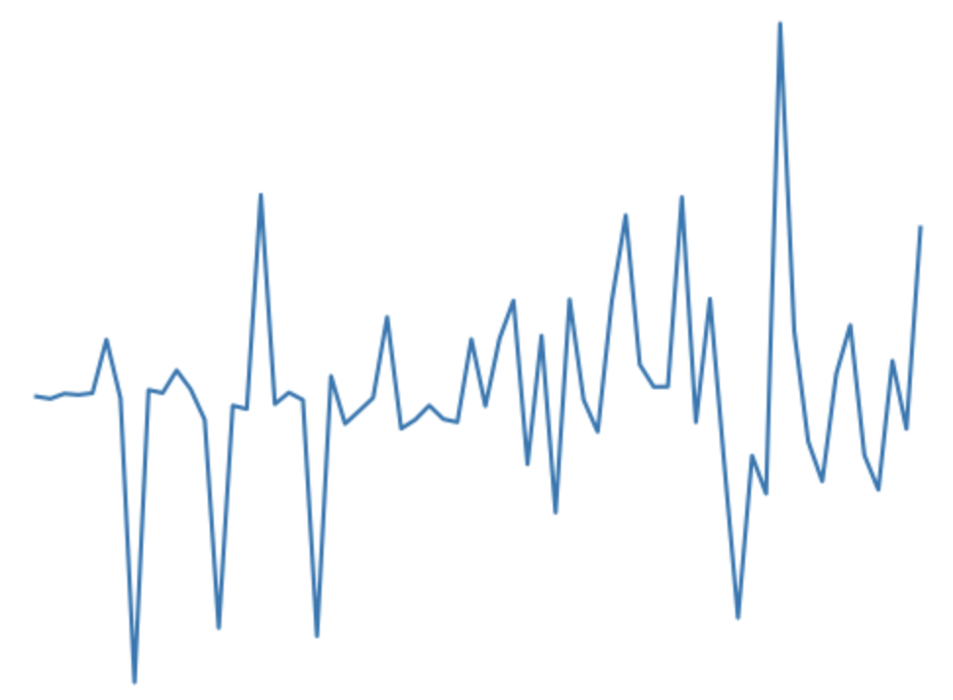
Unsupervised Anomaly Detection
Train a simple transformer encoder to reproduce IPM profiles
Goal is not denoising, the transformer will generally reproduce any noise in the signal, but to use the embedding
The embedding is averaged over all input tokens and passed to an unsupervised classifier
3x transformer encoder layers
Linear Embedding
Sin/cos positional encoding
Linear Layer
Classifier
Anomalous?: Y/N

Slide 14
Anomaly Detection Results
Dataset for training/testing was already filtered to remove impossibly large emittance values
Classifier does an excellent job at recognizing unusual profiles from the embedding presentation
Quantification of the classifier performance requires more assessment edge cases
Anomalous
Normal

Slide 15
Conclusion
Simulation tool in Warp for modeling the AGS IPMs
Can be used to build a surrogate model for fast evaluation of parameter scans and eventually single measurements
Some unsupervised approaches show promise for helping to improve profile measurement reliability and assist with data cleaning
Next steps
  Start to build up a labeled dataset of IPM profiles for quantifying denoising and classifier performance
  Apply transformer embedding to simulation-based inference
  Run an experiment to test the Warp model

Slide 16
AI/ML Polarization and Brightness Collaboration Members
BNL: Kevin Brown, Yuan Gao, Lucy Lin, Vincent Schoefer, Levente Hajdu,
Nathan Urban, Christopher Kelley
Cornell: Georg Hoffstaetter, Eiad Hamwi, David Sagan, Matt Signorelli
SLAC: Auralee Edelen, Ryan Roussell
JLAB: Malachi Schram, Armen Kasparian
RPI: Yinan Wang
Radiasoft: Jon Edelen, Chris Hall, Nathan Cook

