Slide 1


Use Of
Generative AI & LLMs For Accelerator Design
Onur Gilanliogullari • Brahim Mustapha

Slide 2
Outline
Lattice Design Processes
01
RAG-LLMS
02
MCP Bridge || Tools
03
Demo
04
Conclusion
05

Slide 3

Lattice Design Process
Reality Check
Expensive Inner Loops
(tracking, tune extraction, scans) slow iteration
Resonances
low-order lines, margin accounting, footprint “leakage”
Collective Effects
IBS vs emittance, aperture limits, space charge effects
System Constraints
compactness/length, cost, magnet limits, dispersion/chromaticity control
Human Loop
define → simulate → parse → compare → tweak → repeat
Use Of Generative AI And LLMs For Accelerator Design

Slide 4
Time Spent in a Lattice Design Workflow
Nonlinear & Tracking
Errors & Correction
Collective-Effects Passes
Linear Optics
Concept & Requirements
Integration & Reviews
35%
25%
15%
10%
10%
5%
0
5
10
15
20
25
30
35
Share Of Total Effort ( % )
Use Of Generative AI And LLMs For Accelerator Design

Slide 5
AI-assisted Framework
to shorten cycles while keeping physics judgment in the loop
Linear Designs
Carried Out With
MAD-X / ELEGANT / Xsuite / custom scripts
Proposed
Solution
Numerical Effects Computed
space-charge tune shifts/footprints
RAG-assisted LLM
parses inputs, normalizes units, fetches prior runs/docs, summarizes & compares
Outcome
reproducible metrics (ΔQ⁹⁵, centroid, anisotropy, resonance margins) + suggest → verify loop
Use Of Generative AI And LLMs For Accelerator Design

Slide 6




Large Language Models (LLMs)
What & How
Training
& Alignment
LLM
Capabilities
Inputs & Limits
Strengths
Good Practice
neural sequence models trained to predict the next token over very large corpora (Transformer-based, billions of parameters).
writing, Q&A, summarization, reasoning, code generation, multi‑turn dialog.
prompts are tokens within a finite context window; decoding uses temperature/top‑p; outputs are probabilistic.
pretraining on general text → instruction tuning → safety/alignment
broad knowledge, few‑shot learning, rapid prototyping. Weaknesses: hallucinations, prompt sensitivity, stale world knowledge.
be explicit about the task & format, constrain outputs, provide examples, and evaluate systematically.
Examples of LLMs
More
Use Of Generative AI And LLMs For Accelerator Design

Slide 7
Retrieval‑Augmented Generation (RAG)
How it Works & Why
Goal: Ground model outputs in your own data to reduce hallucinations and keep answers up‑to‑date.
Core Components
embeddings model, vector store (e.g., FAISS/Chroma), retriever (k, filters), reranker, prompt template; optional caching/guardrails.
Benefits
correctness, traceability, privacy over sensitive docs. Risks: garbage‑in‑garbage‑out, context limits, added latency.
Best Practices
chunk docs (~200–500 tokens + overlap), store metadata, log sources, evaluate groundedness/faithfulness, monitor latency/accuracy trade‑offs.
When To Use
domain Q&A, policy/compliance search, docs/code assistants; complements fine‑tuning rather than replacing it.
Workflow
User Query
Embedder
Vector DB
Retriever
Prompt Builder
LLM
Grounded Answer
Use Of Generative AI And LLMs For Accelerator Design

Slide 8


MCP + LLM Integration
Architecture
Definition
Purpose
Key pieces
Model Context Protocol: an open-source standard that allows AI models to access external data, tools, and functionalities through a standardized communication framework.
let the LLM call external tools (via MCP) to analyze data, orchestrate jobs, and return grounded answers.
LLM Orchestrator • MCP Client • Tool Gateway • Tool Servers (Twiss matcher, plotting, file I/O) • Vector DB (RAG) • Artifact store.
Contracts
Observability
JSON‑typed inputs/outputs, idempotent endpoints, timeouts, error codes, run IDs and provenance.
structured logs, metrics (latency/cost), and saved artifacts (e.g., mcp_runs/run_…/profile.csv, particle_tunes.csv).
Use Of Generative AI And LLMs For Accelerator Design

Slide 9
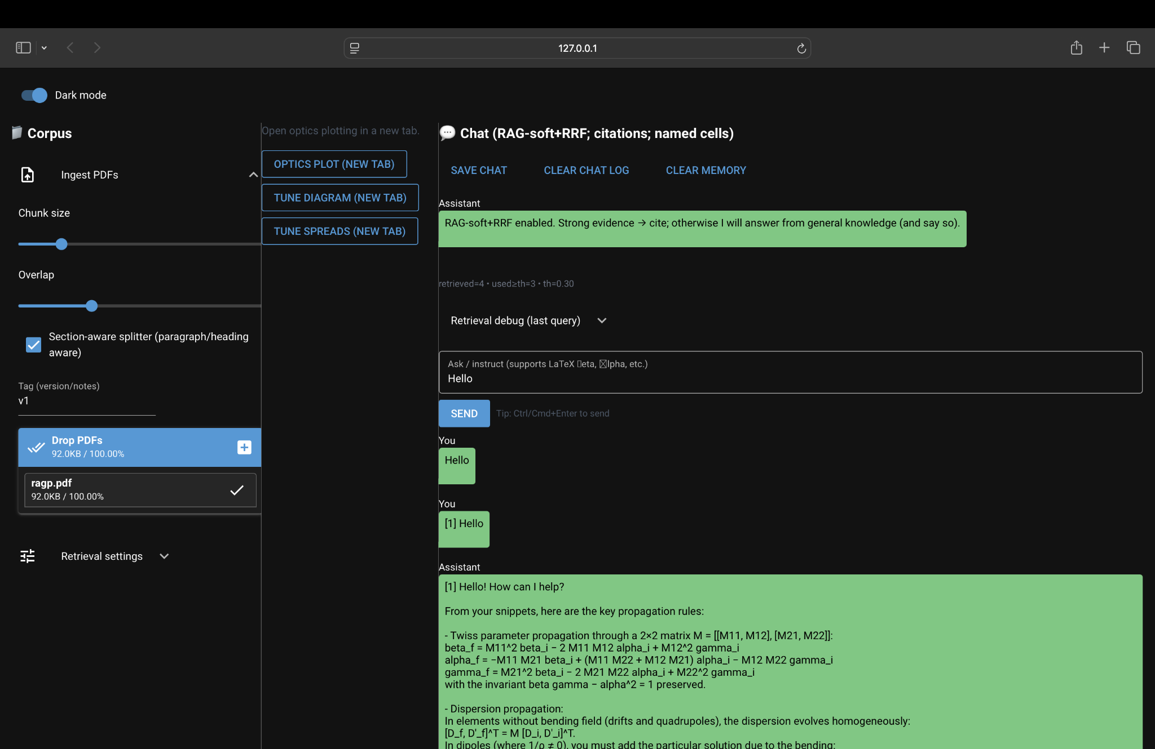
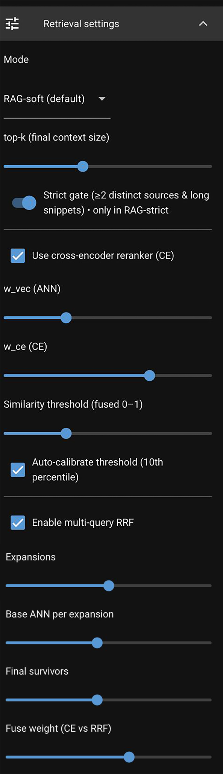
What We
Have Developed
Prototype
RAG stack
Chroma vector store with HuggingFace embeddings (all‑mpnet‑base‑v2); optional CE reranker (BAAI/bge‑reranker‑base) with weight sliders.
Retrieval Modes
RAG‑soft (default) vs RAG‑strict (evidence gate ≥2 sources & long snippets) + Chat‑only; multi‑query RRF expansions with LLM‑generated rephrases.
ARGO’s LLM, pre prompted about accelerator physics/lattice design.
Use Of Generative AI And LLMs For Accelerator Design
Notes:
Here I will make changes most likely.

Slide 10
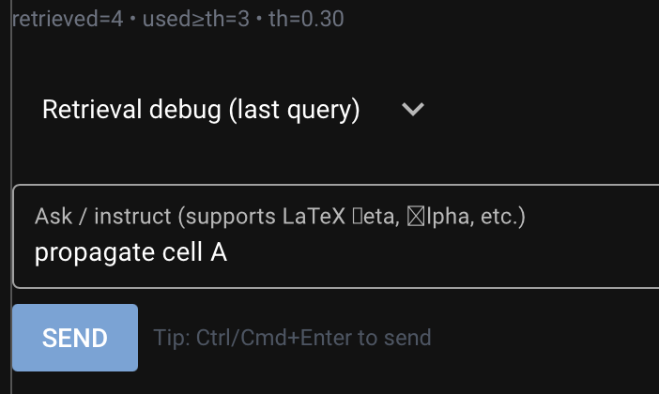
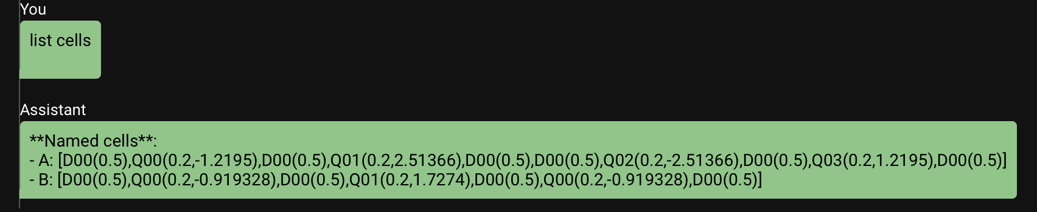
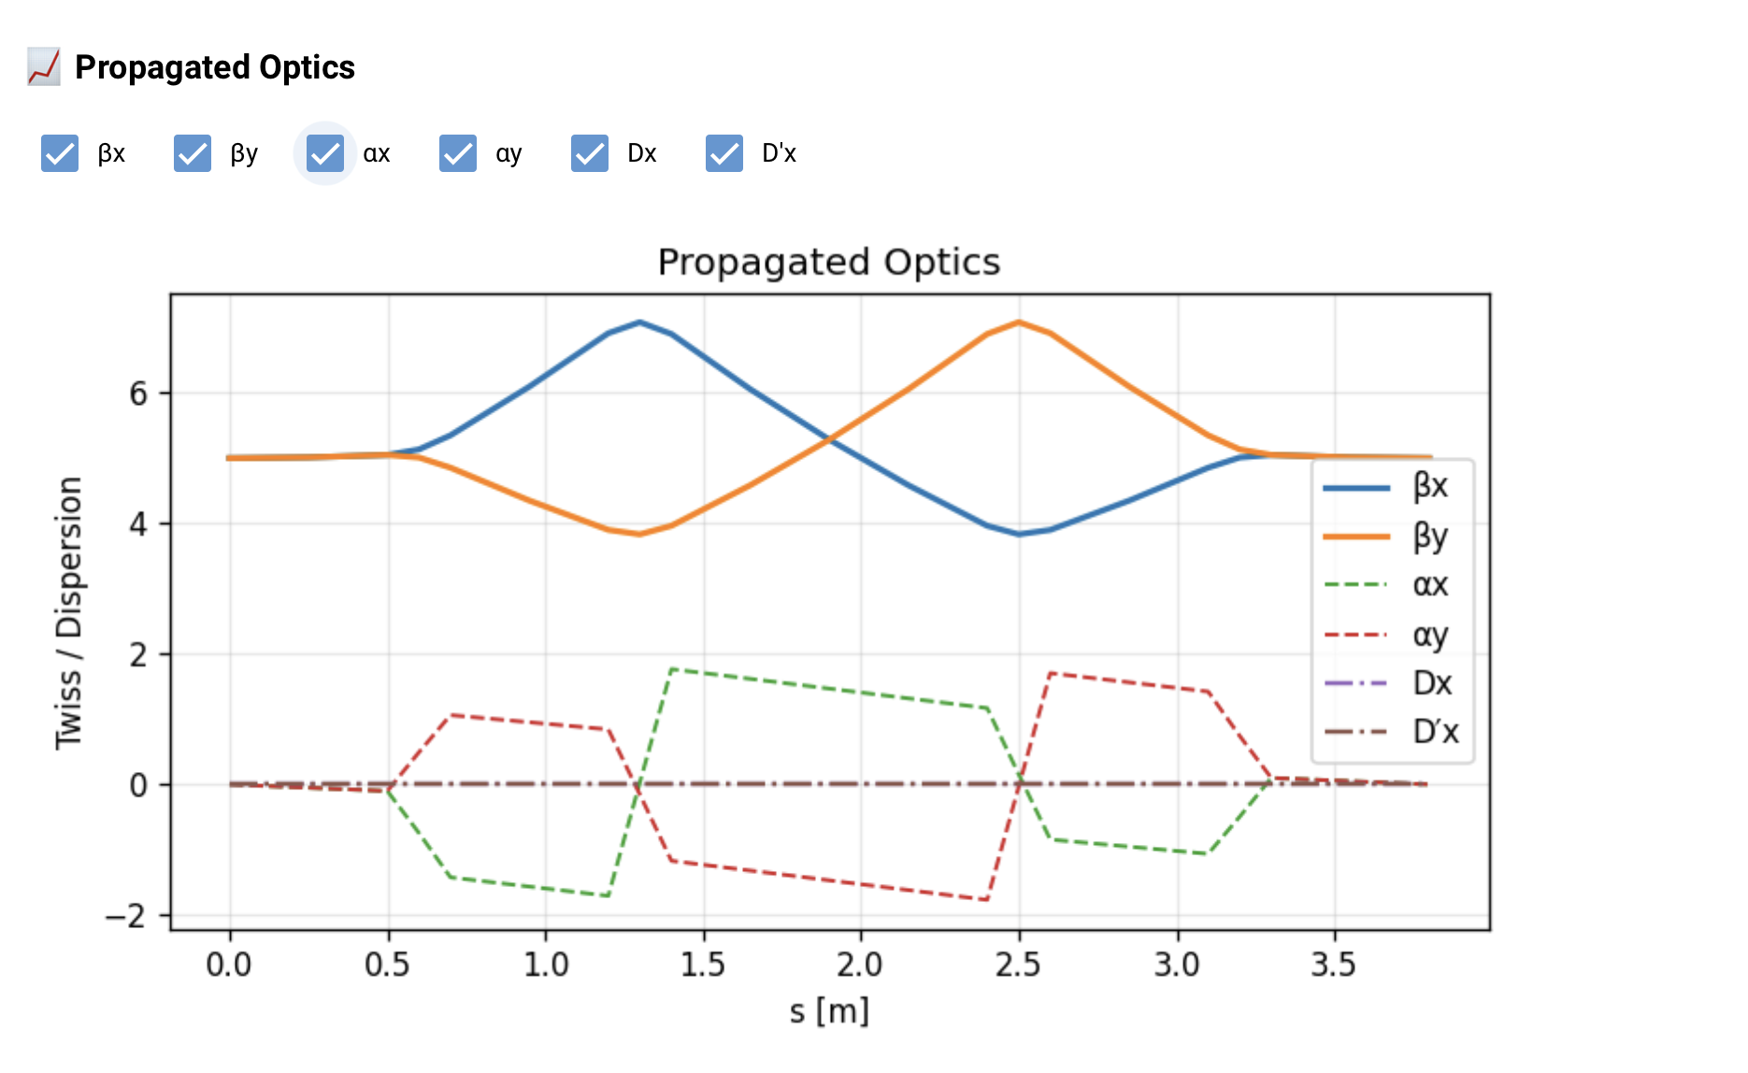
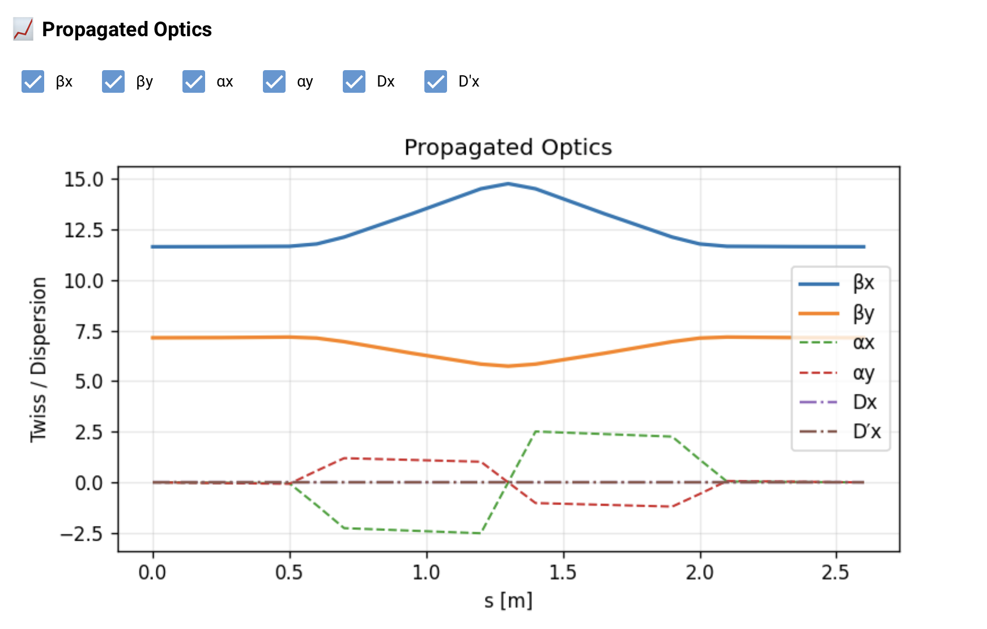
Cell Registry
Created a cell registry for persistent memory of defined cells.
MCP tool: Optics Propagation
External python script for matching/propagating defined cells.
Use Of Generative AI And LLMs For Accelerator Design
Notes:
Here I will make changes most likely.

Slide 11
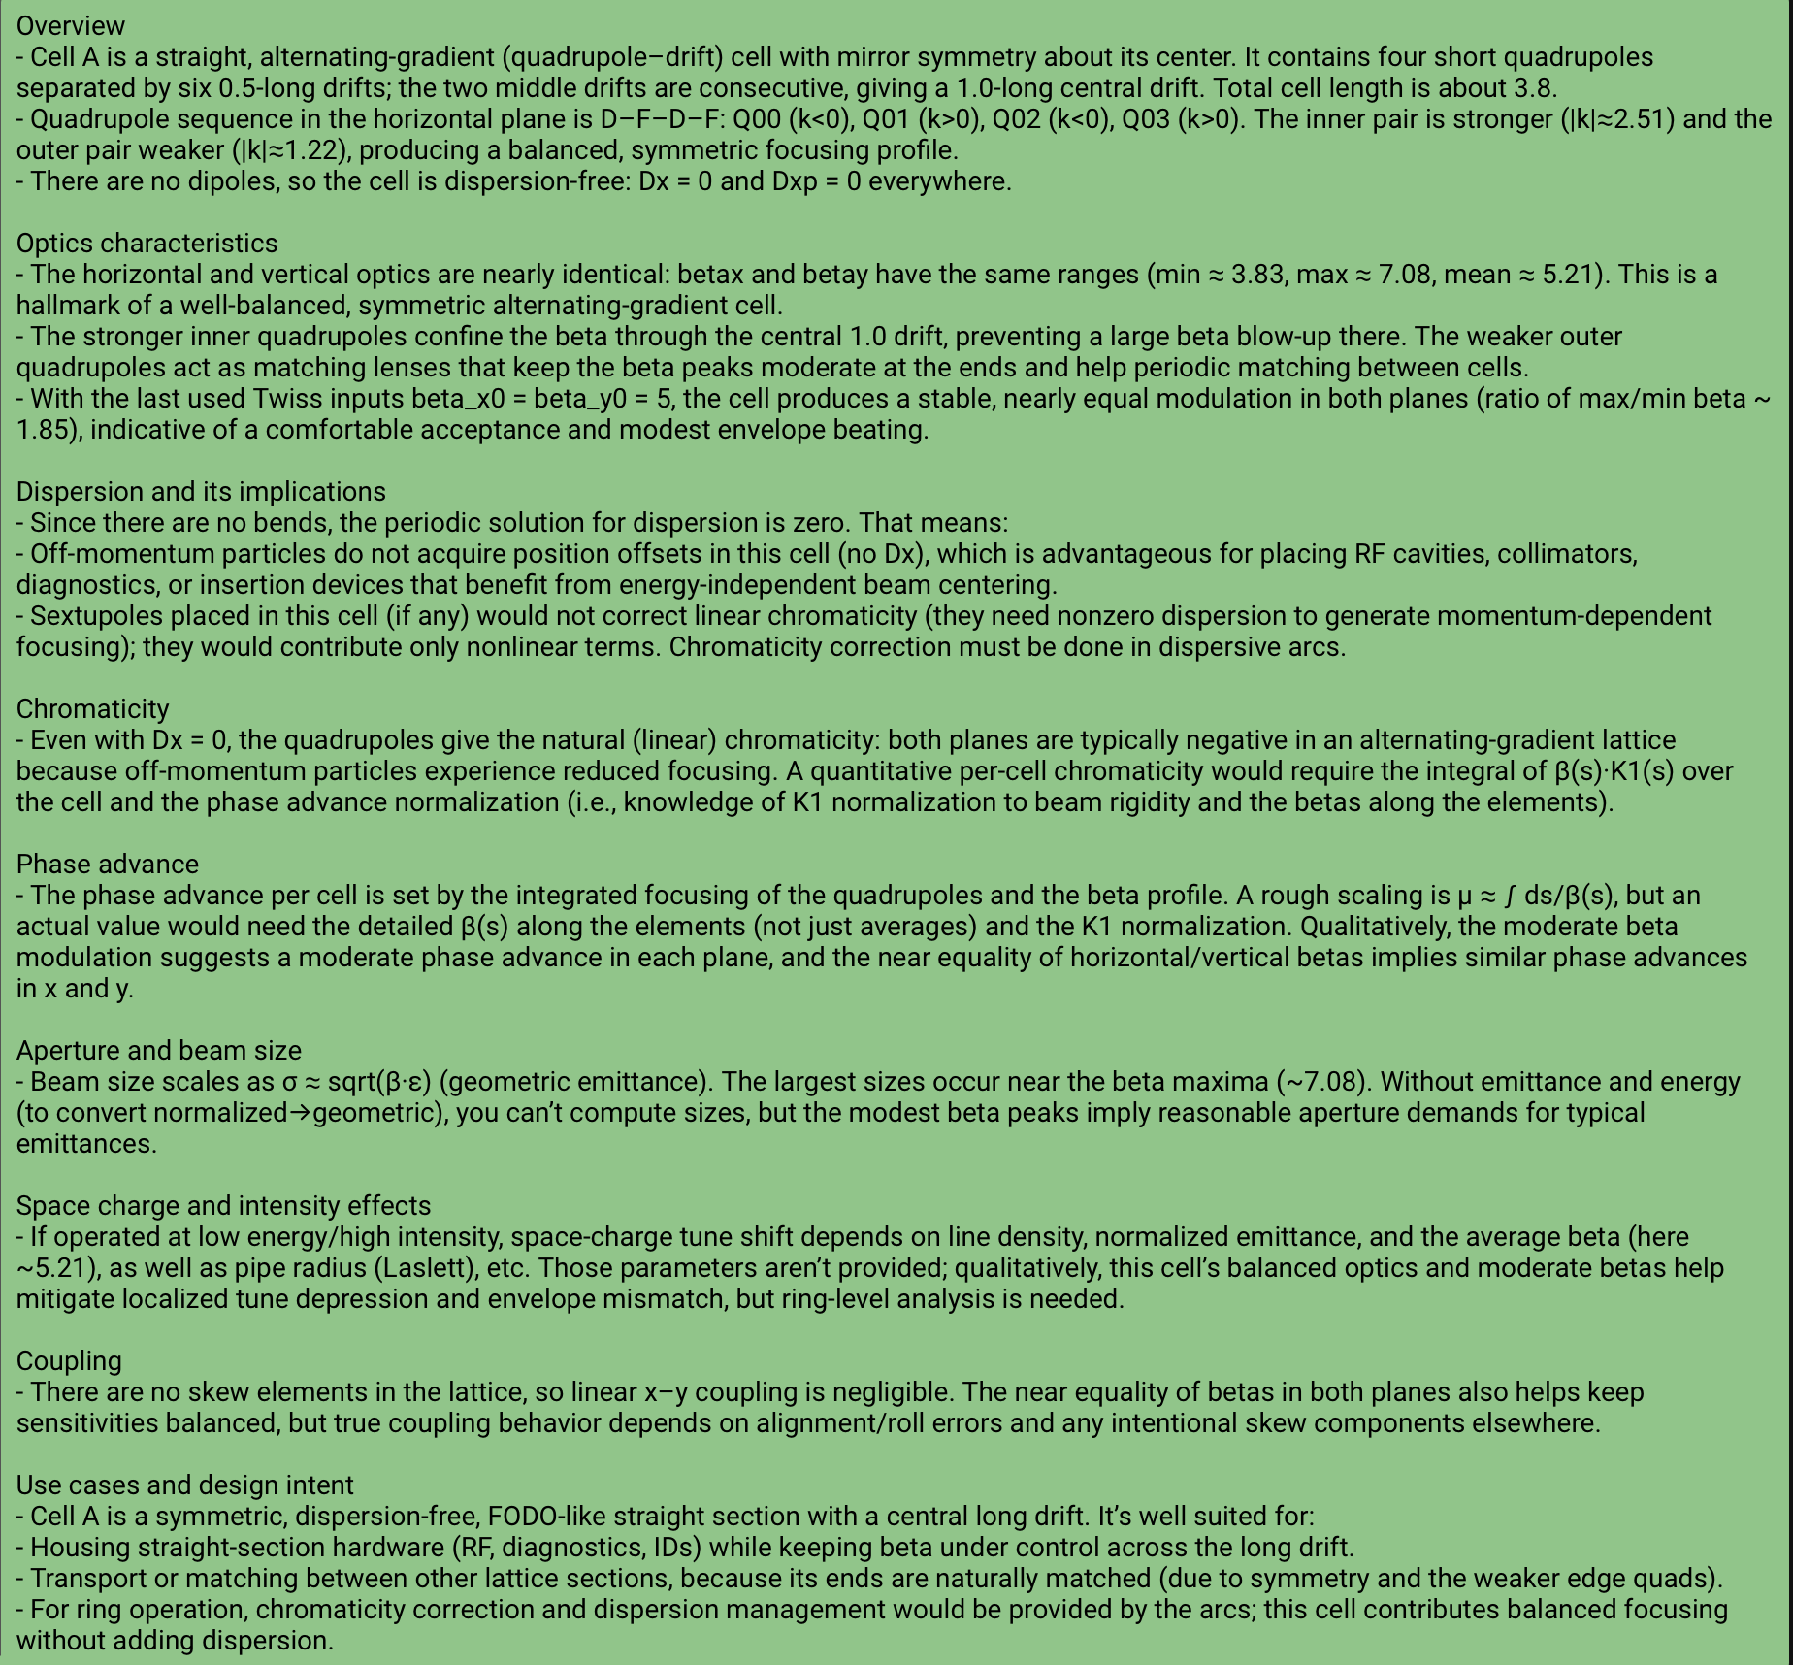
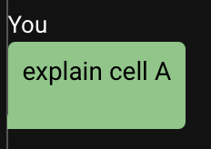
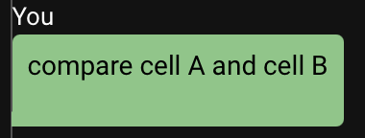
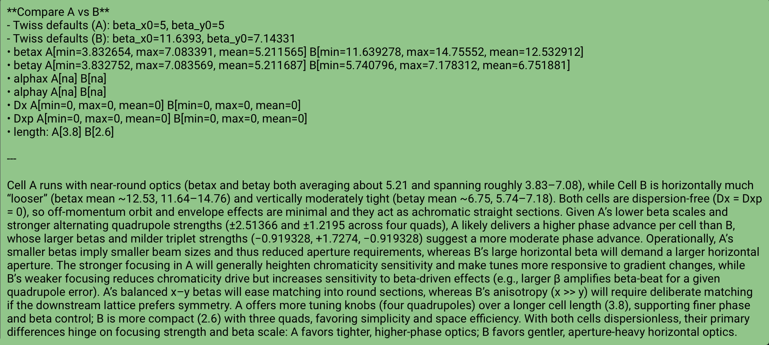
Comparison
Use Of Generative AI And LLMs For Accelerator Design
Notes:
Here I will make changes most likely.

Slide 12
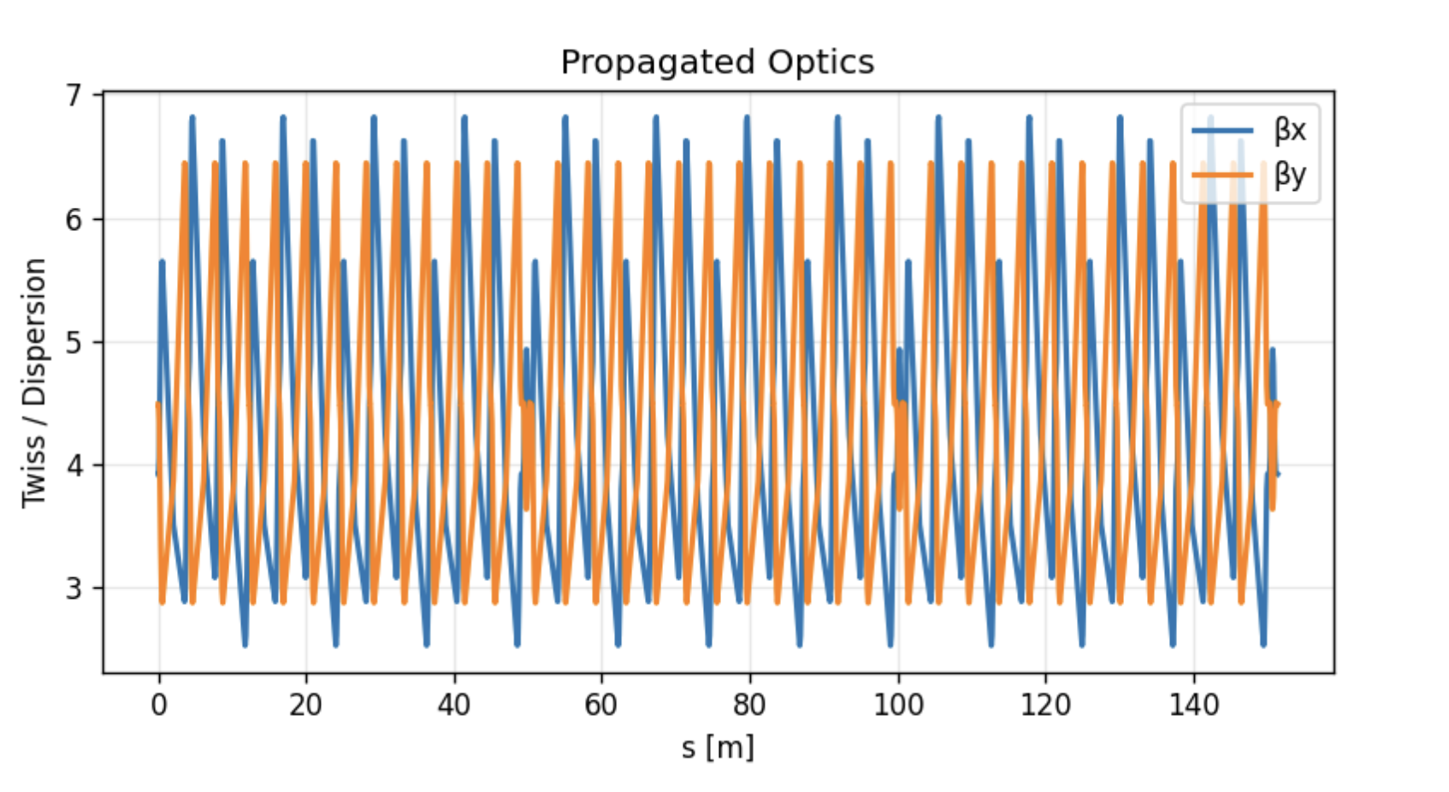
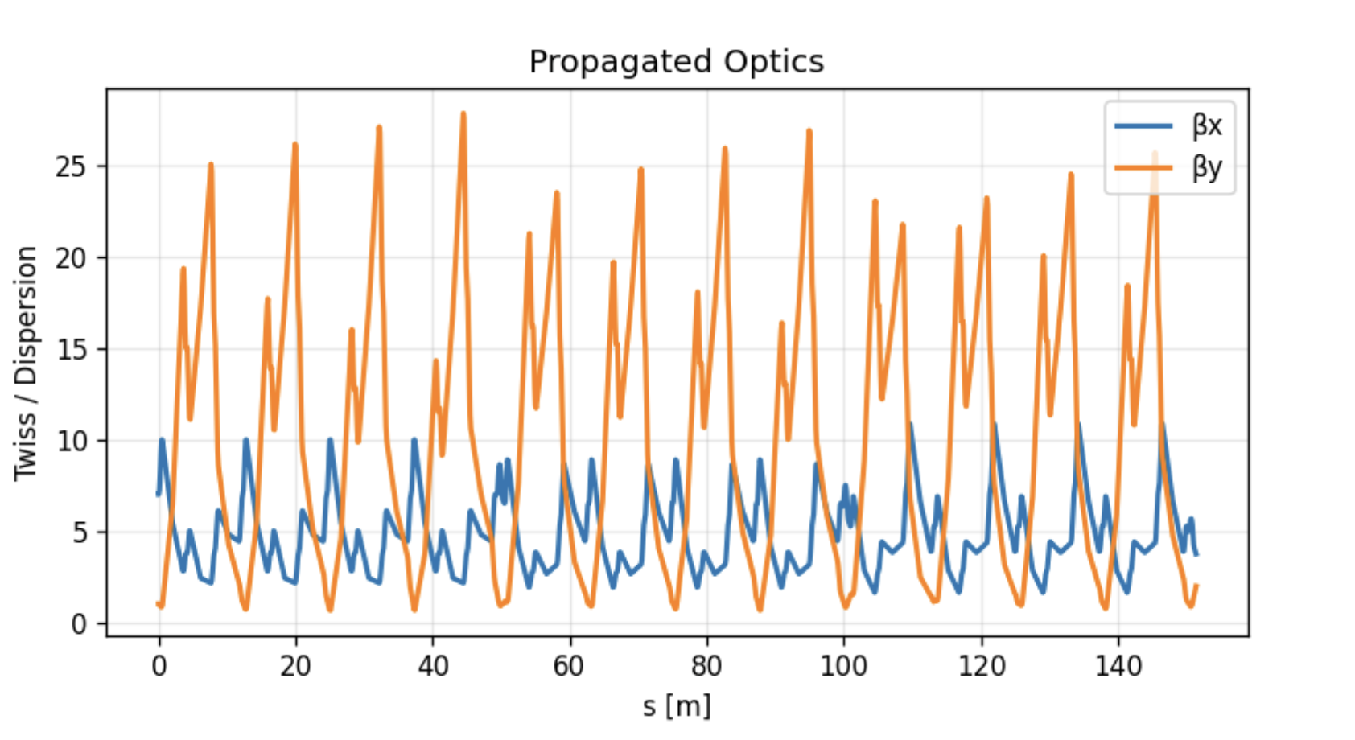
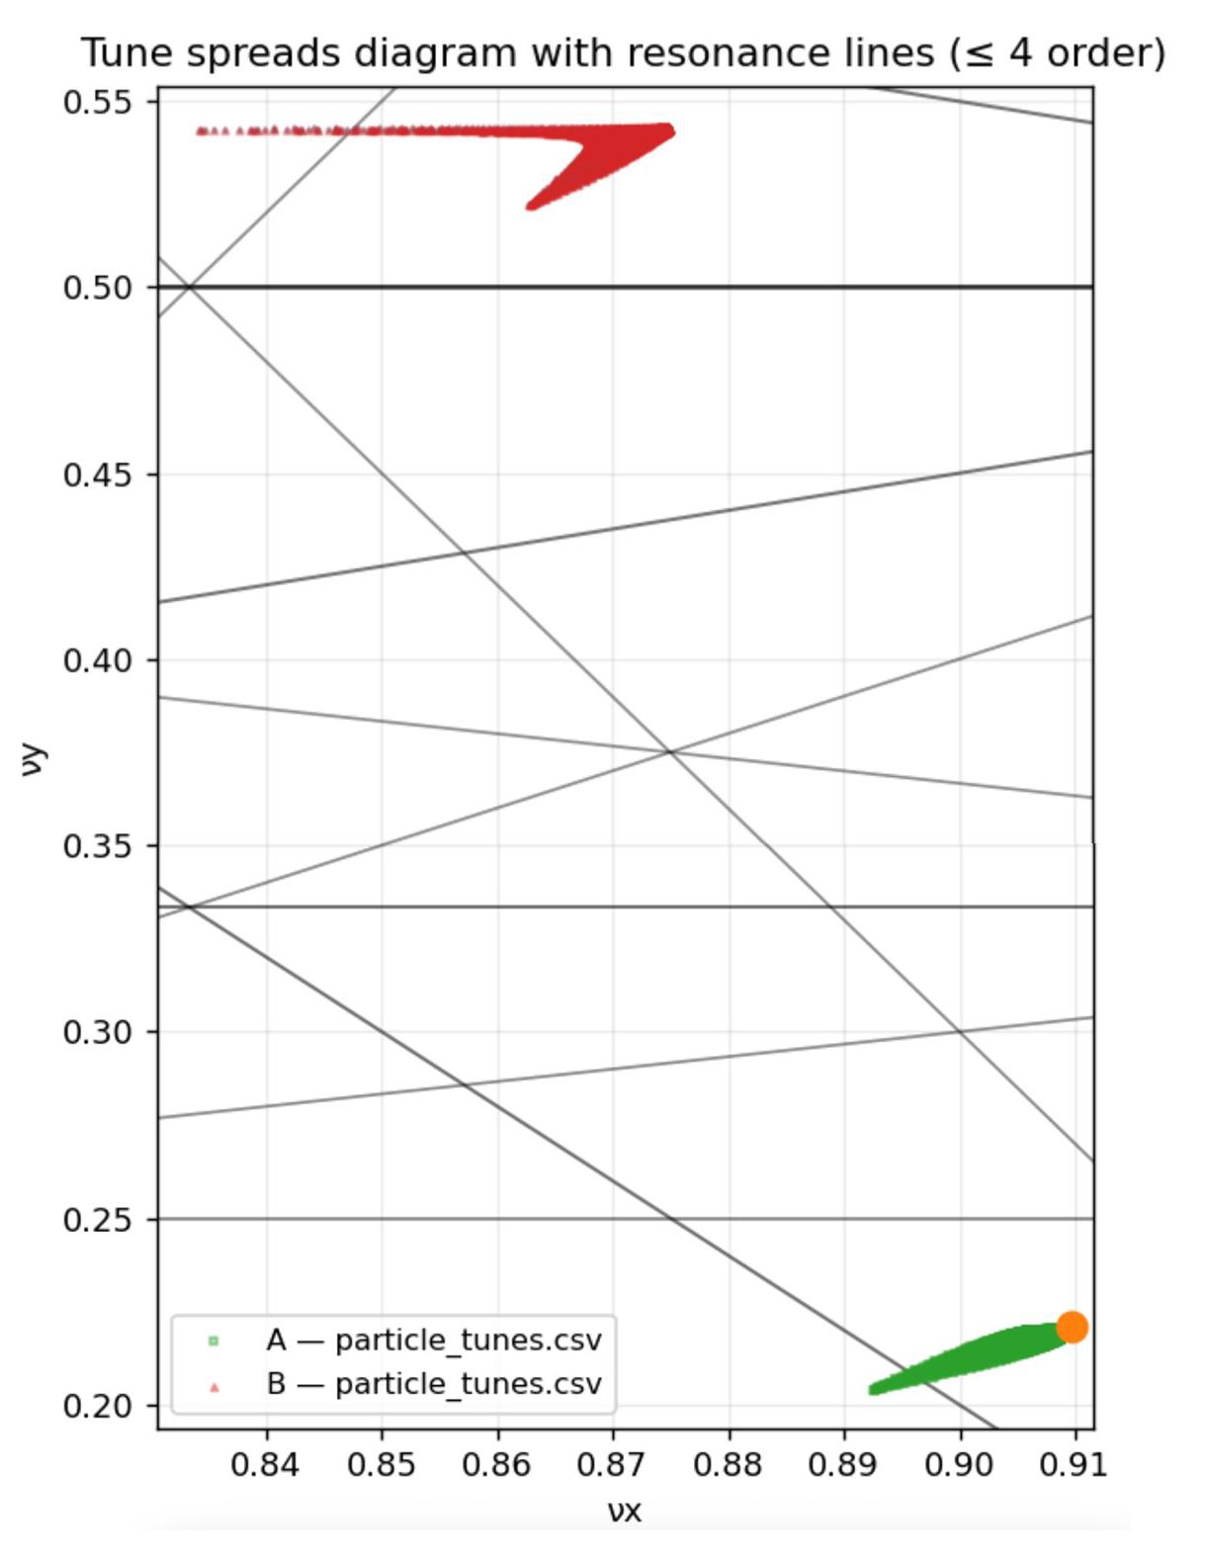
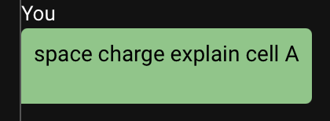
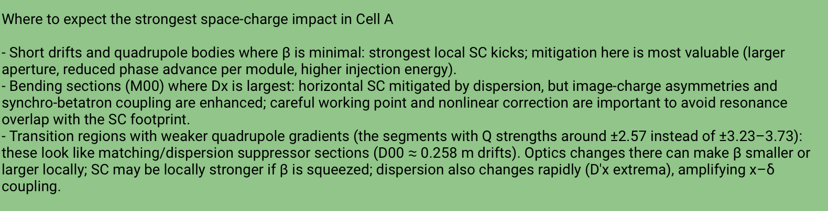
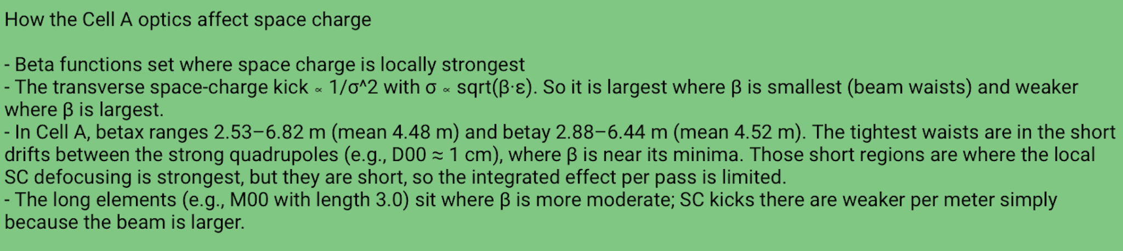
Ring Designs A and B
MCP tool space
charge tune-spread
Reasoning About Space Charge
Use Of Generative AI And LLMs For Accelerator Design
Notes:
Here I will make changes most likely.

Slide 13
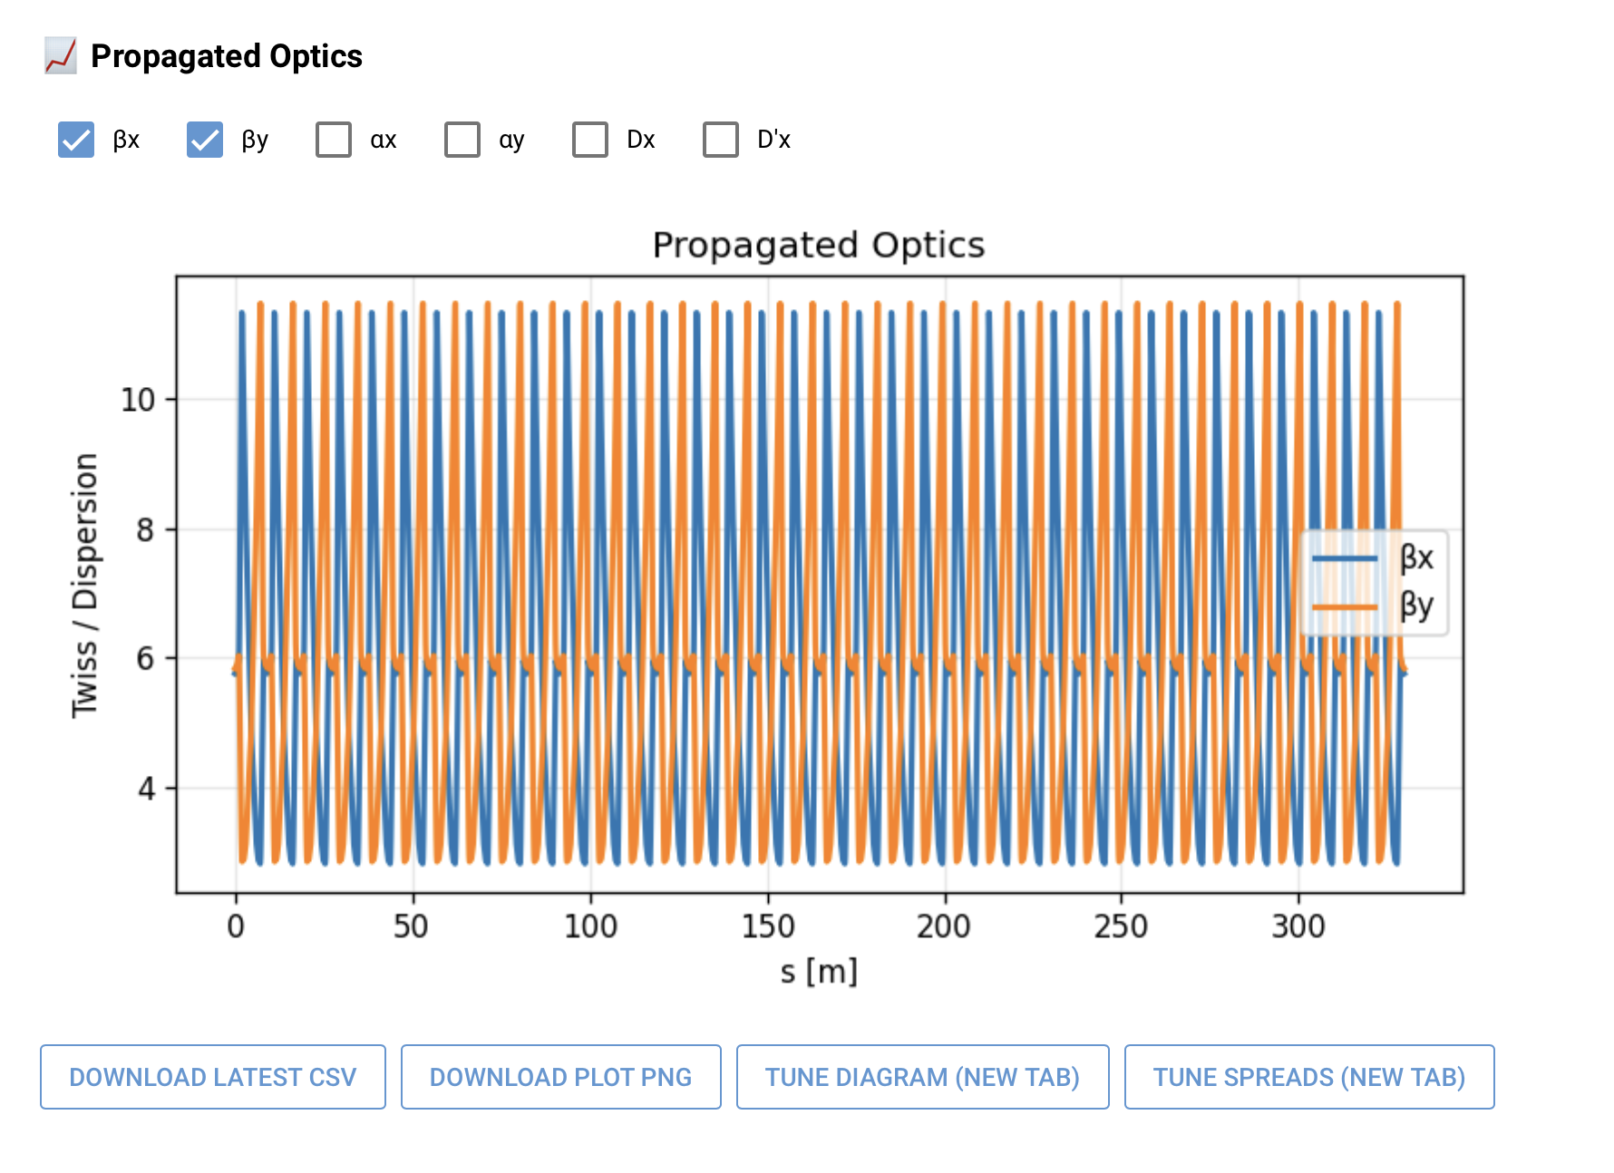

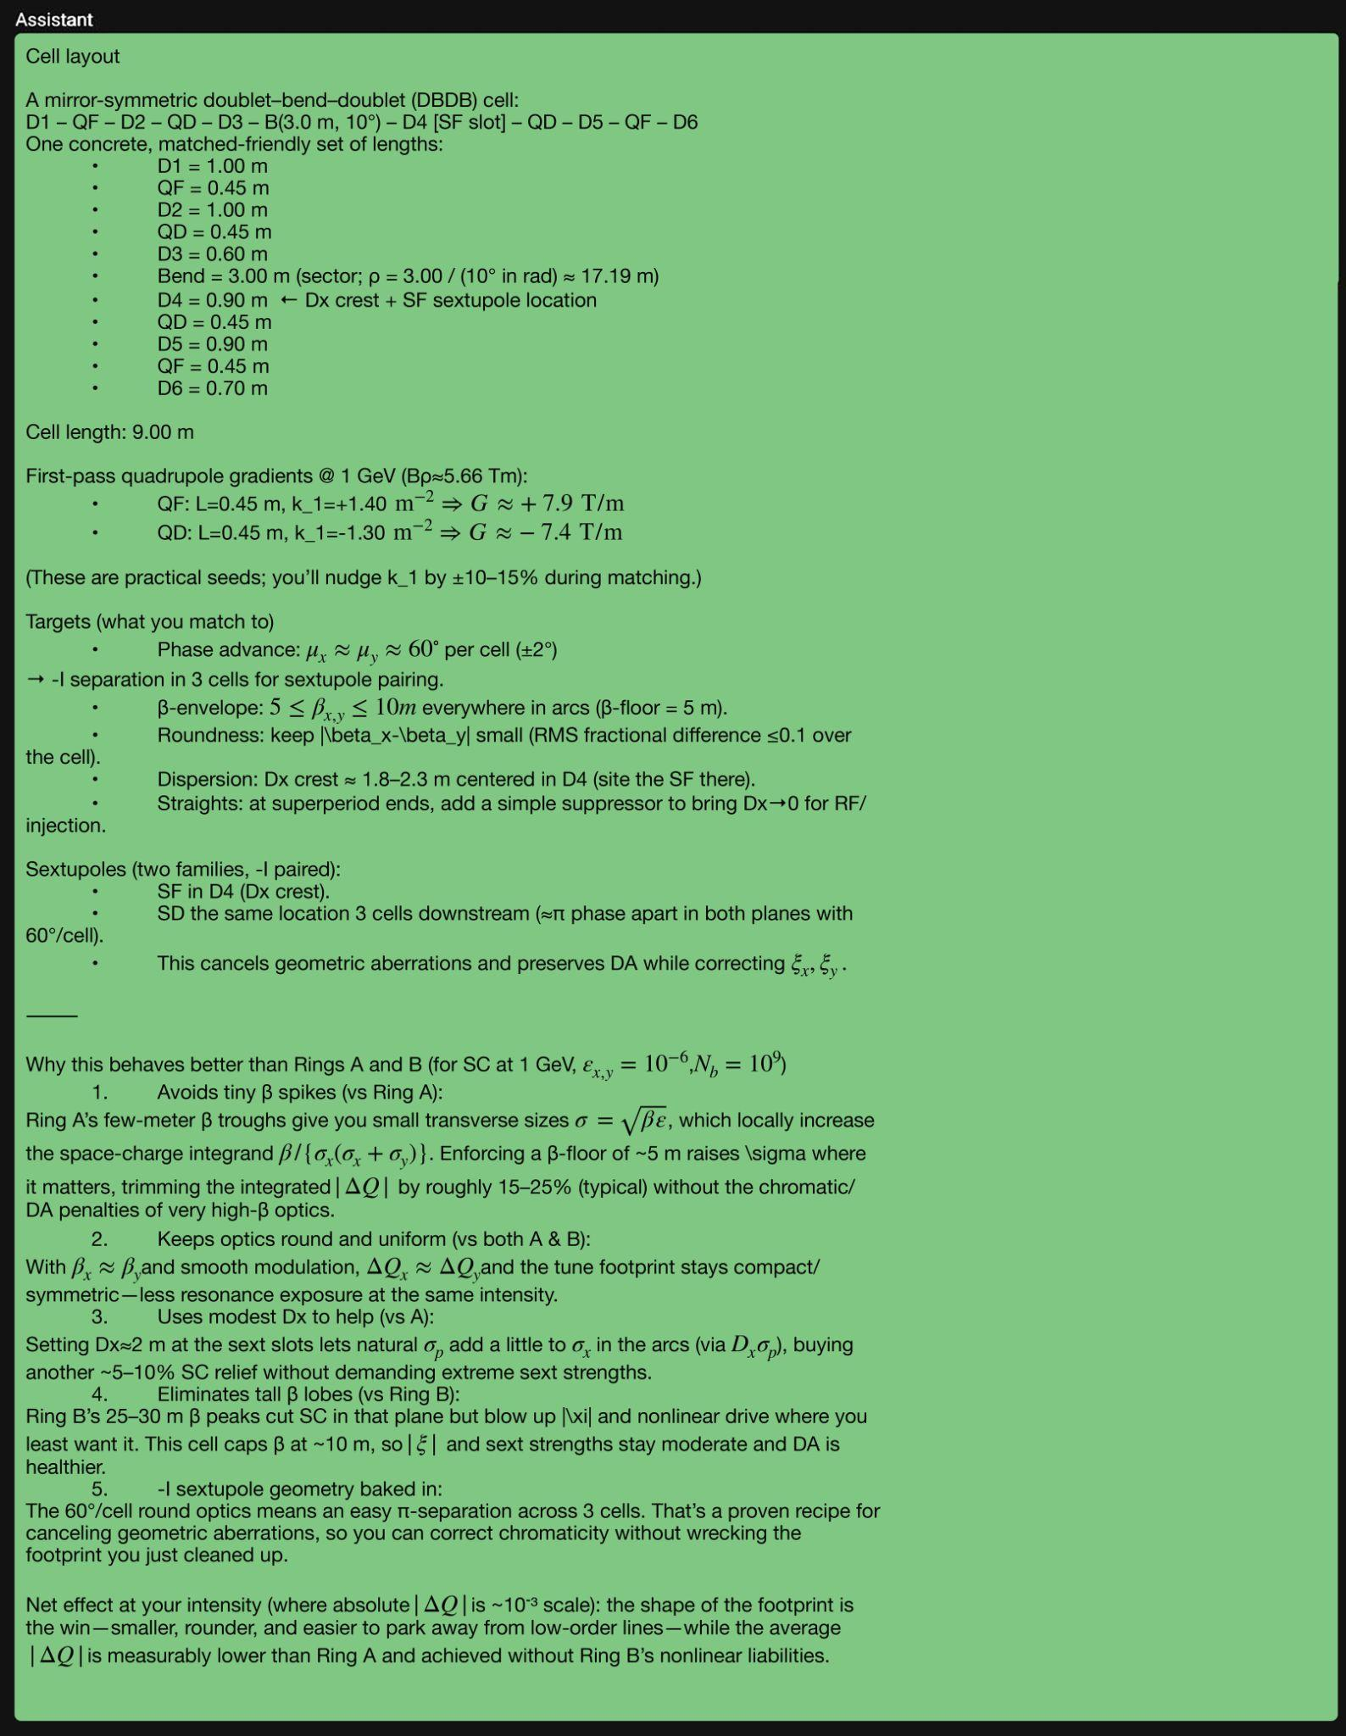
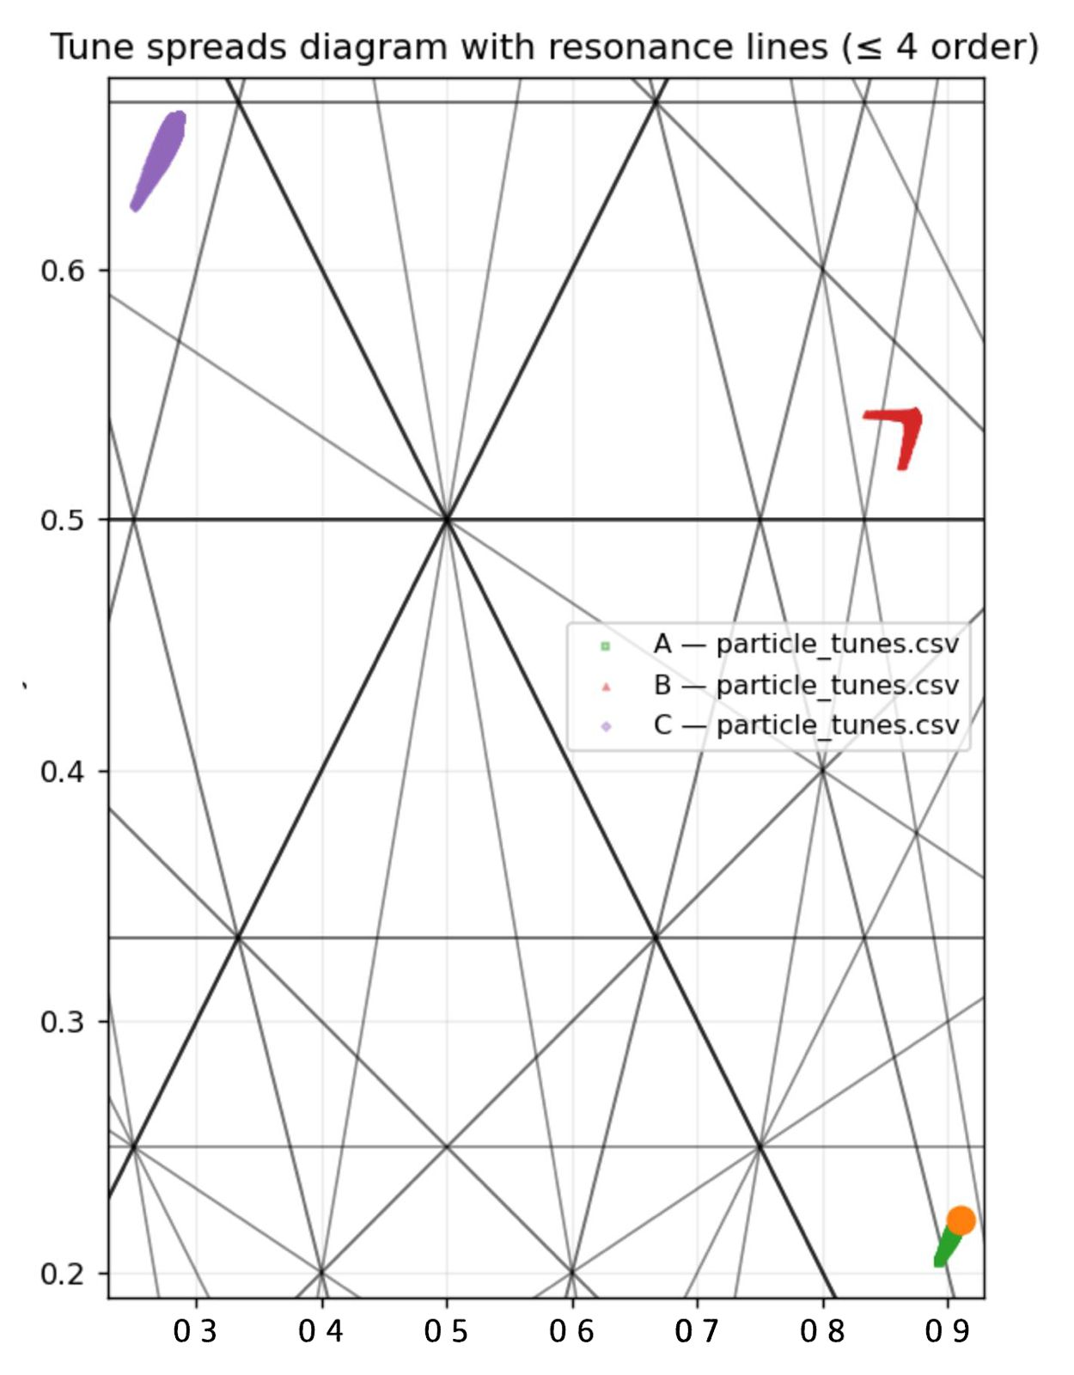
Prompt | LLM Reasoning With Better Design
Use Of Generative AI And LLMs For Accelerator Design
Notes:
Here I will make changes most likely.

Slide 14
Conclusion
We have created an integrated UI framework that combines RAG+LLM+MCP-Tools
LLM’s reasoning is used in the background for comparing cell designs with analytical reasoning from MCP tools.
The LLM was prompted for a better design in terms of space-charge behavior, and successfully created.
Use Of Generative AI And LLMs For Accelerator Design

Slide 15
Q&A

Slide 16

Thank You for Your
Time and Support
Onur Gilanliogullari • Brahim Mustapha

