Slide 1

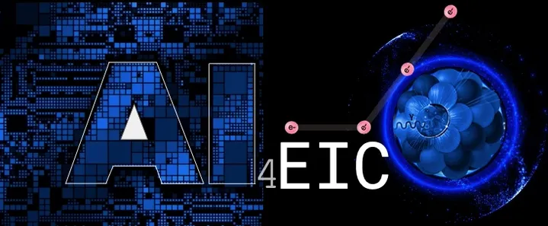
What we talk about when we talk about gluon saturation
Peter Jacobs
Lawrence Berkeley National Laboratory
UC Berkeley
In collaboration with:
Raymond Ehlers, LBNL/UCB
Andreas van Hameren, Krakow
Florian Jonas, CERN
Piotr Kotko, Krakow
Krzysztof Kutak, Krakow
Farid Salazar, Temple
Bjoern Schenke, BNL/SBU

Slide 2
Gluon saturation: a central element of the EIC physics program
Is this the correct description of the low-x structure of matter?
How do we explore it experimentally?
→

Slide 3
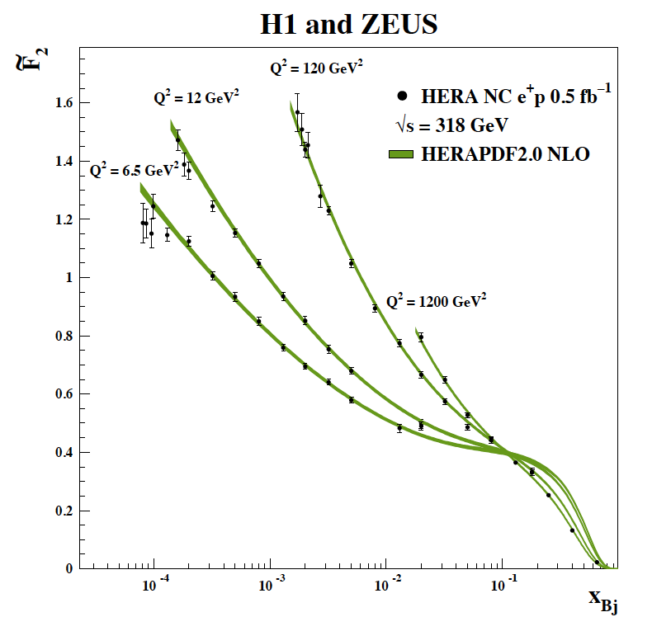

Precision QCD: evolution
HERA F₂ data beautifully described by DGLAP (linear evolution)
But any single data point says little
It is the high level of agreement of theory and data over a vast kinematic range that is convincing
Eur.Phys.J.C75 (2015) 12, 580
gluon saturation $⟺$non-linear evolution
When we talk about gluon saturation, we talk about non-linear evolution.

Slide 4
QCD phenomena evolve only logarithmically in x and Q²
→ experimental study of non-linear QCD evolution requires “logarithmically broad” coverage in (x,Q²)
Universality: correct theoretical description at low-x must self-consistently describe measurements of multiple observables at low (x,Q²) in multiple collision systems

Slide 5
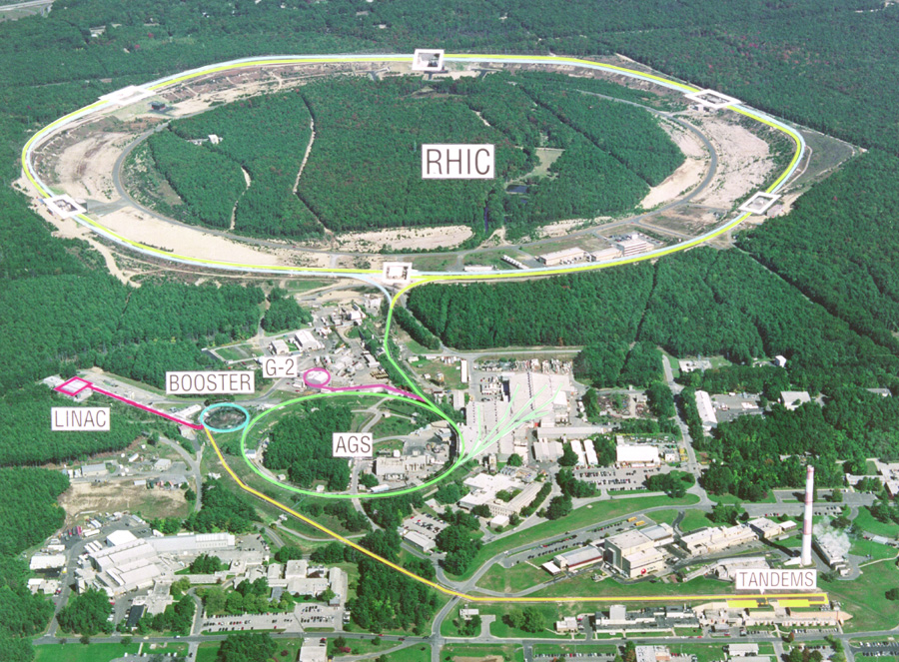
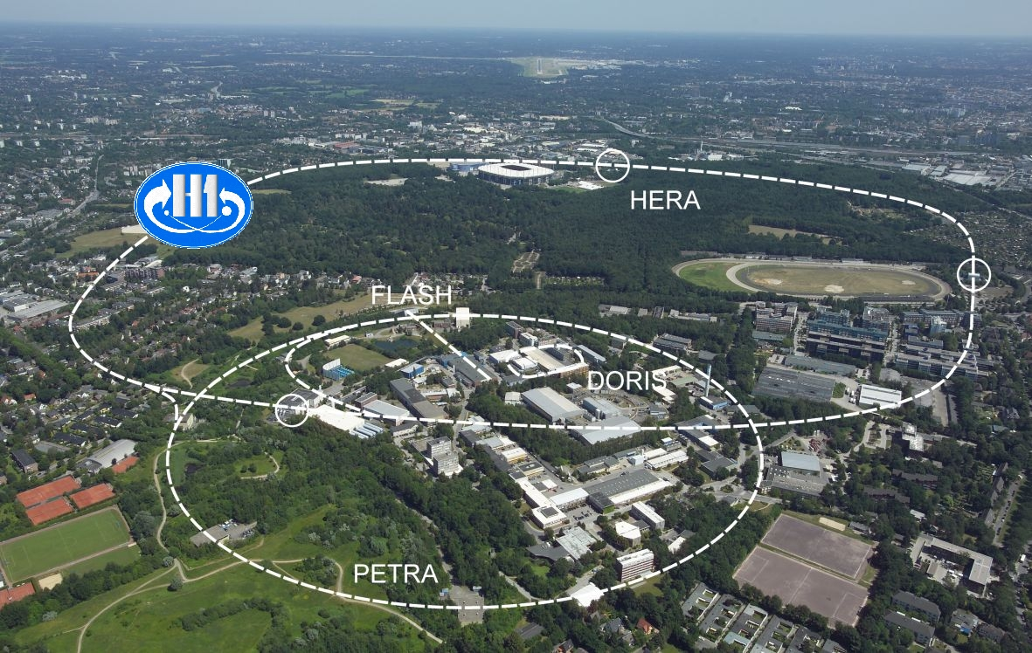


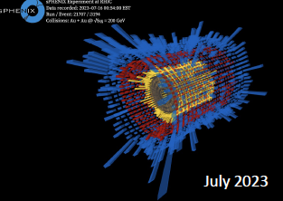
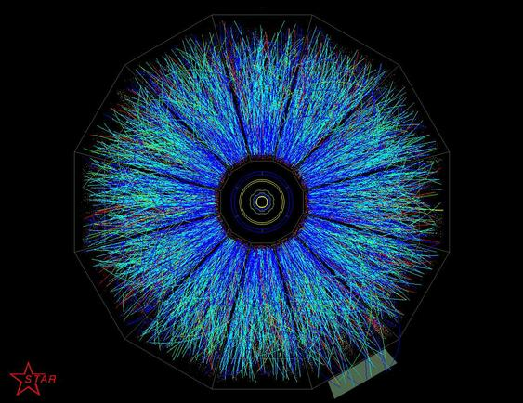

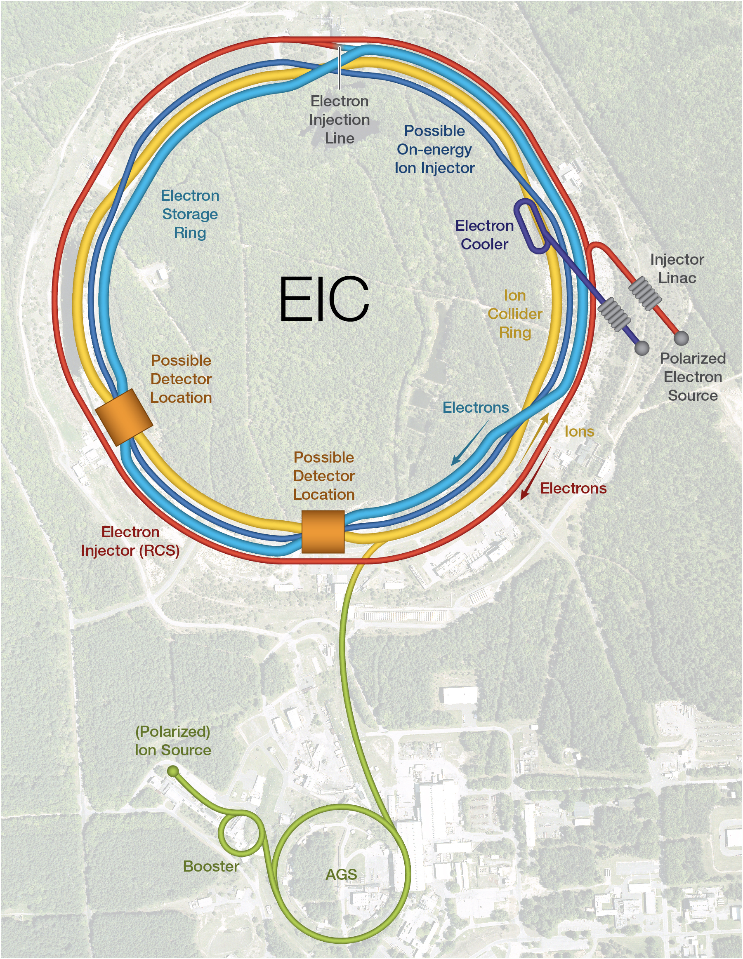
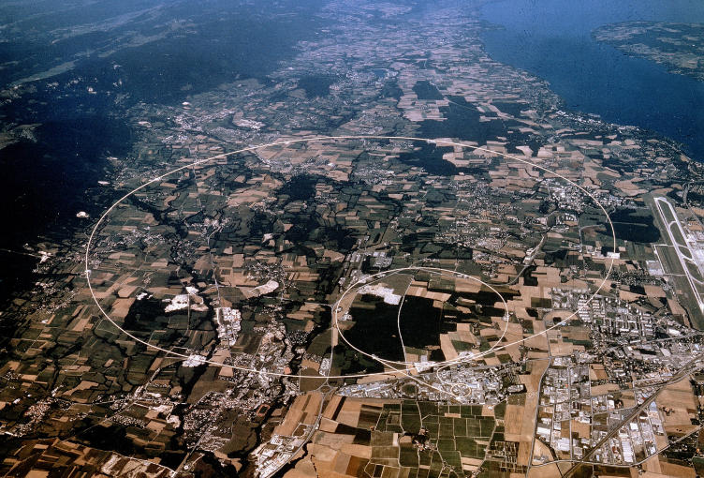
Multi-messenger program: combine measurements from e-A DIS and diffractive interactions at HERA+EIC, with forward p-A collisions at RHIC+LHC
→ ML-enhanced Bayesian Inference
LHC

Slide 6
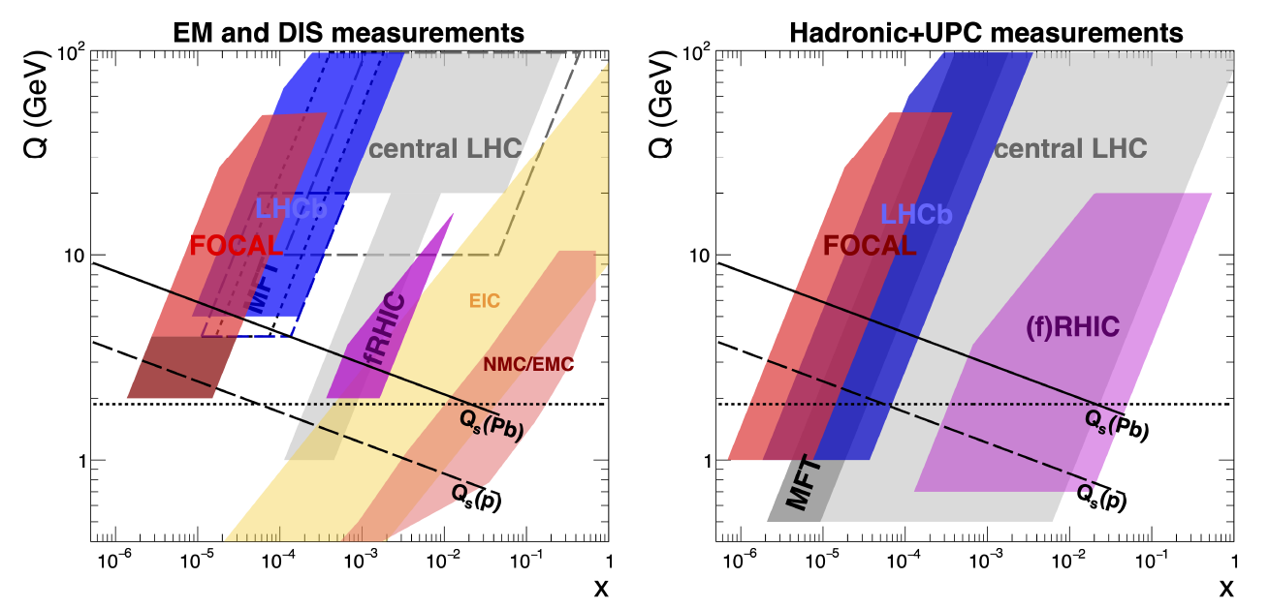
Kinematic coverage
LHC
Run 2/3
FoCal
upgrade
EM in hadronic collisions:
direct γ, DY

Slide 7
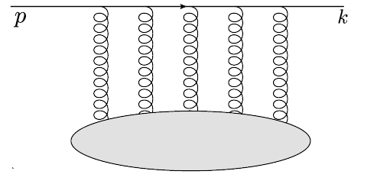



Theoretical interpretability: dipole formalism
Forward p+A:
Inclusive π⁰, jet, direct γ
γ+jet
balanced di-jet,…
e+A DIS
Interaction cross section
Structure Functions F₂, F_{L}
Multiple processes in e-A DIS and forward p-A are described theoretically by the same dipole-medium forward scattering amplitude T_{LO} → calculable beyond LO
Compare e-A DIS and forward p-A: universality
Dipoles in DIS:
Gribov, Sov. Phys. JETP 30 (1970) 709-717
Bjorken and Kogut, Phys. Rev. D 8 (1973) 1341
Frankfurt and Strikman, Phys. Rept. 160 (1988) 235
A. H. Mueller, Nucl. Phys. B 335 (1990) 115
Nikolaev and Zakharov, Z. Phys.C 49 (1991) 607
Dipoles in particle production:
Kopeliovich, Tarasov and Schafer, Phys. Rev. C 59 (1999) 1609
Gelis and Jalilian-Marian, Phys. Rev. D66 (2002) 014021
Kovchegov and A. H. Mueller, Nucl. Phys. B 529 (1998) 451
Kopeliovich, Raufeisen and Tarasov, Phys. Lett. B 503 (2001) 91

Slide 8
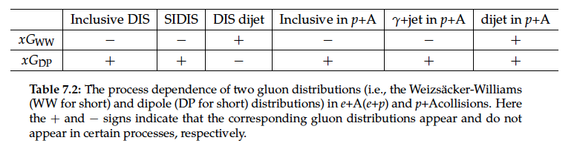
EIC Yellow Report: e+A DIS vs forward p+A
Nucl. Phys. A1026 (2022) 122447
Dominguez, Xiao and Yuan 1009.2141
Dominguez, Marquet, Xiao and Yuan 1101.0715
Sect. 7.5.4: Low-x gluons and factorization in eA (ep) vs pA and AA
“…pA collisions can serve as a gateway to the EIC as far as saturation physics is concerned, and it also plays an important and complementary role in the study of these two fundamental gluon distributions (Weiszacker-Williams and Dipole)…The small-x factorization in DIS and pA collisions is expected to hold at higher order [1228], since the higher-order corrections do not generate genuine new correlators in the large Nc limit.”
quadrupole
dipole

Slide 9
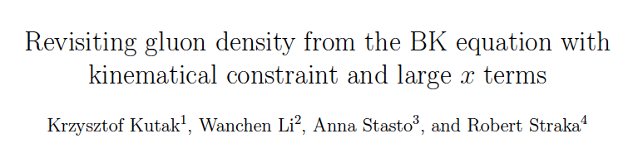
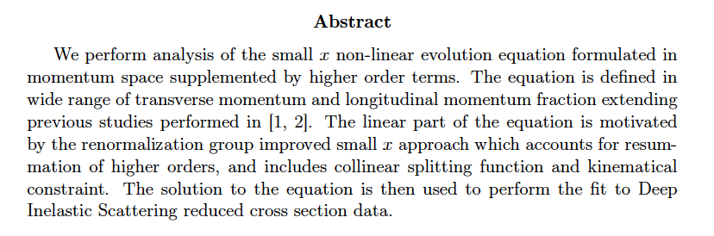
Illustrative worked example:
Phys.Rev.D 111 (2025) 11, 116021 arXiv:2502.15465

Slide 10
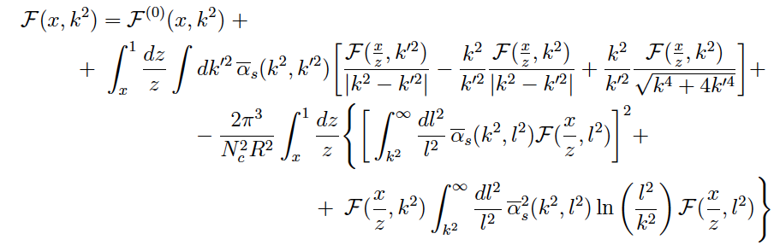

Evolution of unintegrated gluon density: BK equation
Phys.Rev.D 111 (2025) 11, 116021 arXiv:2502.15465
Evolution in x at transverse momentum k
starting distribution
Linear
evolution
Non-linear evolution
Ansatz for starting distribution (Golec-Biernat/Wuesthoff)
Fit parameters
Fit to HERA reduced x-section data data

Slide 11
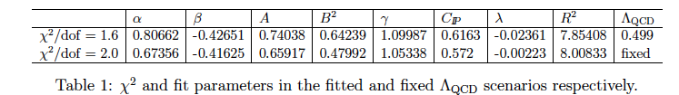
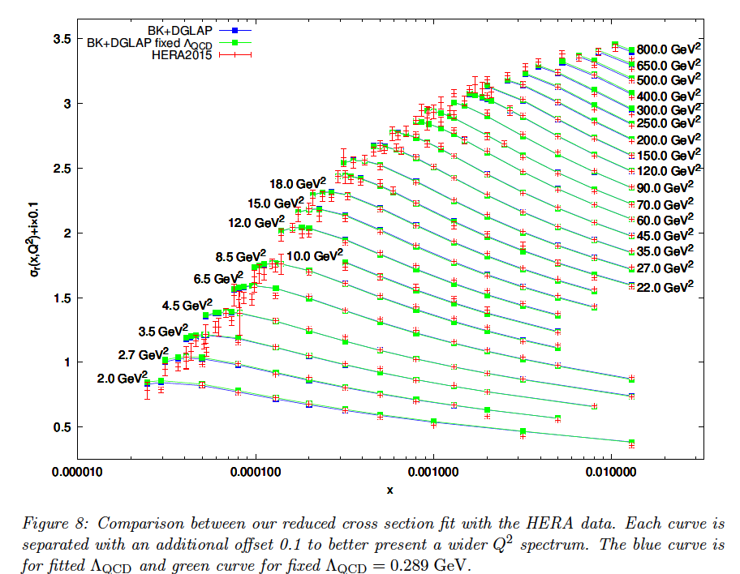
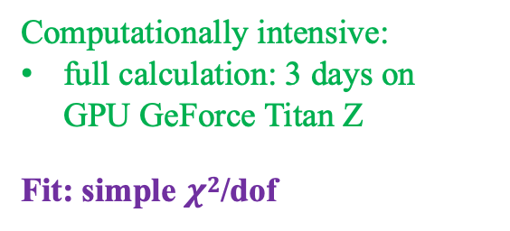
BK evolution fit to HERA data
Excellent fit to data over vast kinematic range
HERA data cannot discriminate linear from non-linear evolution
Computationally intensive:
full calculation: 3 days on GPU GeForce Titan Z
Fit: simple $χ2$/dof

Slide 12
Bayesian Inference
Study of complex phenomena often requires the rigorous comparison of theory/model calculations and experimental measurements
→ Inverse Problem
Solution: Bayes’s Theorem
(N-dimensional vector)
likelihood
prior
posterior
Inference:
sample likelihood over N-dimensional space with “sufficient” granularity
posterior distribution = prior distribution constrained by likelihood
Computationally demanding for:
expensive forward model (e.g. Quark-Gluon Plasma hydrodynamics; BK/JIMWLK evolution for low-x)
large parameter space dimension N (including nuisance parameters)

Slide 13
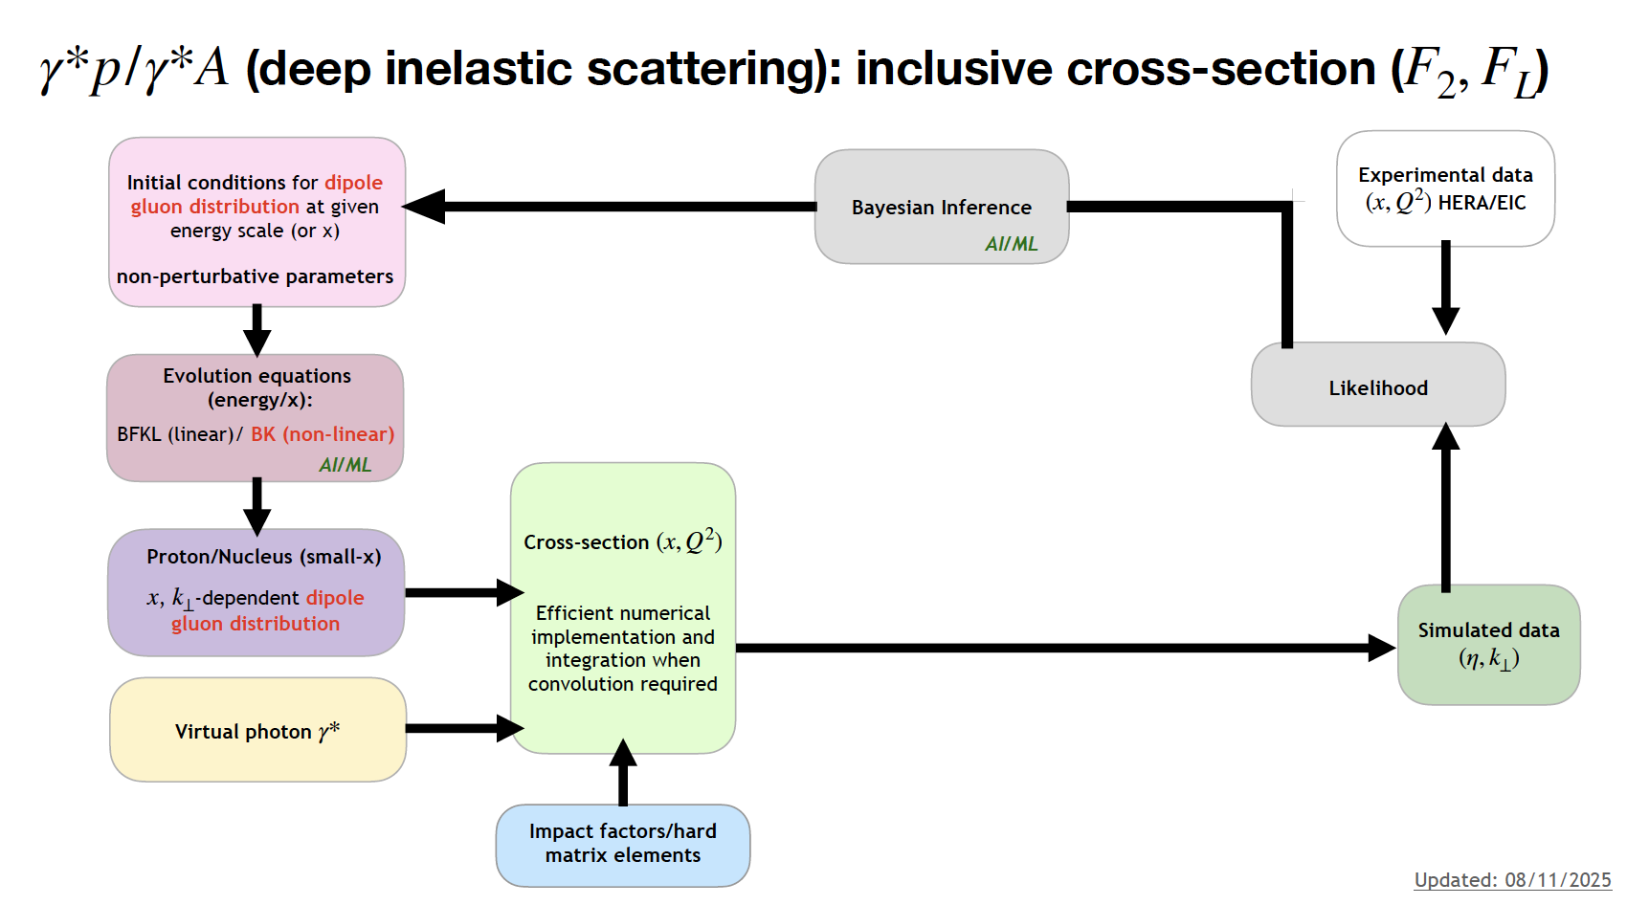
quadrupole/JIMWLK
dipole/BK

Slide 14
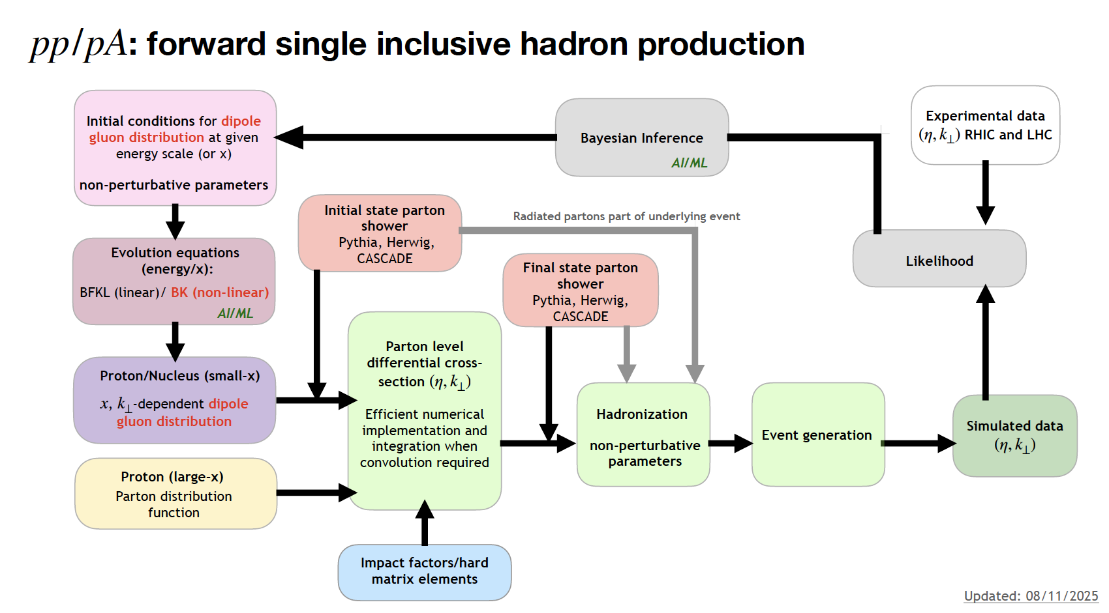
quadrupole/JIMWLK
dipole/BK

Slide 15
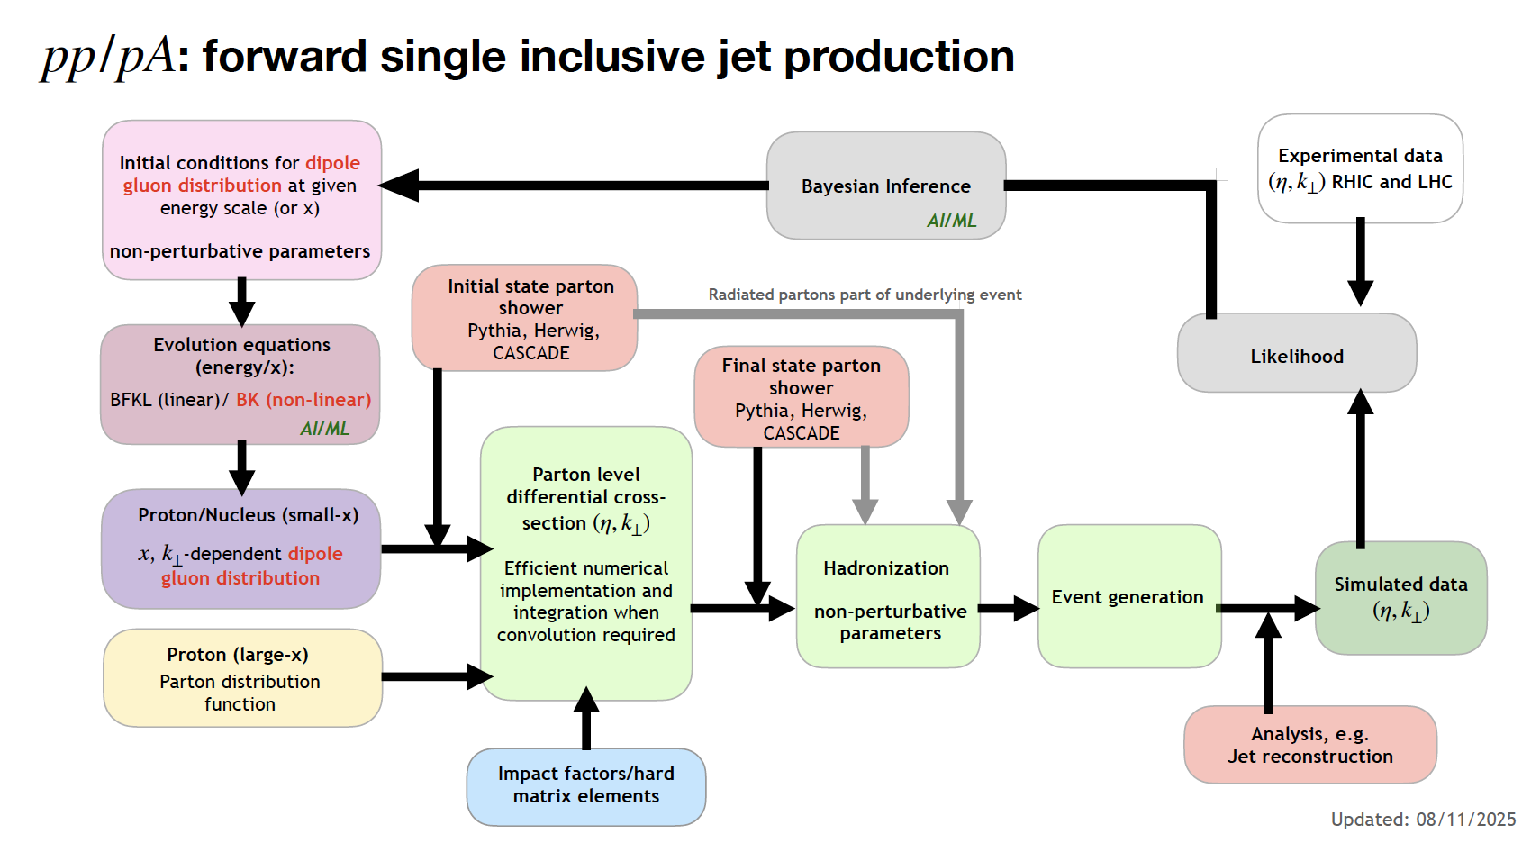
quadrupole/JIMWLK
dipole/BK

Slide 16
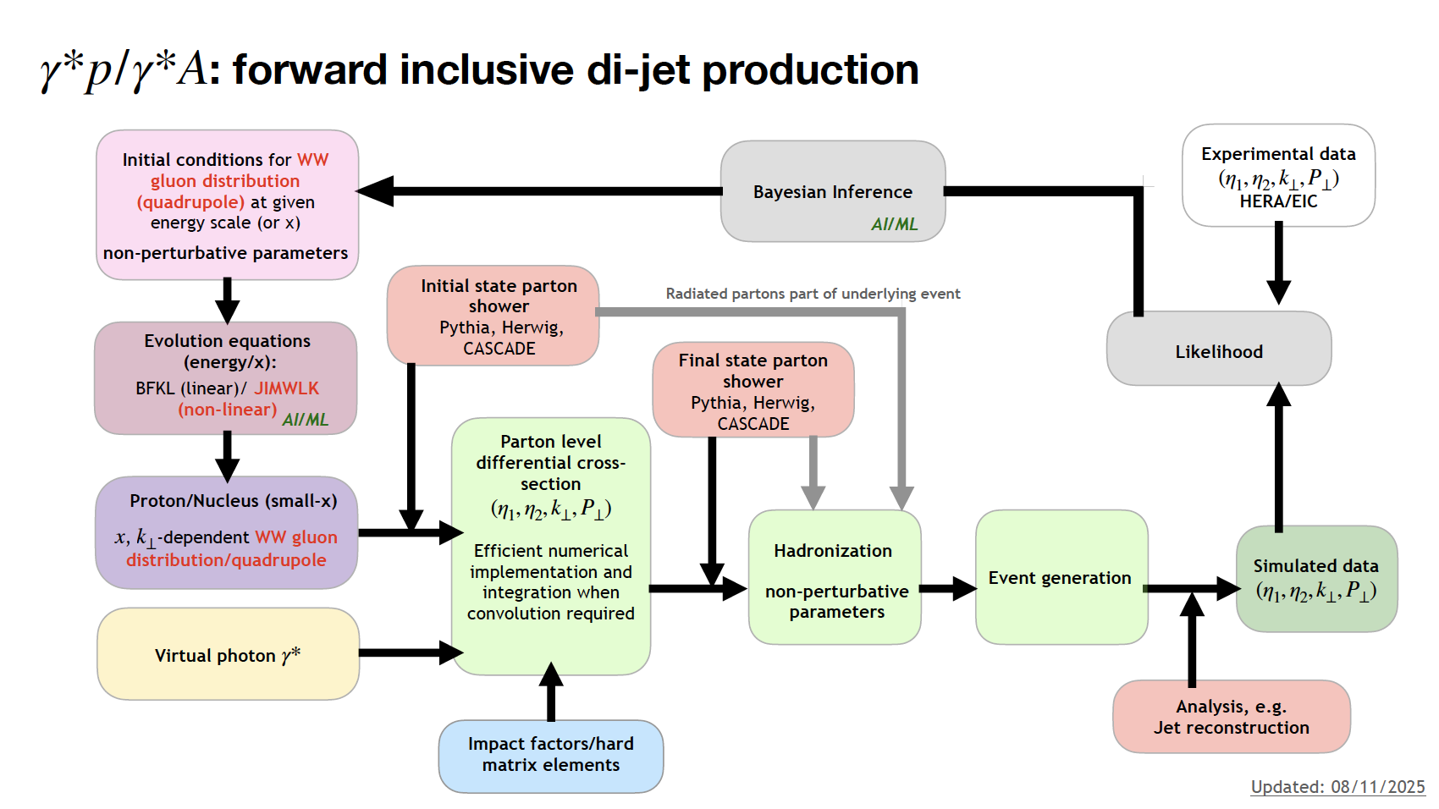
quadrupole/JIMWLK
dipole/BK

Slide 17
ML in Bayesian Inference (low-x)

Slide 18
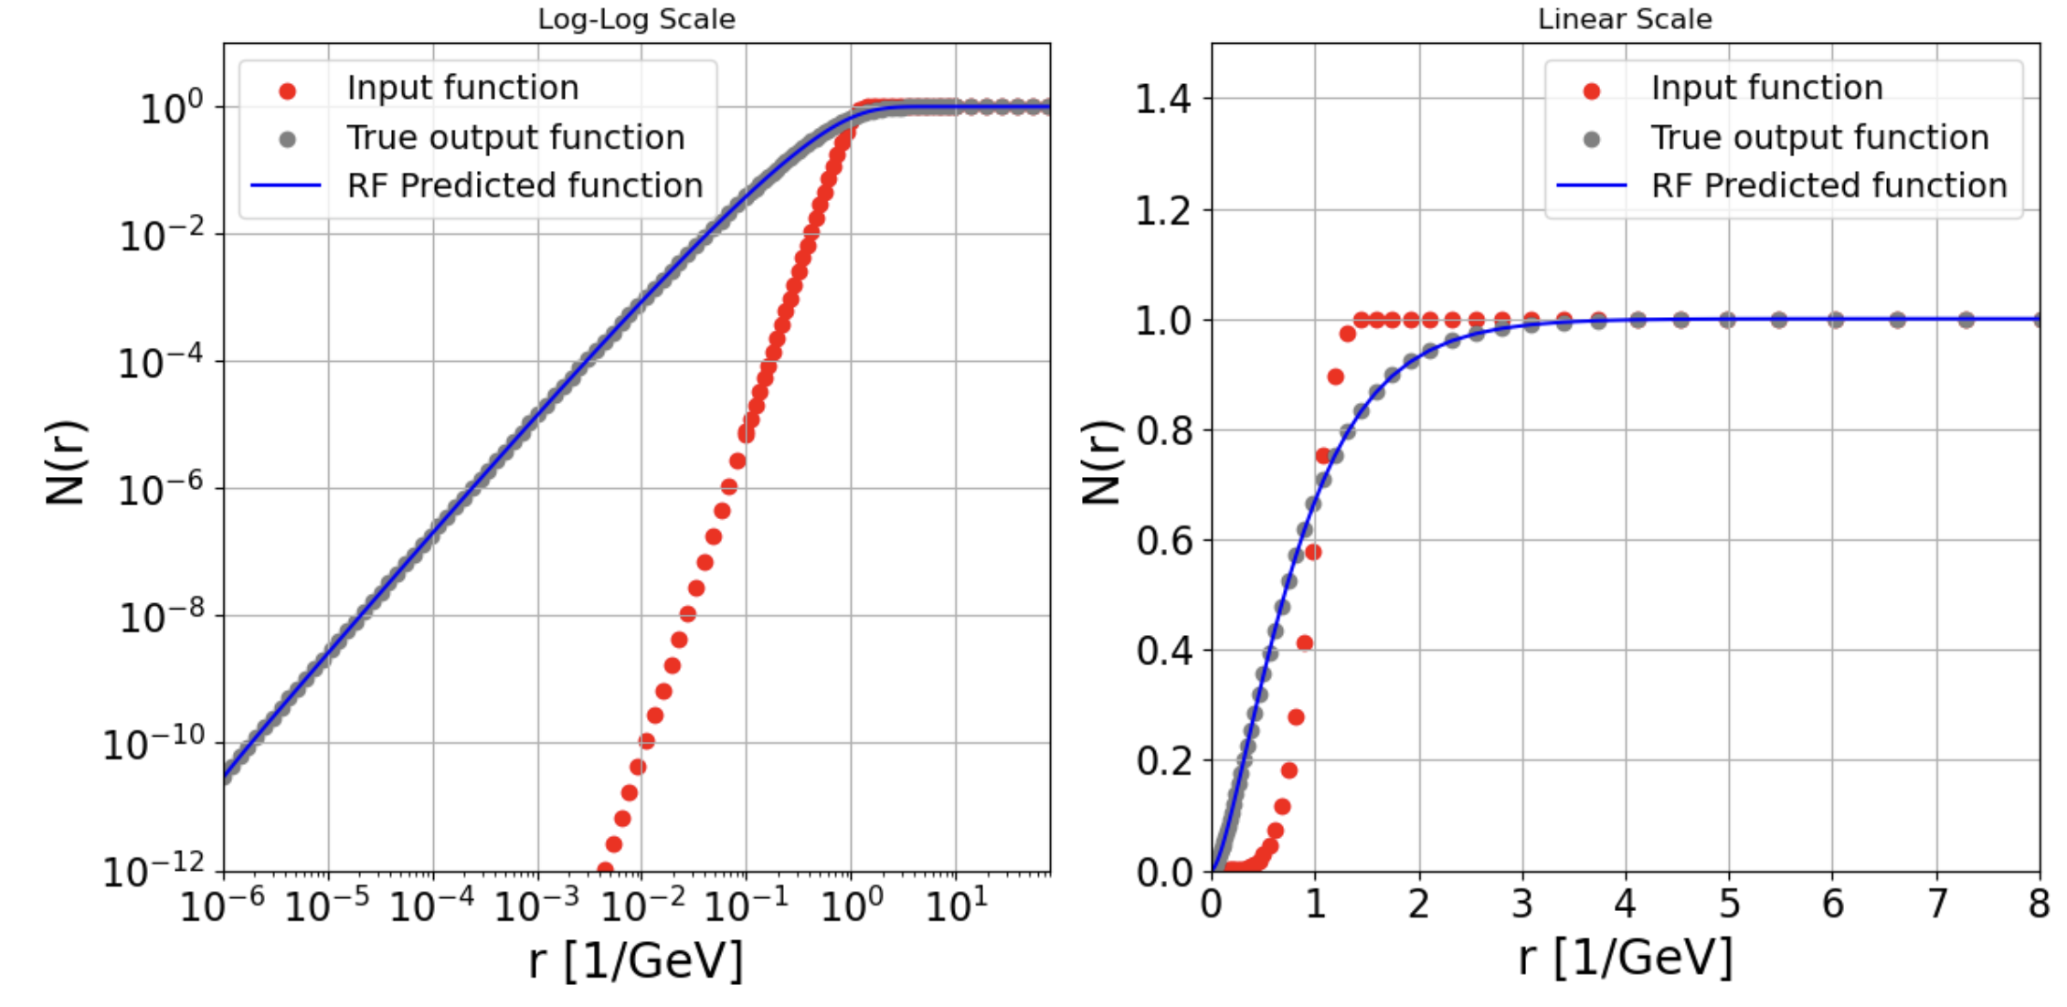
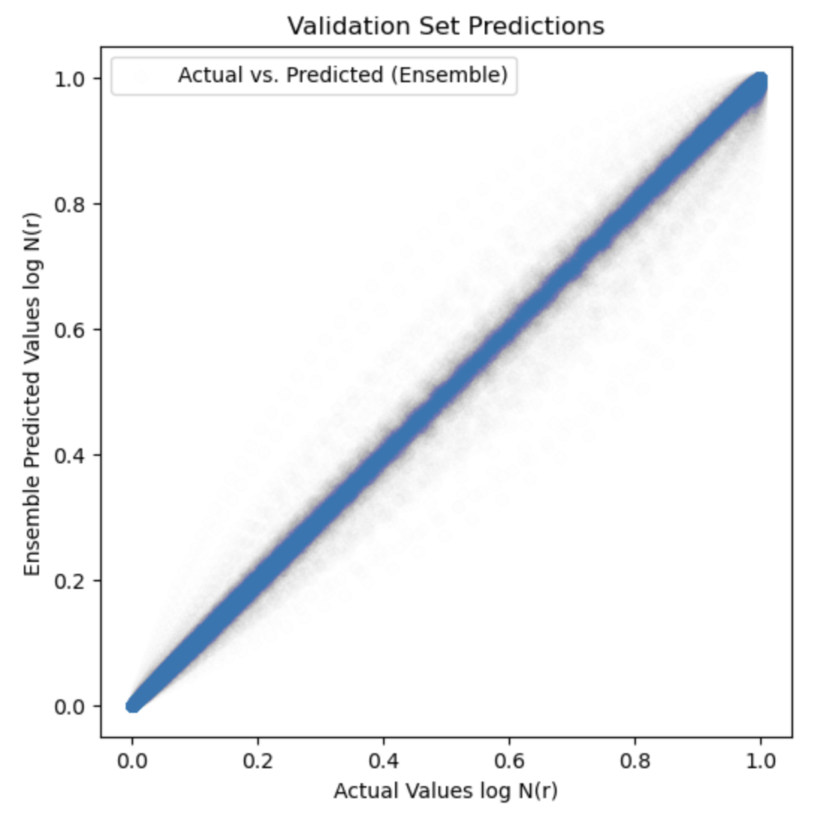

ML for efficient evaluation of BK evolution kernel
Bjoern Schenke et al
SURGE Collaboration: https://www.bnl.gov/physics/surge/
Fast BK evolution at low-x
leading log BK​ (NLL ​in progress)
training data: ​initial dipole amplitudes 𝑁(𝑥_0,𝑟) and directly calculated BK evolved amplitudes 𝑁(𝑥,𝑟) ​
train Random Forest model to predict evolved dipole amplitude
$$x={10}^{−2}→{10}^{−6}$$
https://pypi.org/project/DipoleAmplitudePredictor/

Slide 19
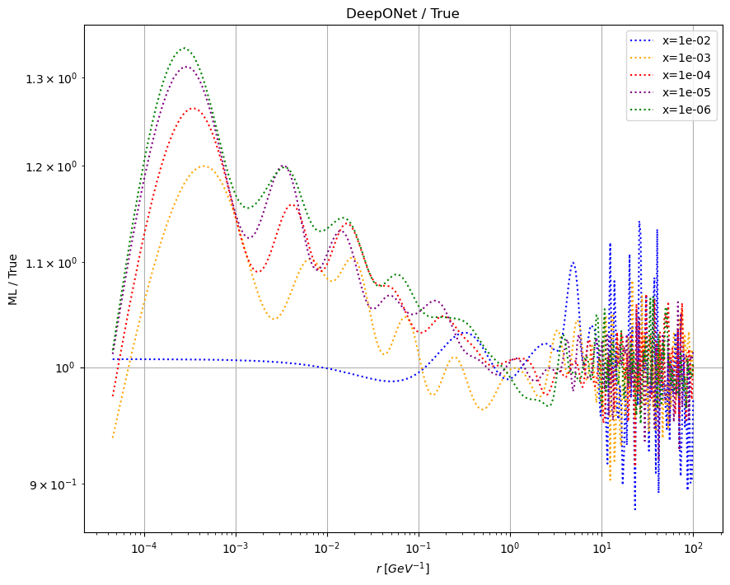
Next-generation ML models for BK evolution
F. Olness, B. Stevenson, R. Preston, J. Khan, P. Risse, B. Schenke
Compare ML models:
Random Forest
MLP (Multi-Layer Perceptron)
DeepONet ​
learning nonlinear operators from data ​(arXiv:1910.03193)​
Model/Truth
Dipole size r

Slide 20
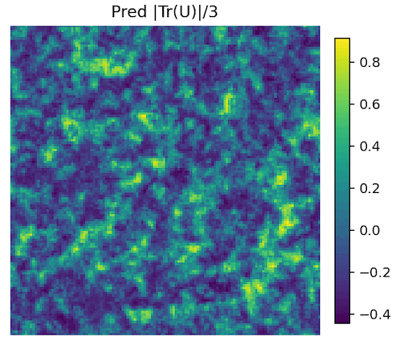
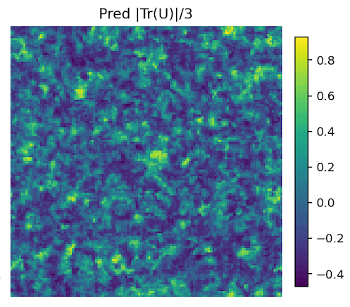
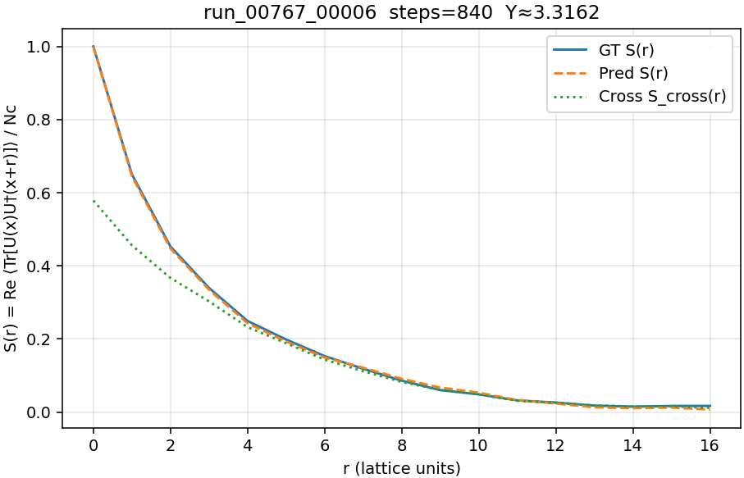
ML for JIMWKL evolution
B. Schenke, S. Tiwari, work in progress based on Lappi+Mantyssari, Eur.Phys.J.C 73 (2013) 2, 230
Fourier Neural Operator Model for JIMWLK evolution:
predicts evolved Wilson lines including fluctuations
Initial conditions: MV model
Vary coupling g ~ Q_{s}
Vary Λ_{QCD} , other model parameters
Y=rapidity; evolve from initial condition at Y=0
Correlation length ~ 1/Q_{s}
trace of Wilson line on 2D lattice
(lattice units)

Slide 21
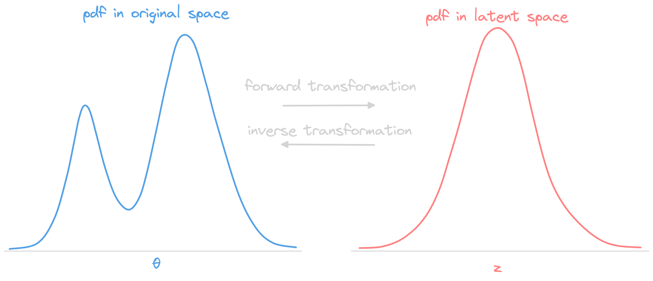
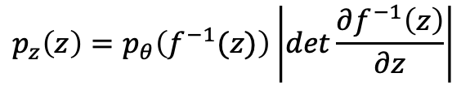


Normalizing flows
Generative model encoding bijective mapping between a complex (~multimodal) distribution and a simple (~Gaussian) distribution
$$z=f(θ)$$
$$θ=f^{−1}(z)$$
$$p_{z}\left(z\right)=p_{θ}\left(f^{−1}(z)\right)\left|det\frac{∂f^{−1}\left(z\right)}{∂z}\right|$$
NF for sequential Bayesian analysis:
arXiv:2310.04635

Slide 22
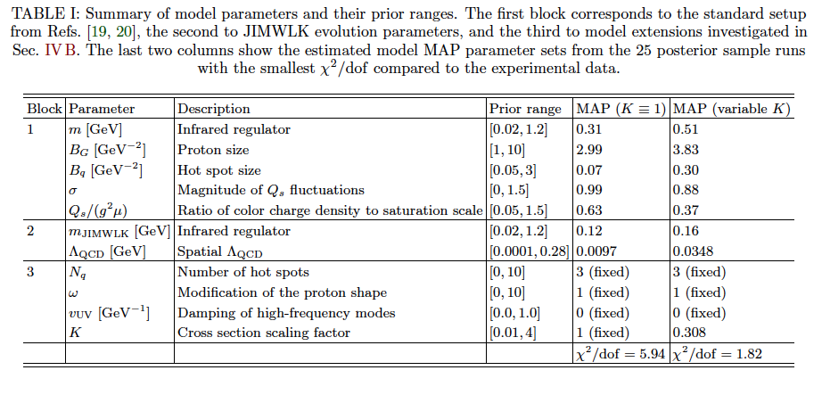

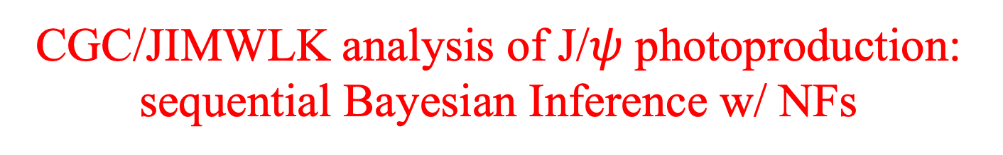
CGC/JIMWLK analysis of J/$ψ$ photoproduction: sequential Bayesian Inference w/ NFs
Data: J/$ψ$ photoproduction from γ+p and γ+Pb
Mantysaari et al., arXiv:2507.14087
Roch and Shen, arXiv:2509.14911
Sequential Bayesian Inference:
calibrate first on γ+p and then γ+Pb (or vice versa)
second-step prior is first-step posterior encoded as NF
compare to single-step joint calibration
CGC model parameters

Slide 23
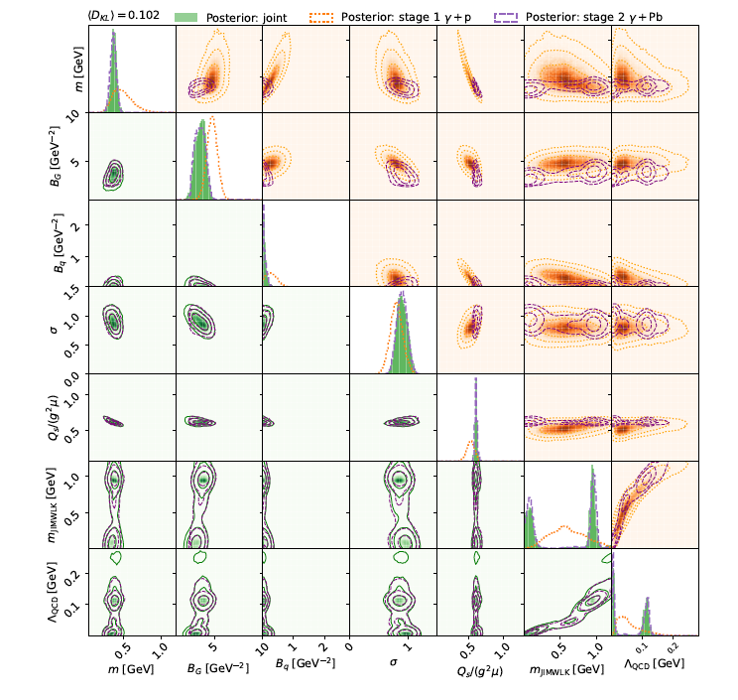
Stage-2 (sequential) and joint (single-step) calibrations agree well
Requires robust (preconditioned) MCMC sampler:
pocoMC (https://pocomc.readthedocs.io/en/latest/)

Slide 24
Summary
+ photons + UPCs + heavy flavor + …

Slide 25
Backup

Slide 26
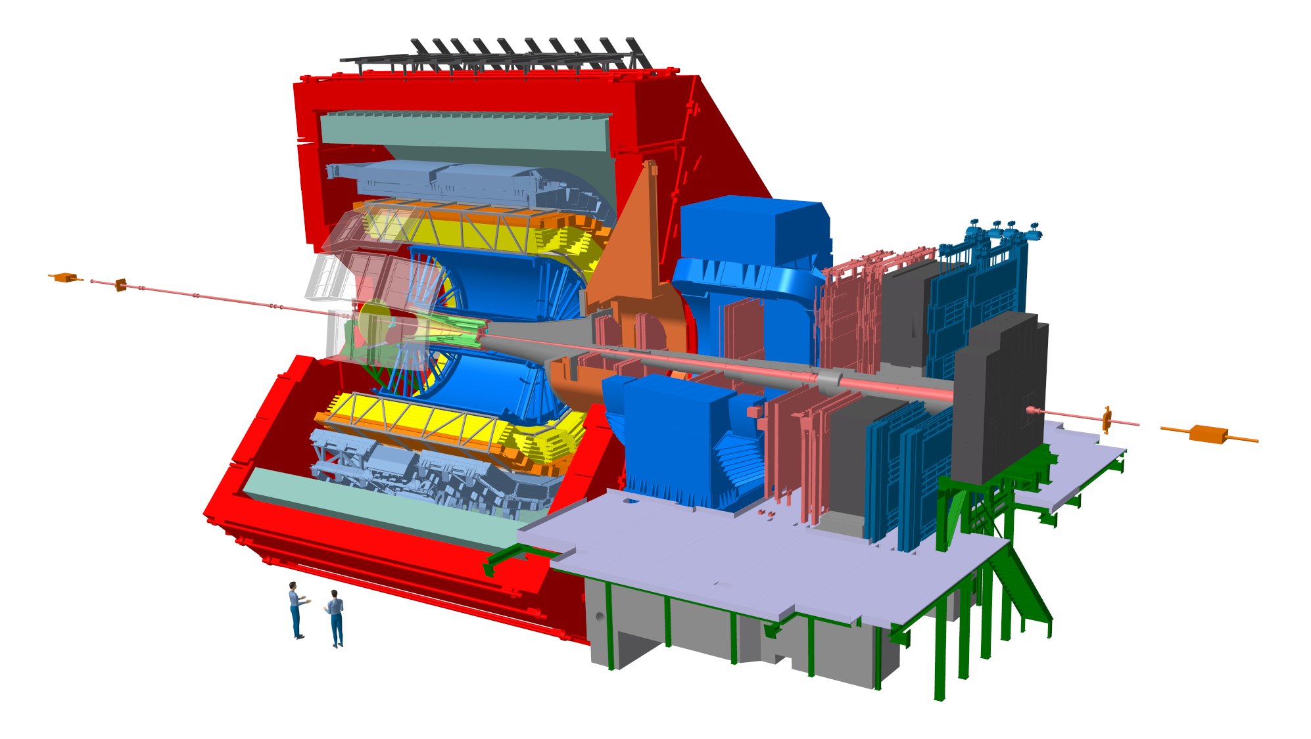
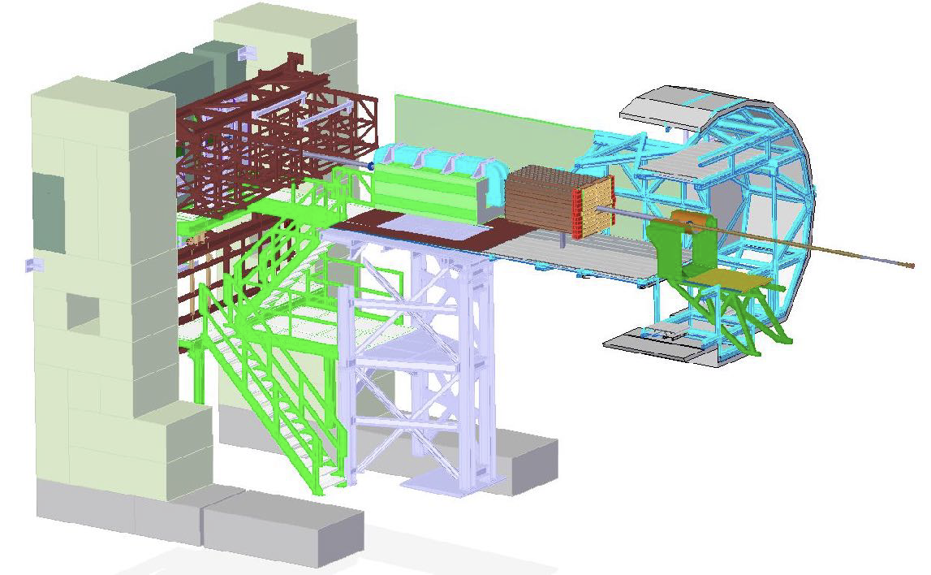
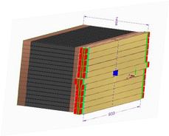
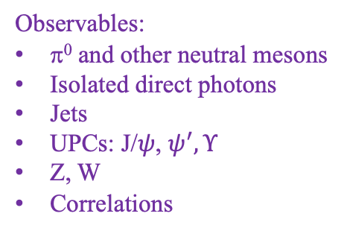
The ALICE Forward Calorimeter (FoCal) upgrade
Letter of Intent: CERN-LHCC-2020-009
Physics Program: ALICE-PUBLIC-2023-001
https://inspirehep.net/literature/2661418
Physics Performance: ALICE-PUBLIC-2023-004
Technical Design Report: ALICE-TDR-022
CERN-LHCC-2024-004
FoCal-E: high granularity Si-W sampling calo
FoCal-H: conventional metal-scintillator sampling calo
FoCal
(not to scale)
3.4<η<5.8
Main physics goal: study universal structure of matter at low-x
Flagship measurement: isolated direct photons for p_{T}>~2 GeV/c at very forward η
Observables:
π⁰ and other neutral mesons
Isolated direct photons
Jets
UPCs: J/$ψ$, $ψ^{′}, Υ$
Z, W
Correlations
Installation: LHC Long Shutdown 3 Operation: LHC Run 4 (start 2029)

Slide 27
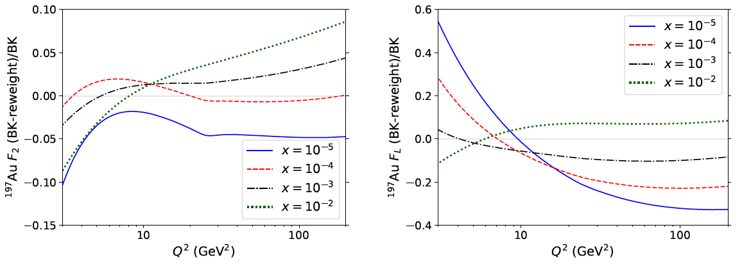
Non-linearity via DIS structure fns
Armesto et al.
PRD 105 (2022) 11, 114017
arXiv:2203.05846
Example: what is the sensitivity of DIS Structure Functions for discriminating linear and non-linear evolution?
Toy model:
Compute F₂ and F_{L} in EIC and LHeC kinematics; no exp. uncert
Both collinear factorization and CGC (non-linear) approaches
Match at x~10⁻² and Q²~10 Q_{s}²
Evolve away from matching region and compare
Relative difference of nonlinear and linear evolution
¹⁹⁷Au F₂
¹⁹⁷Au F_{L}
EIC
EIC
EIC: F₂ difference ~few percent; F_{L} difference ~10% $→$challenging

Slide 28
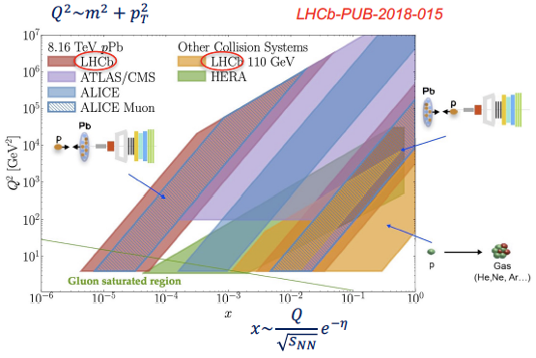
LHC Run 2/3 measurements at low x

Slide 29
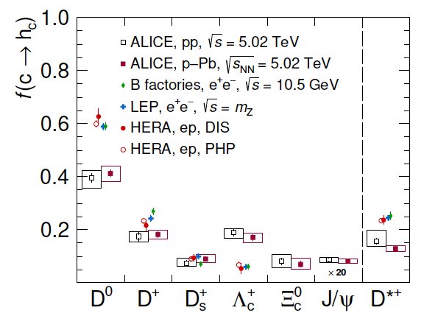
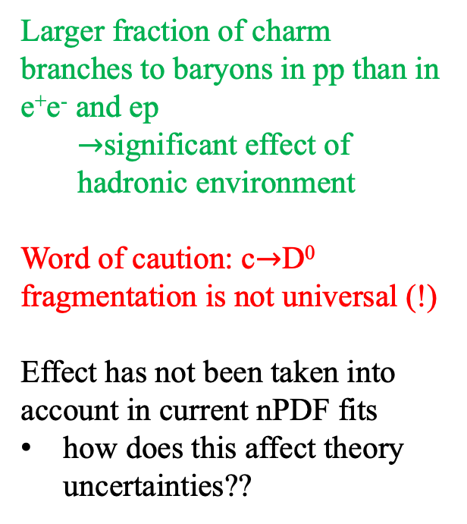
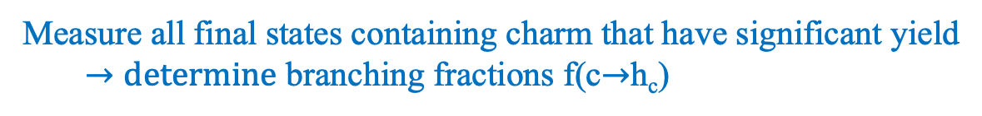
ALICE: charm fragmentation in p+p collisions
Eur.Phys.J.C 84 (2024) 12, 1286
Measure all final states containing charm that have significant yield
$→determine$ branching fractions f(c$→$h_{c})
Larger fraction of charm branches to baryons in pp than in e⁺e⁻ and ep
$→$significant effect of hadronic environment
Word of caution: c$→$D⁰ fragmentation is not universal (!)
Effect has not been taken into account in current nPDF fits
how does this affect theory uncertainties??

Slide 30
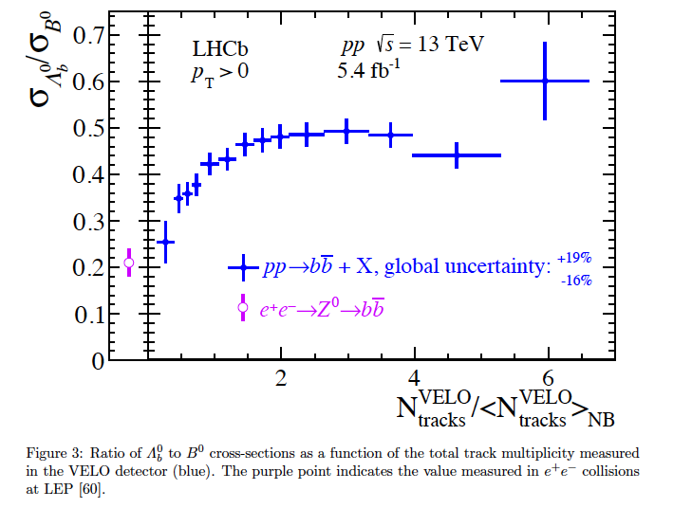
LHCb: beauty fragmentation in pp
Phys.Rev.Lett. 132 (2024) 8, 081901
Ratio of beauty baryon/meson yield vs Event Activity
Same picture in the beauty sector: relative branching into baryons vs. mesons depends on the hadronic environment!

