Slide 1
Compress by Importance and more
AI4EIC
10-27-2025

Slide 2
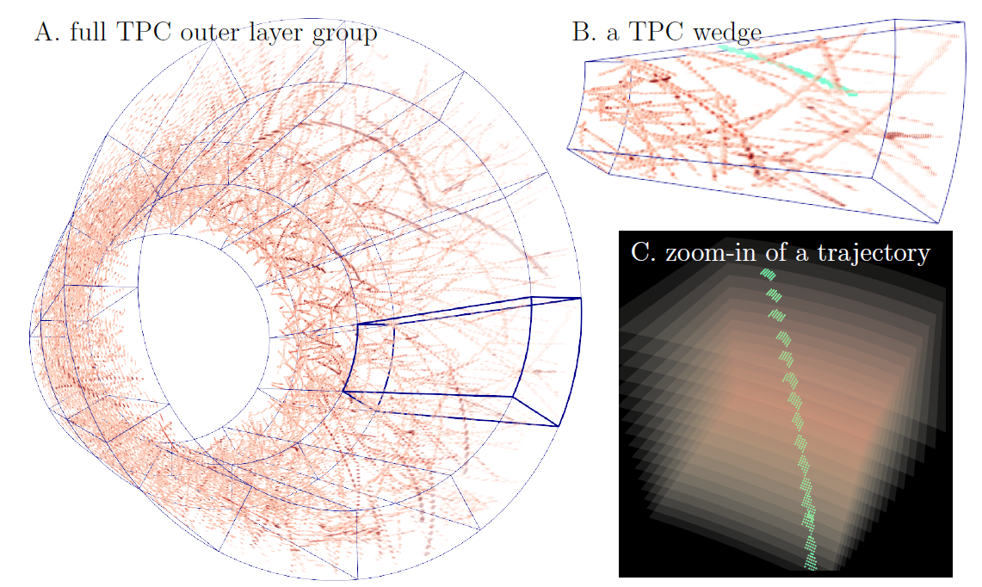
Task:
Compress Tracking Detector data
Examples:
TPCs at sPHENIX and EIC
Baseline:
Do it accurately
Restrictions:
Do it on On-Time
Note: In fact, I become less and less worried about the throughput constraint recently, because the fast development in novel AI hardware. As an example, I just learned this past weekend that FPGA can handle convolution. Amazing, right!

Slide 3
Autoencoding as a Natural Solution to Data Compression
Encoder
Code
Decoder
?
Since we are dealing with image data, the encoder and decoder are designed using convolutional neural network
Then, the reconstruction is compared with the input. While the difference between them is minimized with gradient descent, we get a good encoder/compressor with its matching decoder/decompressor.

Slide 4
Compression by Size
(and what’s wrong with it TPC data)
Convolution is great at changing the size of the input
Channel dimension
Spatial dimensions

Slide 5
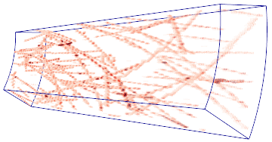
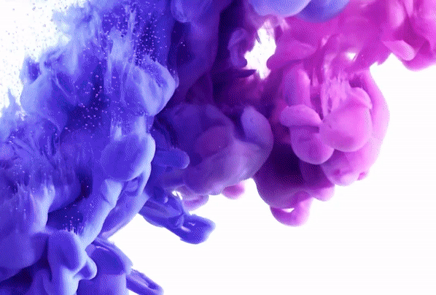
Inductive bias of CNN: Spatial Homogeneity.
Convolution is mixing locally. Hoping a model based on homogeneous convolution to work is almost like hoping mixed color could be separated properly again
Although we may assume macro spatial homogeneity, the TPC data is NOT homogeneous on a micro level.

Slide 6
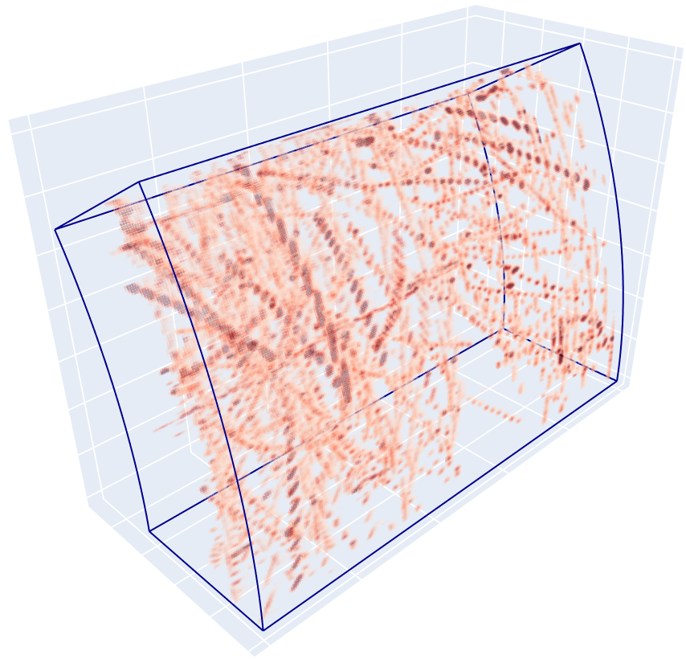

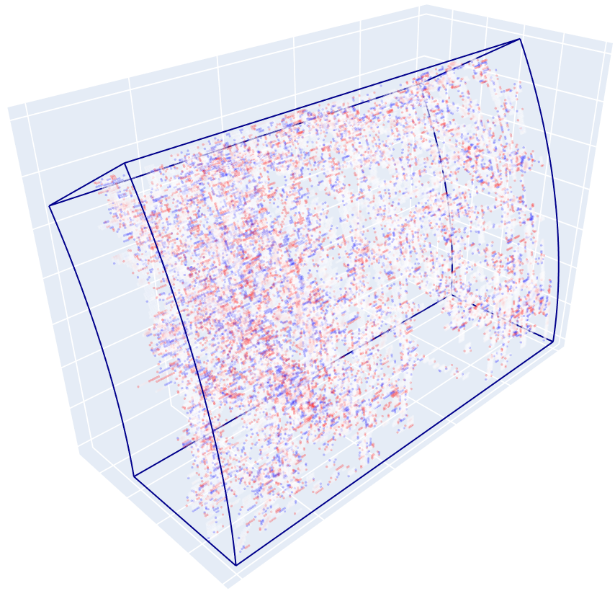
Bruised reconstruction
Reconstruction by the compression-by-size approach
input
Difference

Slide 7
Moreover
Compression-by-size produces
fixed size output, even if there is no signals in the input
Used the same amount of the time to compress, even if there is no signals in the input

Slide 8
Can We Compress in a Different Way?
Anyway, we just need to save the data with fewer bytes…
It can be achieved by shrinking the input, but it can also be accomplished by saving only part of the input…

Slide 10
Then, I determined to be lazy…
I just let my encoder to do nothing but to drop signals randomly…
MSE dropped from ~220 to ~19 with only 50% randomly selected signals
And to ~90 with 25% randomly kept signals
What if, the encoder can choose signals smartly to keep?

Slide 11
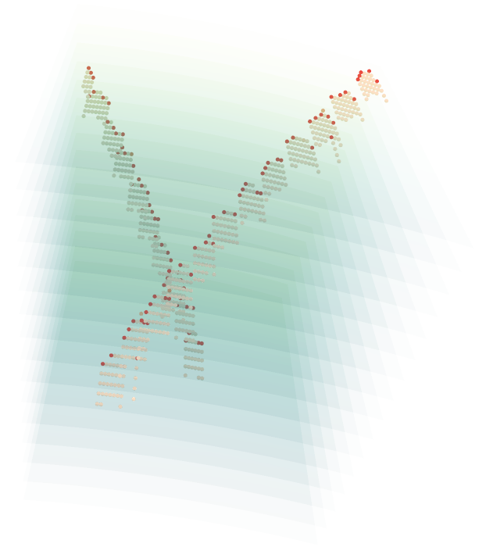
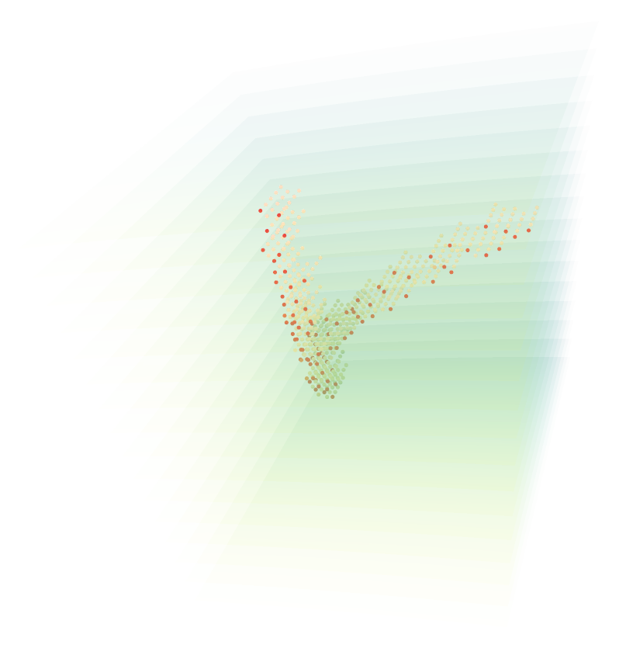
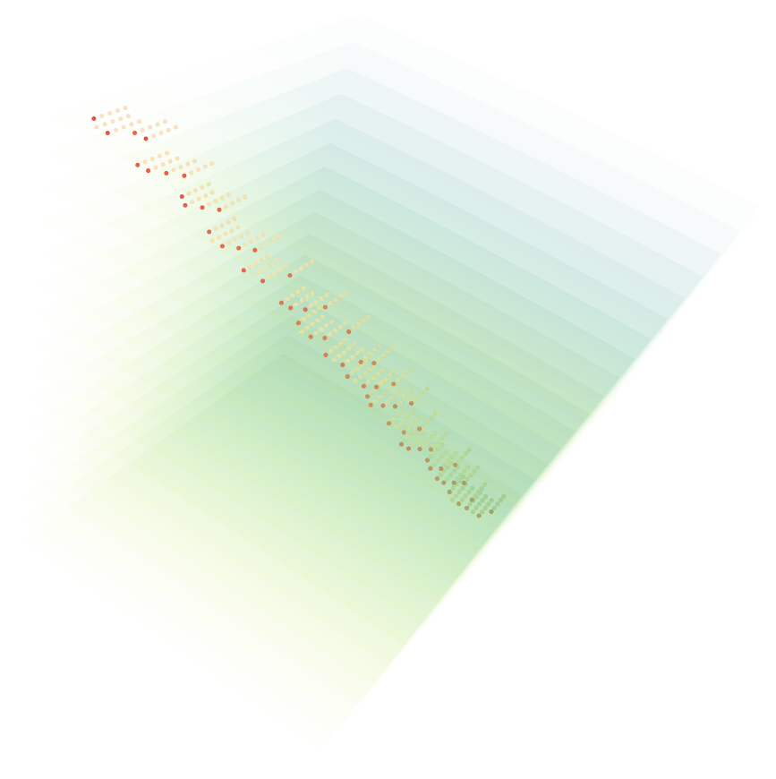
Can We Compress by Importance

Slide 12
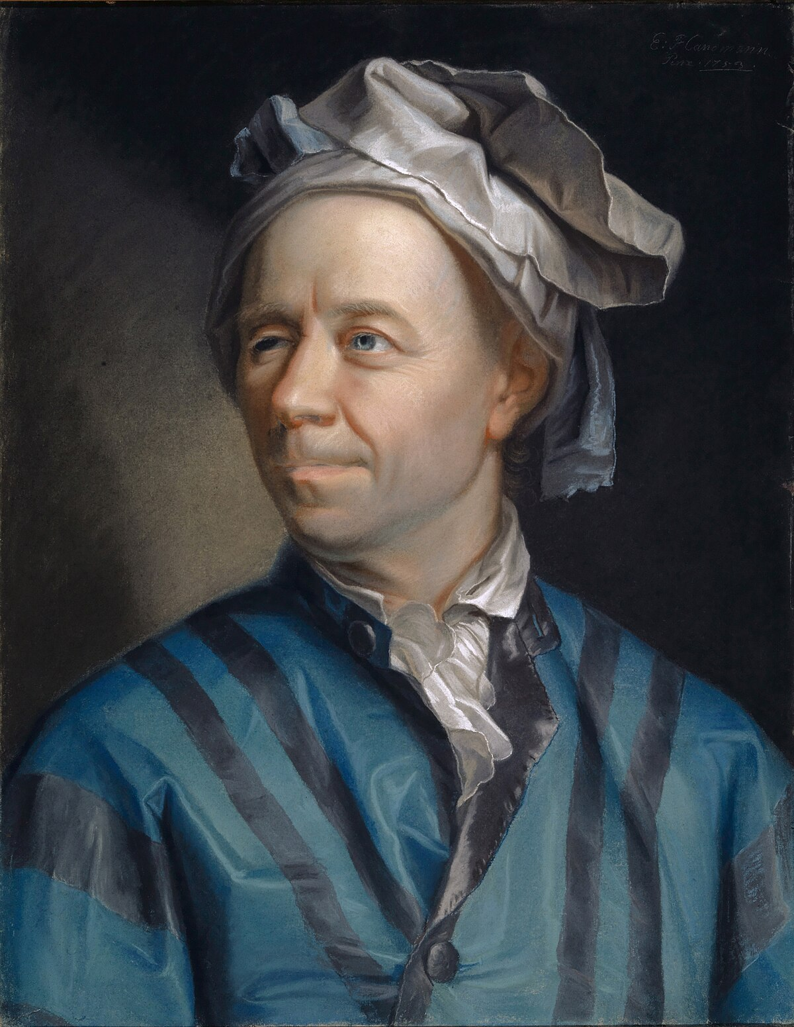
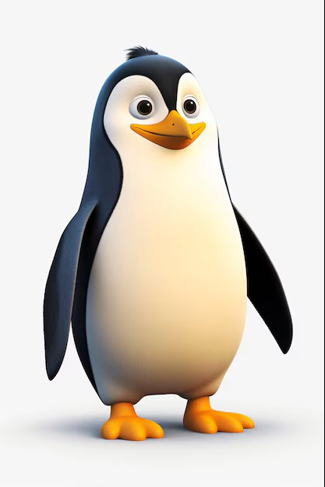
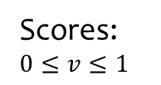
Voxels ids:
1
2
3
4
5
6
7
8
9
10
Encoder that is an importance score assigner
Scores:$0≤v≤1$
.42
.35
.93
.01
.57
.88
.71
.89
.95
.99
Now, we need to determine voxels to keep, but how?
By choosing a threshold, of course!
Threshold = 8.15484548538

Slide 13
Threshold = 8.15484548538
1
1
This is good, but how can we compress?
Scores
Voxel ids
2
2
Decoder
.93
3
3
3
4
4
.88
6
5
5
We penalize too high a sum of scores. So, only a small fraction of voxels will be saved.
.89
8
6
6
.95
9
7
7
.99
10
8
8
9
9
10
10
Gradient Back propagation
Construction accuracy

Slide 14
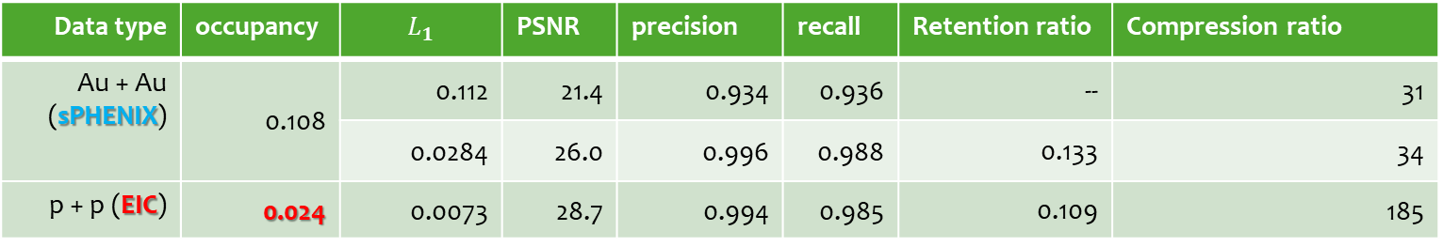
Compression by importance works
for both Au + Au and p + p collision
Data type | occupancy | $$L_{1}$$ | PSNR | precision | recall | Retention ratio | Compression ratio
Au + Au (sPHENIX) | 0.108 | 0.112 | 21.4 | 0.934 | 0.936 | -- | 31
 |  | 0.0284 | 26.0 | 0.996 | 0.988 | 0.133 | 34
p + p (EIC) | 0.024 | 0.0073 | 28.7 | 0.994 | 0.985 | 0.109 | 185
Additionally, compression by importance achieves variable compression ratio!
With the Sparse Convolution Engine, Compression by Importance can also achieves higher throughput on sparser data

Slide 15

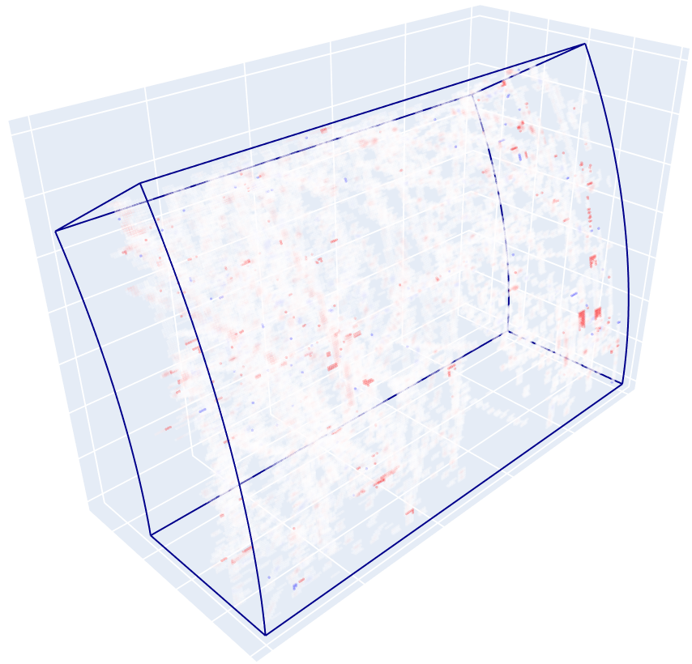
Better reconstruction
Reconstruction by the compression-by-importance approach
input
Difference

Slide 16
From a Reviewer:
Can we use the importance score as a sliding bar to control how much data to save?
Implication:
The higher the cutoff, the fewer data to save, the lower the reconstruction quality. The lower the cutoff, the more data to save, the higher reconstruction quality to achieve.
Tunability after Training!

Slide 17
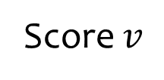
And the infinitely possible scores are wasted!
Count
The Encoder is not motivated at all to produce any number between 0 and the threshold.
1
Score $v$
Threshold = 8.15484548538
An absolutely arbitrary nonsense!

Slide 18
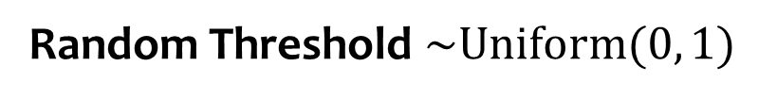
Random Threshold $\sim \text{Uniform}(0, 1)$
1
Density
Random threshold
Random threshold
Random threshold
1
2
3
.42
.71
.99
1
Threshold
Kept:

Slide 19
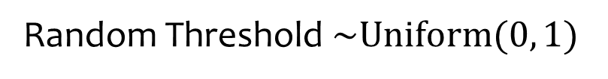
Random Threshold $\sim \text{Uniform}(0, 1)$
1
Now, we get rid of absolutely arbitrary nonsense! But will it work?
Density
Random thresholding can push truly important voxels, and only truly important voxels, to high scores.
viv
.71
1.0
1
Threshold

Slide 20
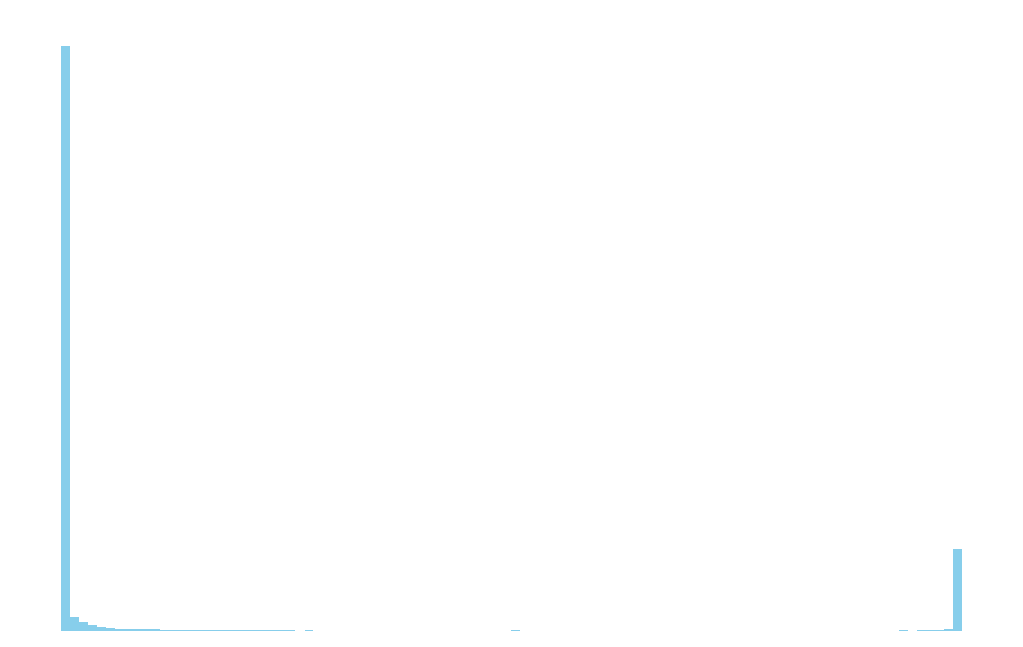
Will random thresholding use the full range of the scores?
Count
Not really!
I really hope it to be a triumph story, but …
1
Scores

Slide 21
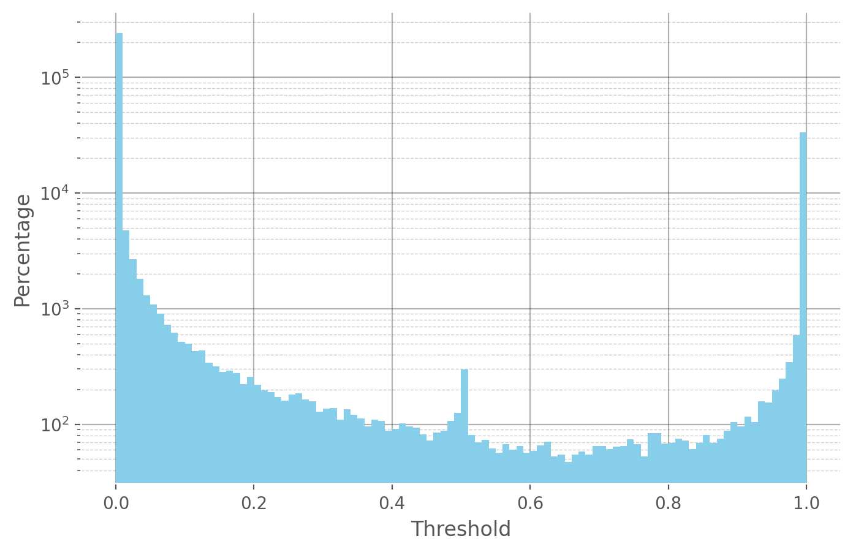
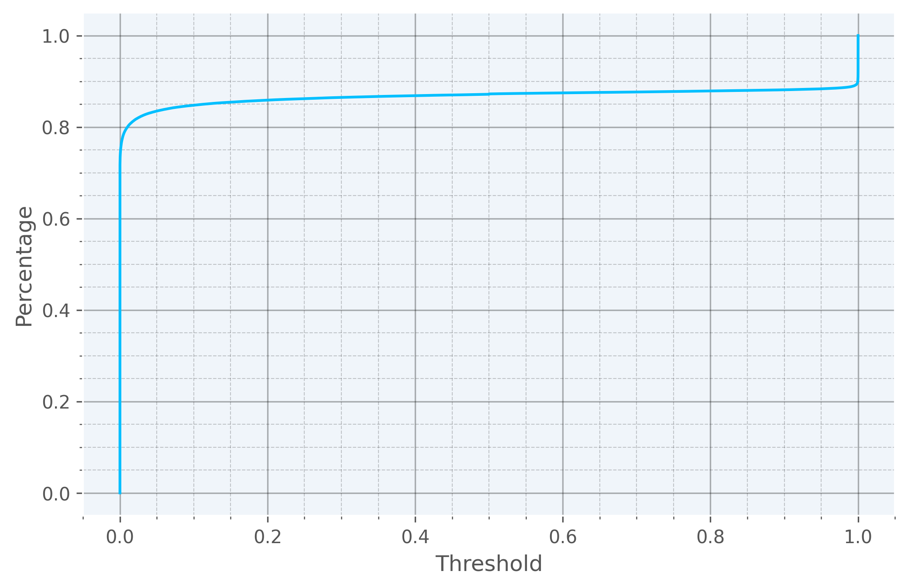
Distribution of the scores
Cumulative distribution of the scores
Log scale
score
score

Slide 22
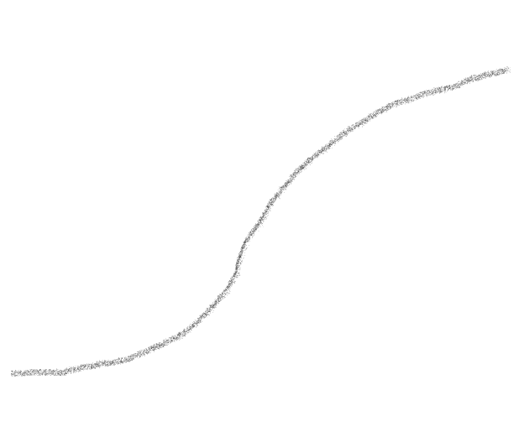
Limited control by importance score
Cumulative distribution of the scores
Very narrow tunable range
A sliding bar
Have you ever used a faucet that goes from trickling to a gushing when you rotate it by 0.1 degree? Well, we have it here.
Importance score

Slide 23
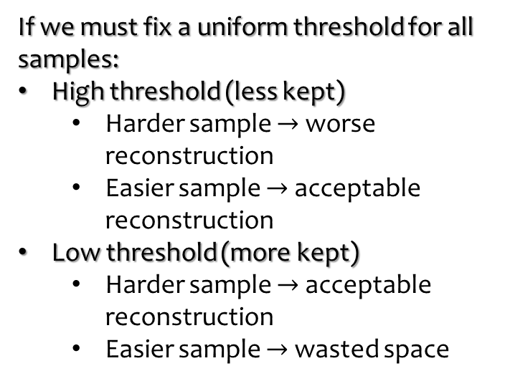
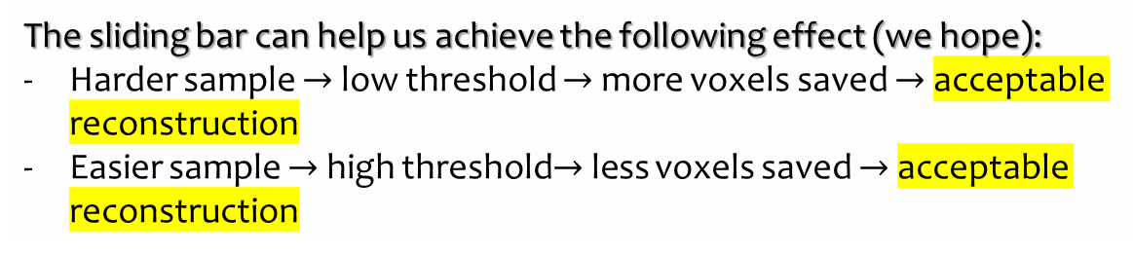


If we must fix a uniform threshold for all samples:
High threshold (less kept)
  Harder sample $→$ worse reconstruction
  Easier sample $→$ acceptable reconstruction
Low threshold (more kept)
  Harder sample $→$ acceptable reconstruction
  Easier sample $→$ wasted space
Cumulative distribution of the scores
A sliding bar
The sliding bar can help us achieve the following effect (we hope):
Harder sample $→$ low threshold $→$ more voxels saved $→$ acceptable reconstruction
Easier sample $→$ high threshold$→$ less voxels saved $→$ acceptable reconstruction
score

Slide 24
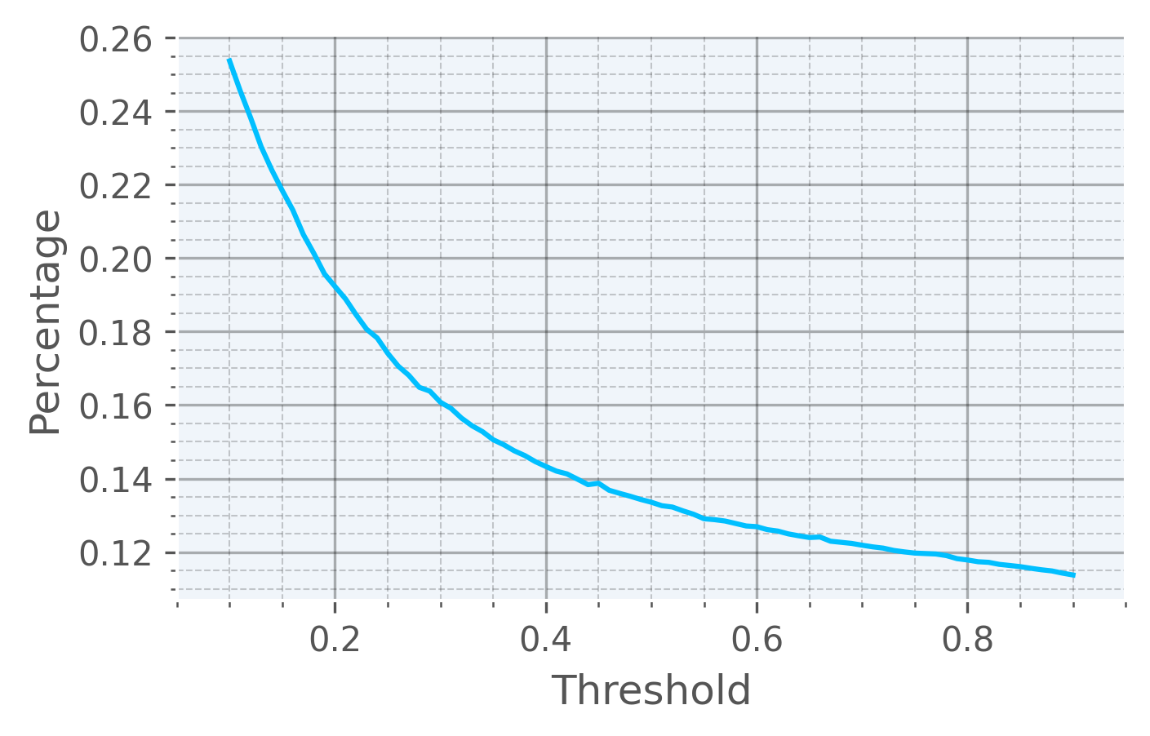
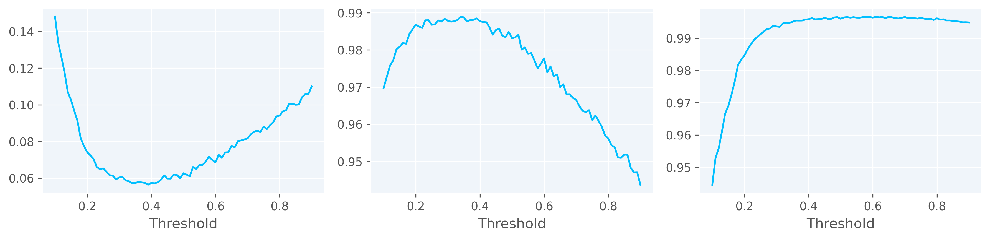


Let us accept the fact that the tunable range of the fraction of kept voxels can only be this small.
But can we at least get what we hope?
Nope!
$$L_{1}$$
Recall
Precision
?
?
More voxels saved doesn’t guarantee better performance!

Slide 25
A model that is not Trained to be flexible will not have flexibility after training
We can tell the model that if more voxels are going to be saved, I am going to request a better reconstruction. But if less voxels are saved, I won’t penalize you too much for a bad reconstruction.
But how do you train the model to be flexible?

Slide 26
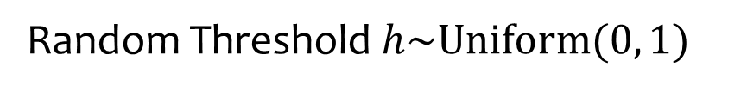
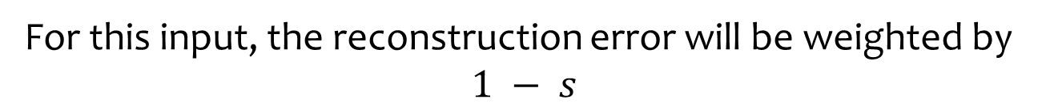
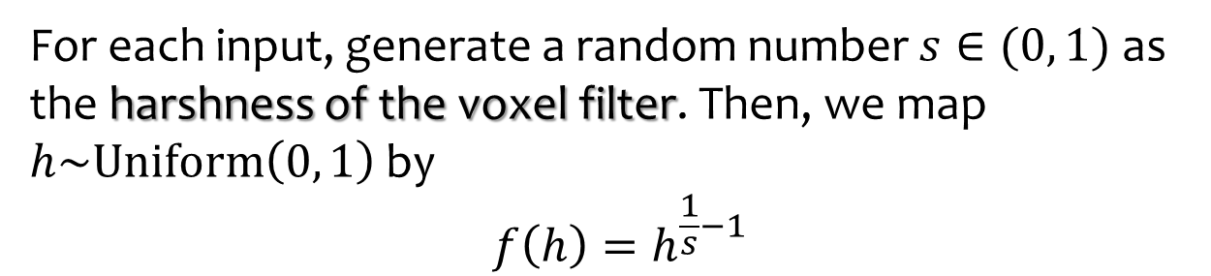
How to Train a Model to be Flexible
Random Threshold $h\sim \text{Uniform}(0, 1)$
For each input, generate a random number $s∈(0, 1)$ as the harshness of the voxel filter. Then, we map $h\sim \text{Uniform}\left(0, 1\right)$by
$$f\left(h\right)=h^{\frac{1}{s}−1}$$
Density
For this input, the reconstruction error will be weighted by
$$1 − s$$
1
Threshold

Slide 27
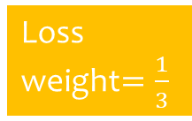





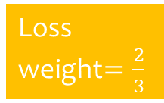
Loss weight$=\frac{1}{3}$
Loss weight$=\frac{2}{3}$
harshness $s =\frac{2}{3}$
harshness $s =\frac{1}{2}$
Loss weight $=\frac{1}{2}$
1
1
Density
Density
harshness $s =\frac{1}{3}$
mean$=\frac{2}{3}$
mean$=\frac{1}{3}$
Threshold
1
Threshold
1

Slide 28
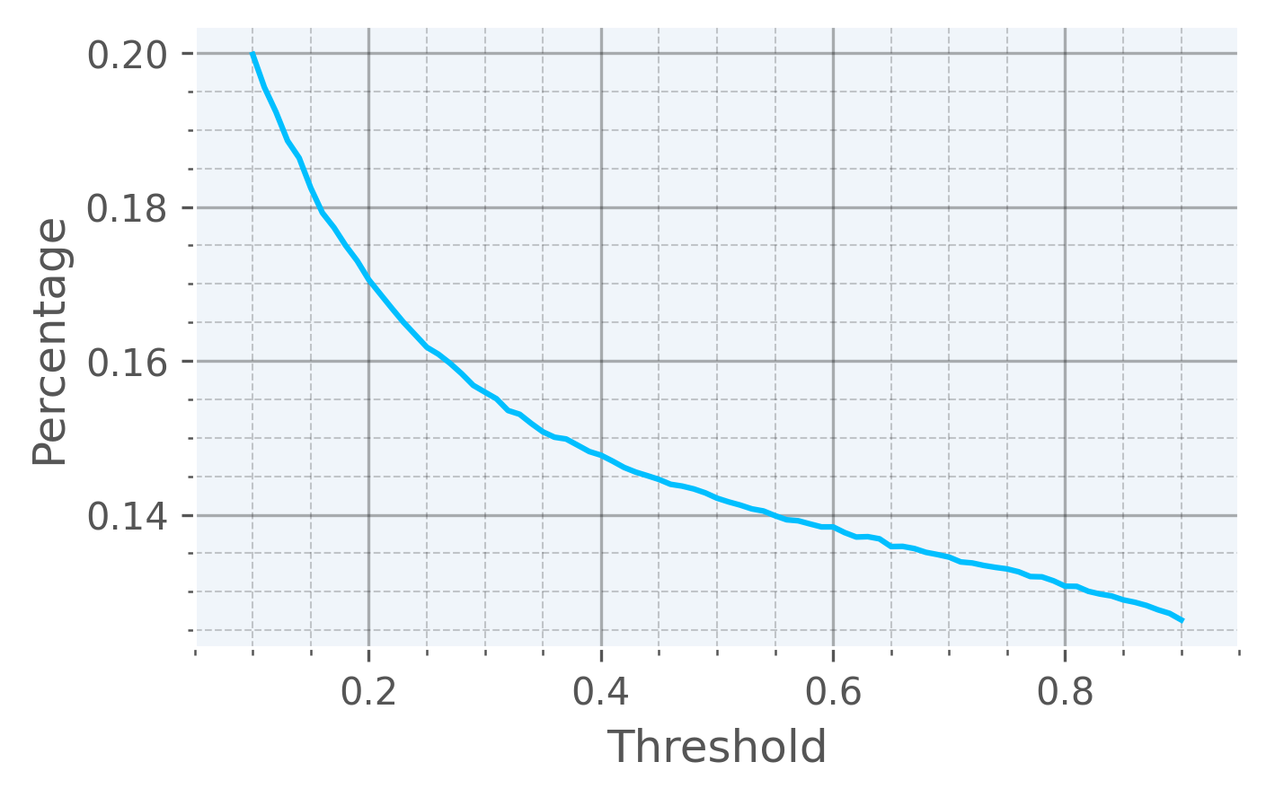
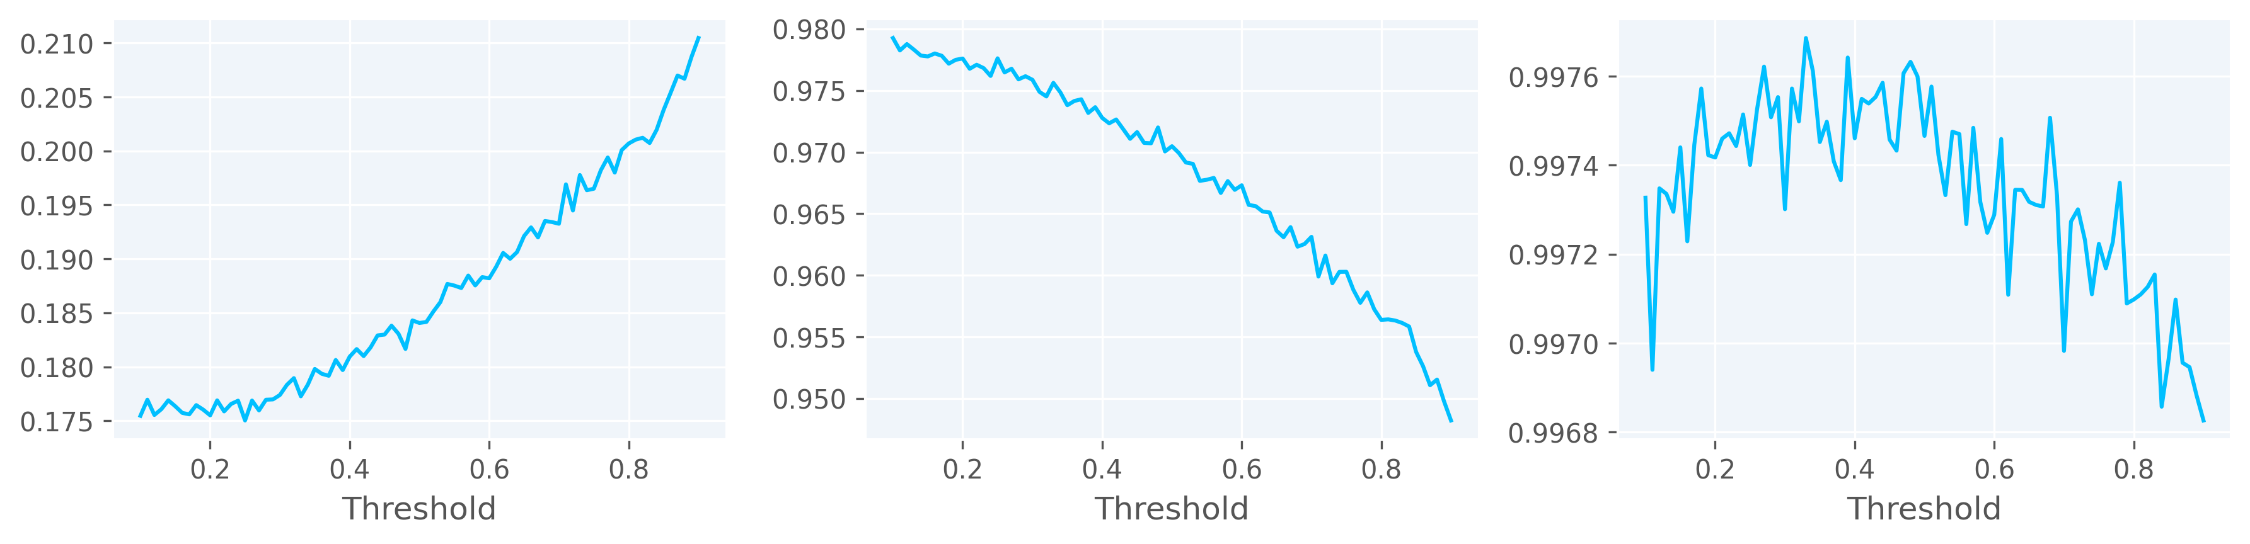
A Model trained to be flexible indeed exhibit flexibility after training – more voxels saved leads to better reconstruction accuracy!
$$L_{1}$$
Recall
Precision
?

Slide 29
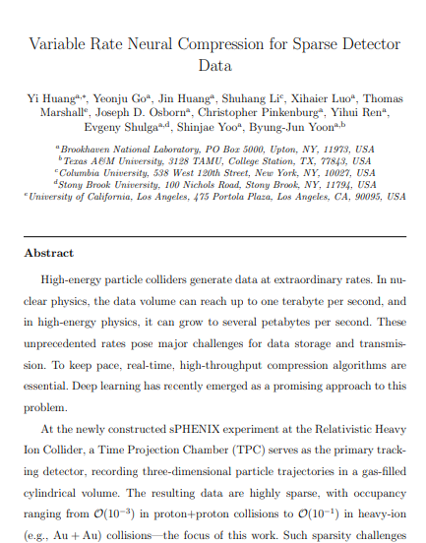
Summary
For sparse data, we can compress by importance for
  A variable compression ratio
  A higher throughput with proper software support
Tunability after training is possible but still a major challenge
Dataset: https://zenodo.org/records/14064045
GitHub repo: https://github.com/BNL-DAQ-LDRD/NeuralCompression_v3

