Slide 1
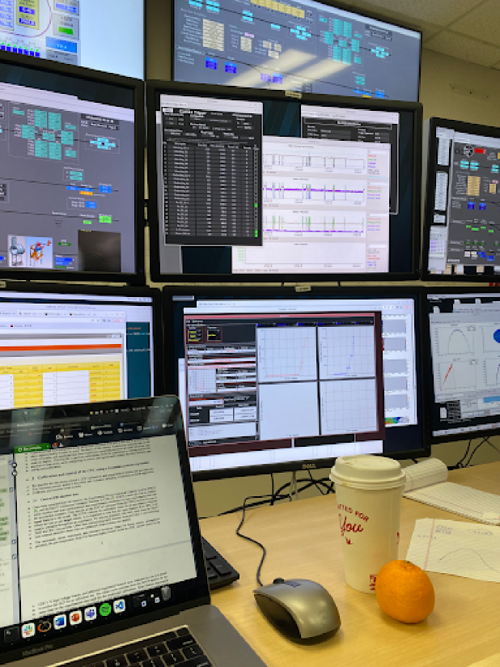



AI-Enabled Data Quality Monitoring with Hydra
Developed and maintained by the Experimental Physics Software and Computing Infrastructure group

Slide 2

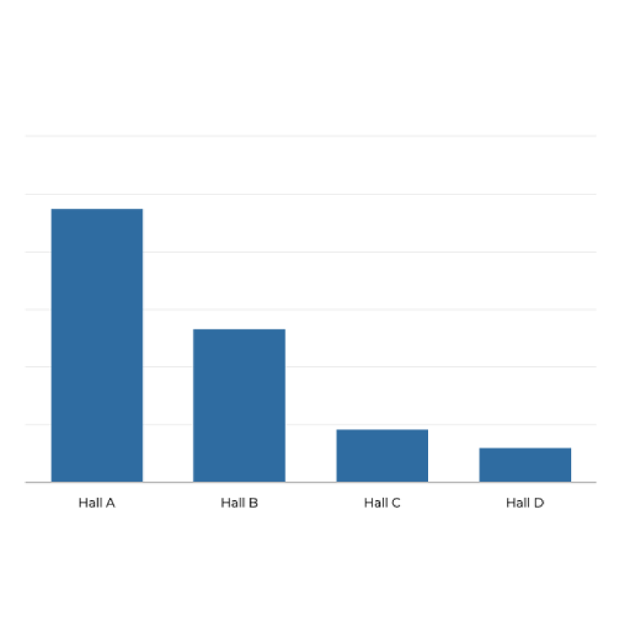
Human-based monitoring doesn’t scale
Fatigue
Continuous monitoring is mentally exhausting.
714
Inconsistency
Human judgement can vary significantly between individuals.
400
Slow response time
Humans can only process so much information at a given time.
138
90
Scalability
Human-based systems do not scale efficiently as data volumes increase.
Approximate number of individual histograms per experiment per run, monitored by the shift crew

Slide 3
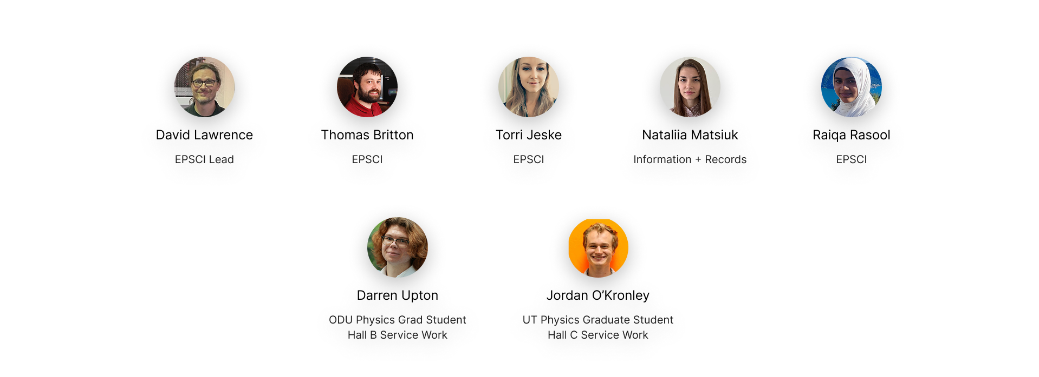
Hydra Developers

Slide 4
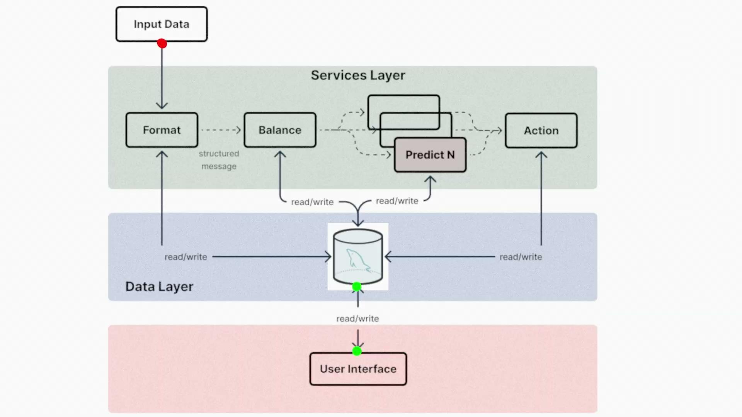
Framework Design
Hydra is a multi-tiered system based on a robust MySQL database which links to both the web-based user interface and the back-end processes.
Total processing time (cpu only) of ~500ms

Slide 5
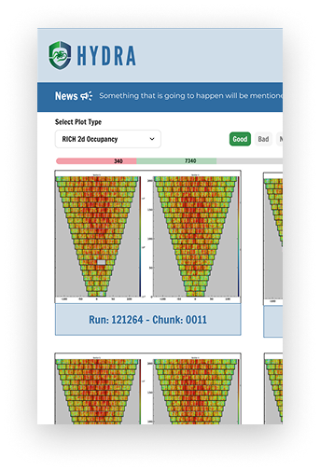
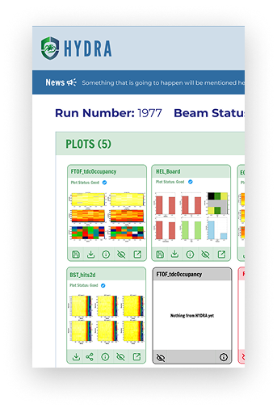
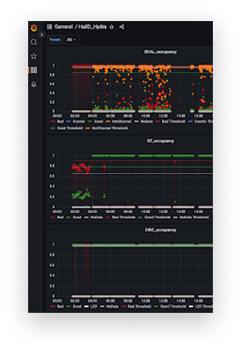
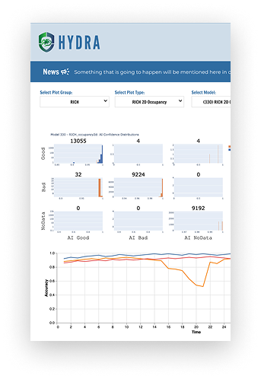
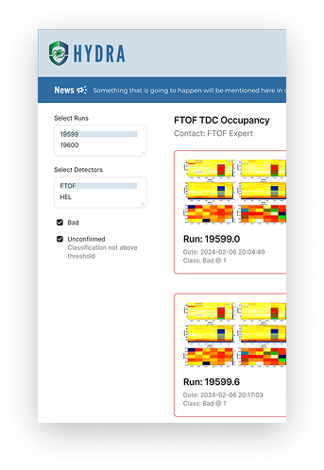
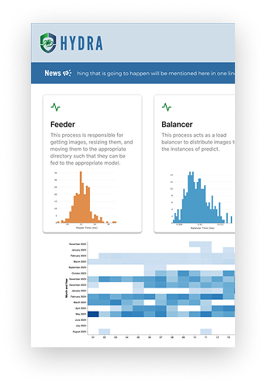
User Interface
Labeler
Efficiently label images for supervised learning
Run
See predictions in real time
Grafana
Uses Grafana to trend outputs and build custom dashboards
Library
Evaluate model performance and manage models
Log
Rolling feed of problematic images
Status
Monitor Hydra system health and performance

Slide 6
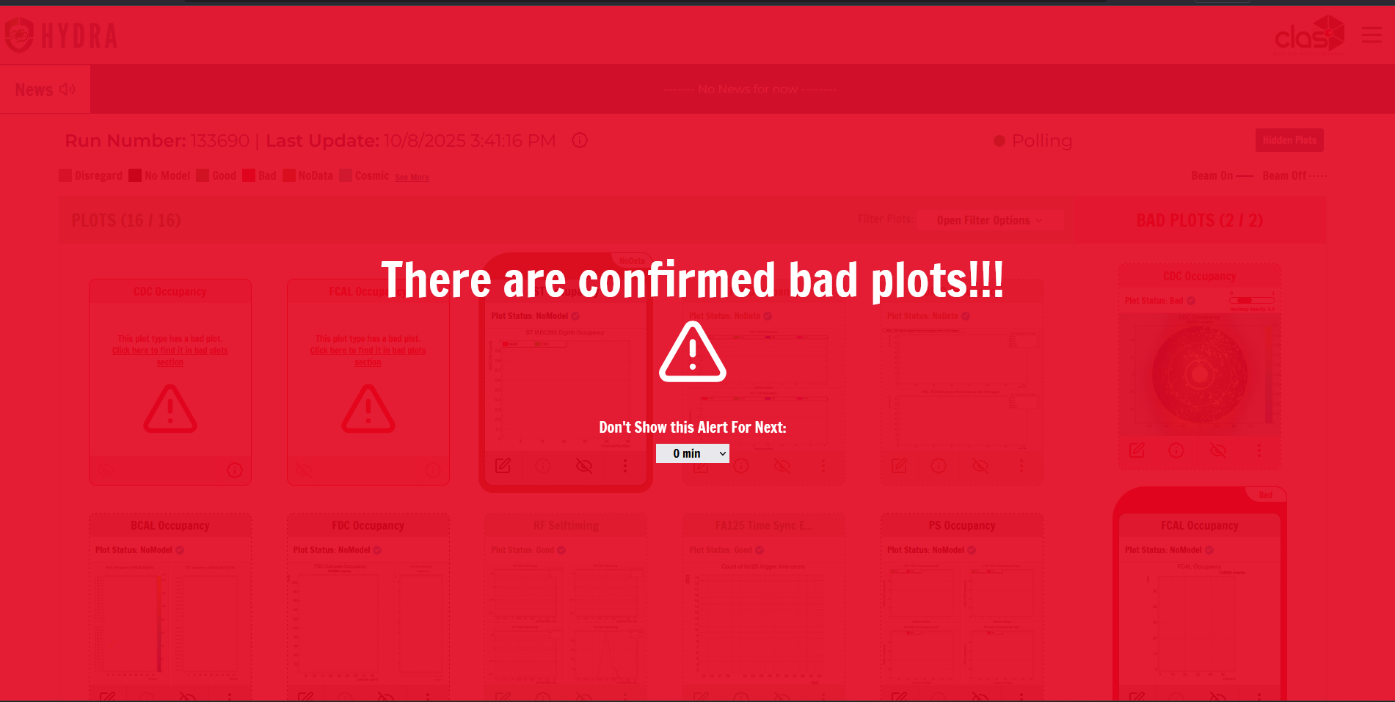
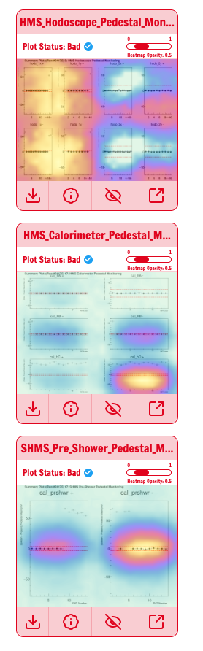
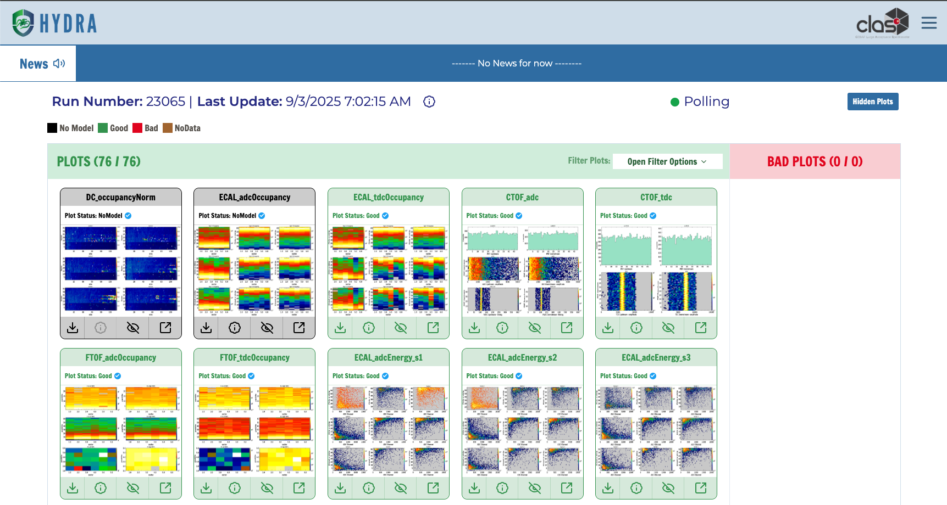
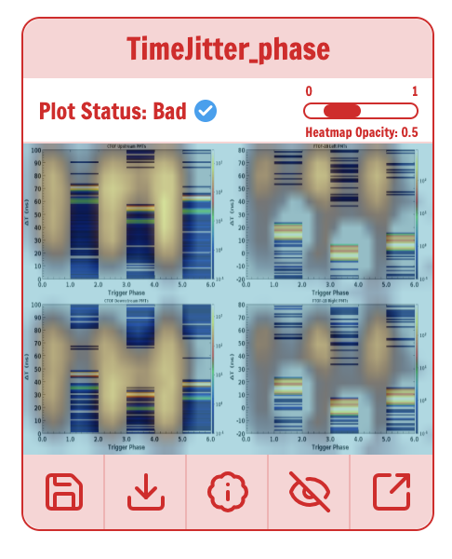
Online Data Quality Monitoring (Hydra Run)
Provides a security cam view to operators

Slide 7
Summary Statistics
Year deployed | 2019 | 2022 | 2024 | 2024
 | Hall D | Hall B | Hall A | Hall C
Labeled Images | 638,071 | 360,190 | 5,438 | 7,800
Plot Types | 208 | 82 | 42 | 105
Active Models | 19 | 61 | 0 | 6
Input frequency | 15 / min | 16.4/min | - | 0.98/min
Total number of images | 9,172,981* | 747,554 | - | 139,419
Total analyzed | 1,732,883 | 2,324,870 | - | 83,580
Hall D has online and offline monitoring plots Halls A/C do not have automatic generation of monitoring plots Hydra stores a significant amount of labeled and unlabeled data to develop models with

Slide 8
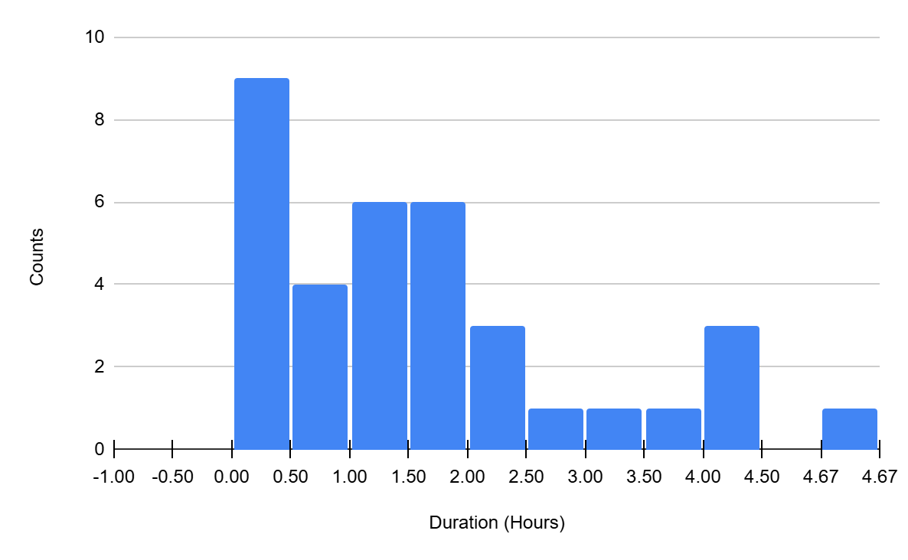

Human Performance
Hydra’s automated record keeping indirectly gives insight into data quality monitoring performance
Benchmarking
Time-to-diagnosis
Key Takeaways:
General response times are "immediately solved", "solved by the end of a run", and "solved by the end of the shift or halfway through"
Experienced and inexperienced shift crews make “big” mistakes
People tend to make the big, long mistakes after a few shifts into the run year (maybe they get comfortable )
confirmed incident durations during latest run group

Slide 9
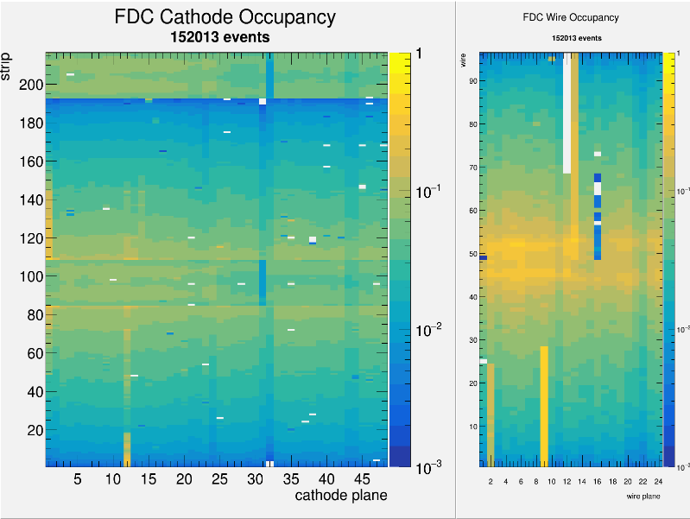
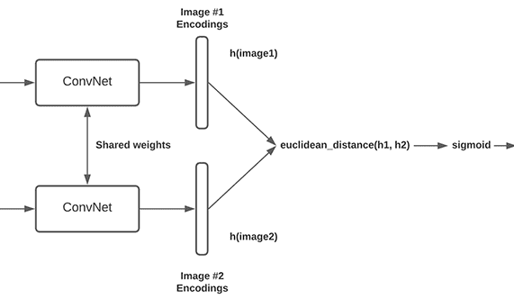
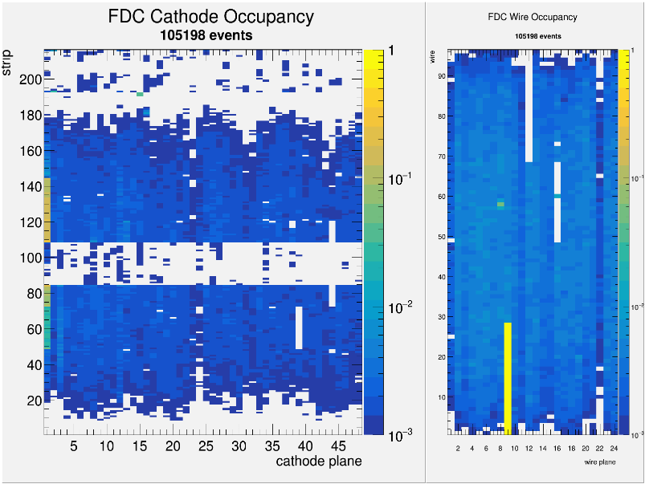
Siamese Neural Networks
Monitoring plots evolve during runs, especially after configuration changes
Classification models may not be robust to these changes
Using a supervised Siamese neural network, Hydra can flag previously unseen images by their distance to labeled examples instead of forcing a class
not similar
10/27/2025

Slide 10
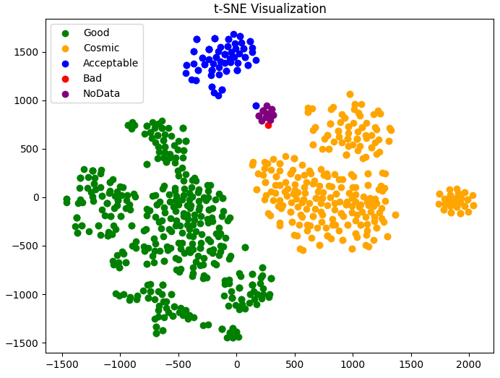
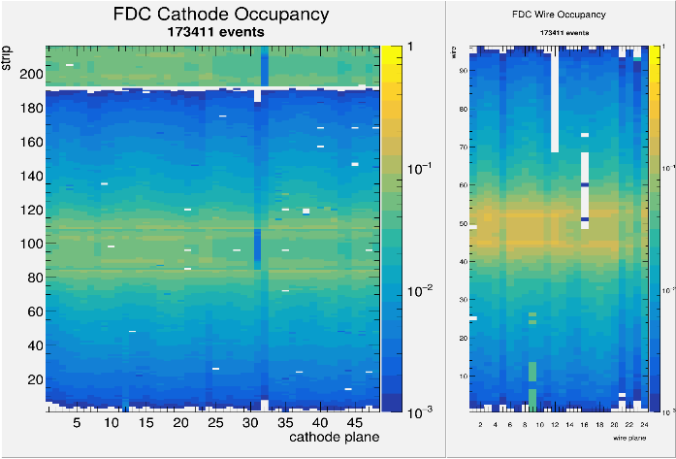
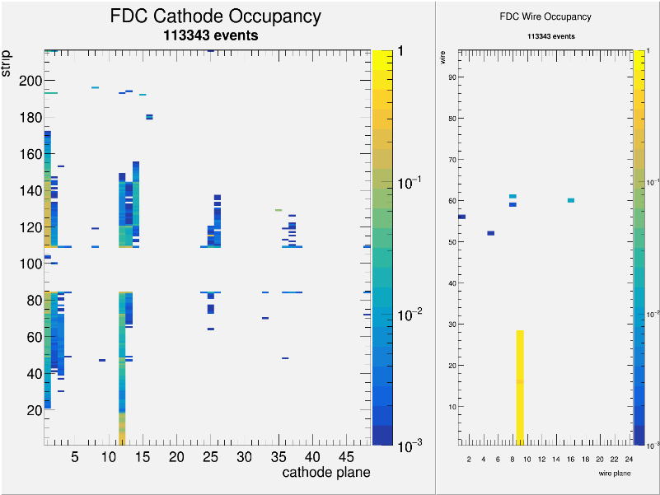
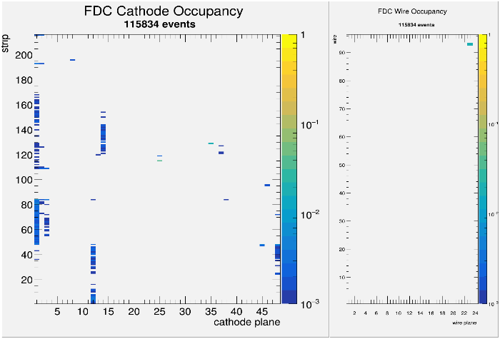
Identifying mislabeled images
Clustering on the embeddings from the siamese model can be used to identify mislabeled images that are used in training
Visually identify mislabeled points!
Mislabeled acceptable
Acceptable
No data
10/27/2025

Slide 11
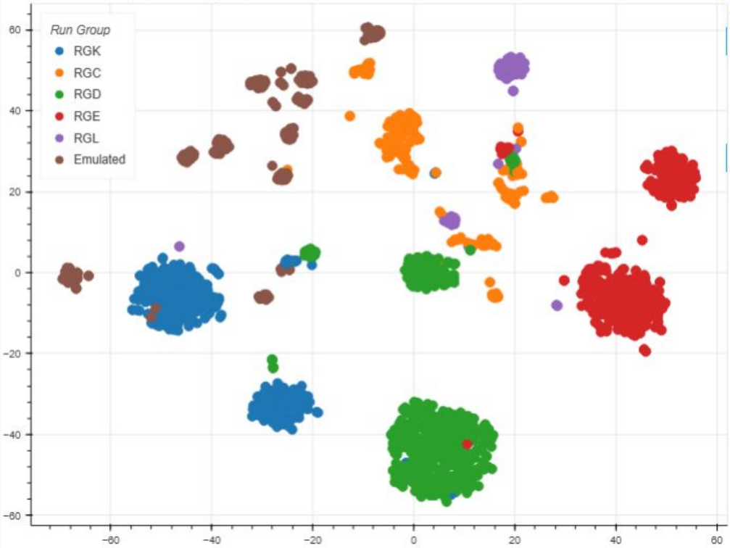
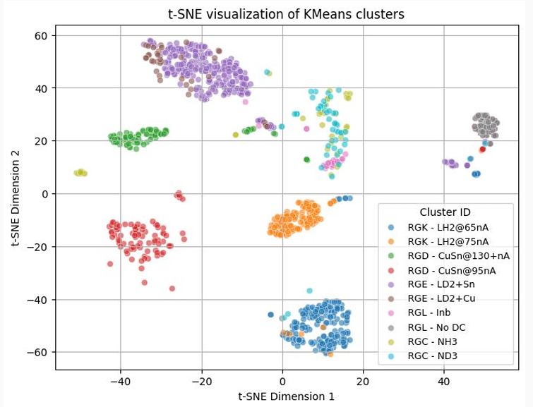
Unsupervised Learning
K-Means Clustering
Image data from different experiments can be clustered to identify different operating conditions using the Run Conditions Database.
10/27/2025

Slide 12
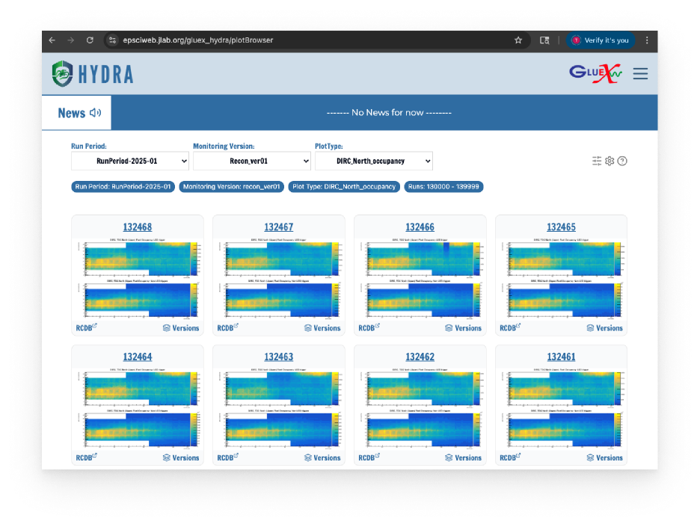
Image-based Data Visualization
Visualize images stored in Hydra’s database
Integrates with outside resources (e.g. the Run Conditions Database RCDB)
Enables other workflows in Hydra
e.g. Offline monitoring for calibration
10/27/2025

Slide 13
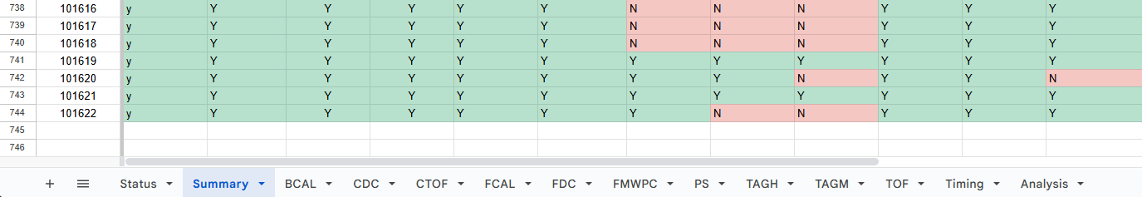
Hydra for Offline Data Quality Monitoring
GlueX performs monitoring launches to perform quality assurance checks and flag problems before full reconstruction
Manual, human driven checks on hundreds of different plot types
With Hydra, detector experts can opt-in to using supervised and/or unsupervised learning techniques to analyze the images produced in the monitoring launches
In the future, Hydra’s online system will act as a first filter for offline QA
Example spreadsheet-based analysis, where monitoring volunteers fill in status indicators for hundreds of plots and hundreds of runs for each detector system.
10/27/2025
Online Hydra acts as a first filter
Use comparative (less supervised) methods to analyze plots
Human in the loop for corrections and edge cases

Slide 14


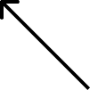
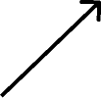


Cosine Similarity Method
Measures the cosine of the angle between two non-zero vectors in a multi-dimensional space.
Values can range from [-1,1].
1 means the vectors point in the same direction (similar)
0 means they are orthogonal
-1 means they point in opposite directions (dissimilar)
similar vectors
orthogonal vectors
dissimilar vectors
10/27/2025

Slide 15
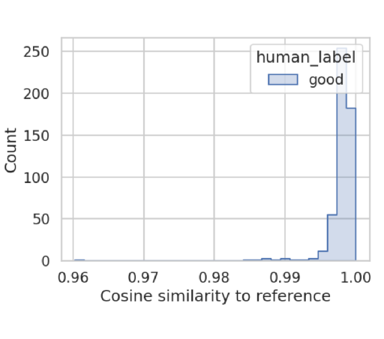
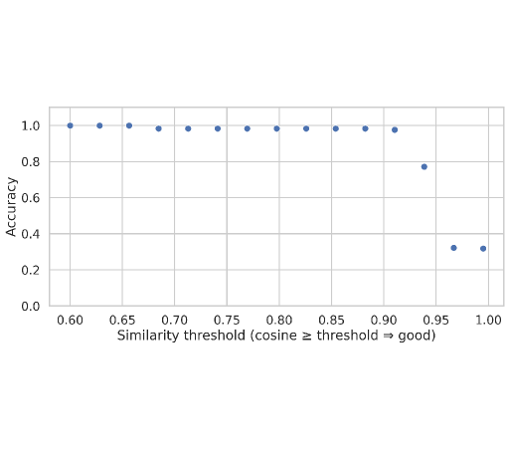
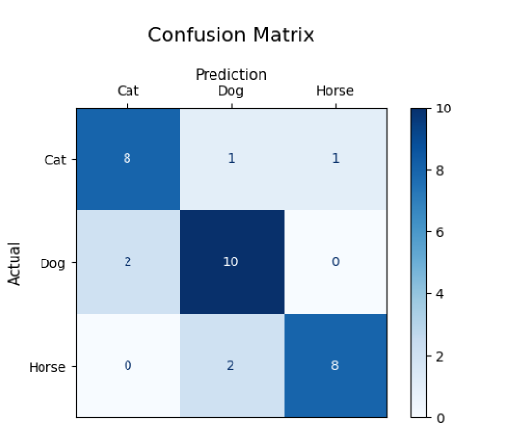
Analyzing similarity scores per plot type
Histogram the scores
Threshold Analysis
Compare to human labels
The outputs are numbers from -1 to 1
We can establish thresholds such that any images with a similarity score above N are similar, below N are dissimilar.
If we have human labels, we can use them as ground truth and obtain metrics from a confusion matrix.
10/27/2025

Slide 16
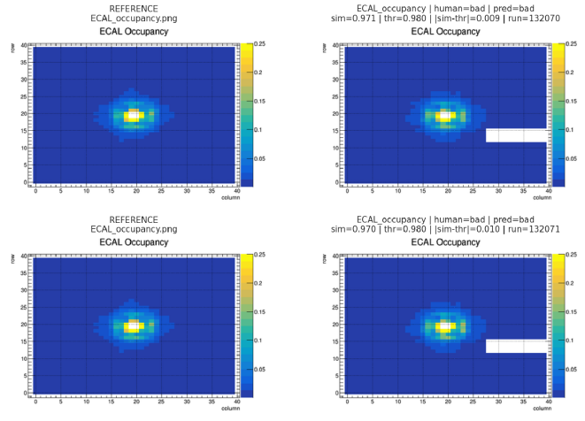
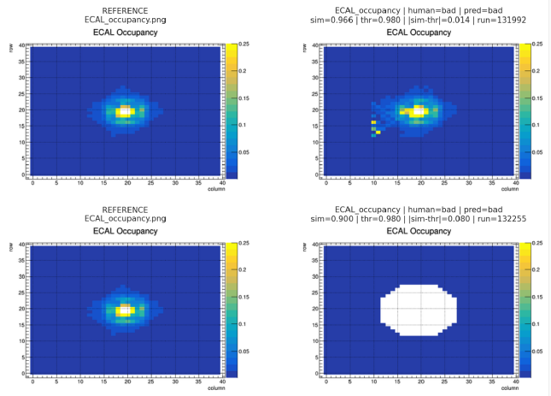
Cosine similarity method examples
10/27/2025

Slide 17
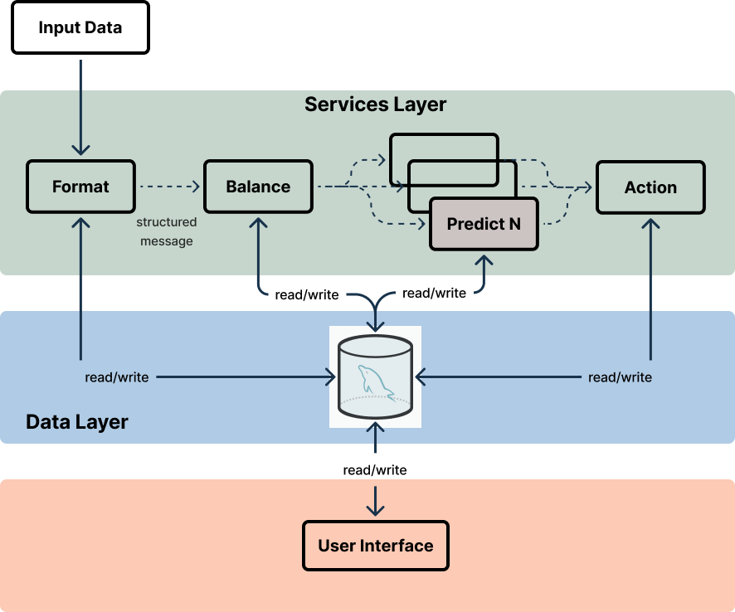
Development focus areas
ML enhancements
Alternate methods for sorting and identifying Bad/dissimilar images (e.g. Clustering, Siamese)
Multimodal support
Start Hydra models with limited data and get more detailed responses as the models learn
Auto-MLops
Centralized inference
Integration with Kubernetes to allow for scalable parallel inference
External program support
Autonomous writing to electronic logbooks
Administrative controls
Expose more detailed control of Hydra's operation via the web to allow users to more finely control Hydra
10/27/2025

Slide 18
Summary
Hydra is a scalable framework for training and managing AI models for data quality monitoring and visualization
Hydra is under development!
Data visualizations
Plot Browser
Unsupervised learning
K-Means Clustering
Supervised learning
Classification
Siamese models
Hydra enables deeper insights into data acquisition, both human and machine factors
10/27/2025

