Slide 1

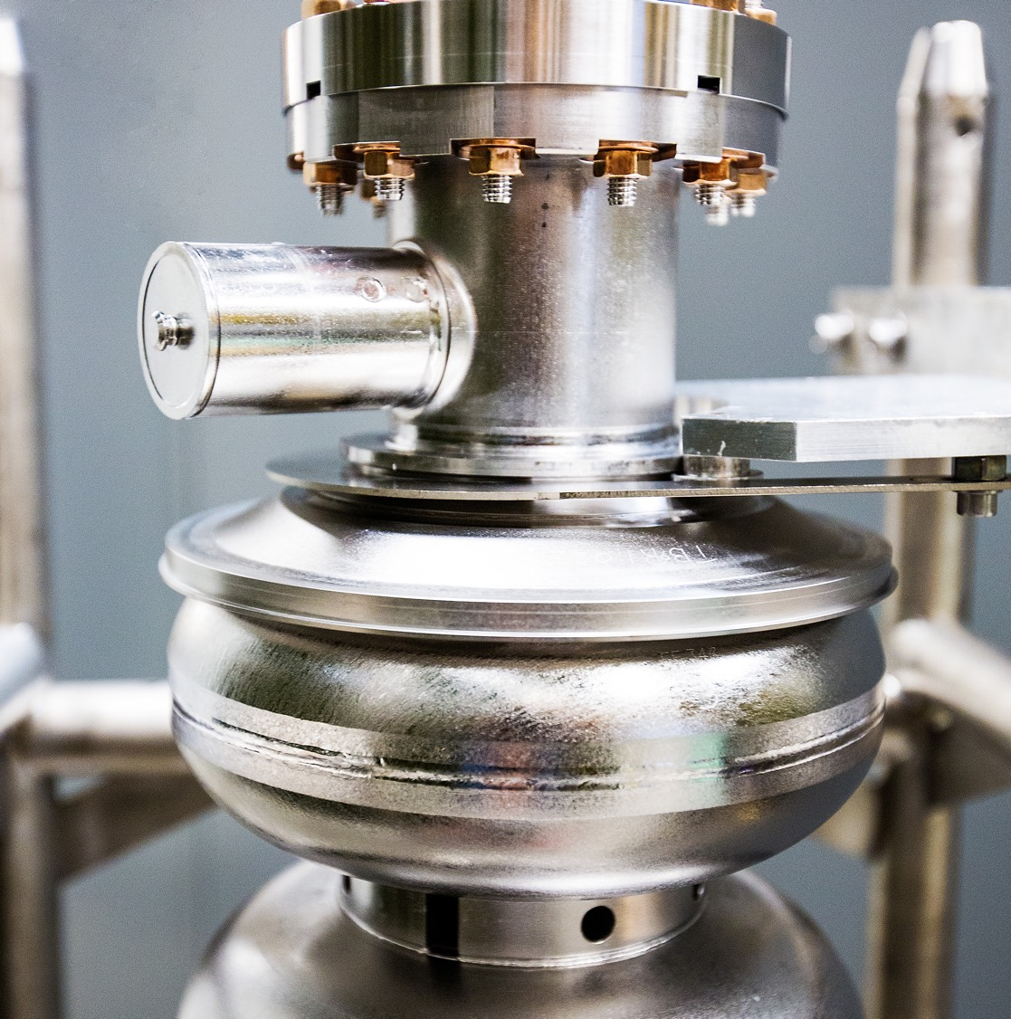
Streaming Monitoring
Optimization Control System
SMOCS
October 27th, 2025
Armen Kasparian
Built in support with Malachi Schram and Kishan Rajput and the Jefferson Lab Data Science Department

Slide 2
Why SMOCS?
Currently, there exists a significant amount of overhead required for utilizing time series streaming data with custom applications
Interfaces for custom packages
Conversions between non standard data formats to time series data formats
Compute resources availability in control rooms
SMOCS is designed to be a platform agnostic solution that bridges the gap between live streamed accelerator data and custom applications
Aimed at reducing the overhead between running custom applications on live streamed data
overhead
Accelerator
Data Processing

Slide 3
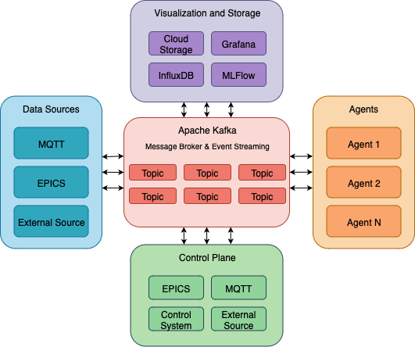
What is SMOCS?
Kafka based distributed data streaming platform
Designed for real time data streaming, processing, ML model training/inference, and controls

Slide 4

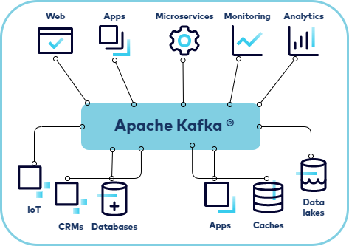
Message Brokering
Kafka serves as the central messaging infrastructure connecting producers, consumers, agents, and controllers
Industry standard package and perfect for this use case
Enables real time data flow between all components
Standardized message formatting
Once data is ingested, data is passed and stored in a standard format applicable to all potential use cases
https://docs.confluent.io/

Slide 5
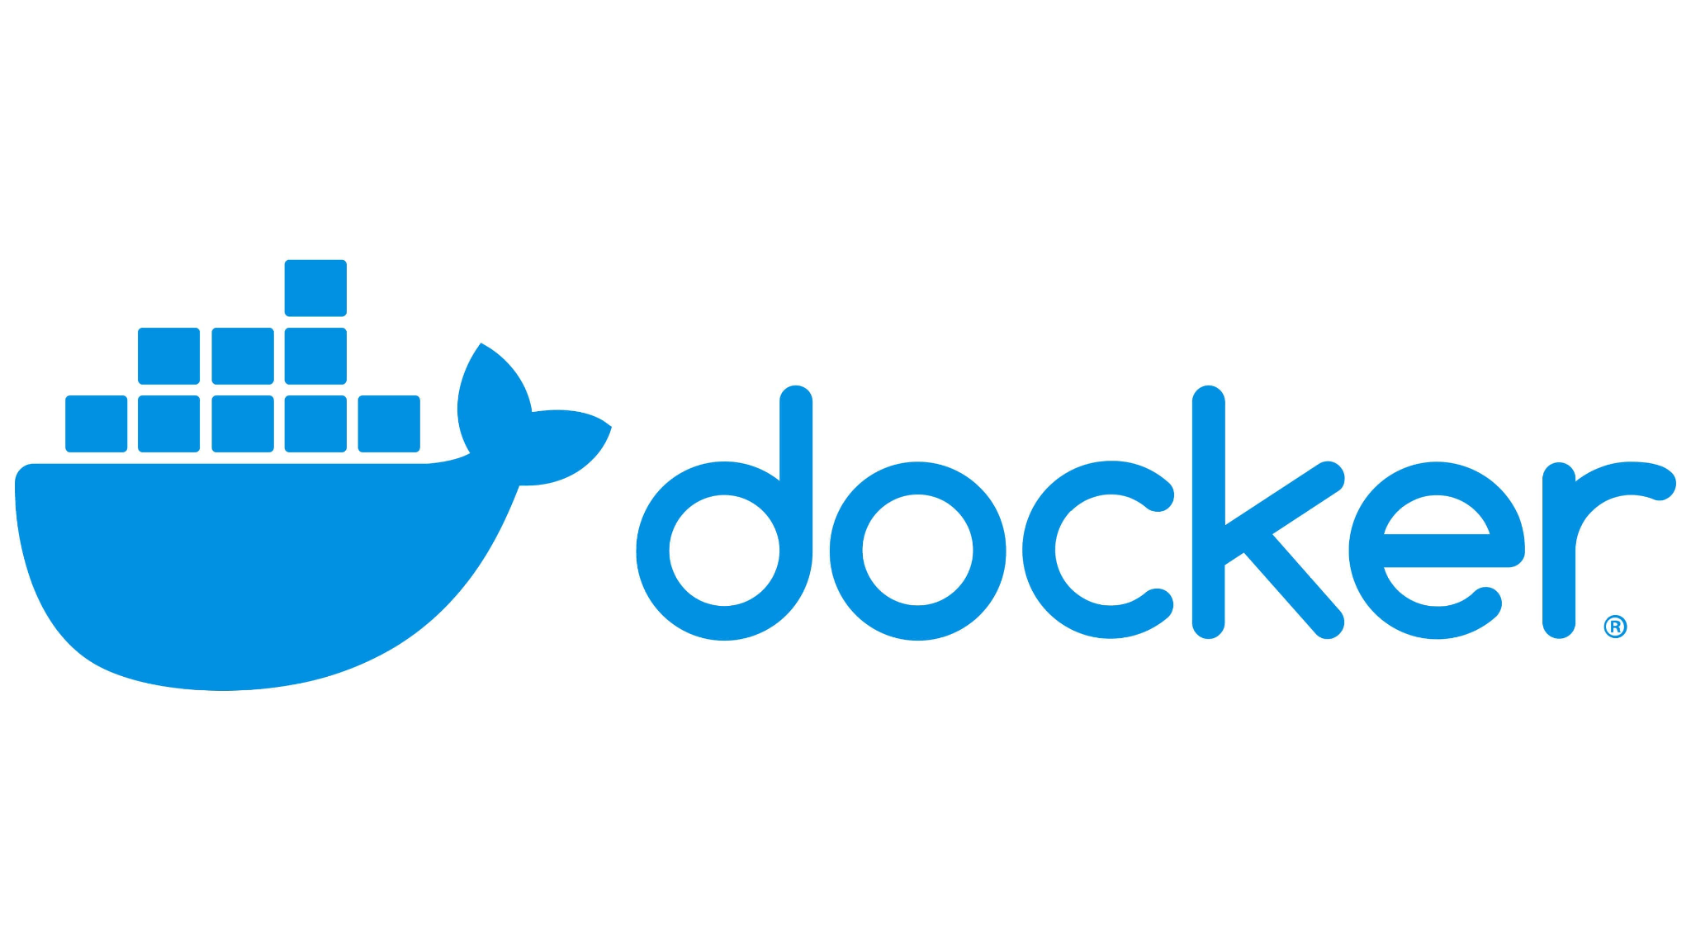
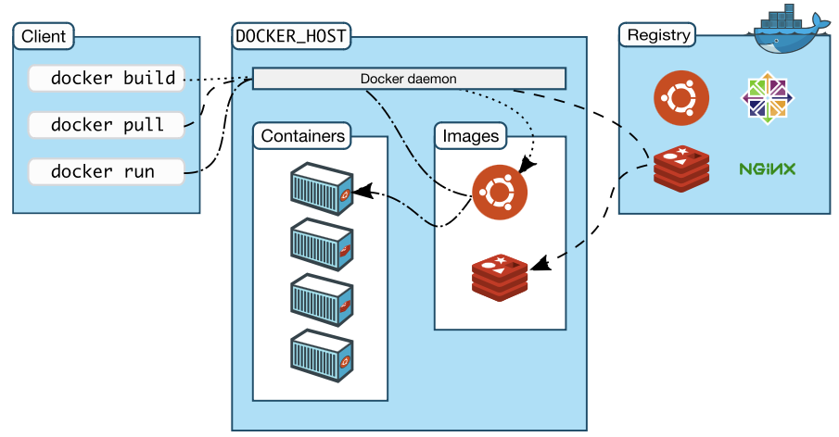
Containerization
Environmental isolation and dependency management
Encapsulates each container with specific versioning and dependencies preventing conflicts between different services
Simplified deployment and Scalability
Spin up or spool down new containers depending on the needs of the project
Multiple containers can be deployed simultaneously, each processing different data streams from Kafka topics without interfering with one another
enabling horizontal scaling of compute intensive workloads
Portability with Infrastructure Abstraction
Containerization allows for a system developed on one system to run consistently across multiple other systems
Fault isolation and resilience
Each containerized component runs in isolation with its own resources and lifecycle management
Example: If an agent container crashes during training or a consumer fails, it can be restarted independently without bringing down the entire system, while Kafka maintains message persistence.
https://docker-docs.uclv.cu/

Slide 6
SMOCS Building Blocks

Slide 7
Producers
Producers

Slide 8

Producers
Producers use an event driven push model
External events trigger message publication
Single threaded architecture preserves message ordering
Designed to take external data and push it into Kafka
Example Producers:
EPICS → Kafka Producer
MQTT → Kafka Producer
etc.
External Source
Producers
Kafka Broker
Example:
EPICS → Kafka Producer
SMOCS Kafka Broker
Custom Format
Standard Format

Slide 9
Consumers
Consumers

Slide 10

Consumers
Consumers use a pull based model from Kafka
Messages are processed synchronously in order
Single threaded looping design
Designed to read in data from the Kafka Broker
Example Consumers:
Kafka → InfluxDB Consumer
Kafka → S3 Buckets
etc.
Kafka Broker
Consumers
Example:
SMOCS Kafka Broker
Standard Format

Slide 11
Streaming Processes
Streaming Processes

Slide 12

Streaming Processes
Combine design of the Producer (Composition) and Consumer (Inheritance)
Follows Consumer single threaded looping architecture with Kafka messaging after data consumption and processing
Designed to both read in from Kafka and push back into Kafka
Example Streaming Processes:
Gymnasium Kafka Environment Wrapper
etc.
Kafka Broker
Streaming Processes
Example:
SMOCS Kafka Broker
Standard Format

Slide 13
Agents
Agents

Slide 14
Agents
Three thread agent design pattern allows multithreaded orchestration
All agents get access to a MySQL DB for internal data storage
Data Ingestion Thread
Consumes real time sensor data from Kafka topics
Stores structured data in MySQL using shared DB manager
ML Training Thread
Queries DB for training data
Implements agent specific training and evaluation logic
Publishes training results to Kafka for monitoring
Model saving
ML Inference Thread
Consumes same real time sensor data as Data Ingestion thread
Automatically loads models
Processes and packages data for model inference
Model inference results sent to Kafka for monitoring

Slide 15
Walkthrough
Consumers
Producers
Agents
Streaming Processes

Slide 16
Agents

Slide 17
Agent Architecture Visualization
Designed to asynchronously ingest data, train models, and perform inference on live streamed data
Agent
Kafka Topic
Data
Data Ingestion Thread
Formatted Data
MySQL DB
Kafka Broker
ML Training Thread
Training Metrics
Training Data
Kafka Topic Data
ML Inference Thread
Inference Results
Inference Results

Slide 18
Custom Agent: Autoencoder Anomaly Detection
Autoencoder built to detect anomalies utilizing reconstruction error as anomaly metric
Data Ingestion Thread
Reads in Kafka topics specified in configuration
Stores data in agents MySQL DB
ML Training Thread
Pulls batch of training data from MySQL DB
Trains AE model on window of data
Publishes training results to Kafka topic
ML Inference Thread
Reads in Kafka topic specified in configuration
Takes most recent data and runs it through most recent checkpointed model
Publishes inference results to Kafka topic

Slide 19
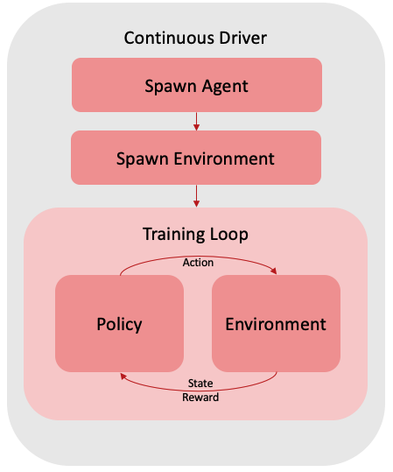
Scientific Optimization and Control Toolkit (SOCT)
https://github.com/JeffersonLab/SciOptControlToolkit
Jefferson Lab’s reinforcement learning package
Composable
Easy to add new agents and environments
Registration mechanism
Allows for easy development and use of new components
Standard OpenAI Gymnasium API
Utilize industry standard Gymnasium environment specification
Visualizations
Tensorboard integration allows for live monitoring of training
Reproducible
Models and configurations are saved and stored for inference/retraining
Easily pull in previous runs for continued research

Slide 20
Prebuilt Agent: SOCT Reinforcement Learning Agent
Three thread agent design pattern extends to custom agents found in other packages
Can be designed to be interoperable with custom packages
Flexible design allows for custom agents developed with any package, tool, service
Data Ingestion Thread
Reads in Kafka topics specified in configuration
Stores data in SOCT agent buffer
ML Training Thread
Calls SOCT agent training function
ML Inference Thread
Reads in Kafka topic specified in configuration
Takes most recent data and runs it through SOCT agent action for inference

Slide 21
Demo

Slide 22
Demo
Data:
CEBAF PVS
- IPMK203.XPOS
- IPMK203.YPOS
- IPMK203.PHAS
- IPMK101.XPOS
- IPMK101.YPOS
- IPMK101.PHAS
- IPMK401.XPOS
- IPMK401.YPOS
- IPMK401.PHAS
Gymnasium control environment
Running Pendulum-V1 as an example
Agents:
Autoencoder agent 1
Training on reconstruction of CEBAF PVS
Autoencoder agent 2
Training on reconstruction of pendulum gymnasium state environment
SOCT TD3 Agent
Learning how to optimally control the pendulum found in the gymnasium environment

Slide 23
Demo Architecture
InfluxDB
Visualization
+
Tensorboard
Prebuilt SOCT
TD3 RL Agent
(Training on pendulum)
CEBAF Data
Pendulum Data
EPICS Producer
Kafka Broker
Autoencoder Agent 2
(Training on CEBAF)
Gymnasium Kafka Wrapper
(running pendulum)
Autoencoder Agent 1
(Training on pendulum)
Notes:
Example:
I have built a virtual simulation environment in gymnasium, while running a reinforcement learning agent on the real accelerator I would like to compare the results to a reinforcement learning agent running on the virtual simulation environment. I can spool up a SOCT agent container that runs the virtual simulation environment with the same type of reinforcement learning agent to see how they compare live!

Slide 24
Summary
Designed for Complex Systems: SMOCS is designed to bridge the gap between streaming data and ML applications and visualizations
Real Time Data Streaming: A platform agnostic solution utilizing industry standard message passing with Kafka and containerization utilizing Docker
AI/ML Integration: Supports custom machine learning and reinforcement learning agents for model prediction and control

Slide 25
Appendix

Slide 26
Kafka Data Formatting
Mandatory Structure
Timestamp
Channels
Dictionary structure
Base class validation
All base classes that interact with Kafka have validation enforcement of messages sent and received
Example:
{ "timestamp": 1706123457.123, "channels": { "variable_0": -0.123, "variable_1": 0.456, "variable_2": -1.789, "variable_3": 0.234,"reward": -0.05, "done": false, "episode": 42 } }

Slide 27
Fully Standalone Agent: SOCT Standalone
Visualization
Prebuilt SOCT
RL Agent
EPICS Producer
Kafka Broker
SOCT
Standalone
Spawn Agent
Spawn Environment
Control System Proxy
Training Loop
Policy
Action
Virtual
Environment
State
Reward
Notes:
Example:
I have built a virtual simulation environment in gymnasium, while running a reinforcement learning agent on the real accelerator I would like to compare the results to a reinforcement learning agent running on the virtual simulation environment. I can spool up a SOCT agent container that runs the virtual simulation environment with the same type of reinforcement learning agent to see how they compare live!

Slide 28
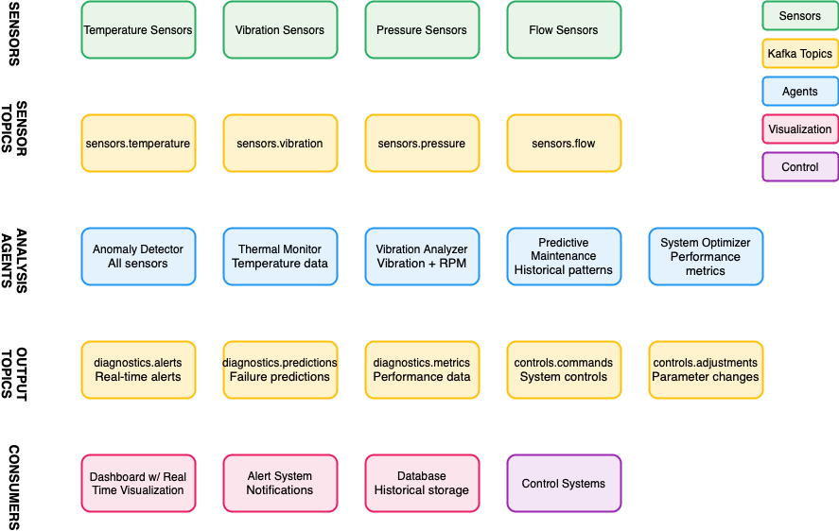
Example Pipeline

