Slide 1
Machine Learning for Charged Particle Tracking
Ahmed Mohammed, Kishansingh Rajput, Simon Taylor, Denis Furletov, Sergey Furletov, Malachi Schram

Slide 2
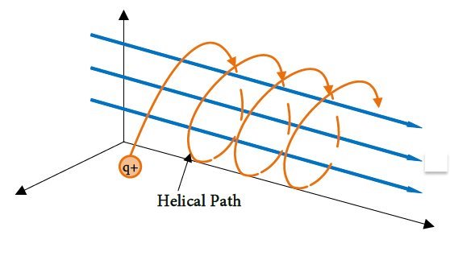
Track Reconstruction
Track Finding
  Many particle tracks per event
  Group hits belonging to same particle
  Traditional solution: Uses distance between hits and fits a helical model to find patterns
Track Fitting
  For each found track, estimate initial particle parameters (ex: momentum, charge)
  Traditionally solved by Kalman filter
x
y
z
[1]
Traditional combinatorial track finding scale worse than linearly with multiplicity.
Machine Learning (ML) can help speedup
[1] van't Klooster, Thomas. "Electric Micro Propulsion: Development of a LaB6 Cathode for Micro Electric Thrusters." (2018)

Slide 3
Existing ML Solutions
Supervised Neural Network (NN) ➔ Matches Ŷ with Y
Only simulated data contains Y ➔ Suitable for training
Recurrent NN (RNN) Regression ➔ Finding needs long seed
Detector Data naturally forms a graph:
  Graph Nodes: Hits
  Graph Edges: Unknown Track Segments
Graph NNs (GNNs): Embeddings updated via message passing
Node-Classifier GNN: Same RNN problem
Edge-Classifier GNN: Rejects extra edges
RNN Regressor
A
A
A
A
Node-Classifier GNN
Edge-Classifier GNN
X
A
A
A
0
A
1
B
B
B
B
0
C
C
X
C
C
z
z

Slide 4
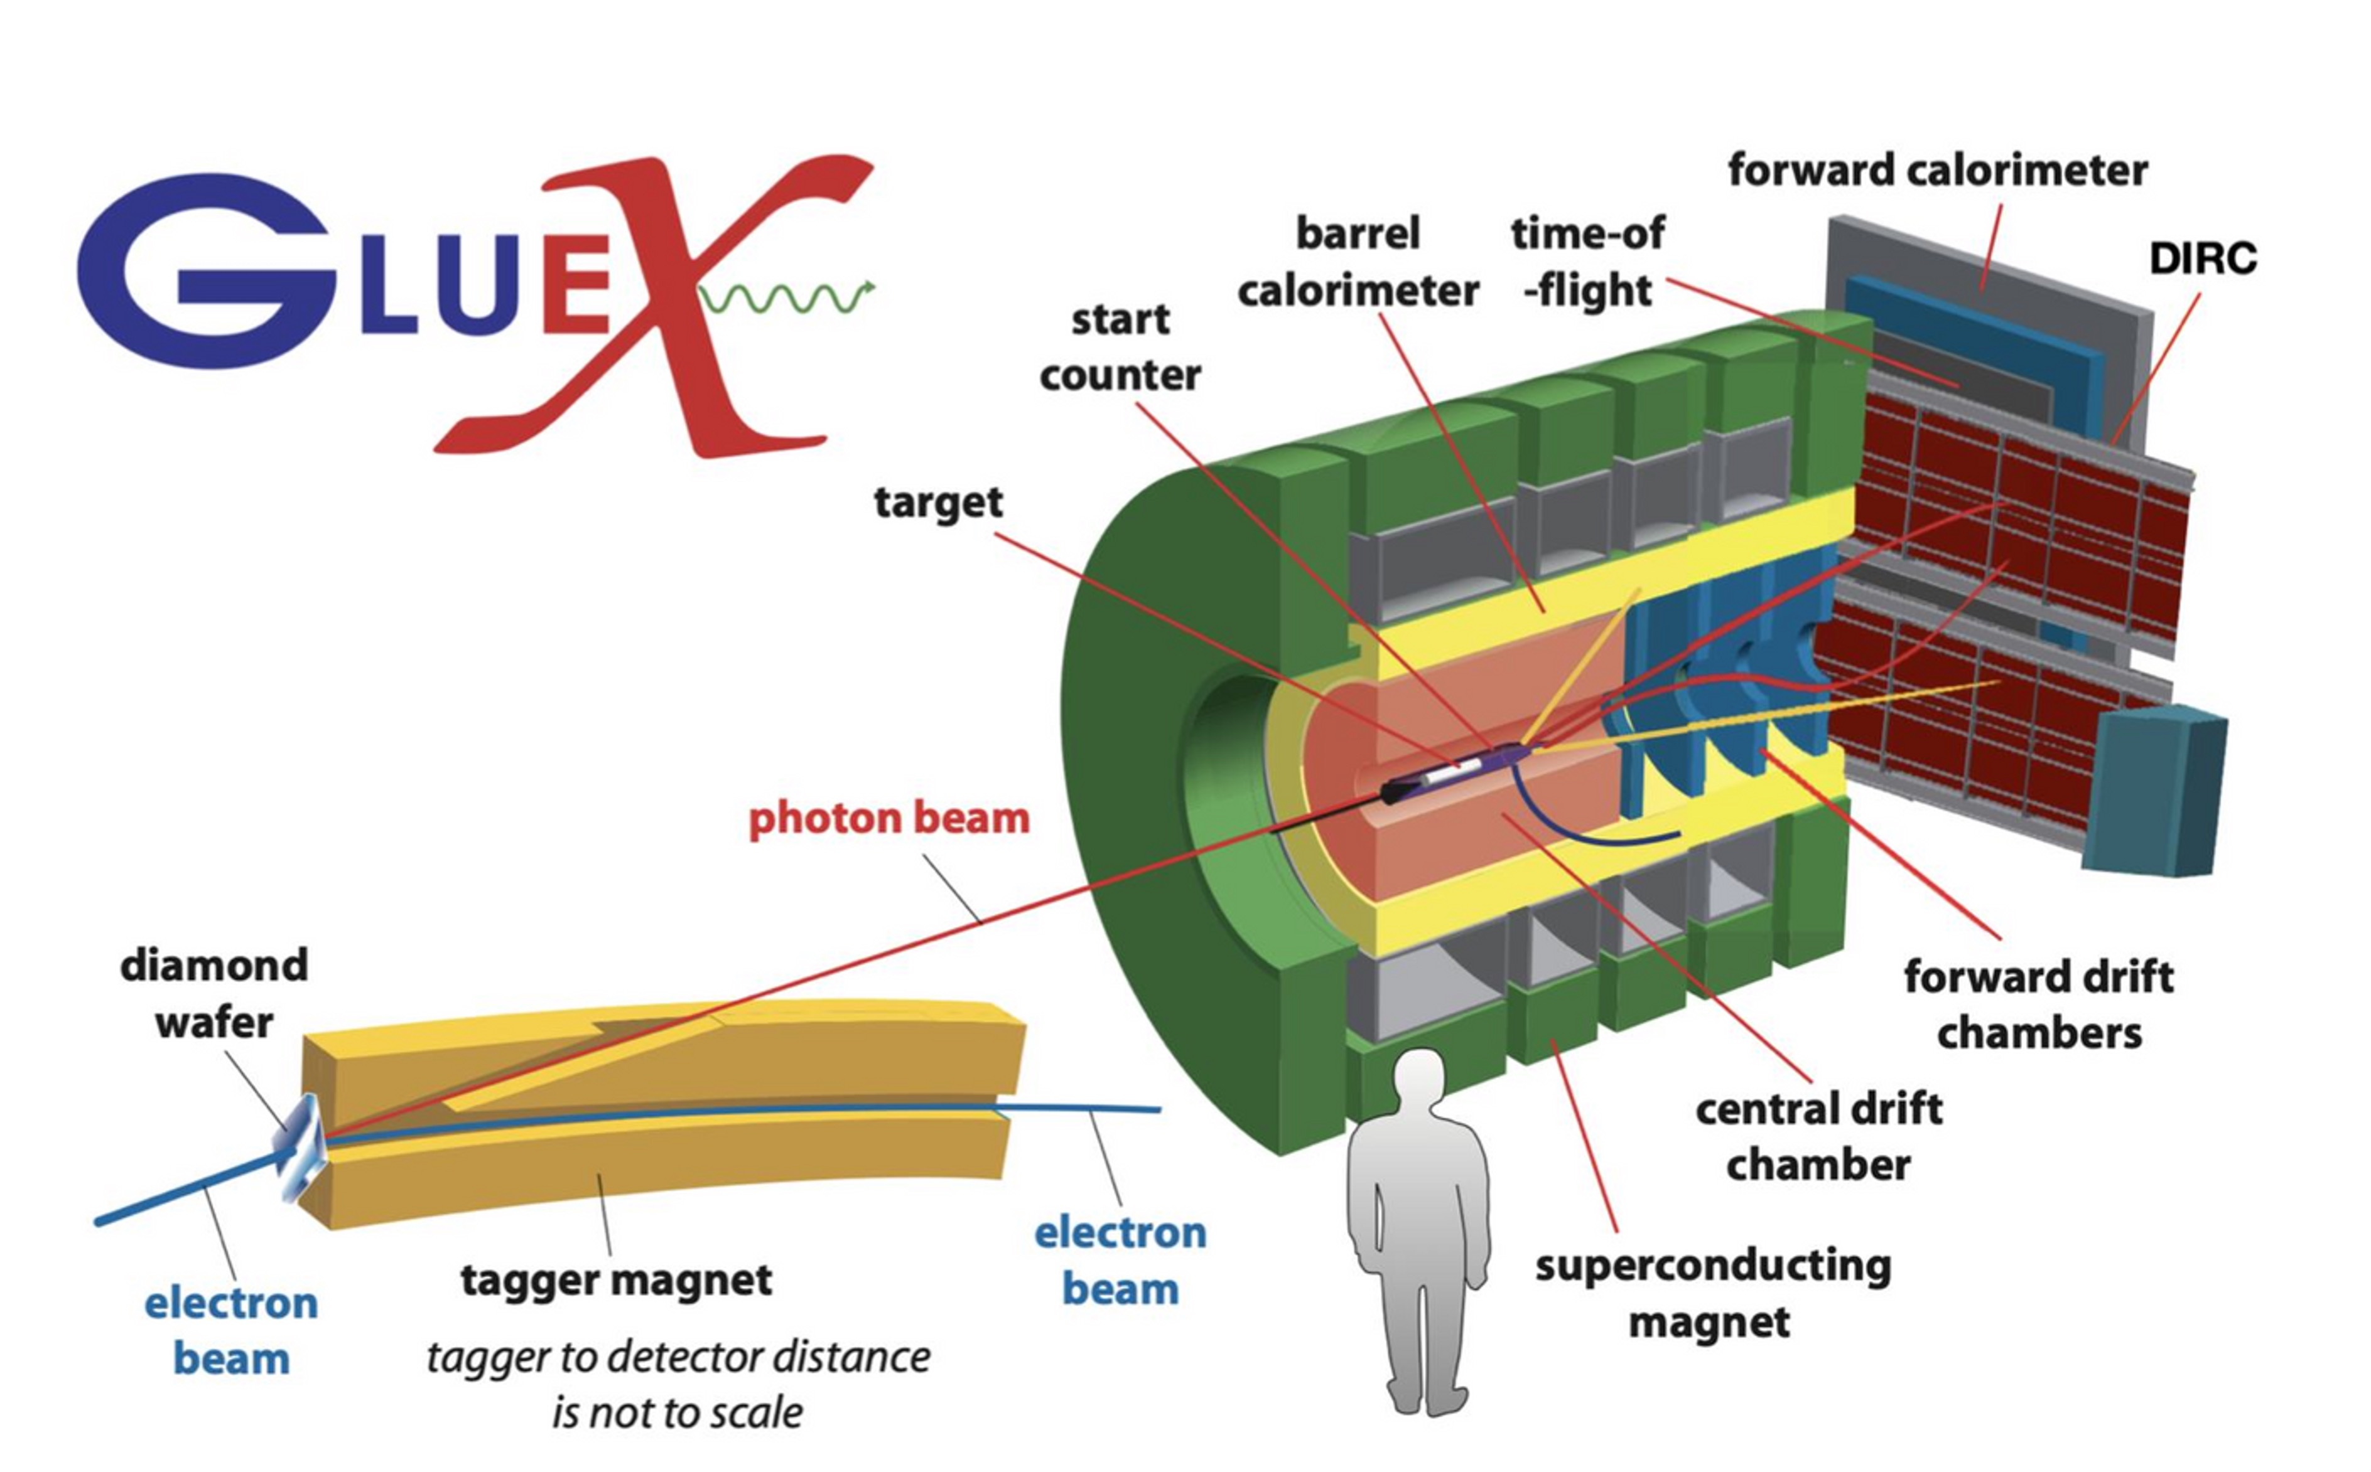
GlueX Spectrometer
Used to search for and measure exotic hybrid mesons predicted from lattice QCD
Individual Hit Features: (x, y, z)
Forward Drift Chamber (FDC) schematic. Wires on detector layers (red discs) record hit coordinates (x, y, z) via ionization energy deposits.

Slide 5
ML Pipeline Summary
Event: Hit Coordinates, Mag. field, and Particle ID & Track Params (in simulation only)
Edges: Potential track segments
GNN (with I message passing iterations) Input: Event graph g has:
  Hit Features g.X: (#hits, 3) ➔ 3: (r, Φ, z)
  Edge List g.E: (#edges, 2) ➔ 2: src & dst node ids
  Edge Labels g.label: (#edges,) ➔ True/False if same/different track_id (simulation only)
GNN Output: g without “False” edges (Ideally)
Group Track Hits ➔ A, B, … ➔ Fit Track Parameters

Slide 6
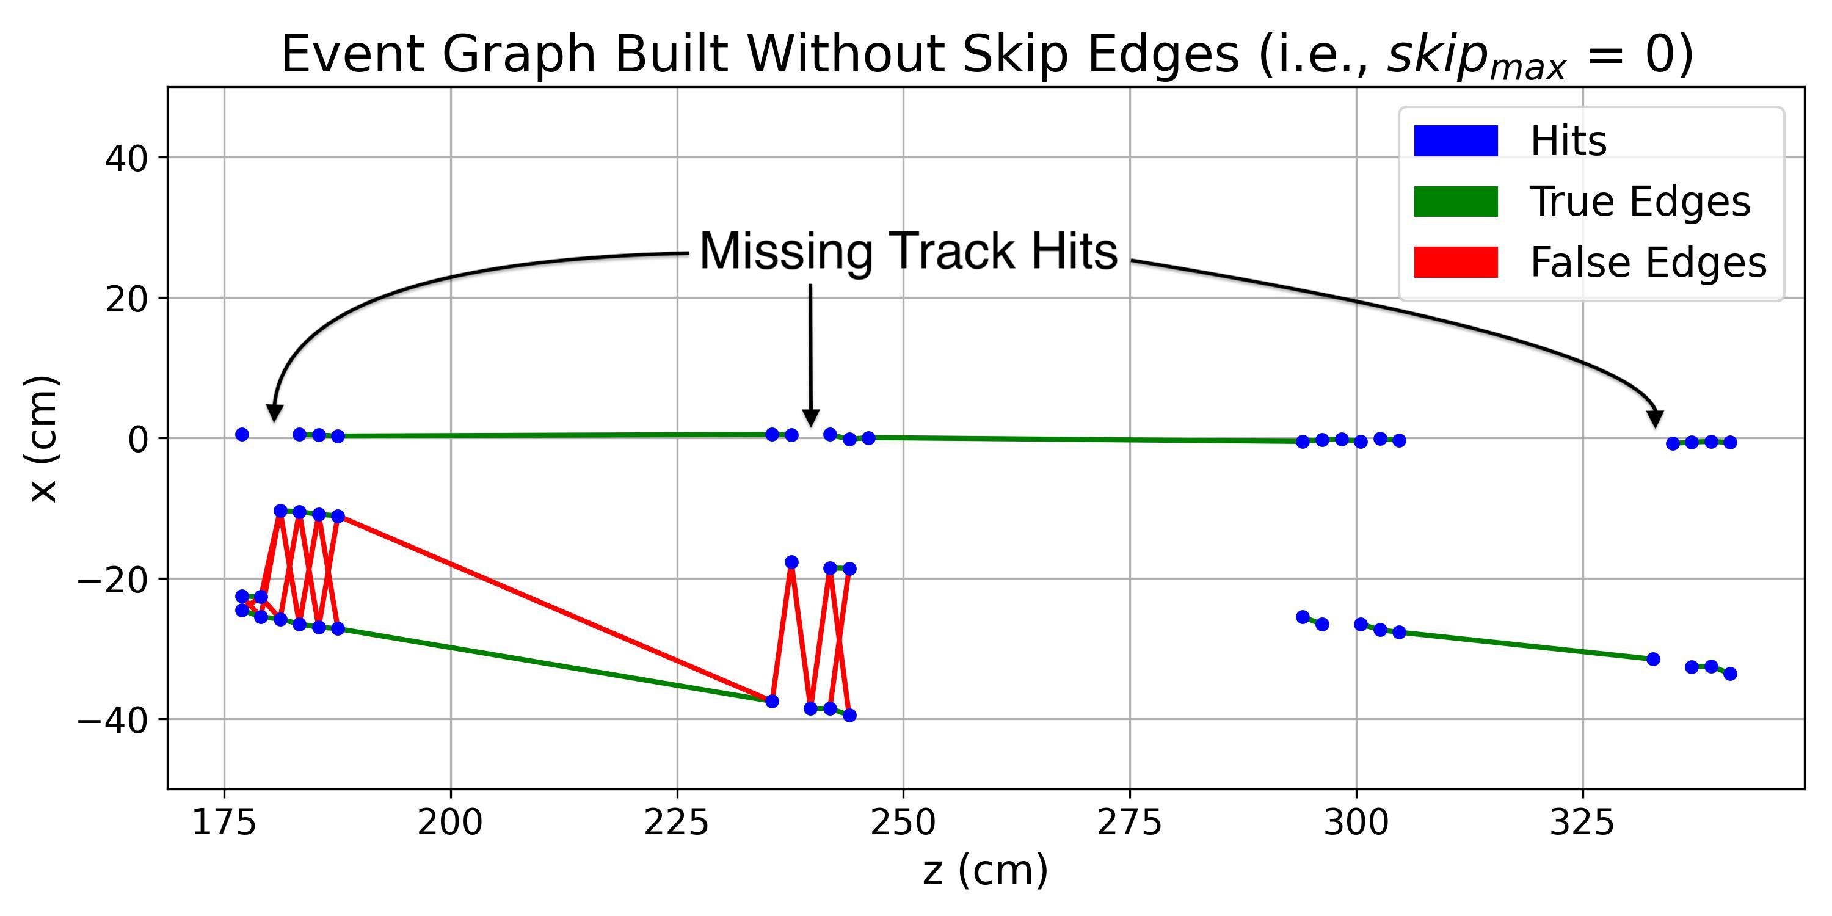
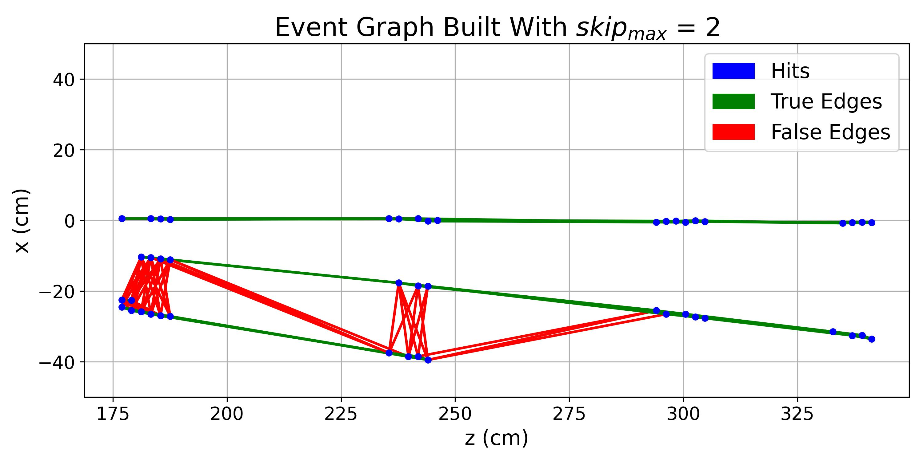
Graph Builder Details
Connecting ALL hit pairs results in:
  Dense graphs ➔ High computational cost
  High imbalance between true & false edges
Solution: Create edges with some constraints that guarantee high efficiency
Missing Track Hits impede track finding
Mitigated by forming residual/skip edges between non-adjacent hits (skip_{max} = 3)

Slide 7
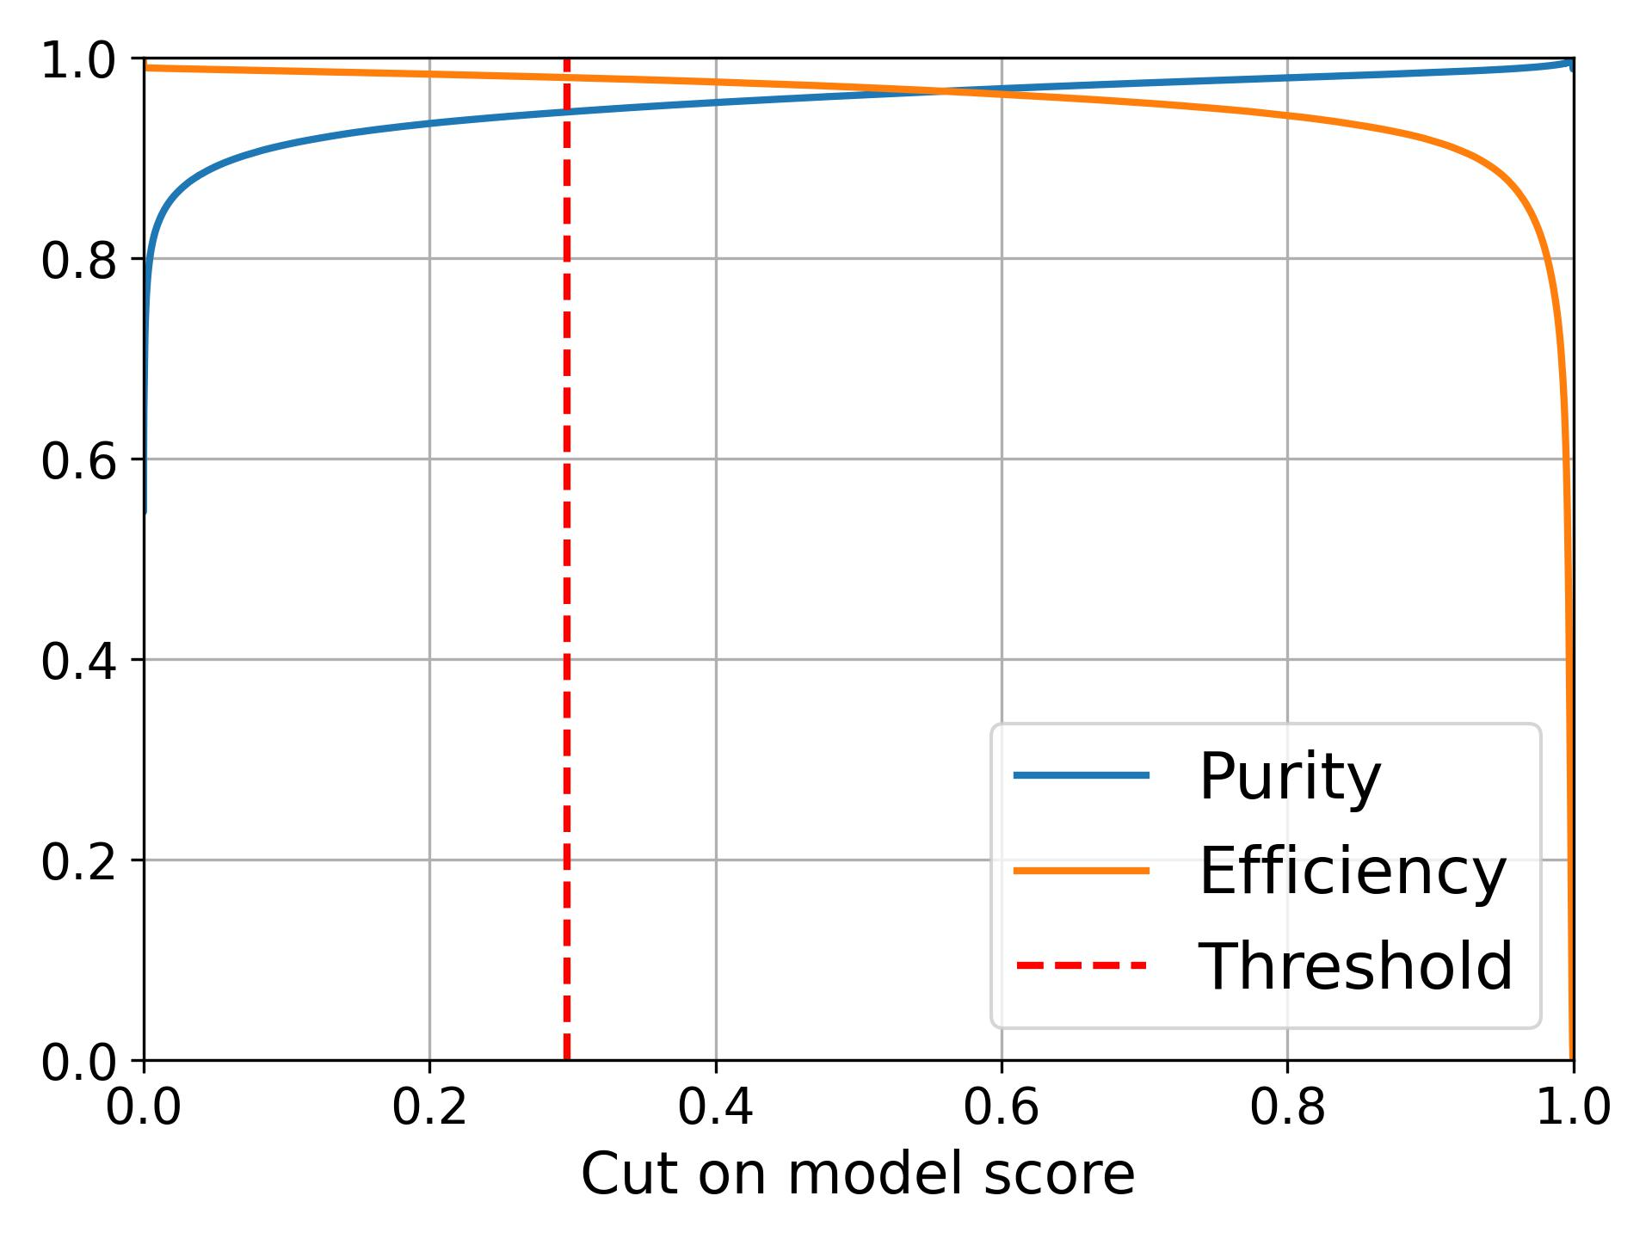
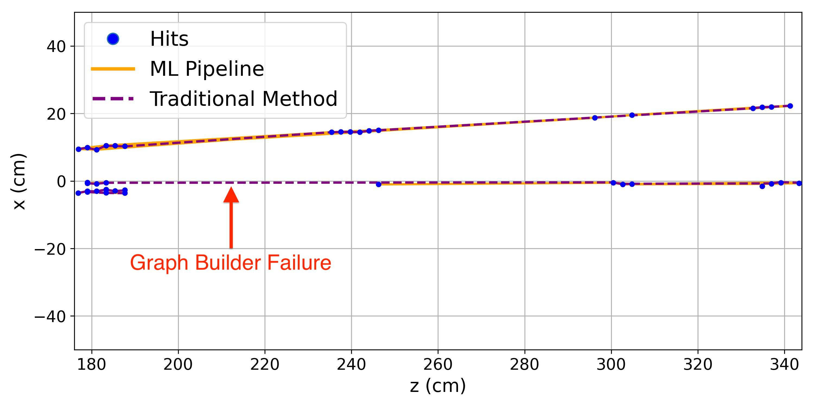
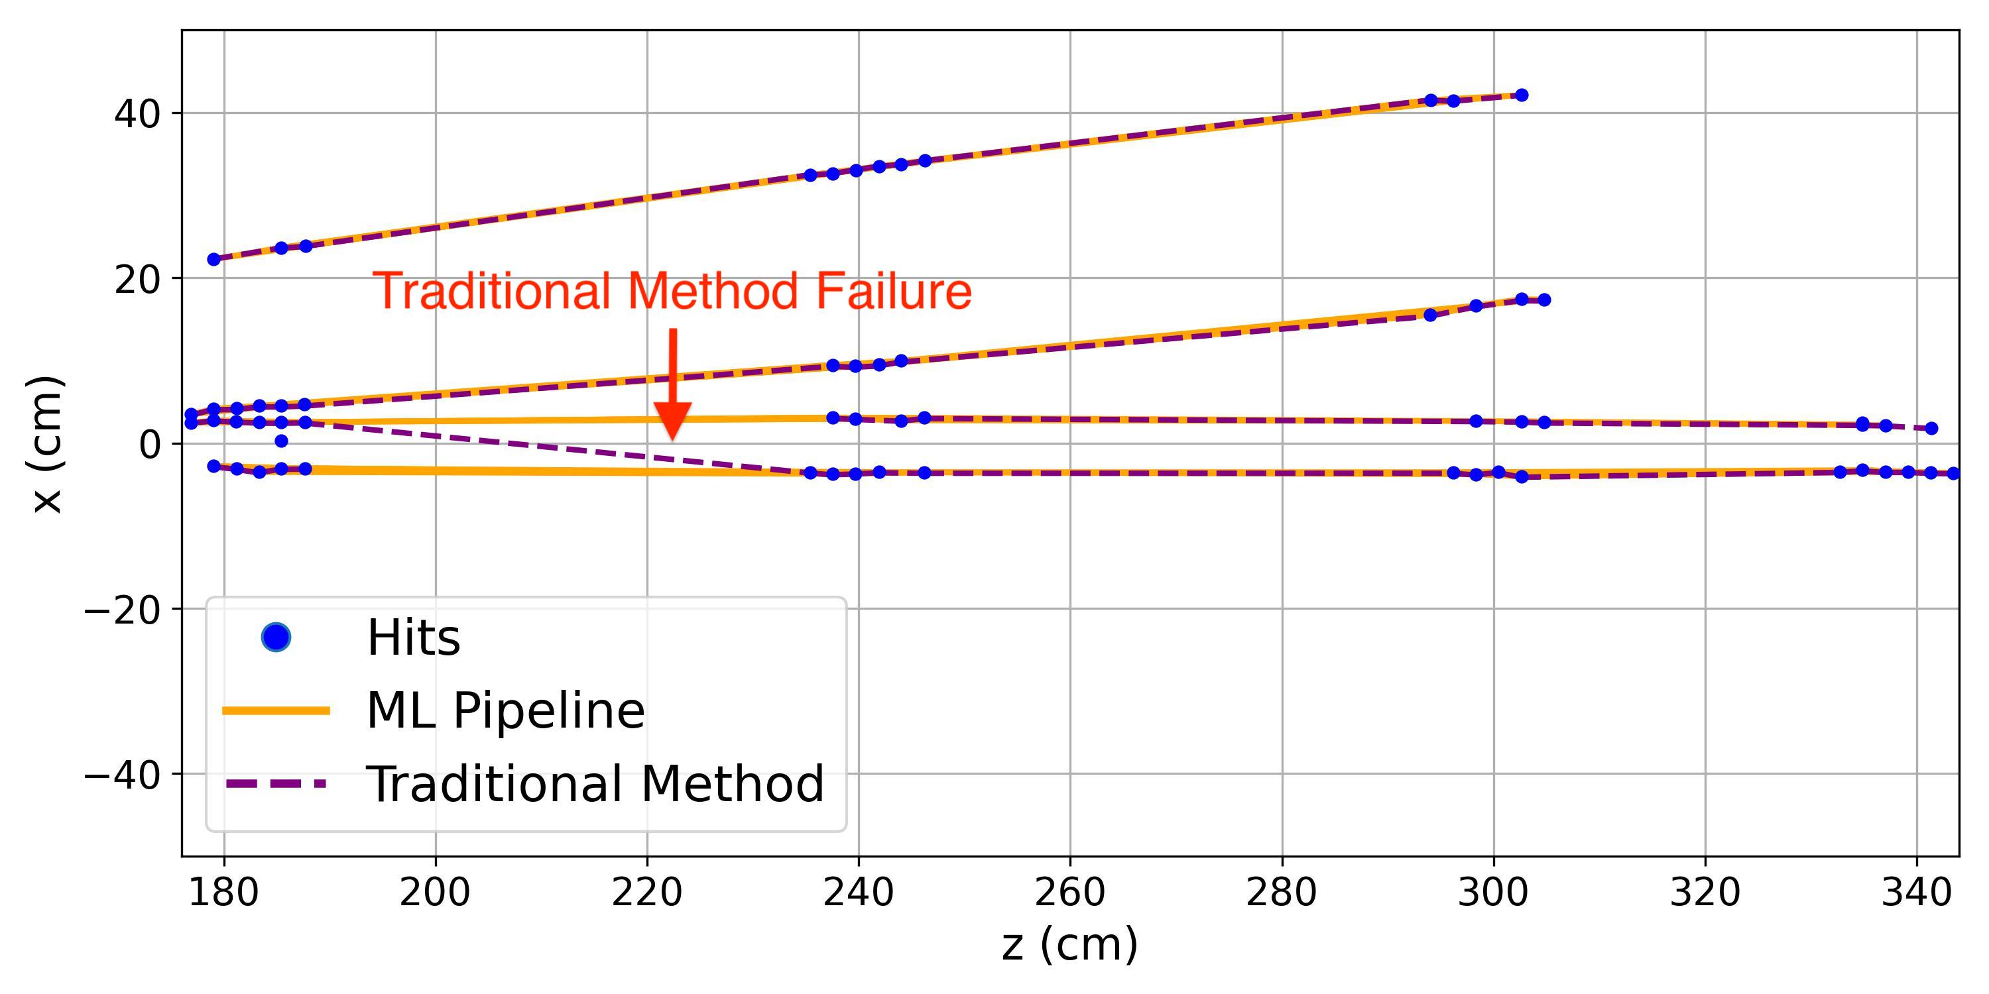
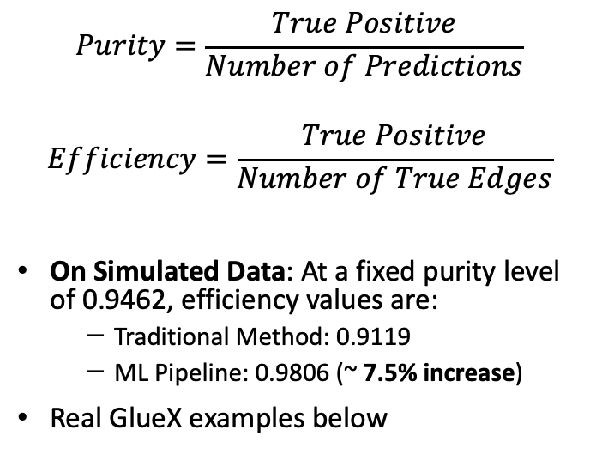
Segment-Based Performance Results
$$Purity=\frac{True Positive}{Number of Predictions}$$
$$Efficiency=\frac{True Positive}{Number of True Edges}$$
On Simulated Data: At a fixed purity level of 0.9462, efficiency values are:
  Traditional Method: 0.9119
  ML Pipeline: 0.9806 (~ 7.5% increase)
Real GlueX examples below

Slide 8
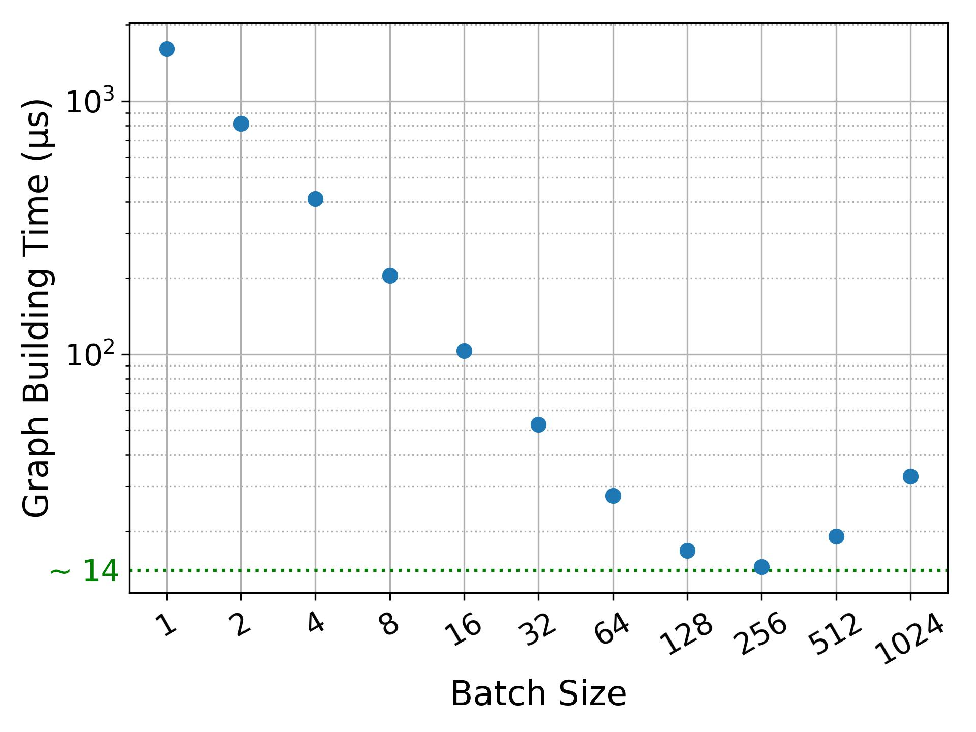
Timing Analysis
Lowest Graph Building Time on A100 (~ 14 µs) @ batch_size=256
Pipeline Results ➔ Table
Limited gain with I increase ➔ Shortcuts
81.6% time reduction @ batch_size=256: 28 µs (pipeline) vs 152 µs (traditional method)
Largest W fitted on FPGA is 16 ➔ slight reduction in efficiency (0.9565) ➔ 98.4% time reduction to 2.5 µs between successive outputs
W \ I | I = 1 | I = 2 | I = 3
W = 64 | 0.9771; 27 ± 1 | 0.9839; 37 ± 1 | 0.9848; 41 ± 5
W = 128 | 0.9806; 28 ± 1 | 0.9848; 41 ± 2 | 0.9857; 87 ± 21
W = 256 | 0.9808; 74 ± 26 | 0.9847; 112 ± 17 | 0.9852; 219 ± 23
Pipeline Eff. at purity of 0.9462; Inference Time (µs)

Slide 9
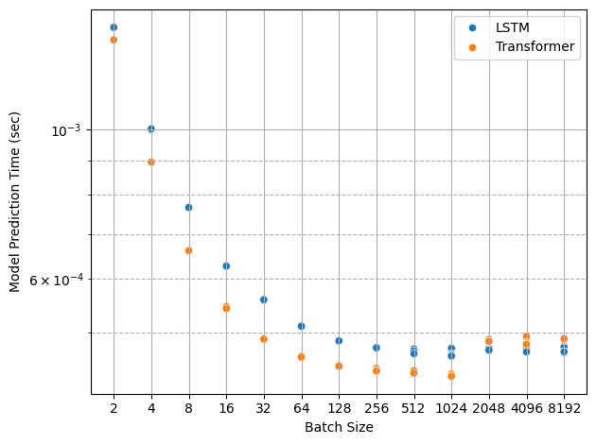
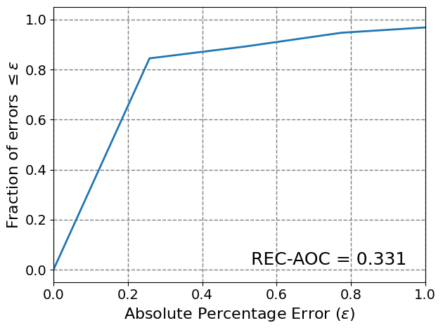
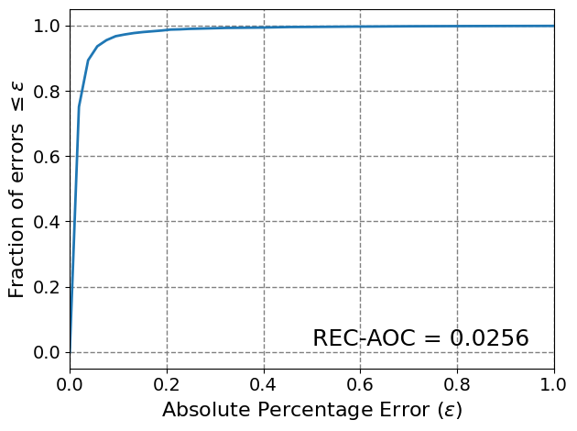
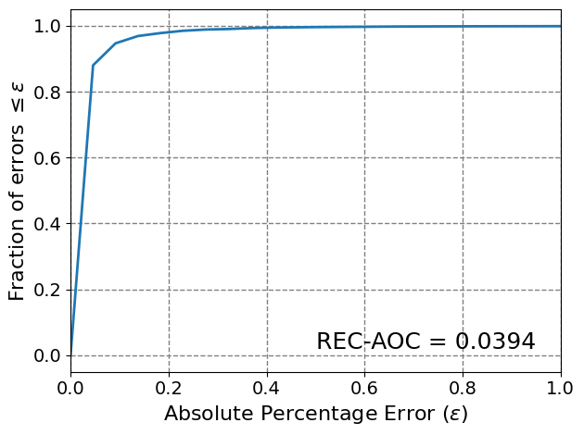
Early Stage LSTM/Transformer Fitting Results
Assumption: Perfect Finding ➔ Estimate Momentum & Charge
Charge Prediction Accuracy:
Traditional (0.9019) vs LSTM (0.9948) vs Transformer (0.9924)
Figures below: P_{𝜭} Regression Error Characteristic (REC) curves
Timing: To GPU ➔ Model ➔ To CPU
TODO: Investigate Traditional method & more on timing
Traditional
LSTM
Transformer

Slide 10
Conclusion & Future Work
Conclusion
  Edge-Classifier GNN outperforms traditional method in terms of performance (7.5% increase in efficiency) & inference time (81.6% reduction) on A100
  Results in: Geometric GNNs for charged particle tracking at GlueX
On-going Work
  Track Fitting: Fitting takes ~90% of the total reconstruction time in traditional pipeline ➔ Promising early results using LSTM & Transformer
  Full pipeline real-time deployment on CPU/GPU/FPGA
  Evaluate on TDIS (high multiplicity)
Questions? Ask:
  Ahmed Mohammed (ahmedm@jlab.org)
  Kishansingh Rajput (kishan@jlab.org)
Open to collaboration ☺

Slide 11
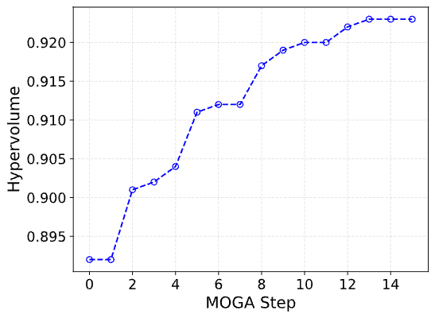
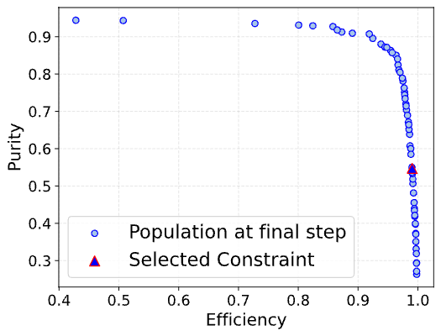
Backup (Graph Builder)
Residual edges cause track loops ➔ Can be addressed in a postprocessing stage
Constraints:
  xy-plane Distance Constraint: d_{xy}^{(a,b)} < 34.4 cm
  Slope Constraint: d_{xy}^{(a,b)} / dz^{(a,b)} < 5.4
  Azimuth Angle Diff. Constraint: |dϕ^{(a,b)}| < 2.3 rad
Multi-Objective Genetic Algorithm (MOGA) study ➔ Chose Pareto Front point achieving a minimum efficiency of 0.99
Redundant True Edge

Slide 12
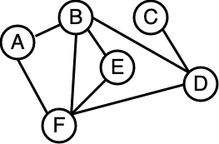
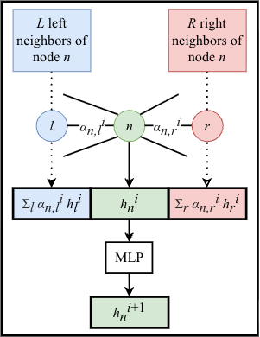
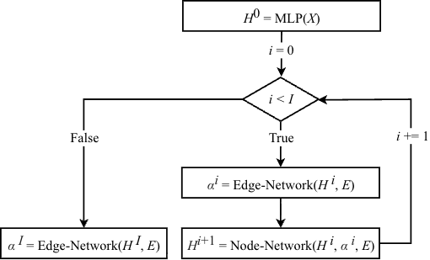
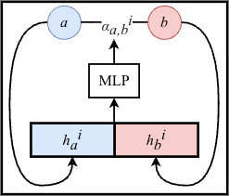



Backup (GNN)
${\{…, h}_{C}$^{(i)}, $h_{D}$^{(i)}, …}
Edge-Network
${\text{\{}…, \text{α}}_{C,D}$^{(i)}, …}
Node-Network
${\{…, h}_{C}$^{(i+1)}, $h_{D}$^{(i+1)}, …}
Edge-Classifier GNN
Edge-Network
Node-Network

Slide 13
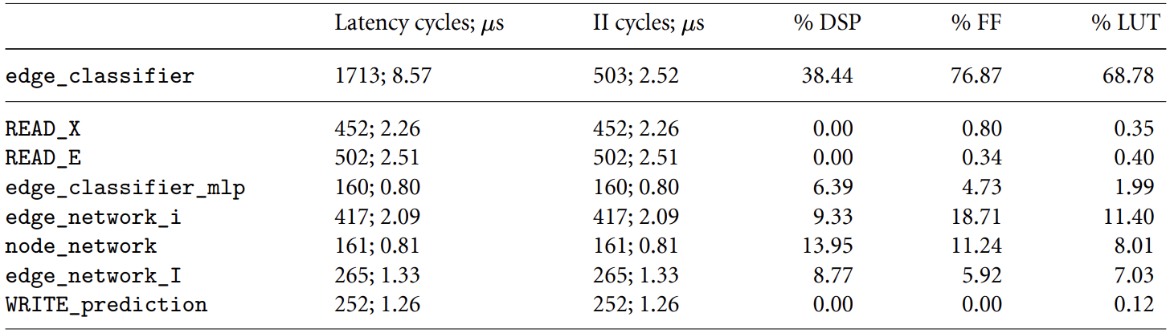
Backup (FPGA)
Resources and timings of various functions on the FPGA with the same hyperparameters specified previously (I = 1, W = 16, D = 1). READ_X and READ_E refer to reading node features and adjacency list from the data stream, respectively. WRITE_prediction refers to writing last edge-network call (i.e. edge_network_I) predictions to the data stream.

