Slide 1

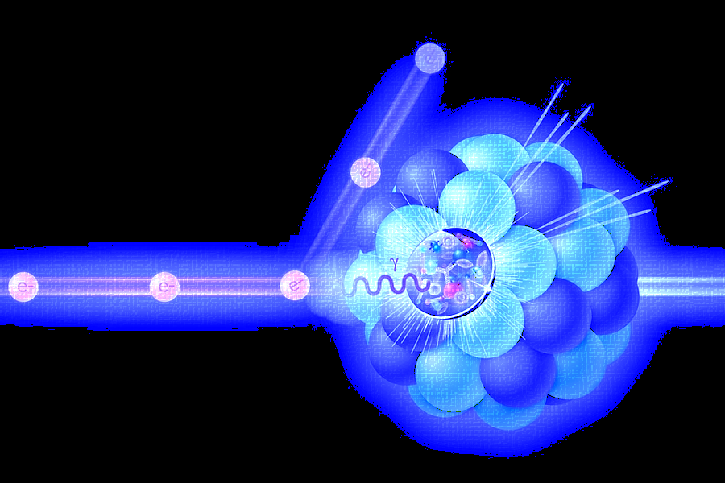
Electron-Proton Scattering Event Generation using Structured Tokenization
AI4EIC
October 29th, 2025
Steven Goldenberg
The research described in this presentation was conducted under the Laboratory Directed Research and Development Program at Thomas Jefferson National Accelerator Facility for the U.S. Department of Energy.

Slide 2
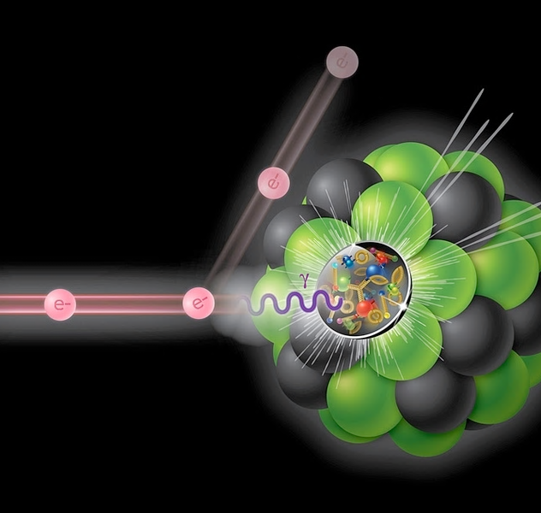
Modeling Scattering Events
Electron-proton scattering events generate dozens of particles with complex characteristics
Particle identification
Transverse momentum
Azimuthal angle
Pseudorapidity
Transformer-based generative models often rely on tokenizations of data
Key Question:
What level of complexity should our tokens represent?
Insight:
Expressivity grows linearly with vocabulary size but exponentially in sequence length!
Notes:
Motivation is to accurately model, encode, and reproduce events with statistically and physically accurate particle characteristics

Slide 3
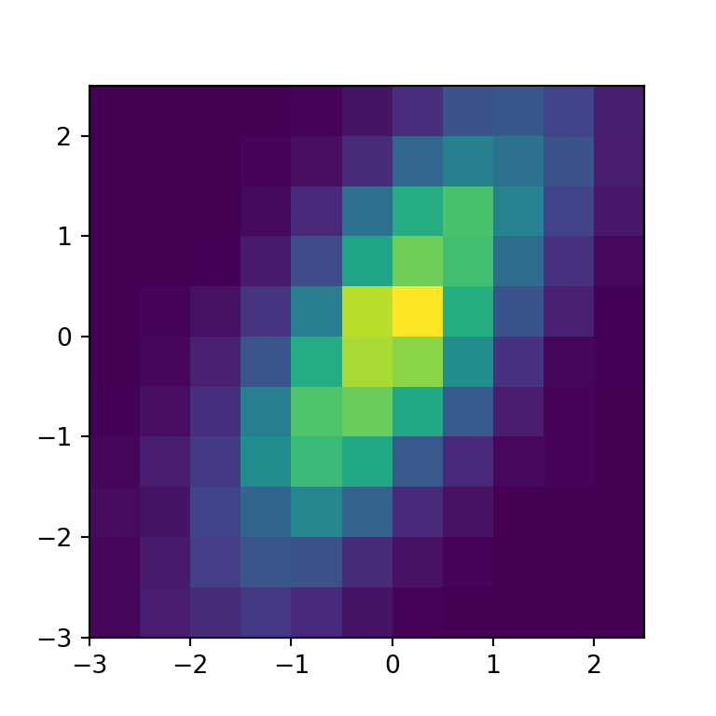
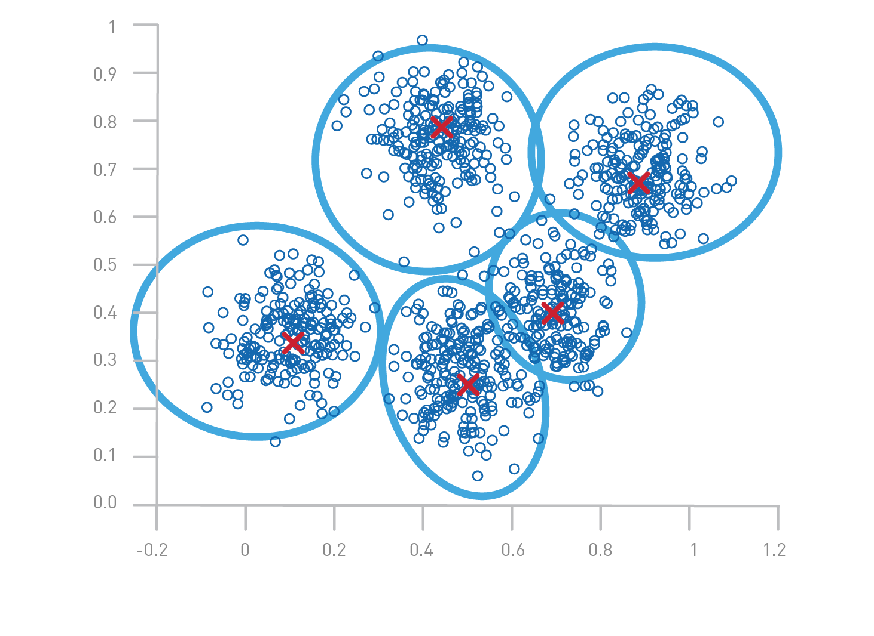
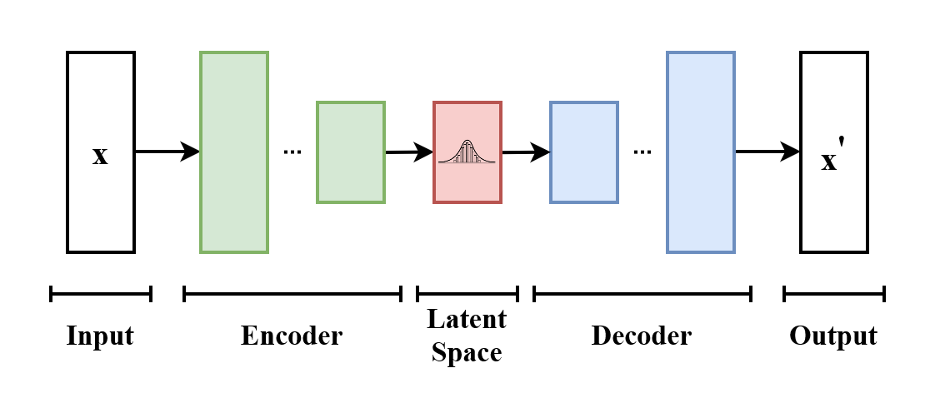
Full Particle Tokenization Methods
Uniform binning
K-means clustering
VQ-VAE
+

Slide 4
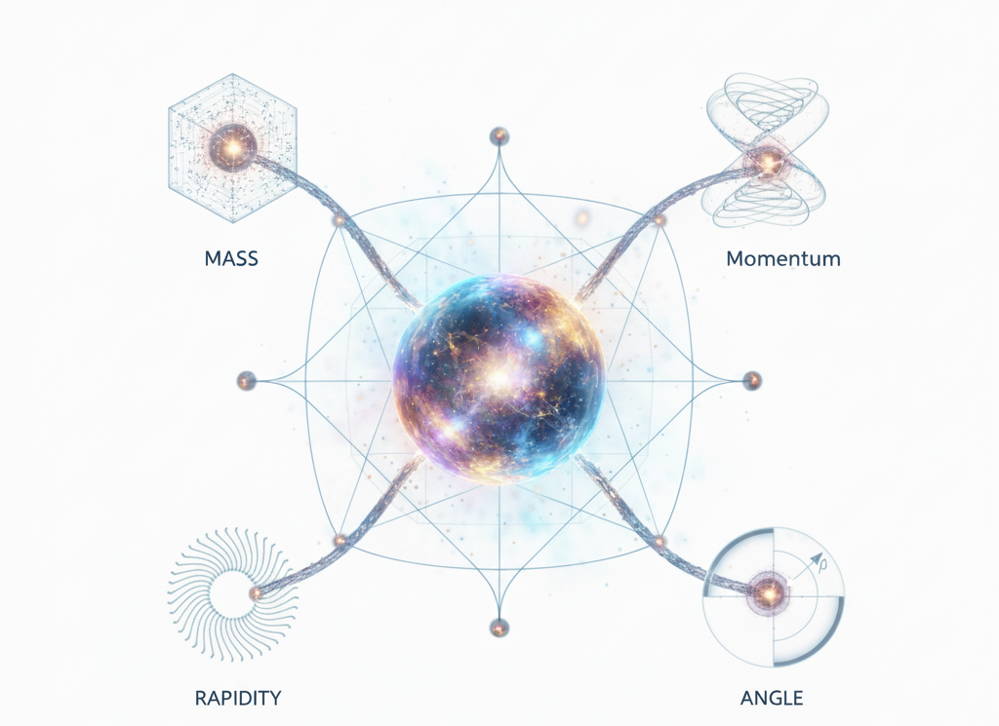
Structured Tokenization
Represents each particle using multiple tokens
Continuous features (momentum, rapidity, angle) can share the same vocabulary by enforcing “structure”
Compared to a 10³ binning for 3 combined features, the same vocabulary size can produce 1000³ different particles!
pID
Momentum
Rapidity
Angle
1000-1019
0 - 999

Slide 5
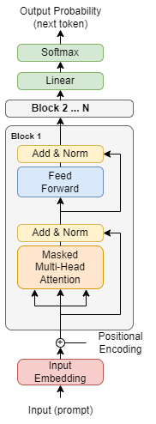
Generative Transformer Model
Utilizes tokenized data for sequence prediction
Embedding layer to a latent dimension of 512
Positional encoding
6 Transformer Blocks
8 Headed Multi-Attention
Layer normalization
2 layer MLP with ReLU activations and feed-forward dimension of 2048
Sequence length longer for structured tokenization (502 vs 102)

Slide 6
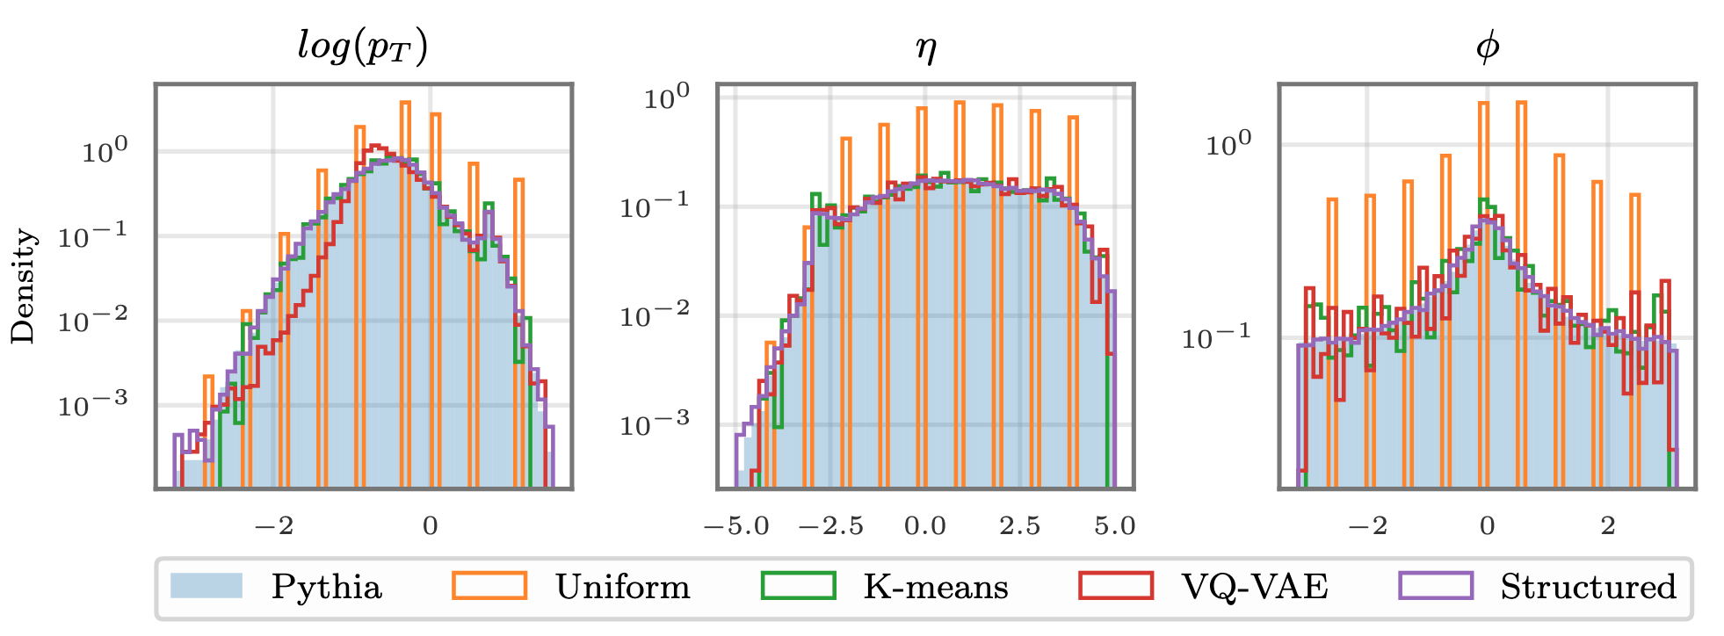
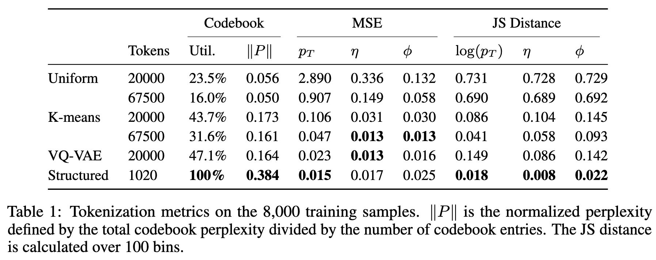
Tokenization Results
Given Pythia simulated EIC-scale events:
Uniform binning requires far more bins to be useful
VQVAE and K-means perform well but require large vocabularies
Structured tokenization significantly reduces reconstruction errors with a minimal set of tokens

Slide 7
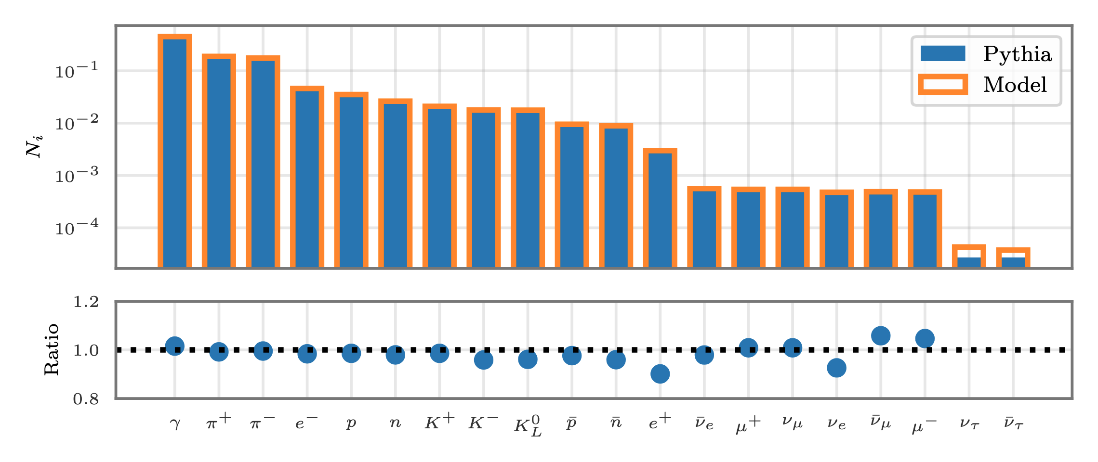
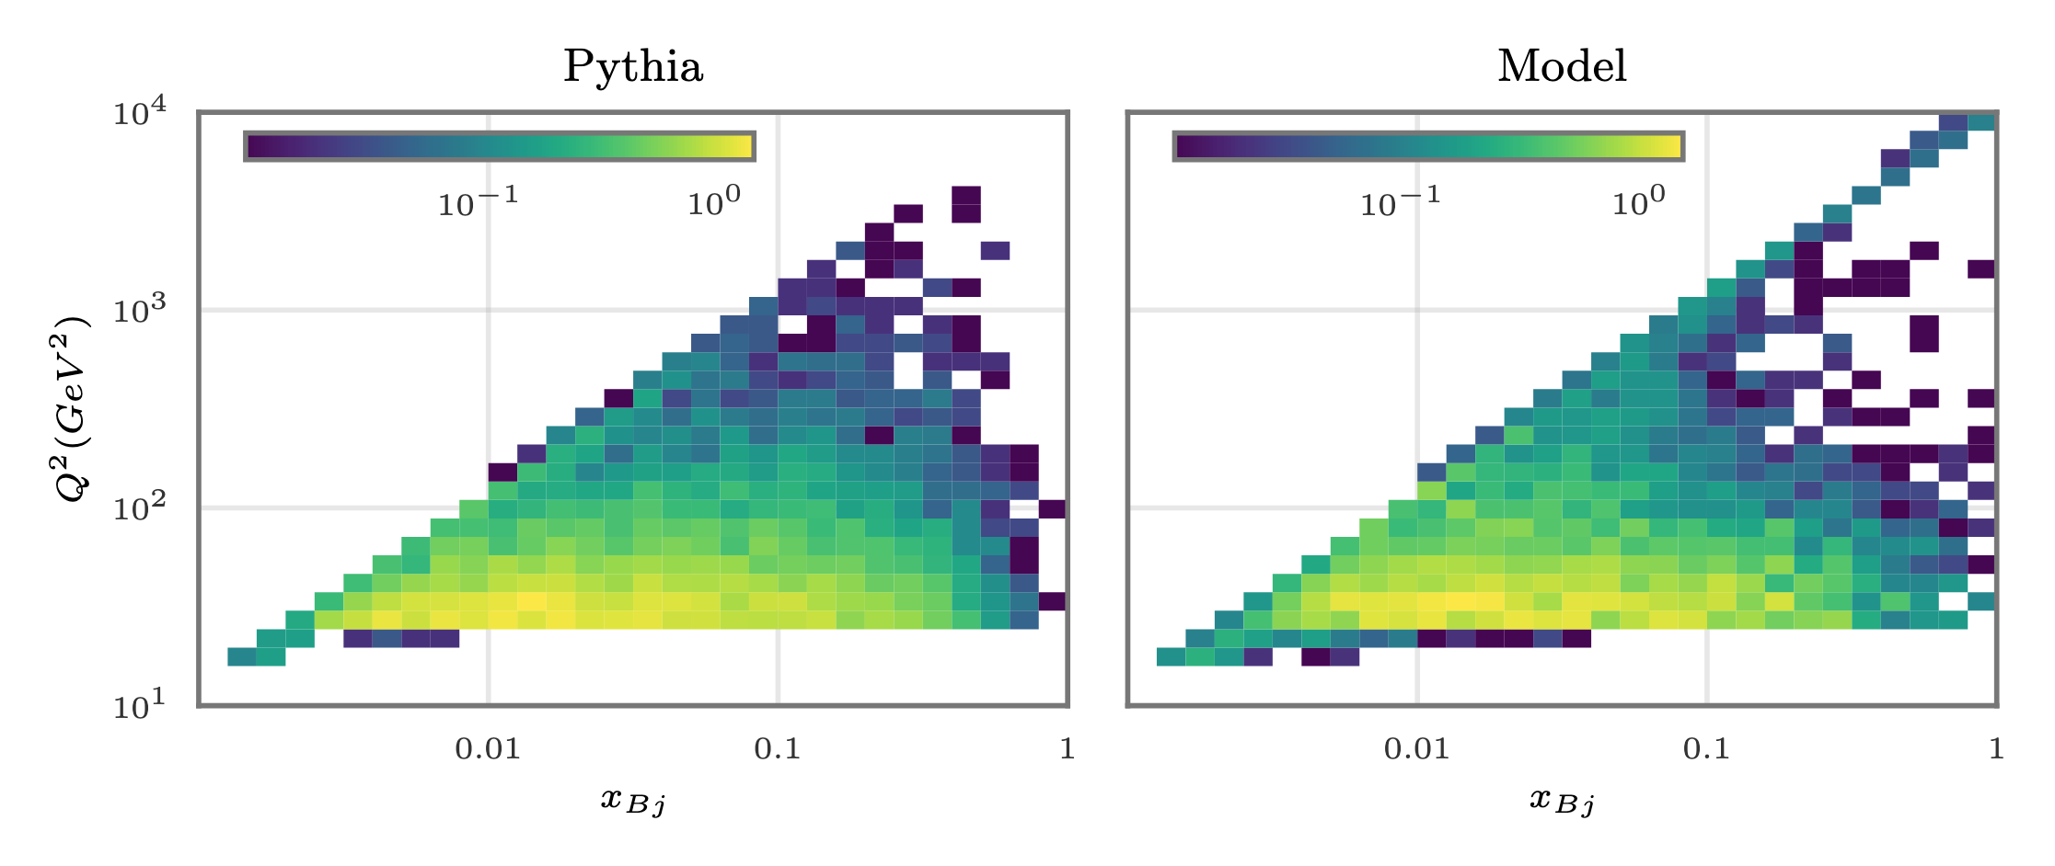
Generative Results
Longer sequences from structured tokenization did not reduce generation performance
Over 10k events, particle fractions match the true Pythia data
Generated reasonable derived x/Q² plots without constraints

Slide 8
Conclusions
Structured tokenization significantly improves reconstruction and generation of complex features
Longer sequence lengths improve accuracy, but increase training and inference costs
More work needs to be done to balance these objectives
Future work needed for conditional generation
Necessary for useful foundation models
Our work suggests standard LLMs could be fine-tuned for event generation given highly structured text

Slide 9
Thank you! Questions?

