Slide 1
Silicon dummy sensor removal

Slide 2
Introduction
The UK had a complete wafer of silicon dummy sensors (8 full-size 5-RSU and 8 full-size 6-RSU LAS for some time
Issue was that this was still on the backing foil
Removal from the backing foil was considered a high-risk process
After discussion with colleagues,we procured a ceramic vacuum chuck
This is still on order, expected in June
To speed up the process we sent the wafer to CERN and two weeks ago we removed the dummy sensors with a setup from ALICE ITS3
Thanks to Michele Sacchetti (Bari) and Antoine Junique (CERN)
In a similar fashion the mechanical dummies for LBNL have been removed
This went well, but very different from what I expected

Slide 3
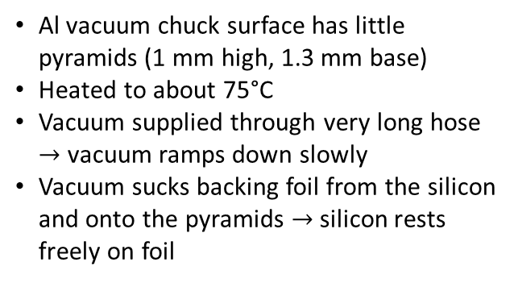
Procedure
How I thought it would work
How it was done
Foil has been UV-exposed already by the manufacturer (there is a small red marker indicating this)
Still tacky enough to allow for transcontinental shipping
Step 2
Step 1
UV light
Backing foil
Pull foil off carefully
Silicon
Vacuum chuck
Vacuum chuck
At start
Al vacuum chuck surface has little pyramids (1 mm high, 1.3 mm base)
Heated to about 75°C
Vacuum supplied through very long hose $→$ vacuum ramps down slowly
Vacuum sucks backing foil from the silicon and onto the pyramids $→$ silicon rests freely on foil
At end
Vacuum chuck
Vacuum chuck

Slide 4
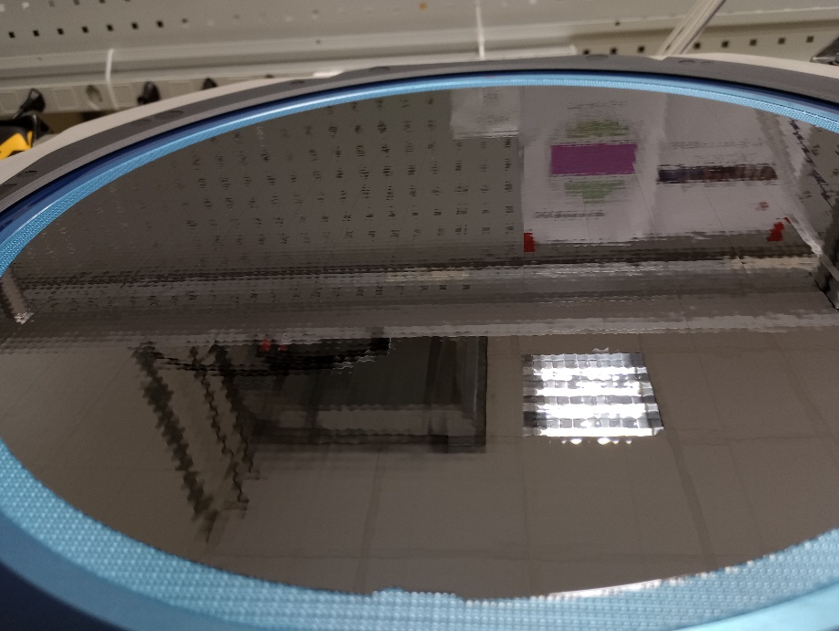
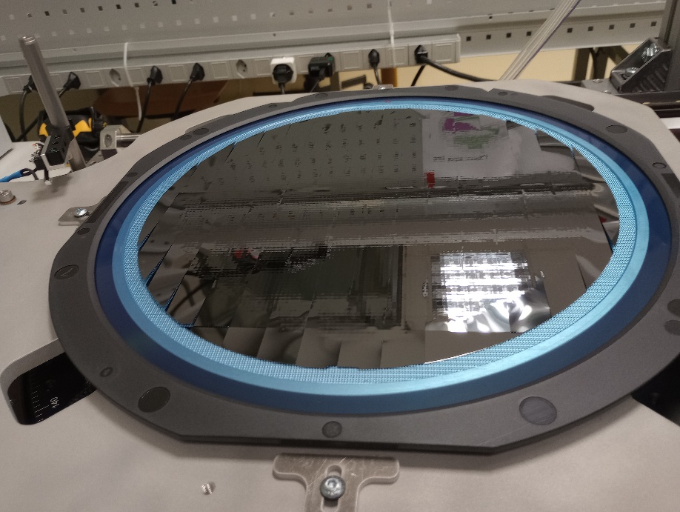
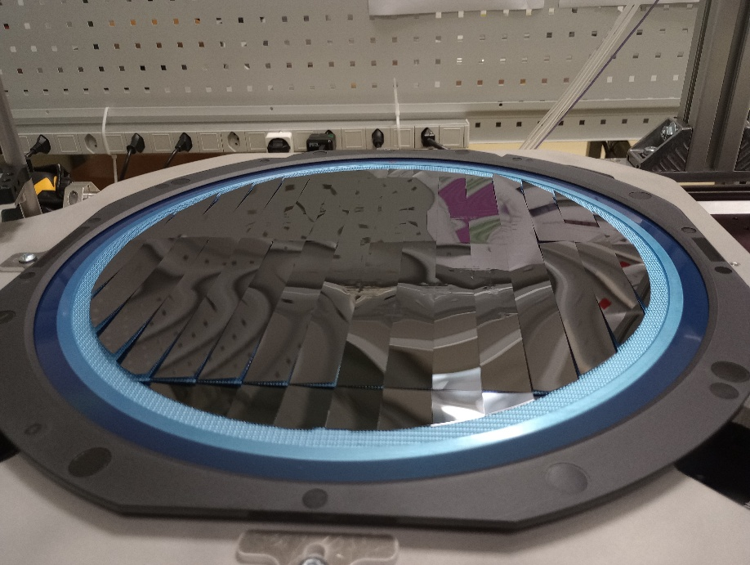
Pictures
At the beginning
Reflections are wobbly due to pyramids on the jig
Some way through
Backing foil gets sucked onto jig starting from outer rim
Silicon starts to lifts off
At the end
Silicon has lifted off everywhere

Slide 5
Storage
We supplied 5 GelPak boxes (inside the box there is a sticky soft plastic layer)
The ALICE people told us that their experience is that these do not work with thin Si
We used this to store the non-full-size silicon pieces from the rim of the wafer and I can see that they are right
Too tacky, and it’s hard to get the silicon off
Instead they suggested (and gave us) membrane boxes, where the silicon is held between two non-sticky plastic membranes
Also placed the silicon on a plate of G10, and covered with a sheet of cleanroom paper and then a 2mm layer of foam (for compression)
We used this method for the full-size LAS dummies

Slide 6
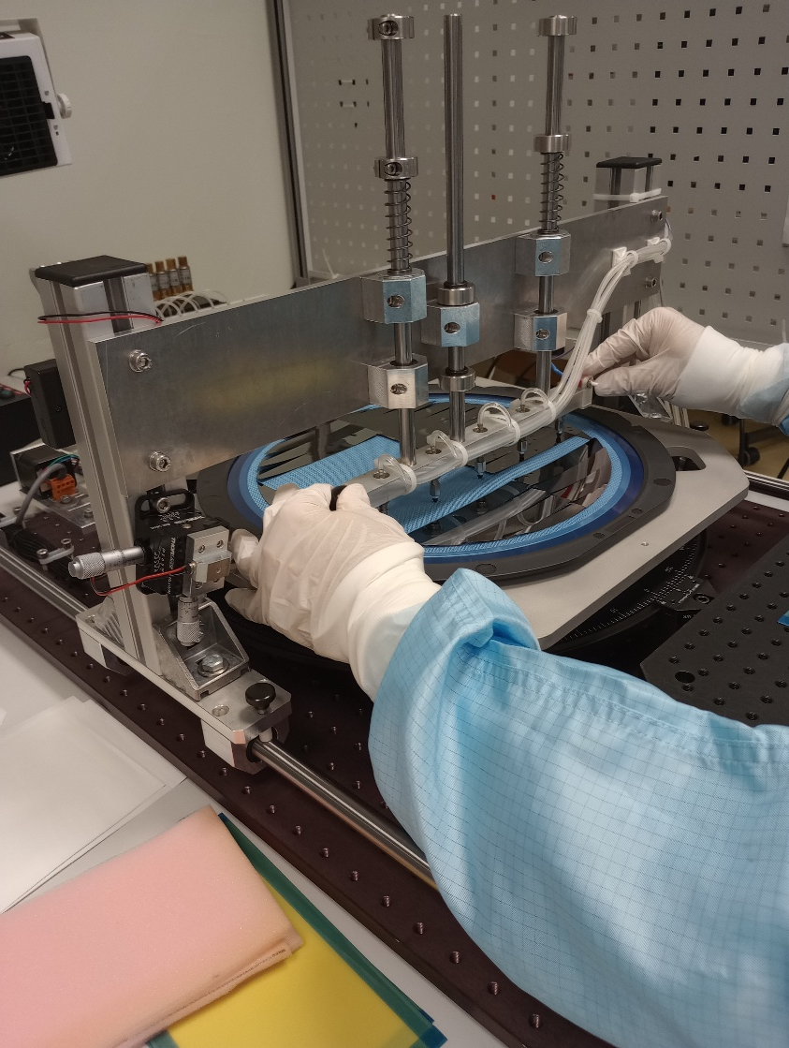
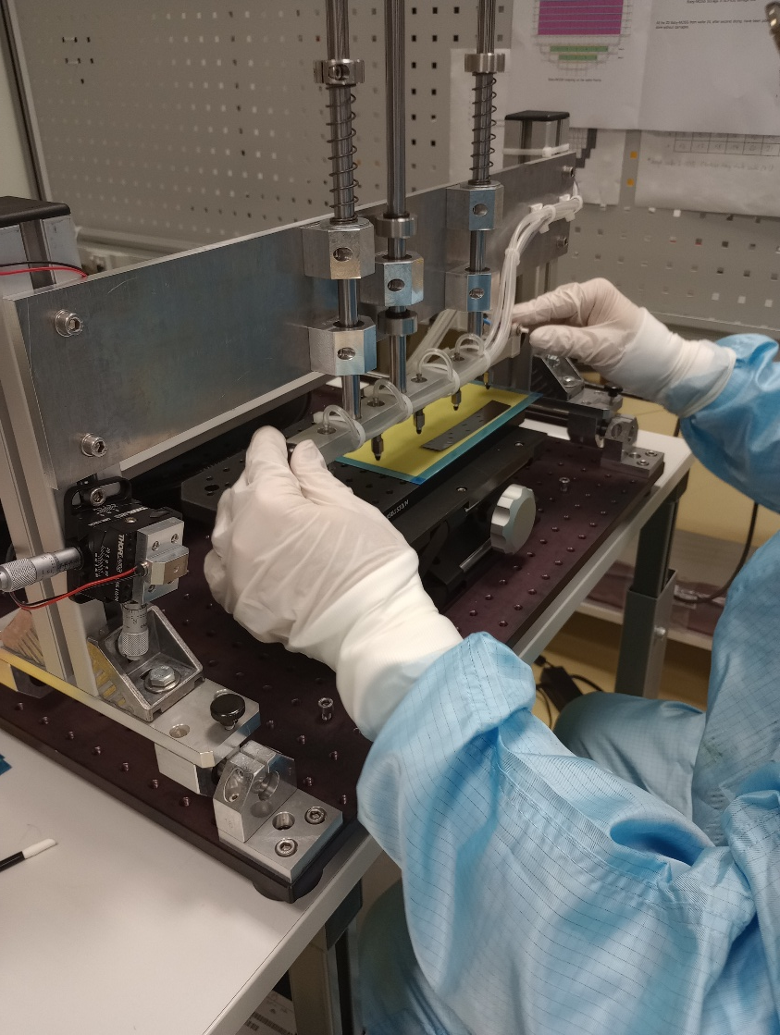
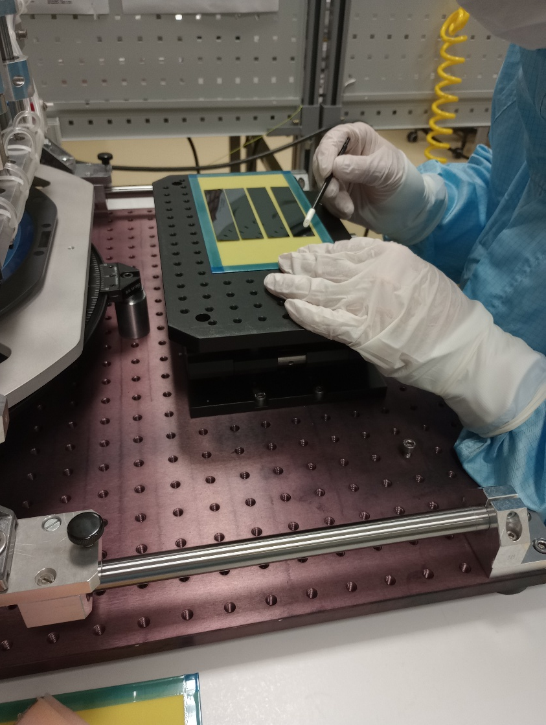
Final removal
Silicon is picked up with vacuum suction cups
Suction cups are mounted on bridge that can travel

Slide 7
Next steps
James is organising shipment back to the UK (Birmingham)
Can then be used for module assembly trials
Will need to think about how to do the removal for production
I still would like to see how removal using the original chuck design works
But maybe we will only use this only as a test fixture
We could copy the ALICE setup
This would require some effort and money, but it is a proven system
Or maybe we could ask CERN to do the removal for us during production
Maybe not really convenient because we would need to ship back and forth

