Slide 1
Astrolinx
Bi-Weekly Update

Slide 2
Changes Overview
Added nets
New footprints
New board outline
HV filter circuit
New outline
Changed regulators to 3045s
Added impedance resistor for timestamp_clk

Slide 3
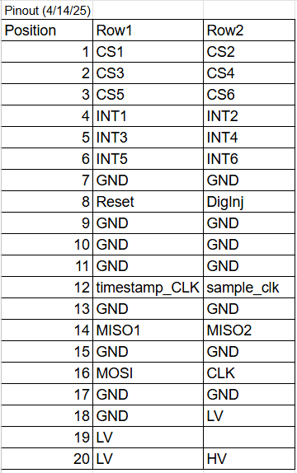
Added Nets
Added DigInj, timestamp clock, reset, sample clock
Removed CS7-12, INT7-12

Slide 4

New Footprints
Simulated placing wire bonds
Adjusted footprint for route-ability and clearance (HV net and bond-to-bond)
Have three (left, middle, and right). Angles are better for wirebonding

Slide 5
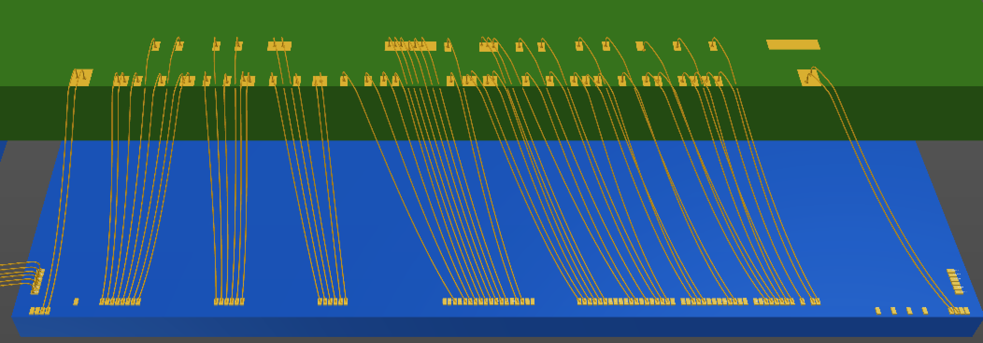
Last Footprint

Slide 6
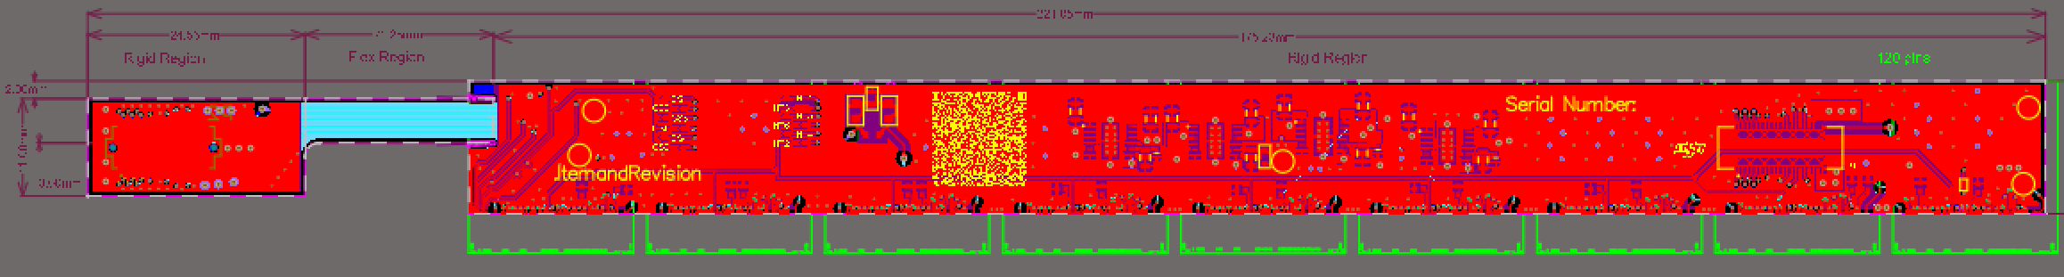
New Board Outline
Neck moved up
Neck moved into board
Neck thinned
Shortened downstream end
Increases clearance for module to module

Slide 7
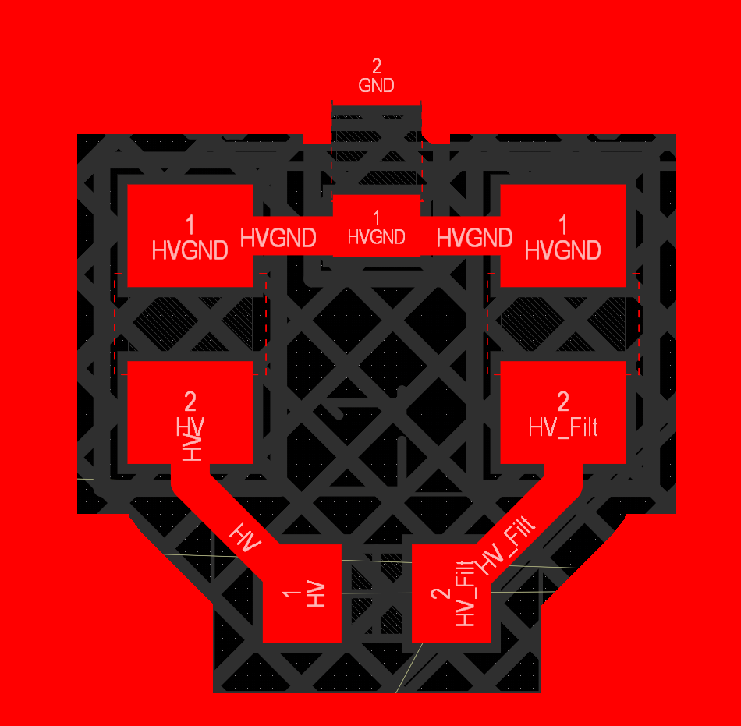
HV Filter Circuit

Slide 8
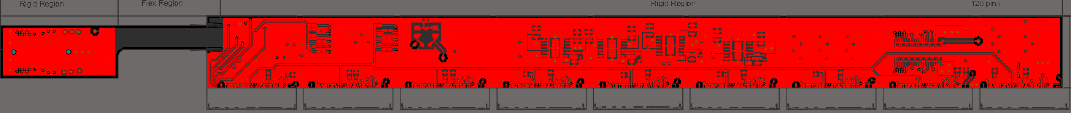
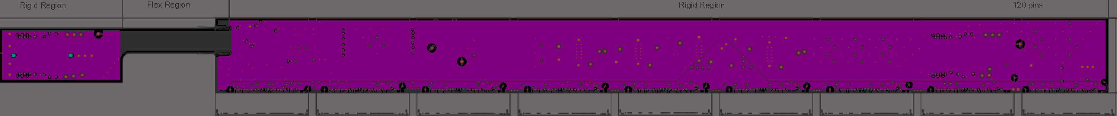
Layers

Slide 9
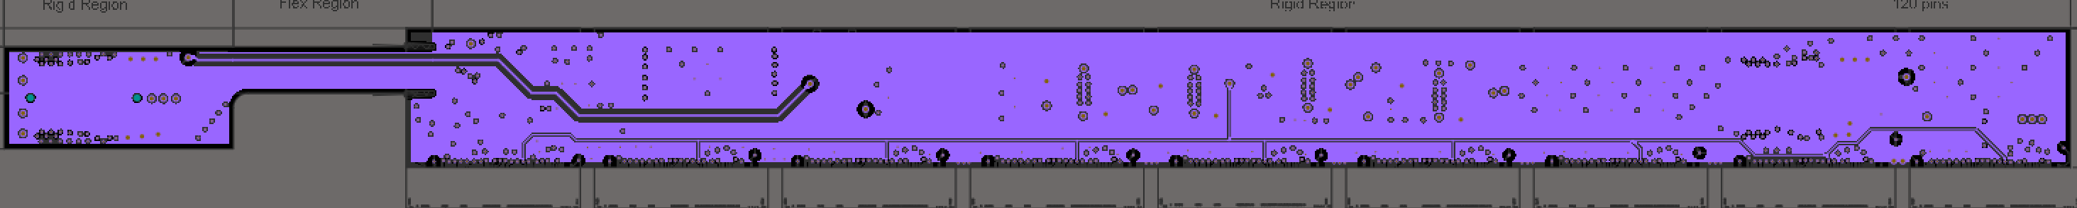
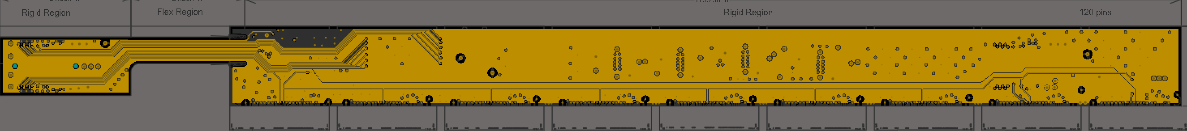
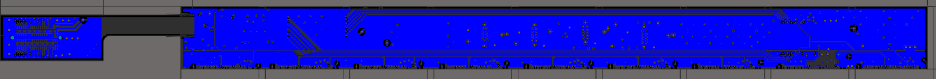
Layers

Slide 10
Upcoming
The design is near completion. Address any concerns in this meeting, quick internal review of last minute changes, ordering
Read out board routing

