Slide 1
SIDIS status
Ralf Seidl (RIKEN)
Stefan Diehl (UConn)

Slide 2
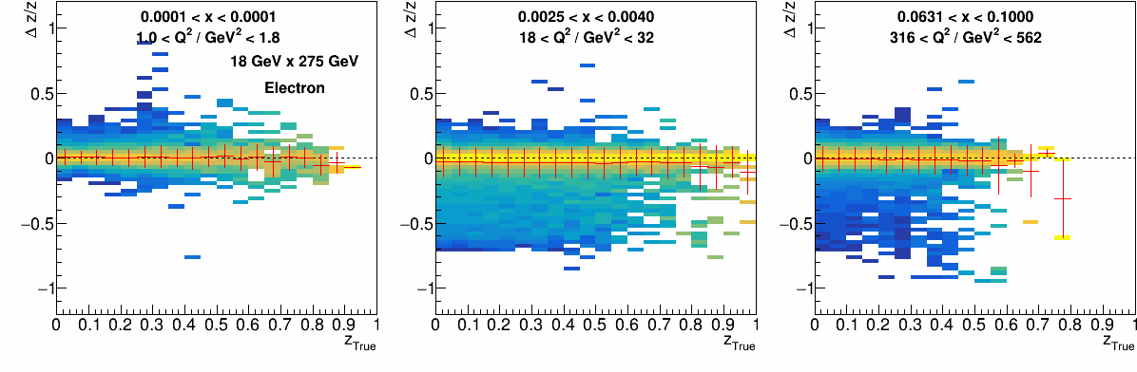
preTDR plots: SIDIS resolutions (z shown for pions
Resolutions for three sample x-Q² bins using Electron method
Similar sample resolutions available for other SIDIS variables P_{hT}, φ_{h},φ_{S}, etc
Improvements expected from better DIS electron kinematics reconstruction using not just tracking

Slide 3
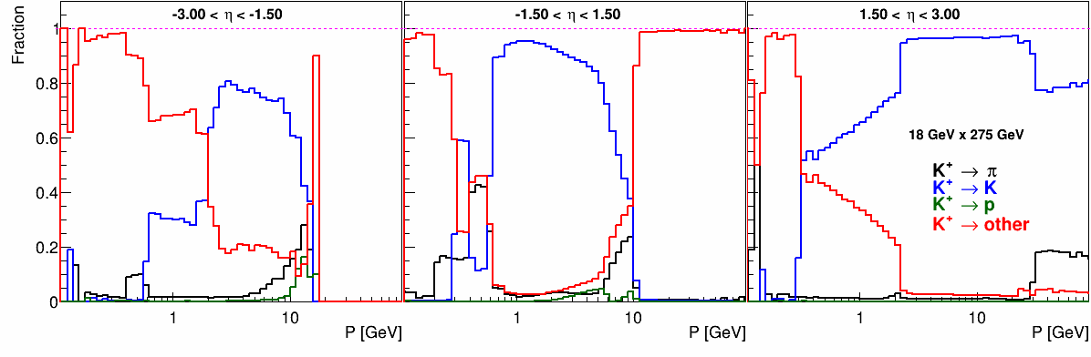
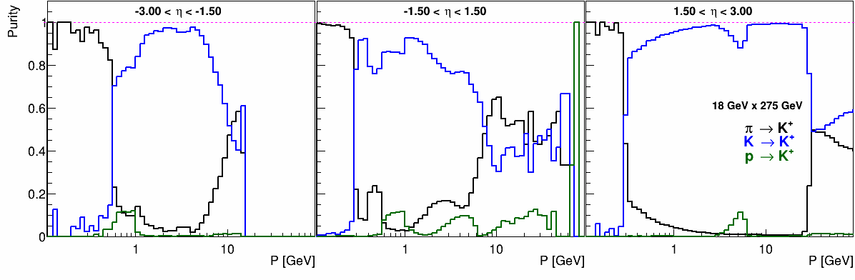
preTDR plots: PID efficiencies and purities
Kaon PID efficiencies and purities vs hadron P in three rapidity ranges
Similar plots for pions and protons available
Improvements expected from proper likelihood based PID reco

Slide 4
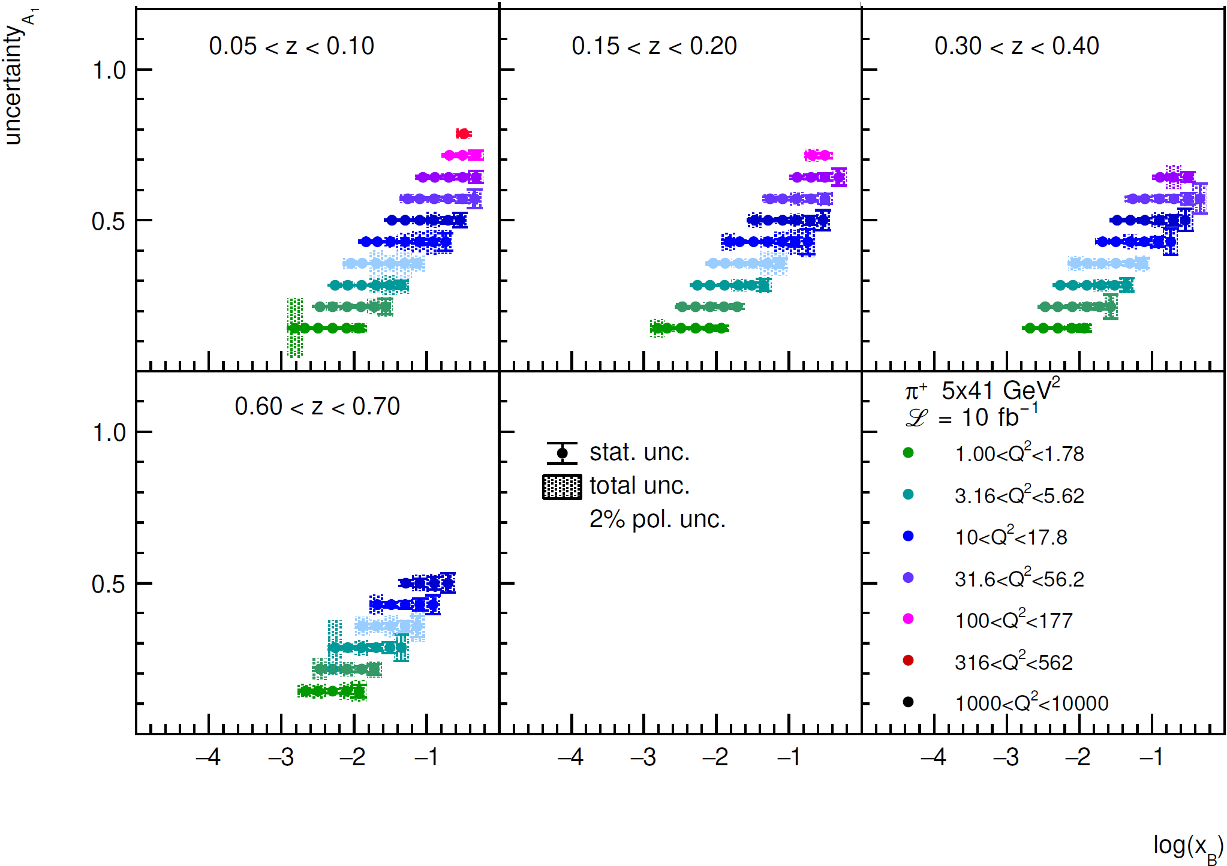
preTDR plots: A_{1p}^{π} for 5x41
A₁ asymmetries for pions as a function of x in bins for Q2 and z
Similar plots available for 18x275 energy and neg. pions and kaons
Longer term improvements expected from better systematics handling (unfolding) and radiative corrections
Charlotte van Hulse

Slide 5
preTDR plots: Collins asymmetries
Collins asymmetries for π⁺ in three x-Q² sample bins as a function of z/P_{hT} in bins of P_{hT}/z
Longer term improvements expected from better systematics handling (unfolding) and radiative corrections

Slide 6
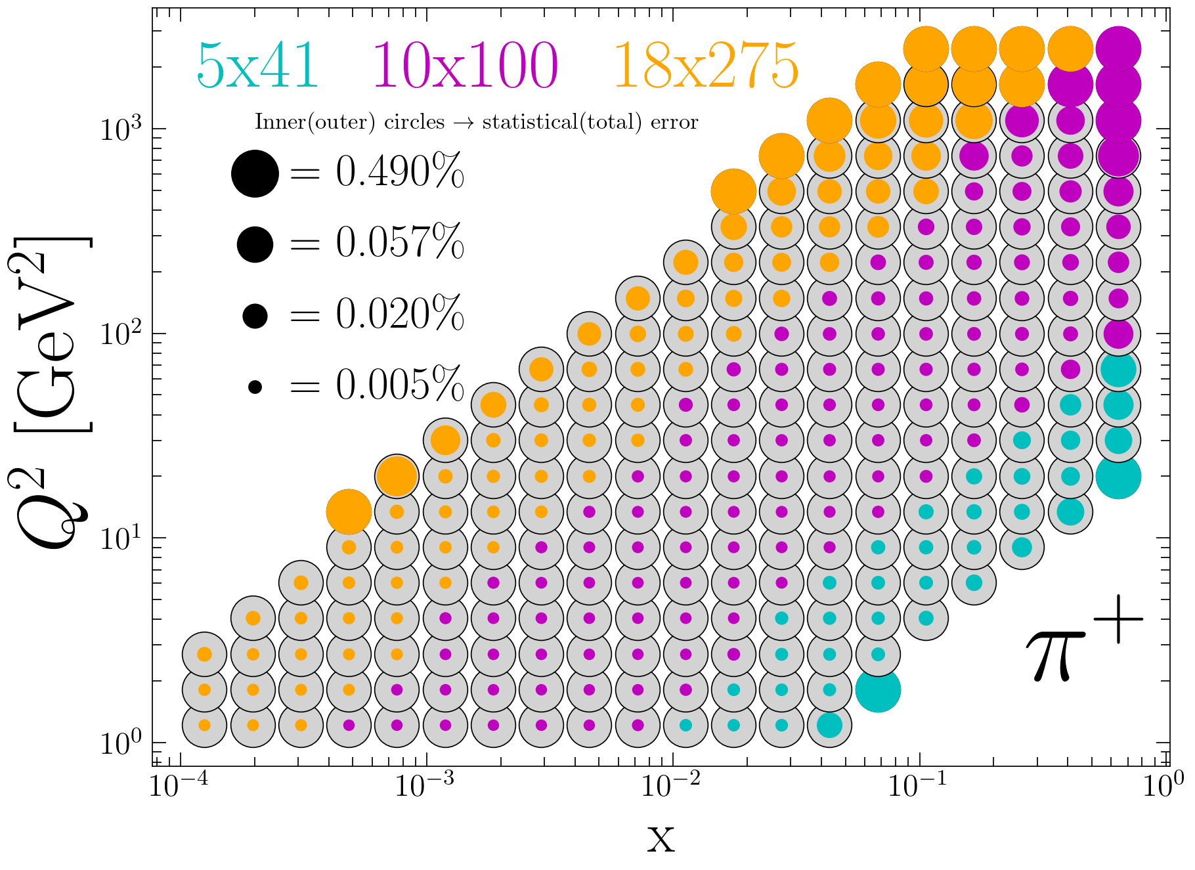
preTDR plots: unpol TMD uncertainty expectations
Gregory Matousek

Slide 7
preTDR plots:MAP24 based uncertainty impact unpol TMDs
Uncertainties from MAPS24 studies performed by Lorenzo Rossi (Pavia) using pseudo-data from Gregory Matousek (Duke)
Lorenzo Rossi

Slide 8
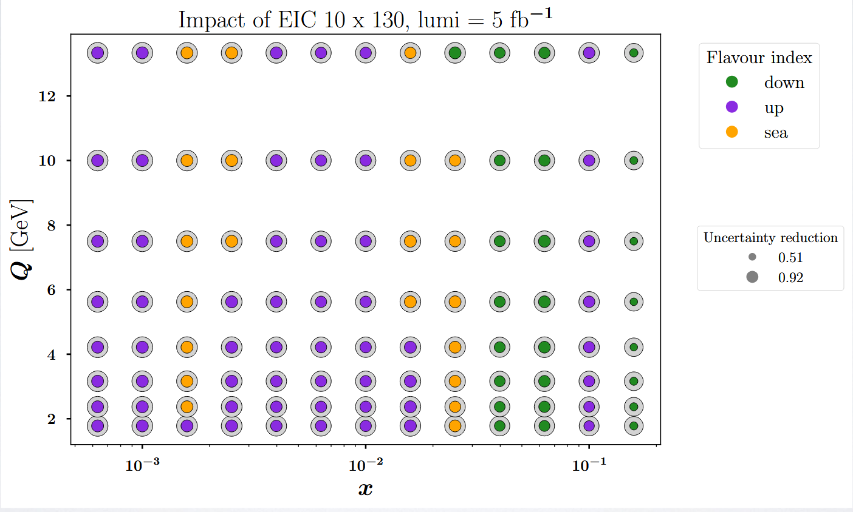
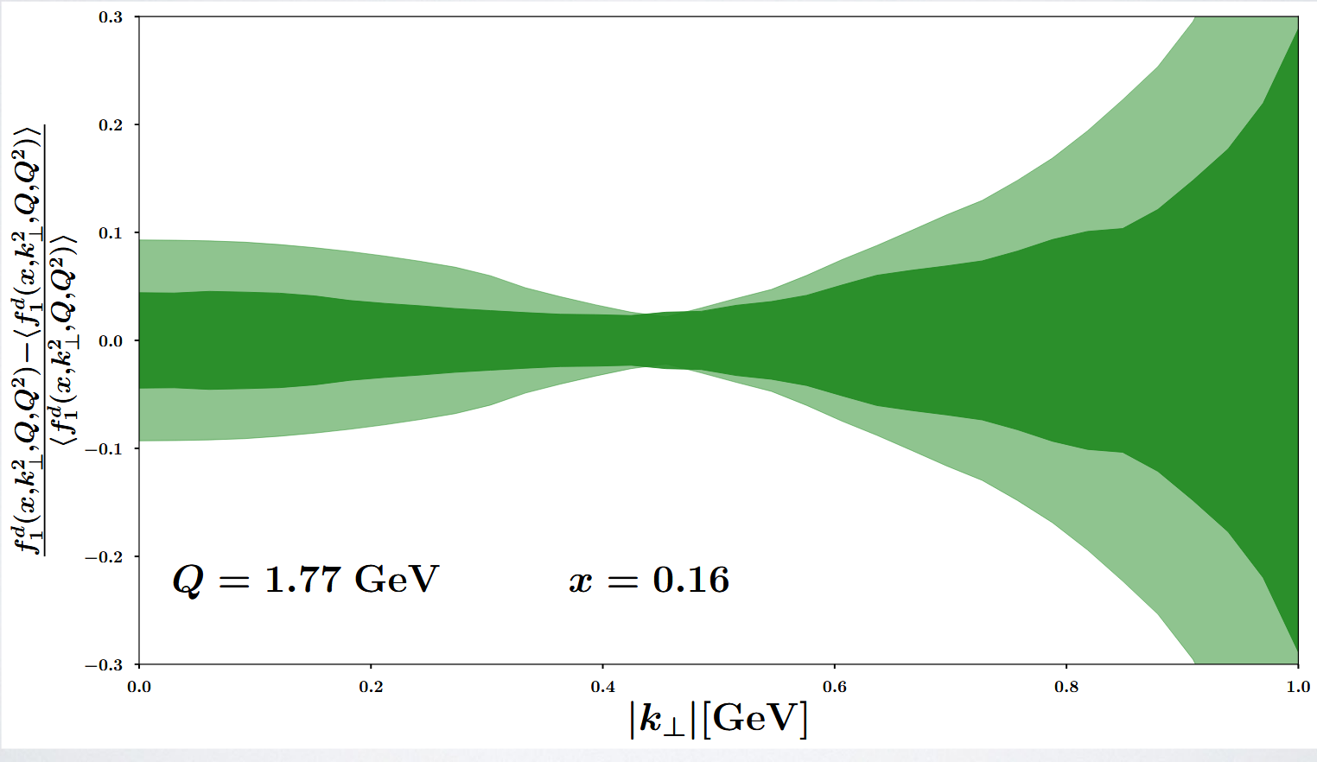
Earliest science impacts, only e+p 10x130 and 5fb⁻¹
Lorenzo Rossi and Marco Radici

Slide 9
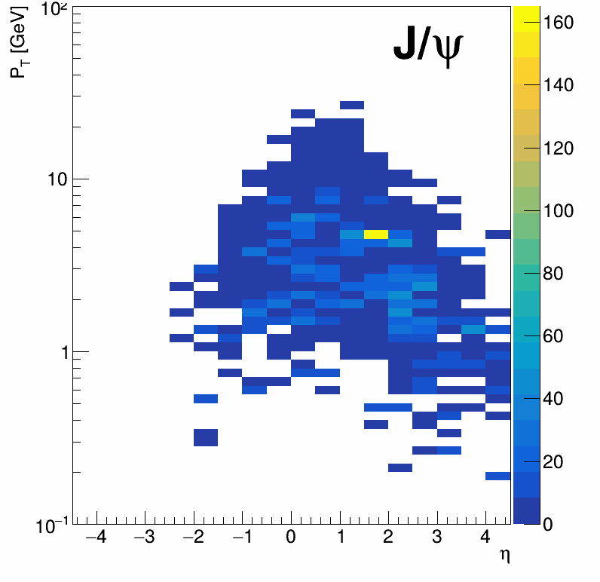
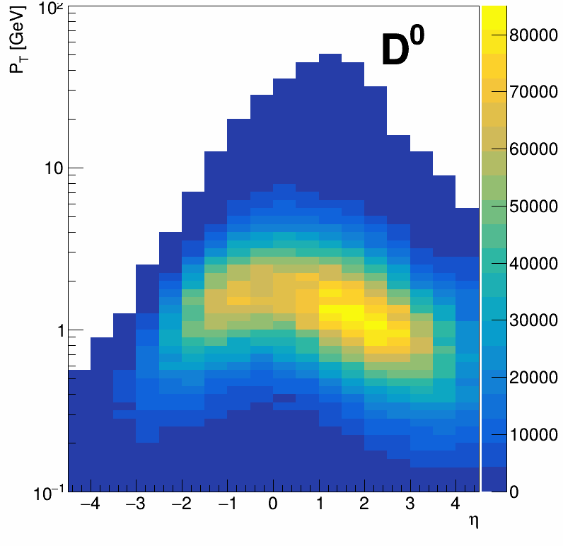
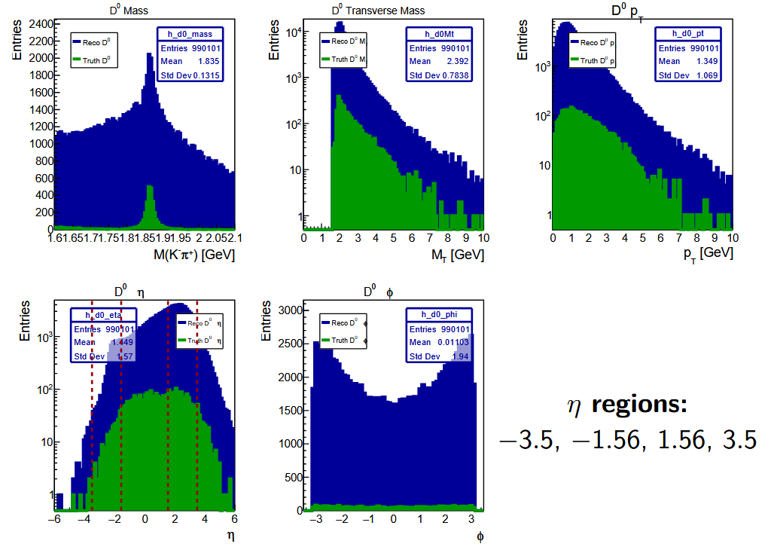
Gluon Sivers via SIDIS J/ψ →SIDIS D
DIS/NC w/DIS cuts
DIS/NC w/DIS cuts
Very few semi-inclusive J/ψ (most from B decays) although some more expected based on H1 measurements
➔ Better to use open HF for gluon Sivers studies
Artur Hoghmrtsyan

Slide 10
Important topics that are poorly covered at present
Nuclear PDFs/FFs via regular (light hadron) SIDIS → needed for early science. eRu + eAu samples to be produced →Analyzers welcome
(n)PDFs/FF for gluons via D meson/HF SIDIS →coordinate with HF/Jets group, some work started for gluon Sivers by Artur
Di-hadron fragmentation (DiFFs) studies mostly dormant since YR/proposals
Higher twist azimuthal asymmetries in single/di-hadron SIDIS (TMDs and DiFFs
Check inclusive hadron AN measurements (similar to RHIC and fixed target DIS experiments)
Unpolarized cross section studies for azimuthal modulations (Cahn/BoerMulders effects effects)
Help improve PID response toward likelihoods from all detectors with PID information (pRICH, dRICH, TOF, EMCALs)

Slide 11
Other Status
Meetings bi-weekly Tuesday 8:30 ET
Ongoing work:
Realistic PID studies for new Italian participants (mostly also working on dRHIC)
eAu/eRu preparations →BeAGLE is being produced
eD/e³He preparations →BeAGLE is being produced
Charlotte SIDIS variable implementation in Reconstruction software; cross check with RCS ongoing
Charlotte + student started looking at high-Pt di-hadrons for gluon Sivers

