Slide 1
Setup for tile testing
Y. Khyzhniak, M. Stefaniak, M. Lisa, D. Brandenburg

Slide 2
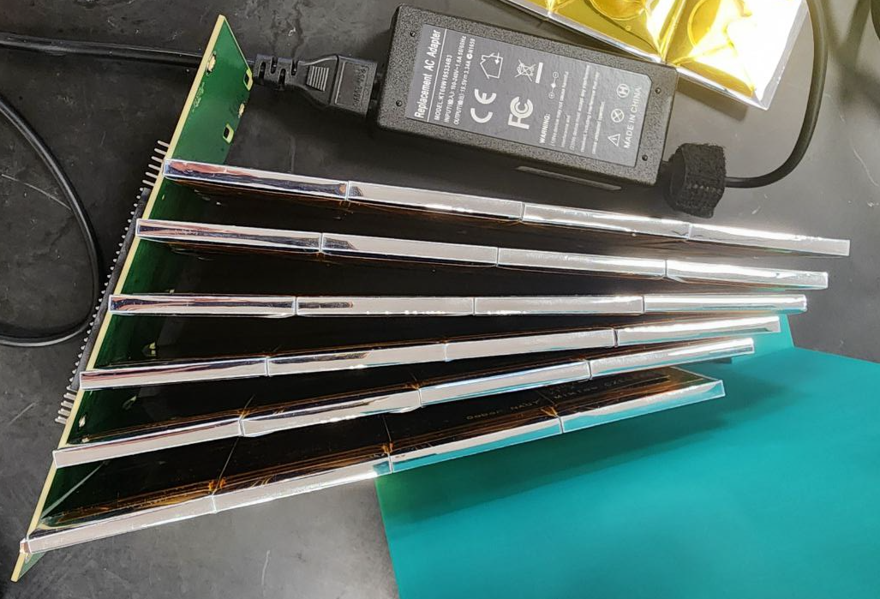
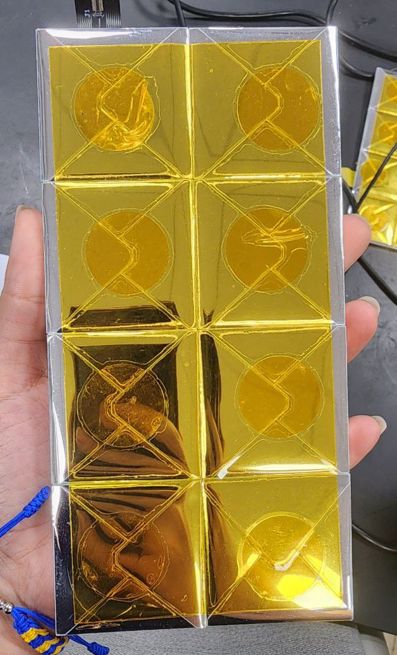
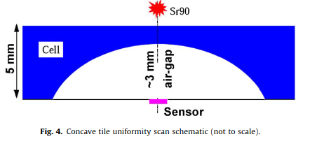
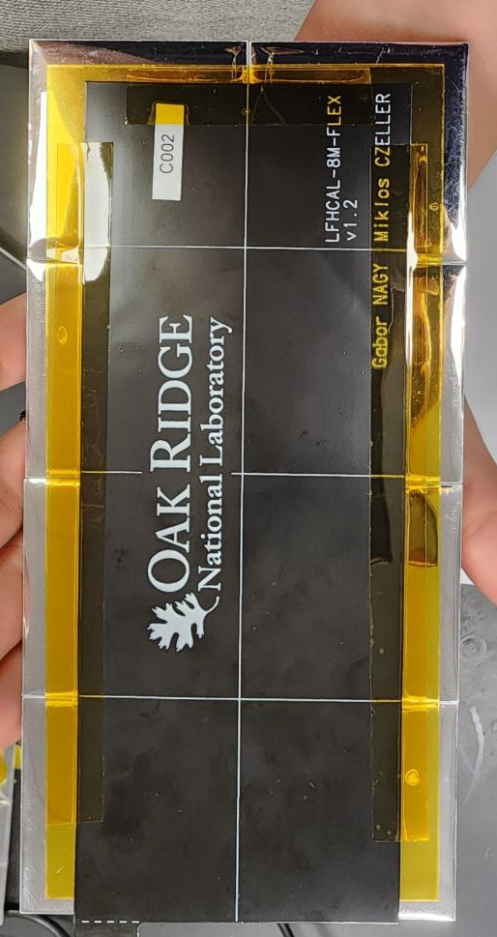
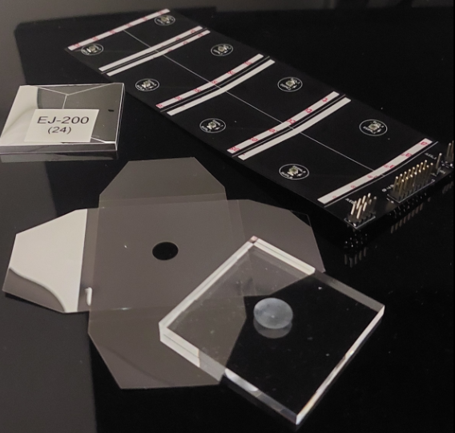
LFHCAL tiles
CALICE AHCal inspired SiPM-on-tile approach
Tiles and SiPM from Oak Rige for initial tests
Concave tile

Slide 3
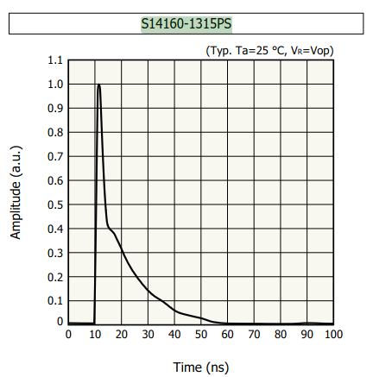
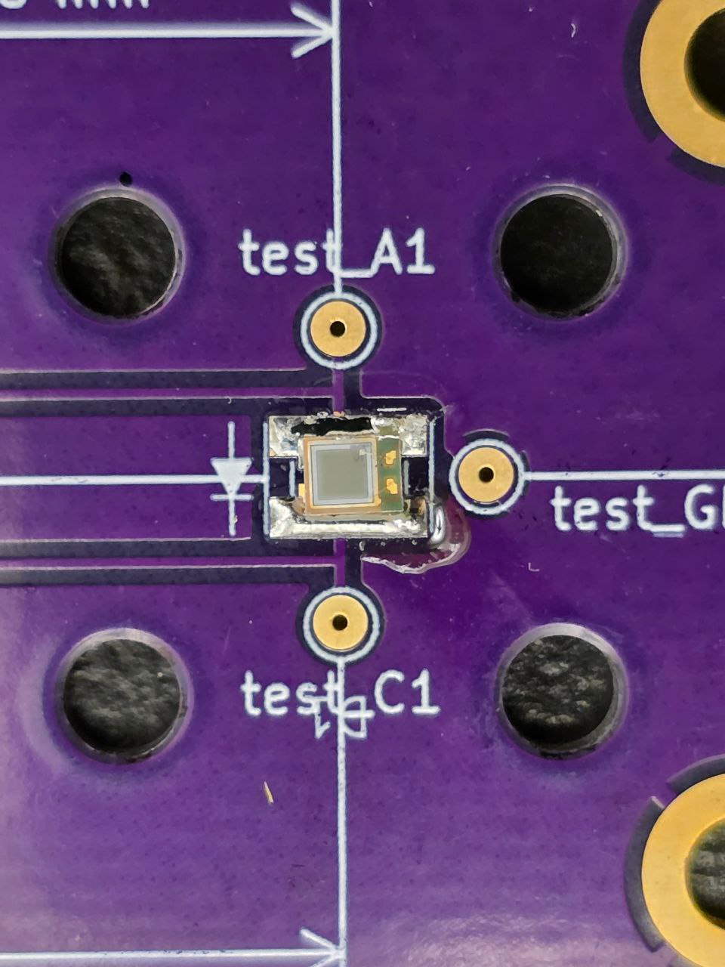
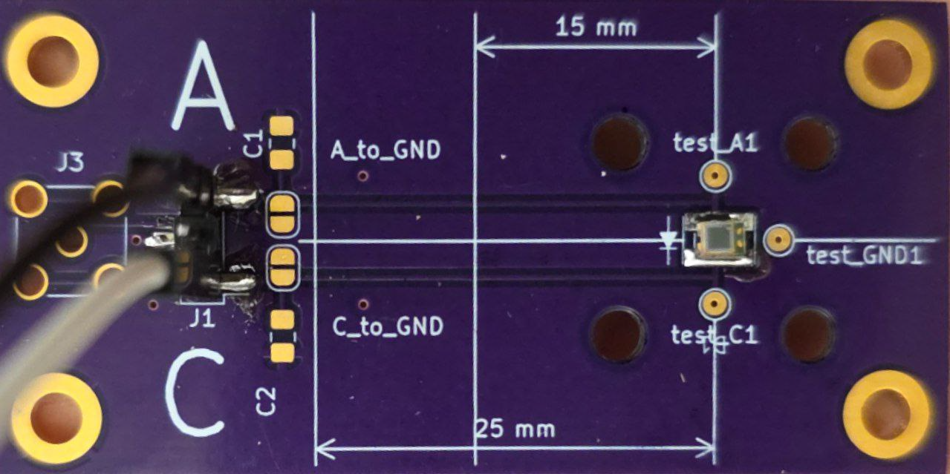
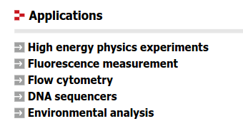
SiPM on PCB board
Typical pulse shape
S14160-1315PS
Photosensitive area (mm): 1.3 × 1.3
Number of pixels: 7284
Breakdown voltage (V): 38 ± 3

Slide 4
How is the SiPM physically connected to the tile?
Incident light
In this configuration there is no physical connection between SiPM and tile
The spherical hollow acts like an optical lens
It causes photons that scatter inside the tile to be redirected downward toward the SiPM located underneath
This design increases the probability that light generated far from the SiPM still reaches it, helping recover signal from across the tile

Slide 5
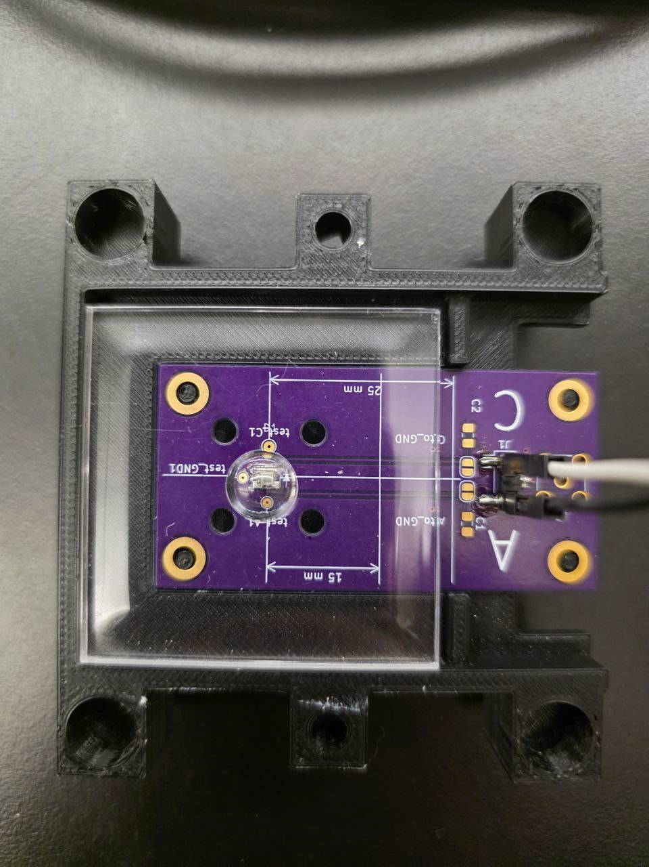
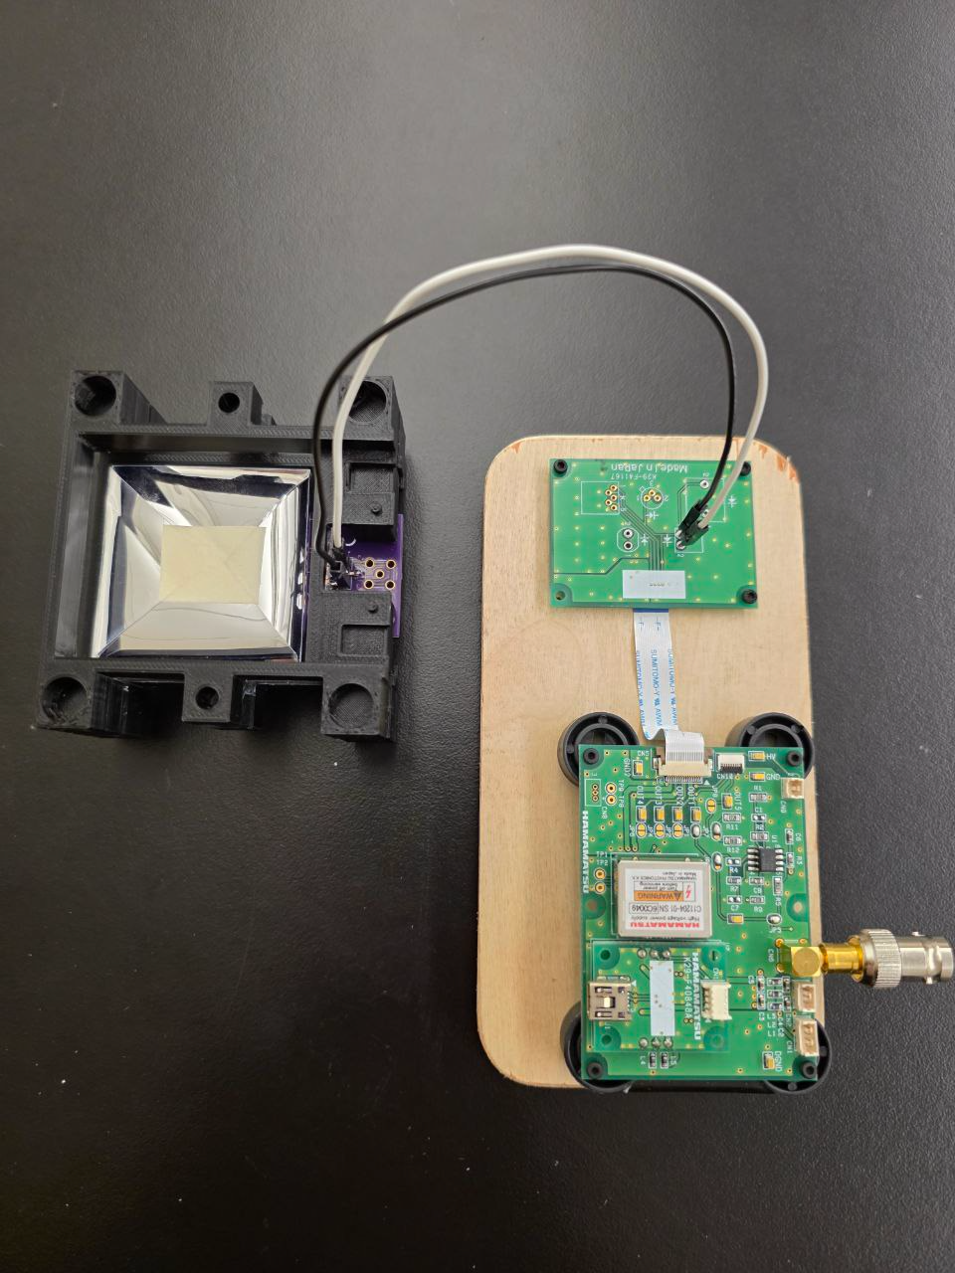
How is the SiPM physically connected to the tile?
In this configuration there is no physical connection between SiPM and tile
Unwrapped Tile on top of the SiPM
Wrapped Tile on top of the SiPM

Slide 6
Why is the spherical hollow visible in the unwrapped tile you hold in your hand not visible in the photo with the different tile sizes / thicknesses?
As tile size increases, the SiPM-on-tile approach becomes less effective due to:
Uniformity degrades with larger tiles
The optical features become less prominent in large tiles due to longer photon travel paths and increased internal scattering
As alternative we going to test different SiPM placement

Slide 7
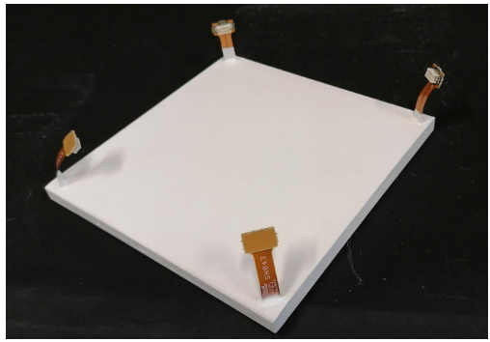
Wrapping: alternative
Even small tiles are difficult to wrap perfectly, often leaving gaps at the corners and air gaps, folds, or wrinkles which can scatter light unpredictably
Edge artifacts can lead to position-dependent signal variations → worse uniformity
Over time, adhesive tapes can peel or degrade, especially with temperature changes or humidity
Larger tiles make this problem worse, creating bigger unwrapped areas
Instead of foil wrapping, a white reflective paint can be used, for example
Four SiPMs are attached to flex cables, which are glued into grooves at the tile corners for optical readout.

Slide 8
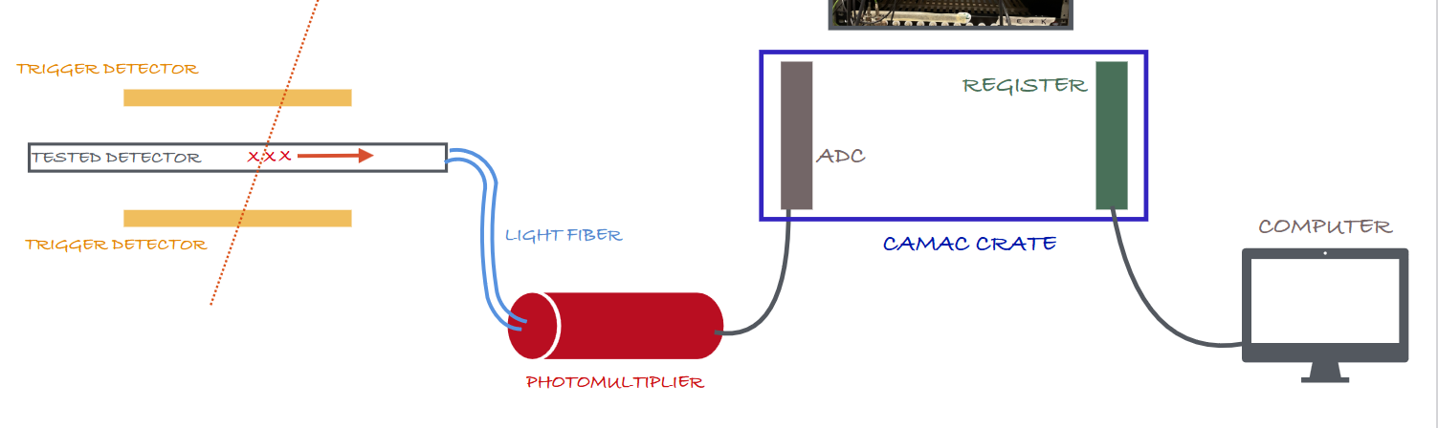
Is the controlling board an explicit component of the sketch Maria showed last Tuesday, page 5 of the slides uploaded to the nHCal indico? Is it shown in any of the photos of the muon telescope?
No, here is the more right way to show it
Also, there is no fibers+PMT → instead we have SiPM-on-tile
SiPM-on-tile + controlling bard

Slide 9
SiPM control board
The black 3D-printed housing holds a scintillator tile with reflective coating
The purple PCB next to the tile hosts the SiPM socket and initial signal routing
Hamamatsu Readout Module (C11204-01)
SiPM bias voltage generator
Amplifier chain: SiPM current pulses to voltage signals
Analog output (SMA): connector sends analog signal to scope/DAQ
USB control
Flat ribbon cable interface

Slide 10
SiPM control board
The black 3D-printed housing holds a scintillator tile with reflective coating
The purple PCB next to the tile hosts the SiPM socket and initial signal routing
Hamamatsu Readout Module (C11204-01)
SiPM bias voltage generator
Amplifier chain: SiPM current pulses to voltage signals
Analog output (SMA): connector sends analog signal to scope/DAQ
USB control
Flat ribbon cable interface

Slide 11
SiPM control board
The black 3D-printed housing holds a scintillator tile with reflective coating
The purple PCB next to the tile hosts the SiPM socket and initial signal routing
Hamamatsu Readout Module (C11204-01)
SiPM bias voltage generator
Amplifier chain: SiPM current pulses to voltage signals
Analog output (SMA): connector sends analog signal to scope/DAQ
USB control
Flat ribbon cable interface

Slide 12
Initial testing: the idea
Cosmic ray testing setup
A simple muon telescope:
Two scintillators placed above and below the test tile
Trigger condition:
A valid event occurs only when both scintillators detect a signal in coincidence
If there is no coincidence:
Ignore the event as background
Trajectory of a cosmic ray particle
Scintillator
Scintillator

Slide 13
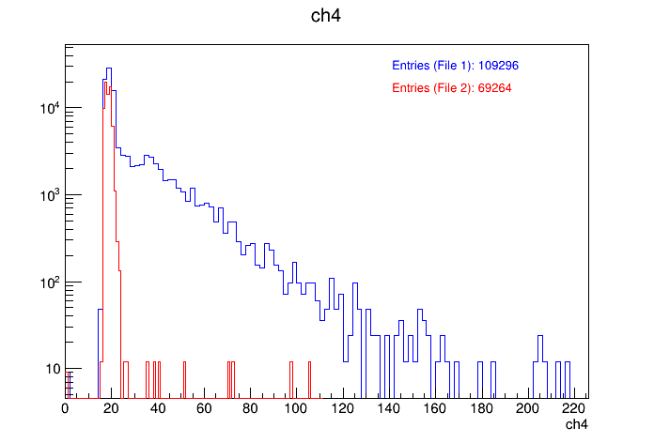
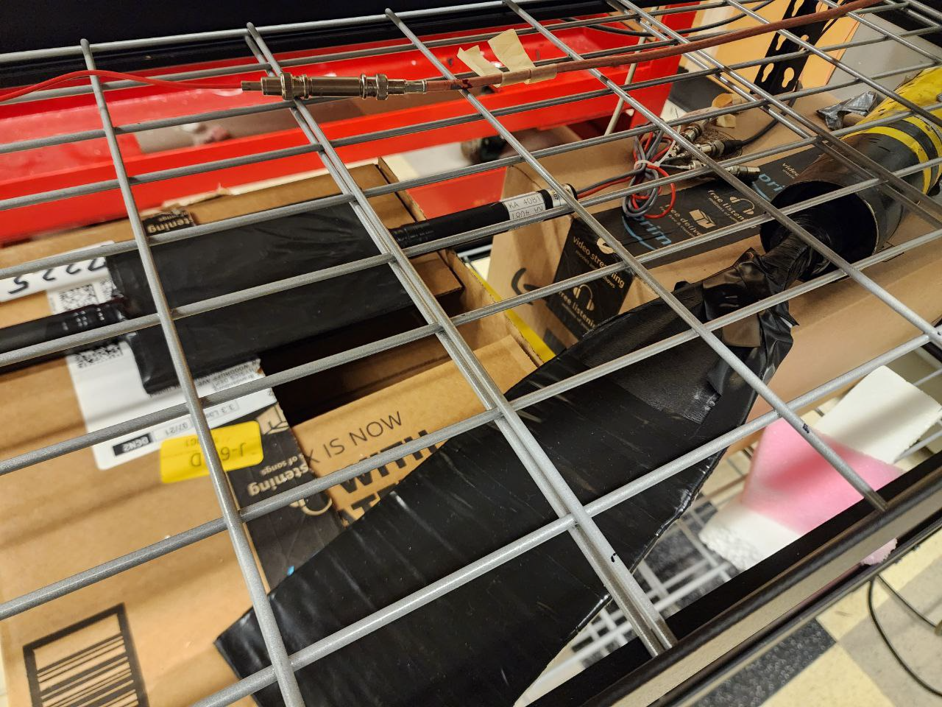
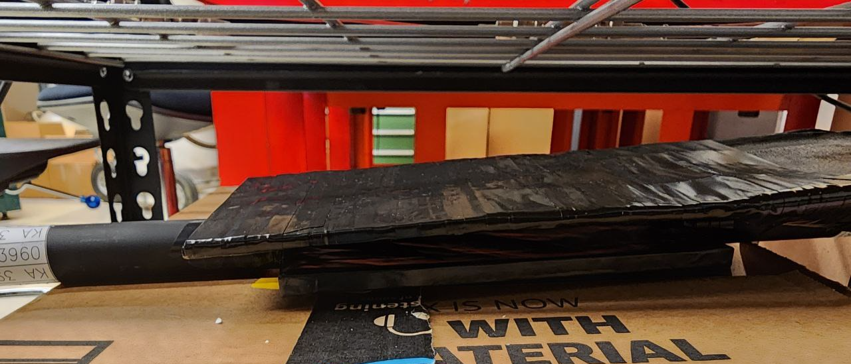
Setup: muon telescope
Background Data

Slide 14
Oak Rige tiles testing
Cosmic ray testing setup
A simple muon telescope:
Two scintillators placed above and below the test tile
Trigger condition:
A valid event occurs only when both scintillators detect a signal in coincidence
When a coincidence is detected:
Open the gate to read out the signal from the concave test tile
If there is no coincidence:
Ignore the event as background
Trajectory of a cosmic ray particle
Scintillator
Concave tile
Scintillator

Slide 15
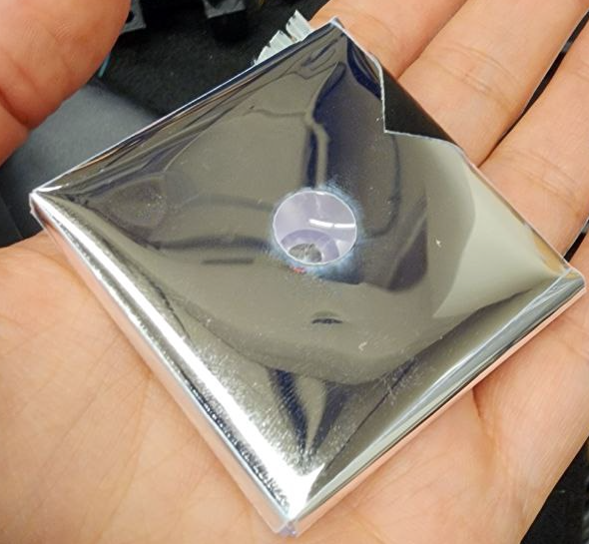
Setup: muon telescope
Putting SiPM-on-tile in between triggering scintillators → data from tile
Background Data

Slide 16
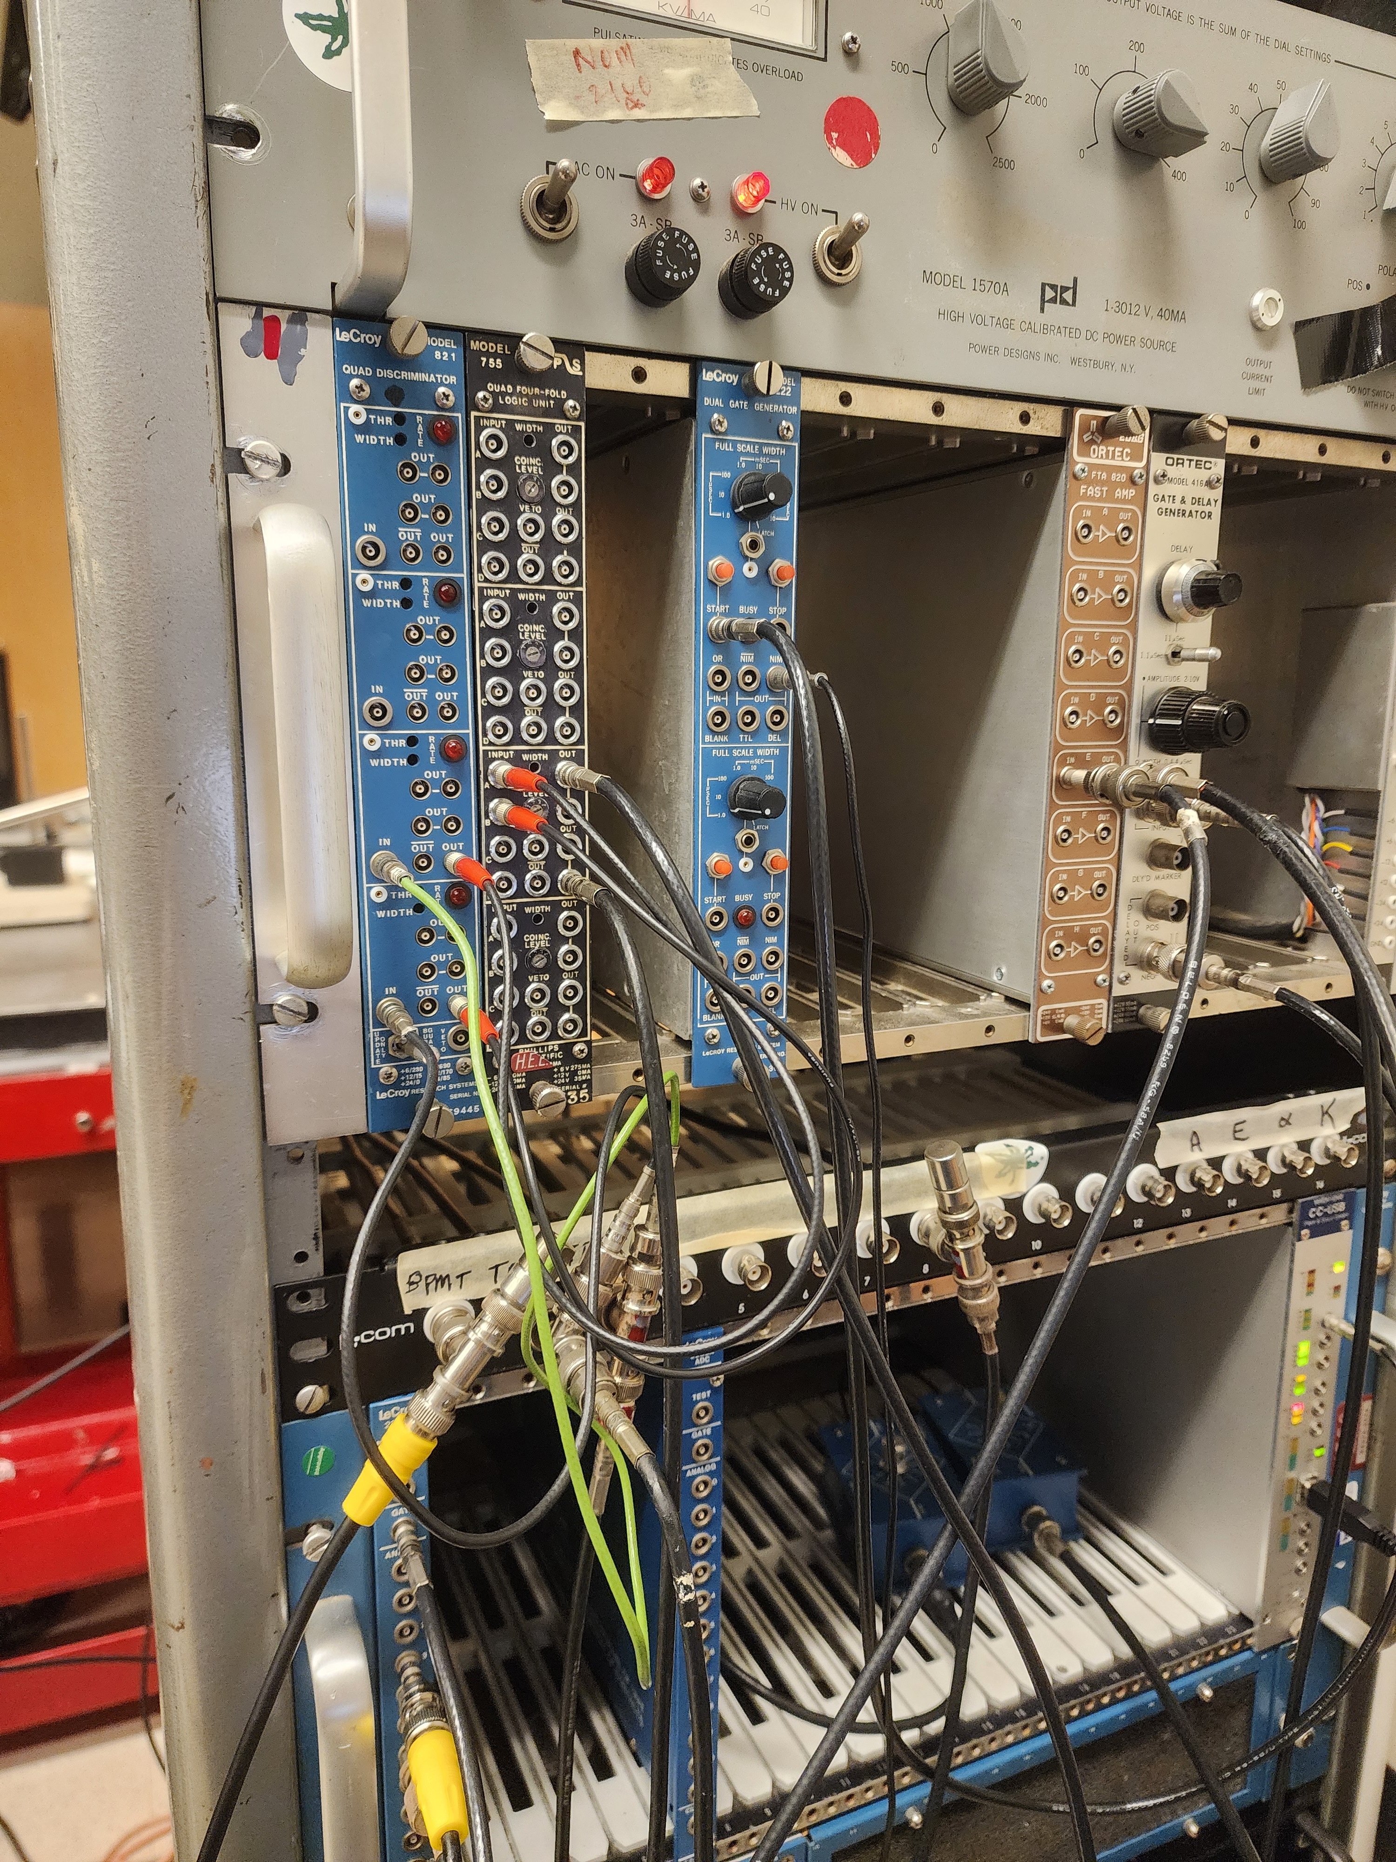
Electronics
Scintillator on Top → PMT → Discriminator
Scintillator on the Bottom → PMT → Discriminator
→ Coincidence (AND logic)
→ Gate signal
→ CAMAC ADC integration window

Slide 17
Electronics
Scintillator on Top → PMT → Discriminator
Scintillator on the Bottom → PMT → Discriminator
→ Coincidence (AND logic)
→ Gate signal
→ CAMAC ADC integration window

Slide 18
Electronics
Scintillator on Top → PMT → Discriminator
Scintillator on the Bottom → PMT → Discriminator
→ Coincidence (AND logic)
→ Gate signal
→ CAMAC ADC integration window

Slide 19
Electronics
Scintillator on Top → PMT → Discriminator
Scintillator on the Bottom → PMT → Discriminator
→ Coincidence (AND logic)
→ Gate signal
→ CAMAC ADC integration window

Slide 20
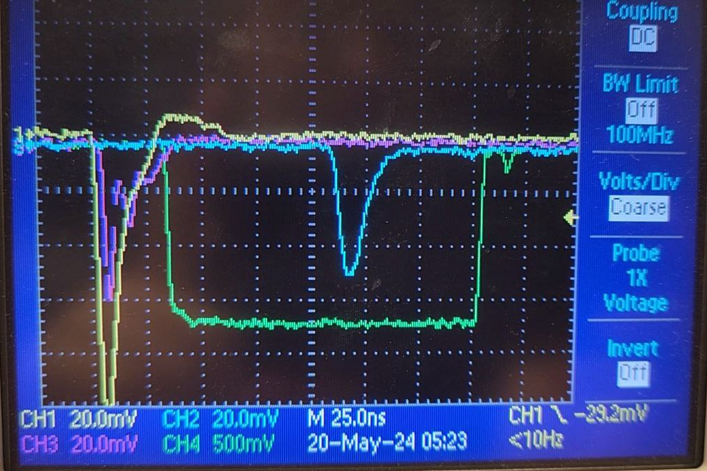
Electronics
Scintillator on Top → PMT → Discriminator
Scintillator on the Bottom → PMT → Discriminator
→ Coincidence (AND logic)
→ Gate signal
→ CAMAC ADC integration window

Slide 21
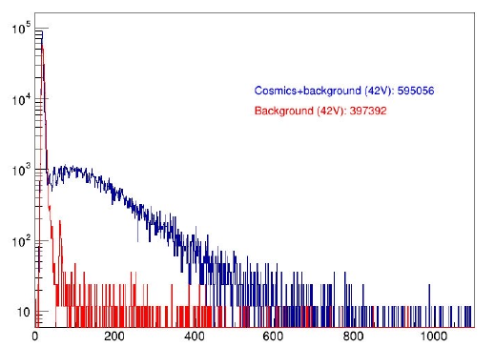
Electronics
Delayed (by purpose) signal from SiPM-on-tile

Slide 22


Plan
Cosmics → Sr-90 source
Half-life: 29.1 years
Mode of decay: Beta radiation
E < 0.546 MeV
E < 2.28 MeV
Can penetrate ~1cm of plastic

Slide 23
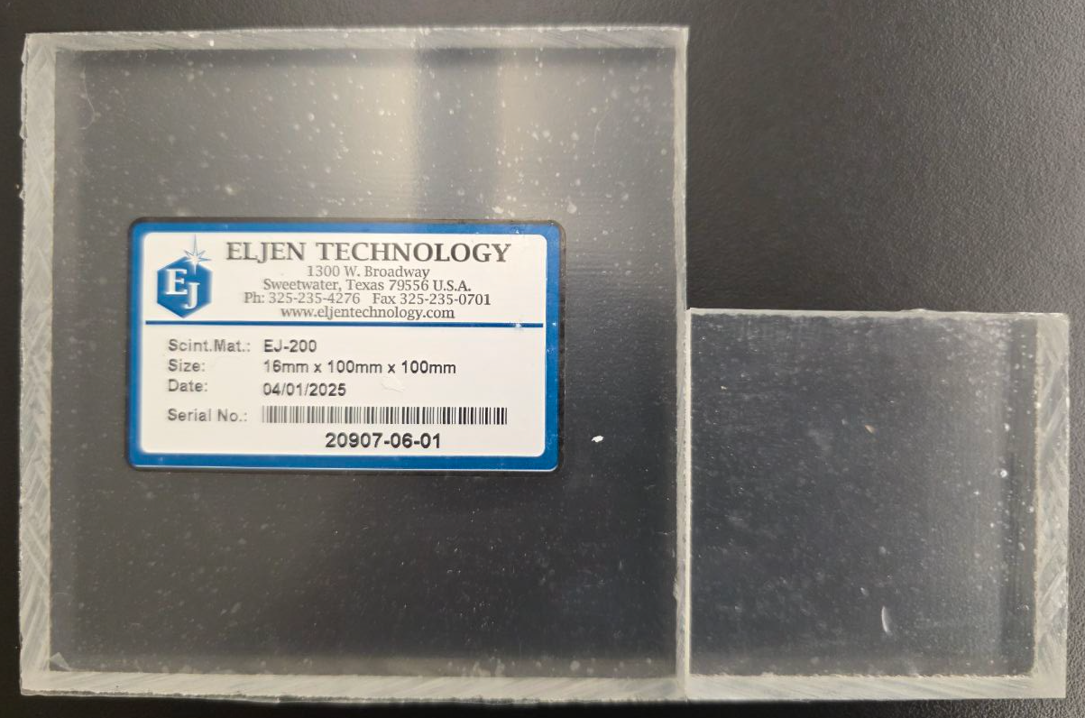
Plan
Vary tile size (5×5 cm², 10×10 cm²)

Slide 24
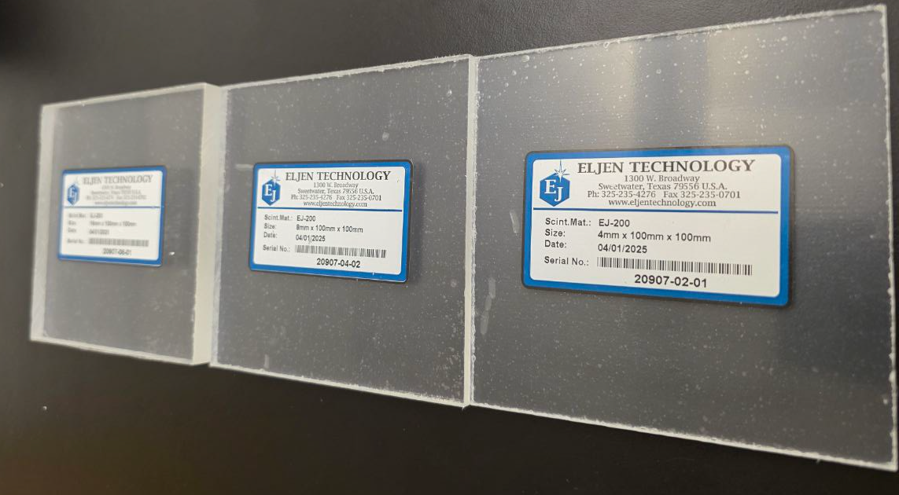
Plan
Vary tile thickness (4,6,8 mm)

Slide 25
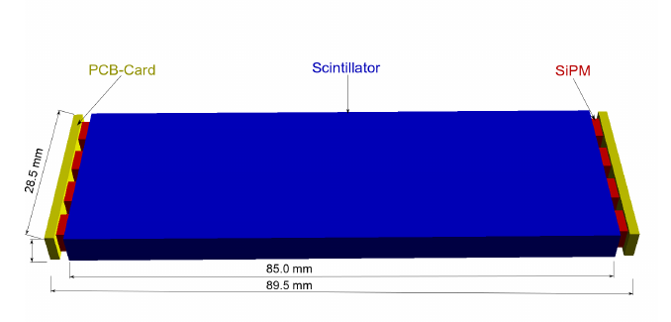
Vary SiPM placement (center, corner, edge)

Slide 26
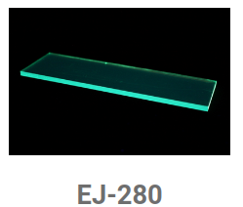
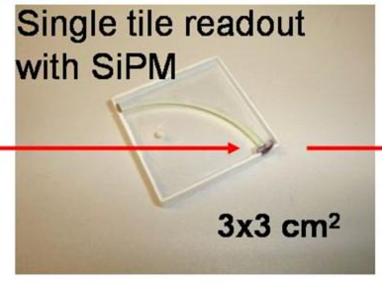
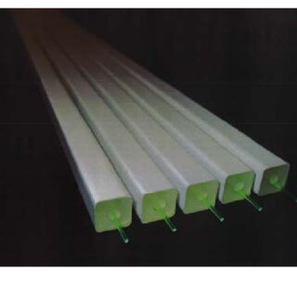
Vary SiPM placement: with wavelength shifting bars, fibers

Slide 27
Plan
Cosmics → Sr-90 source
Vary tile size (5×5 cm², 10×10 cm²)
Vary tile thickness (4,6,8 mm)
Vary SiPM placement (center, corner, edge), with wavelength shifting bars, fibers
Tile coating (wrapping, painting)
Check performance:
Light yield per MIP
Signal uniformity
Long range plan: timing resolution, optical cross-talk (if relevant; configuration-dependent)
Target timeline: ~2 months, aiming for completion by July 11 (ideally)

