Slide 1

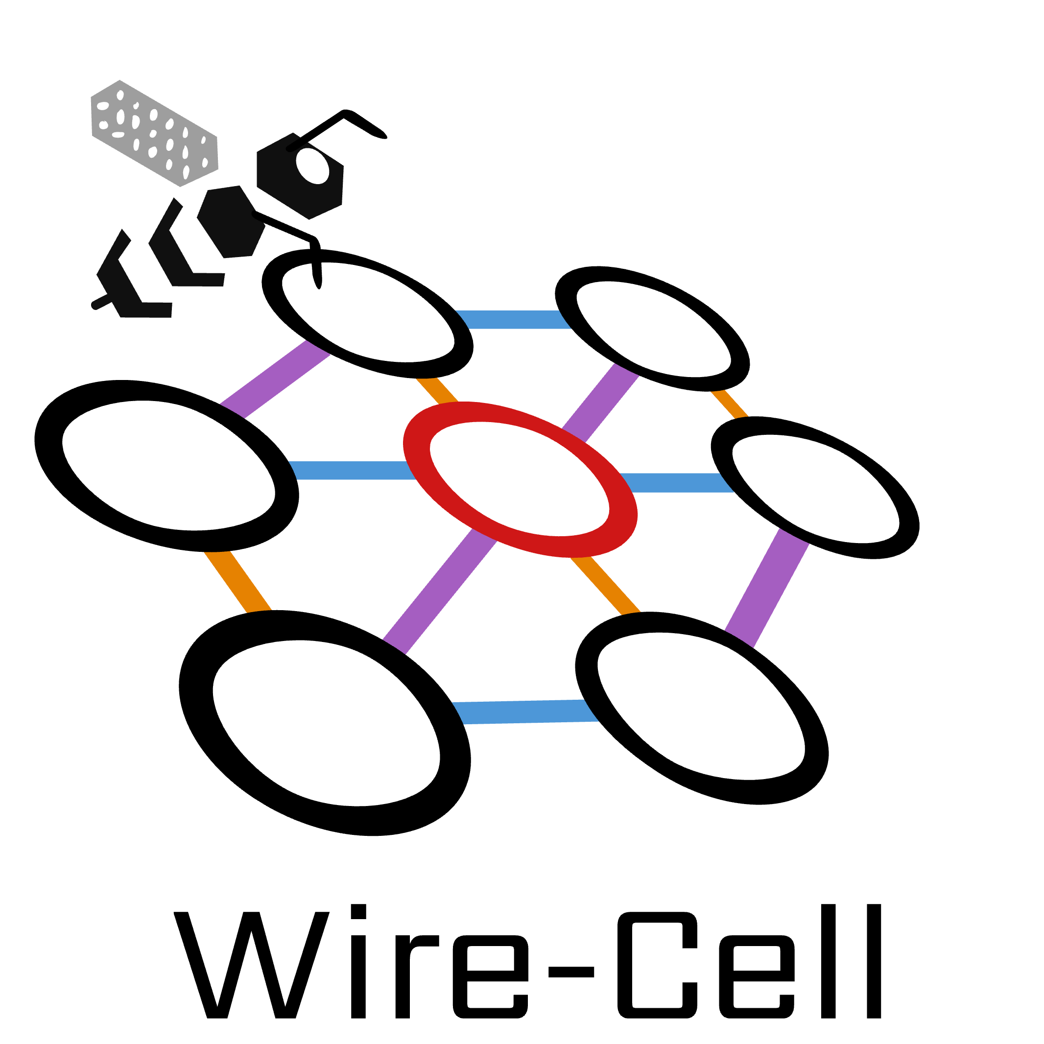
Wire-Cell Updates
Haiwang Yu for the Wire-Cell team
SBND CM @ The University of Sheffield
2025-06-04

Slide 2

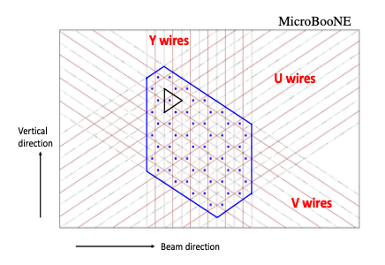
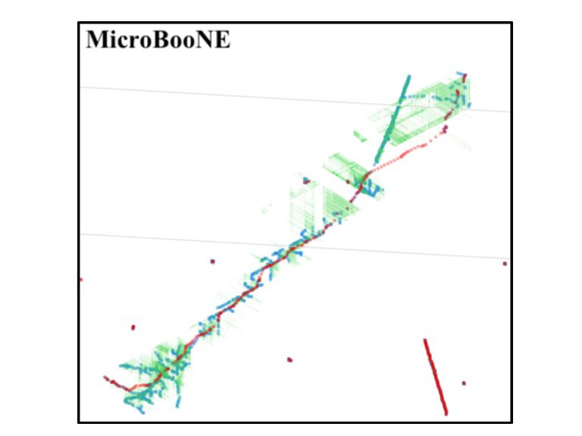
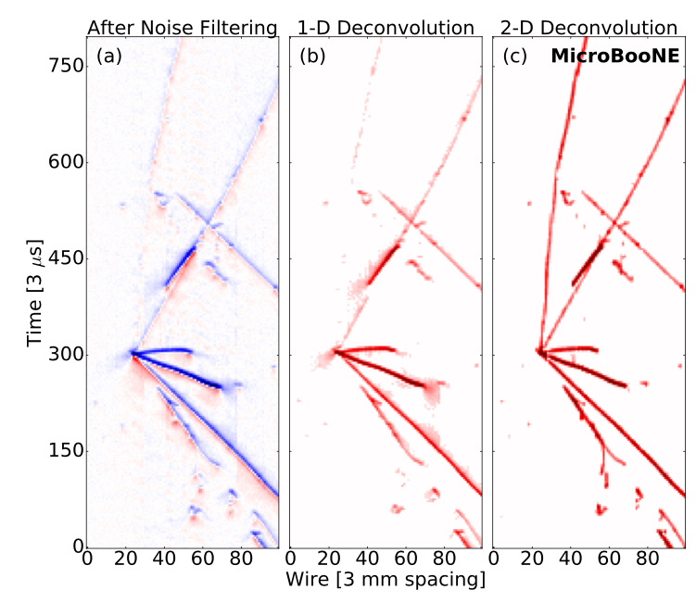
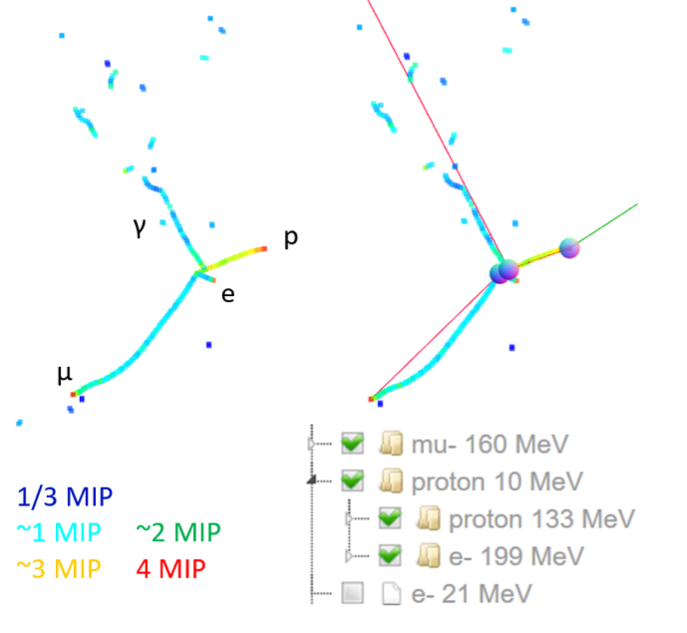
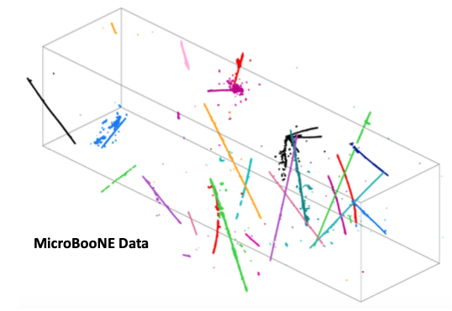
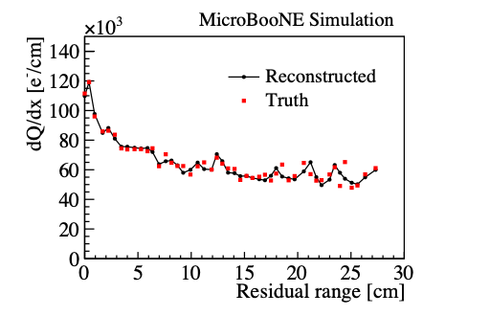

Wire-Cell Event Reconstruction
Sep. 2025
End 2025
Part 1: Sim-NP-SigProc
Part 2: Img-Clus-QLMatching-nu-select
Part 3: 3D PatRec
TPC simulation
noise filtering
signal processing
3D imaging
clustering
charge-light matching
3D trajectory & dQ/dx fitting
cosmic muon tagger
multi-track fitting
DL-3D vertexing
particle identification
JINST 12 P08003 (2017) JINST 13 P07006 (2018) JINST 13 P07007 (2018) JINST 16 P01036 (2020)
JINST 13 P05032 (2018) JINST 16 P06043 (2021)
Phys. Rev. Applied 15, 064071 (2021)
JINST 17 P01037 (2022)

Slide 3
Progress:
SBN Team
Part 1 – Lynn, Moon, Prabhjot
Baseline Sim/Noise Filtering/SigProc deployed in production
DNN-ROI production ready – Moon, Avinay, Gray
Part 2
Imaging, clustering – evaluation and validation – Ewerton, Prabhjot
QL-Matching – initial version – Lynn, Haiwang
BNL Team
Part 2:
Multi-apa/face generalization – Xin, Brett, Haiwang
Other Infrastructure updates
IO design for ql-matching results – Brett
For using Lynn's QL-Matching work
uboone QL-Matching file reader – Brett
For development validation
Retiling: fill gaps in 3D – Xin, Brett
Prepare for Part 3
Moon's talk, Reco. 1
Lynn's talk, Reco. 1
This talk
Notes:
Add description of part 1
echo other talks: link, plots
less technical language
links to SBND

Slide 4
Plan
SBN Team
Part 1
Wrap up DNN-ROI – production, paper – Moon, Avinay, Gray, Haiwang
Part 2
DL-nu-clustering – targeting NC pi0 – Avinay, Prabhjot, Haiwang
Initial generic nu selection – Haiwang, Prabhjot, etc.
Part 3
validation, optimization, deployment
BNL Team – Xin’s summary of rest works
Rest of Part 2
Cosmic taggers
Part 3
Single/multi trajectory fitting
NeutrinoID PatRec
PatRec
Track & Shower separation
Vertex related
Sparse-RCNN
EM Shower related
Moon's talk, Reco. 1
This talk
Notes:
Tagger & Kinematics Info
RNN
less technical language
links to SBND
discuss the production timeline
physics analyses for nu2026
April 2026
DetVar sample? Wire mod or hit mod?

Slide 5
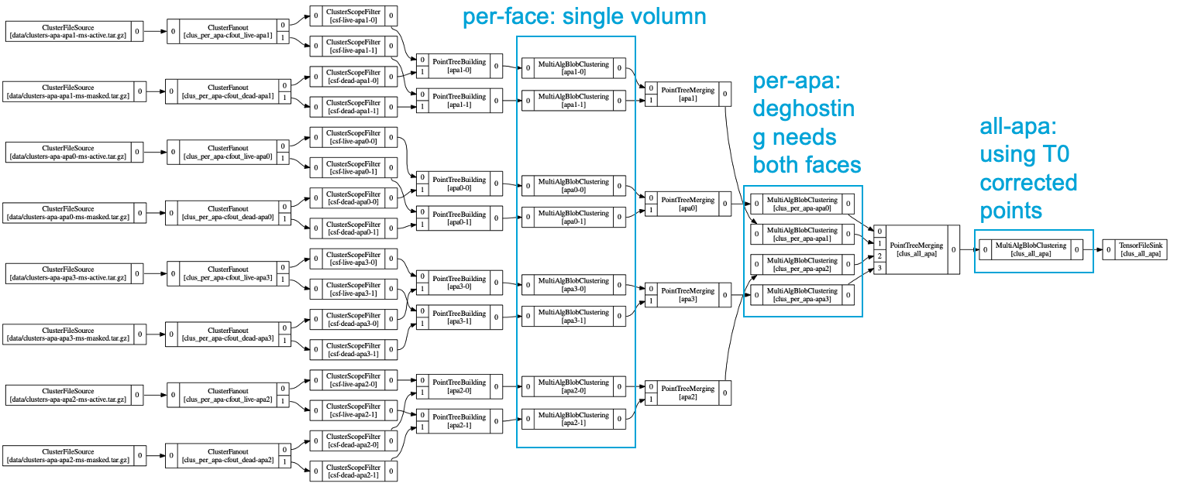
Multi-apa/face generalization
Add apa/face information
wpid in Facade, standalone
Add alternative scope
T0 x correction
Update lower-level utility functions
Update higher-level algorithms
Update configurations
Test for PDHD – 4APA/8Faces
Notes:
why use PDHD
easy to adapt to SBND

Slide 6
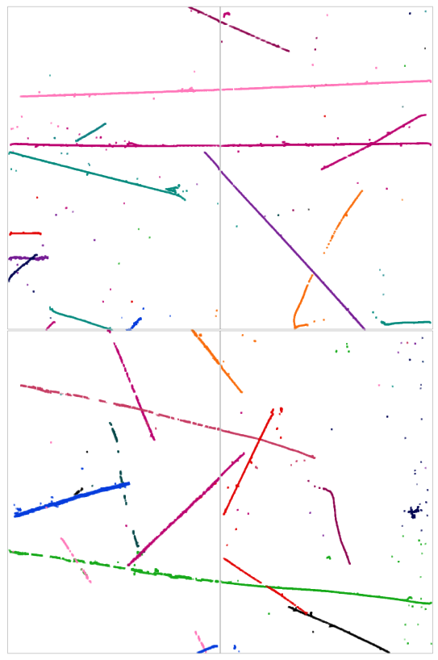
Using PDHD to show the multi-apa effect
APA crossing tracks
Dummy T0 correction applied
Configuration for SBND is straight fowrad
Working on merging with Lynn's QL-Matching work
https://www.phy.bnl.gov/twister/bee/set/6f9a9a6f-1a87-465c-b427-56374ab2a534/event/0/

Slide 7
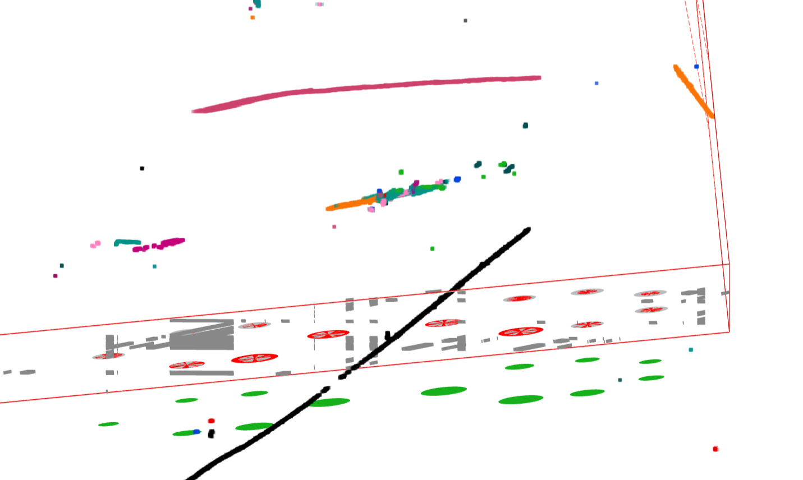
Potential improvements from uboone
Isochronous events
include more 2D information
Neutrino Vertexing
improving the Sparse-RCNN-Vertexing
Prolonged signal
DNN-ROI
Clustering failure
important for photon related analysis
separate gammas are not clustered together for NCpi0 → important for SBND (Lee)
try AI/ML clusgtering
Clustering failure
https://www.phy.bnl.gov/twister/bee/set/d620d2d4-0608-47b9-a5aa-169b9d743c4d/event/291/

Slide 8
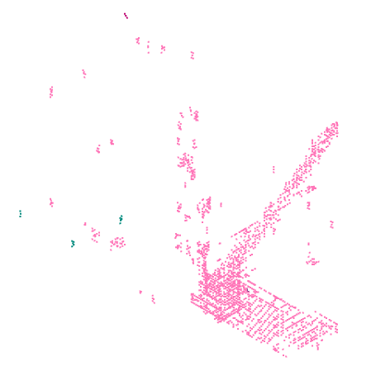
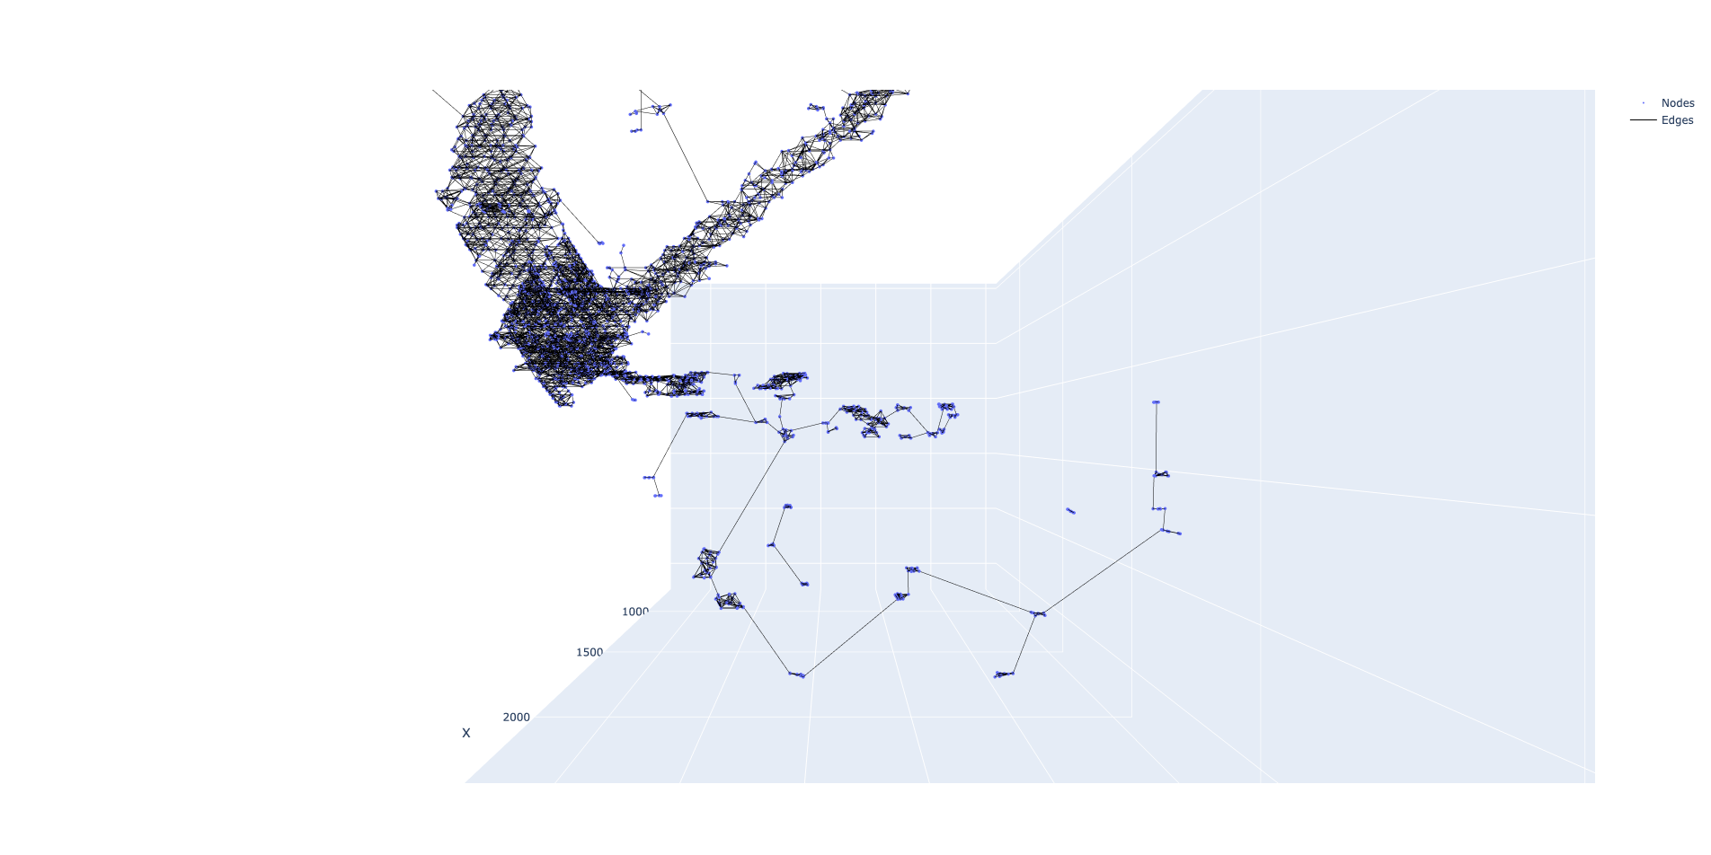
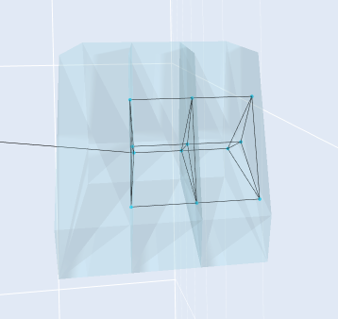
Wire-Cell 3D information: 3d points, point-point edges and blobs
BEE:
DUNE-FD-VD, numu, one APA
3d points, point-point edges
Zoom in to show blobs
BEE link
torch_geometric.data
visualization: plotly
https://github.com/HaiwangYu/sbnd-dl-clustering

Slide 9
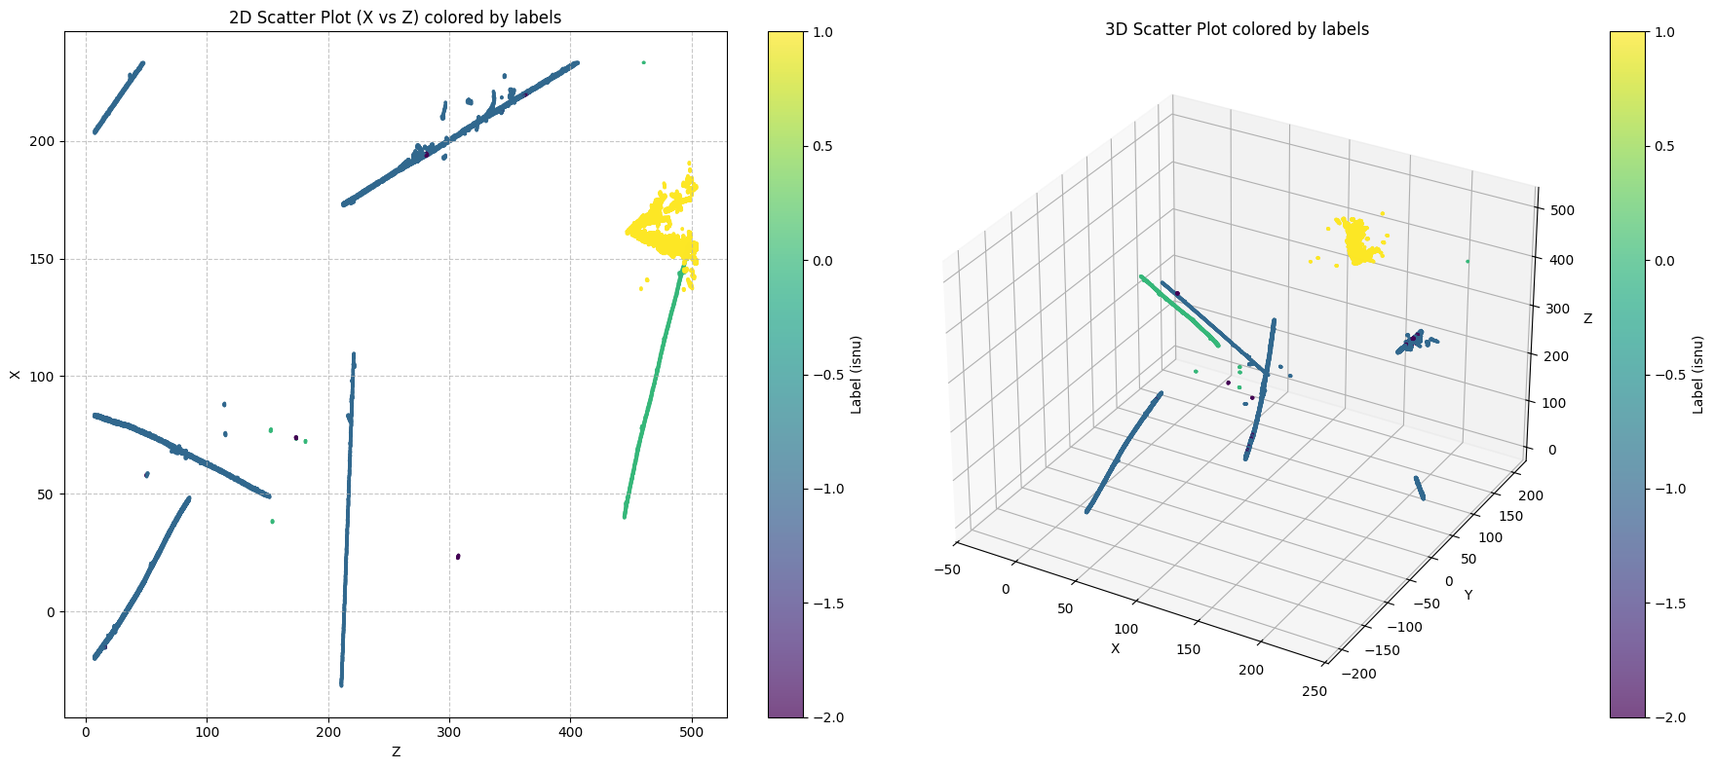
Labling of Wire-Cell 3D points
SBND Simulation - Avinay

Slide 10
Towards generic neutrino selection
MicroBooNE generic neutrino selection
3D Imaging
Clustering
QL-Matching
Through-going muon tagger (TGM)
SCE corrected FV boundaries
Stopping muon tagger (STM)
track direction
SBND adaptation
QL-Matching alone is enough?
much higher neutrino event fraction, ~30 times w.r.t. uboone (Michelle’s slides)
SCE, track direction still needed for down stream PatRec
In uboone, other reconstruciton paradigms used wire-cell generic neutrino tagger
could be useful in SBND?
if so we can port that information to LArSoft together with the 3D points
Notes:
https://sbn-docdb.fnal.gov/cgi-bin/sso/RetrieveFile?docid=40270&filename=maths.pdf&version=2

Slide 11
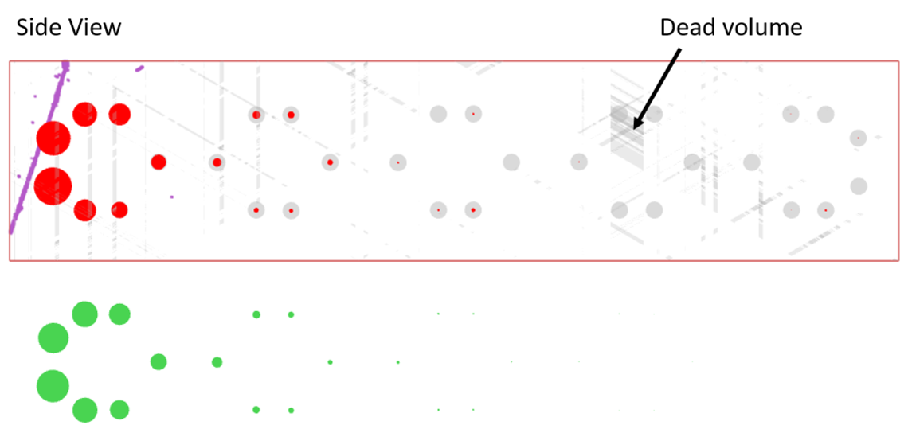
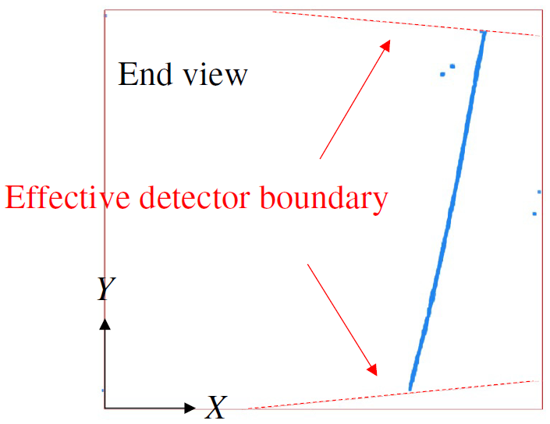
Rejecting Through-Going Muons (TGM)
Y
TGM: cosmic-ray muons go all way through the active TPC volume
Identification: the two endpoints of TPC cluster at/outside the effective detector boundary
SCE correciton is needed
Z (beam direction)
Effective detector boundary because of space charge effect
Neutrino:Cosmic-ray in MicroBooNE
Charge-light matching
1 : 6.4
Fiducial volume used in analysis: 3 cm inside the effective boundary
Improved by factor of 6
TGM rejection
1 : 0.9
Notes:
With the charge-light matching, the main background is the cosmic muon in random coincidence with the beam spill.
Within which, The dominated one is the through-going muons that cross through the active TPC volume.
This kind of background can be identified by examining if the two end points of the TPC clusters are outside the effective detector boundary.
After rejecting this kind of through-going muon background, we improve the neutrino signal to noise ration from 1:6.4 to about 1:1.

Slide 12
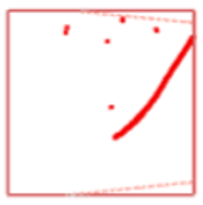
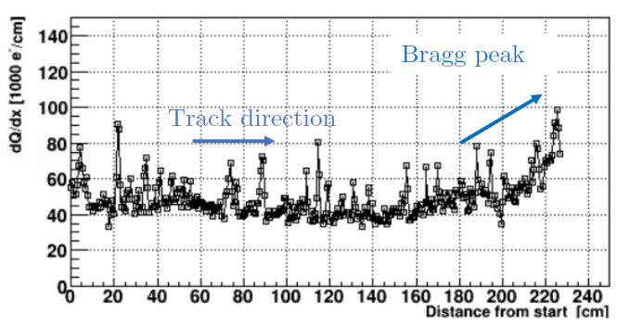
Rejecting Stopping Muons
STM: cosmic-ray muons enter and stop inside the active volume
Identified by directionality: from outside to inside
Tracks from neutrino activities will go out of detector from inside
Tracks from background will enter the detector from outside
Y
Trajectory and dQ/dx fitting → Bragg peak → directionality
dQ/dx vs. residual range is also important for the particle identification for tracks
X (drift direction)
Neutrino:Cosmic-ray in MicroBooNE
Charge-light matching
1 : 6.4
Improved by factor of >6
TGM rejection
1 : 0.91
Improved by factor of ~3
STM rejection
1 : 0.36
Additional Cuts
1 : 0.20
Notes:
The second largest background is the random-coincident cosmic-ray muon stopped inside the detector. The topology of this kind of background is very similar to the case where you have a neutrino interaction, and the muon exiting the detector.
This kind of background can be rejected by identifying the direction of the track:
tracks from neutrino activities start from inside and end outside
while the bkg. stopping muons start from outside and end inside.
The direction of the track, can be determined by searching for the Bragg peak near the stopping point. At the same time, the charge per unit distance: dQ/dx vs. the residual range is also important to perform particle identification for tracks.
To achieve this, Wire-Cell invented a new algorithm to fit the track trajectory as well as the dQ/dx.

Slide 13
Summary
The multi-apa/face generalization work setup foundation for future PatRec porting works
Also took us a lot of time
Lynn's initial QL-Matching results showed promissing results and establish foundation for generic nu selection
The Wire-Cell 3D information and labling is almost ready to use
e.g., DL neutrino clustering
The BNL team is actively working on porting the rest PatRec – targeting end of 2025
The SBND team is working on adaptation/validation of ported algorithms and new developments
If we have users that are interested in the Wire-Cell 3D points or the generic nu selection, we can include that in the Sep. 2025 production

Slide 14
backups

Slide 15
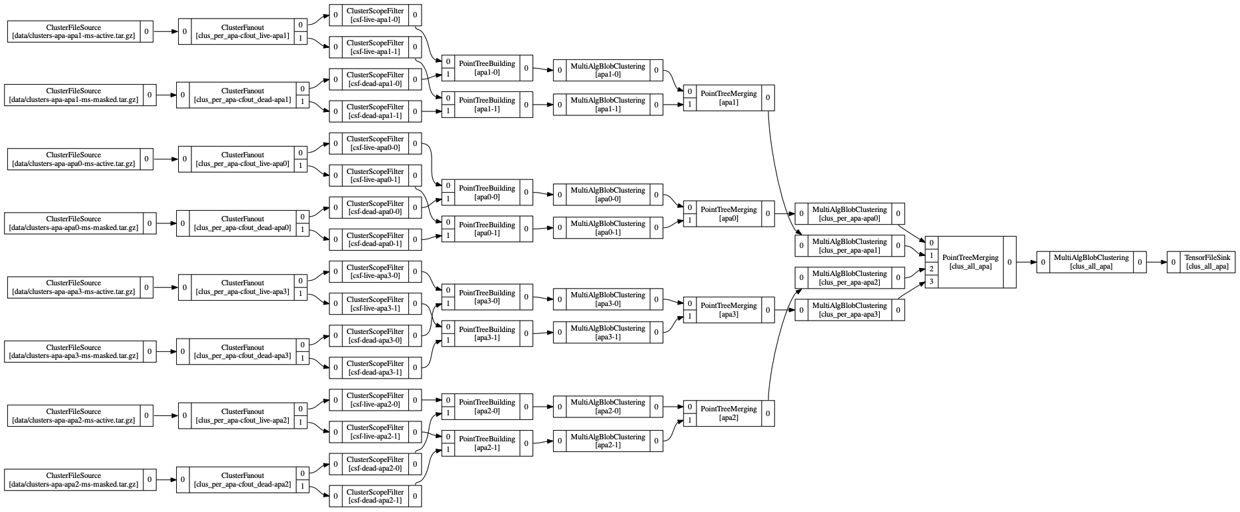
Test for PDHD – 4APA/8Faces
3 Clusterings: per-face; per-apa; all-apa
https://github.com/HaiwangYu/wcp-porting-img/blob/main/pdhd/wct-clustering.jsonnet
per-face: single volumn
per-apa:
deghosting needs both faces
all-apa: using T0 corrected points

Slide 16
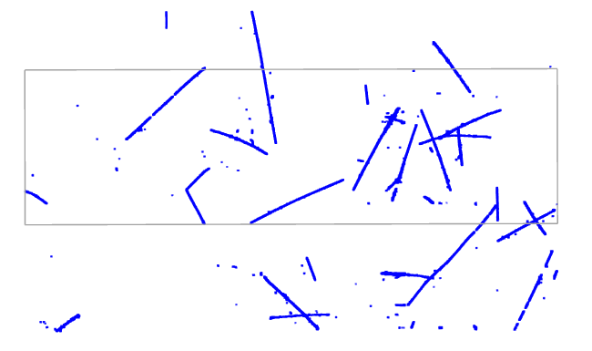
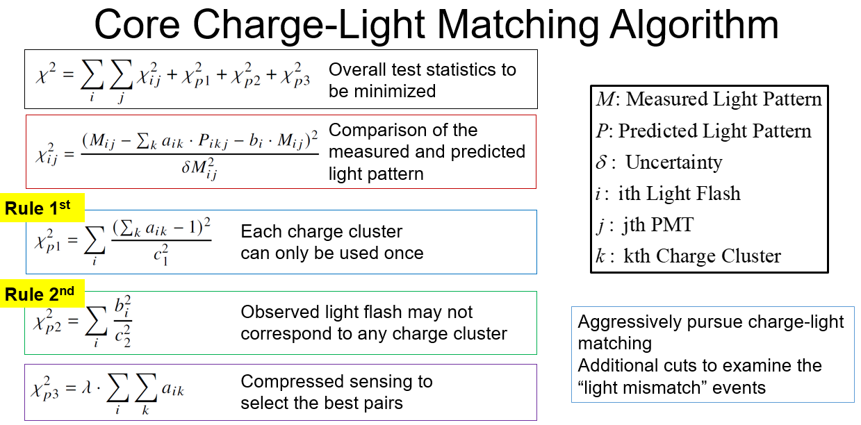
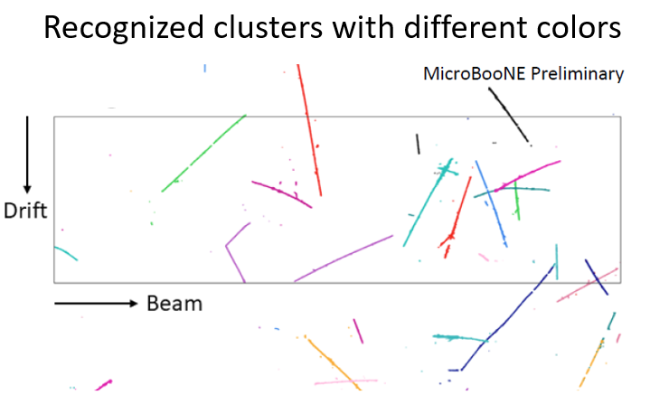
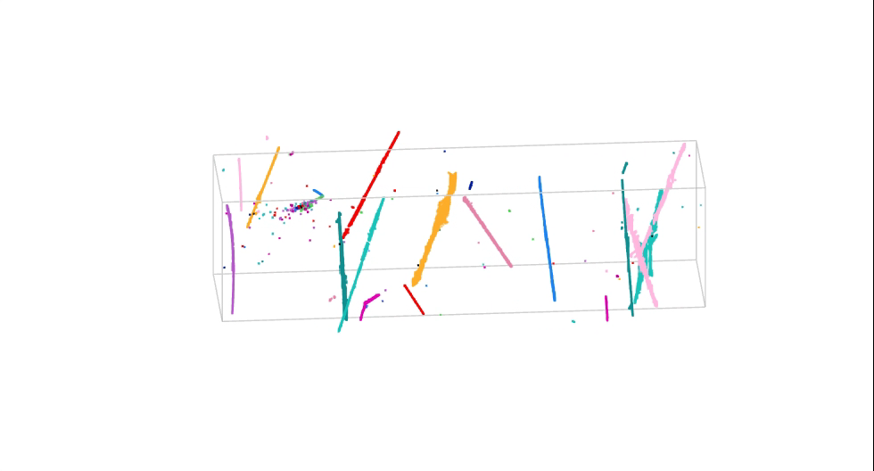
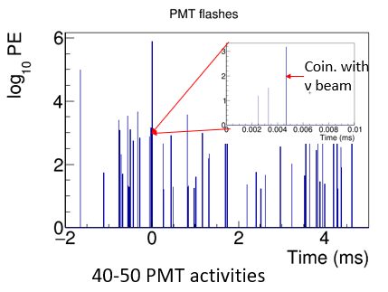
Many-to-many QL-Matching
4.8 ms drift window
JINST 16 P06043 (2021)
Matching Hypotheses
Clustering
3D Image
Light Reconstruction
Hypotheses Selection
20-30 TPC activities
Light signal proportional to (reconstructed 3D) charge
Known light acceptance given position
Predicted vs. Measured light pattern with Compressed Sensing
All possible hypotheses
One cluster → at most one flash (inefficiency in the light system)
One flash → many or zero TPC clusters within corresponding active volume (activities in inactive volume)
Notes:
Here is how this algorithm works. We have 20-30 TPC charge activities.
At the same time, we have 40-50 PMT light activities.
First, we perform a charge clustering algorithm to group all reconstructed 3D charge into separate clusters, each cluster represents a possible particle or physics activity.
Then, all possible hypotheses of charge-light matching pairs are calculated in P_ijk.
Then 3 extra constrains are added
1, each TPC cluster can be only used once;
2, some light may won't match due to e.g., TPC activities outside the active volume;
and 3, L1 regularization for compressed sensing.
This animation shows one charge-light matching result by showing individual TPC clusters, the predicted PMT pattern in green and the measured PMT pattern in red.
Given the matched charge-light pair, if we cut on the light signal in coincidence with the beam, we can select the neutrino interaction candidate.

Slide 17
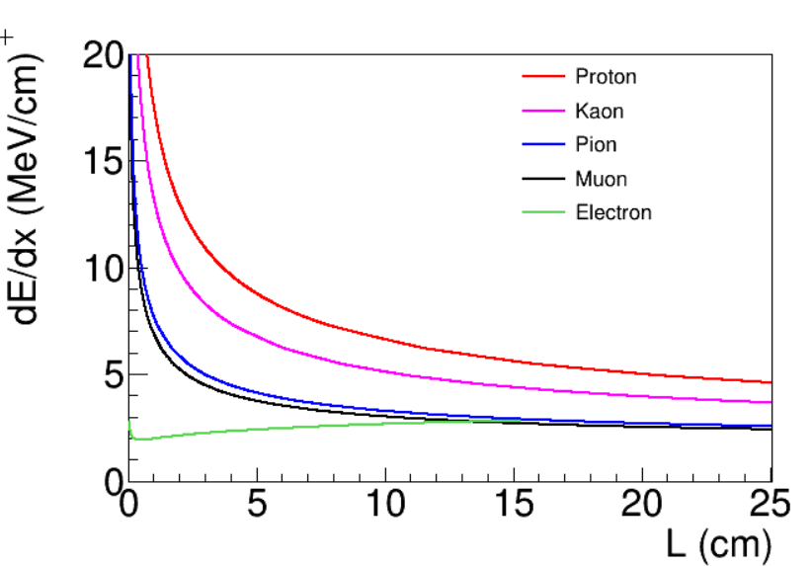
Rejecting Stopping Muons
STM: cosmic-ray muons enter and stop inside the active volume
Y
Identified by directionality: from outside to inside
Tracks from neutrino activities will go out of detector from inside
Tracks from background will enter the detector from outside
X (drift direction)
Trajectory and dQ/dx fitting → Bragg peak → directionality
dQ/dx vs. residual range is also important for the particle identification for tracks
Notes:
The second largest background is the random-coincident cosmic-ray muon stopped inside the detector. The topology of this kind of background is very similar to the case where you have a neutrino interaction, and the muon exiting the detector.
This kind of background can be rejected by identifying the direction of the track:
tracks from neutrino activities start from inside and end outside
while the bkg. stopping muons start from outside and end inside.
The direction of the track, can be determined by searching for the Bragg peak near the stopping point. At the same time, the charge per unit distance: dQ/dx vs. the residual range is also important to perform particle identification for tracks.
To achieve this, Wire-Cell invented a new algorithm to fit the track trajectory as well as the dQ/dx.

Slide 18
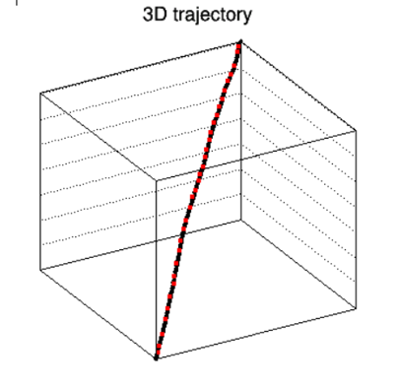
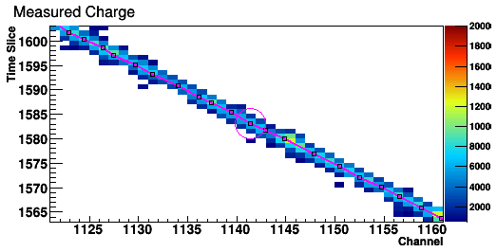
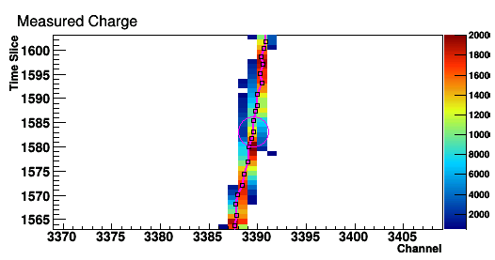
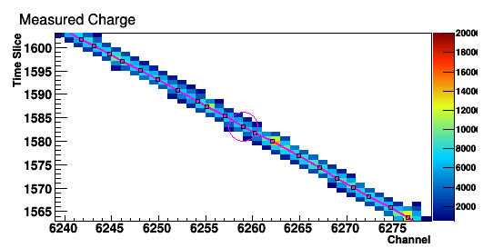
Principle of the Fit
Come up with a 3D track hypothesis (3D trajectory points and dQ/dx)
Predict the deconvolved signals on all projection views
Minimize the difference between the observation and prediction
U view
V view
W view
Notes:
Here is the principle of the fit. First, we need to come up with a 3D track hypothesis, which includes the 3D trajectory and their associated dQ/dx.
Then, we can predict the deconvolved signal on each of the projection view. The minimization of the difference between the observation and prediction would help us to find the best 3D track hypothesis.

Slide 19
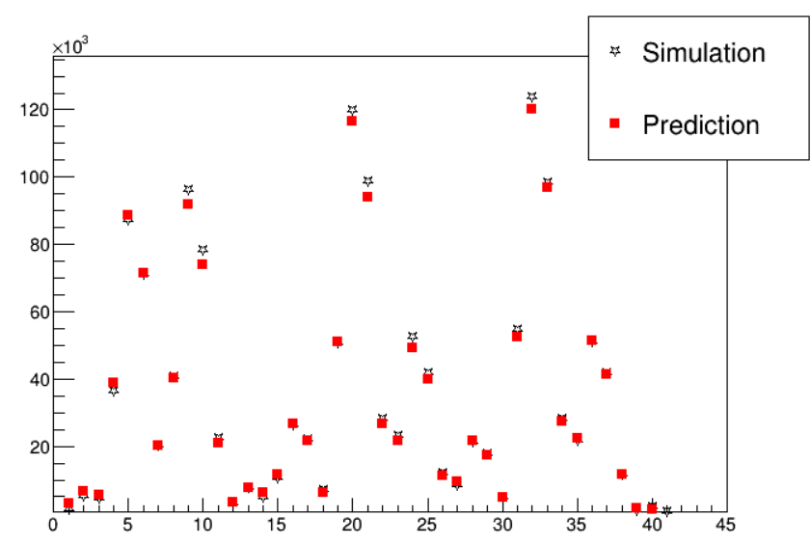
Simplified Prediction of the Deconvolved Signal
Convolve with field res.
dQ/dx at generation
diffusion
Electron at anode plane
Induced current on wires
Charge
At signal processing stage, we have two additional effects:
Software filters (time and wire dimension)
Usage of position-averaged overall response function
Simplified model
Convolve with elec res.
Pixel # in 2D Projections
Deconvolved signal
Signal Processing Chain
Digitized amplified current
Full process of signal formation and signal processing is complex → significant burden in computation
A simplified model was developed
Notes:
One key of this technique is to be able to make prediction of the deconvolved signal based on each track hypothesis. This is challenging, given the long chain in TPC signal simulation and signal processing.
Since we spent a long time studying the signal formation/processing, we come up with a simplified model based on smearing, which allows us to quickly and accurately model the deconvolved signal.

Slide 20
Trajectory and dQ/dx Fitting
Unknowns
Measurements
Neutrino:Cosmic-ray
Charge-light matching
1 : 6.4
Improved by factor of >6
TGM rejection
1 : 0.91
Improved by factor of ~3
STM rejection
1 : 0.36
Additional Cuts
1 : 0.20
Notes:
The minimization is achieved through a two-step process. The first step focuses on the 3D track trajectory positions, and the second step focuses on the dQ/dx extraction.
With this technique, we reliably reconstruct the track trajectory and dQ/dx, which allow us to identify Bragg peak. After rejecting the stopping muons and some additional background, we achieved a signal to background ratio of 5:1.

Slide 21
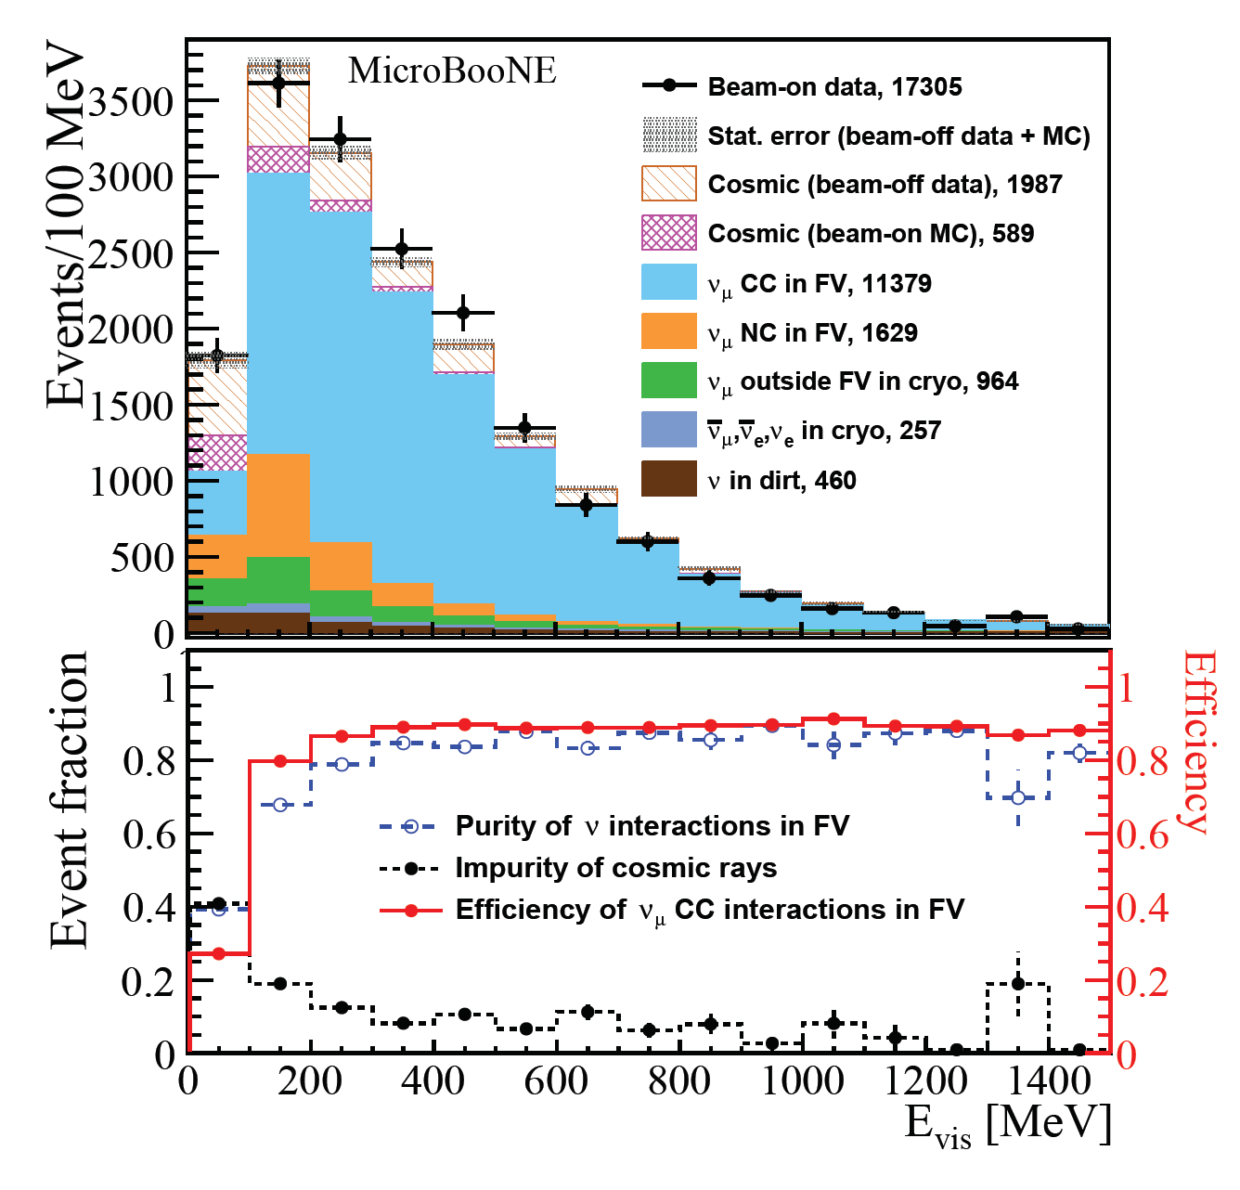
Preselection
Generic neutrino detection powered by many-to-many charge light matching and additional cosmic taggers to reject in-time coincidence cosmic-ray muons
99.999% cosmic-ray muon background rejected
Start with 1:20,000 neutrinos to cosmics
End with 5.2:1 neutrinos to cosmics
90% efficiency for ν_{e}CC and 80% efficiency for ν_{µ}CC
ν_{e}CC purity ~0.4% at this stage
Phys. Rev. Applied 15, 064071
Notes:
With all these tools together, we achieved a generic neutrino setection. 99.999% of cosmic muon background are rejected.
Started with 1:20,000 neutrinos to cosmic ratio, we achieved a 5.2:1 ratio after the preselection.
At this stage, we still maintain a 90% and 80% efficiencies for nueCC and numuCC, respectively.
But for nueCC, the purity is still low due to the FermiLab booster neutrino beamline configuration.

Slide 22
DL-Clustering data preparation
artROOT
Sim/SP/Img
Clus
sampling -> 3D points (KDTree, PCA, Hough)
physics-informed graph
ITensons in .npz
Points or Graph
graph2file utility function
CellTree_module
SimEnergyDepo in .json
trackID?
MCParticle in .root or .json?
trackID?
Post processing
Labeled data
Notes:
additional labeling whether a track is out of box without correction

Slide 23
save out reco.
Facade::Grouping -> boost::multi_array<float, 2> -> WireCell::Stream::write() (.npz)
a Facade::Util function that is called at the end of MABC
similar like a BEE dumper
meta data: run, subRun, eventNum
blob:
[blob_idx], q, qp0 (uq), dqp0 (duq) ..., wind_min_dp0 (wind_u_min) ...,
ncorners, corner0_x, corner0_y, corner0_z, ... corner11_z [max 12 corners]
points:
[pt_idx], x, y, z, q, blob_idx, qp0 (uq), dqp0 (duq) ...
point_graph:
head (pt_idx), tail, weights (pp-dist.)
light?
Notes:
add the existing clustering information

Slide 24
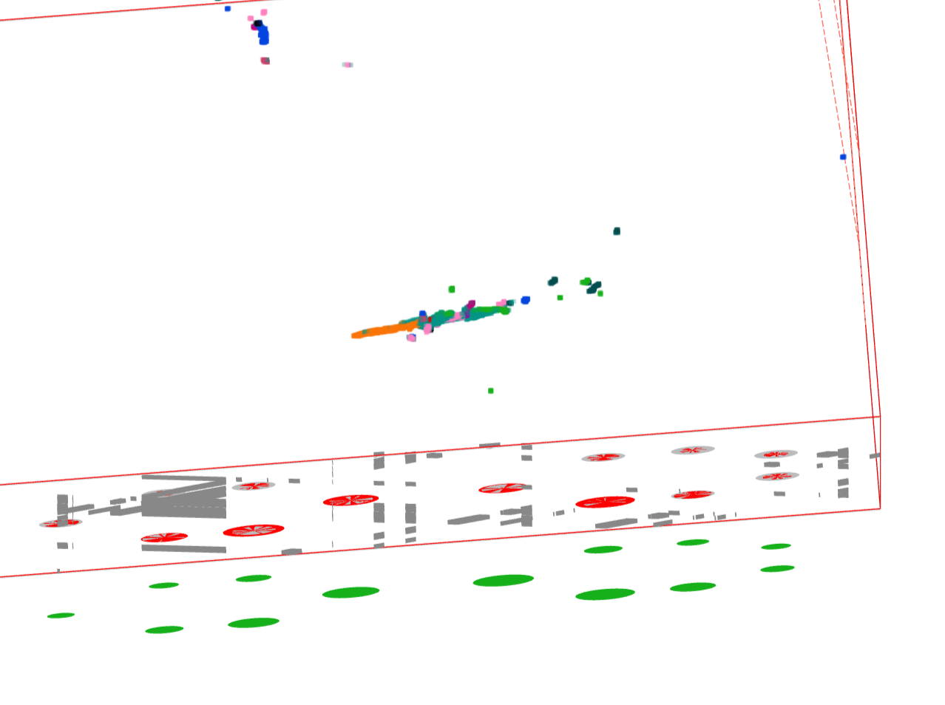
Another Identified Problem
Another problem identified
Clustering of NCpi0 parts …
Multiple activities, not be able to clustered together ….
Clustering problem (before Q-L matching)
https://www.phy.bnl.gov/twister/bee/set/d620d2d4-0608-47b9-a5aa-169b9d743c4d/event/291/
Separate gammas are not clustered together for NCpi0 → important for SBND (Lee)

Slide 25
Sep: generic nu-selection, user of this?
neutrino2026:
Lynn, Pandora, inclusive nueCC xsec
use WC QLMatching?
PID?
Moon, 1mu1p
Prabhjot, img-clus-match-nu-sel
Avinay, end of this year with high chance of extension
physics analysis on photon
reach out to Lee

Slide 26
DL-Clus

Slide 27
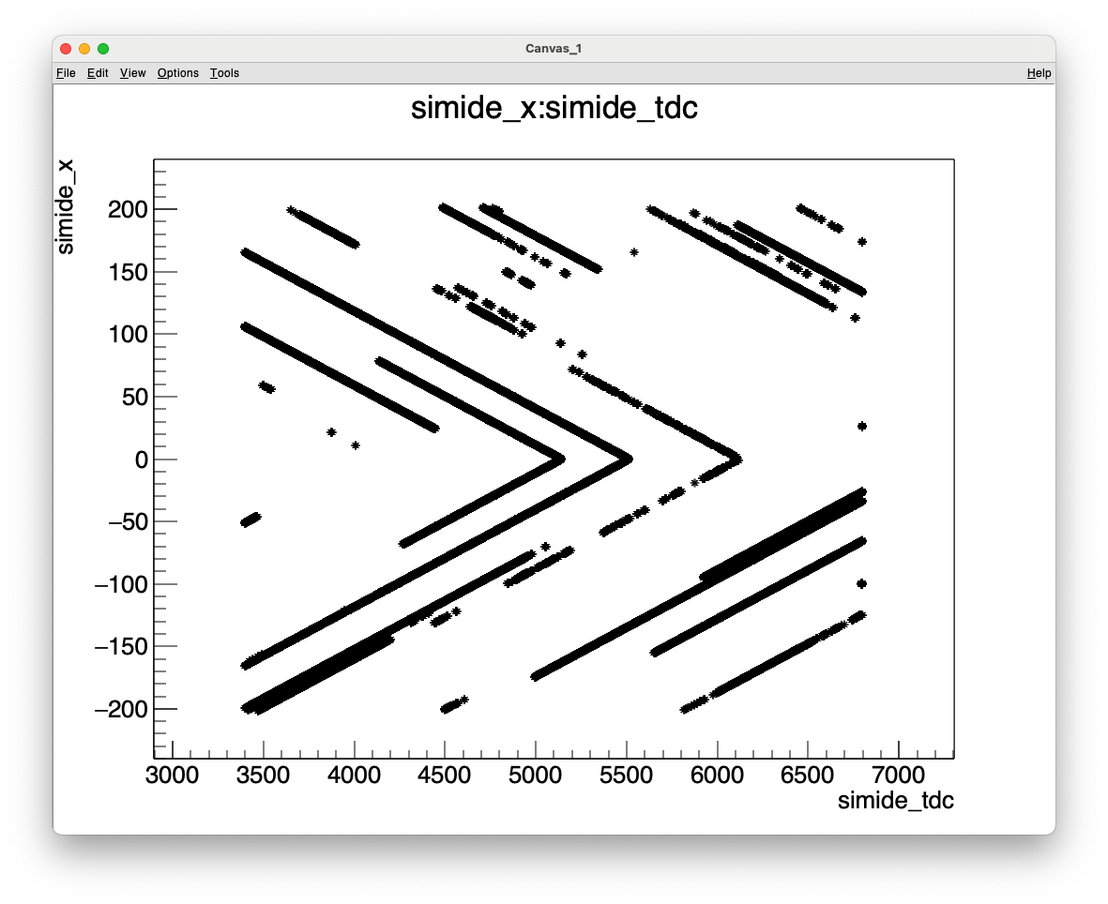

Slide 28
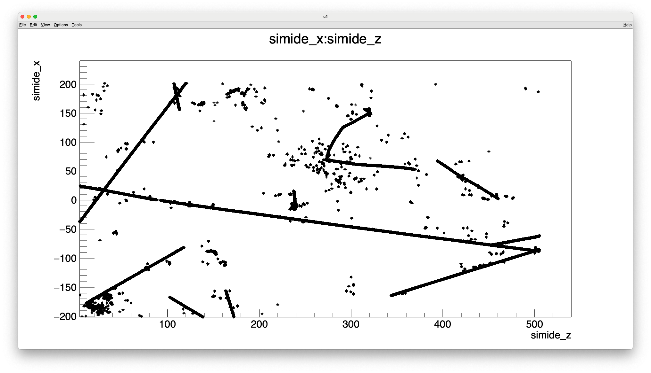
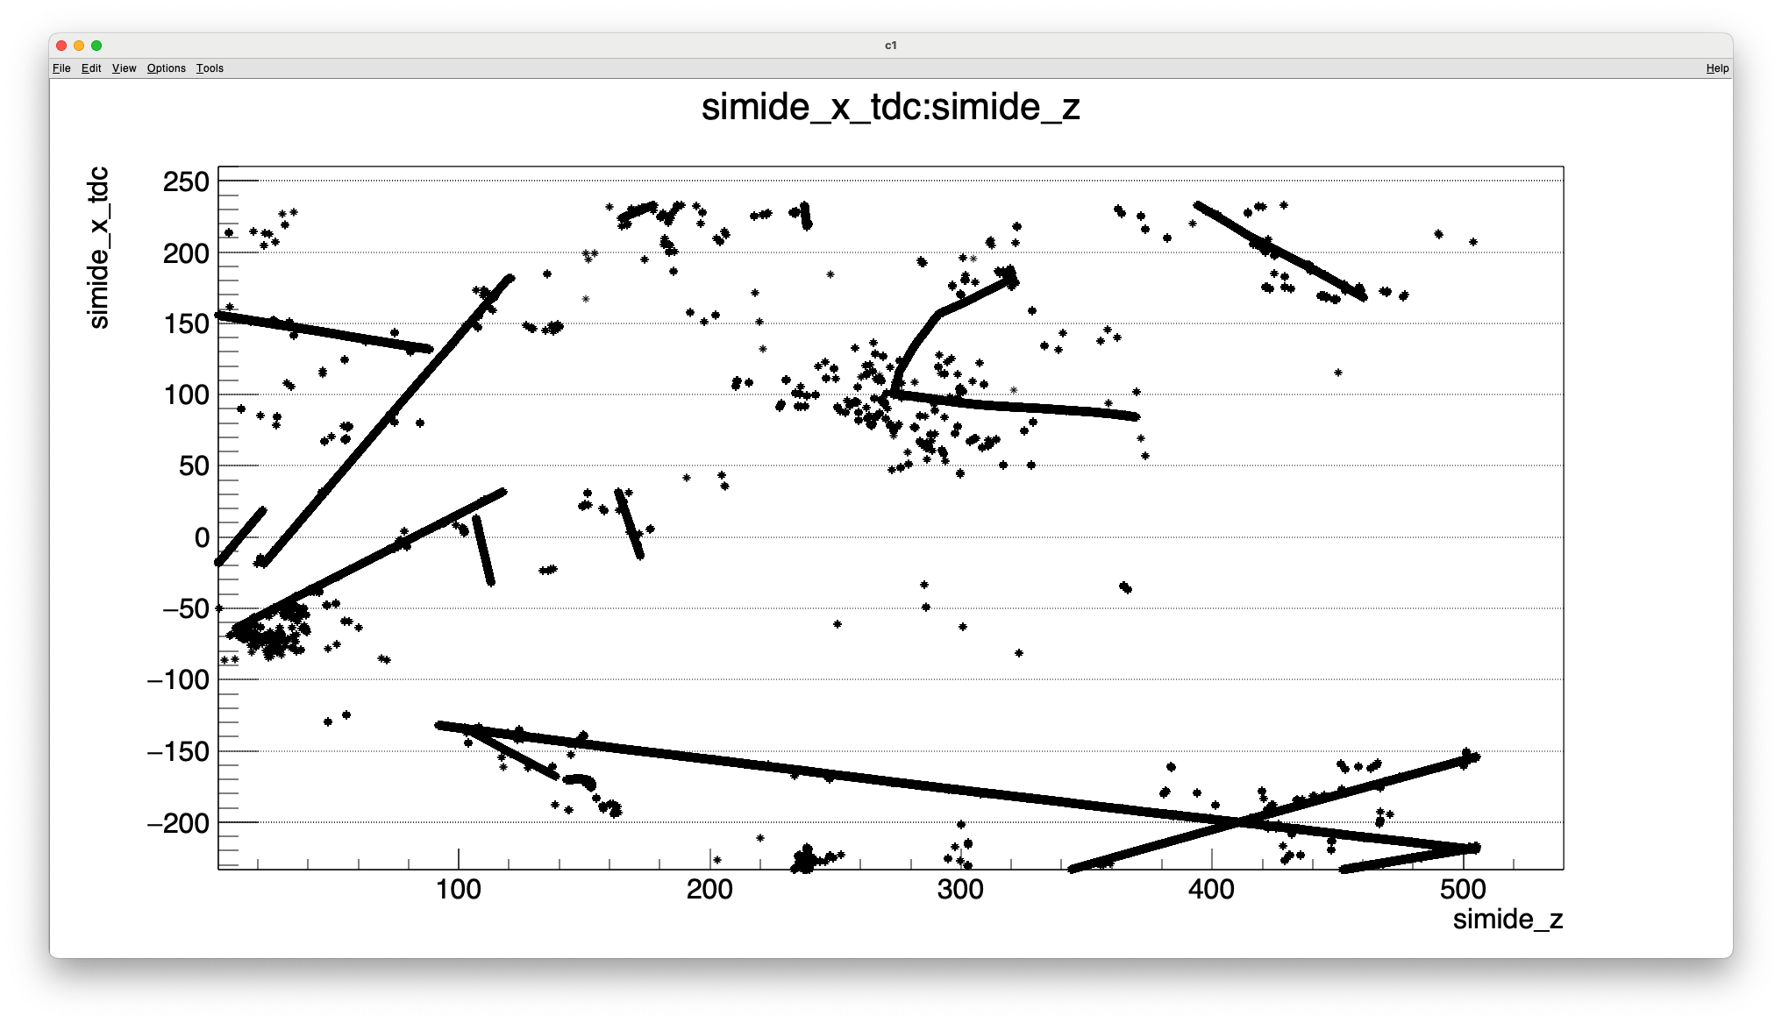
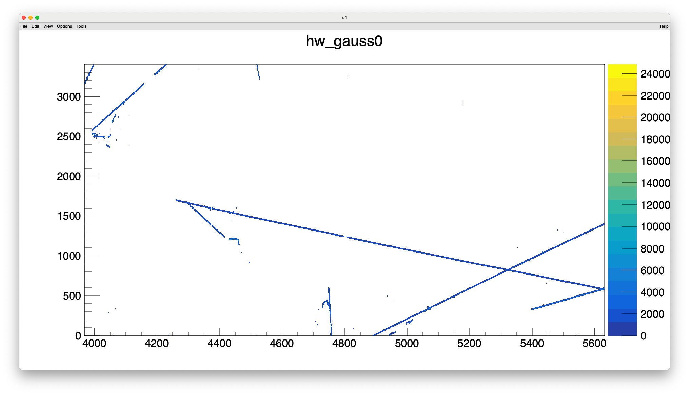
issue with SimChannel IDE

Slide 29
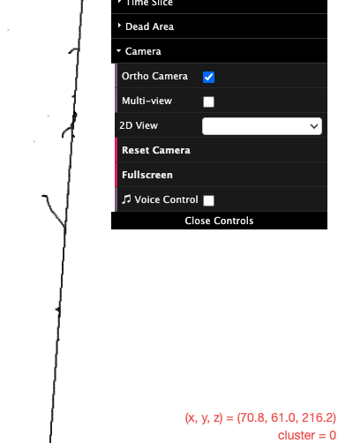
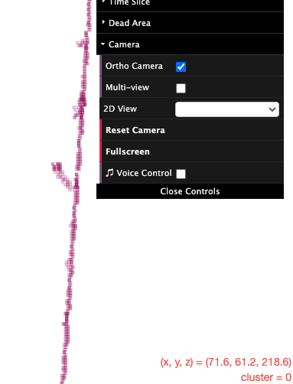
Avinay-mar, z-offset 0.5cm
https://www.phy.bnl.gov/twister/bee/set/80364363-b233-43d8-8bee-be394a0260ee/event/0/

Slide 30

max_distance=4cm

Slide 31
Scaling up for production
LArSoft env:
wcls-img-clus.fcl -> g2f-apa?-face?—r-s-e.npz
blobs
points: x,y,z,q,blob_idx
ppedges
celltree_sbnd.fcl -> celltree-apa?—face?-r-s-e.json
python env (sklearn, etc):
label.py -> g2f-label-apa?-face?—r-s-e.npz with per point tags
points: x,y,z,q,blob_idx,isnu
train python env (torch, torch_geometric)
load g2f arrays which can be used as torch_geometric.data

Slide 32
Generic nu selection

Slide 33
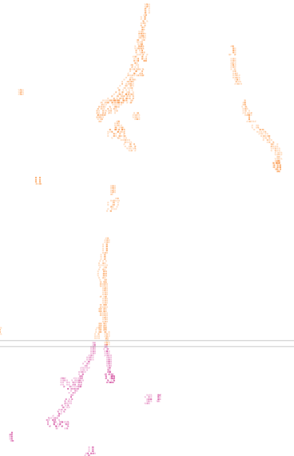
Thoughts on resolving this issue
match first or merge (two apa info) first?
merge first let us use all possible information
consider chi2 for two apas
can we handle overlapping TPC activities?
rm front/back porch first?
caveat: random coincidence merging?
https://www.phy.bnl.gov/twister/bee/set/826f2384-5551-4926-9863-37829ef3a175/event/1008/

Slide 34
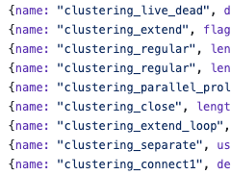

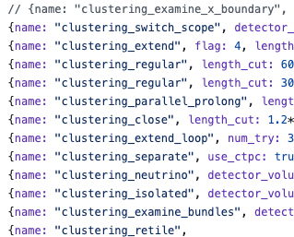
PDHD stages:
per-face
per-apa
all-apa

Slide 35
Potential approach
MABC
per-face clus
MABC
no-t0-corr stitching
MABC
per-face clus
ql-matching
MABC use t0-corr Scope
light for all apa

Slide 36
backups

Slide 37
DL-clus data – Avinay etc
merge apply-pc to master
link larwirecell with wct for the IO
generic nu selection
outline the requirement, status of the tagger
TGM – HY etc
STM tagger – BV, XQ
tagged 3d points to larsoft (spacepoint)
have the user first
Technical
SigProc paper
DNN-ROI paper
imaging-clustering-qlmatching generic nu selection
Physics
nue x-sec
End of 2025:
Full WC without nue BDT tagger
2026: more DL

Slide 38
Wire-Cell SBND group:
BV, XQ, etc:

Slide 39
Hanyu: Plan to port back general nu selection
LEP. reco., blip protection

