Slide 1
SVT Air Thermal System and Flow Distribution
ePIC SVT Working Meeting
Nick Payne
Stony Brook, NY
7/9/2025

Slide 2
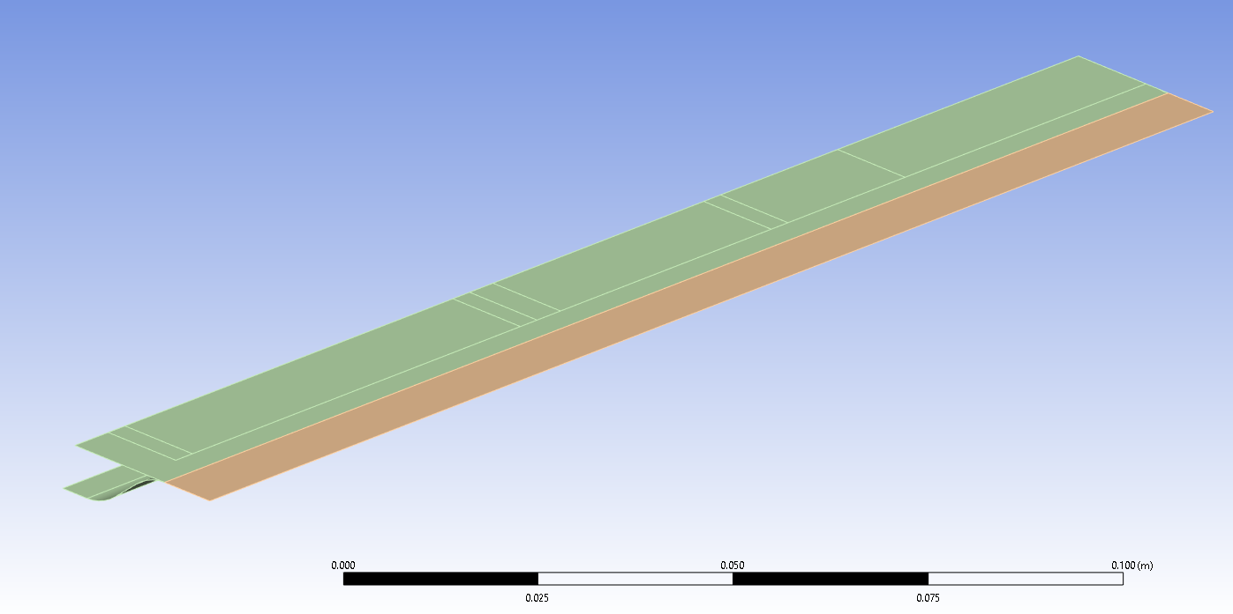
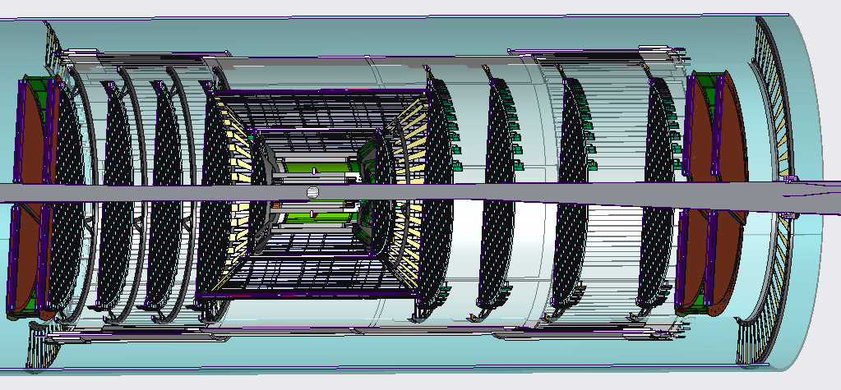
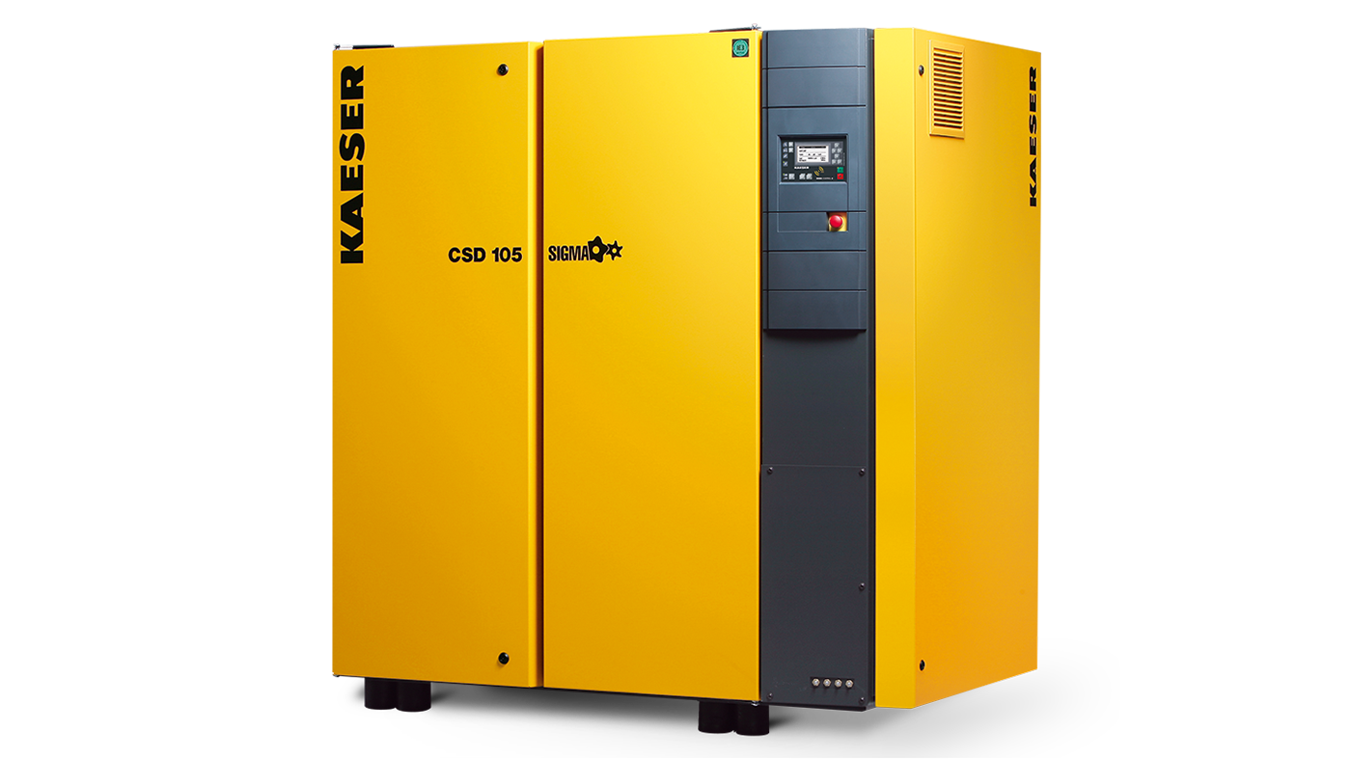
Topics
1
Cooling air requirements for 1 channel: CFD+FEA study
System total air requirements
System air handling and pressure estimation
2
3

Slide 3
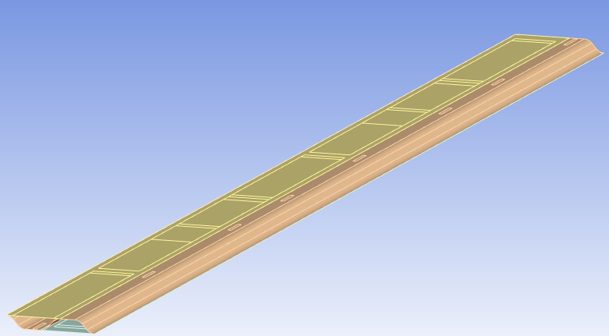
Model Approach
FEA Configuration: 7 sensor modules - single channel
Nusselt number correlations for uniform wall temperature and uniform heat flux did not fit well.
CFD + FEA coupled thermal fluid simulation
CFD model resolves the cooling air flow and HTC.
FEA model computes the heat transfer of the channel structure.
7
6
5
4
3
2
1

Slide 4
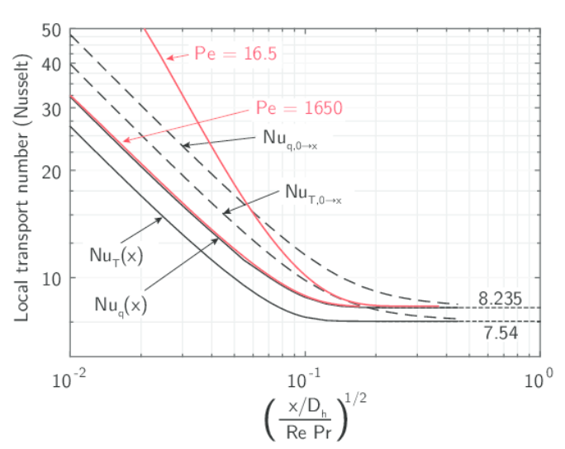
Entrance Region
Nusselt number is inherently higher at the entrance of the duct.
Temperature of air changes by about 5°C during passage through the channel.

Slide 5
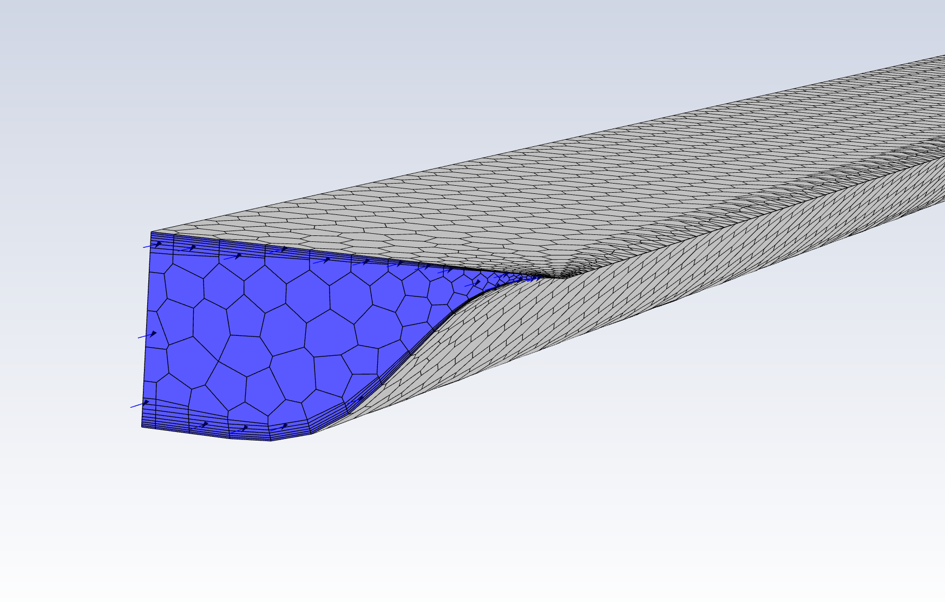
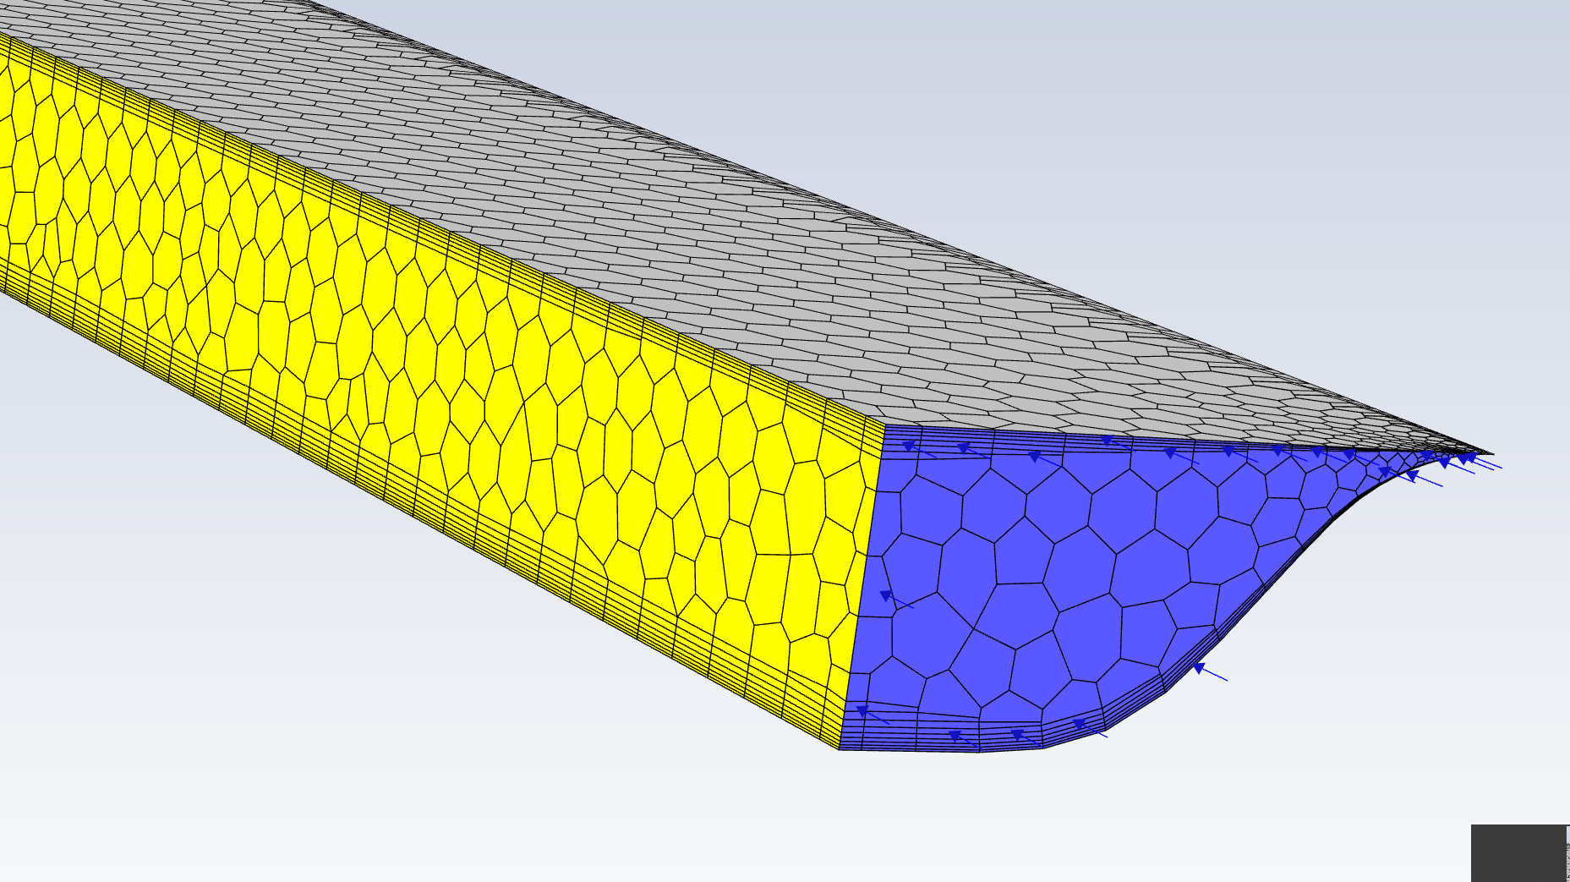
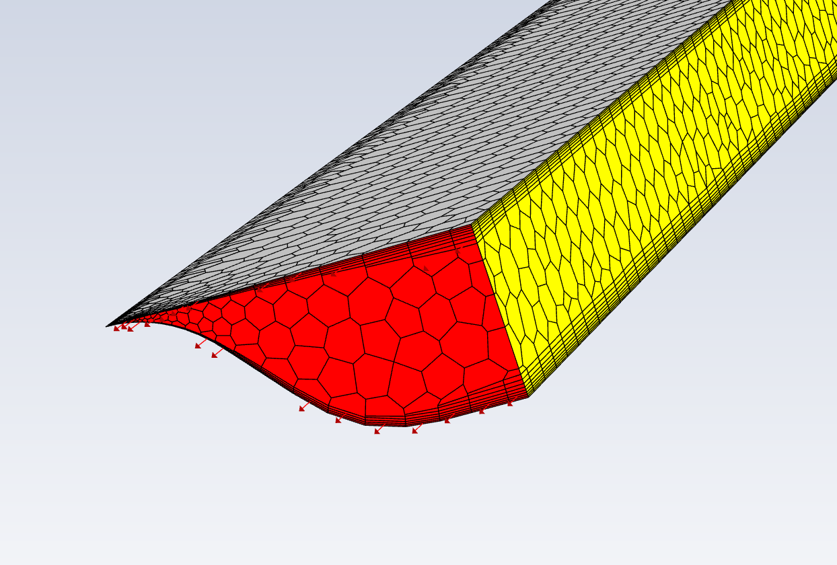
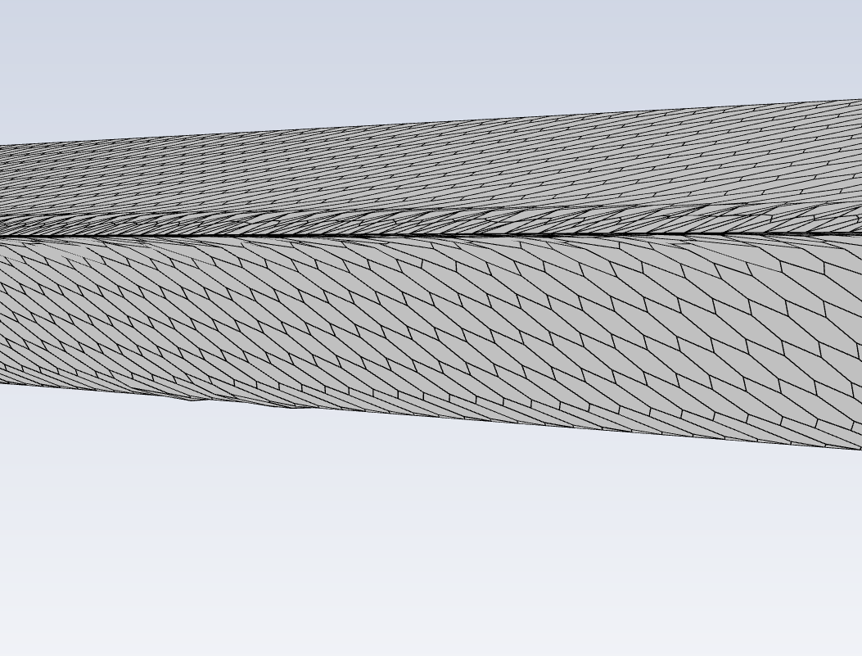
CFD Model Details
Coarse mesh in corners, high y+.
Relatively little flow in this region.
Turbulence model: SST k-omega, target y+ measure is on the order of 1.
Fluid material model: air, Ideal gas
Boundary conditions:
Inlet (blue) 8.9 m/s air
Outlet (red) 0 psig
Symmetry (yellow) no mass, thermal flux
Wall (gray) fluid velocity = 0

Slide 6
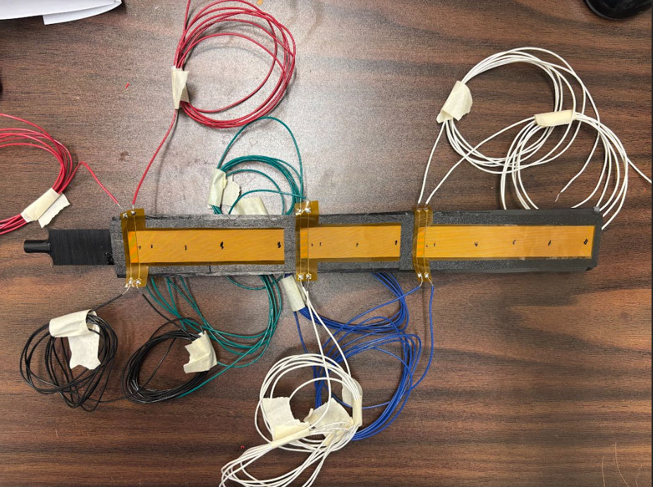
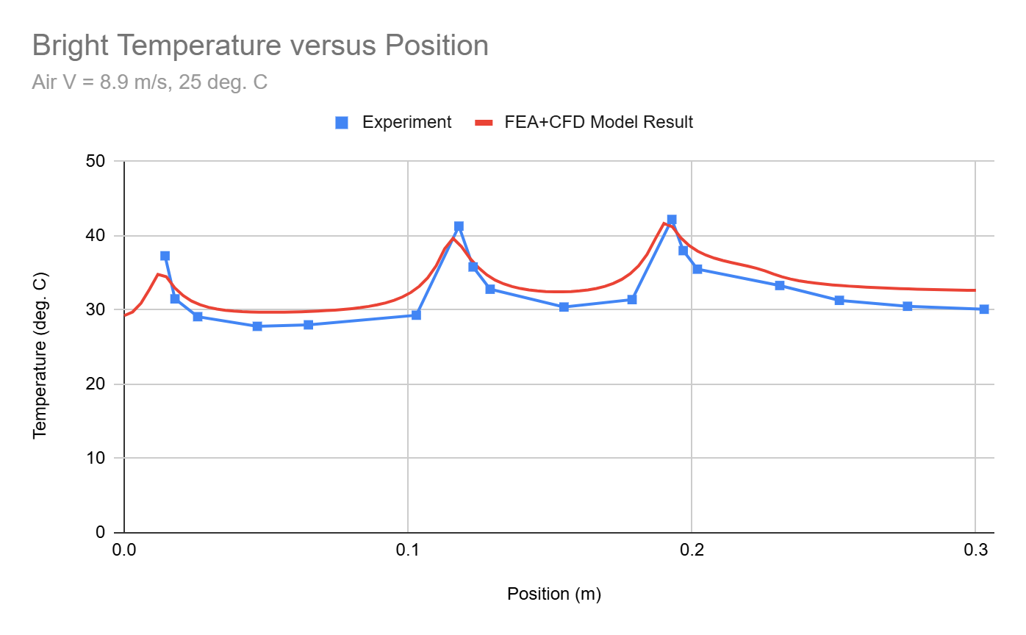
Model Validation
Temperature prediction within 1-3°C

Slide 7
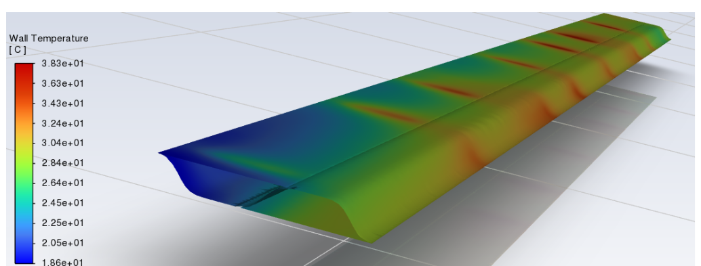
“U-turn” Model Result – Wall Temperature
Large temperature asymmetry from inlet to u-turn.
Air inlet
Air outlet

Slide 8
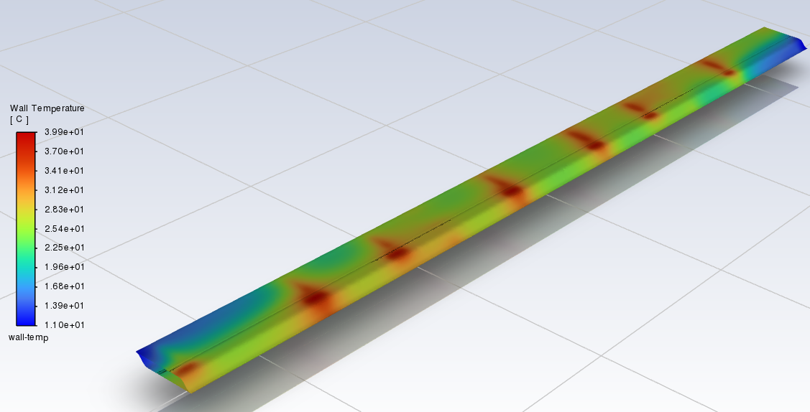
Counter Flow Model Result – Wall Temperature
Symmetric Temperature Field resulting from counter flow configuration.

Slide 9
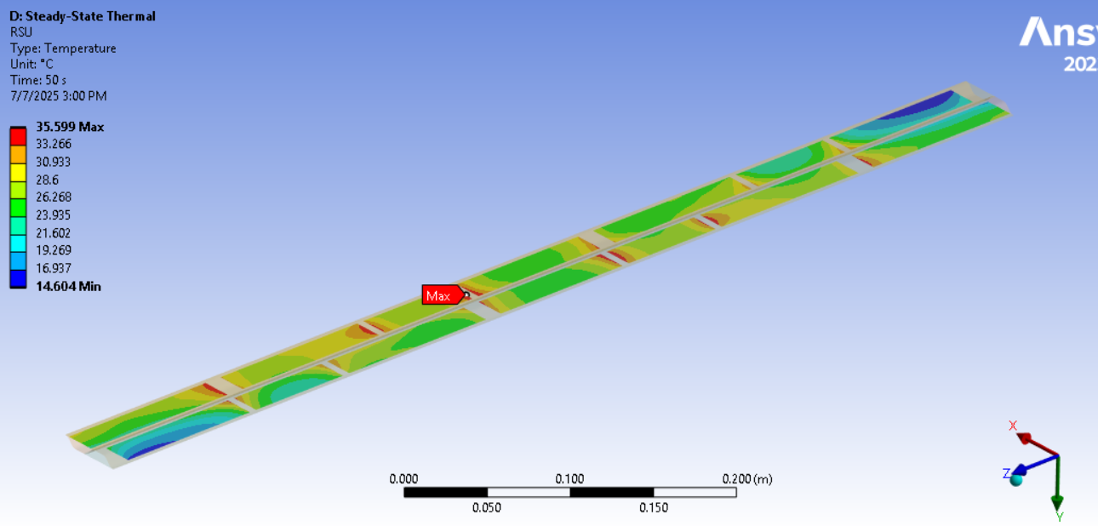
FEA Model - RSU Maximum Temperature
Max Temp = 35.6 °C
Air boundary conditions: 10m/s. 5°C

Slide 10
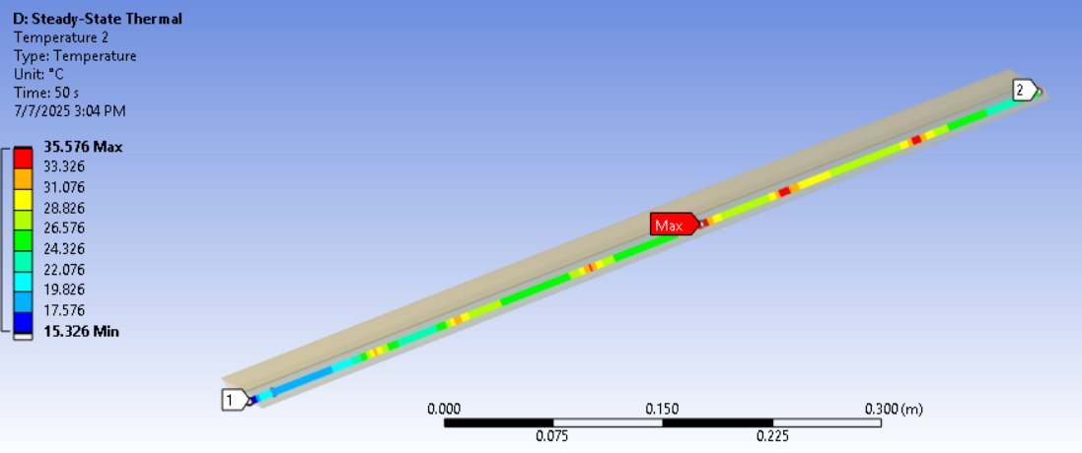
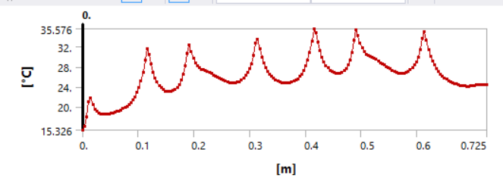
Temperature versus Channel Position
Air boundary conditions: 10m/s. 5°C

Slide 11
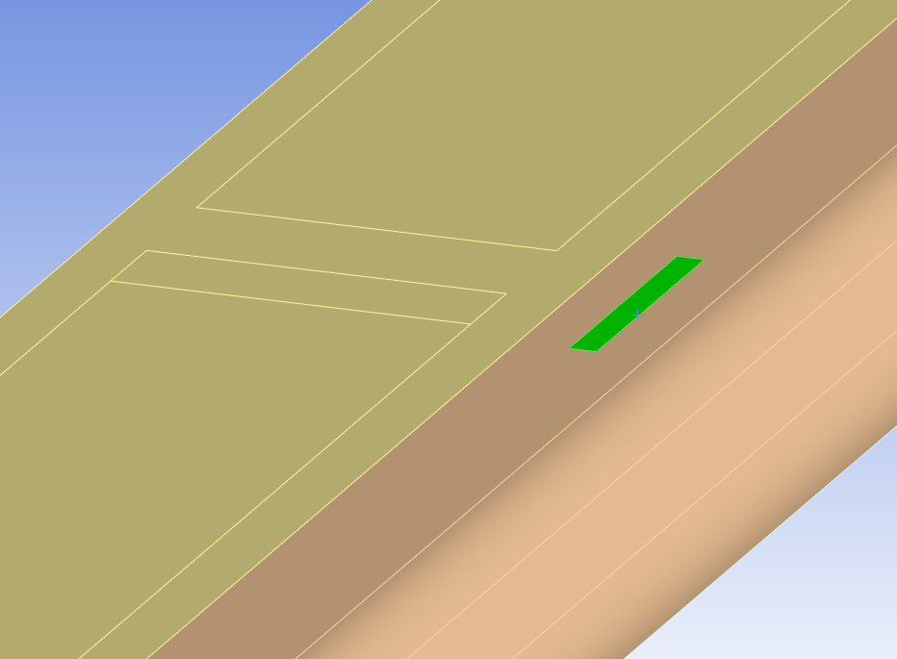
Overall Study Findings
Required cooling air velocity per channel is ≈10 m/s.
Air inlet temperature required to be 5°C.
AncASIC required to be placed away from the LEC to avoid high power density region.
Flow configuration: Alternating flow directions in neighboring channels minimize temperature gradient in the channel.
LEC
AncASIC

Slide 12
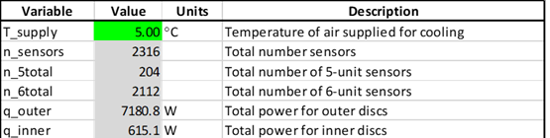
Total Disc Air Requirements
Total number of channels: 454
7795.9 | W | Total disc power
1007.2 | cfm | Total disc volume air flow
0.72 | kg/s | Total disc mass air flow
7.85 | in^2 | Total air tube cross sectional area
at 1 atm.
Assuming pressure < 100 psig

Slide 13
Notional System Architecture
Air distribution scheme mirrored on each side of the detector.
2
3
1
Air service lines
4
Compressor
Service line branching
Detector system domain

Slide 14
Flow Branching and Pressure Estimation
Assumptions:
All flow is balanced at every junction.
Only pipe friction losses incorporated.
Adiabatic process.
Isentropic process.
Approximately incompressible (M<0.3)
2 in
1 in
1/2 in

Slide 15
Compressor Pressure Estimation
Author: Joseph Silber, LBNL
Boundary conditions
source temperature | Tₛ | K | 287
source pressure | Pₛ | bar | 3.530
" | " | Pa | 357,668
" | " | psi | 51.9
source mass flow rate | ṁₛ | kg/s | 0.73
final exit pressure (atmosphere) | Pₑ | bar | 1.0
stage index | - | - | 0 | 1 | 2 | 3
num channels (per parent channel) | n | - | 1 | 10 | 1 | 50
mass flow per channel | ṁ = (ṁₛ or previous stage ṁ) / n | kg/s | 0.730 | 0.073 | 0.073 | 0.001
length | L | m | 20.000 | 3.000 | 0.500 | 0.500
hydraulic diameter (mm) | D_mm | mm | 50 | 25 | 25 | 11.5
hydraulic diameter | D | m | 0.050 | 0.025 | 0.025 | 0.012
cross-sectional area along length L | A₁₂ = π D² / 4 | m² | 1.96E-03 | 4.91E-04 | 4.91E-04 | 1.04E-04
interior height for "squashed" tube in annulus | hs | mm | 12 | 8 | 8 | n/a
interior width for "squashed" tube in annulus | ws | mm | 163.6 | 61.4 | 61.4 | -
entrance temperature | T₁ = Tₛ or previous stage T₃ | K | 287 | 282.4 | 282.4 | 277.9
entrance pressure | P₁ = Pₛ or previous stage P₃ | Pa | 357,668 | 278,488 | 161,442 | 120,841
entrance density (ideal gas law) | ρ₁ = P₁ / (R * T₁) | kg/m³ | 4.342 | 3.436 | 1.992 | 1.515
entrance dynamic viscosity | μ₁ = μ₀ * (T₁/T₀)^0.76 | Pa*s | 1.78E-05 | 1.76E-05 | 1.76E-05 | 1.74E-05
Reynold's number | Re = 4 ṁ / (π D μ₁) | - | 1.04E+06 | 2.11E+02 | 2.11E+02 | 9.28E+00
friction factor (Blasius) | f = 64/Re, Re < 2300 = 0.316/Re^0.25 otherwise | - | 0.010 | 0.303 | 0.303 | 6.895
friction pressure drop (Darcy-Weisbach) | ΔP₁₂ = -f * (L/D) * ṁ² / (2 ρ₁ A₁₂²) | Pa | -62,954 | -117,046 | -33,651 | -19,438
downstream pressure | P₂ = P₁ + ΔP₁₂ | Pa | 294,714 | 161,442 | 127,791 | 101,402
downstream temperature (assume minimal heating) | T₂ ~ T₁ | K | 287.0 | 282.4 | 282.4 | 277.9
downstream density (ideal gas law) | ρ₂ = P₂ / (R * T₂) | kg/m³ | 3.578 | 1.992 | 1.577 | 1.271
average density | ρₐ = (ρ₁ + ρ₂)/2 | kg/m³ | 3.960 | 2.714 | 1.784 | 1.393
average volumetric flow | Vₐ = ṁ / ρₐ | m³/s | 0.184 | 0.027 | 0.041 | 0.001
average volumetric flow (cfm) | Vₐ_cfm | cfm | 390.6 | 57.0 | 86.7 | 2.2
average air speed | uₐ = Vₐ / A₁₂ | m/s | 93.9 | 54.8 | 83.3 | 10.1
cross-sectional area on other side of outlet | A₃ = ∞ or next stage's (A₁₂ * n) | m² | 4.91E-03 | 4.91E-04 | 5.21E-03 | 1E+99
area change pressure drop (non-choked) | ΔP₂₃ₙ = ṁ²/(2*ρ₂) * (1/A₃² - 1/A₁₂²) | Pa | -16,226 | 0 | -6,951 | -77
outlet pressure if non-choked | P₃ₙ = P₂ + ΔP₂₃ₙ | Pa | 278,488 | 161,442 | 120,841 | 101,325
outlet pressure if choked | P₃ₓ = P₂ * βₓ | Pa | 155,692 | 85,287 | 67,510 | 53,569
pressure ratio calculated with non-choked eqn | β₃ₙ = P₃ₙ / P₂ | - | 0.945 | 1.000 | 0.946 | 0.999
is choked? | β₃ₙ < βₓ | boolean | FALSE | FALSE | FALSE | FALSE
outlet pressure | P₃ = P₃ₙ or P₃ₓ | Pa | 278,488 | 161,442 | 120,841 | 101,325
outlet pressure (bar) | P₃_bar | bar | 2.75 | 1.59 | 1.19 | 1.00
outlet temperature (isentropic expansion) | T₃ = T₂ * (P₃ / P₂)ᵏ | K | 282.4 | 282.4 | 277.9 | 277.9

Slide 16
Concluding Remarks and Future Work
Compressor required likely somewhat large for these conditions
  3.5 bar @ 390 cfm for discs only. Additional capacity will be needed for the inner and outer barrels.
Approximate cross section for air tubing: 7.85 in^2 (5065 mm^2)
Thermal system interlocks needed during startup.
Solution needed to prevent over-pressure condition.
Air return area required.

