Slide 1
SVT global integration sequence – June 2025 concept
Presented at the SVT workshop at BNL on 10th July 2025

Slide 2
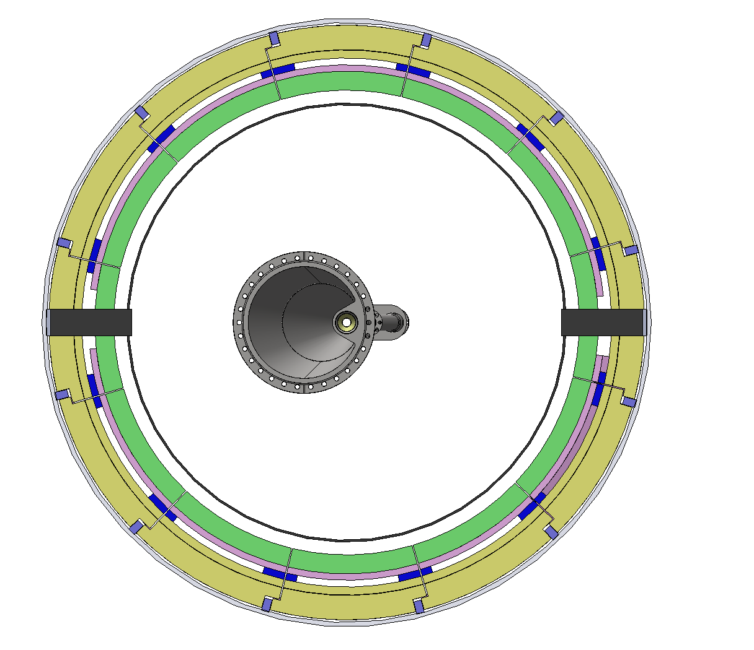
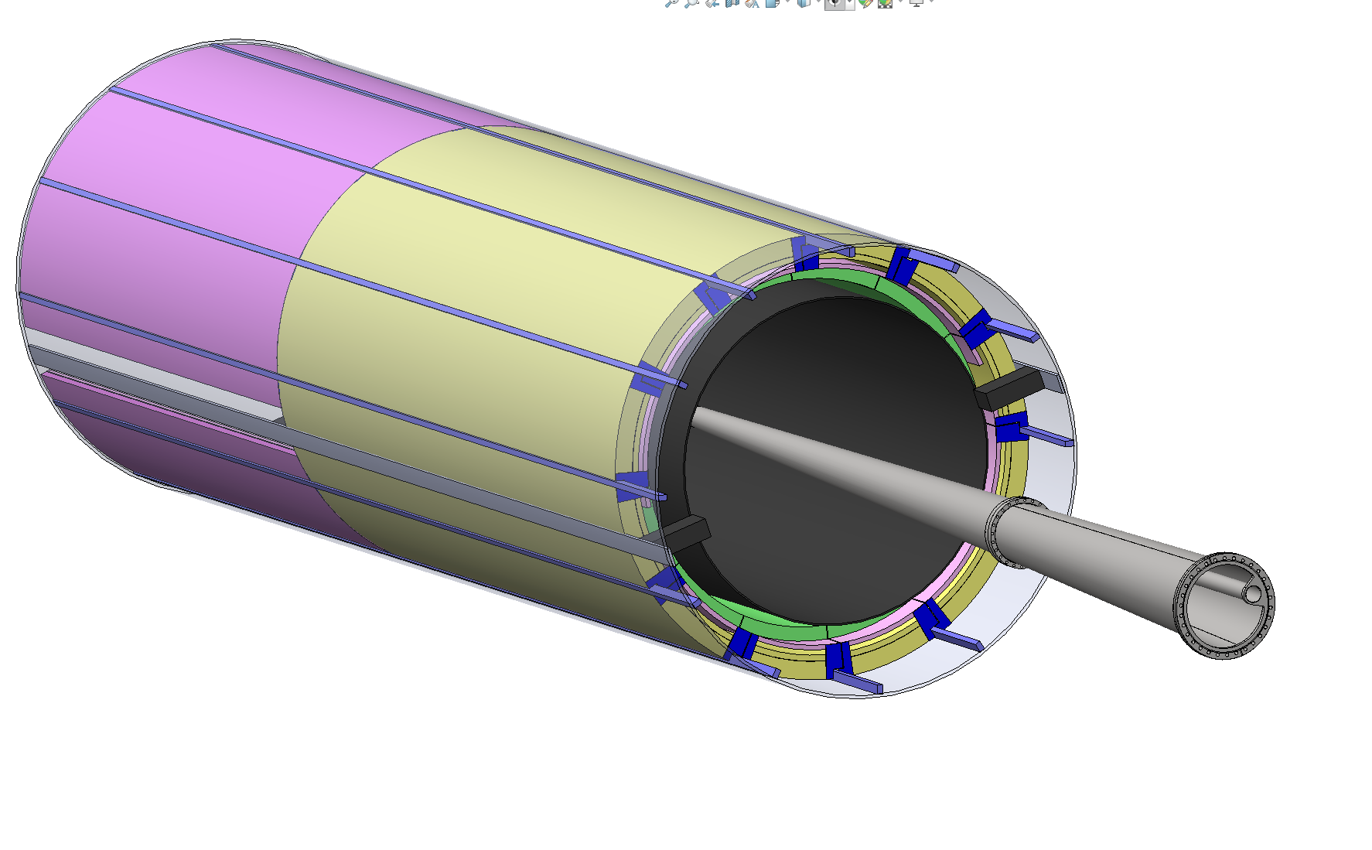
Nomenclature
Gray is the global support tube (GST)
Yellow part is the 12th sector of the Barrel TOF
SVT space separated with the PST and supports the beam pipe
Pink part is the service trays of Cymbal MPGD and Barrel TOF
Blue part are the rails on which service trays + Cymbal MPGD + Barrel TOF slides on
Green part is the 12th sector of the Cymbal MPGD
Black is the SVT support tube (PST)

Slide 3
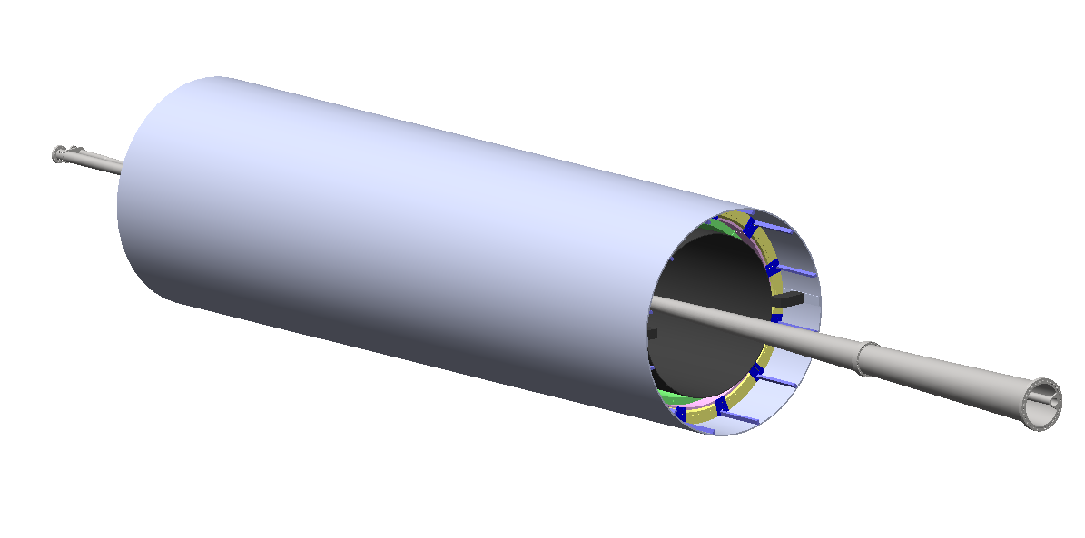
SVT related Global Installation Sequence
Global integration sequence –
GST with the rails in 3 and 9 o’clock is installed inside the Barrel EMCal and supported at 4 mount points at 3 and 9 o’clock on either ends in the assembly hall.
SVT package with the beam pipe is installed into the GST using temporary supports and Eifel tower like installation tool
12 sectors of Cymbal and Barrel TOF are installed into the GST on rails in the experimental cavern.
What this means for SVT –
installation and alignment of the PST + SVT + beam pipe package has about 2 cm radial clearance while installation.
The final cabling of SVT will be AFTER installation of the 12 sectors of cymbal and barrel TOF
Whenever there is a need to service a sector – at least 1/12th of the cabling on SVT will need to be un-done / un-cabled so that we can service this in the experimental cavern itself.

Slide 4
SVT services on the electron going (Z+) direction
The SVT services can use the same rails segmented in 12 sectors / trays to insert services in the GST
There is an effort to provide next iteration of this with Roland + Ben + Sushrut in the next months after this work shop when we know more on the service estimates

Slide 5
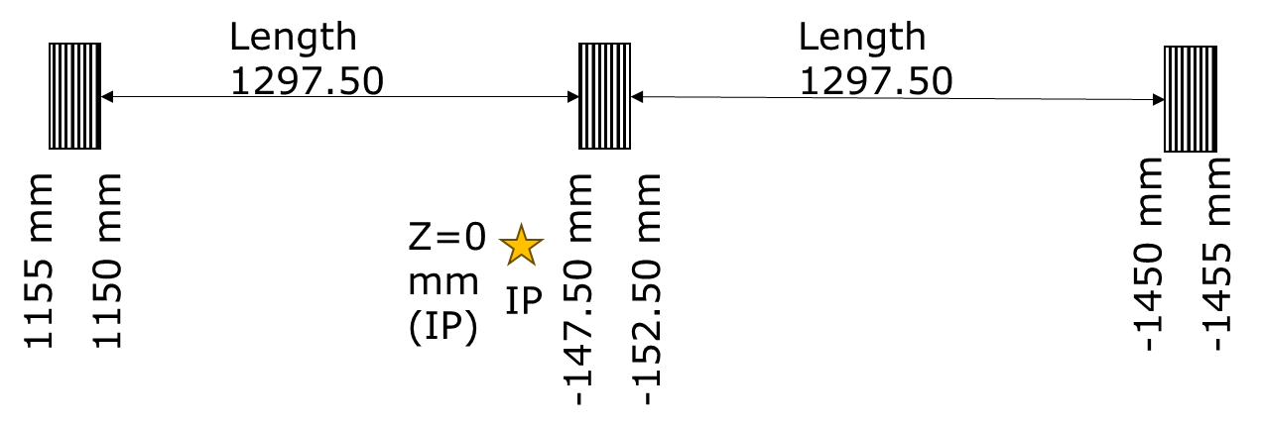
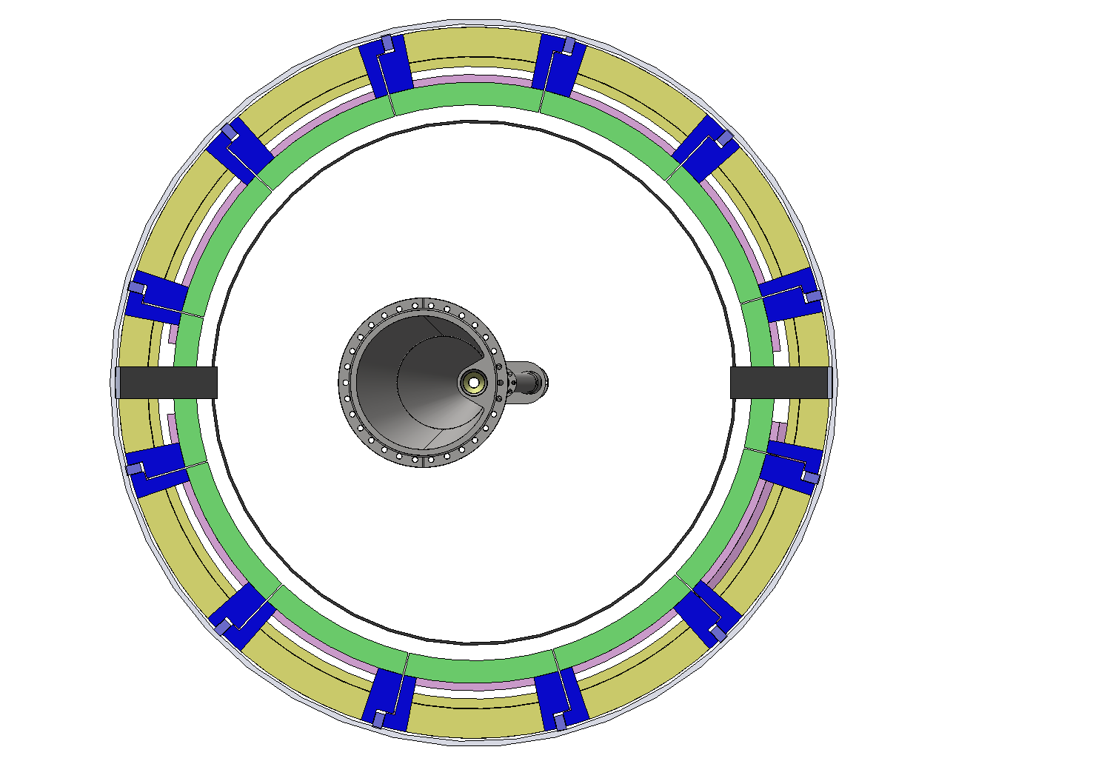
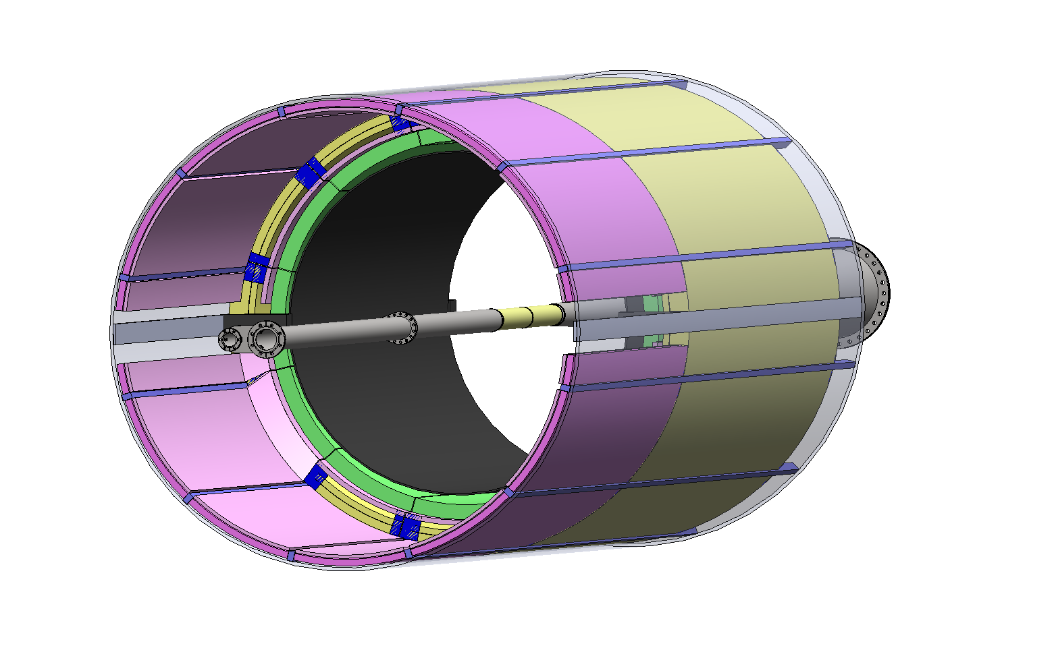
Sector CAD introduction
TOF and Cymbal will be installed as combined sectors (12 sectors total) and will also share the trays for the services.
The dimensions of the TOF and split on the staves (along z) remains unchanged.
No engagement rings but otherwise the length and segmentation remains same
Dark Pink Cymbal+ TOF service space

Slide 6
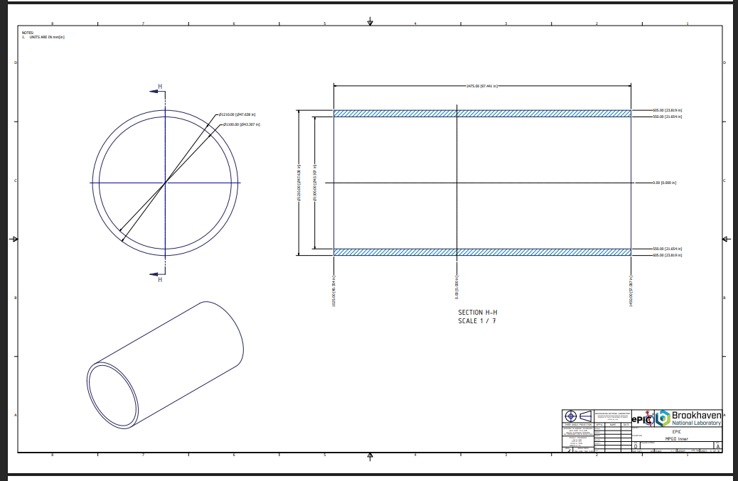
The TOF and Cymbal will be segmented in 12 sectors along the r-phi plane inside the GST.
This will enable installation and removal of the TOF + Cymbal sectors
This is a second degree envelope model with interfaces for both the AC-LGAD barrel* and the Cymbal barrel mounts as positioned in the 12 sectors.
This design allows for complete coverage in r-phi plane
There will be some split / loss of coverage in the z which is unavoidable. (originally was 5mm – still on that scale)
From Dan’s envelope model March_2025

Slide 7
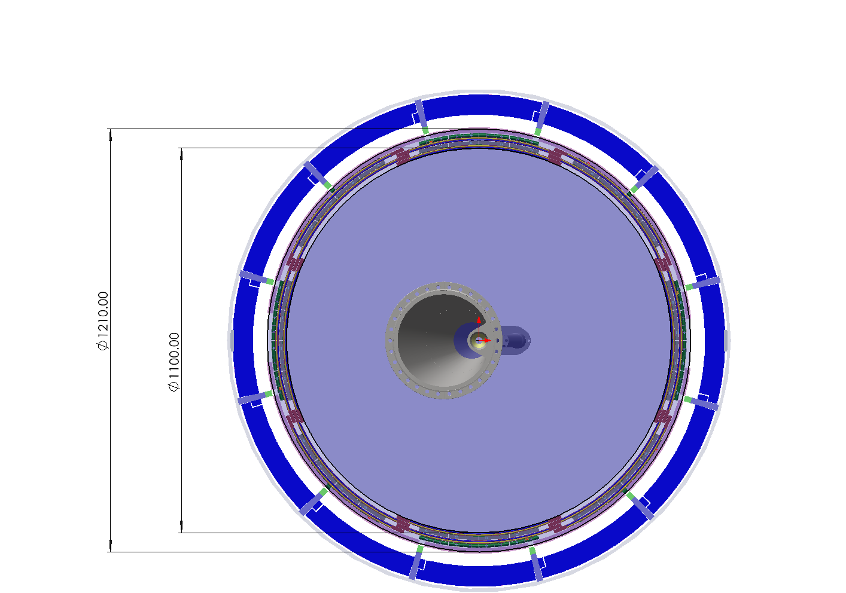
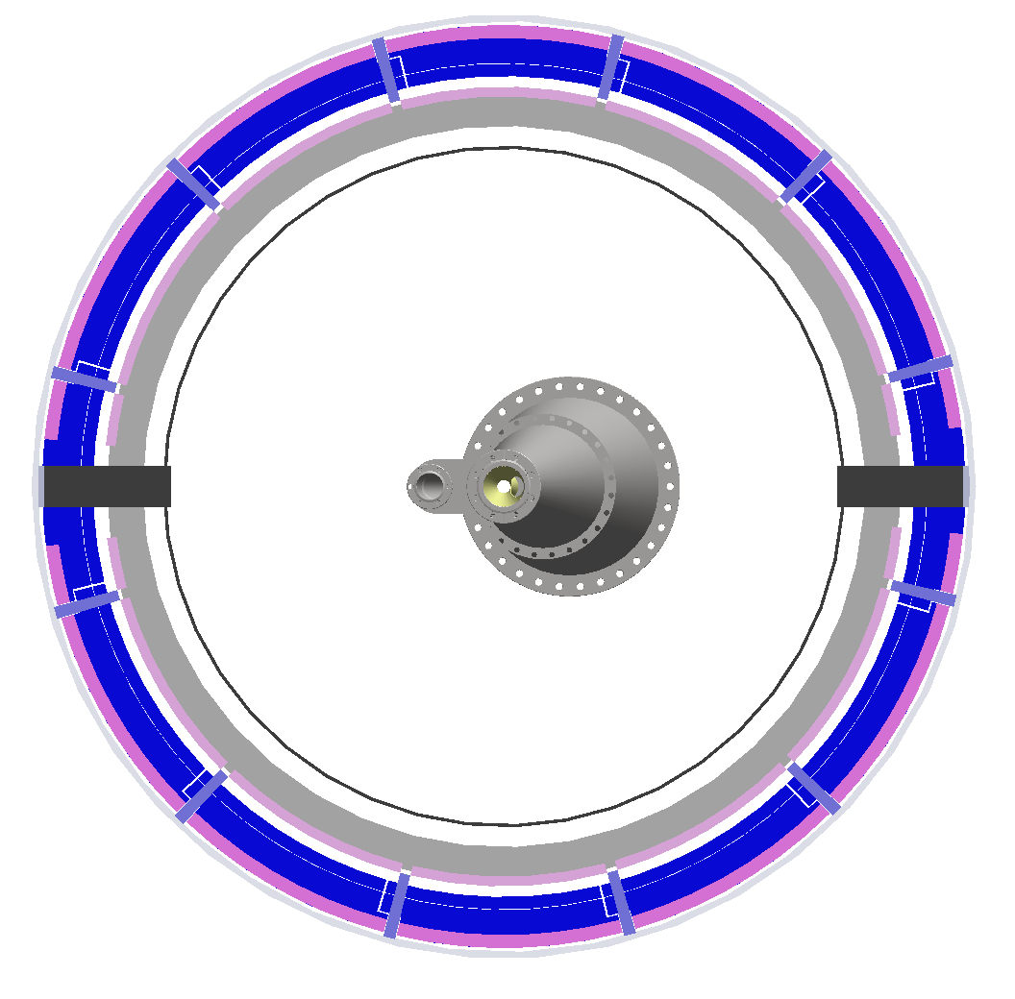
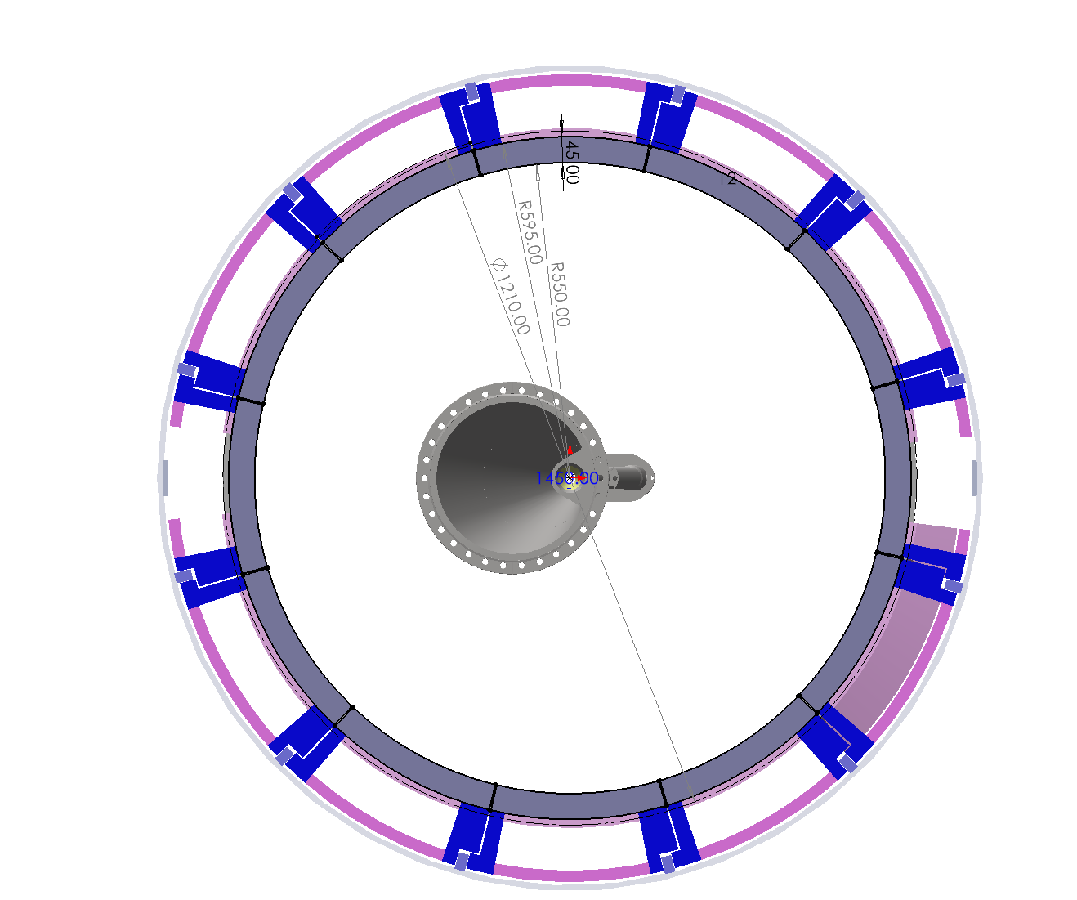
Cymbal MPGD Assembly Scheme

Slide 8
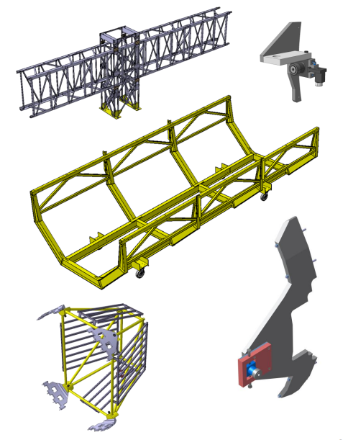
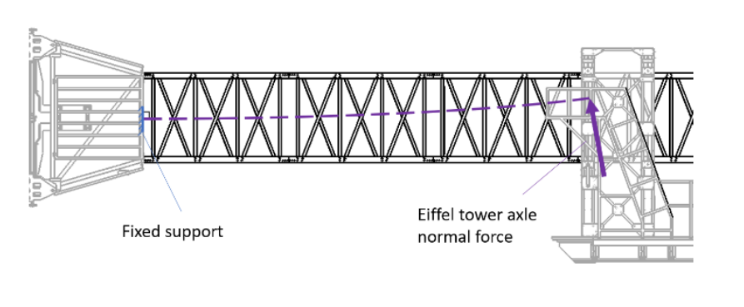
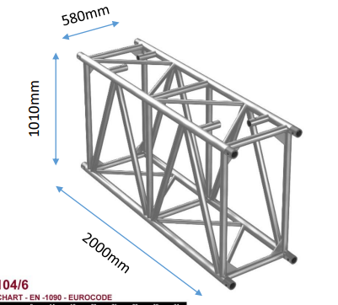
Approach from CMS and adaptation to ePIC
Modular Eiffel Tower
Wheels/Rails
Support cradle already in design for ePIC
Modular structural design that is able to be mounted as the structure is pushed / removed since there is not enough space on the platform on electron side
Pull interface that attaches to the PST
Bananas
1000mm
Pictures from Mikko Barinoff – CMS CERN ; indico 1112851

Slide 9
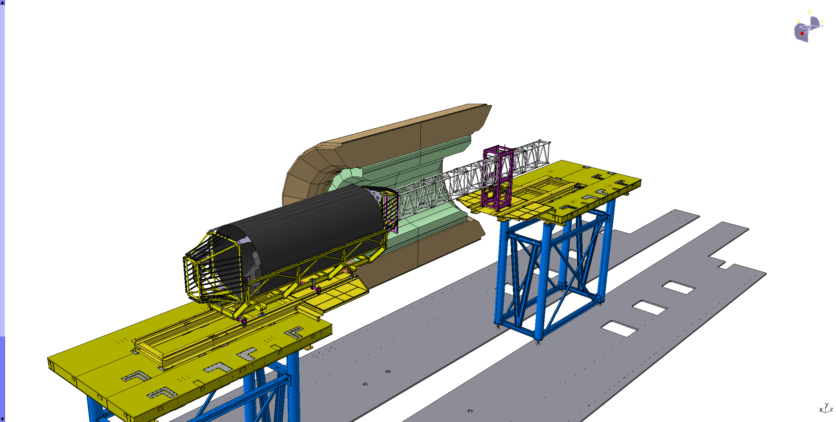
Eiffel tower concept
Concept from CMS for installation and removal for the Tracking detector
(video)

