Slide 1
Integration, Installation and Infrastructure (Triple I Group)
Services and Maintenance
Roland Wimmer

Slide 2
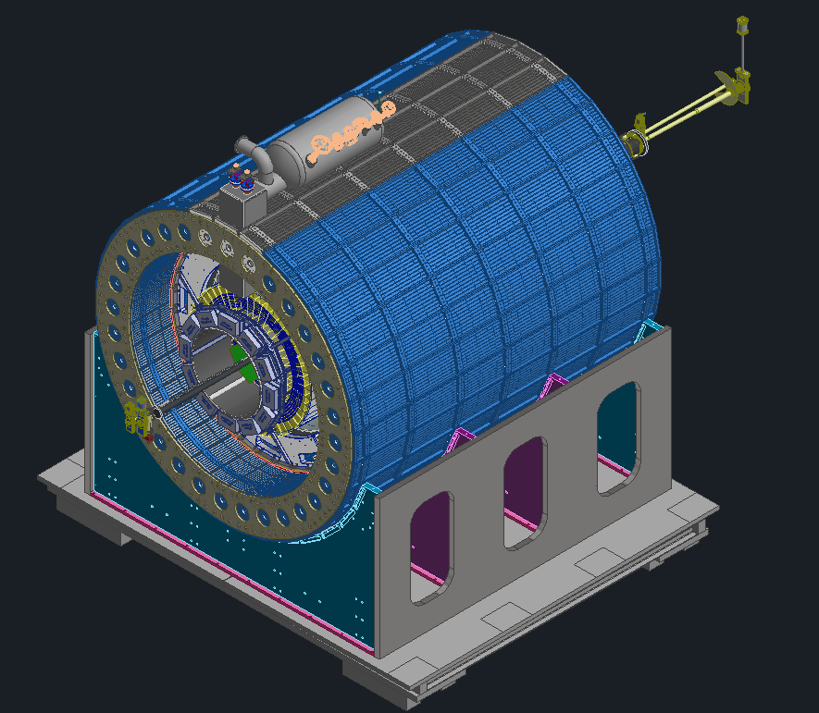
Outline
General Services Update
Backward Cable Trays
Forward Cable Trays
Disconnects
Maintenance updates

Slide 3
Services Breakdown
Inner Services Breakdown
System | Area (cm²) | % of Total
L0-L2 | 184.58 | 7.83%
L3 & L4 | 344.06 | 14.60%
SVT Disks | 1084.18 | 46.00%
MPGD Disks | 154.20 | 6.54%
ToF | 208.59 | 8.85%
CYMBAL | 381.39 | 16.18%
Total | 2357.00 | 100.00%
The tables to the right are snapshots from the master services spreadsheet, there are several known updates that haven’t been populated yet
The orange table shows half the total services from each detector (backward side)
The yellow table shows what percentage of the SVT’s total (forward & backward) services are power, signal and cooling
SVT Total Services Breakdown
Service | Area (cm²) | % of Total
Power | 420.23 | 14.48%
Signal | 1483.20 | 51.09%
Cooling | 999.65 | 34.43%
Total | 2903.07 | 100.00%

Slide 4
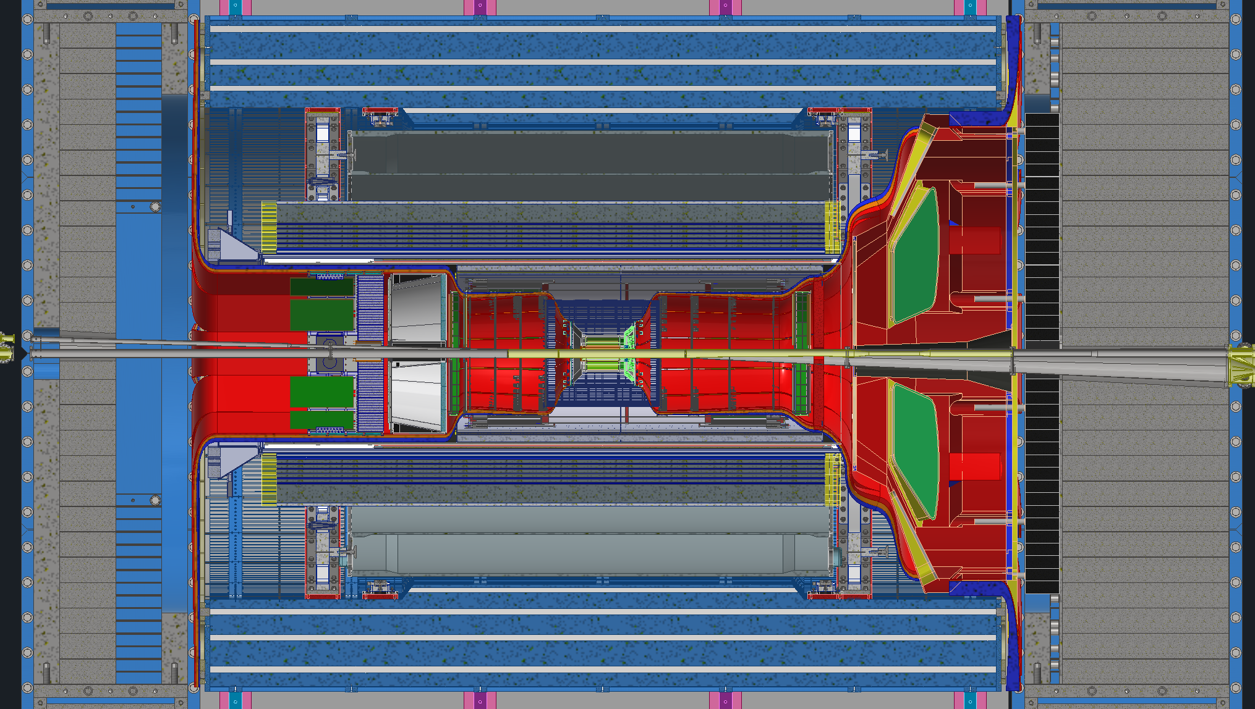
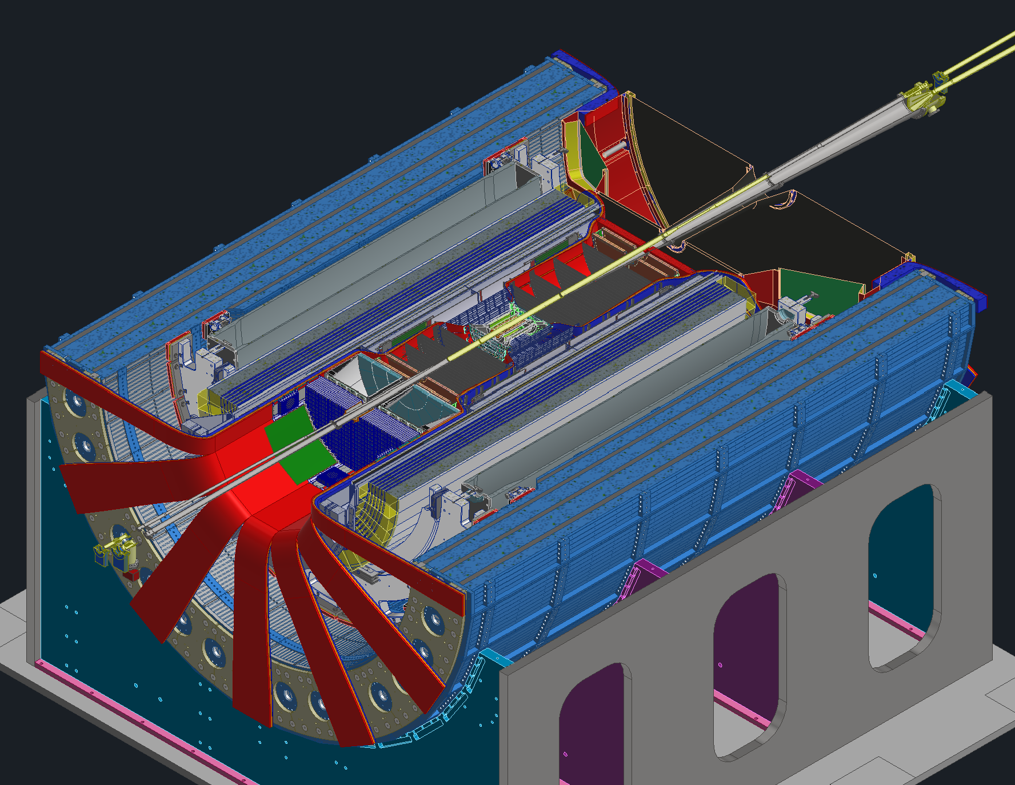
Services
After the recent updates there are areas of concern
Not enough space around pfRICH and EEEMCal
Space in-between barrel EMCal and dRICH is a concern
Services coming out at 3 & 9 O’clock from dRICH and fEMCal
+120%
~95%
~90%

Slide 5
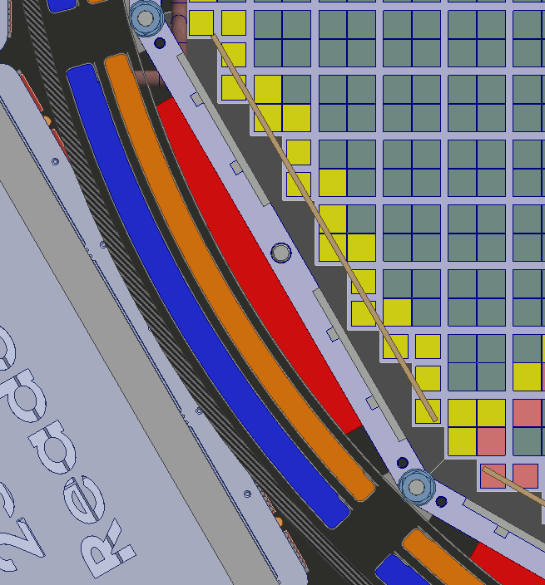
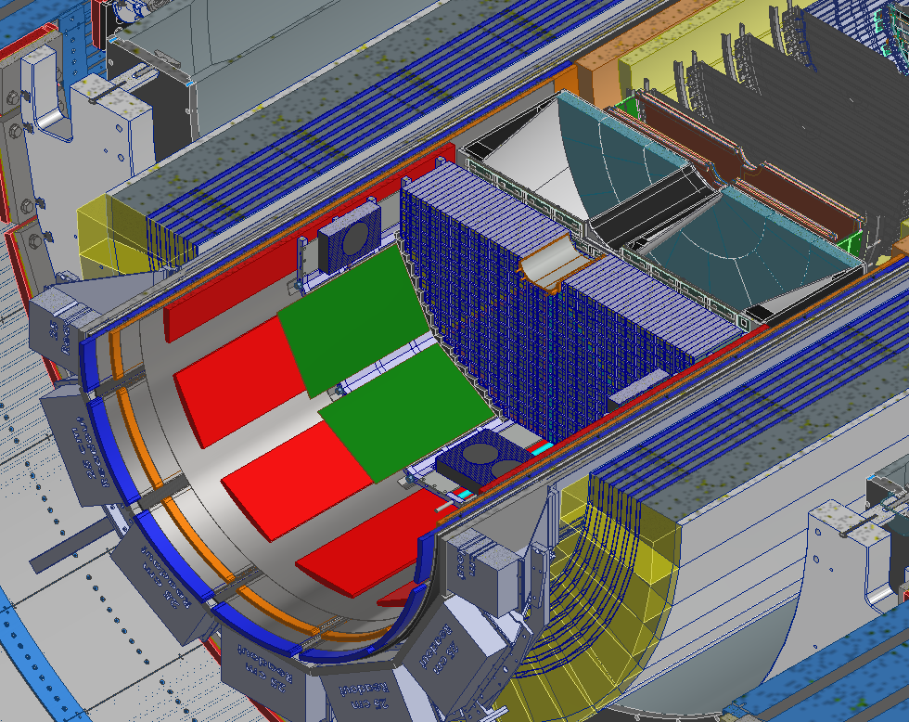
Backward Direction Cable Trays
Cables trays around the EEEMCAL and pfRICH will be broken up into 3 separate trays
Innermost trays will house services from the pfRICH and EEEMCAL
Middle trays are for SVT and MPGD disks
Outermost trays are for CYMBAL and ToF
SVT & MPGD Disks Services
pfRICH & EEEMCAL Services
ToF & CYMBAL Services
*Trays are not Proportional*

Slide 6
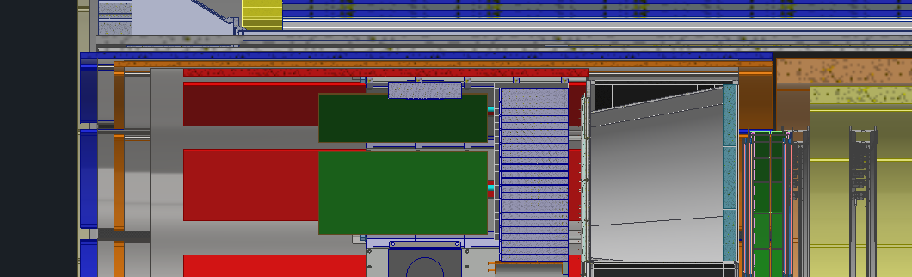
Backward Direction Cable Trays
All the trays will be independent of one another
Trays will slide in and out of the GST via rails
ToF & CYMBAL Services
pfRICH & EEEMCAL Services
SVT & MPGD Disks Services

Slide 7
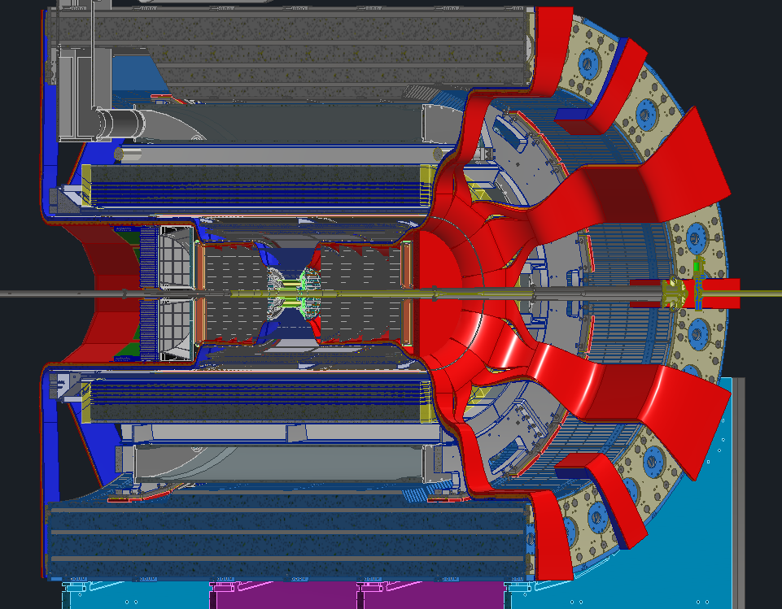
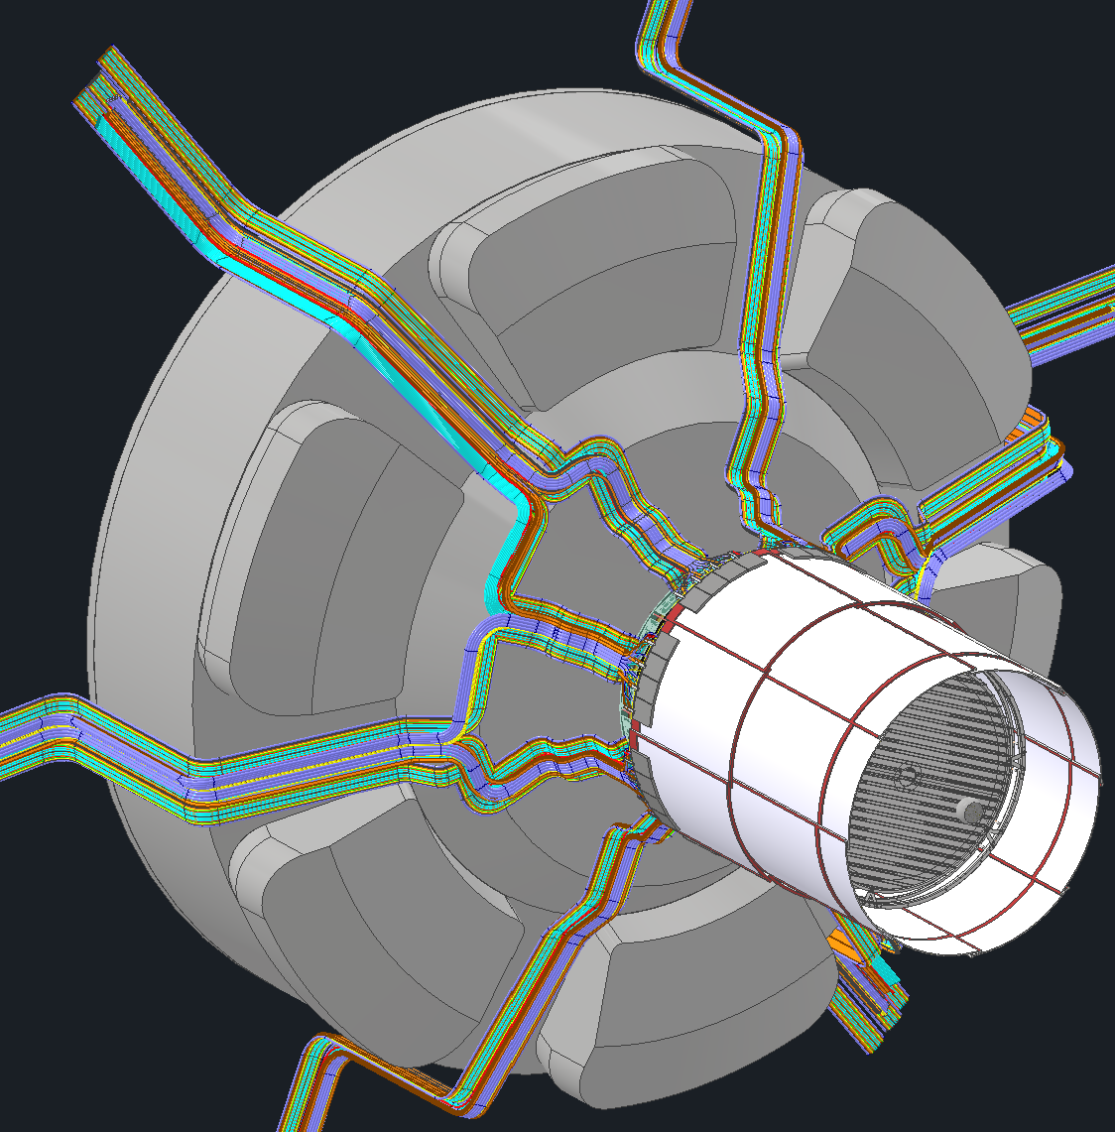
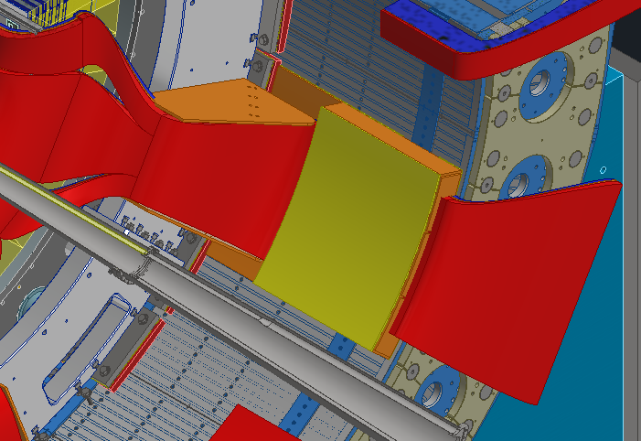
Forward Direction Cable Trays
Trays for services will be a “negative” of the dRICH
Meaning the trays will match the shape of the dRICH such that we maximize available space
6 large trays that feed around the dRICH sensor boxes
Cable tray concept

Slide 8
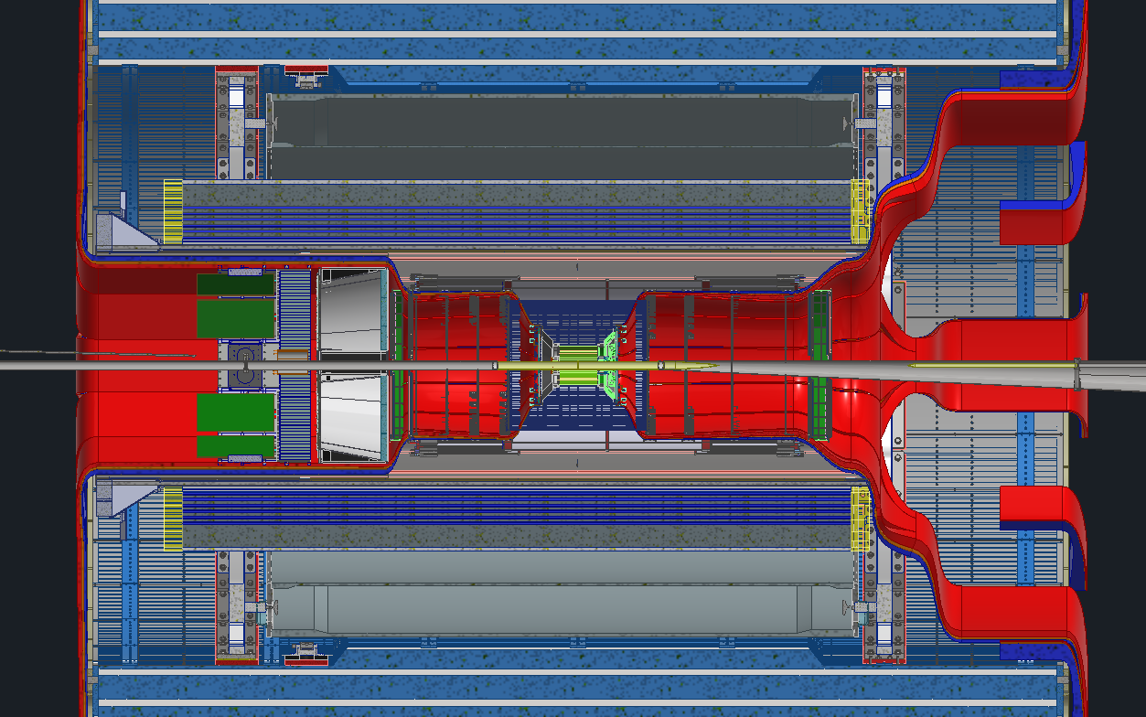
Planned Disconnect Locations
Planning on having 1 disconnect location on each side of the detector
Backward disconnect will be just past the DIRC electronics
Forward disconnect will be between the barrel EMCAL and the dRICH
These are the 2 “earliest” locations with potentially enough space for connectors
Rule of thumb is connectors take twice the amount of space as the cable itself. Finding enough space will be extremely difficult

Slide 9
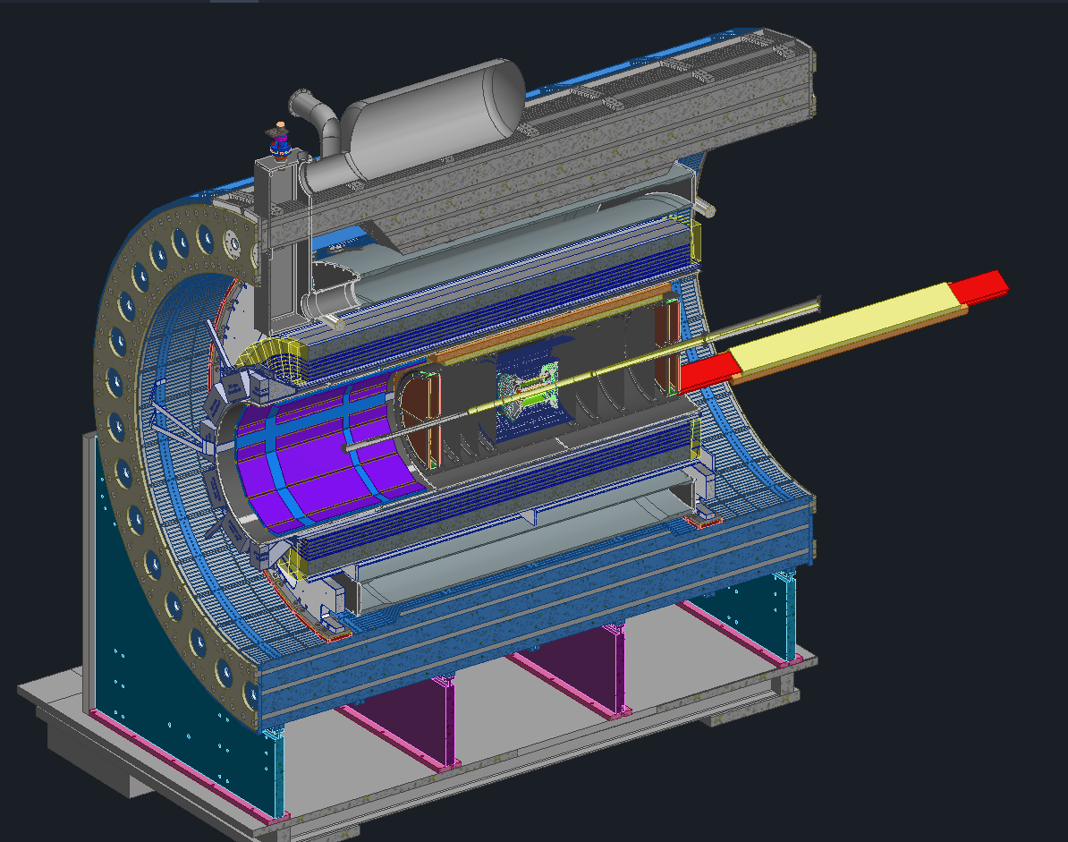
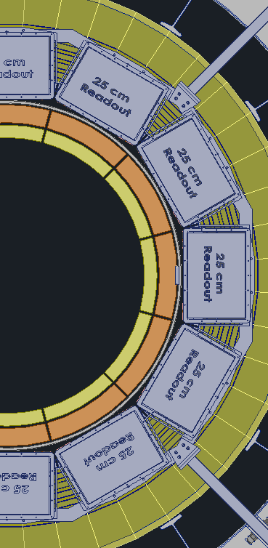
Maintenance Updates
Recent changes were made to CYMBAL and ToF to accommodate maintenance needs
Previously they were both unserviceable without rolling the detector out into the assembly hall
We split ToF and CYMBAL into 12 radial sections and now they are individually removable, independent of the GST and PST
This has a few minor impacts to the surrounding detectors and their services
ToF
CYMBAL

Slide 10
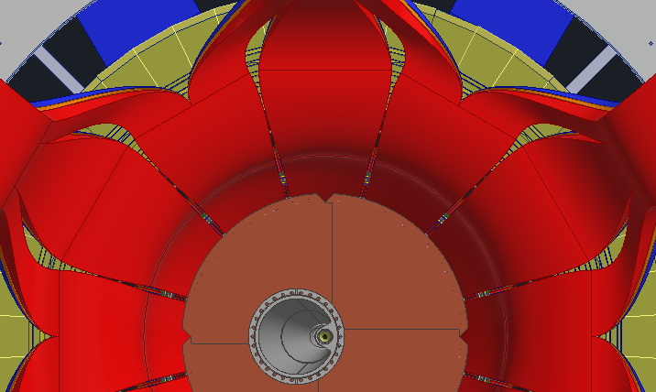
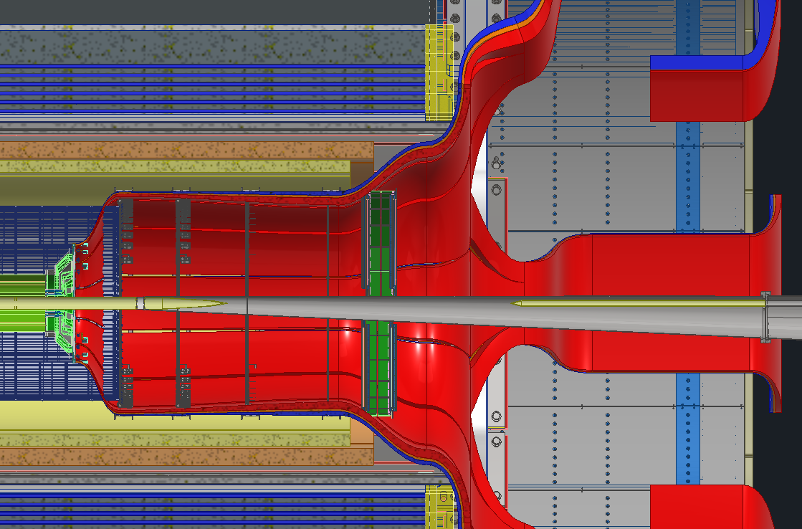
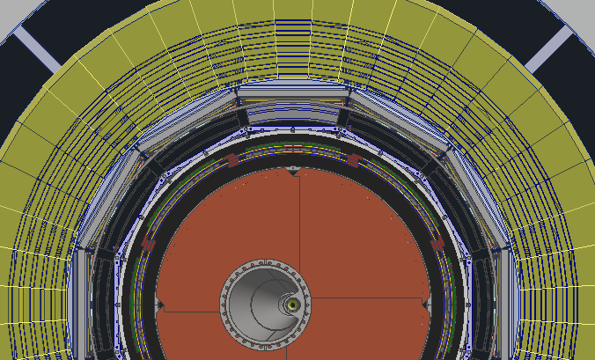
Maintenance Updates
If we wanted to get access to the 12 O'clock position ToF and CYMBAL, we would have to disconnect the SVT services that are in front of that sector and move them out of the way such that we can pull that sector out.
Disconnect

Slide 11
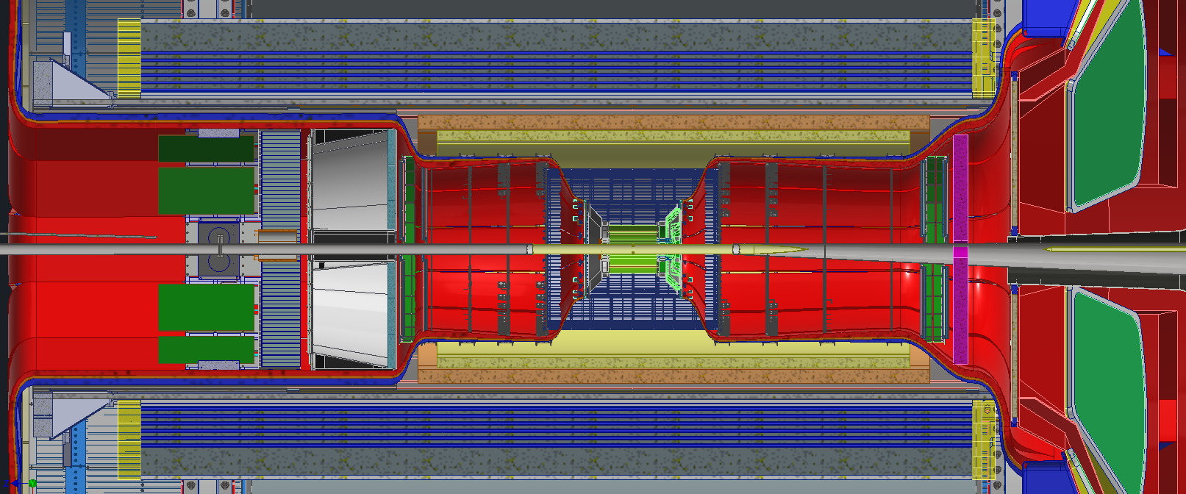
Maintenance Updates
With the ToF and CYMBAL update the services will need a slight rerouting. The MPGD disk will need to be smaller and allow for services to pass by it without hindering the removal of CYMBAL
New services route

Slide 12
QUESTIONS?

Slide 13
Backup Slides

Slide 14
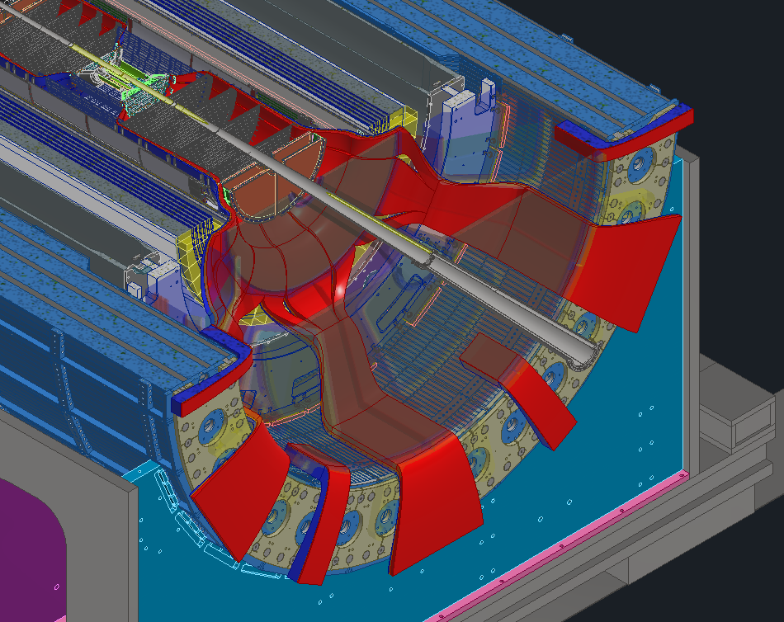

Slide 15
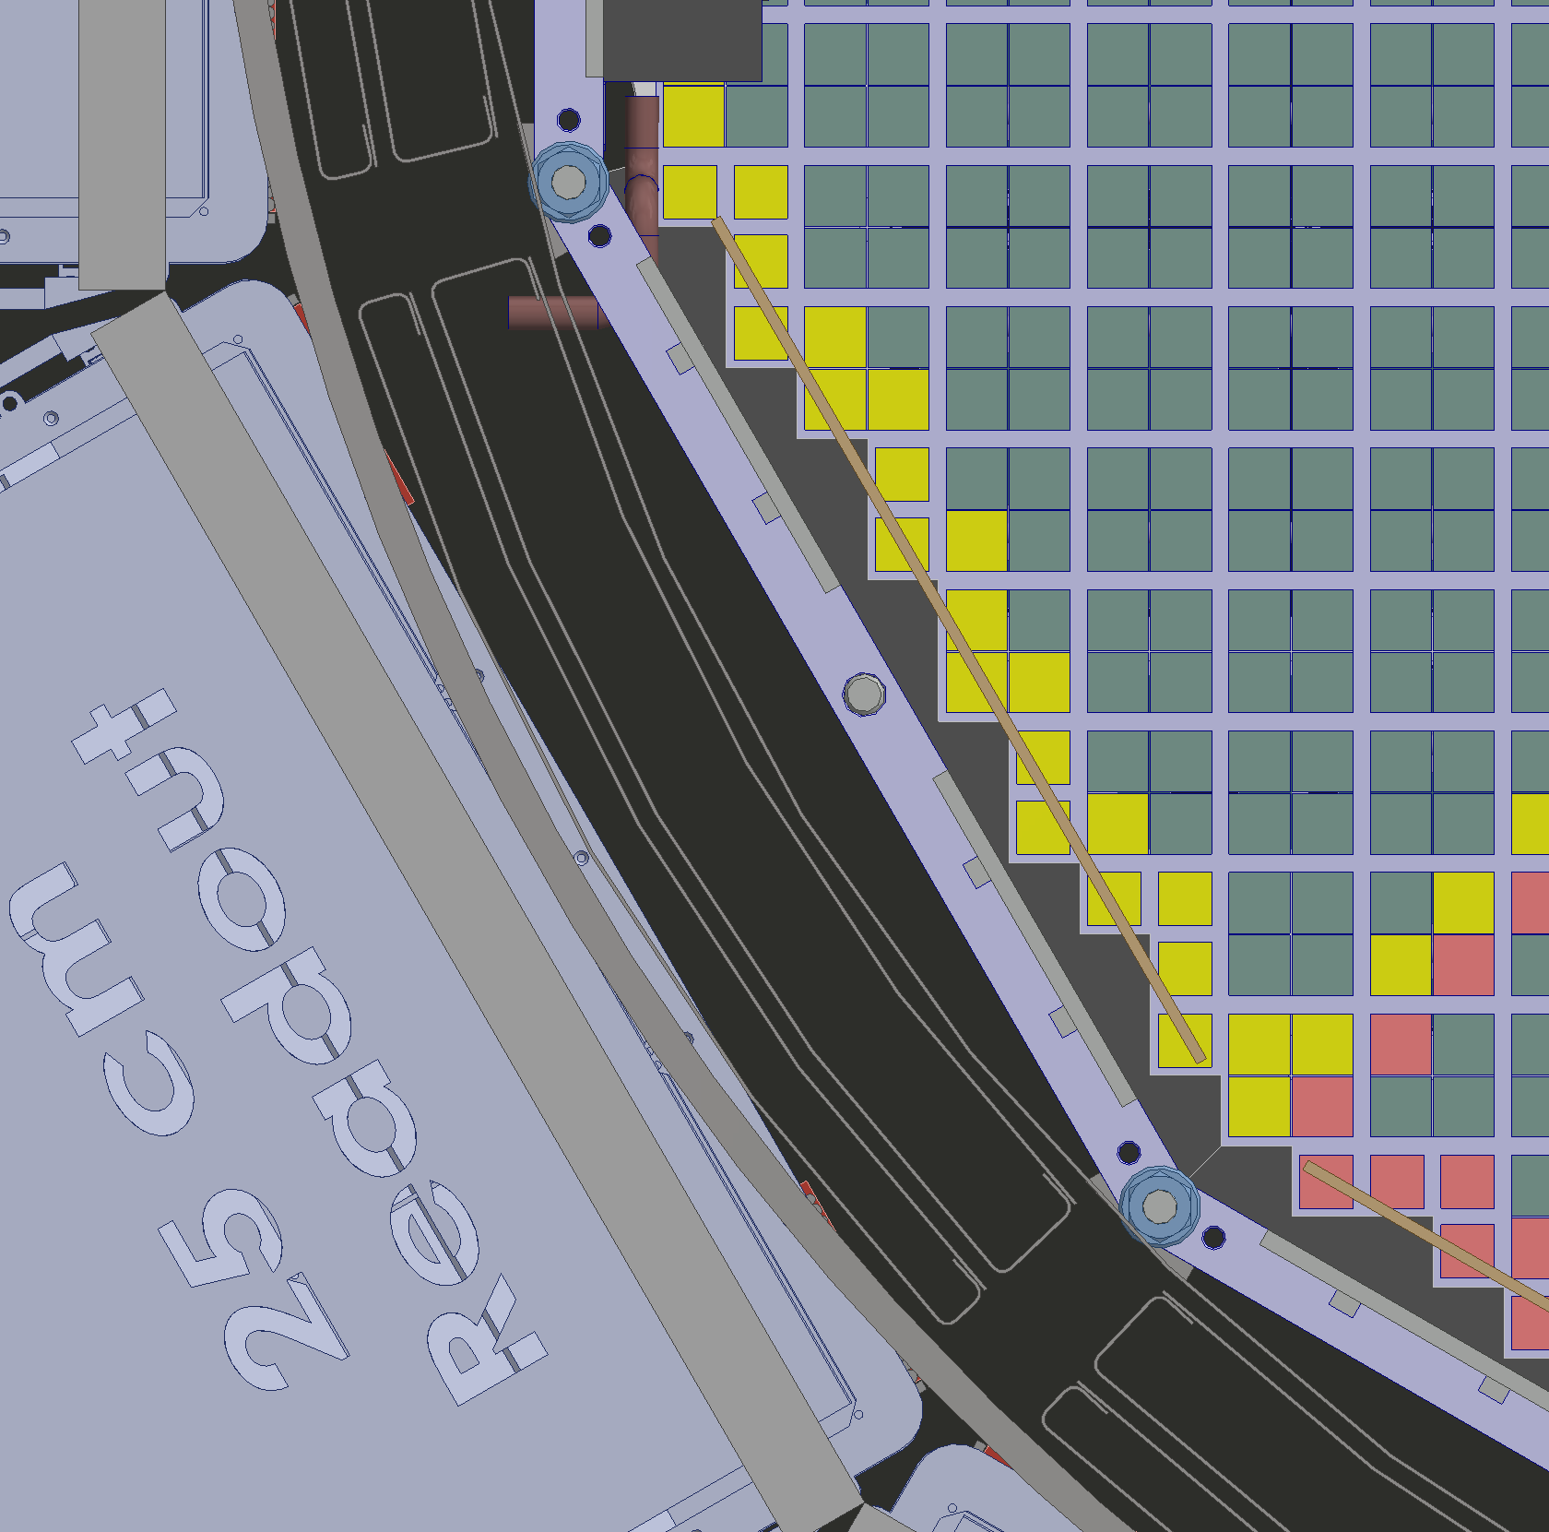

Slide 16
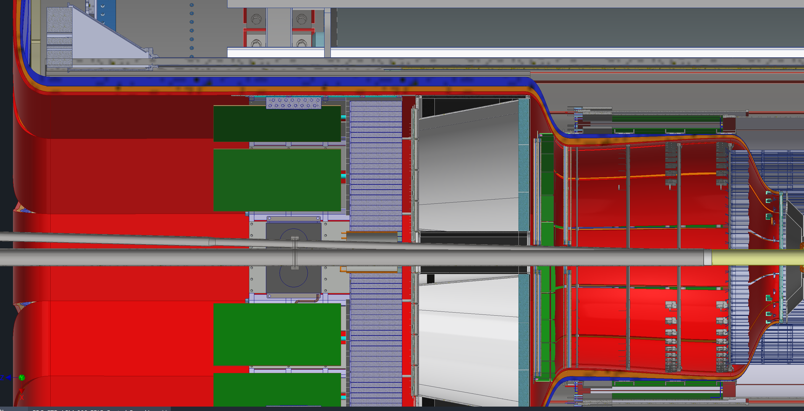
GST Cable Tray Updates

Slide 17
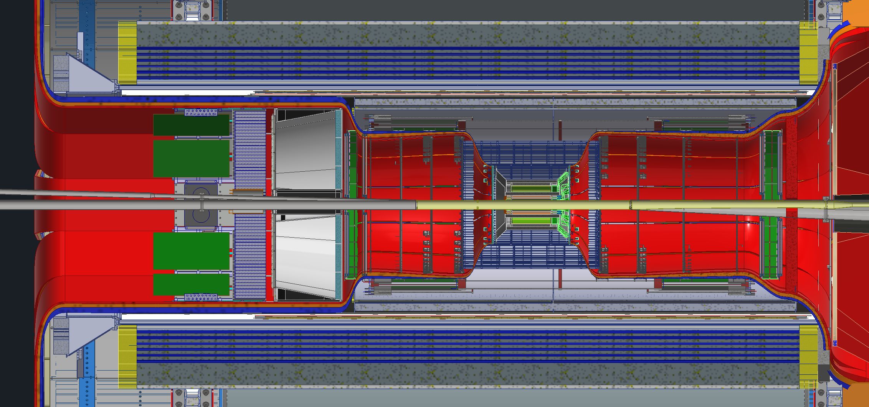

Slide 18
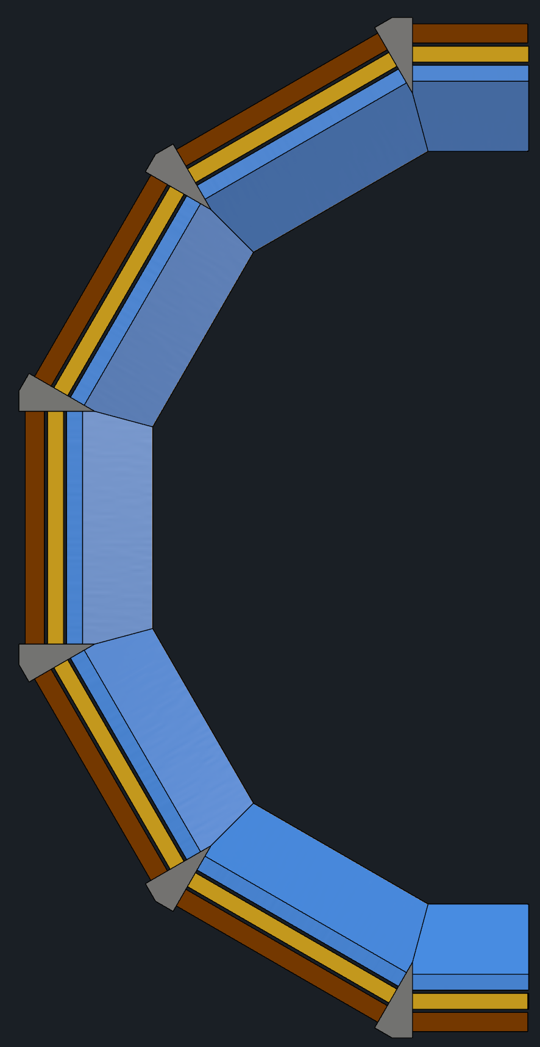
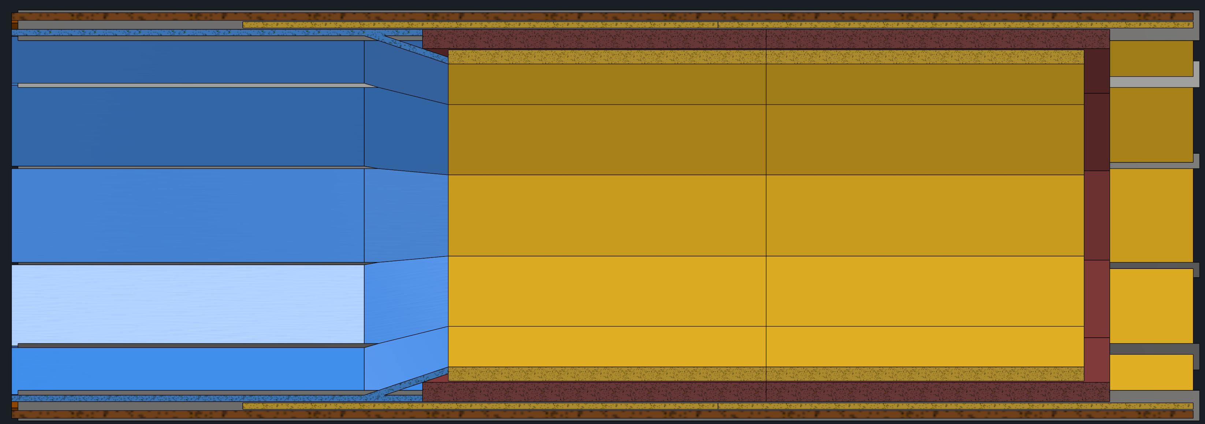
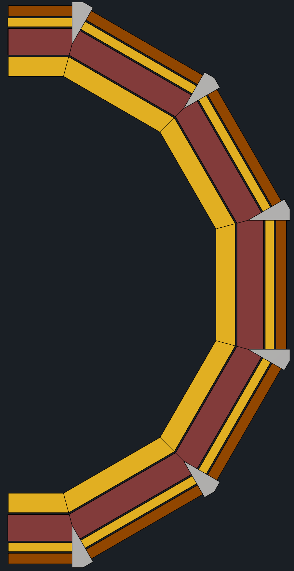
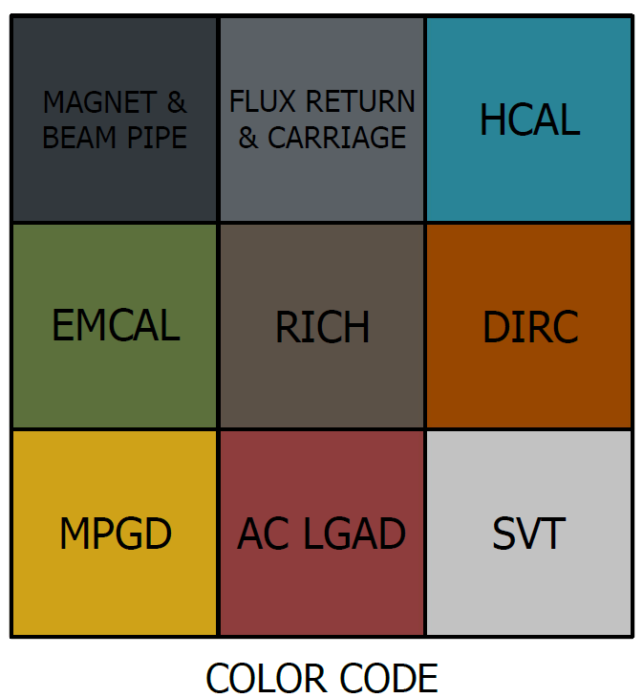
Maintenance Updates
TOF and CYMBAL divided into 12 sections attached together
Barrel TOF and CYMBAL installed on DIRC and MPGD rails
Rails
TOF and CYMCAL services in tray attach to rails
TOF and CYMBAL made in flat panels
Hermetic coverage still possible

Slide 19
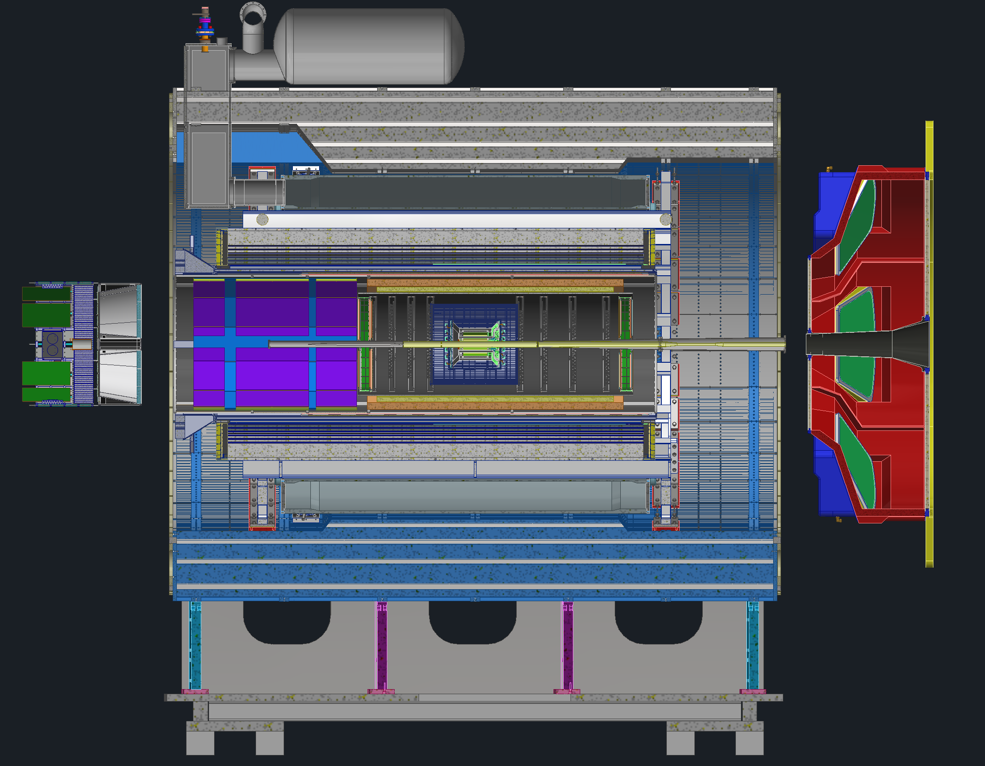
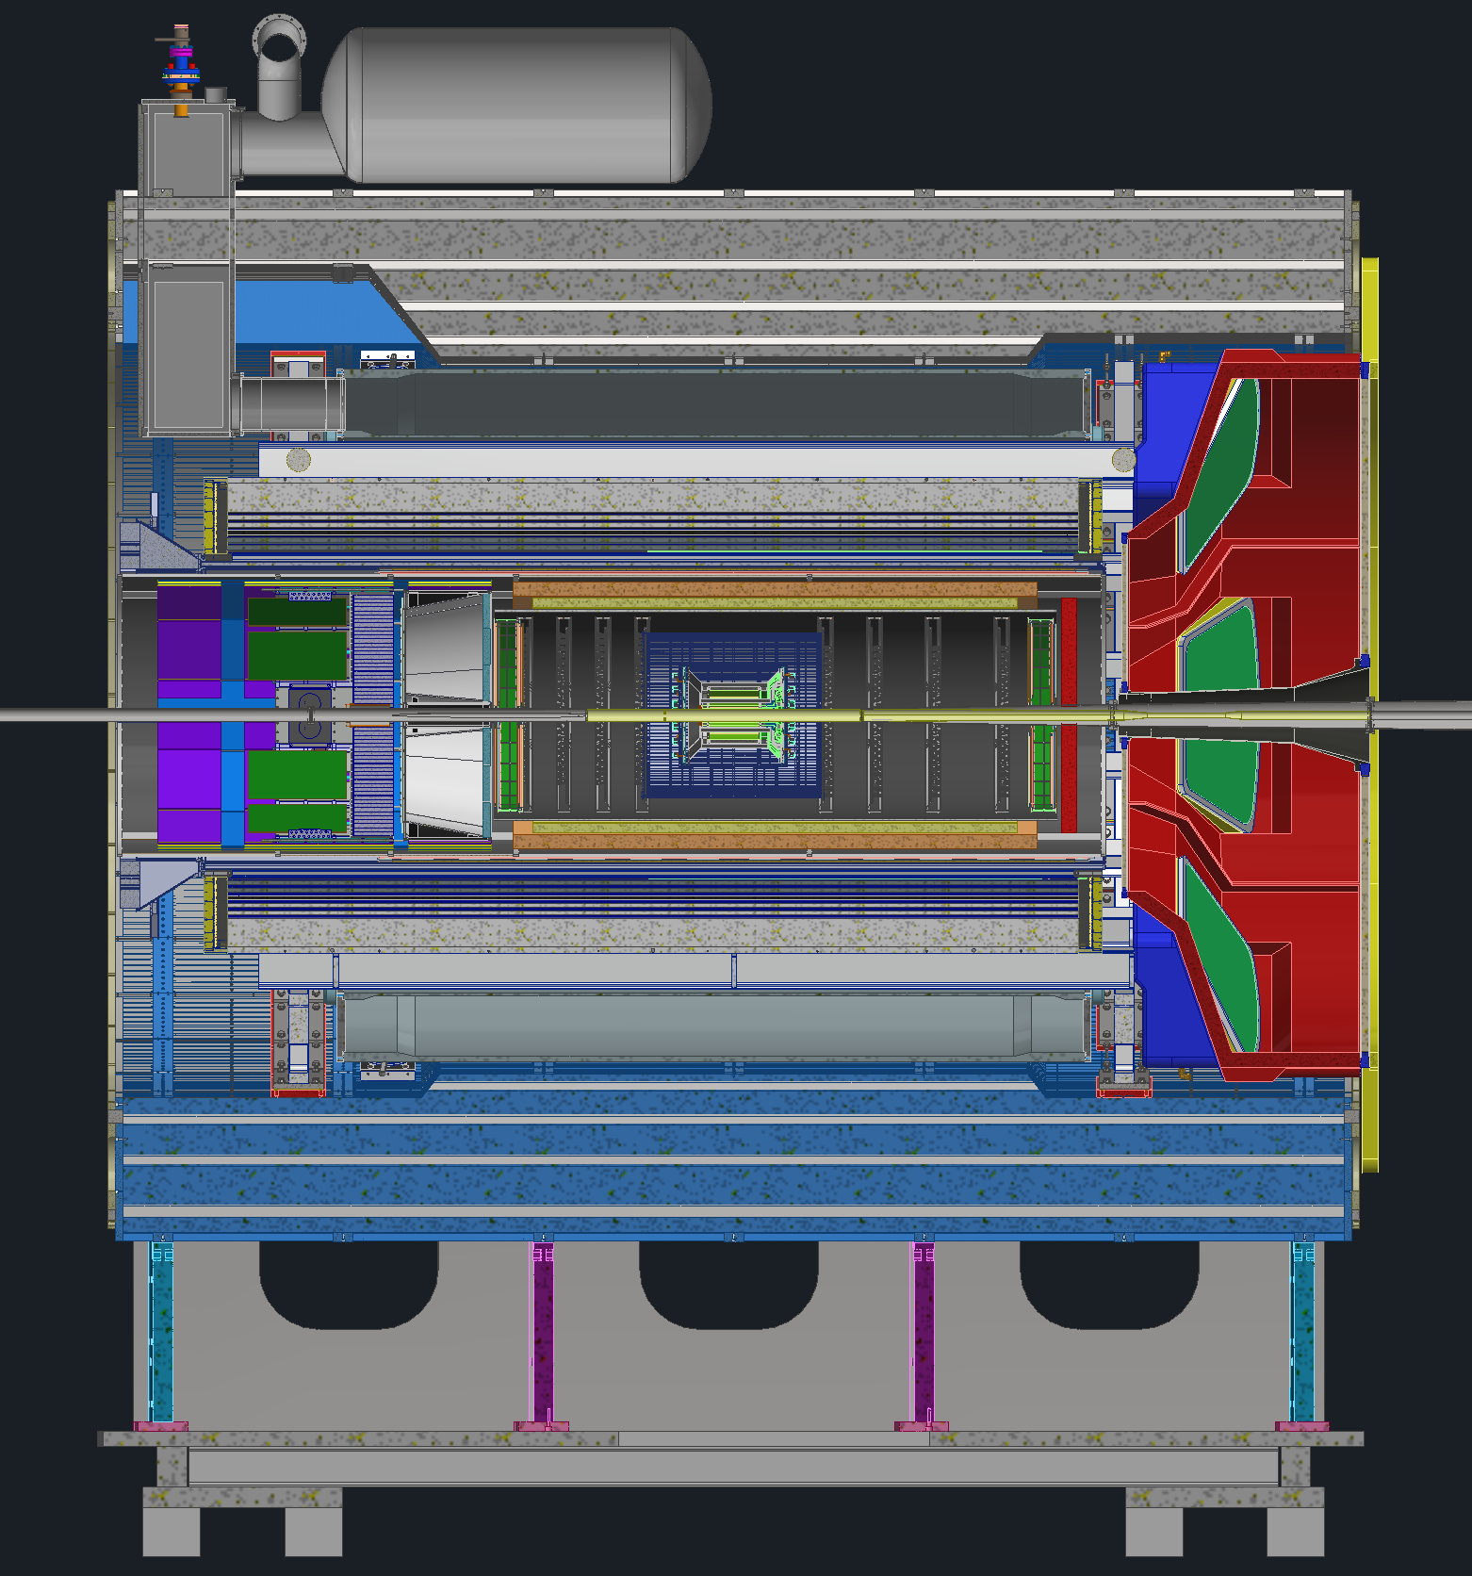
ePIC Barrel Assembly
pfRICH and dRICH detectors are installed from backward side and dRICH detector is installed from Forward side.
After Final Assembly, detector is ready to be rolled in to the experimental hall.

