Slide 1
OB stave update
Work from all the UK groups, material from Marcello Borri, James Glover, Sam Henry, Adam Huddart, Jian Liu from recent UK F2F meeting and otherwise

Slide 2
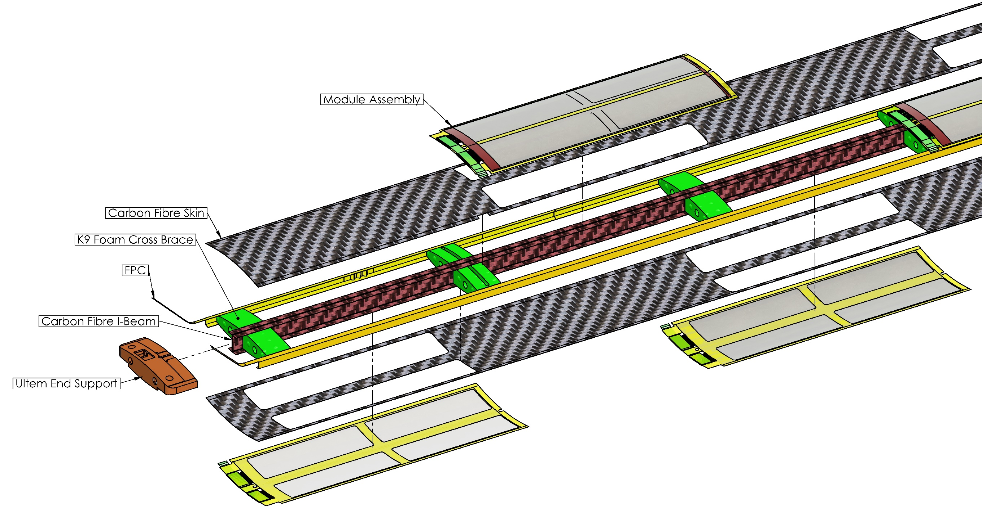
OB Stave Construction
¼ Length Stave End
QSP
L4 X 8 Modules
L3 X 4 Modules
Notes:
We form a skeleton structure with a central carbon fibre I-beam and K9 foam cross braces
K9 foam blocks are located to align with the Ancillary ASIC and LEC of the modules for enhanced heat transfer.
Serial power chain
Flexible Printed Circuit (FPC) is structurally integral to the stave, is part of the gas containment boundary and supplied power and data transfer.

Slide 3
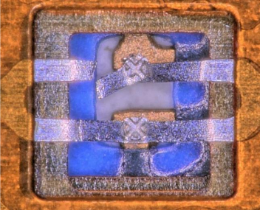
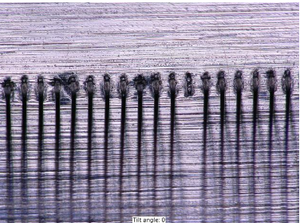
Bonding trials
Wire bonds:
Sensor to module carrier/bridge FPC
AncASIC to module carrier/bridge FPC
TAB bridge FPC to main FPC
Bonding tests (using prototype FPCs from LTU)
Optimisation ongoing
TAB:
Wire bonding:
Different aluminium foils
No major difference in bonding behaviour
Required parameter adjustment beyond standard settings
Foil bond strength showed higher variation compared to gold board
Back support critical
Lessons learned:
Alignment important (to 50 µm)
Reducing step height important

Slide 4
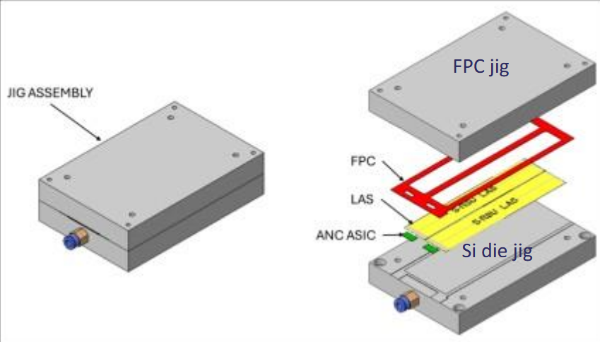
Modules
Started to think about assembly of module prototypes
Will start with flat modules
Some questions:
Automated vs manual assembly?
What glue to use (will start with Araldite, but need to watch viscosity
Thinking of getting some dummy Si with interconnection pads

Slide 5
Where we are with stave prototypes
Not where we wanted to be
Still only quarter L4 stave prototypes built (3 off)
We are tantalizingly close to building our first L3 stave (for some time)
Waiting for mould tooling required for full length stave (held up in Oxford Physics finance department)
Of the quarter L4 stave prototypes one has been equipped with heaters (on a 50 µm steel shim) and is used to shake down our setup
Air flow (working on control of air flow)
Heating
Our first set of heaters don’t have the right power distribution - redesigning
External temperature measurement (TC and thermal imaging)
Internal (air flow) temperature measurement (TC)
Vibrations (capacitive displacement sensors)

Slide 6
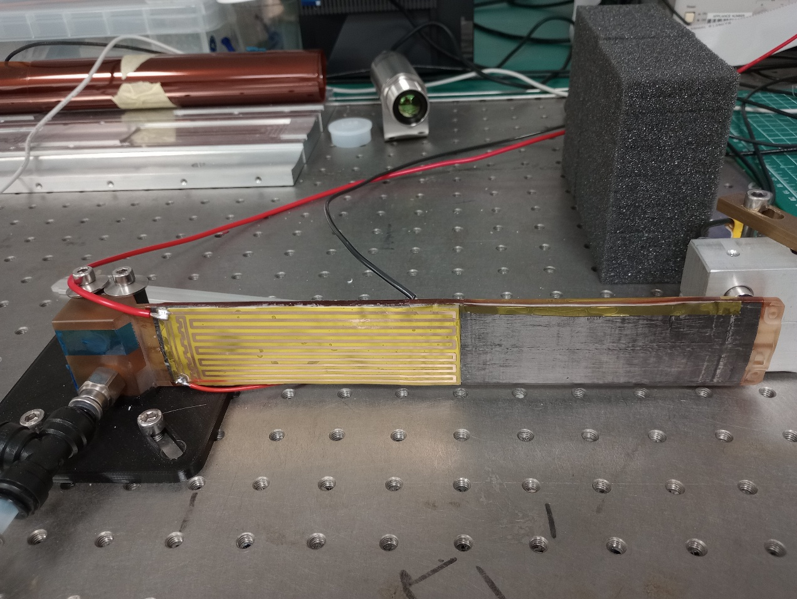
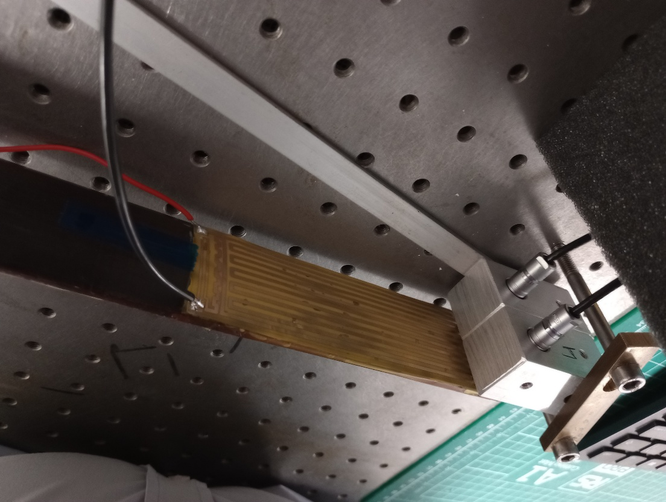
Pictures
TI camera
Front view
Rear view
Capacitive displacement sensors
Air out
Air in

Slide 7
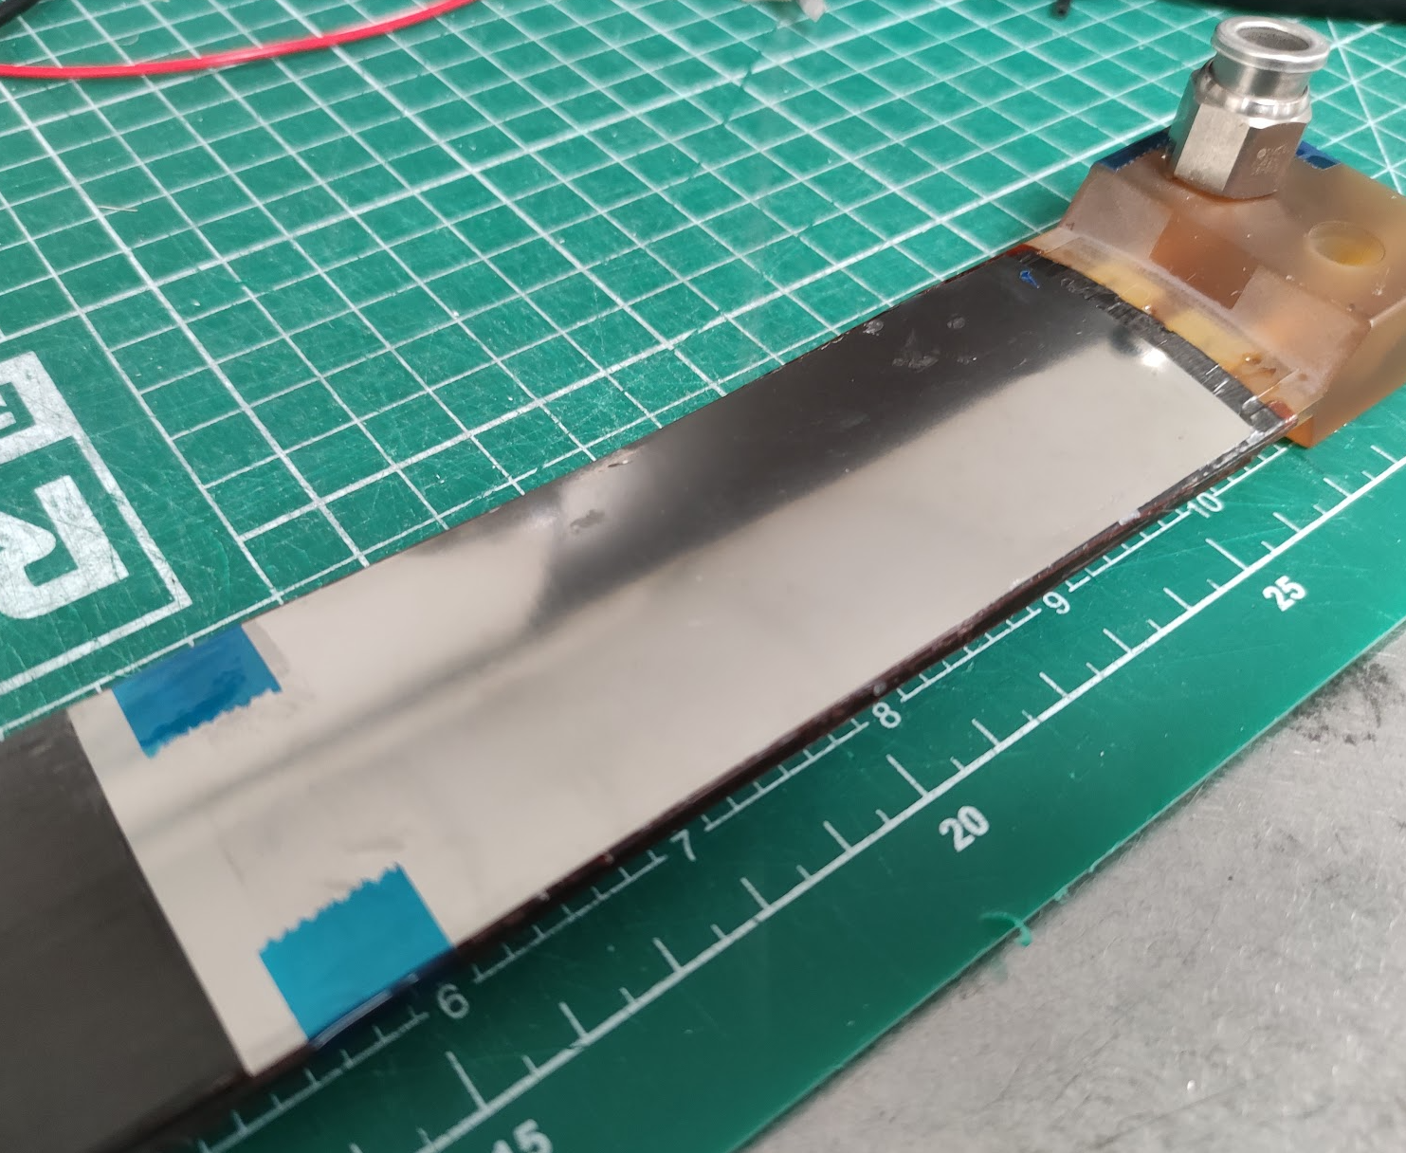
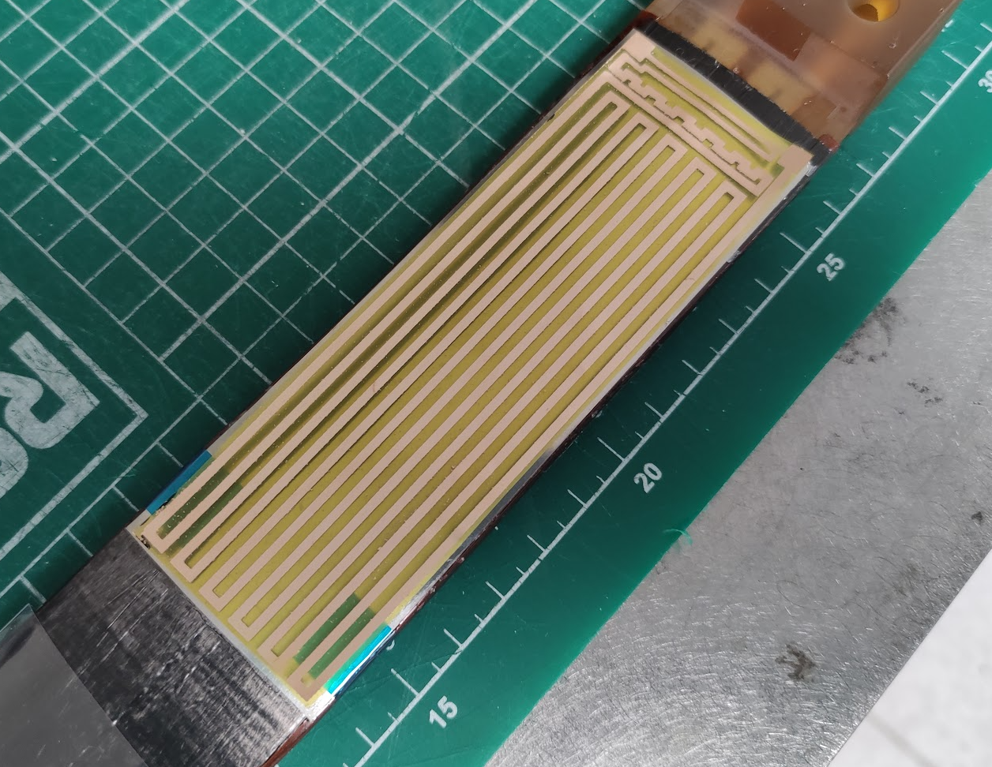
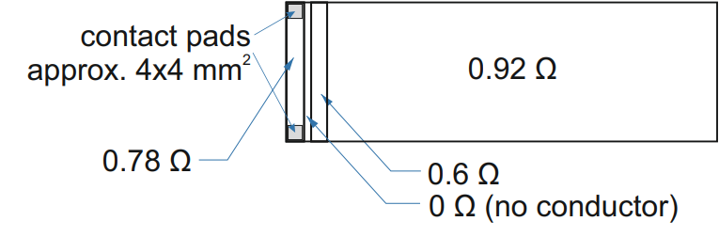
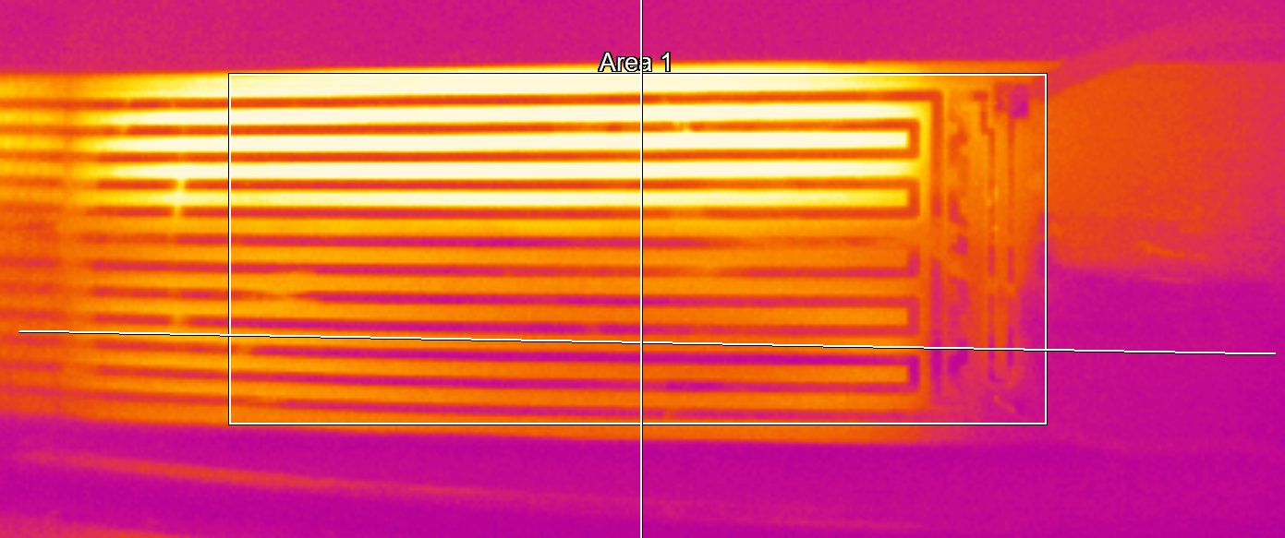
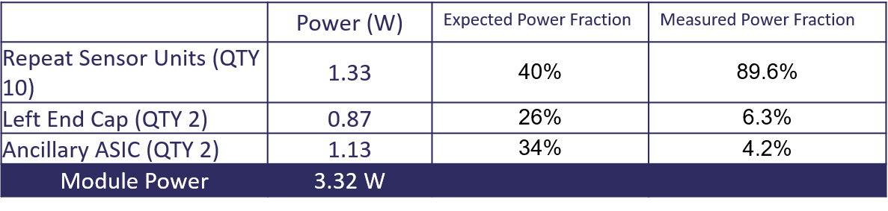
Heaters
Design
1.8 W/quarter stave, 30 l/min air in lower channel
Measured

Slide 8
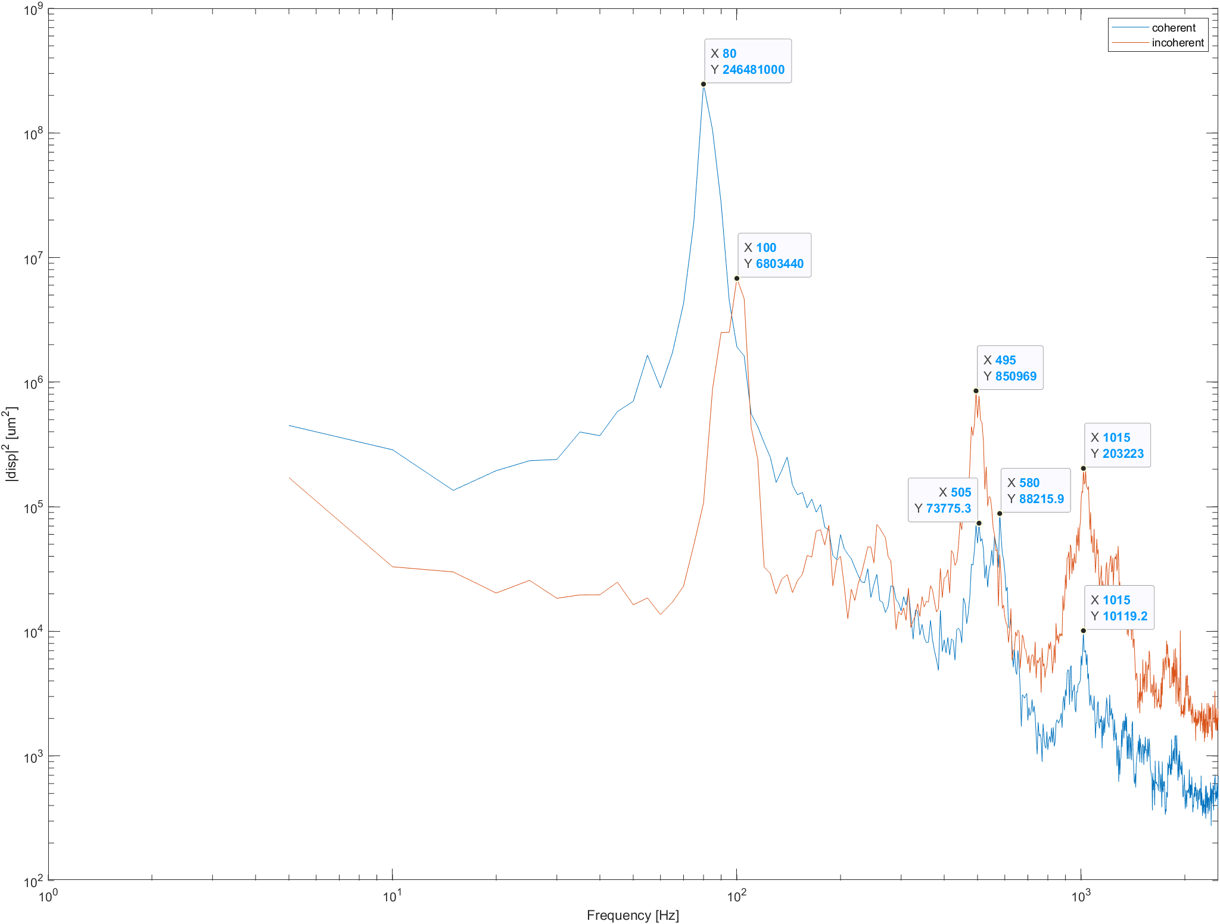
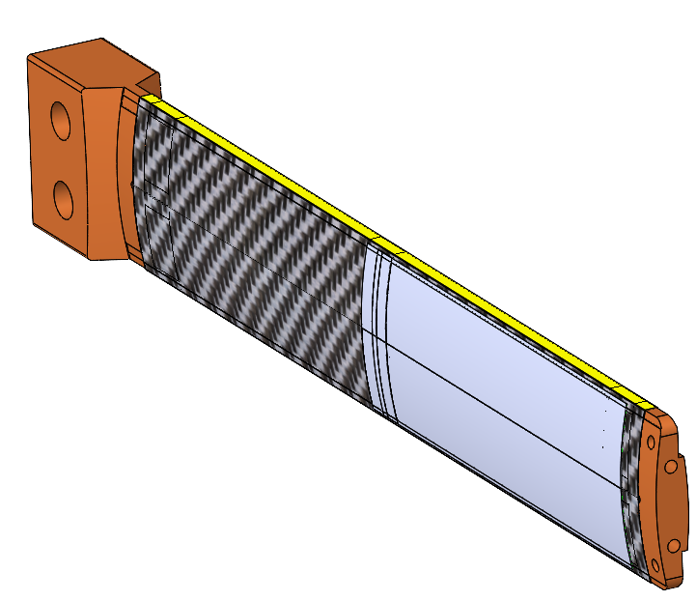
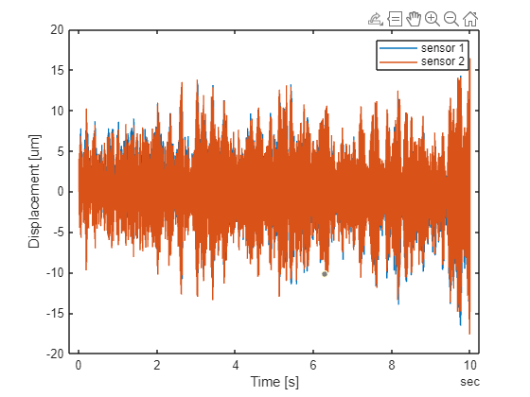
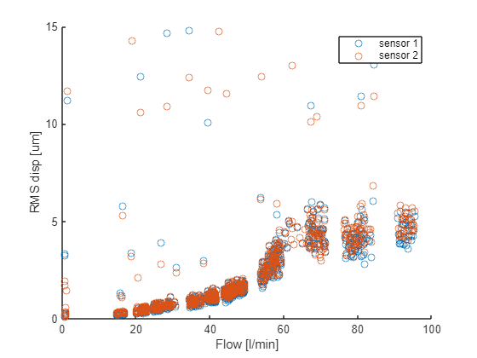

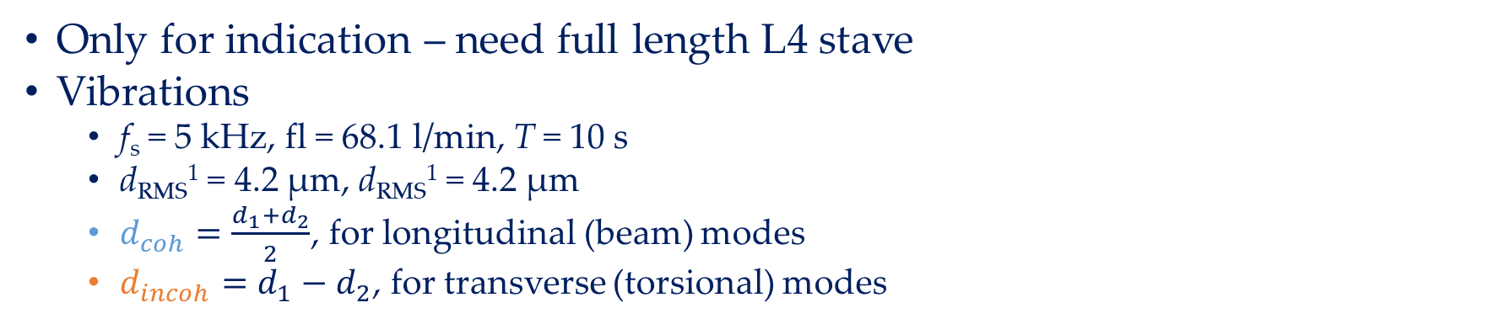
Some preliminary results - Vibrations
Only for indication – need full length L4 stave
Vibrations
f_{s} = 5 kHz, fl = 68.1 l/min, T = 10 s
d_{RMS}¹ = 4.2 µm, d_{RMS}¹ = 4.2 µm
$d_{coh}=\frac{d_{1}+d_{2}}{2}$, for longitudinal (beam) modes
$d_{incoh}=d_{1}−d_{2}$, for transverse (torsional) modes
$d_{coh}=\frac{d_{1}+d_{2}}{2}$, for longitudinal (beam) modes
$d_{incoh}=d_{1}−d_{2}$, for transverse (torsional) modes

Slide 9
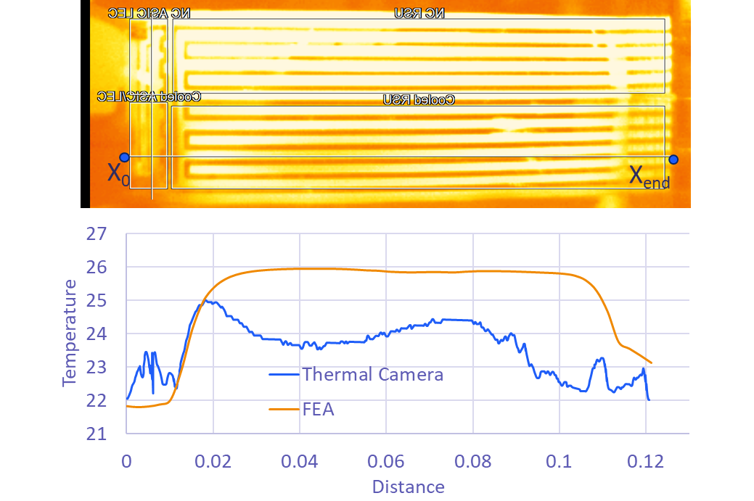
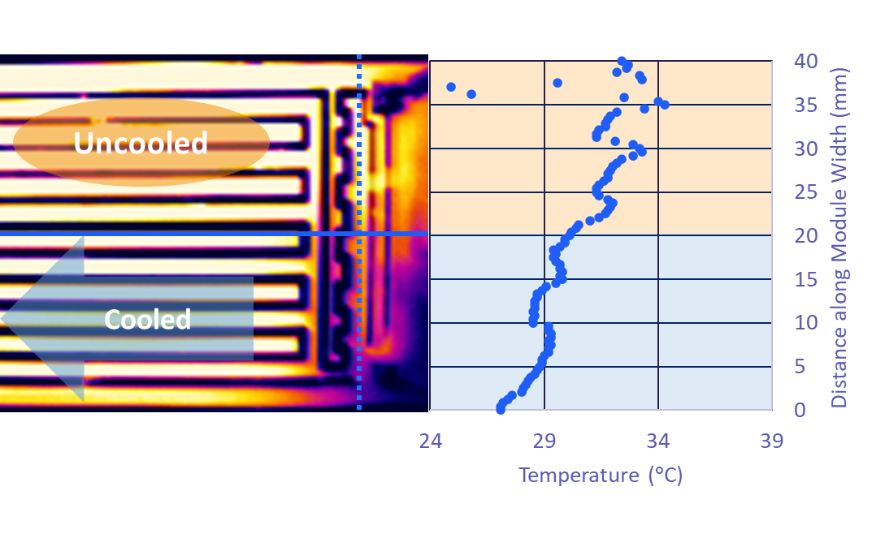
Some preliminary results - Thermal
Only for indication – need full length L4 stave and correct heater geometry
Convection Coefficients
Natural convection - 7 W/m² K from external surfaces
Forced convection - 48.44 W/m² K from internal surfaces
Forced convection - 650 W/m² K from K9 adjacent surfaces
Effect of K9 foam

Slide 10
First thoughts on stave mounting
Start to think about stave mounting
Sequence:
Outer support cone
L4 staves mounted
RDOs dressed on outside of cone
Air connections
Test L4
Inner support cone
L3 staves mounted
RDOs dressed on outside of cone
Air connections
Test L3
Support Cone
Support Cone
RDO
RDO
RDO
RDO

Slide 11
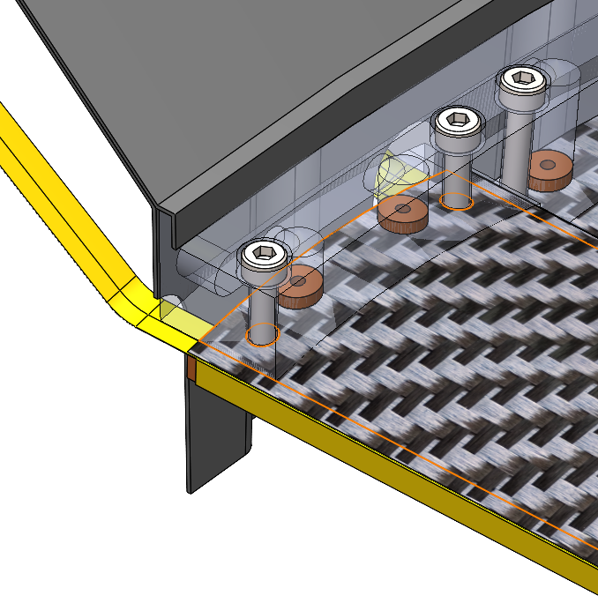
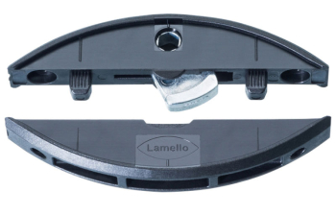
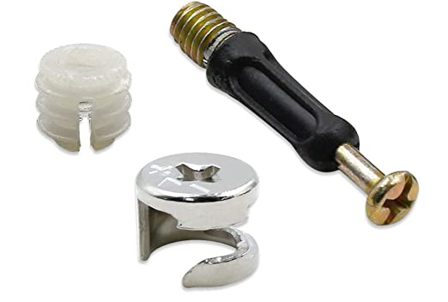
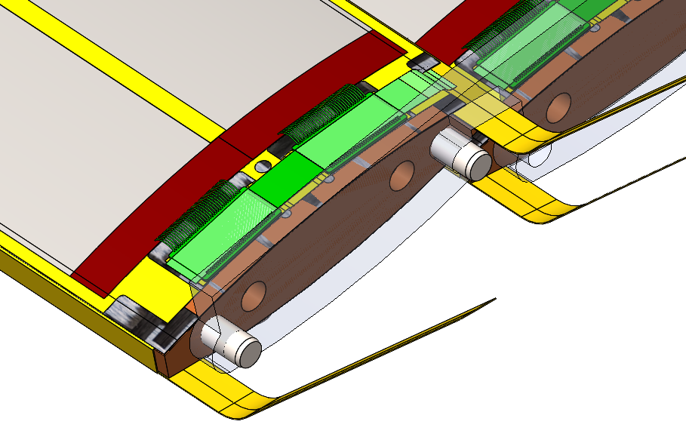
Stave Mounting
Currently fastener access from outer side, these could only be accessed through cutouts in support cone
No space beyond the end module for screw holes
Looking at options for underside/cone end mounting
As modelled:
Coolant flows from one end of the stave (co-current flow),
Sacrificing floating end could allow for counterflow with an equivalent manifold block on both sides
Common mounting face for structural connection and coolant inlet
Coolant channel integrated into mounting manifold
Fixed/Pinned for thermal expansions

Slide 12
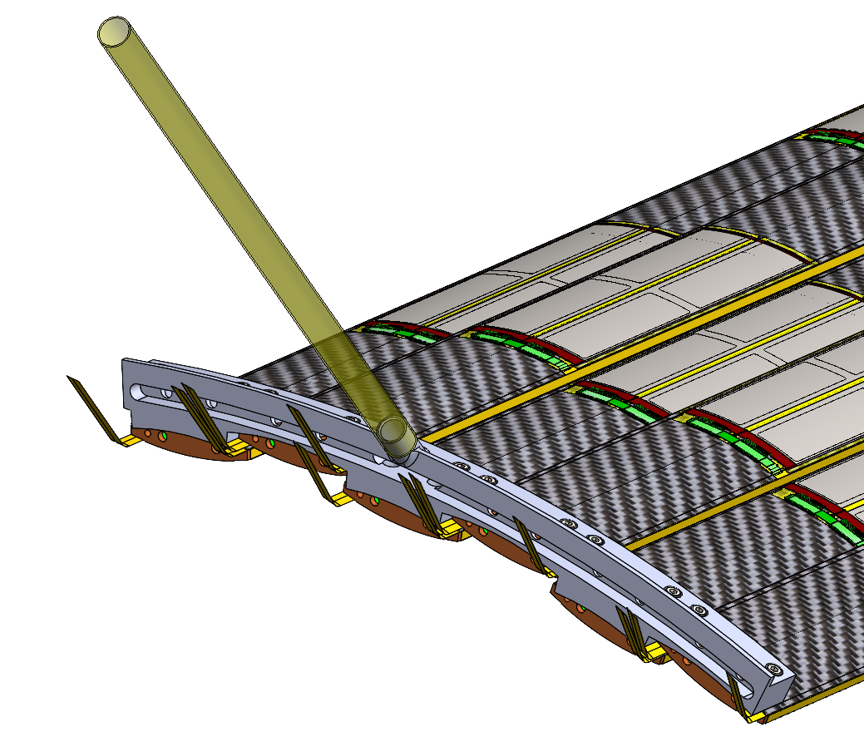
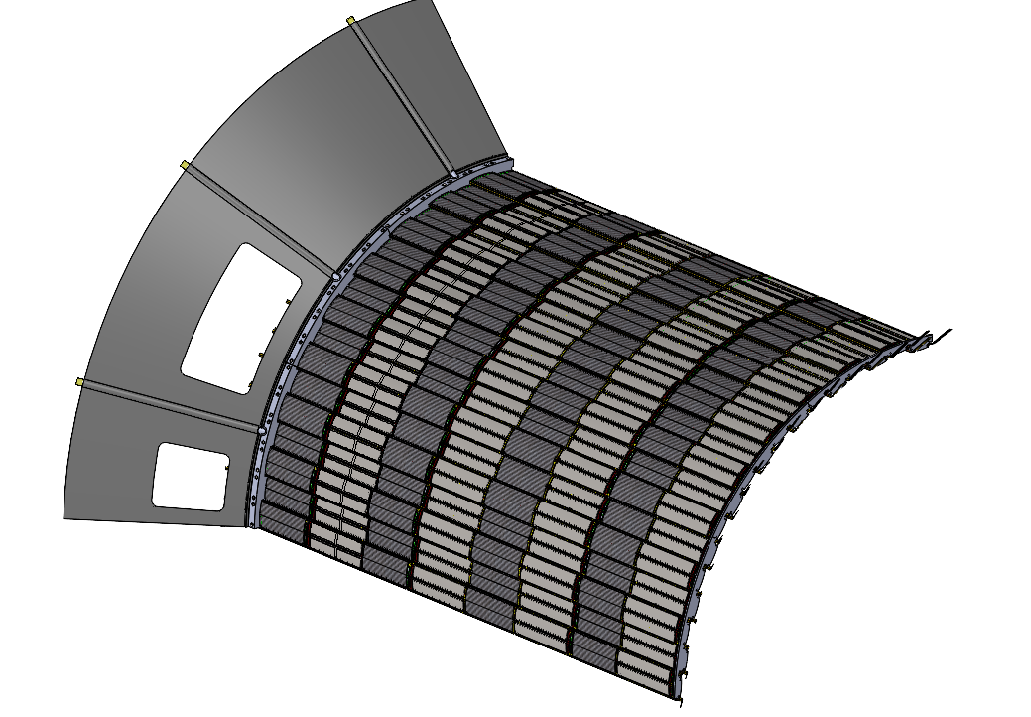
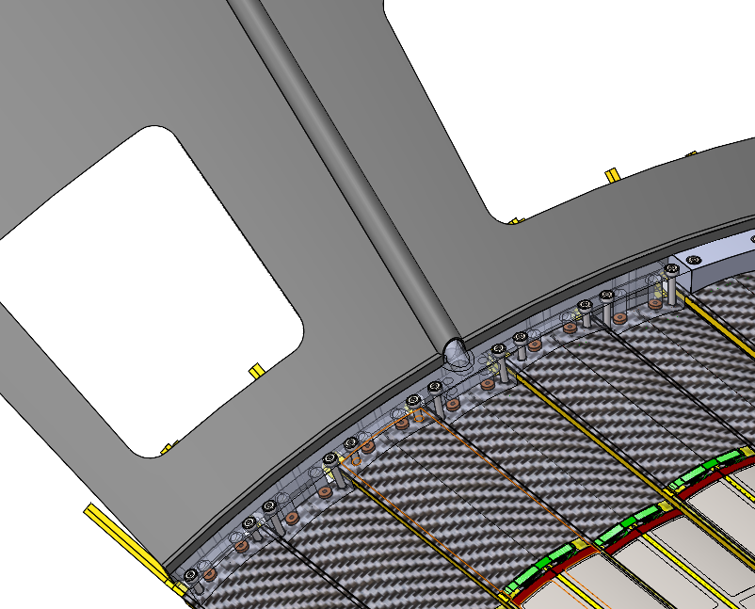
Air supply first thoughts
Staves manifold with a grouping of 6 staves
6 manifolds per half
QTY 12 - 10 mm ID
Ambient
Pressure drop – 0.7 Bar/m
Supply may be 2-3 bar
Flow velocity 300 m/s
Near sonic → much larger feed pipes required
Pressurised
Supply Pressure - 8 Bar
Velocity 38 m/s
Pressure drop – 0.08 Bar/m

Slide 13
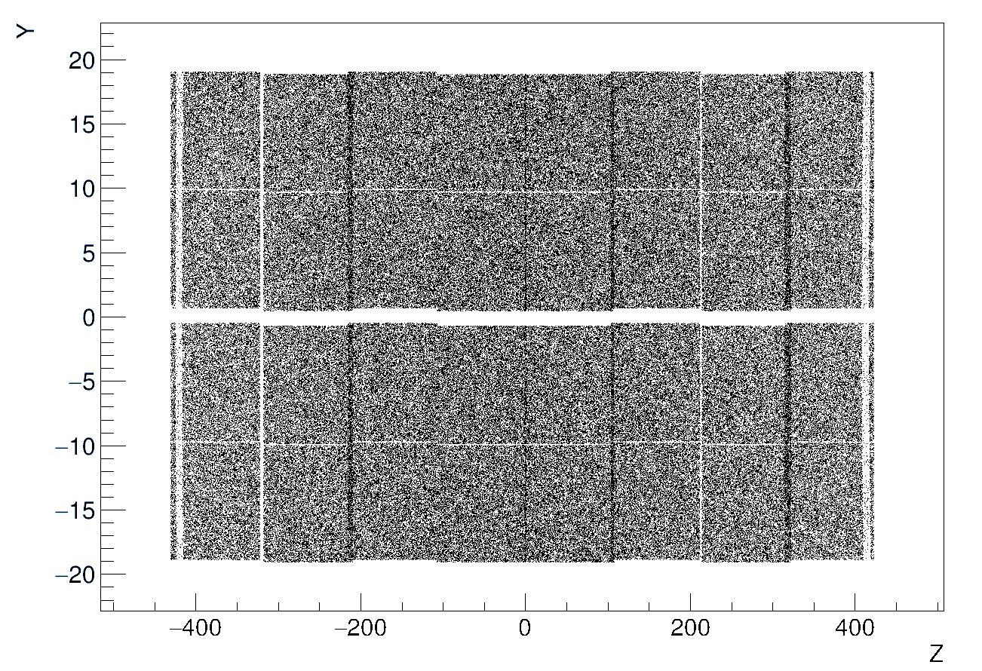
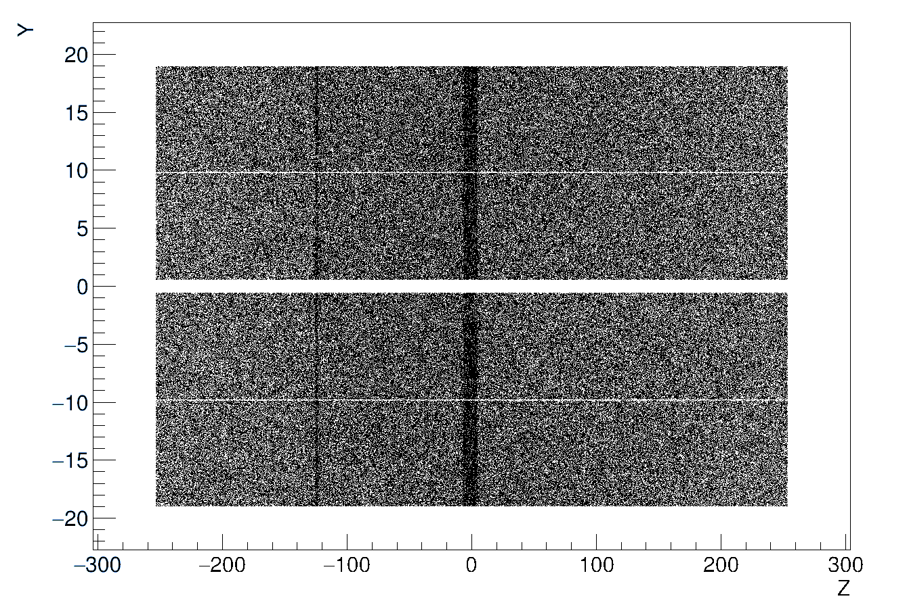
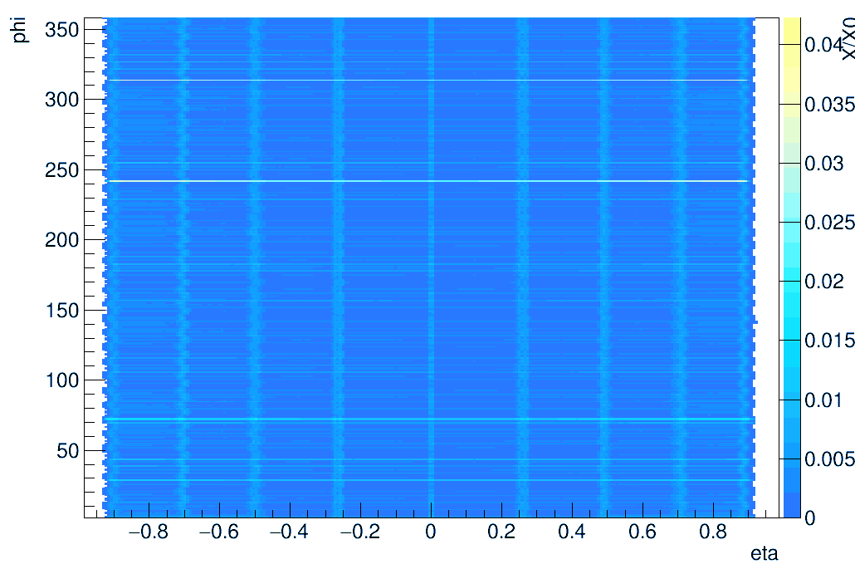
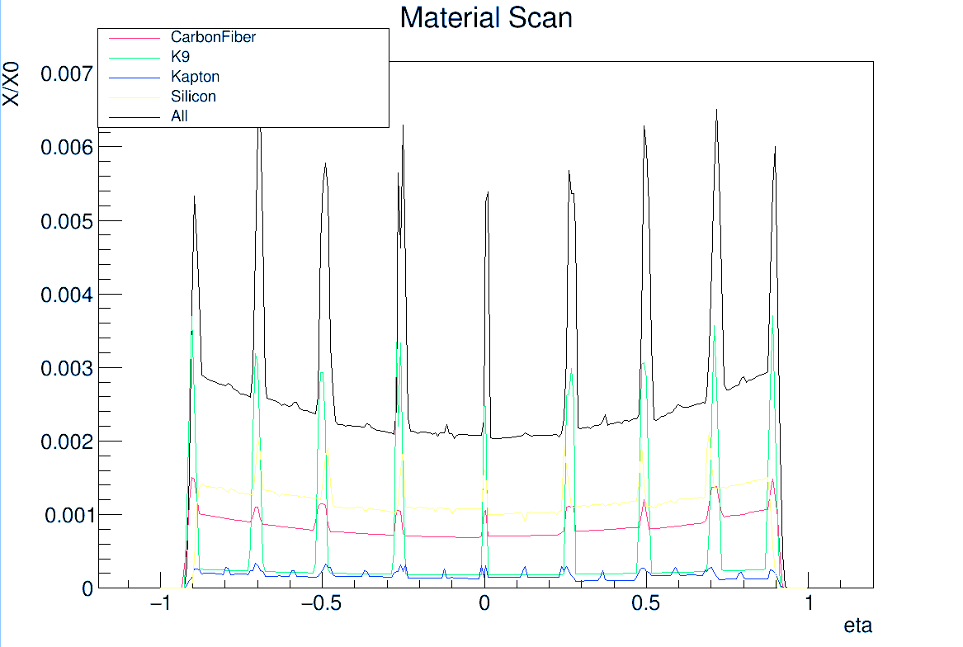
Software
Status
Full OB geometry created from CAD files
SVTOB_UK branch: https://github.com/eic/epic/tree/SVTOB_UK available to all, with scripts to convert CAD to GDML, README
All significant bugs, issues identified so far now understood and fixed
In use by Oxford and Birmingham team
Hit maps and material scans for latest CAD files plotted
Next steps
Update standard epic geometry to better reflect material thickness and active area, perhaps with curved staves
Optimise full version to improve speed
Benchmarking scripts to monitor performance
Hit maps (10⁶ muons) for single stave
L3
L4
Material scan L4 only

Slide 14
Further material

Slide 15
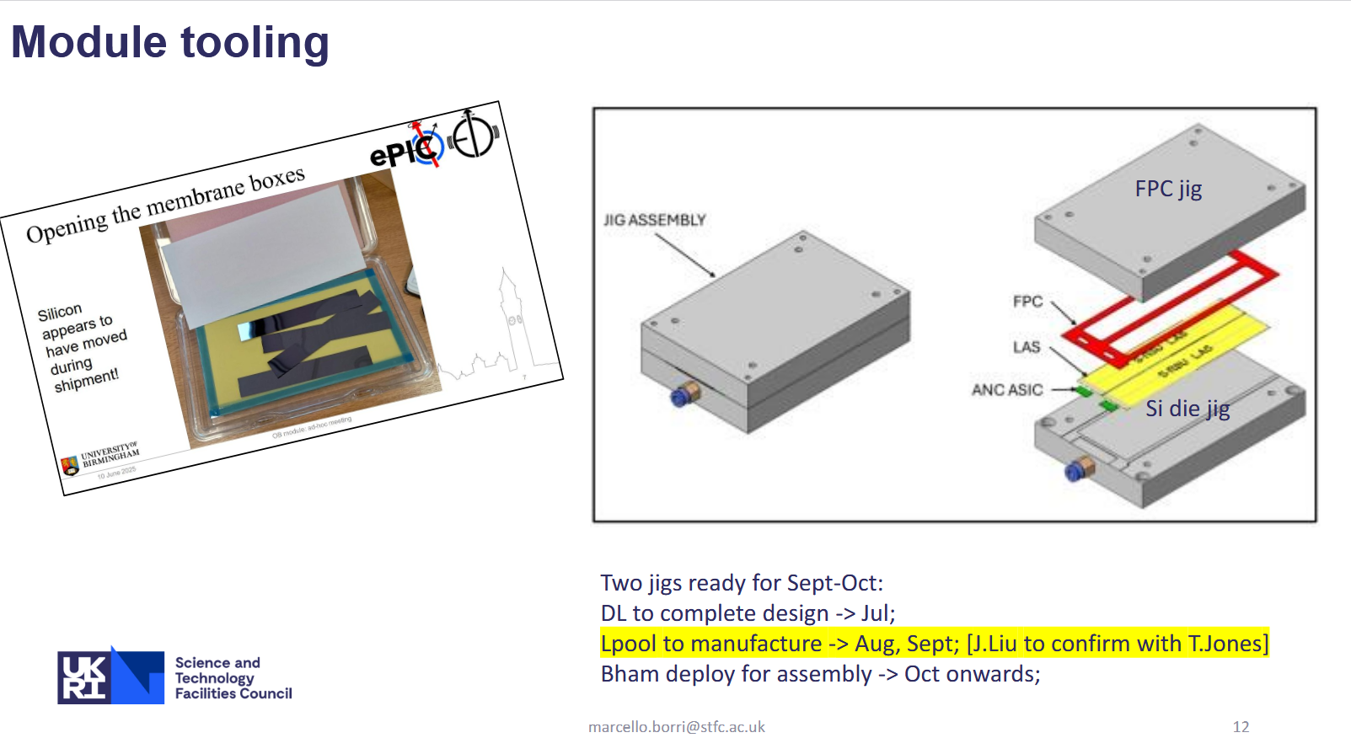

Slide 16
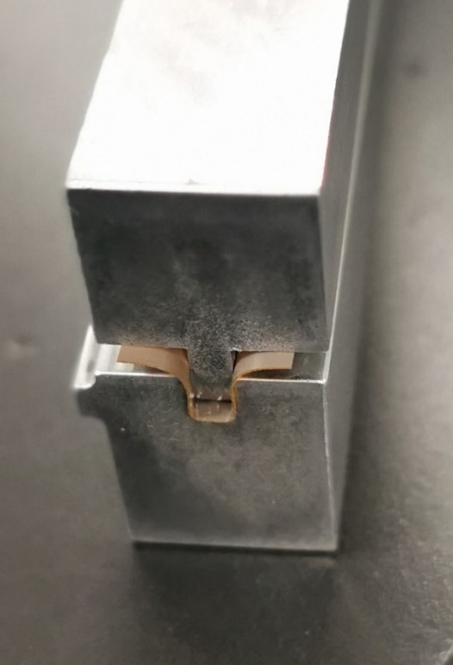
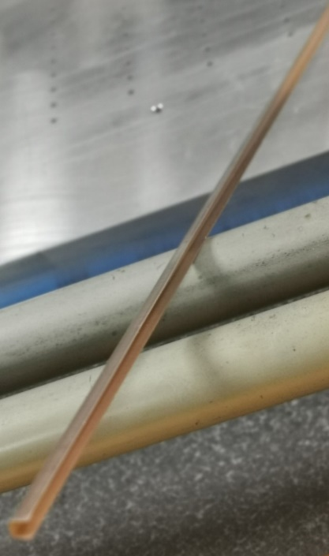
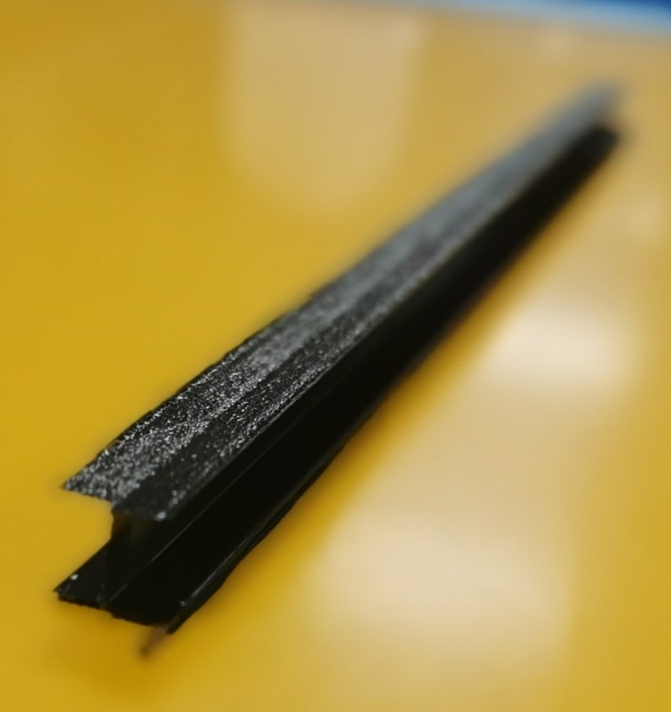
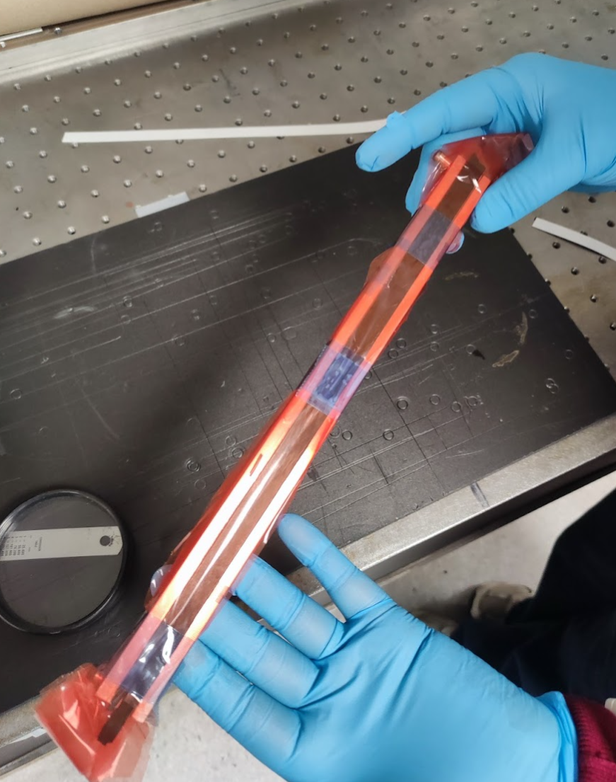
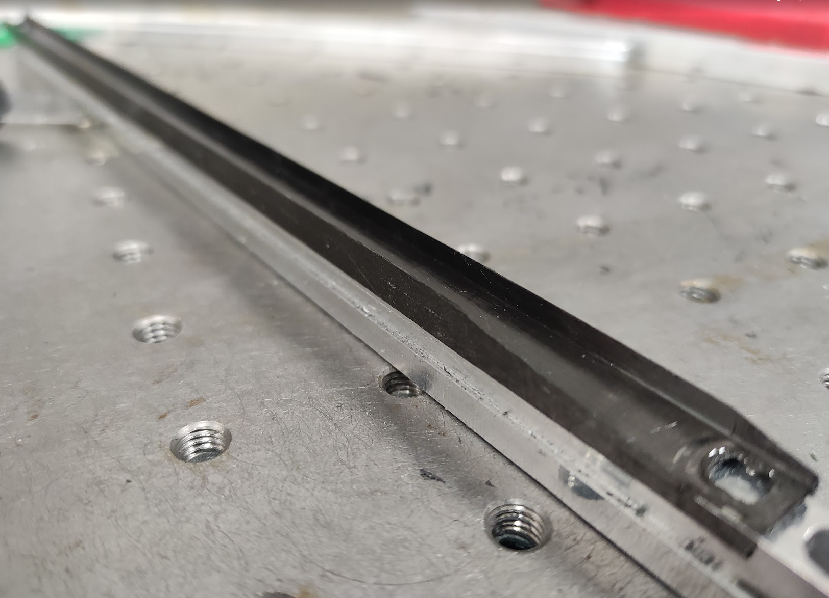
¼ Length Stave Prototypes
Preformed components
Carbon Fibre I-beam pre-cured in a 2-part mould
Flexible Printed Circuits (FPC) preformed (with heat and pressure) into C channel

Slide 17
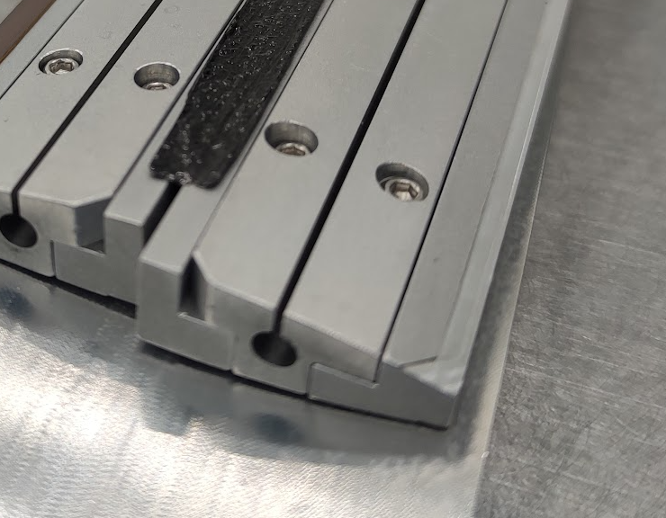
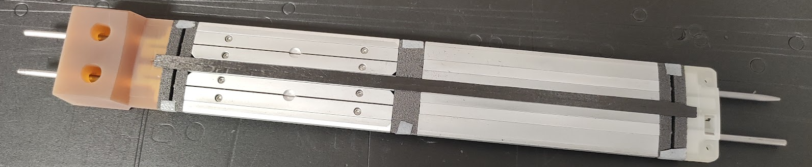
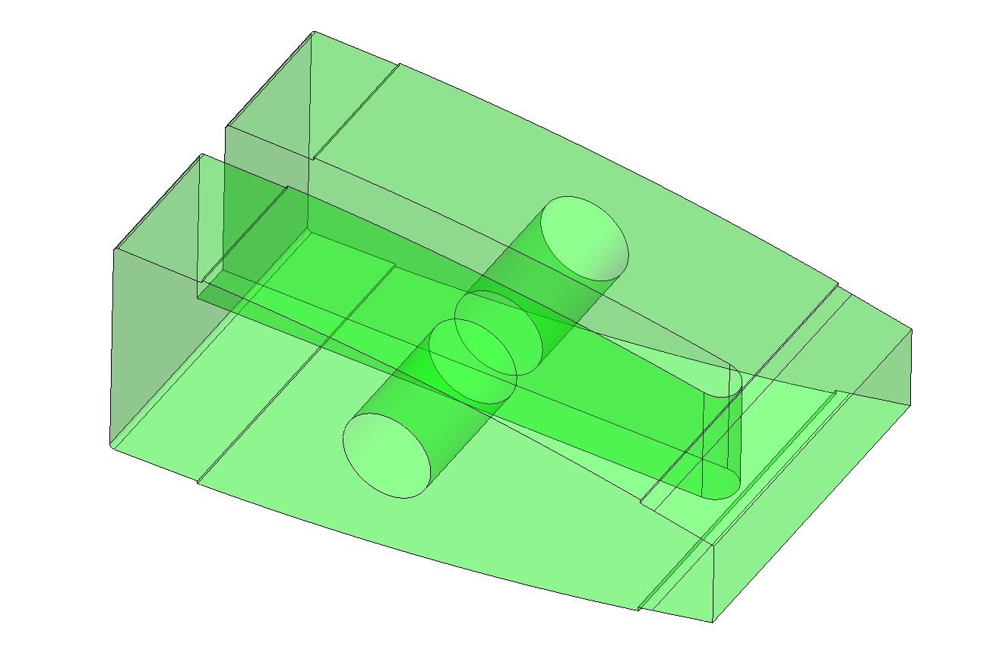
Stave Inner Structure
Aluminium Internal Formers
K9 Foam Heatsink
⌀ 3 mm Silver Steel rods

Slide 18
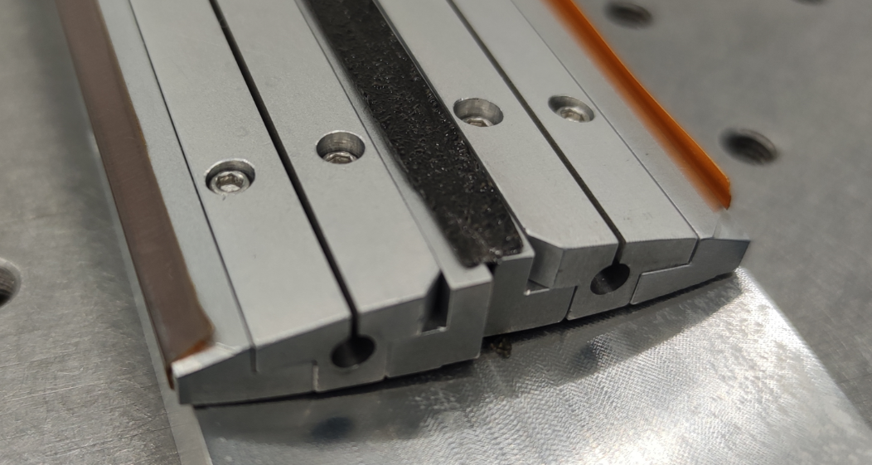
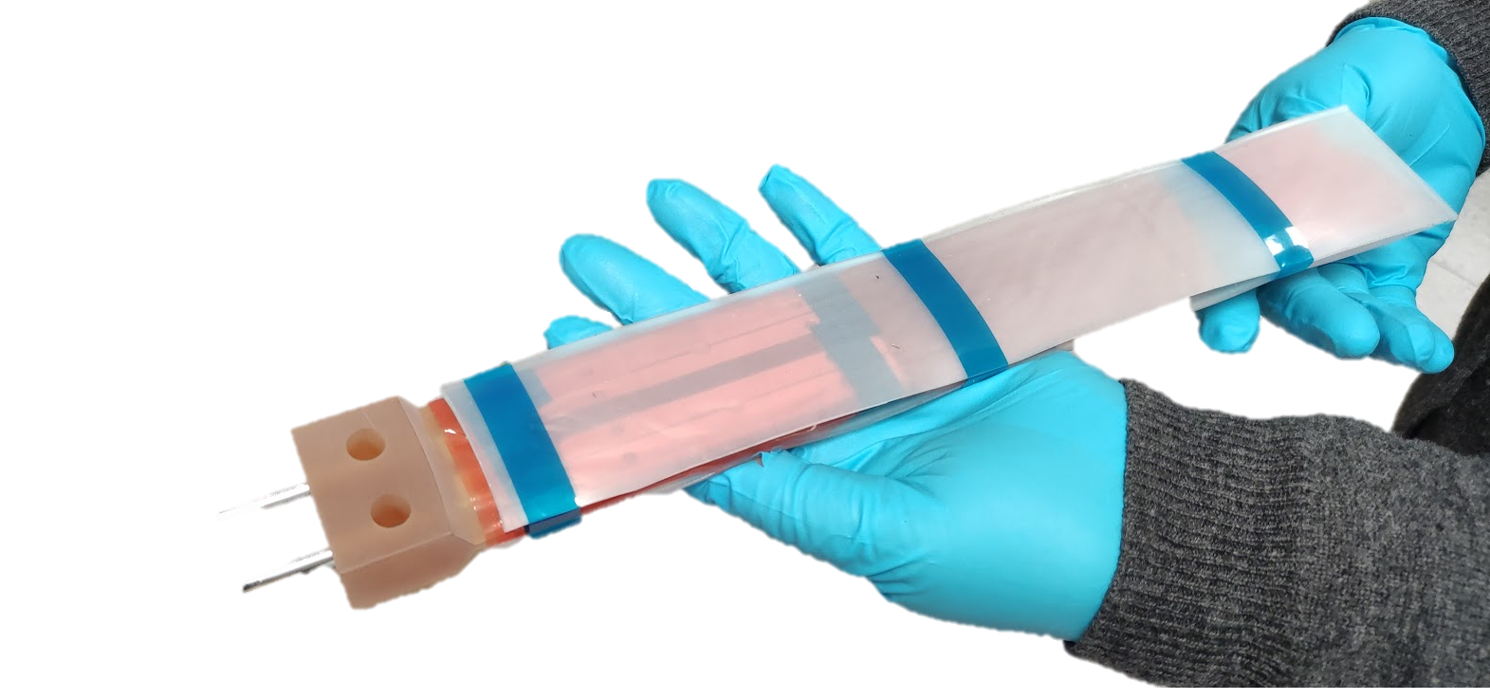
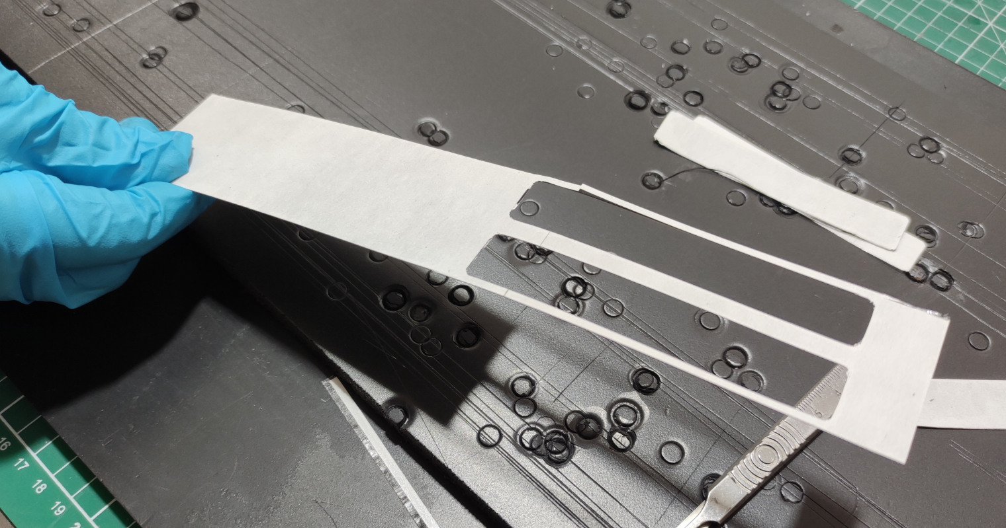
Outer Skin
Airtight boundary formed by FPC, Carbon Fibre face sheet and modules
FPCs Mounted along outer edge, joined to K9 Foam with Prepreg Adhesive Film
Carbon fibre face sheets aligned on inner structure
Silicone rubber sheet added on top and bottom surfaces as an intensifier

Slide 19
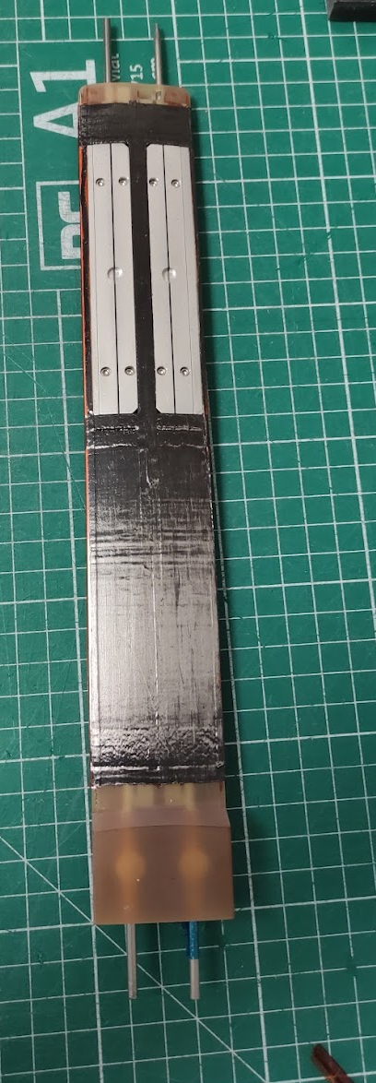
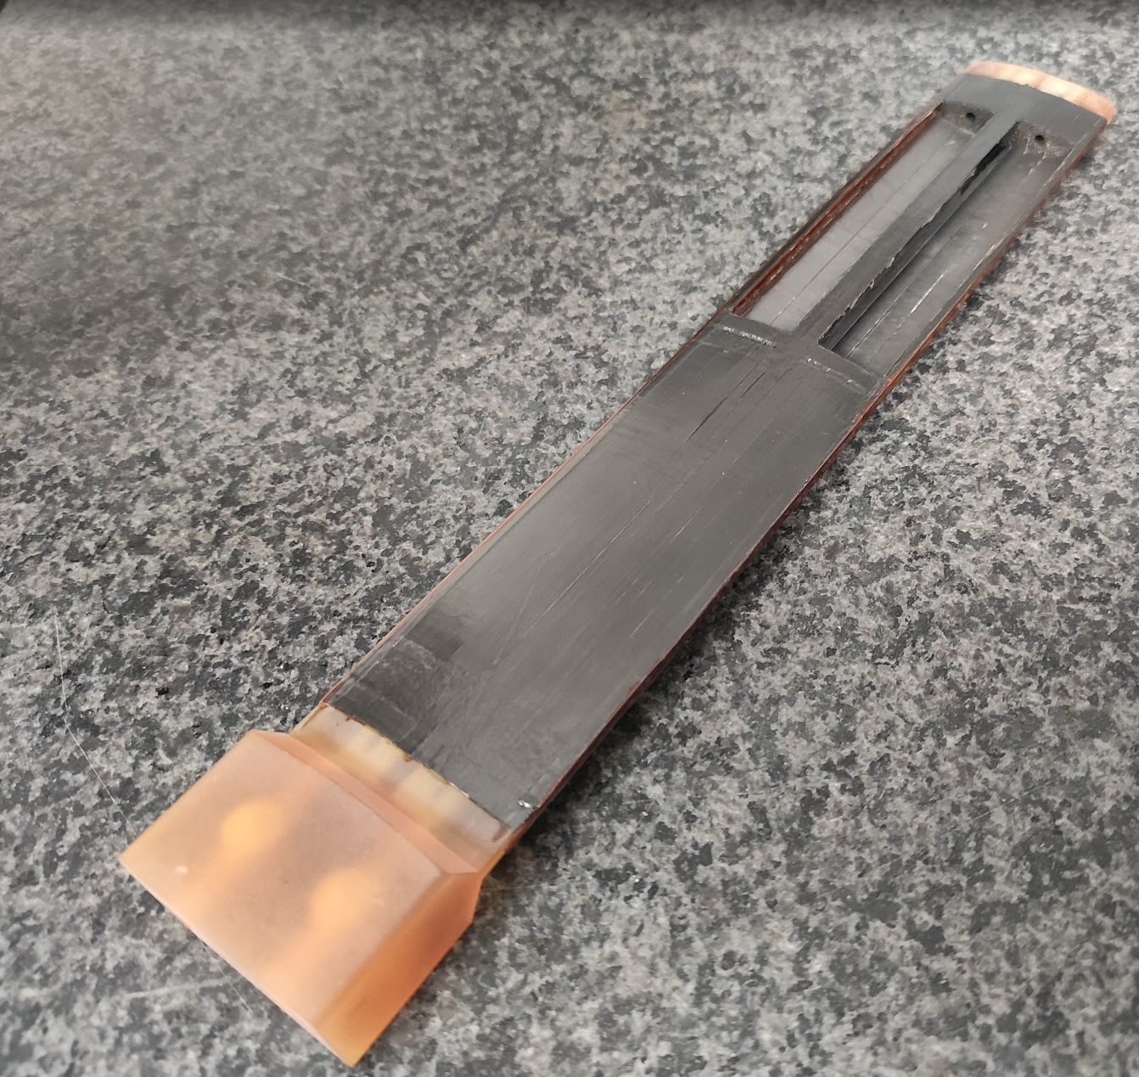
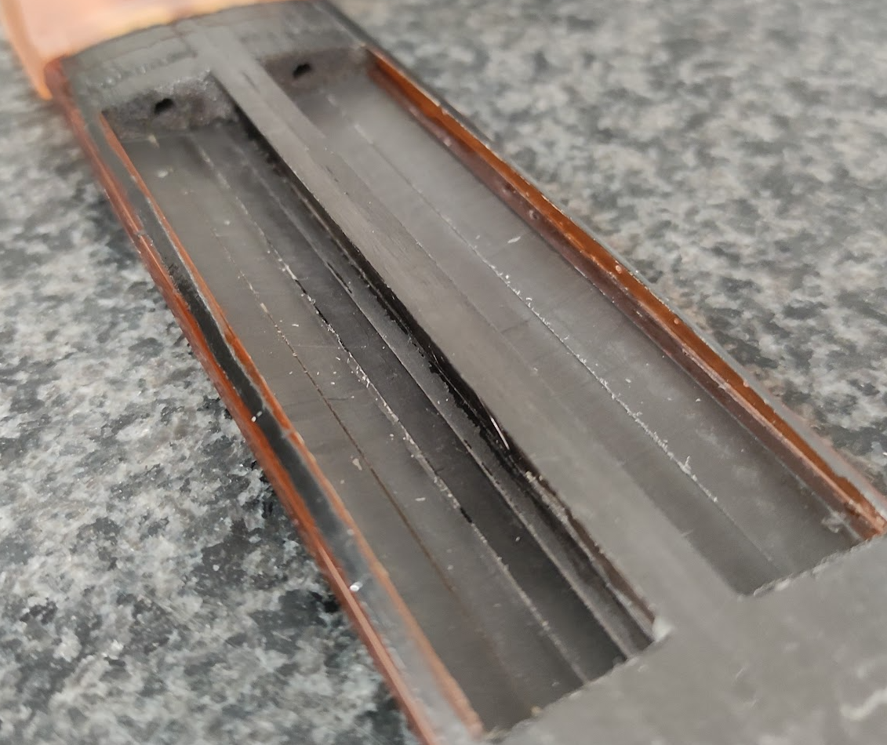
Post-Cured Stave Assembly

Slide 20
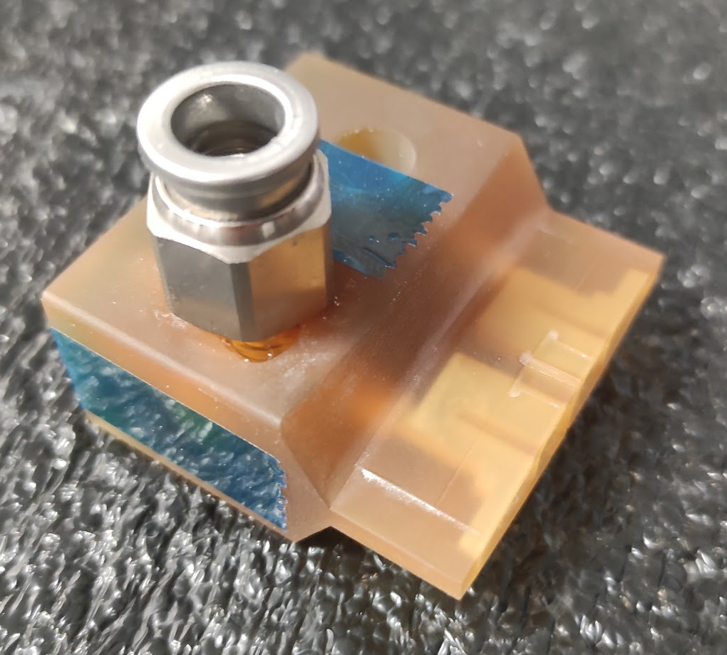
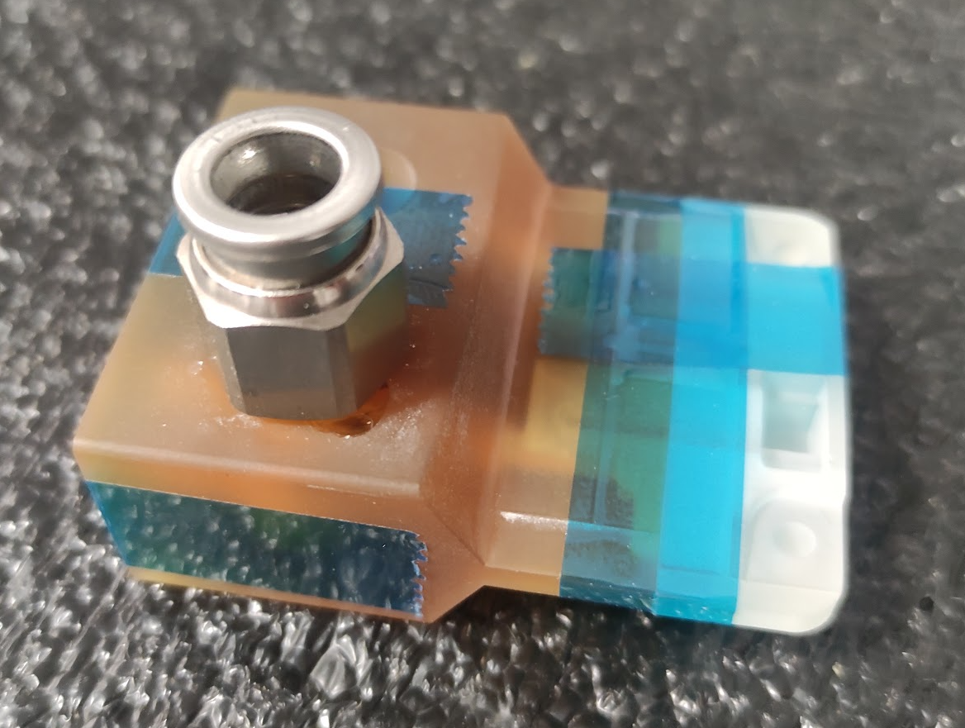
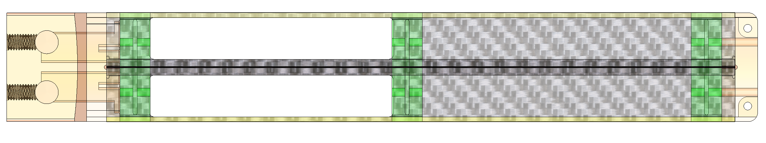
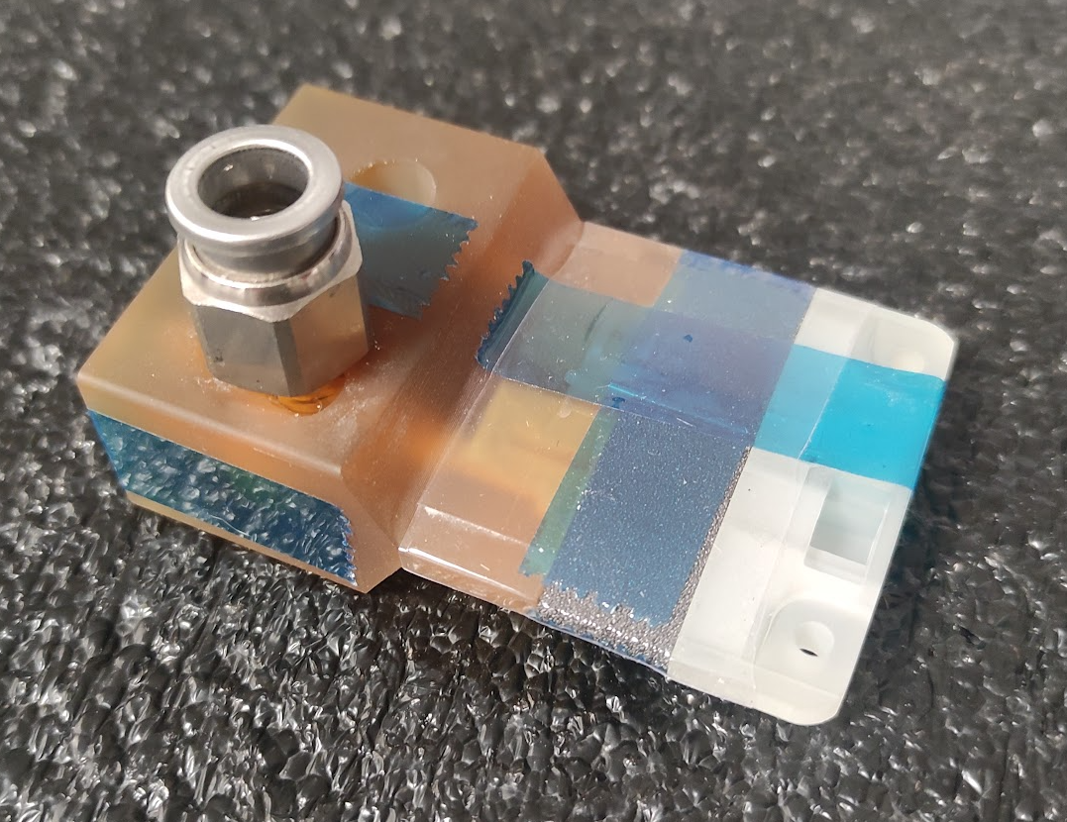
Pressure Loss Contributions
Subassemblies used to isolate contribution
59 ltr/minute pressure drop contributions
Inlet - 0.124 bar
K9 Foam – 400 Pa
Outlet – 400 Pa
Scaled for full L4 stave
Pressure at first K9 foam block
59 lpm → 0.062 Bar
Scaled to 110 lpm → 0.207 bar
Inlet Block
0.0216 Bar
Inlet & Outlet Blocks
Inlet, Outlet & K9

