Slide 1
Progress on BTOF simulation
Tommy Tsang
Kent State University

Slide 2
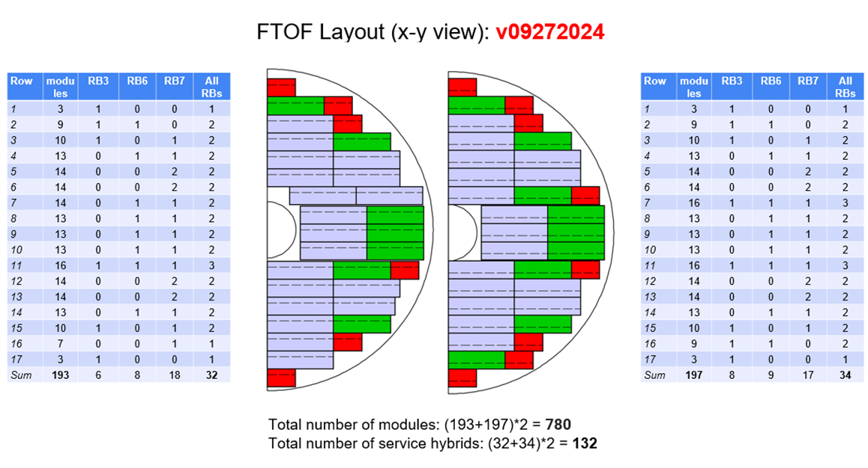
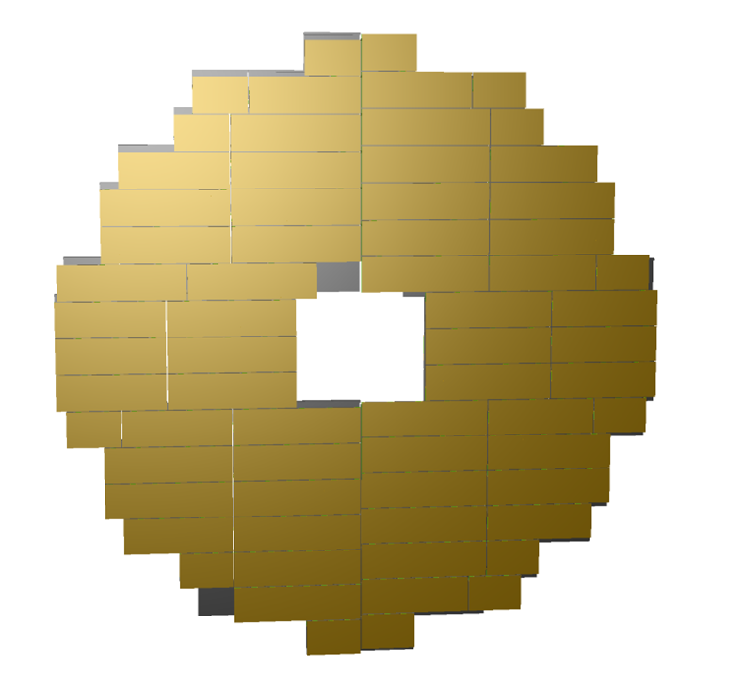
Update ETOF geometry
Design
epic

Slide 3
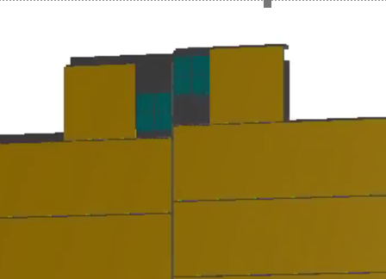
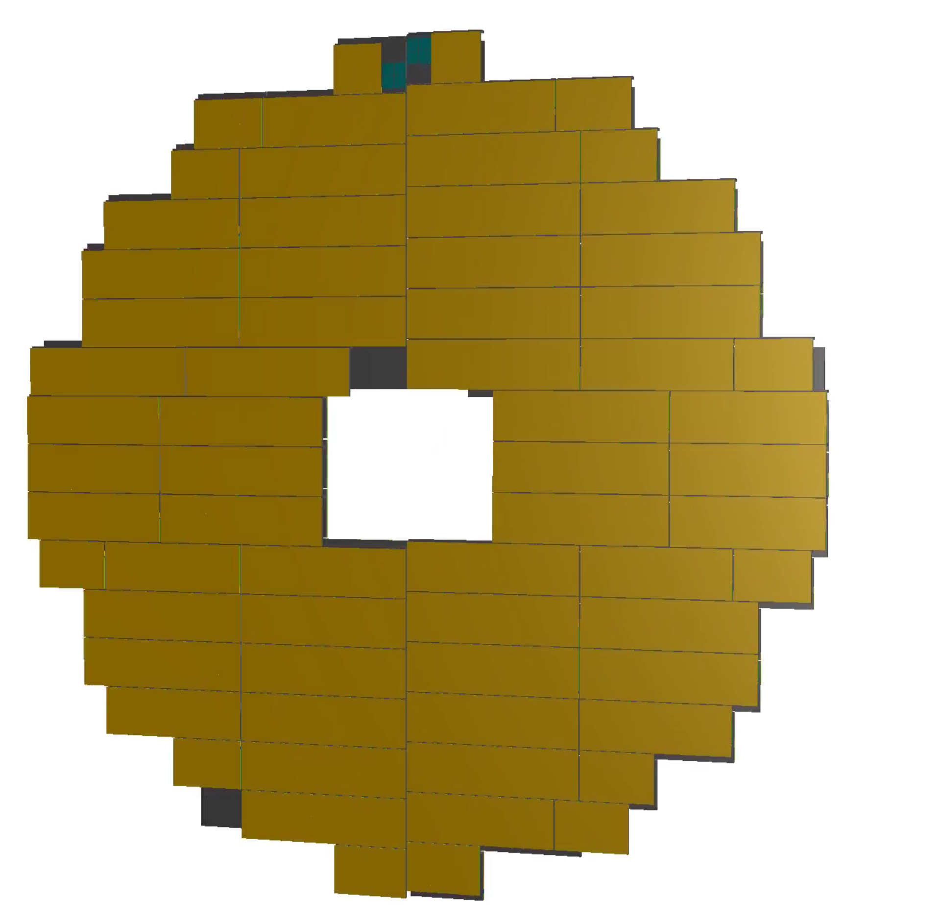
Update ETOF geometry
epic
Design

Slide 4
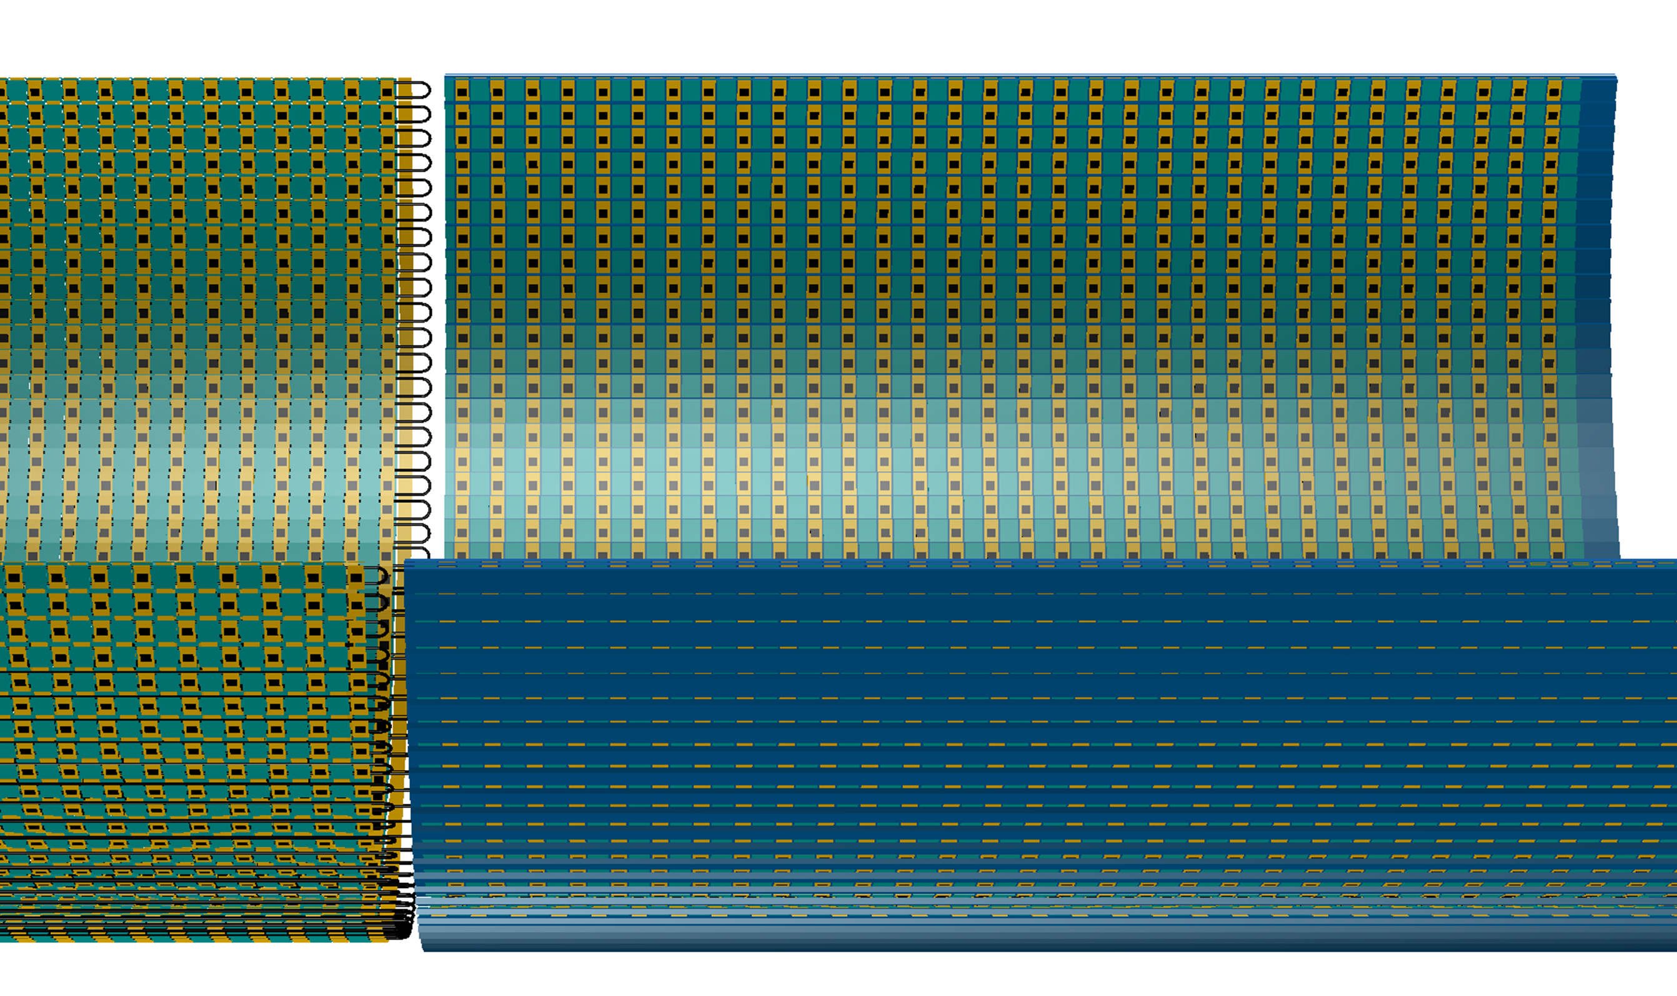
Updated BTOF geometry to match the latest CAD drawing
Latest geometry: https://indico.bnl.gov/event/27154/contributions/104363/attachments/60759/104362/2025%2003%2024%20Mechanics%20Workshop%20TOF%20Presentation.pdf
Cooling tubes with the U shaped bent
Sensor
Rendering from TGeoManager
ASIC
Foam on the left half of the stave is removed to show cooling pipe inside

Slide 5
Work done: Digitization work-flow
Start
Geant hit
Edep in cells
Charge sharing
Pulse Generation
Pulse Combiner
ADC and TDC values
Pulse Digitization
Pulse Discretization
Clustering
Calibration

Slide 6
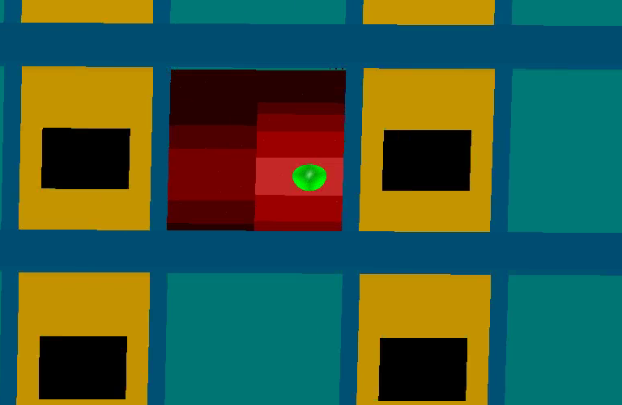
Charge sharing: SiliconChargeSharing
Find all cells inside a sensor
Distribute charge to sensor with 2D gaussian function
Charge sharing is exaggerated for illustration on the right.
Color shows Edep in a cell in log scale
Green marker is the hit

Slide 7
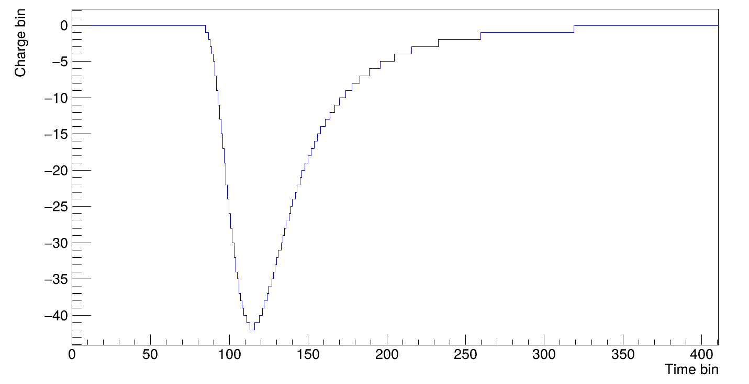
Pulse Generation: SiliconPulseGeneration
Convert hits to digitize pulses using a given function.
Landau is used on BTOF

Slide 8
Pulse Discretization: SiliconPulseDiscretization
Pulse needs to be cut into 25 ns segments.
If peaks happens near the 25 ns boundary, it will be registered as two different hit.
V
Cut the pulse in two halves at t=25 ns
t (ns)
0
25

Slide 9
Pulse digitization: EICROCDigitization
Time when Charge value crosses a threshold -> TDC value.
Max(Min) pulse height -> ADC value
Threshold
ADC value = -42
TDC value = 100

Slide 10
Work in progress
https://github.com/eic/EICrecon/pull/1779

Slide 11
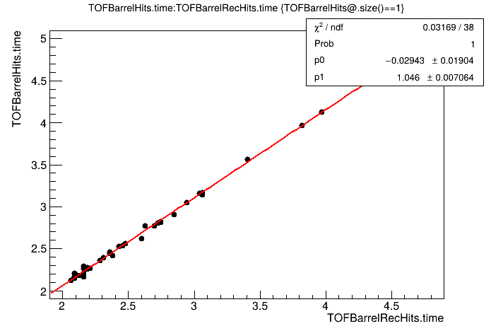
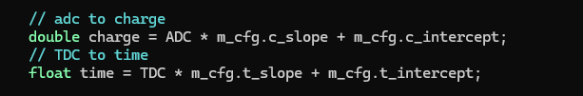
In progress: LGADHitCalibration
Convert ADC/TDC values back into time and charge.
Currently it’s just a linear function. Time work correction TBD.

Slide 12
In progress: LGADHitClustering
Convert hit information from all cells in a sensor back to hit location (TOFBarrelClusterHits, stored as Measurement2D).
Currently it’s just a simple weighted average. My advisor (Prithwish Tribedy) asked students to explore novel algorithm such as ML.
“global/tracking/tracking.cc” is modified to accept TOFBarrelClusterHits instead of TOFBarrelRecHits for tracking.

Slide 13
In progress: LGADHitClusterAssociation
Convert TOFBarrelClusterHits (Measurement2D) back to TOFBarrelRecHits (TrackerHit)
It’s there only to satisfy “TofEfficiency_process”

