Slide 1
pfRICH updates
Simon Snydersmith, Alfredo Colas Gullon, Kevin Chang, Sushrut Karmarkar, Andreas Jung
29 May, 2025

Slide 2
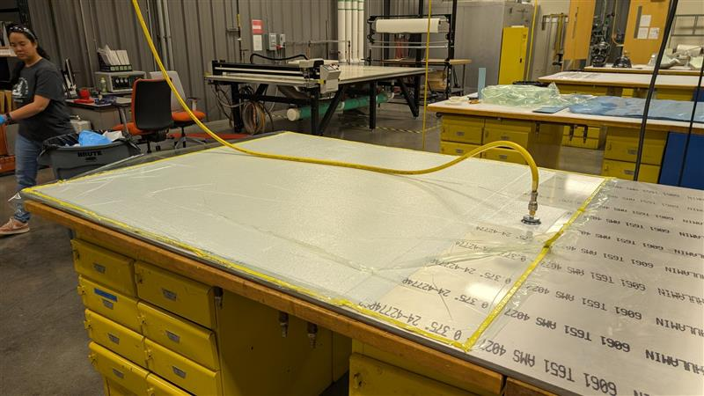
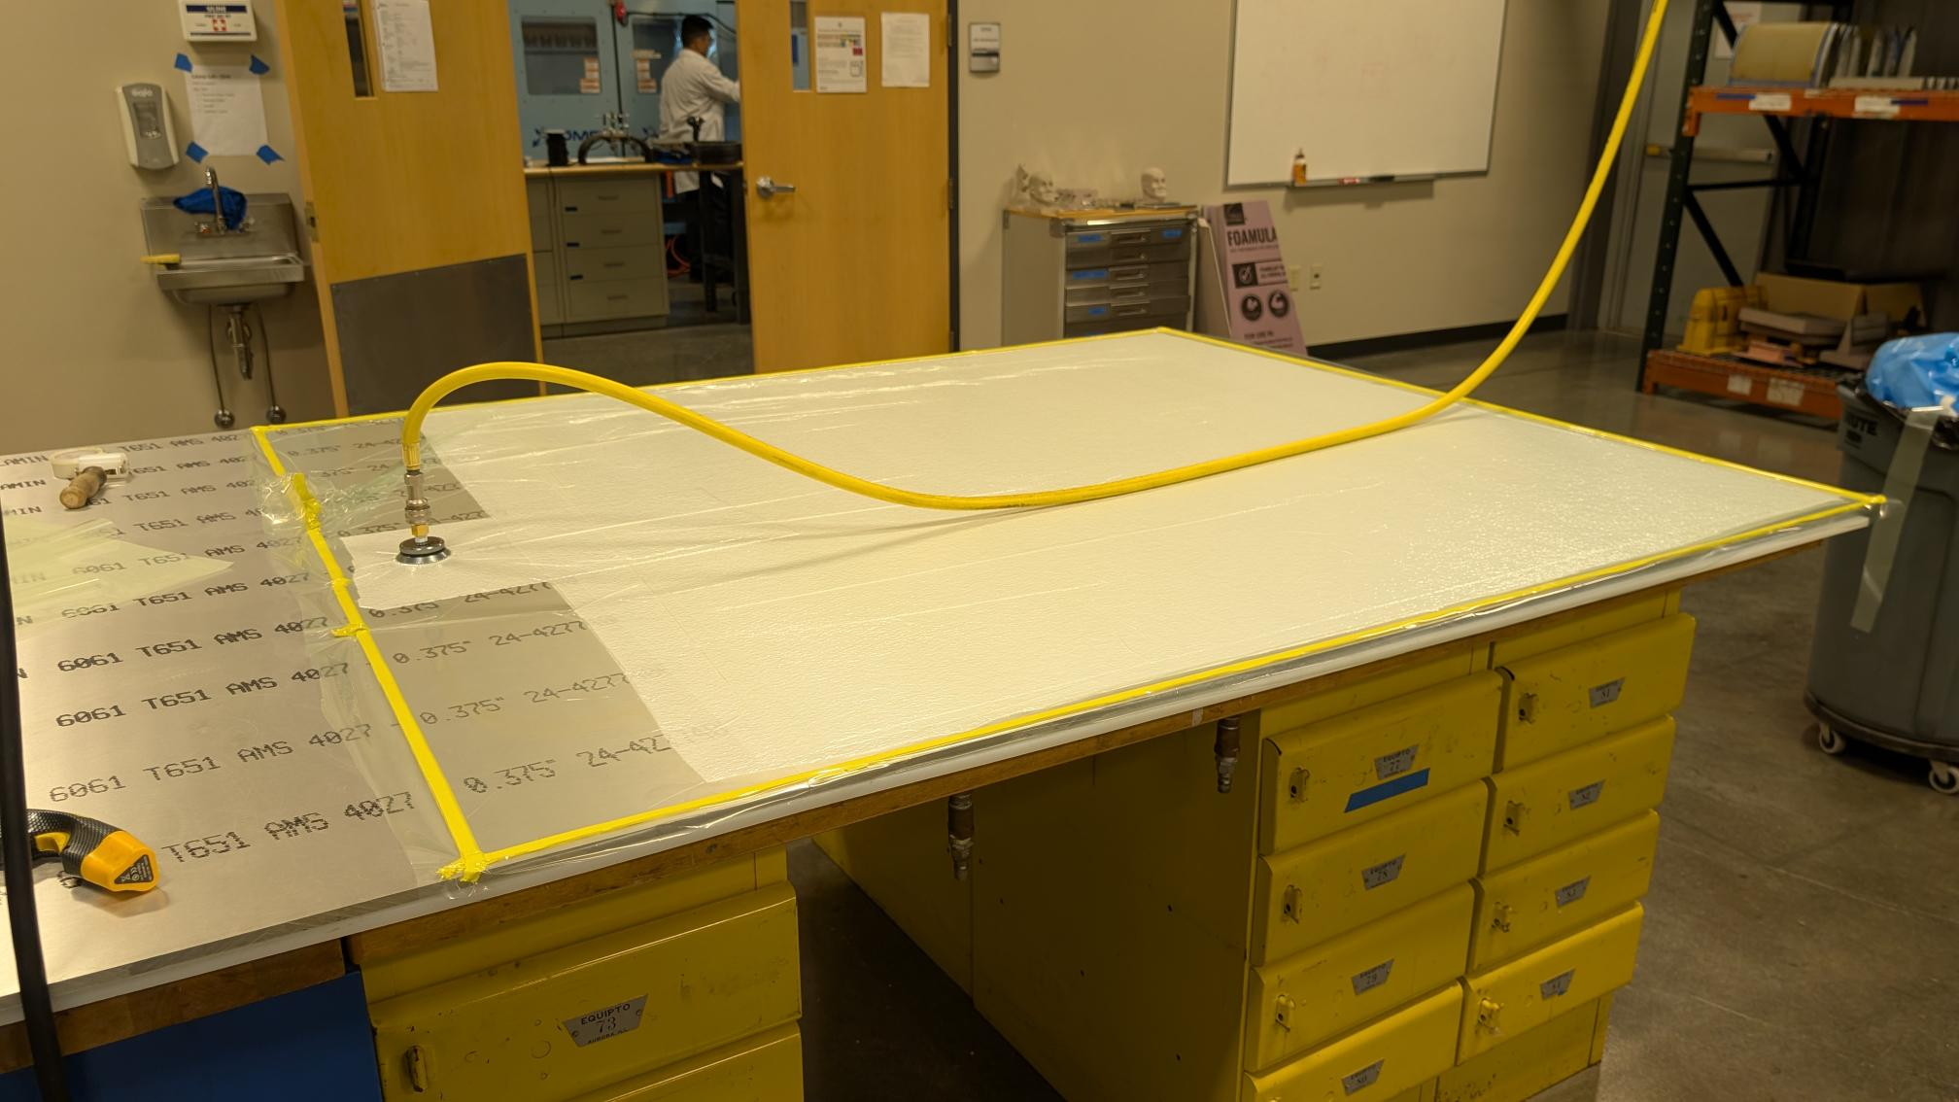
Summary
We have started to layup and cure the sensor plane base plate (large plate)
8 ply – 56 inch x 56 inch – [0/90/0/90]s

Slide 3
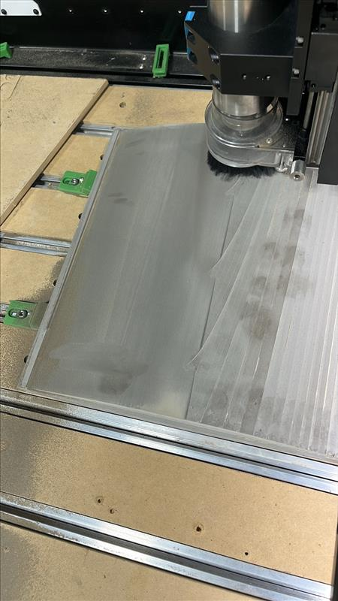
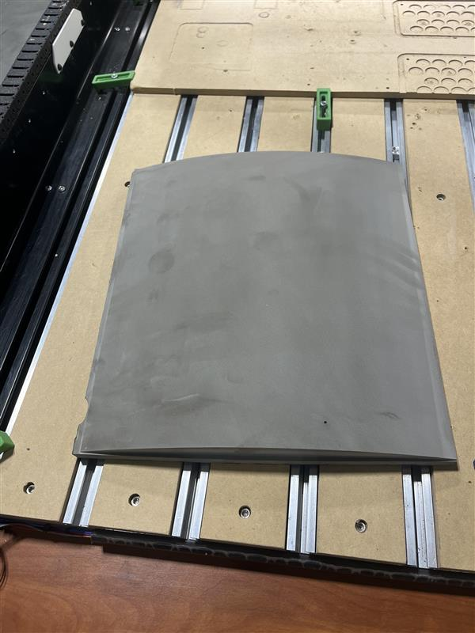
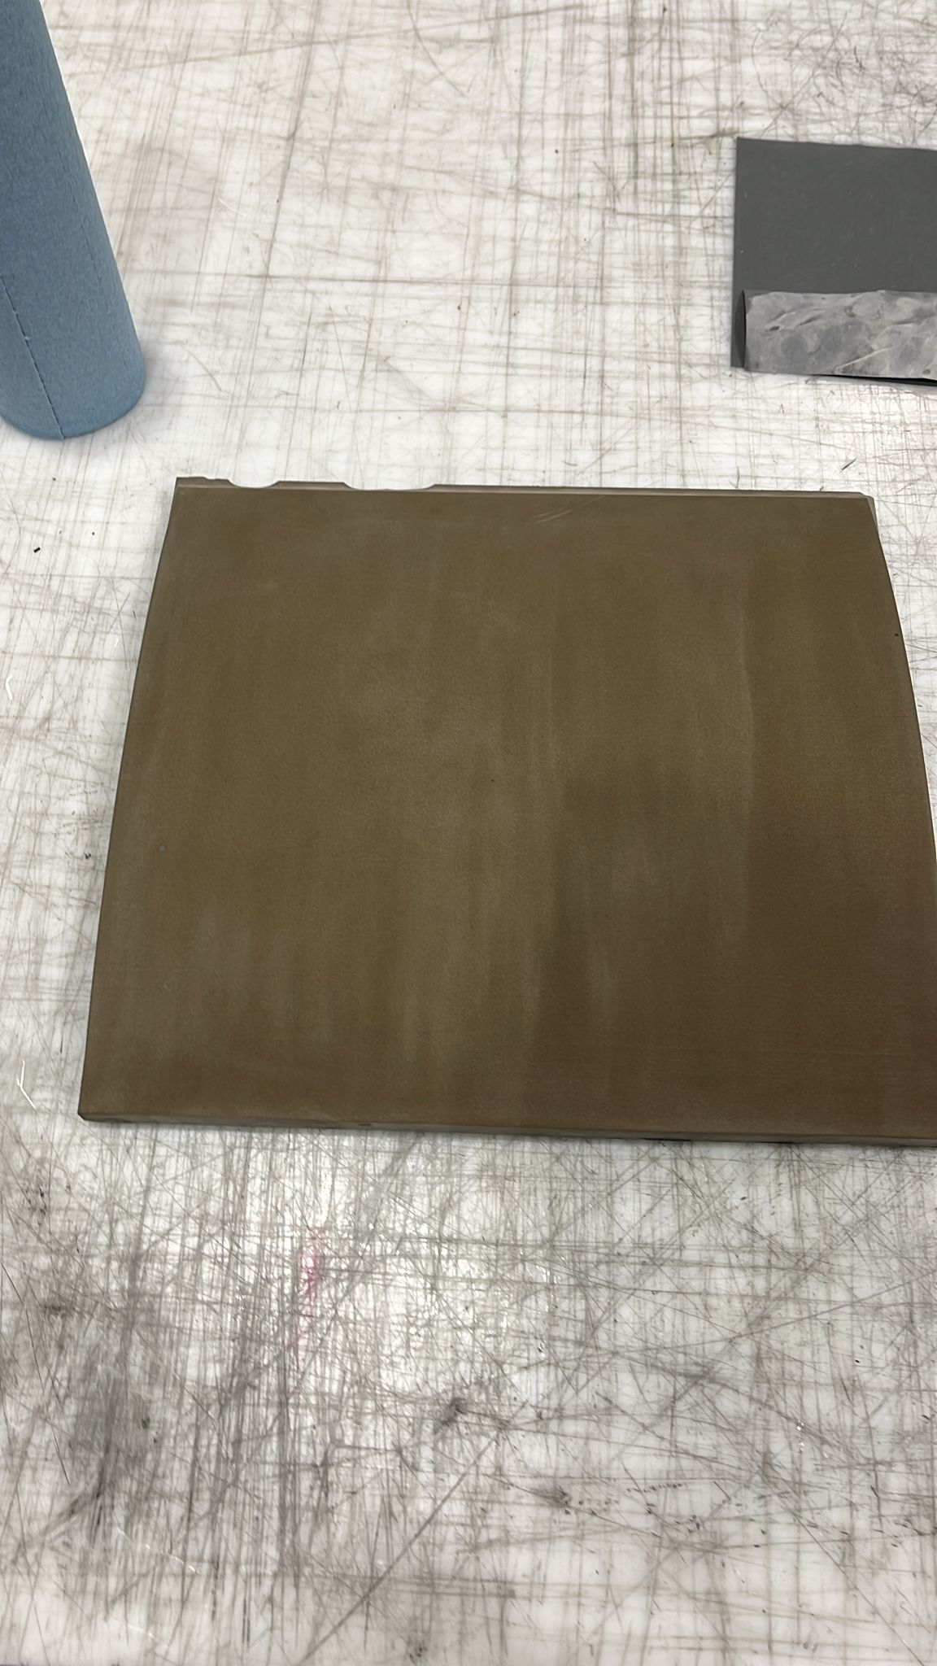
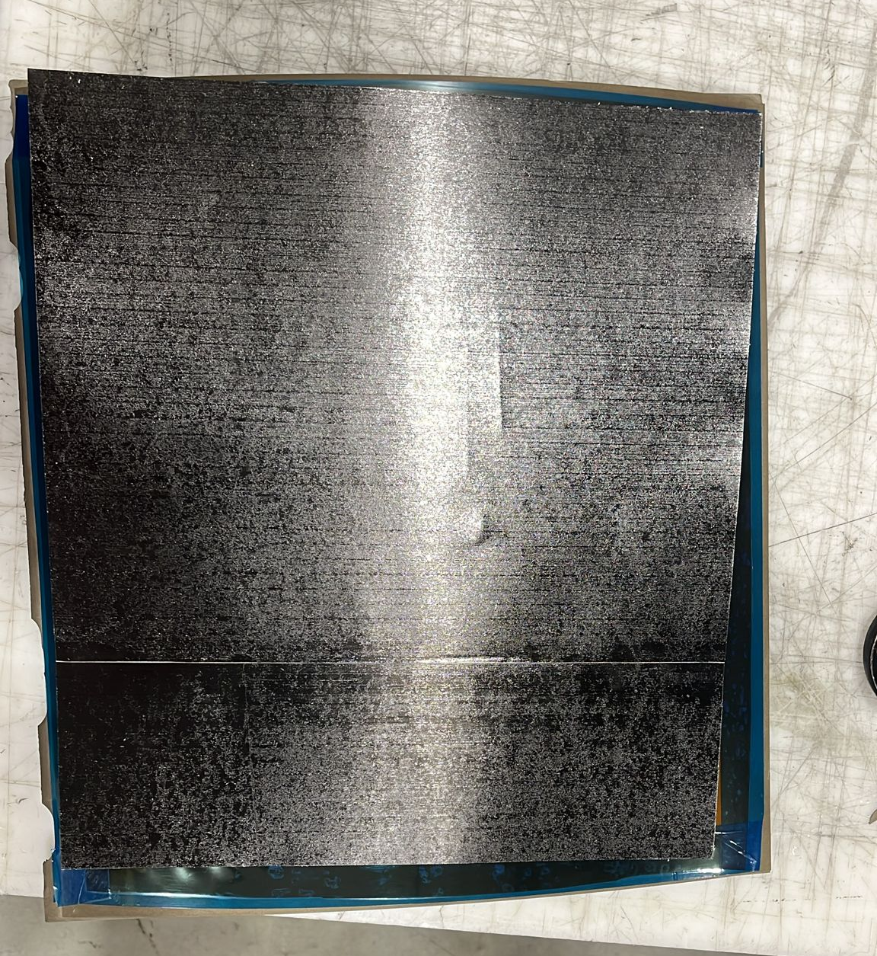
Mirror Updates
4 plates for the flat samples in co-bond this week.
1 co-bonding and cutting finished on Tuesday 27th May
Curved mirror –
Next tool is also ready
First part curing as of 28th May

