Slide 1
Integration, Installation and Infrastructure (Triple I Group)
TIC Update
Roland Wimmer

Slide 2
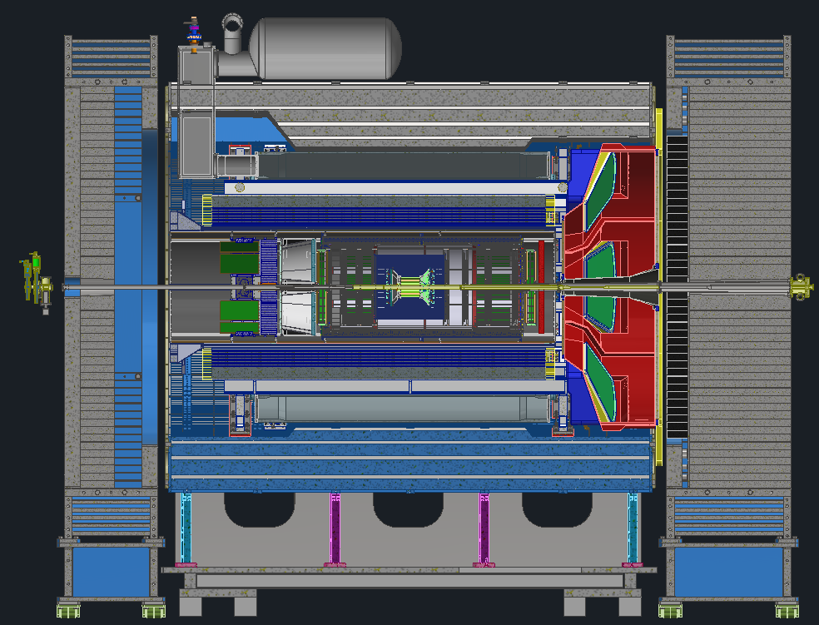
Detector Model Updates
Cradle Update
bEMCAL Update
GST Update
Beampipe & Disk Updates

Slide 3
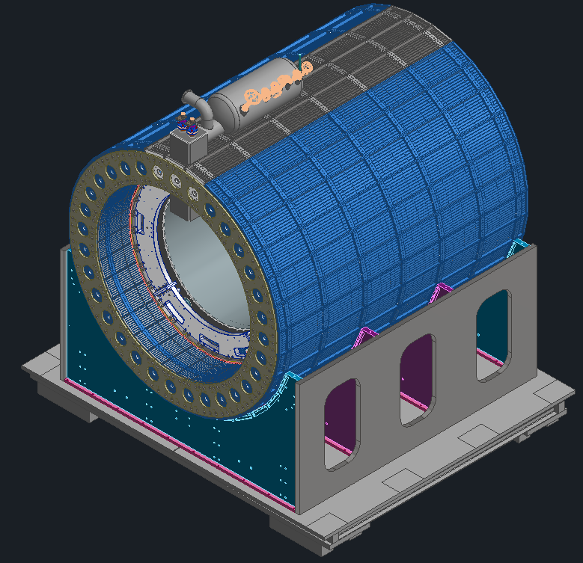
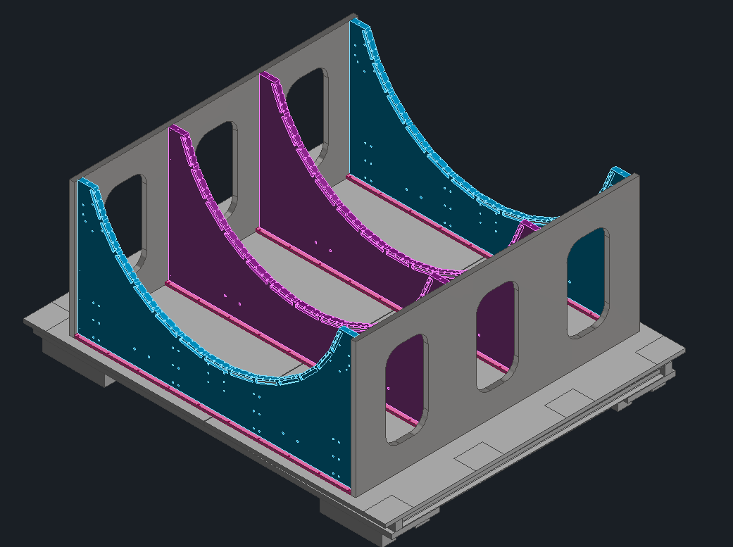
Cradle Update
Reuse cradle supports for HCal from sPHENIX.
Make a new base for cradle as Hilman roller spacing and beam pipe vertical distance from rails are different in 1006 and 1008
HCal electronics can be in the same location and remain fully accessible.
Can reuse sPHENIX platforms
Much lighter design and allows for other considerations like air bearings.
Cradles
Base
Rollers

Slide 4
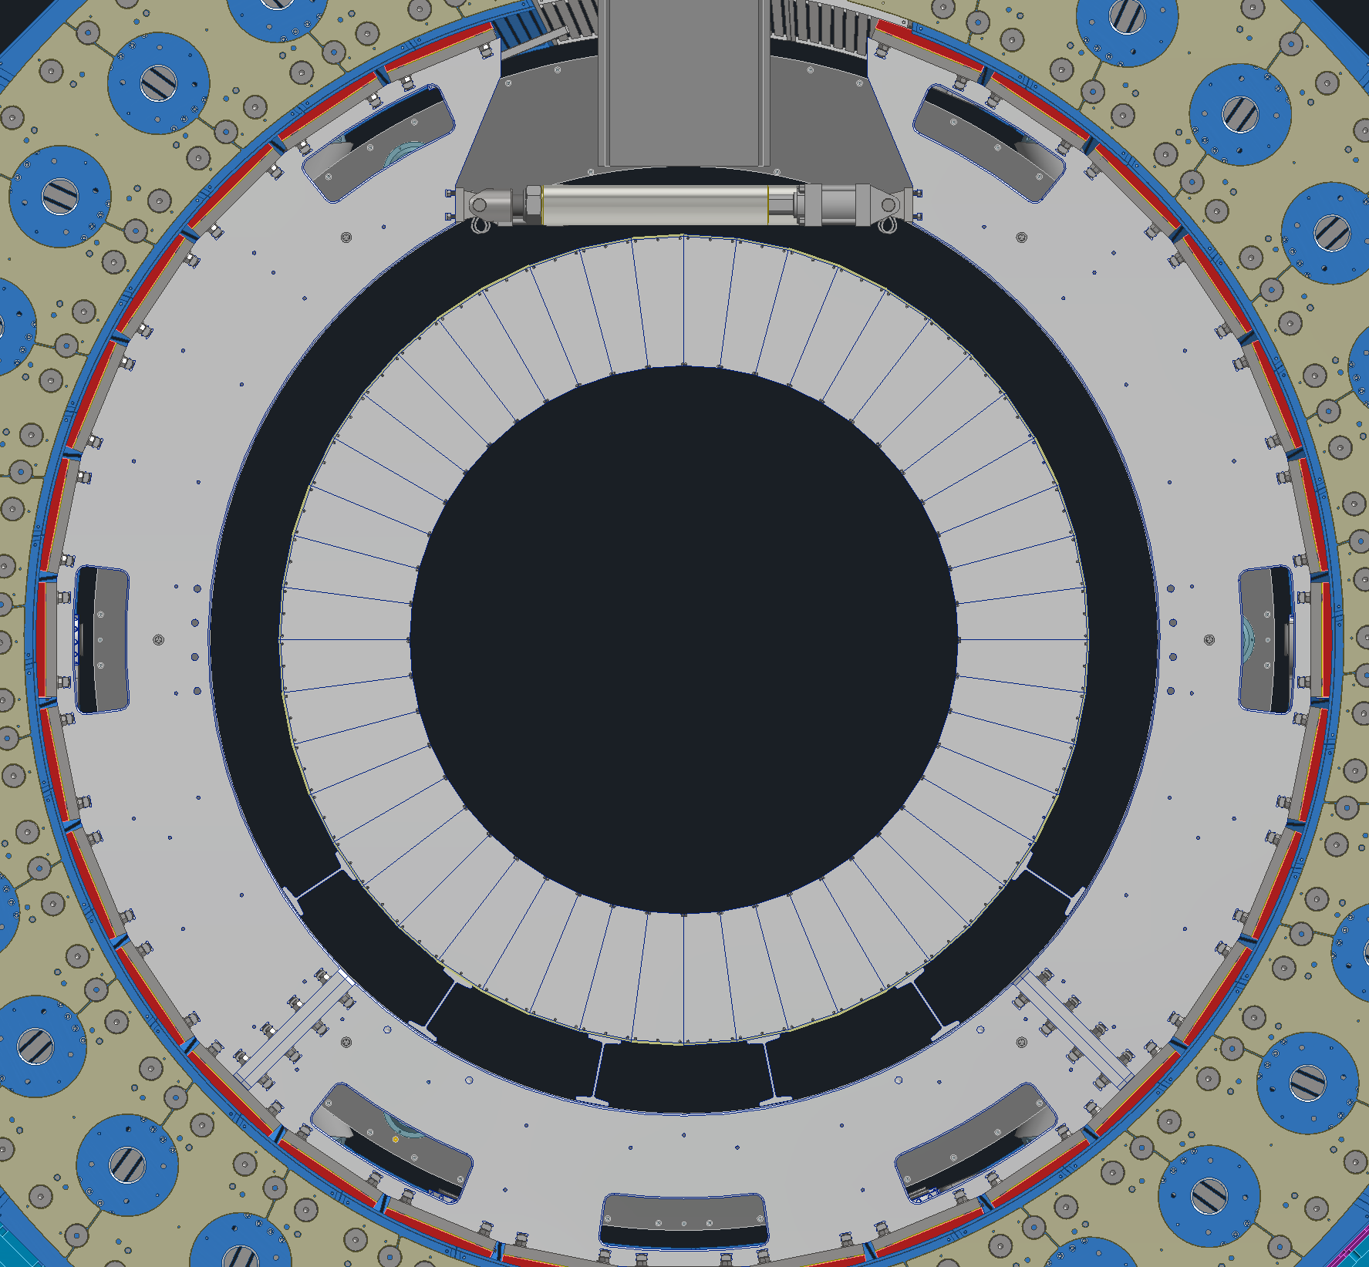
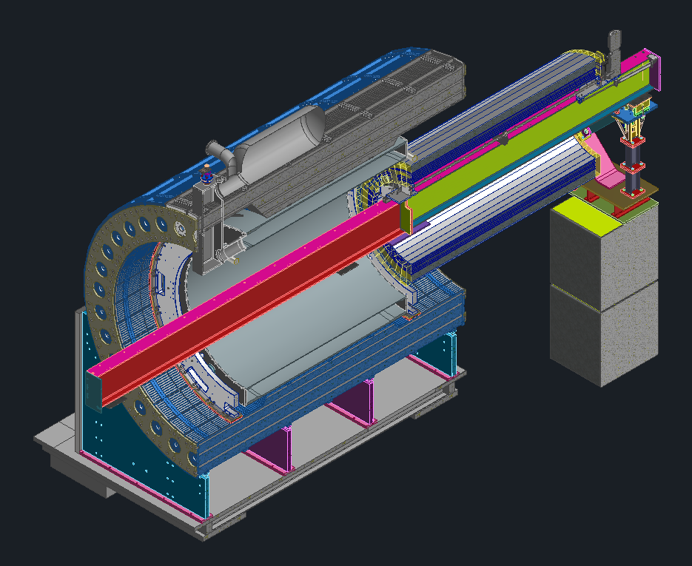
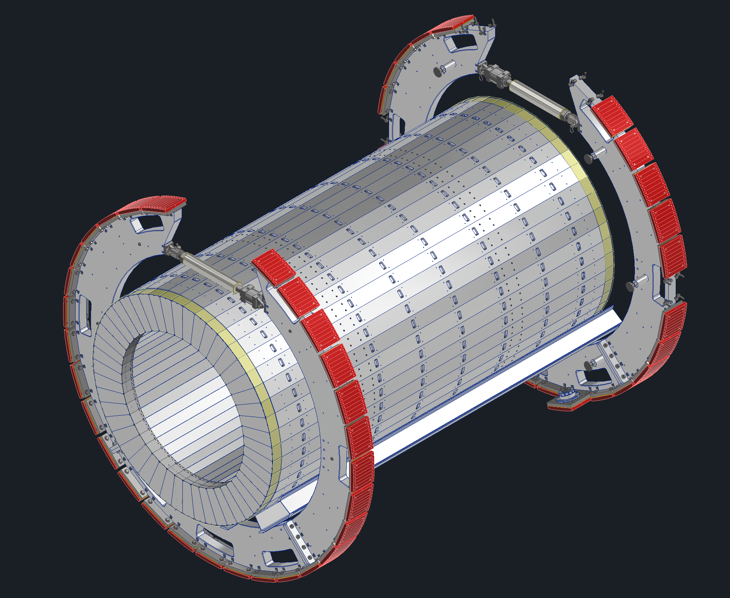
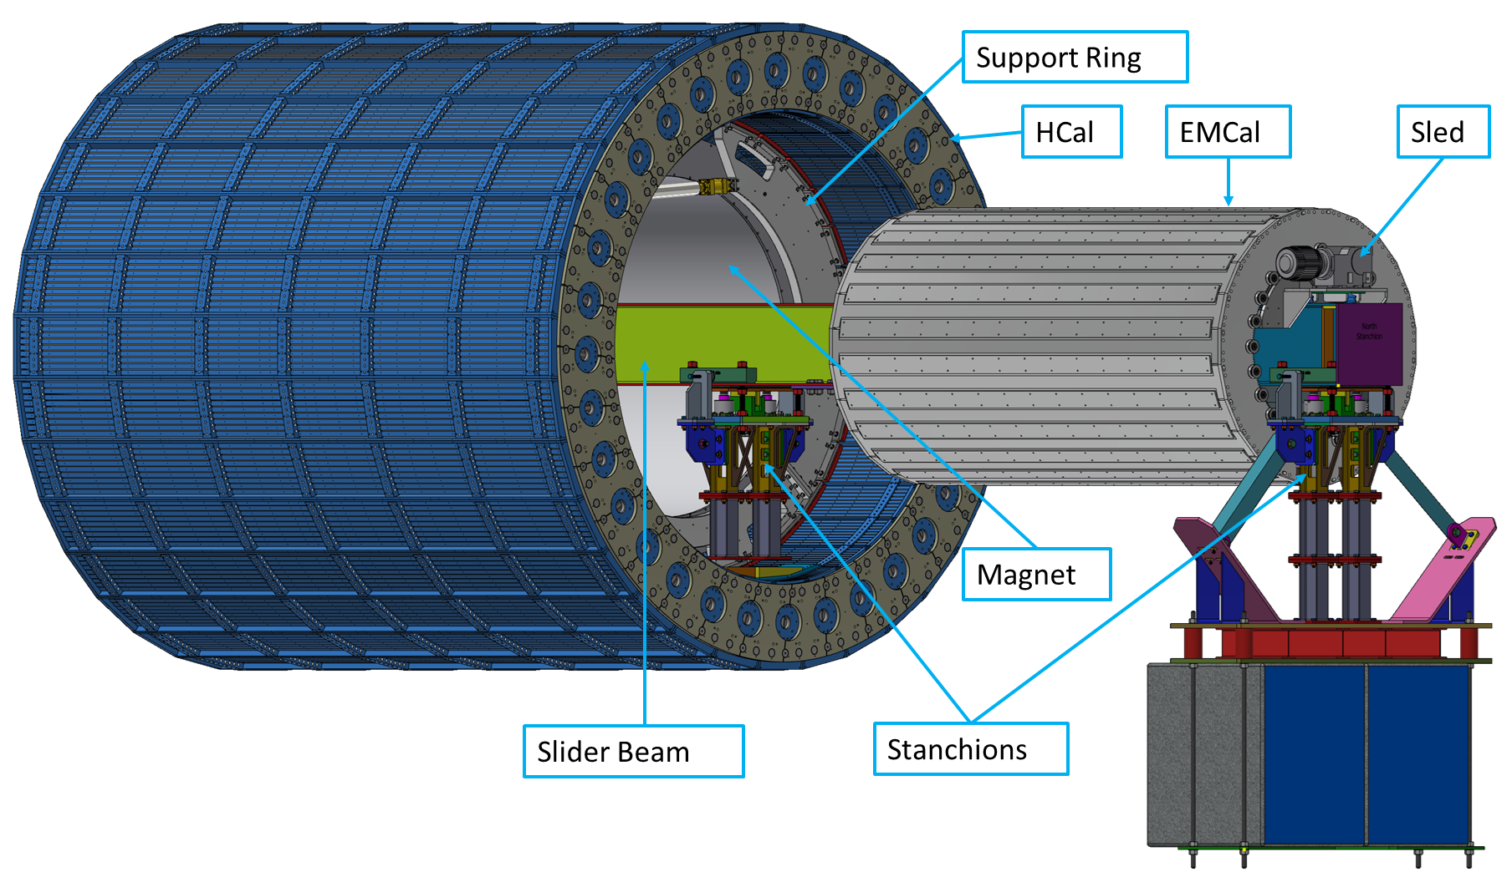
bEMCAL Update
Been working on support structure design, leaning towards using aluminum I beams.
Reuse the inner HCAL assembly tooling from sPHENIX.
No more adjustment other than slight shimming
Barrel EMCAL
Support Ring
Support I Beams

Slide 5
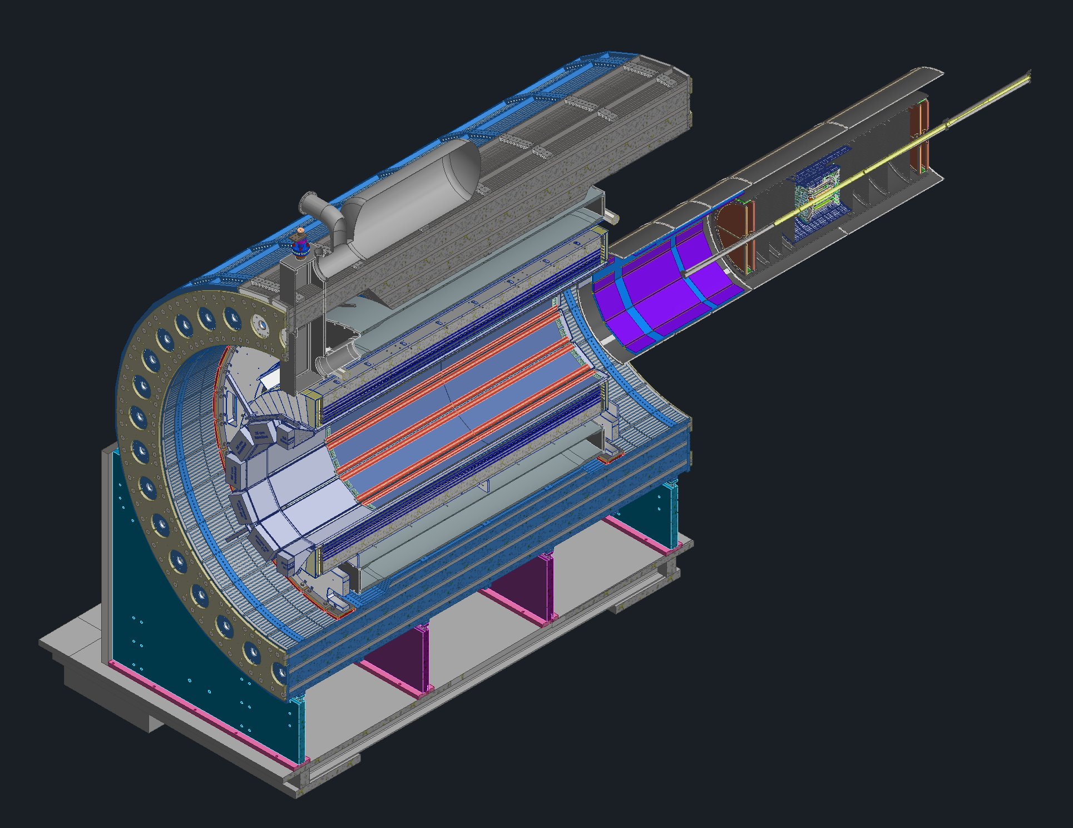
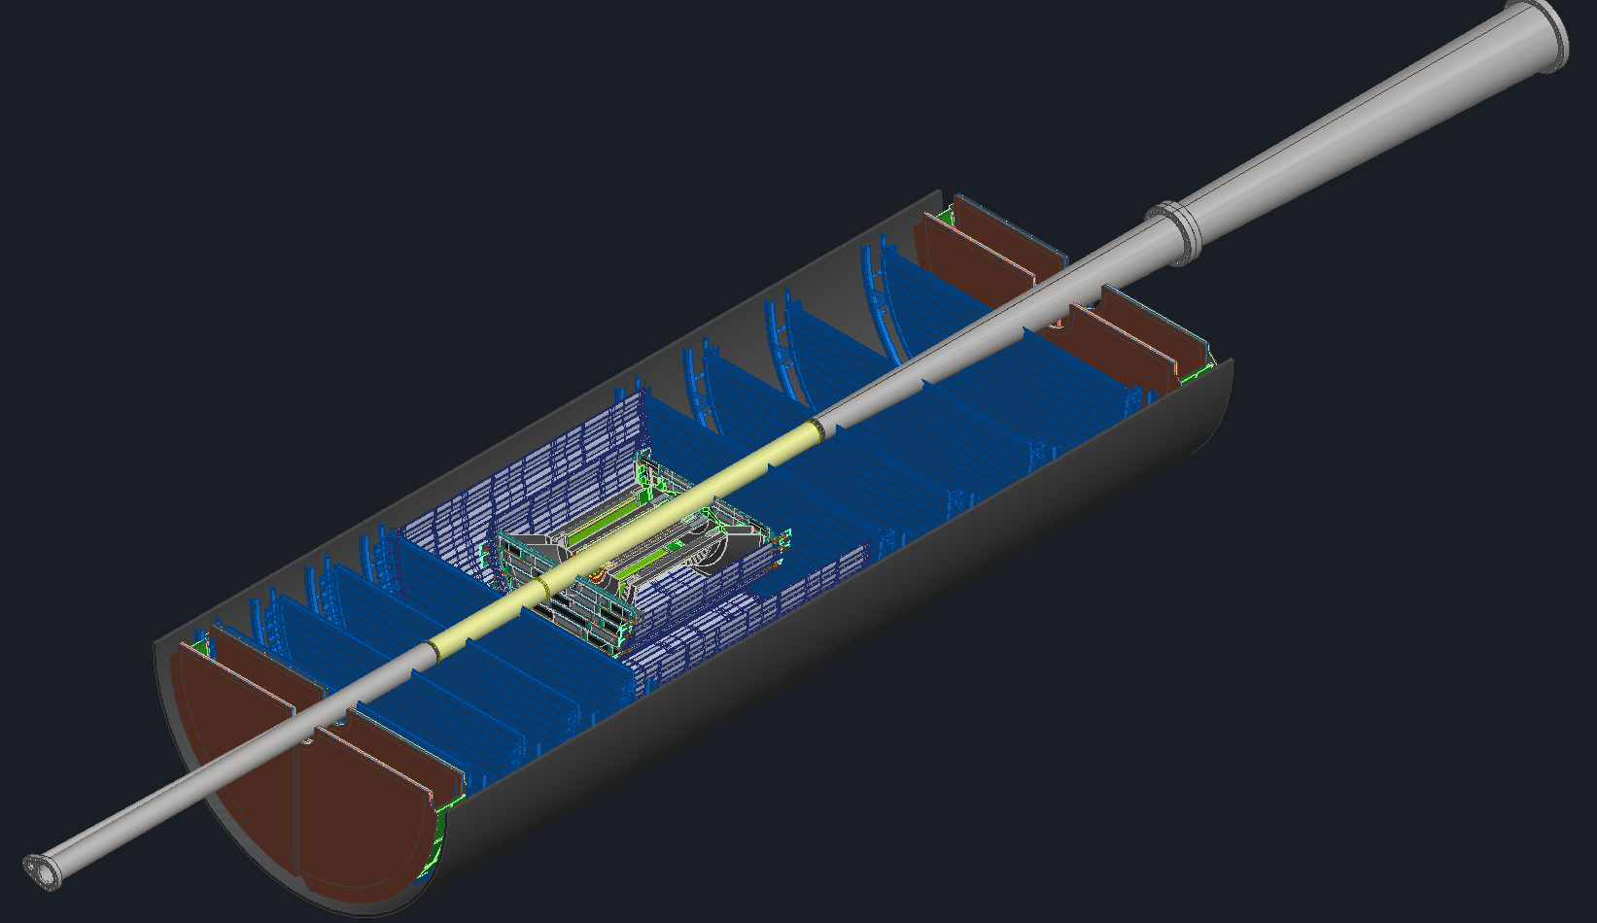
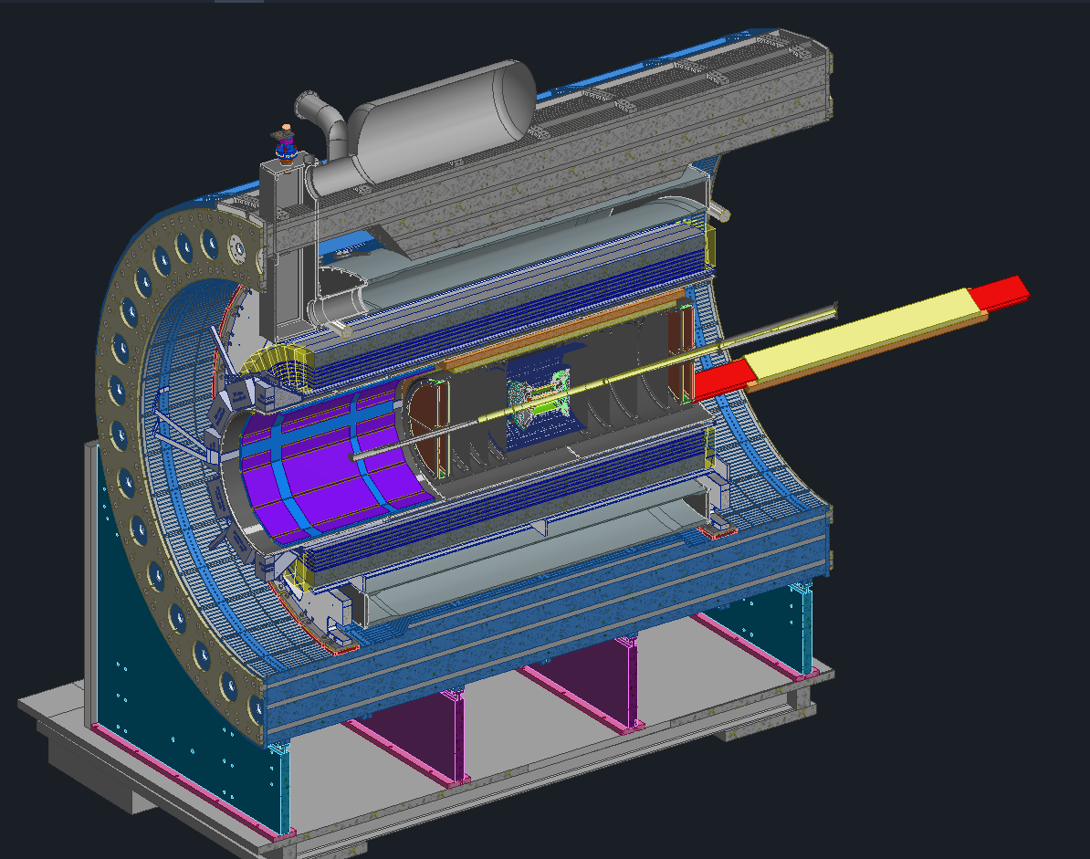
GST Update
Need to make barrel TOF and inner MPGD more easily serviceable (previously attached to GST and installed as one unit)
SVT and MPGD disks are assembled into PST around the beam pipe
Rails allow for TOF and inner MPGD to be installed in 12 section like DIRC and outer MPGD
GST
TOF and MPGD
Module
BP
MPGD
PST
SVT
MPGD

Slide 6
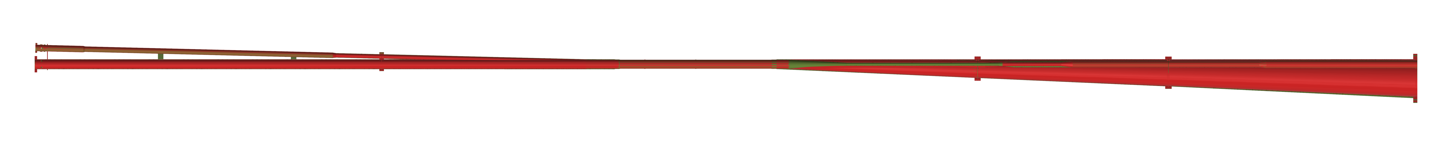
Beam Pipe and Disk ID Update
Most locations, the beam pipe is larger in radius by ~2mm
Beryllium reduced in length from 1.4m to 1m.
Very tight beam pipe locating tolerances (+/-1mm, including manufacturing) may require additional clearance so that beam pipe can be adjusted independently of GST
Beam pipe scaled
Z:X = ~1:5
 |  | Date | 2/20/2025 | 5/27/2025 |  | 2/20/2025 | 5/27/2025
Disk |  |  | Radius (mm) |  |  | X Offset (mm)
Forward | SVT | 1 | 36.75 | 36.75 |  | 0 | 0
 |  | 2 | 40.5 | 42.25 |  | 1 | 3.25
 |  | 3 | 47.5 | 49 |  | 8.5 | 10
 |  | 4 | 55.5 | 57 |  | 16.5 | 17.75
 | MPGD | - | 65 | 68.5 |  | 25 | 24.5
 | TOF | - | 65 | 70.75 |  | 25 | 26.5
Backward | SVT | 1 | 36.75 | 36.75 |  | 0 | 0
 |  | 2 | 36.75 | 40 |  | 0 | 0
 |  | 3 | 38 | 41 |  | -1 | -1
 |  | 4 | 42.5 | 43.25 |  | -3.25 | -3.25
 | MPGD | - | 50 | 50.75 |  | 0 | 5.75
 | TOF | - | - | - |  | - | -
Red = Old, Green = New

Slide 7
Backup Slides

