Slide 1
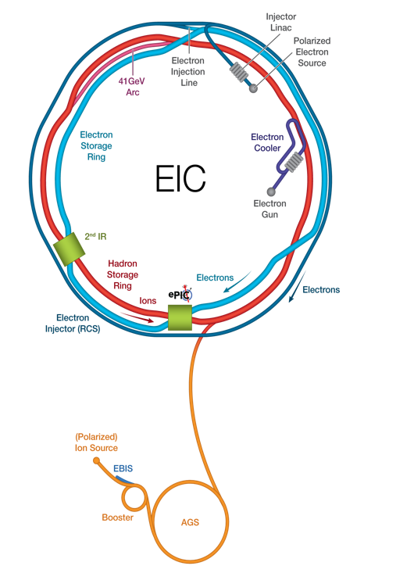








UK-EIC project status update
Daria Sokhan
University of Glasgow
Daresbury Laboratory
Rutherford Appleton Laboratory
Work Package 1 Meeting – 26 June 2025 – Brunel University, London

Slide 2
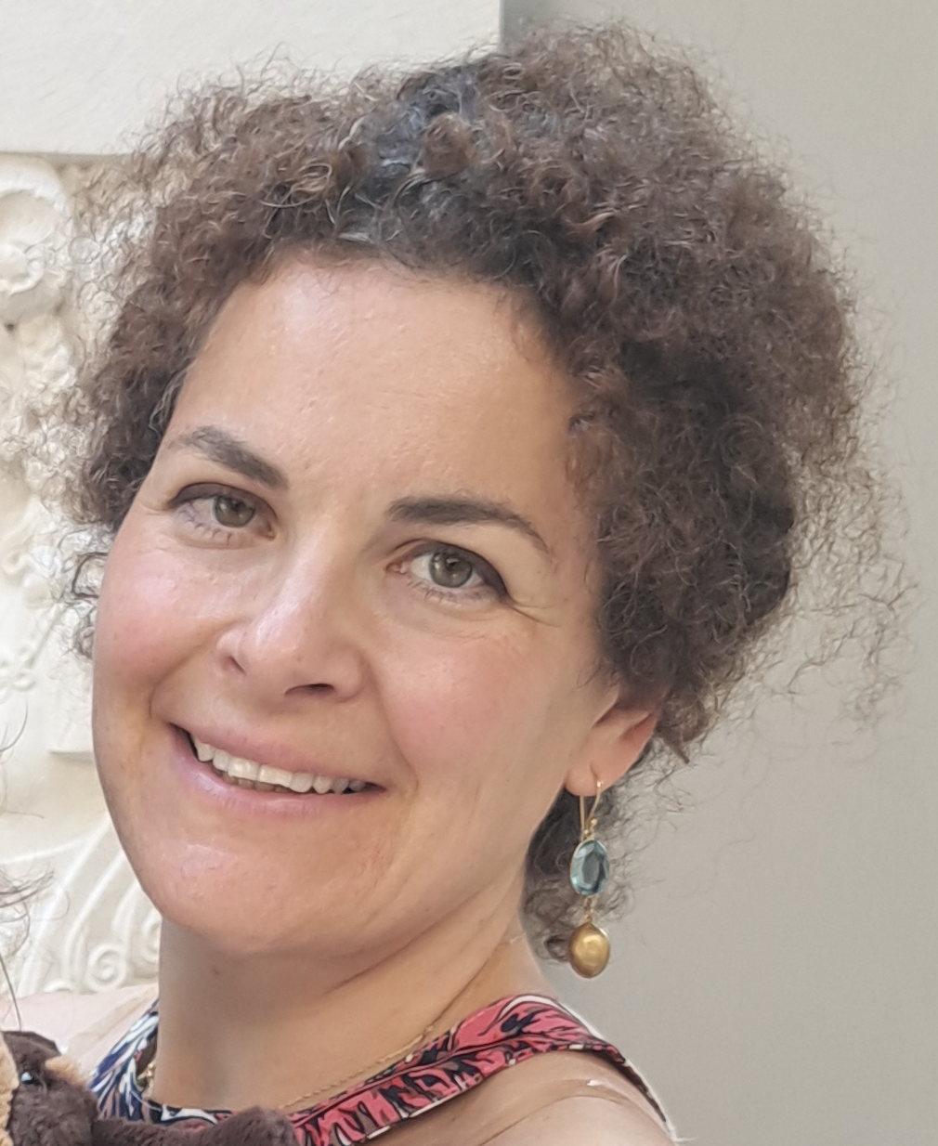

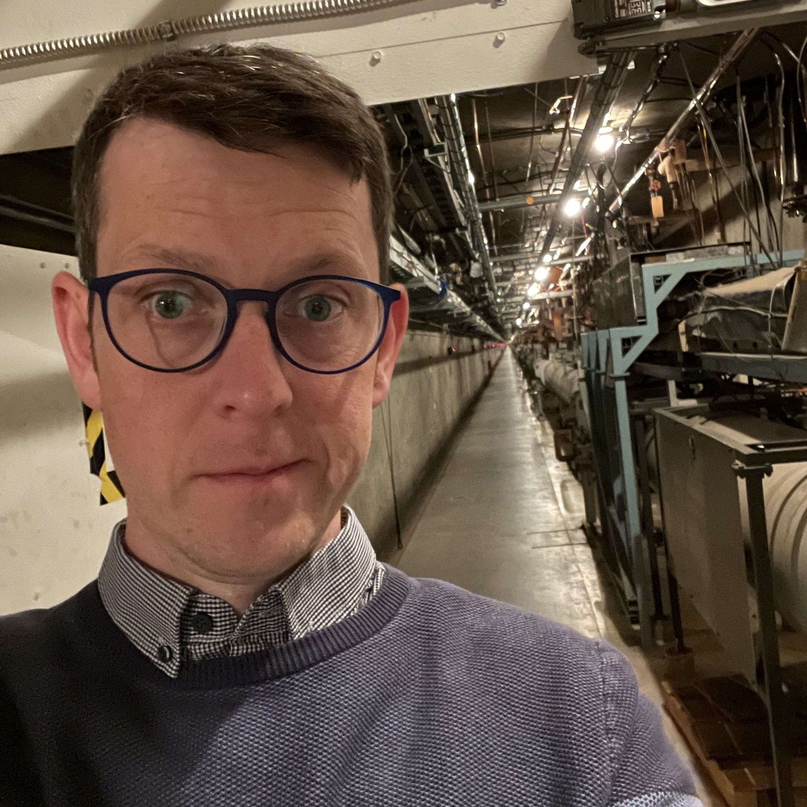
New Management Team – from July 2025
Principal Investigator
Daria Sokhan University of Glasgow
Deputy Principal Investigator
Marcello Borri Daresbury
Project Manager
Paul Aden Daresbury
Three-year term, beginning 1st July 2025
And thank you to Peter for leading this project from inception!
Thank you for your votes!

Slide 3

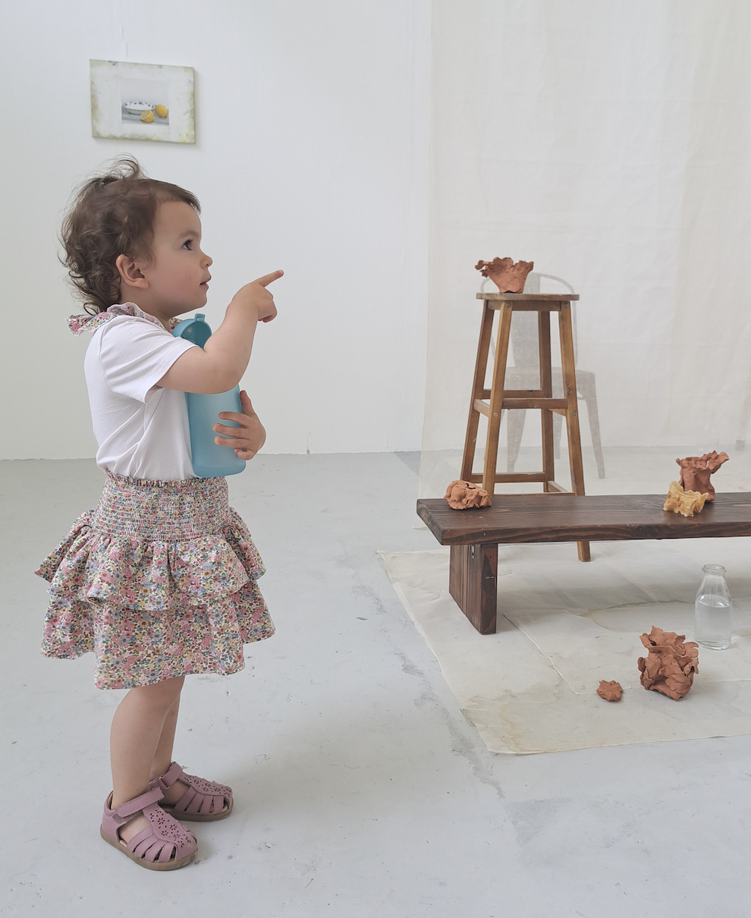
Intro: Daria
Senior Lecturer, University of Glasgow
2009, University of Edinburgh: PhD in experimental hadron physics
2009, INFN Pavia: Fellowship for Foreign Scientists
2010 – 12, IJCLab (then IPN) Orsay, France: CNRS postdoc
2012, University of Glasgow: Lecturership
2021 – 23, Saclay, France: Blaise Pascal Chair (on leave from Glasgow)
Experimental hadron physics: nucleon tomography through Generalised Parton Distributions (GPDs), electron scattering experiments at Jefferson Lab (CLAS Collaboration). Exclusive / Diffractive / Tagged physics processes.
EIC: past co-convener of Exclusive Reactions working groups for EIC Yellow Report, ATHENA proto-collaboration, Detector 1 collaboration (ePIC).
Co-PI of UKRI Preliminary Activity grant.

Slide 4
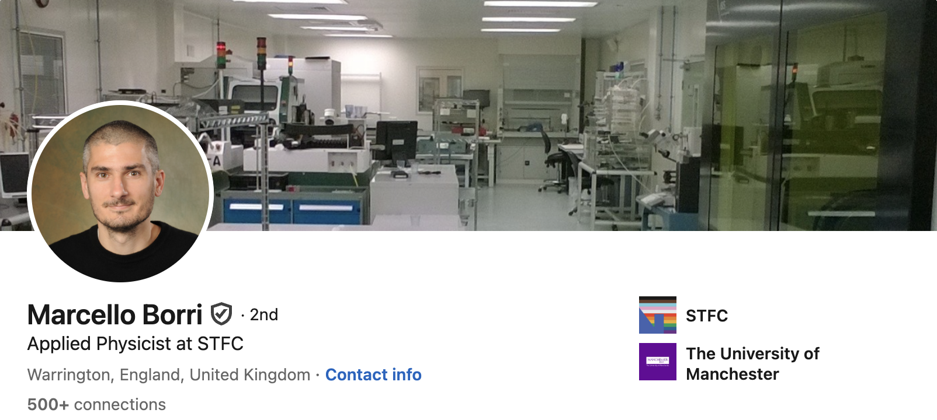
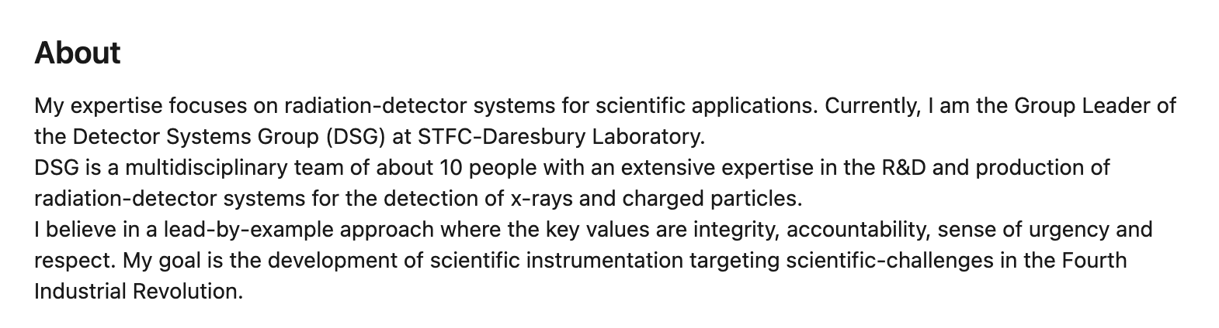
Intro: Marcello

Slide 5
Intro: Paul
Over to Paul…

Slide 6
UK EIC Collaboration
Institute Board representatives:
Birmingham – Paul Newman Brunel – Liliana Teodorescu Glasgow – Daria Sokhan Lancaster – Graeme Burt Liverpool – Marielle Chartier Oxford – Todd Huffman York – Dan Watts RAL TD – Iain Sedgwick RAL PPD – Fergus Wilson DL TD – Marcello Borri
Work Package leaders:
WP1 – Georg Viehhauser WP2 – Ken Livingston WP3 – Nick Zachariou WP4 – Nik Templeton
Thank you to Paul Newman (Birmingham) and Dave Ireland (Glasgow) for creation of the IB and for running of the first EIC-UK elections.
Daresbury Laboratory
Rutherford Appleton Laboratory

Slide 7
UKRI Preliminary Activity Update
Final Oversight Committee met on 9th May 2025. Thank you for your inputs!
Request for a submission of the pre-TDR document to the committee as one of the major deliverables of the project. Awaiting finalisation of v2 in July and permission to share the document draft.
Close-out report expected in September (deadline not yet given) – we’ll be asking for more inputs! ☺

Slide 8
UKRI Full Infrastructure Project - Reminder
Submitted proposal in July 2023 for £58.8m fEC incl. contingency, duration 7 + 1.75 years (Jul 2025 – Mar 2034).
UKRI funding announcement in March 2024: funding would start in FY26/27 (Apr 2026 at earliest).
STFC tentatively agreed with UKRI Infrastructure to advance funding in FY25/26.
Reprofiled £58.8m cost to STFC (£64.1m fEC) incl. contingency, duration 8.25 + 1.75 years (Apr 2025 – Mar 2035).
Budget in FY25/26 was limited to £2.8m.
STFC clarified that grants to HEIs would be at 80% fEC (apart from equipment/exceptions); indexation at 2.48%.
The project underwent a Full Business Case approval process; approved by UKRI ExCo in December 2024.

Slide 9
UKRI Full Infrastructure Project – Current Status
Future EIC funding is caught up in the Government’s Comprehensive Spending Review -- Phase 2 of the CSR (FY26/27 – FY29/30) announced on June 11th. UKRI budget still unknown.
UKRI/STFC’s FY25/26 budget settlement from Phase 1 of the CSR is challenging.
UKRI Infrastructure is unwilling to release funds until EIC funding is confirmed by HM Treasury.
Unfortunately, there is no prospect of additional bridging from STFC this FY.
At the current rate of spend there are sufficient funds at the national labs for work to continue to the end of June; project-funded staff are covered until the end of September.
As of today, no confirmation yet of the Full Infrastructure funding.
Financial planning for the first award: see Peter’s talk.

Slide 10
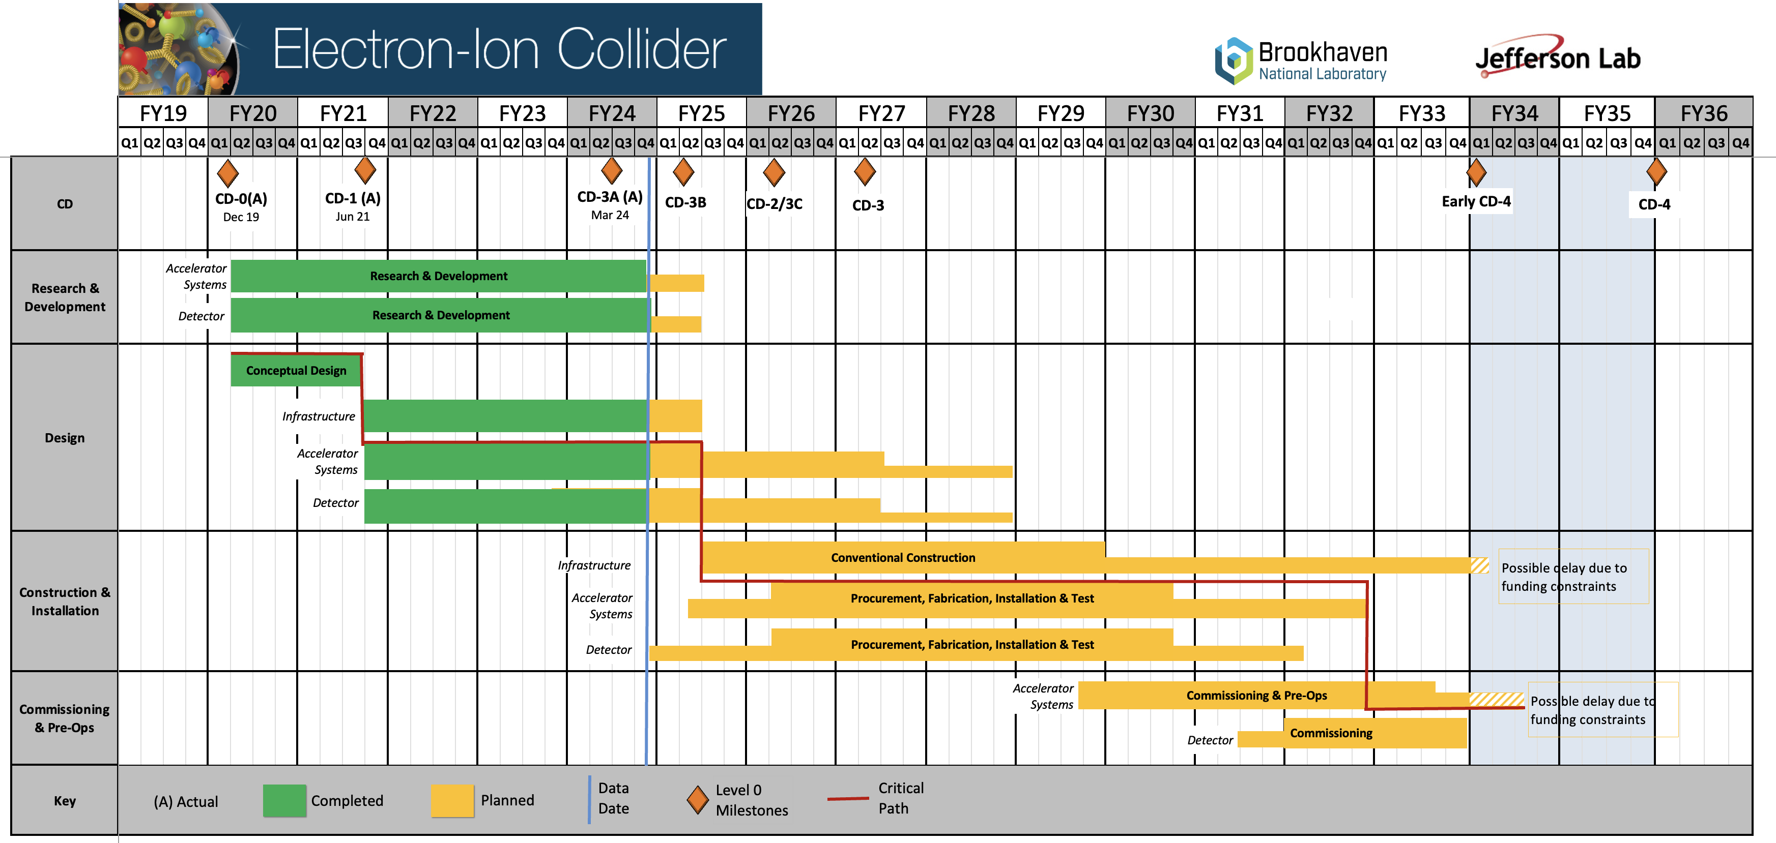
EIC Project Schedule (June 2025)
We are here
CD-2
CD-3
CD-4 (EF)
NOTE: US Financial Years (FY) = Oct-Sep
Critical Decision (CD) Milestones
CD-0 Approve Mission Need
CD-1 Approve Cost Range
CD-2 Approve Baseline Performance
CD-3 Approve Start Construction
CD–4 Approve Project Completion
Upcoming Project Milestones
PDR (pre-TDR) – Sep 2025
CD-2 – Sept 2026
TDR – Sep 2026
CD-3 – Dec 2027
CD-4(EF) – Oct 2033
CD-4 – Oct 2035
Difference between CD-4(EF) and CD-4 is US schedule contingency
(EF = Early Finish)
Conclusion of RHIC
Operations
Phasing the delivery of the accelerator allows science programme to start at CD-4 (EF)
Latest (unofficial) EIC project schedule – CD dates still under discussion
Reflects uncertainty in level of FY25 funding and current plans to phase the delivery of the accelerator

Slide 11
EIC Project Schedule (June 2025)
We are here
2.5 years
1 yr
CD-2
CD-3
8.25 + 1.75 = 10 years
CD-4 (EF)
NOTE: US Financial Years (FY) = Oct-Sep
Critical Decision (CD) Milestones
CD-0 Approve Mission Need
CD-1 Approve Cost Range
CD-2 Approve Baseline Performance
CD-3 Approve Start Construction
CD–4 Approve Project Completion
Upcoming Project Milestones
PDR (pre-TDR) – Sep 2025
CD-2 – Sept 2026
TDR – Sep 2026
CD-3 – Dec 2027
CD-4(EF) – Oct 2033
CD-4 – Oct 2035
Difference between CD-4(EF) and CD-4 is US schedule contingency
(EF = Early Finish)
Preliminary Activity
Full Infrastructure Project
Schedule Contingency
Conclusion of RHIC
Operations
Phasing the delivery of the accelerator allows science programme to start at CD-4 (EF)
UK-EIC Detector R&D Project
UK-EIC Detector Construction Project
Latest (unofficial) EIC project schedule – CD dates still under discussion
Reflects uncertainty in level of FY25 funding and current plans to phase the delivery of the accelerator

Slide 12
EIC Subprojects
EIC Project split into four Subprojects, which follow decoupled paths through the Critical Decisions:
Science Program starts after Subproject 3 is complete.
Subproject 1 - Accelerator – HSR, ESR, INF
 | Subproject 2 - IR Integration, SC Magnets, Detector
 |  | Subproject 3 - Electron Injector, Infrastructure
 |  |  | Subproject 4 - Full EIC Capabilities
HSR: Hadron Storage Ring, ESR: Electron Storage Ring, INF: Infrastructure, IR: Interaction Region, SC: Superconducting
EIC Detector R&D | Oversight Committee Meeting | 9 May 2025

Slide 13
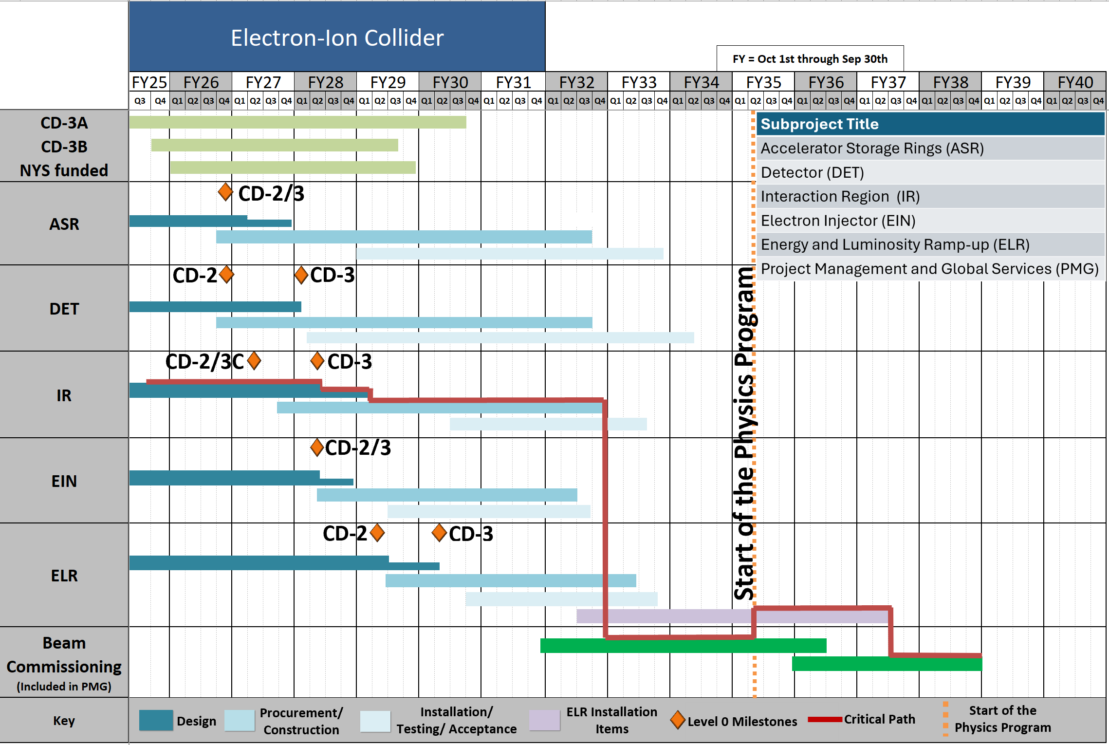
EIC Sub-Project Schedule (June 2025)
CD-4 (EF)
Subproject schedule presented at RRB in June 2025

Slide 14
International Agreements
Agreements between UK/STFC and US/BNL/Jlab for detector/accelerator hardware:
iCRADAs to be signed between STFC and BNL/Jlab for each deliverable,
to be accompanied by detailed Project Planning Documents (PPDs) covering cost and schedule.
Expected by CD-2 (Q4 2026).
Agreement between DOE/BNL and CERN/ITS3 for the SVT sensor
Agreement has been split into two parts: procurement of ER2 (MOSAIX) sensors and the design sharing agreement (DSA). Process for procuring sensors is underway; unfortunately, no progress on the DSA.
Waiting for overarching agreement between DOE and CERN on cooperation for R&D
Hinted that with the chaos in Washington the DSA may be another year or more away
Project recognises this is not acceptable and hopes to find an alternative solution in the next 3 months
Design Sharing Agreement between RAL and BNL/LBNL for the AncASIC:
Difficulty around IP and use of non-commercial versus commercial licenses
In progress: various work-arounds being considered that appear to be viable.

Slide 15

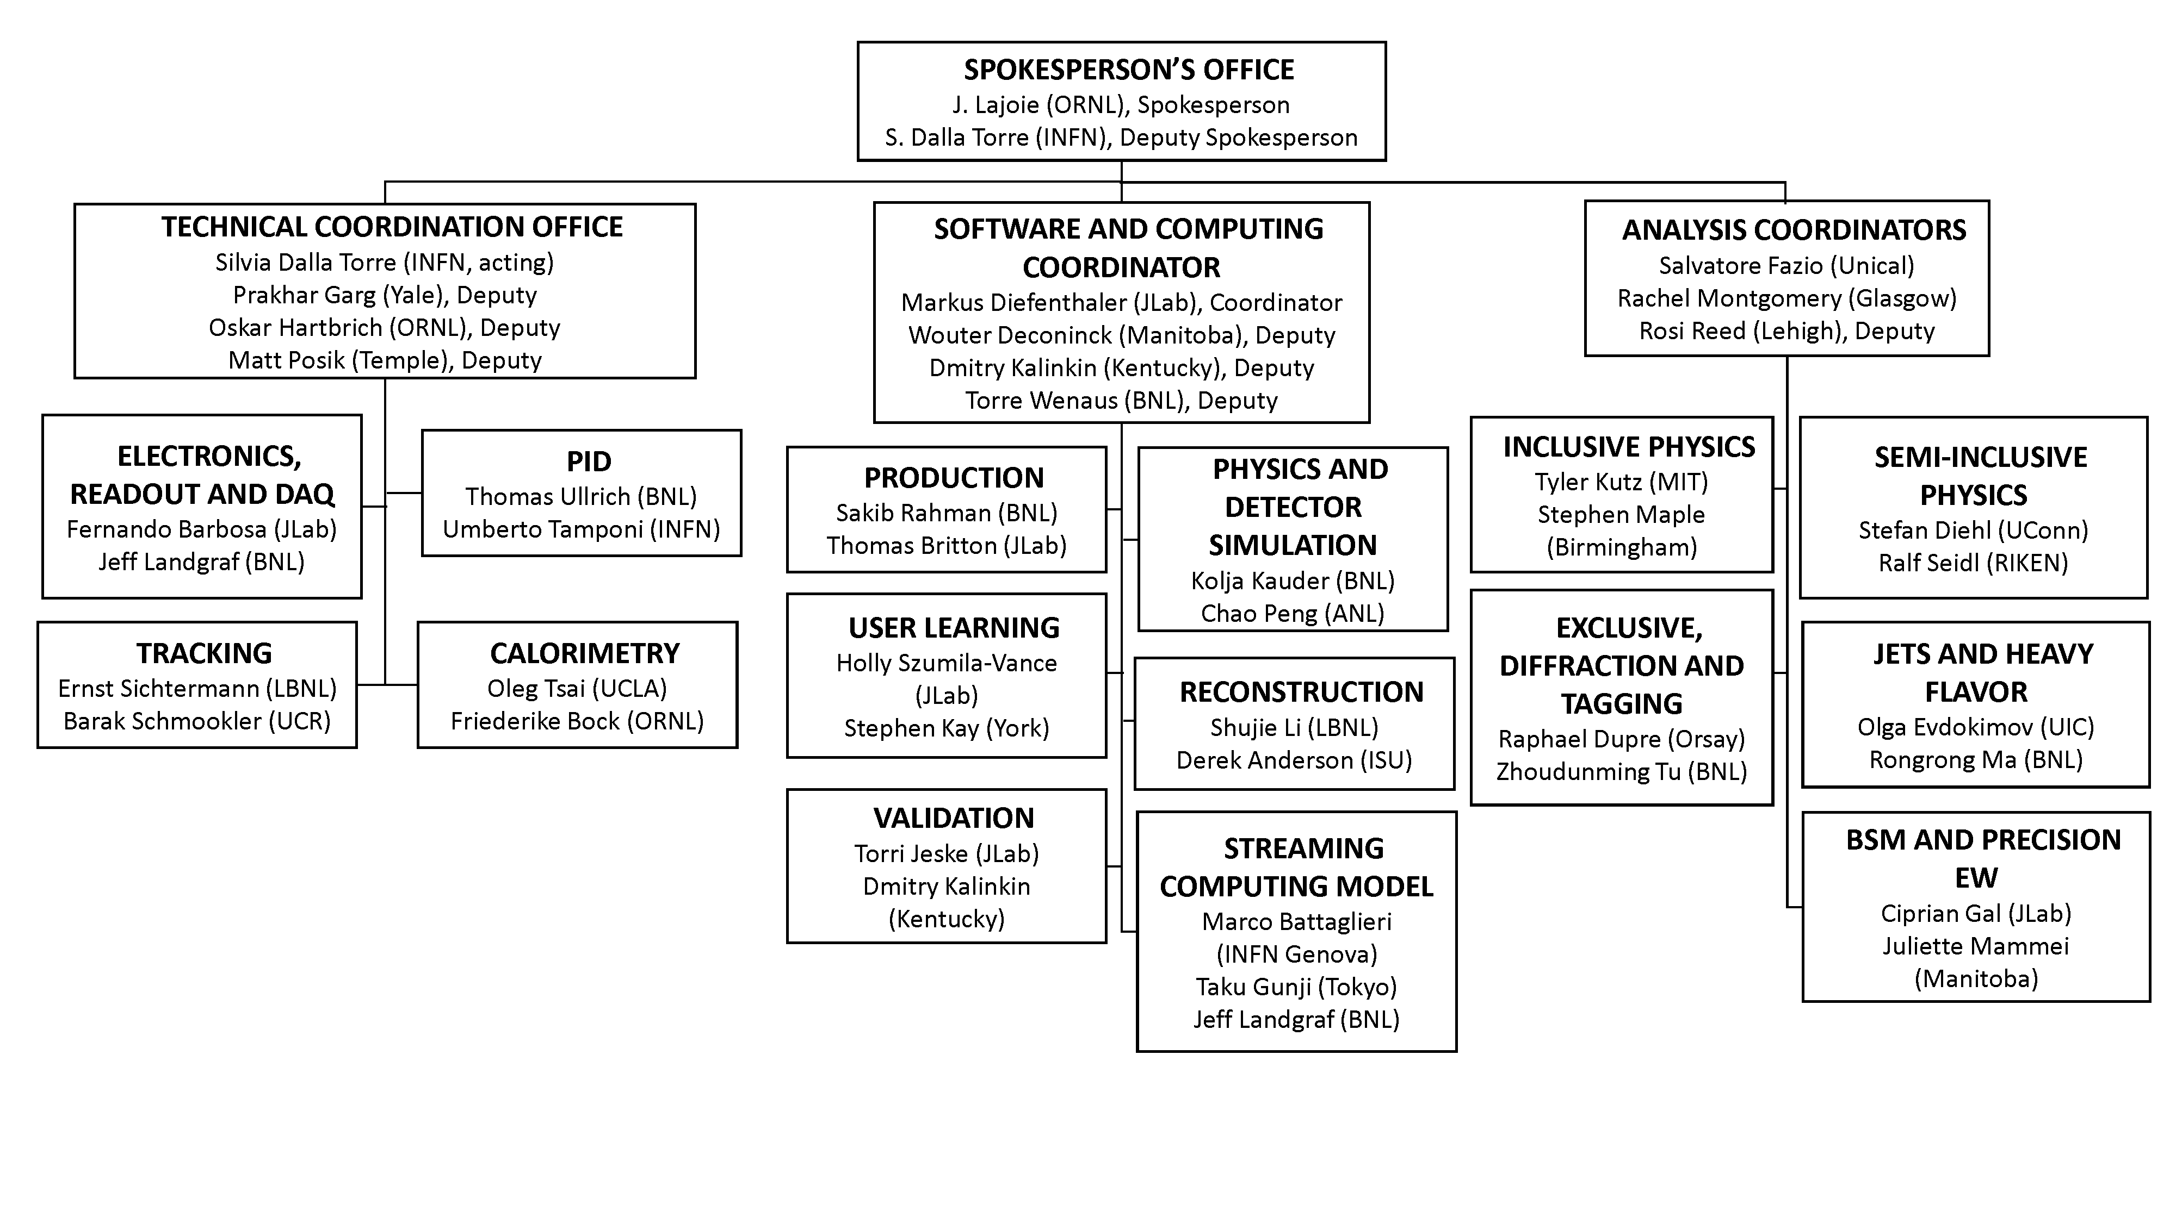
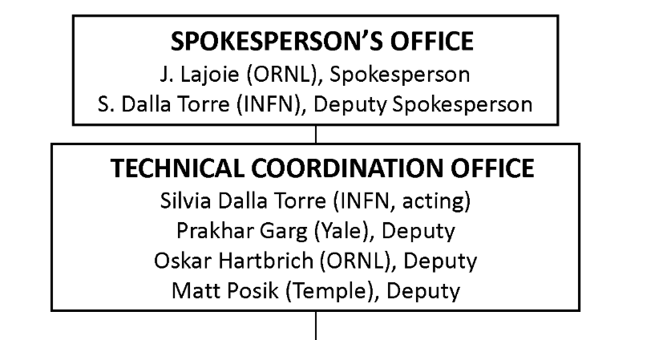

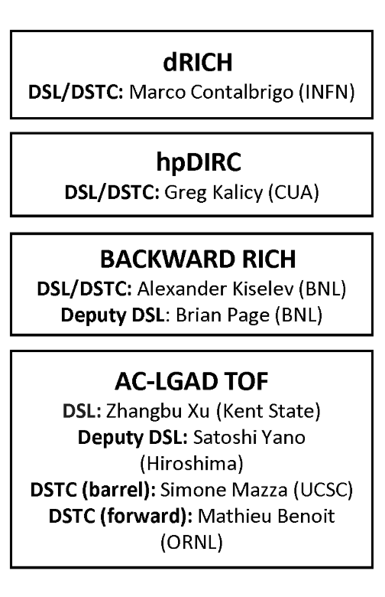
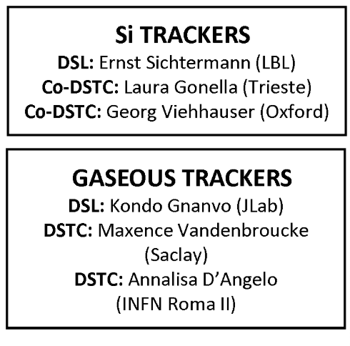
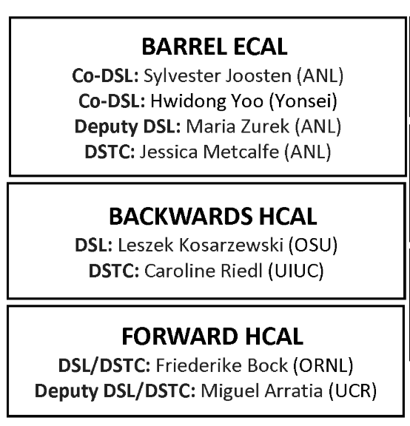
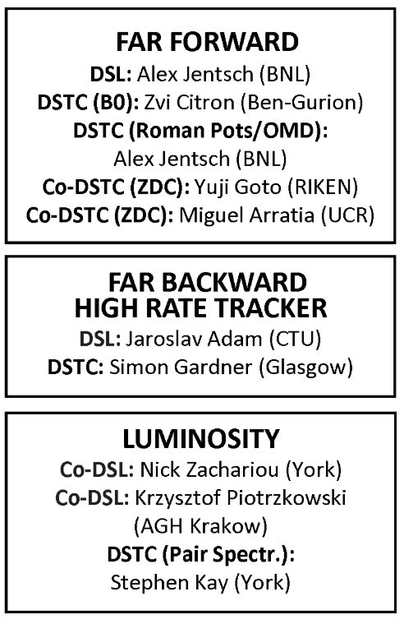
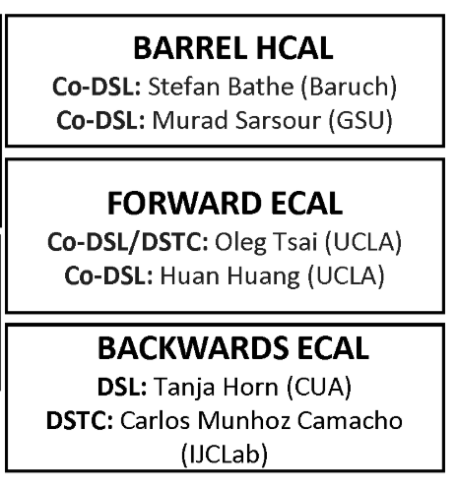
Collaboration
Working Groups
Paul Newman (Birmingham) – Executive Board
Nick Zachariou (York) – Conferences and Talks Committee
EIC Detector R&D | Oversight Committee Meeting | 9 May 2025
Detector Subsystem Collaborations

Slide 16
Collaboration calendar highlights
ePIC Collaboration / EIC Users Group Meetings:
Winter (January 2025): Frascati, Italy: https://agenda.infn.it/event/43344/
Summer: Jefferson Lab, USA (14 – 18 July, jointly with EIC Users Group meeting and the EIC Early Career Workshop 11 – 13 July): https://indico.jlab.org/event/934/overview
Summer 2026: UK bid to host the meeting at Glasgow (awaiting country selection)
Early Science Workshops:
CFNS, Stonybrook, USA (April 2025): https://indico.cfnssbu.physics.sunysb.edu/event/410/
IoP, London, (17 – 18 September), to be confirmed
Calabria, Italy (April 2026), to be confirmed
EIC UK Gatherings:
Birmingham, 18-19 Nov 2024: https://indico.global/event/4815/
Next one planned in York this autumn.

Slide 17
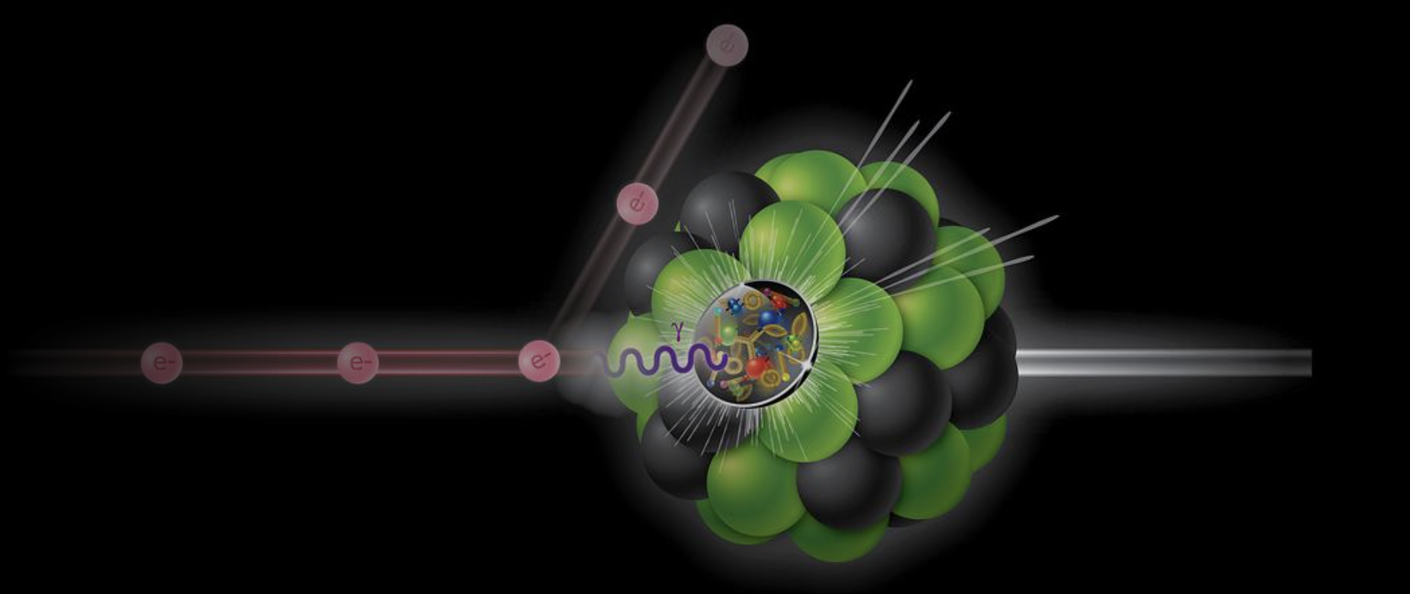

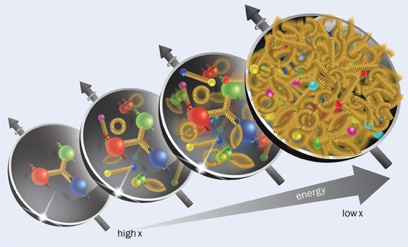
Thank you!
Any questions?

Slide 18
Back up

Slide 19
UKRI Full Infrastructure Project – Preparations
Proposition from STFC, pending confirmation of the Full Infrastructure funding: the initial award will be for 3 years, 7 months, starting 1st Sept 2025. Total spend in each FY will be unchanged.
This required a new reprofile of those years as the first FY of funding (budget: £2.8M) will be only 7 months. Thanks to Peter for finding a solution by front-loading non-staff costs.
The initial award will follow the model of the Preliminary Activity – funding for individual institutions will be awarded to the institutions directly.
Awards done via TFS – forms at each institution will need to be prepared ASAP, to be ready for immediate submission as soon as UKRI gives the green light.
Future awards will go to a single institute and will require collaboration agreements with the others.
Details in Peter’s talk…

Slide 20
EIC Project Schedule (November 2024)
We are here
CD-2
CD-3
NOTE: US Financial Years (FY) = Oct-Sep
Critical Decision (CD) Milestones
CD-0 Approve Mission Need
CD-1 Approve Cost Range
CD-2 Approve Baseline Performance
CD-3 Approve Start Construction
CD–4 Approve Project Completion
Upcoming Project Milestones
PDR (pre-TDR) – Sep 2025
CD-2 – Jan 2026
TDR – Sep 2026
CD-3 – Jan 2027
CD-4(EF) – Oct 2033
CD-4 – Oct 2035
Difference between CD-4(EF) and CD-4 is US schedule contingency
(EF = Early Finish)
Conclusion of RHIC
Operations
Phasing the delivery of the accelerator allows science programme to start at CD-4 (EF)
Latest (unofficial) EIC project schedule – CD dates still under discussion
Reflects uncertainty in level of FY25 funding and current plans to phase the delivery of the accelerator

Slide 21
EIC Project Schedule (November 2024)
We are here
2.5 years
1 yr
CD-2
CD-3
8.25 + 1.75 = 10 years
NOTE: US Financial Years (FY) = Oct-Sep
Critical Decision (CD) Milestones
CD-0 Approve Mission Need
CD-1 Approve Cost Range
CD-2 Approve Baseline Performance
CD-3 Approve Start Construction
CD–4 Approve Project Completion
Upcoming Project Milestones
PDR (pre-TDR) – Sep 2025
CD-2 – Jan 2026
TDR – Sep 2026
CD-3 – Jan 2027
CD-4(EF) – Oct 2033
CD-4 – Oct 2035
Difference between CD-4(EF) and CD-4 is US schedule contingency
(EF = Early Finish)
Preliminary Activity
Full Infrastructure Project
Schedule Contingency
Conclusion of RHIC
Operations
Phasing the delivery of the accelerator allows science programme to start at CD-4 (EF)
UK-EIC Detector R&D Project
UK-EIC Detector Construction Project
Latest (unofficial) EIC project schedule – CD dates still under discussion
Reflects uncertainty in level of FY25 funding and current plans to phase the delivery of the accelerator

