Slide 1
Hello.
Notes:
I’m Paul, responsible for PMing, reports charts document management finances etc.

Slide 2

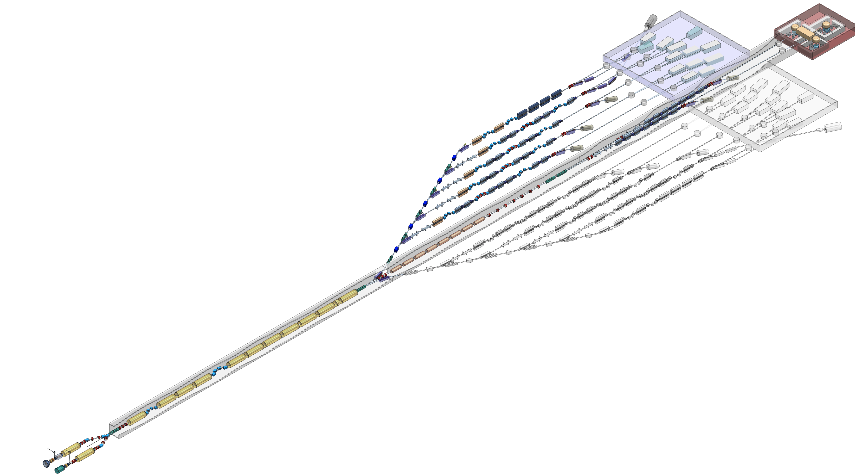




2016
2018
2020
Conceptual Design and Options Analysis
Notes:
Commin gout of the science case was a well defined requirement for what a next generation XFEL was,

Slide 3
Write up
Multiple Separate Documents
350 + Pages per document
CDOA 50+ authors
ST&C 40+ authors
Multiple institutions
Conceptual Design
& Options Analysis
Science &
Technology Case

Slide 4


































UK XFEL
Science Team
UK Research Councils & Government
Other XFELs
And Others….
Notes:
Uk-xfel misnomer?

Slide 5
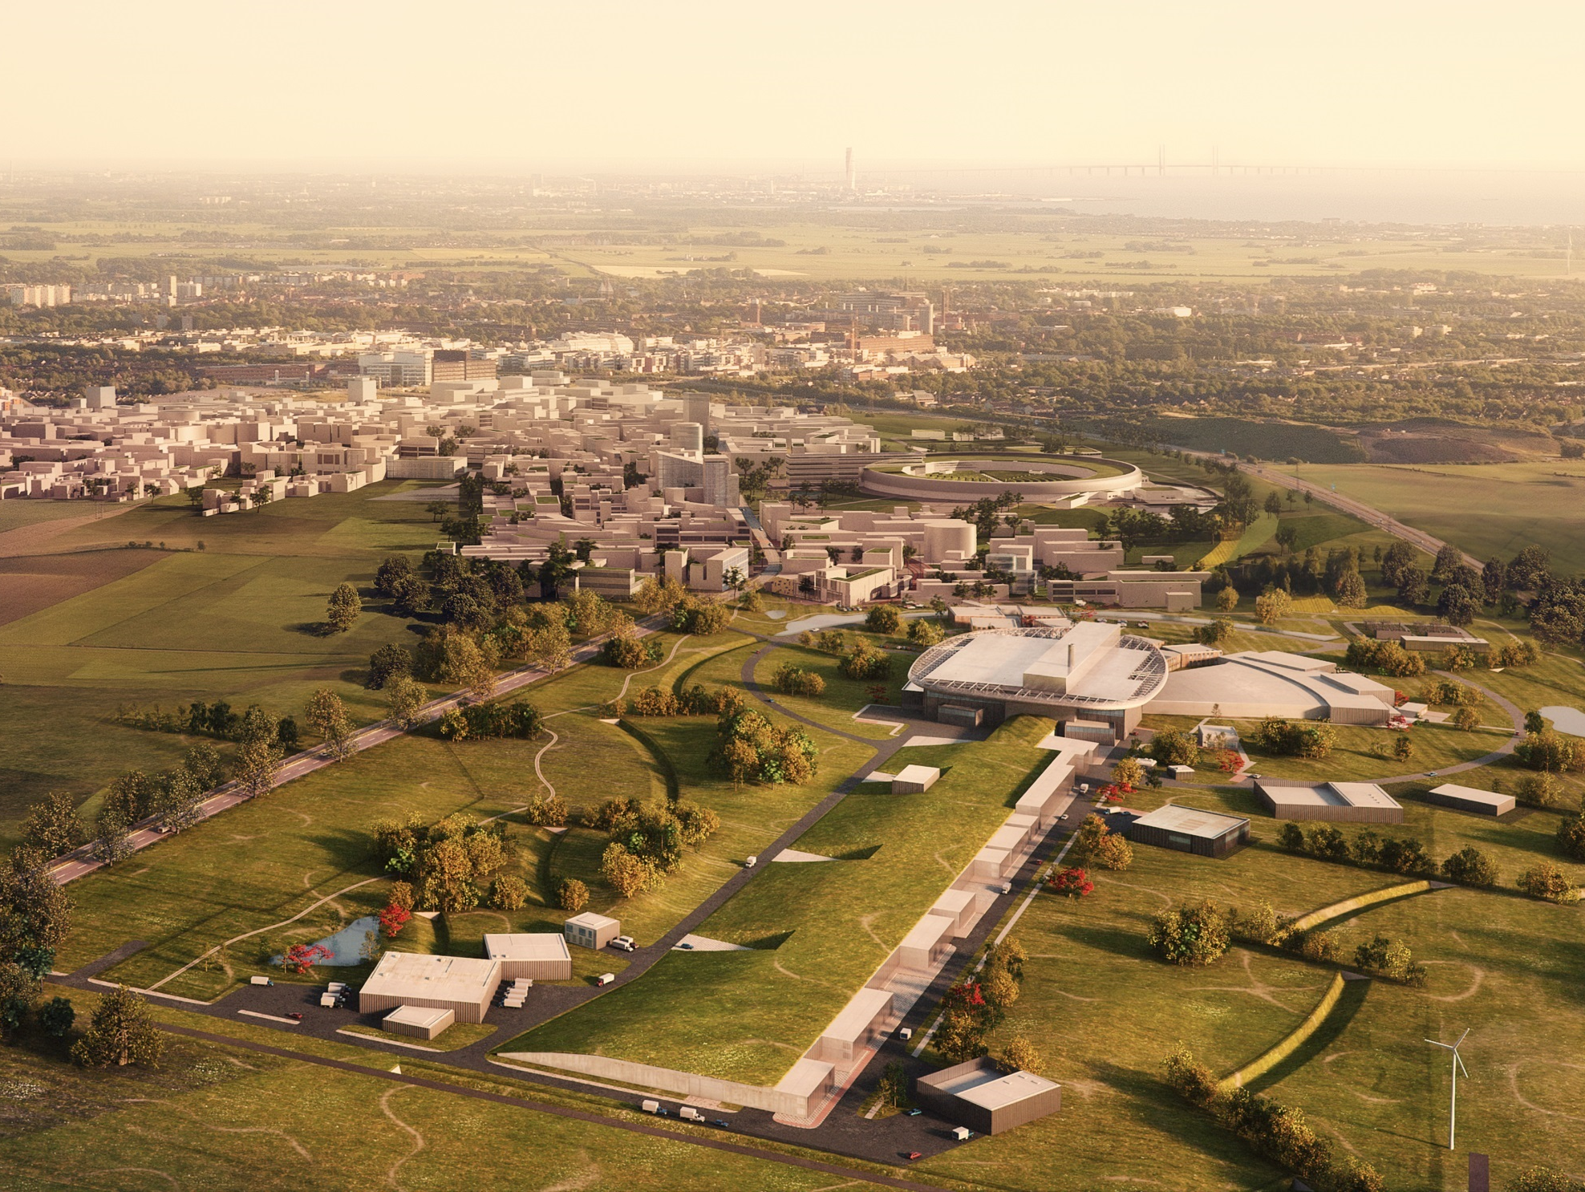

ESS
£165m In-kind contribution with approx. £70m Sub Projects at Daresbury
Responsible for £36m IKC
Vacuum Test Facilities for use by the ESS vacuum group to qualify and test components and systems.
Delivery of Beam Transport Modules 74 modules which contain beam diagnostics and steering magnets.
Delivery of the RF distribution system used to power the accelerating structures.

Slide 6
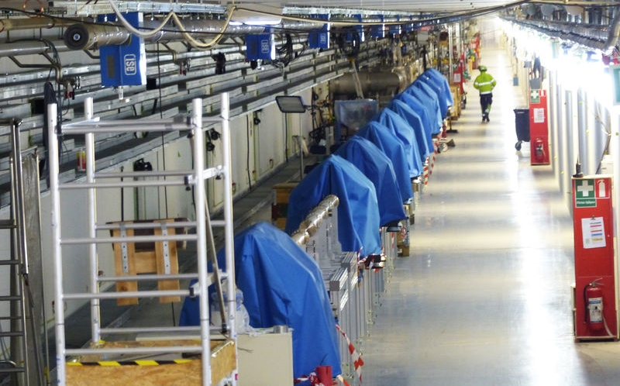

32 LWUs now at ESS!
ESS
Lund, Sweden

Slide 7
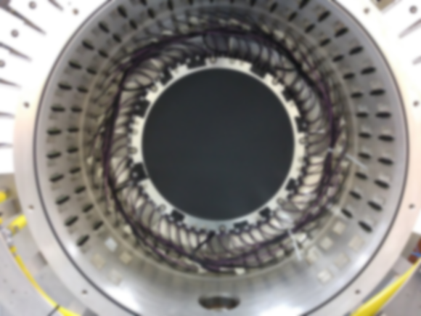
Contact Details

Slide 8

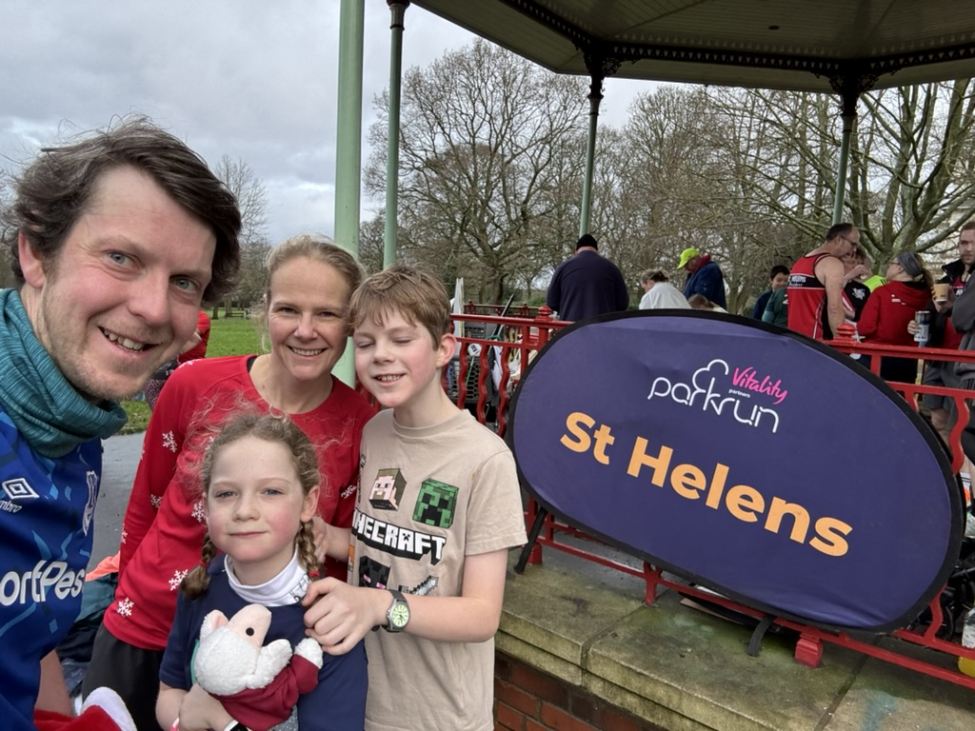

Slide 9
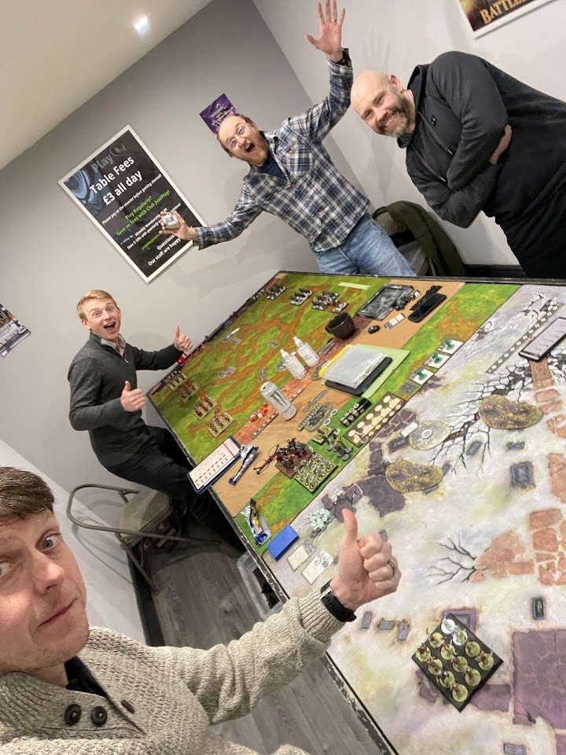
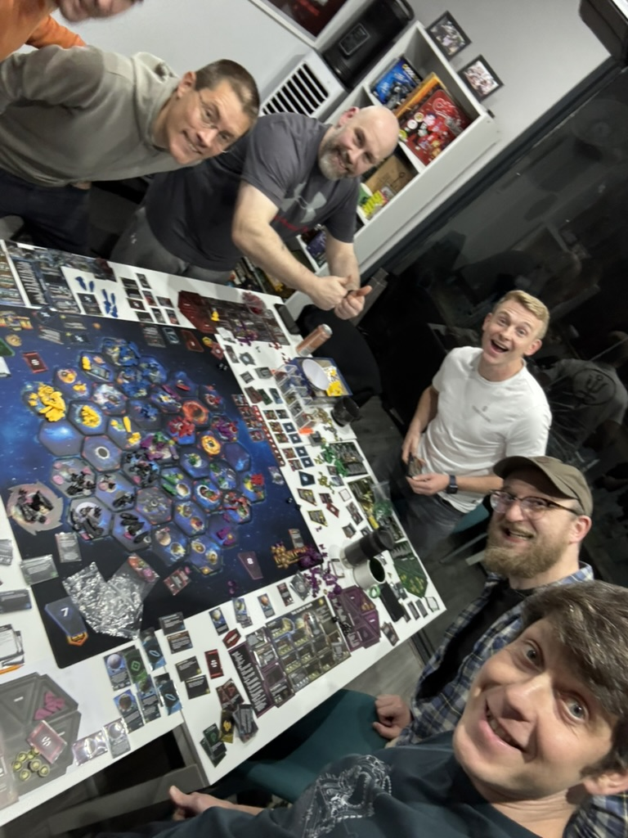

Slide 10
Contact Details
Dr Paul Aden
Paul.Aden@stfc.ac.uk
01925 603219

Slide 11





Dr Paul Aden – June 25
Paul.Aden@stfc.ac.uk
Science and Technology Facilities Council
@STFC_matters
Science and Technology Facilities Council
Notes:
The abstract pattern can be removed or repositioned if required. Be careful to ‘Send to Back’ so that it does not obscure any important information.

