Slide 1
Status of stave prototyping

Slide 2
Where we are
Still only quarter L4 stave prototypes built (3 off)
Waiting for mould parts for full size stave
Also, we are running out of K9 foam (so far using scraps from ATLAS)
We still have 13 half-blocks for full L4 stave, need 18
Started to look for alternatives – no luck yet
Of the quarter L4 stave prototypes one has been equipped with heaters (on a 50 µm steel shim) and is used to shake down our setup
Air flow (working on control of air flow)
Heating
External temperature measurement (TC and thermal imaging)
Internal (air flow) temperature measurement (TC)
Vibrations (capacitive displacement sensors)

Slide 3
What is needed for full length L4 stave prototype
We do have moulds for I-beams and C-channels
For first prototype we do want to use Kapton-only C-channel, but use C-channel with representative amount of aluminium after that
Mould parts for core autoclave cure: order has been placed 3 weeks ago
CF we have (scraps from ATLAS)
K9 foam: 13 machined blocks available, scraps from ATLAS, but we can’t get more from them
On short timescale substitute
Could be non-thermally conductive foam (in fact, would be interesting for comparison)
On longer timescale we need a solution
ATLAS will most likely need to buy more (through LBNL or Yale)
Have already raised an interest
End pieces
Improved design to reduce flow impedance (ok for prototypes, but not final geometry)
3D printed on short notice
Will use stainless/Kapton-Cu heaters again on first prototype
Still waiting for encapsulated silicon dummy sensors
Should be done by now…

Slide 4
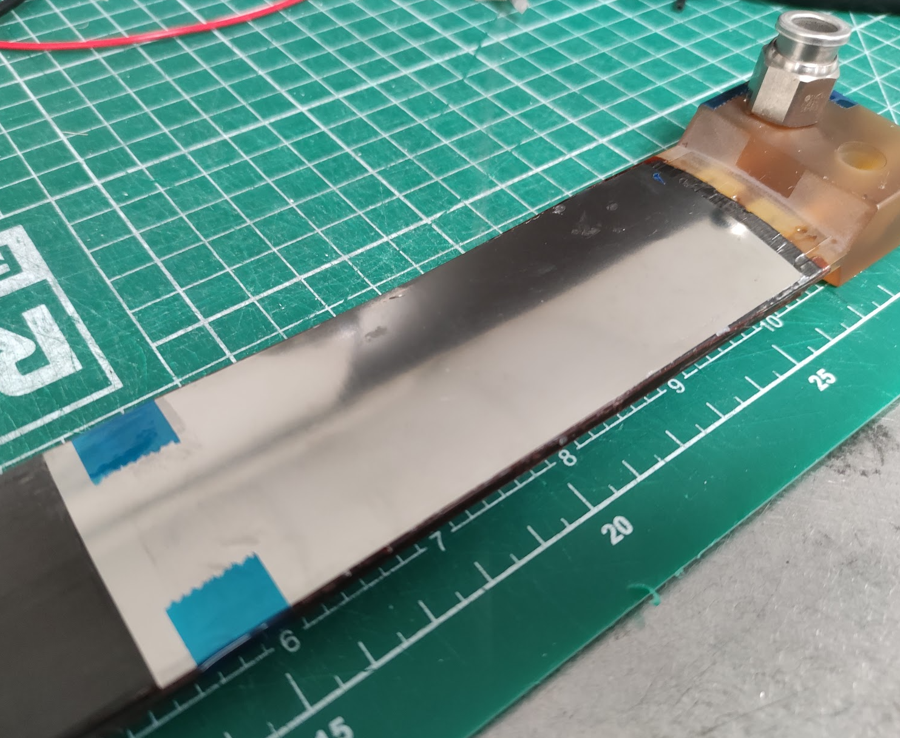
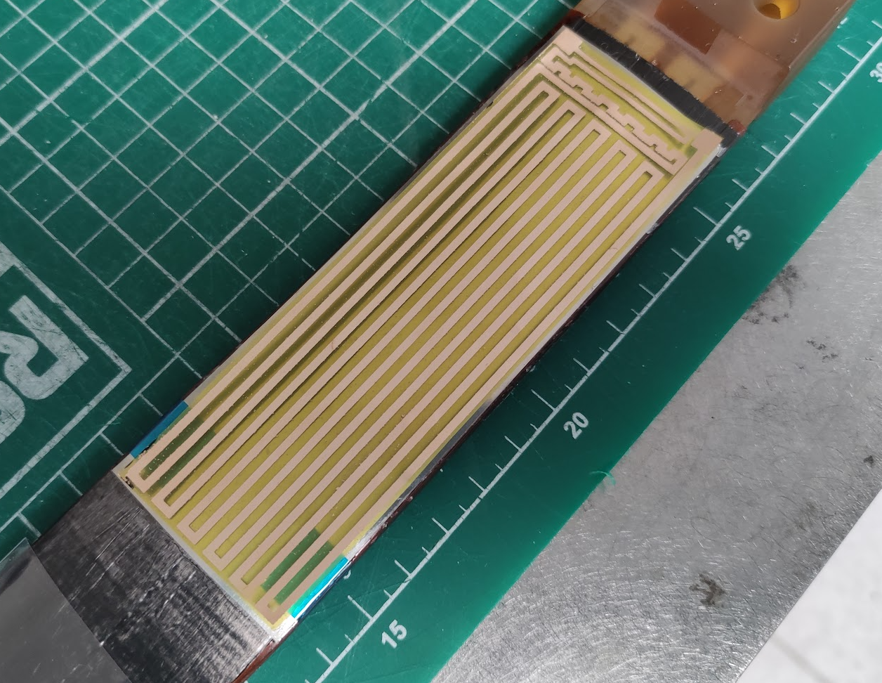
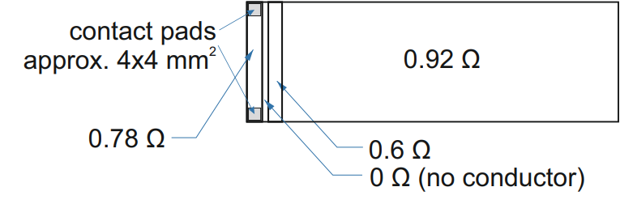
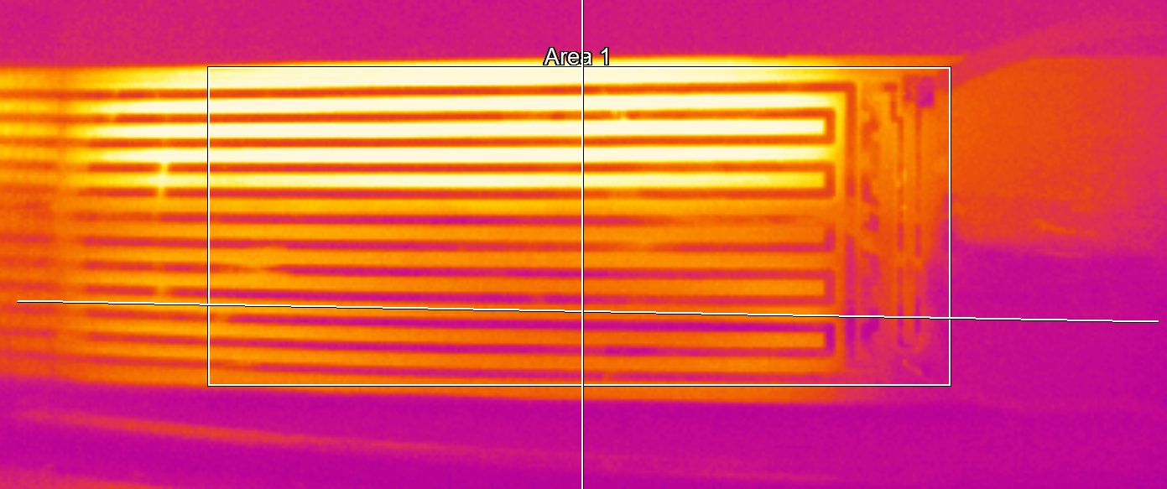
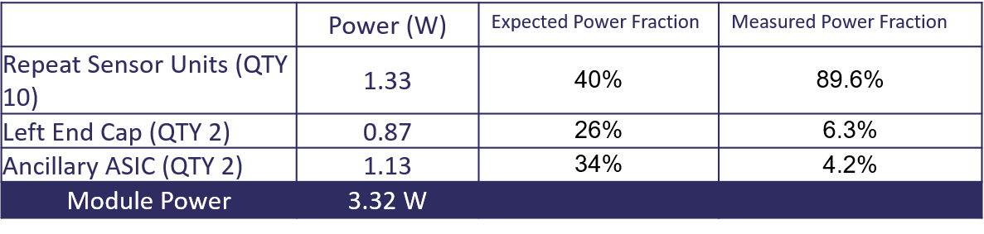
Heaters
Design
1.8 W/quarter stave, 30 l/min air in lower channel
Measured
Redesign under way

Slide 5
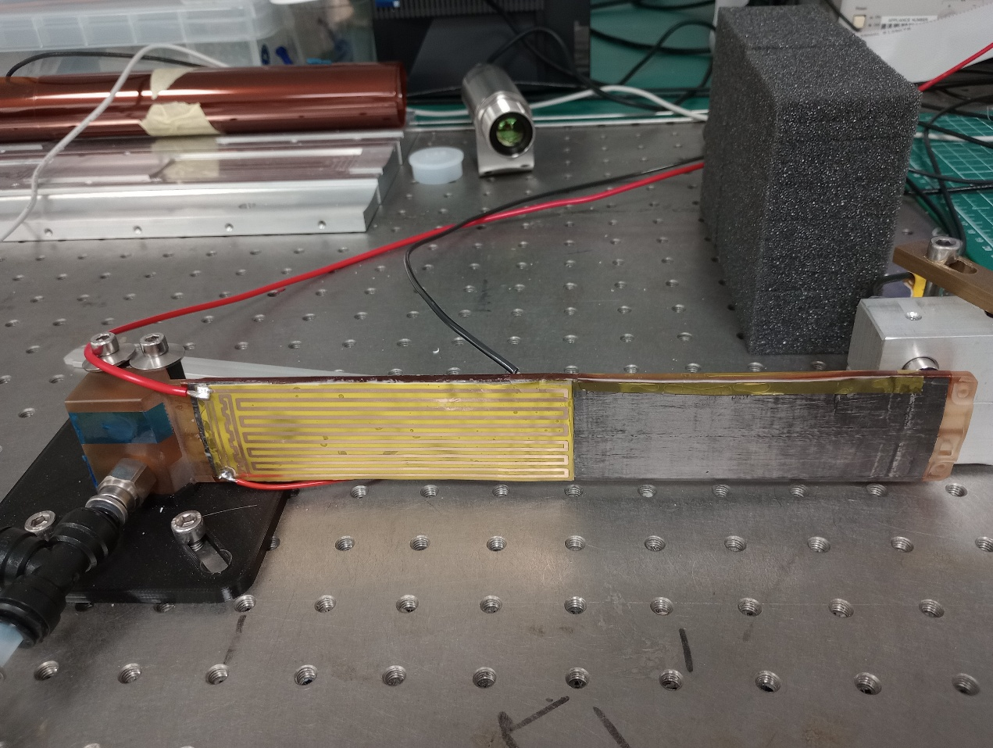
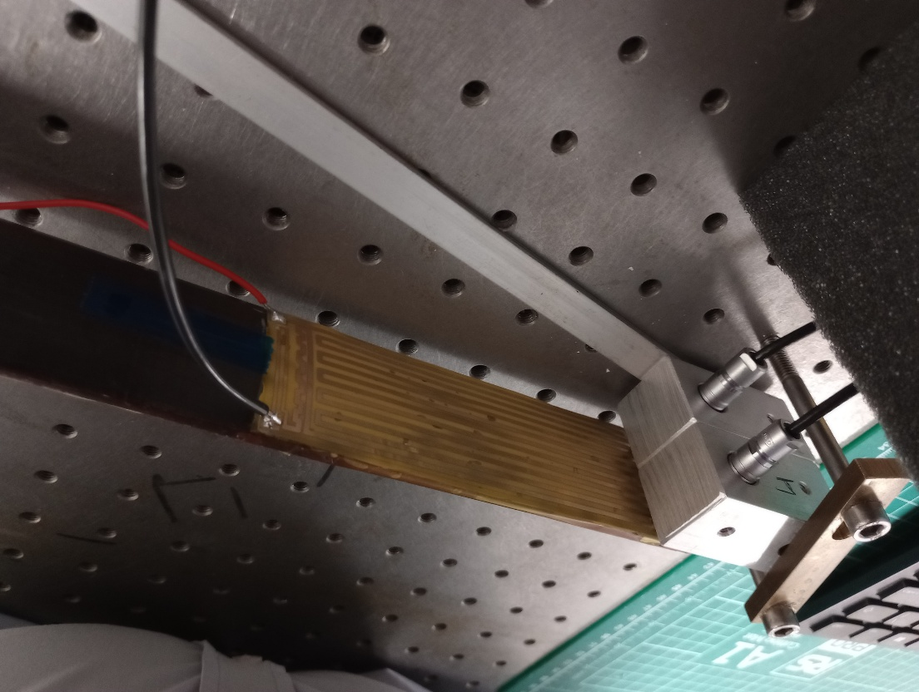
Pictures
TI camera
Front view
Rear view
Capacitive displacement sensors
(Old capacitive sensor holder)
Air out
New geometry
Air in
Currently using outer two positions

Slide 6
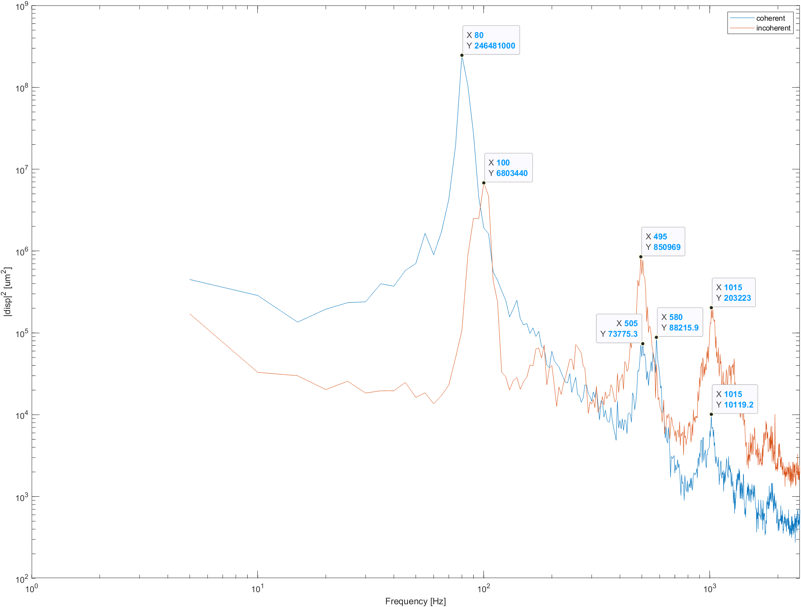
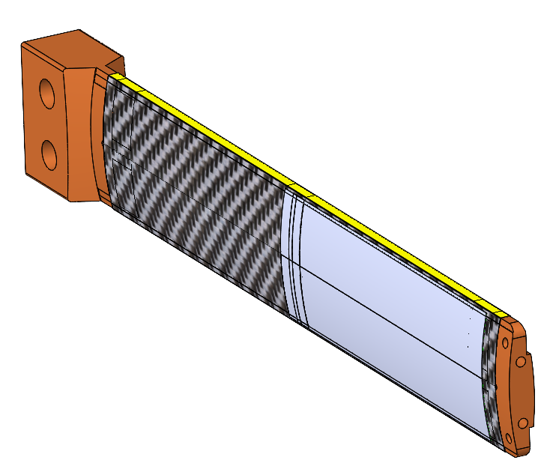
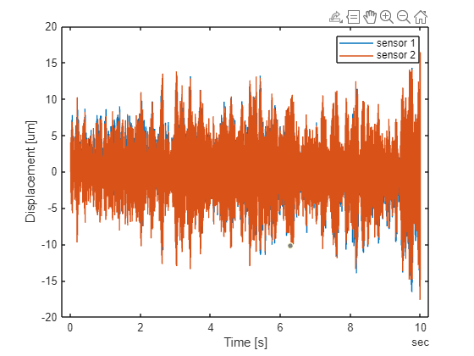
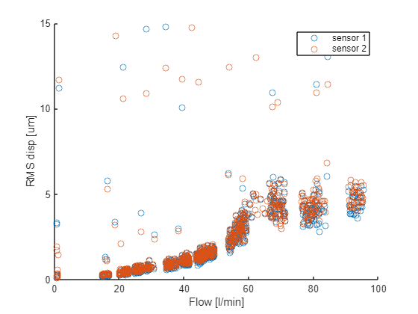

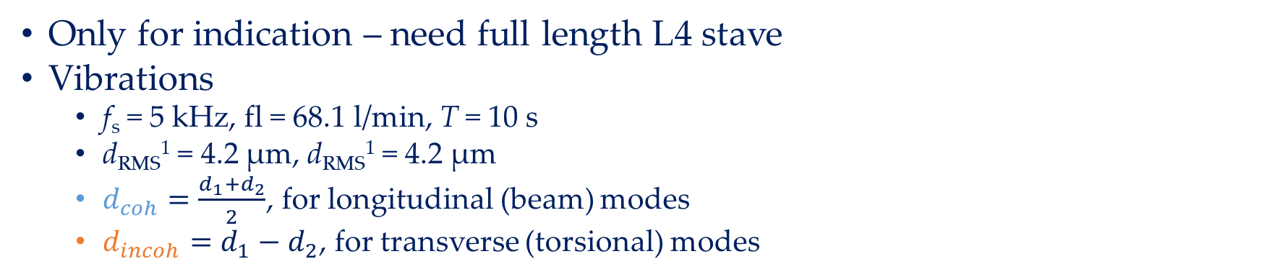
Some preliminary results - Vibrations
Only for indication – need full length L4 stave
Vibrations
f_{s} = 5 kHz, fl = 68.1 l/min, T = 10 s
d_{RMS}¹ = 4.2 µm, d_{RMS}¹ = 4.2 µm
$d_{coh}=\frac{d_{1}+d_{2}}{2}$, for longitudinal (beam) modes
$d_{incoh}=d_{1}−d_{2}$, for transverse (torsional) modes
$d_{coh}=\frac{d_{1}+d_{2}}{2}$, for longitudinal (beam) modes
$d_{incoh}=d_{1}−d_{2}$, for transverse (torsional) modes

Slide 7
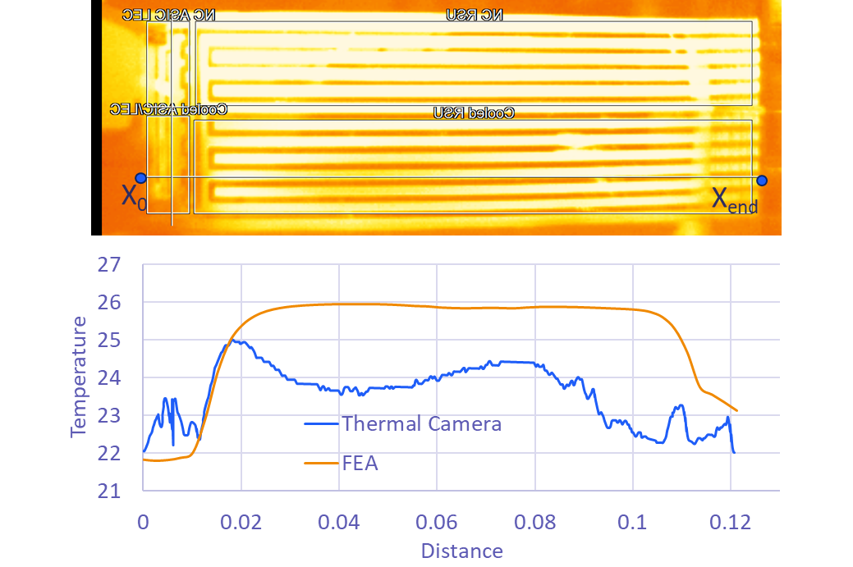
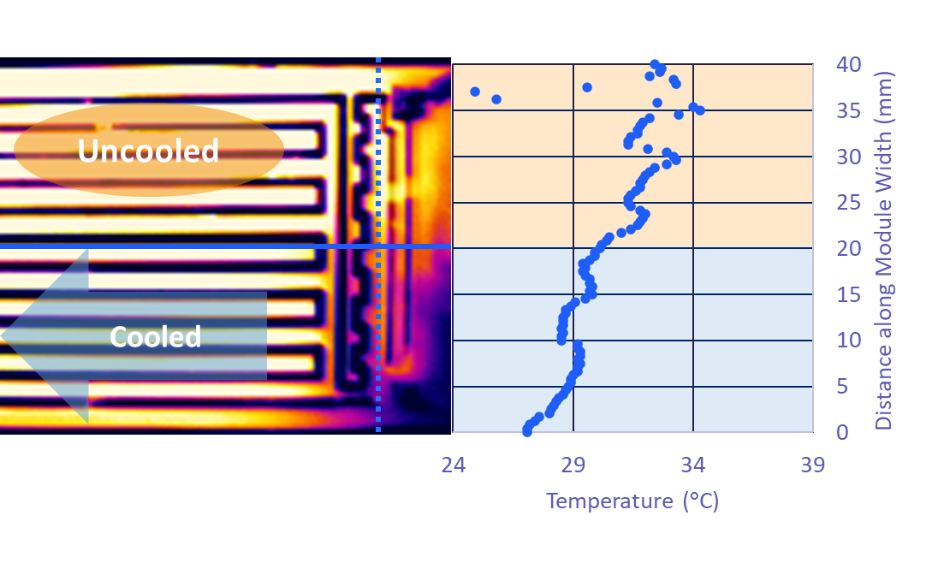
Some preliminary results - Thermal
Only for indication – need full length L4 stave and correct heater geometry
Convection Coefficients
Natural convection - 7 W/m² K from external surfaces
Forced convection - 48.44 W/m² K from internal surfaces
Forced convection - 650 W/m² K from K9 adjacent surfaces
Effect of K9 foam

Slide 8
Next steps
Build L4 stave prototype
Finalise flow control
Using AtomS3 for PWM control of valve
Other features nice to have
Control of heater power supply
Has a USB interface, but not clear how to talk to it
Read information from TI camera into matlab software
Test
Build stave prototypes with Al/Kapton FPC
Build stave with encapsulated silicon heaters
Build a square stave
Would require new set of tooling

Slide 9
Further material

Slide 10
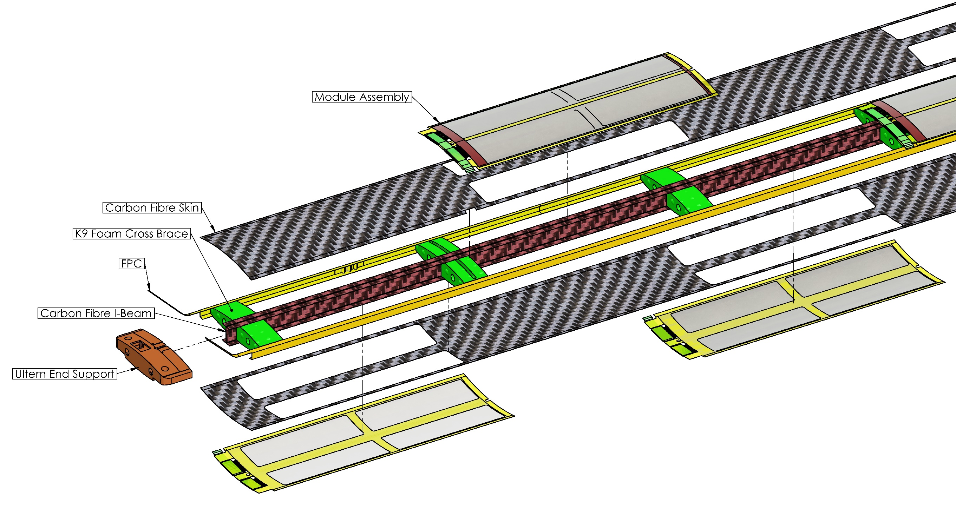
OB Stave Construction
¼ Length Stave End
QSP
L4 X 8 Modules
L3 X 4 Modules
Notes:
We form a skeleton structure with a central carbon fibre I-beam and K9 foam cross braces
K9 foam blocks are located to align with the Ancillary ASIC and LEC of the modules for enhanced heat transfer.
Serial power chain
Flexible Printed Circuit (FPC) is structurally integral to the stave, is part of the gas containment boundary and supplied power and data transfer.

Slide 11
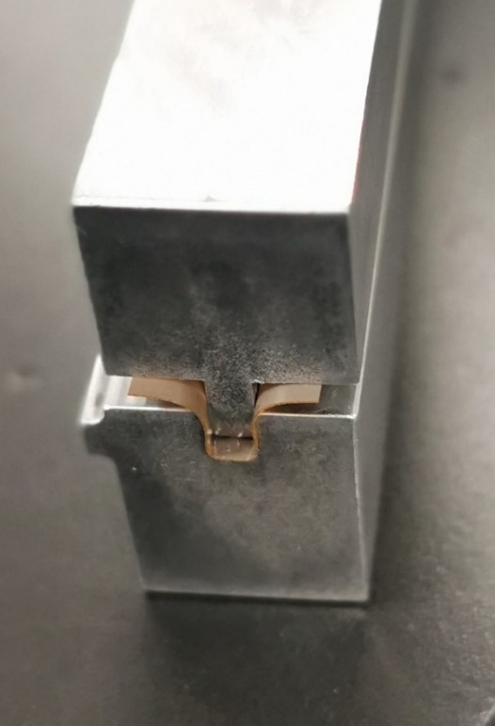
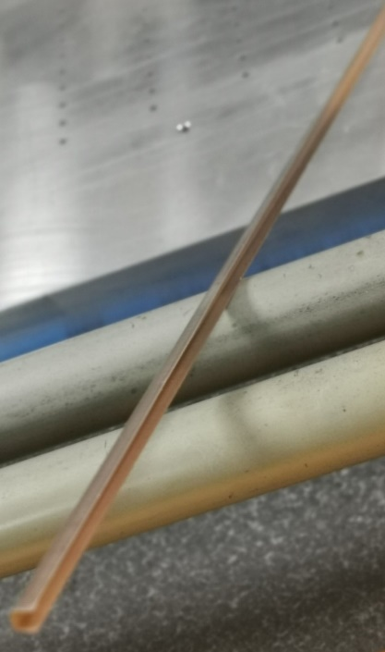
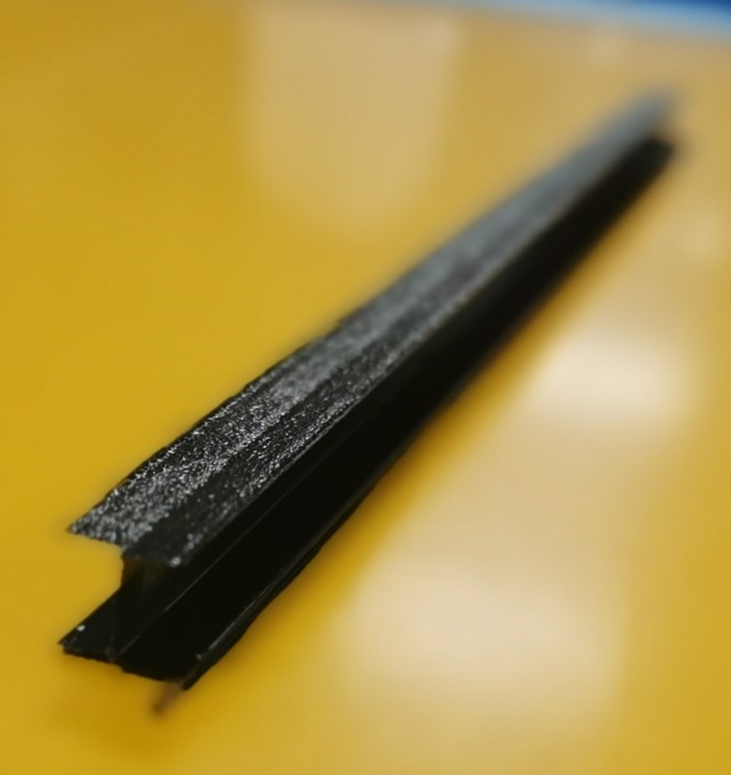
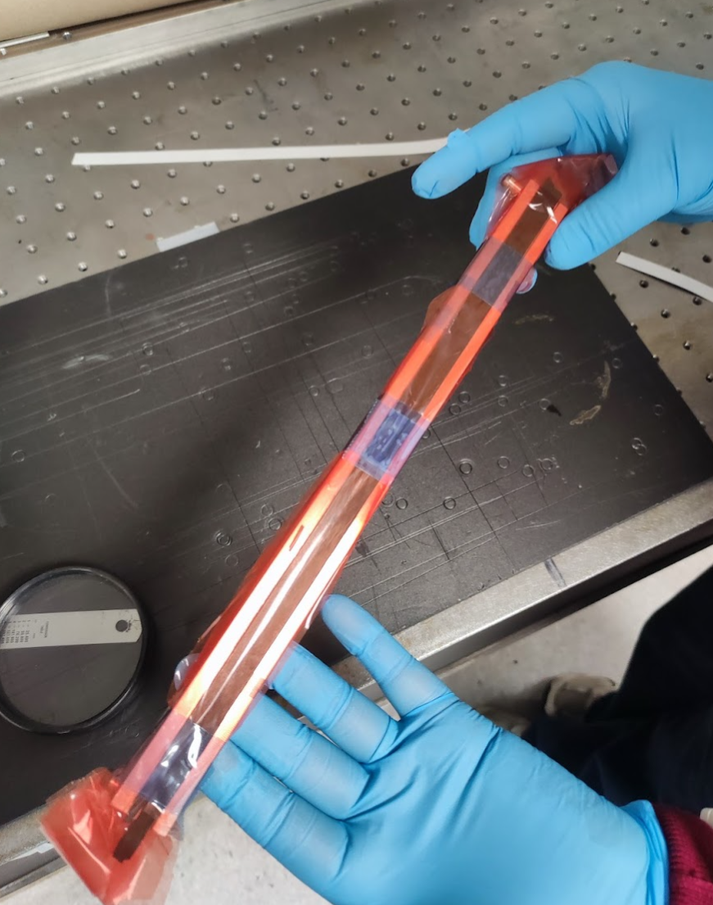
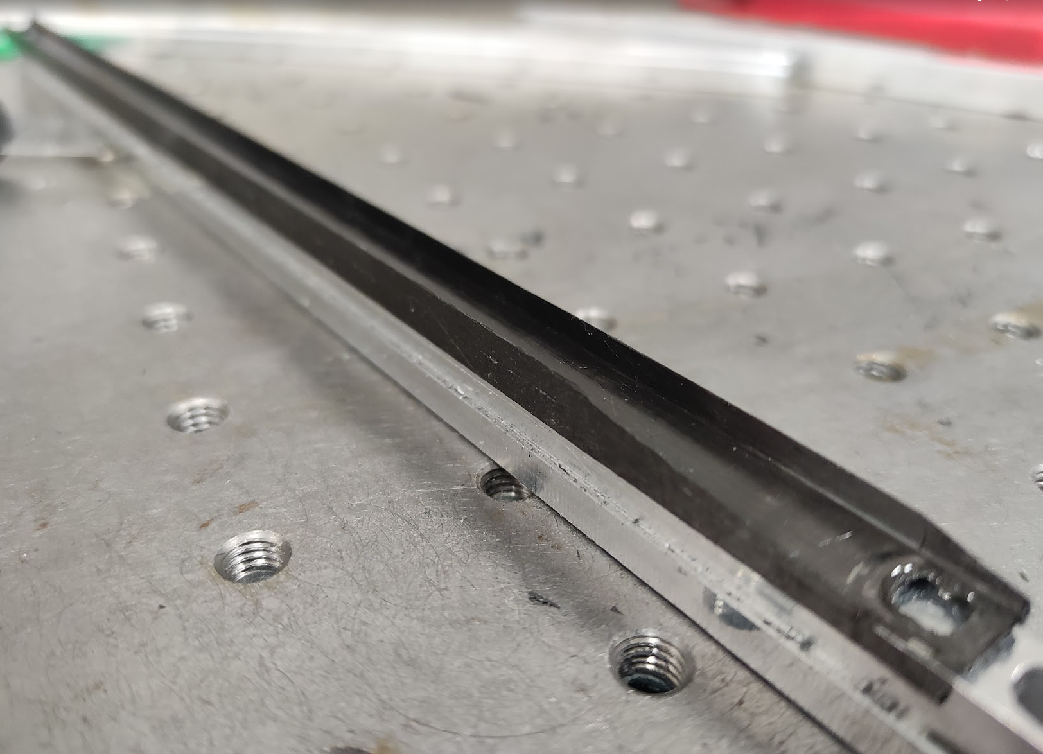
¼ Length Stave Prototypes
Preformed components
Carbon Fibre I-beam pre-cured in a 2-part mould
Flexible Printed Circuits (FPC) preformed (with heat and pressure) into C channel

Slide 12
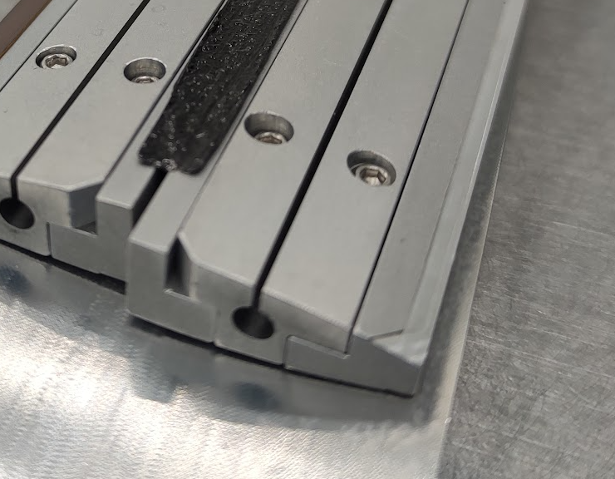
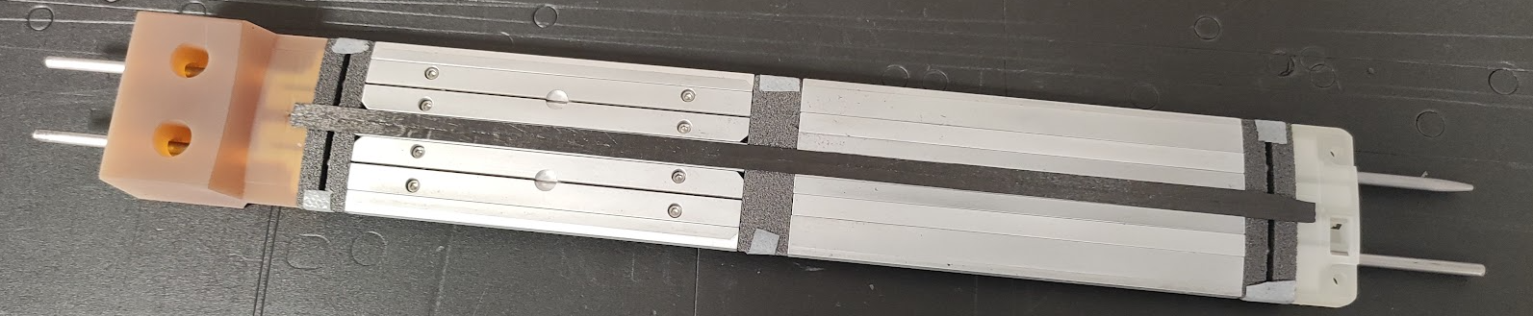
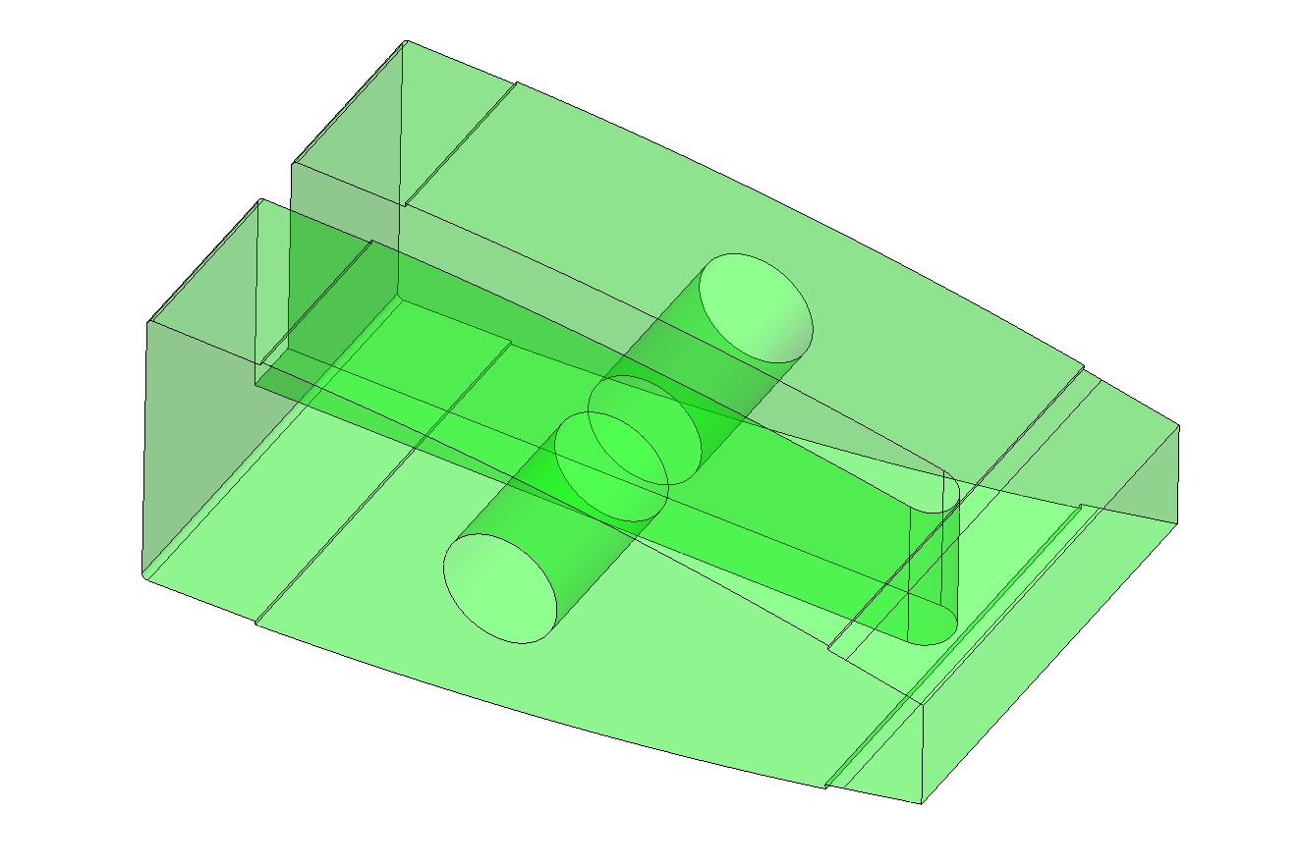
Stave Inner Structure
Aluminium Internal Formers
K9 Foam Heatsink
⌀ 3 mm Silver Steel rods

Slide 13
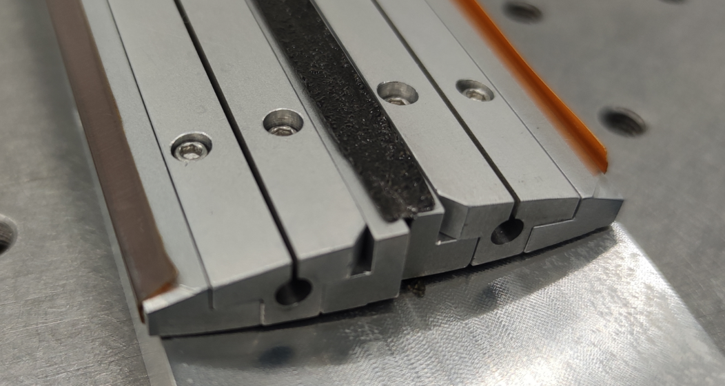
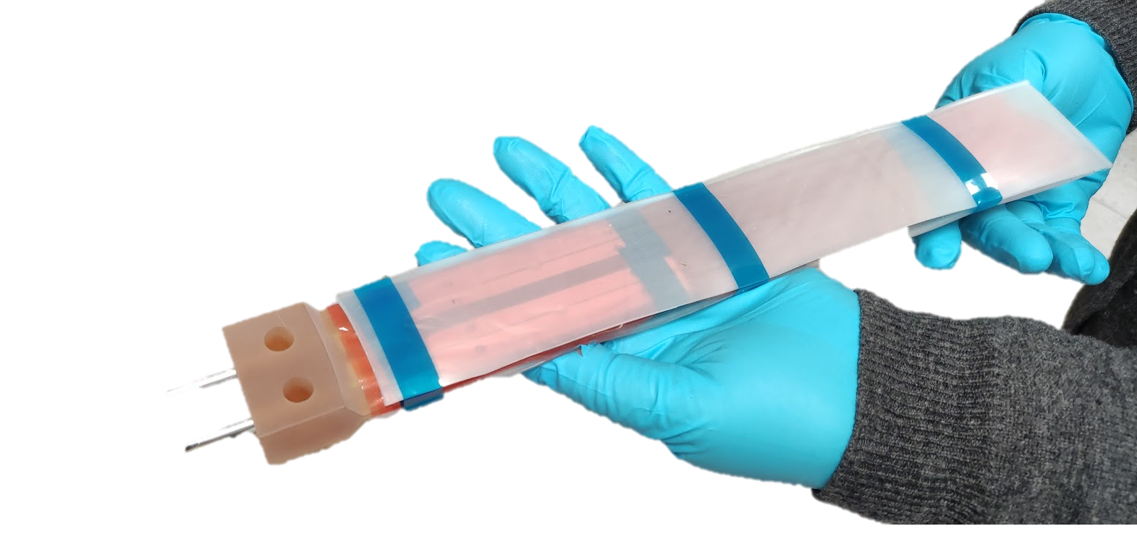
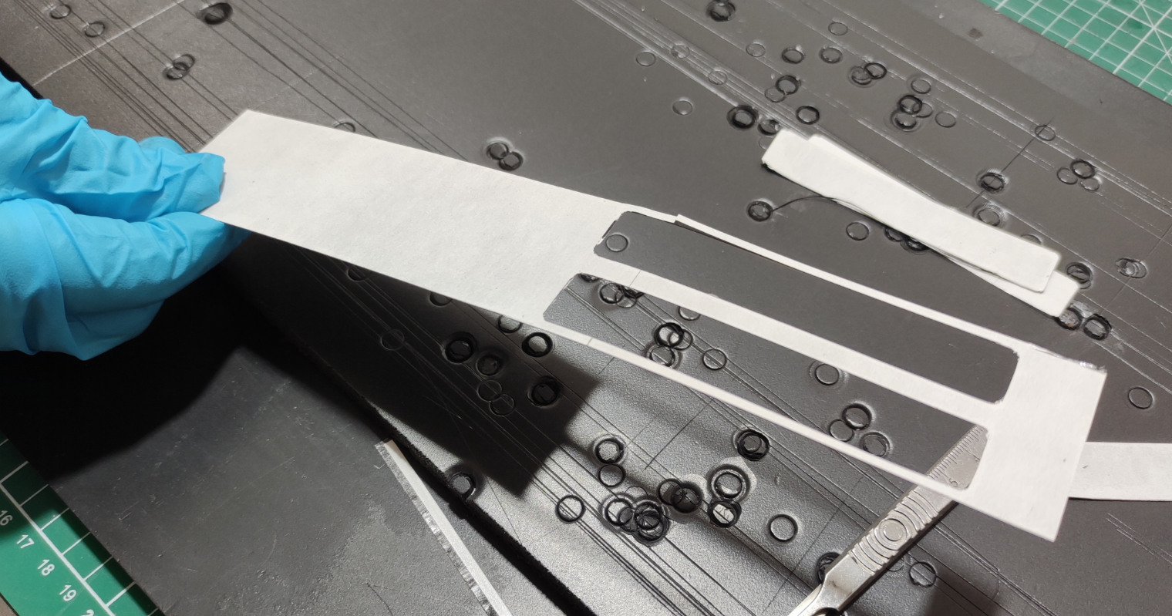
Outer Skin
Airtight boundary formed by FPC, Carbon Fibre face sheet and modules
FPCs Mounted along outer edge, joined to K9 Foam with Prepreg Adhesive Film
Carbon fibre face sheets aligned on inner structure
Silicone rubber sheet added on top and bottom surfaces as an intensifier

Slide 14
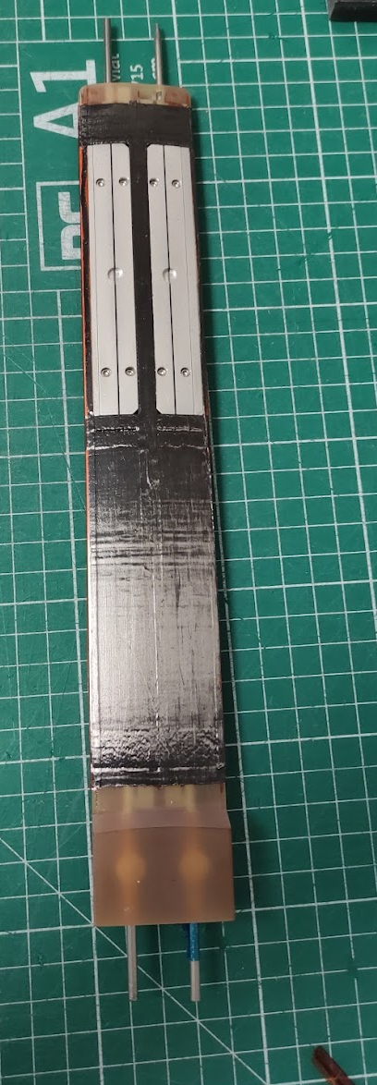
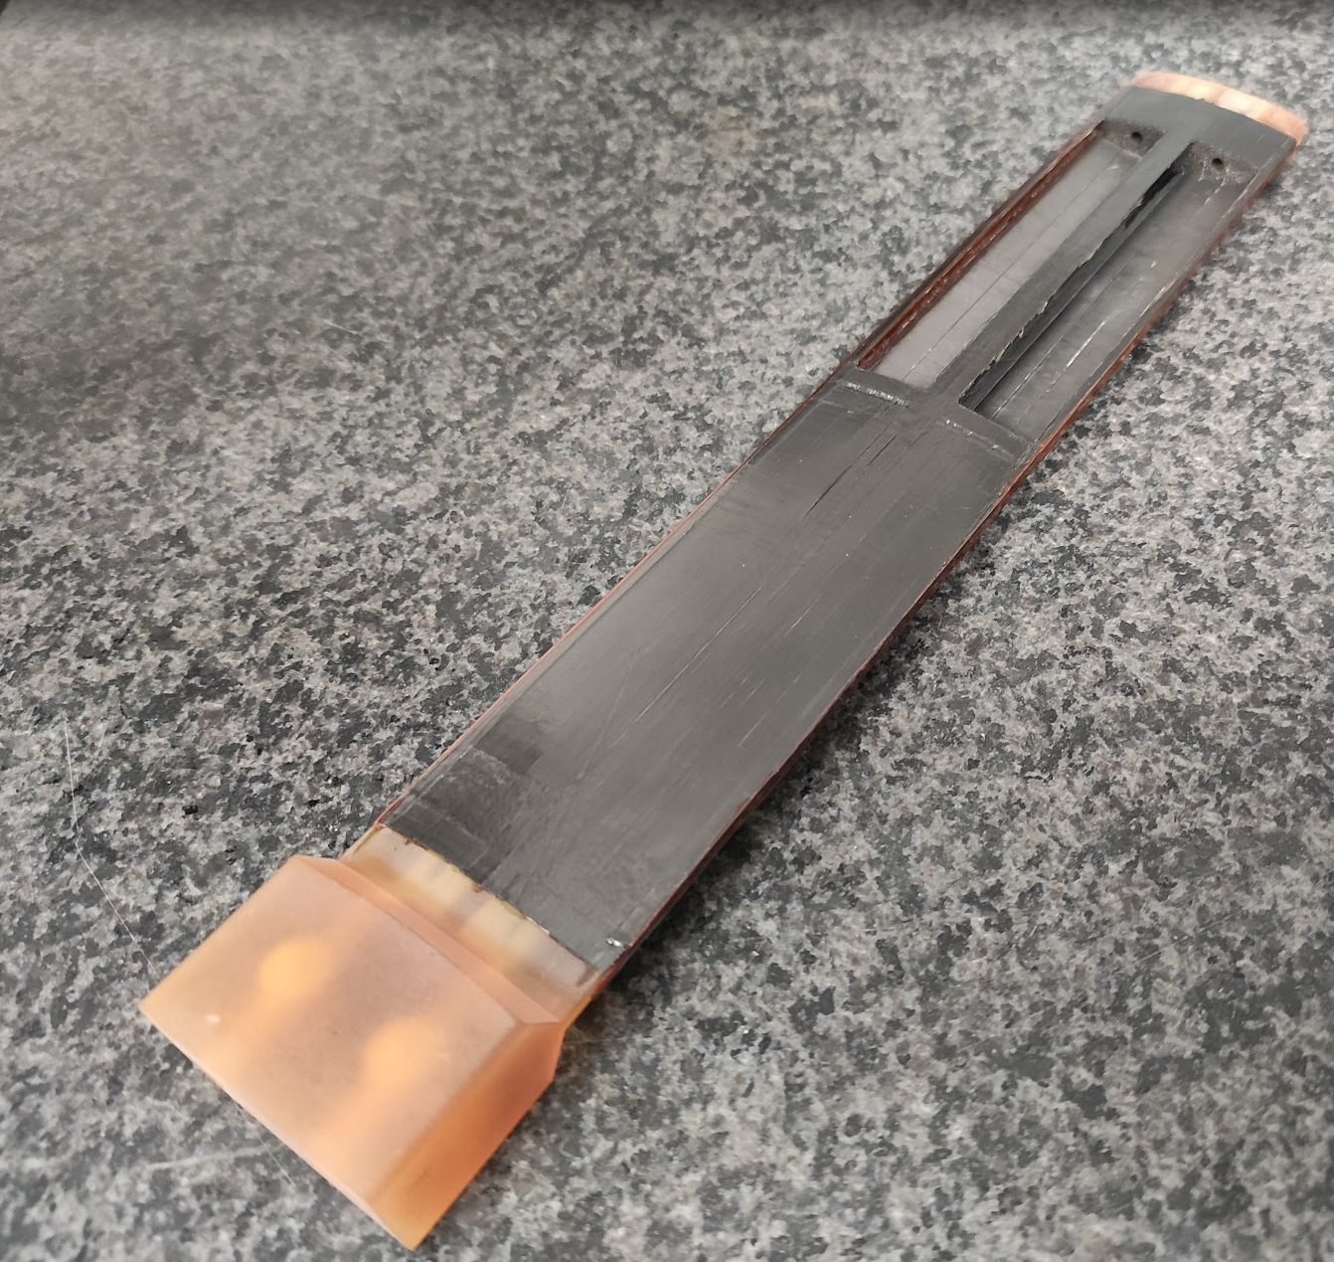
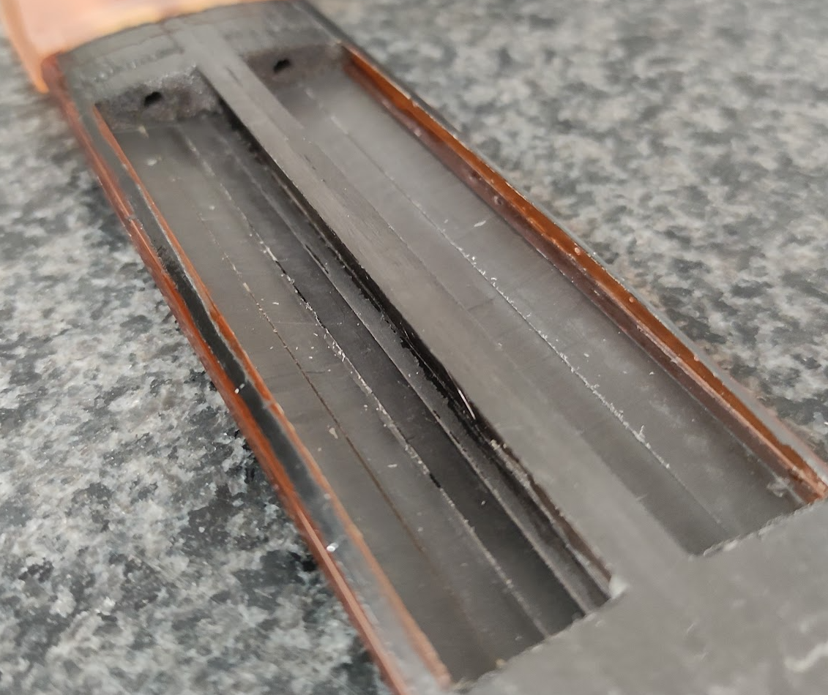
Post-Cured Stave Assembly

