Slide 1


Stave Support and First Thoughts on Air Flow Connection
Adam Huddart

Slide 2
Stave Installation
Built as half cylinders
Each stave will be mounted from the beampipe side
  L4 support cone Installation
  L4 Stave population
  L3 Support cone addition
  L3 Stave population
Support cone carries power, data and cooling
Support Cone
Support Cone
RDO
RDO
RDO
RDO

Slide 3
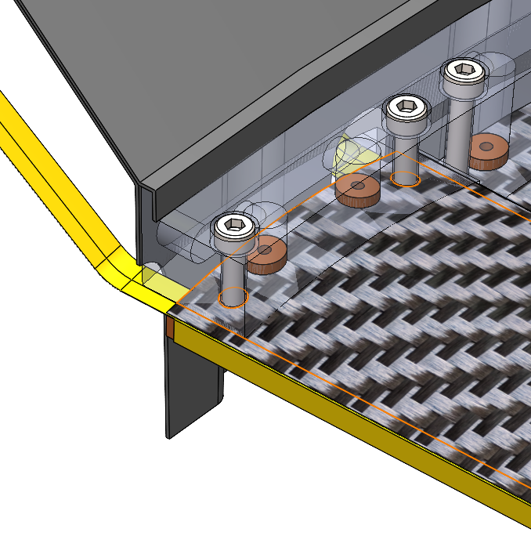
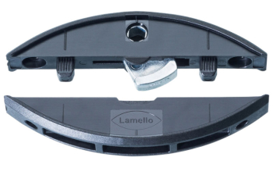
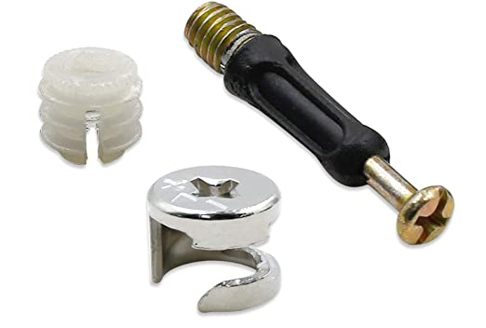
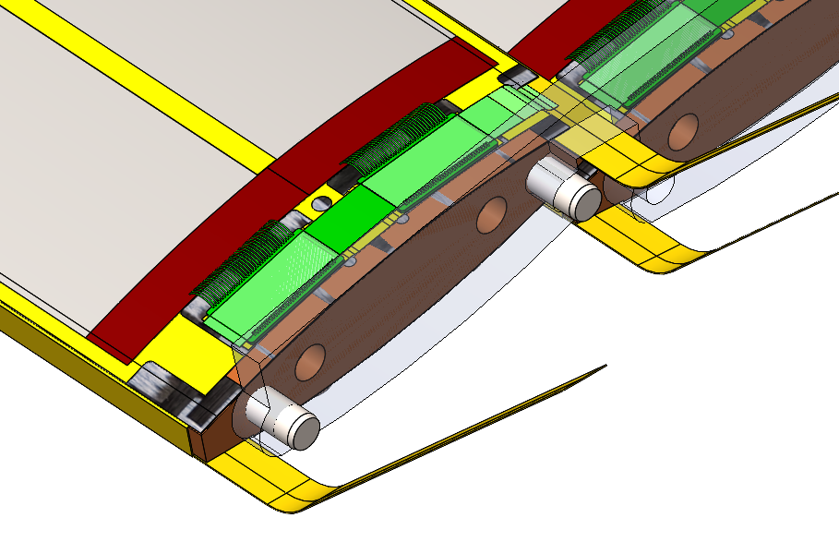
Stave Mounting
Currently fastener access from outer side, these could only be accessed through cutouts in support cone
  No space beyond the end module for screw holes
  Looking at options for underside/cone end mounting
As modelled:
  Coolant flows from one end of the stave (co-current flow),
    Sacrificing floating end could allow for counterflow with an equivalent manifold block on both sides
  Common mounting face for structural connection and coolant inlet
  Coolant channel integrated into mounting manifold
Fixed/Pinned for thermal expansions

Slide 4
Air Flow Connection

Slide 5
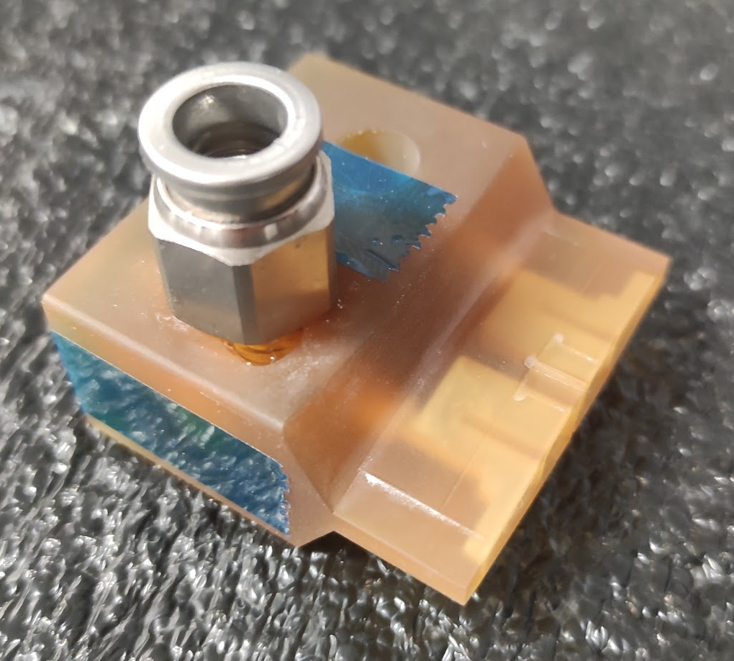
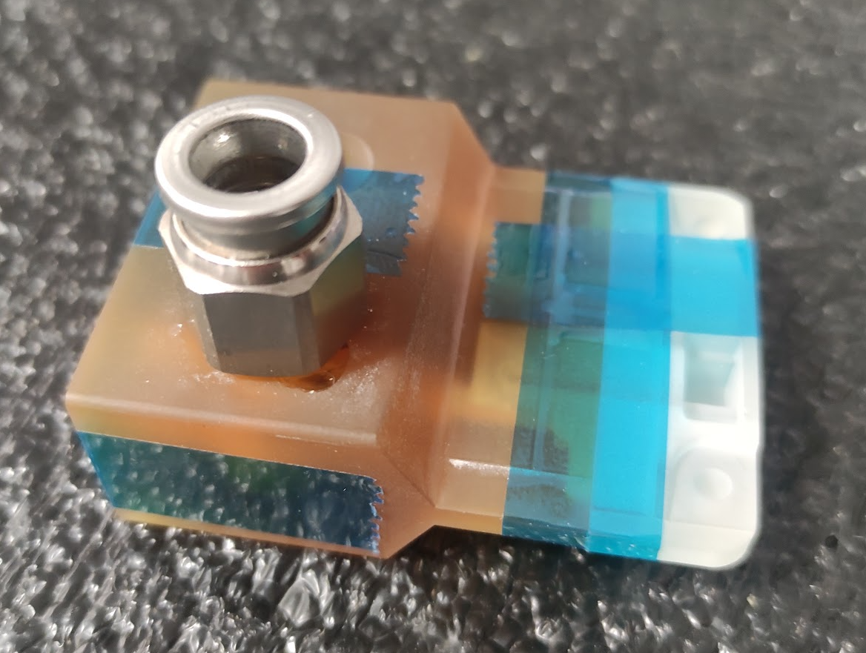
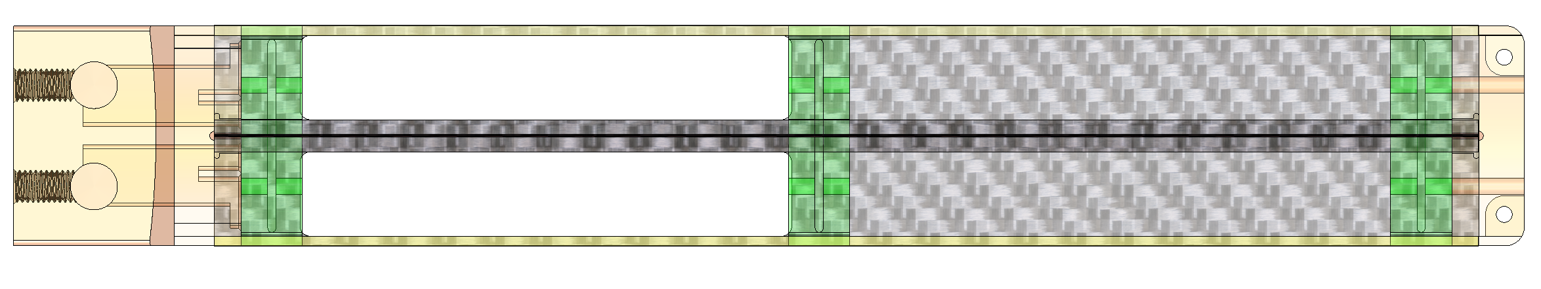
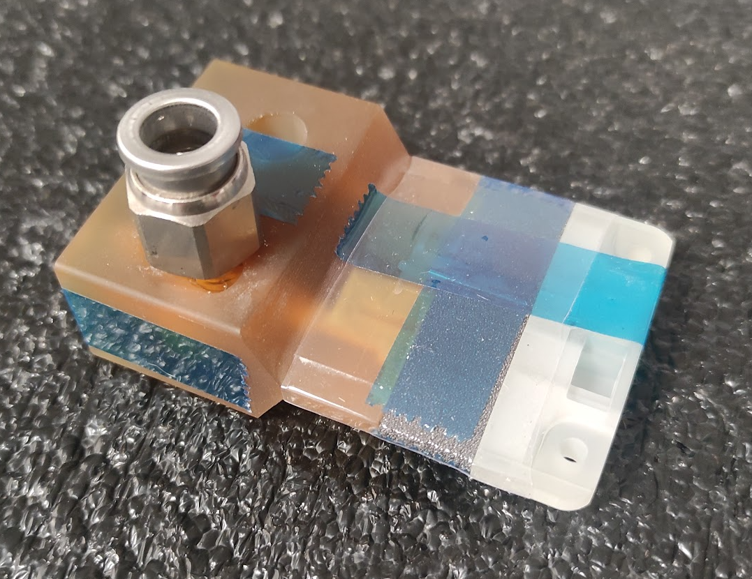
Pressure Loss Contributions
Subassemblies used to isolate contribution
59 ltr/minute pressure drop contributions
  Inlet - 0.124 bar
  K9 Foam – 400 Pa
  Outlet – 400 Pa
Scaled for full L4 stave
  Pressure at first K9 foam block
    59 lpm → 0.062 Bar
    Scaled to 110 lpm → 0.207 bar
Inlet Block
0.0216 Bar
Inlet & Outlet Blocks
Inlet, Outlet & K9

Slide 6
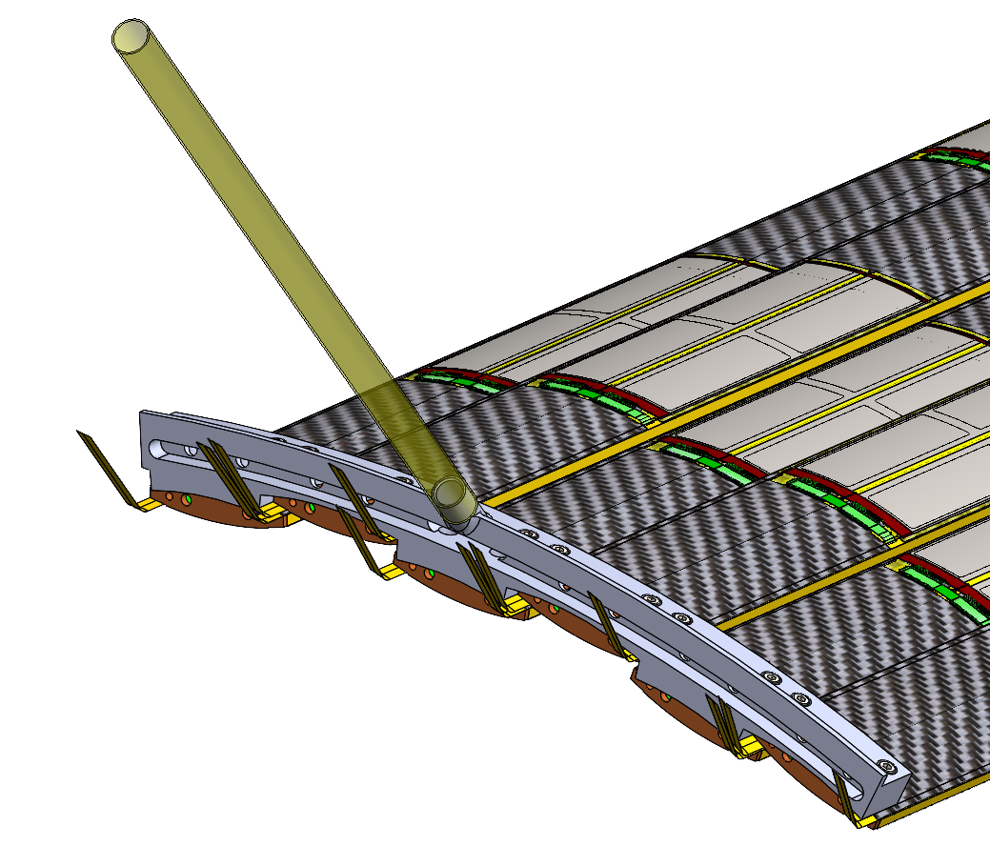
Air Supply Requirements
L4
  72 (assumed 70 elsewhere) Staves
    @48 W = 3.45 kW
  Total mass flow rate for ΔT of 10°C = 0.34 kg/s
    200 litre/minute (normalised) per stave
Air Supply
Ambient or Pressurised
  Ambient (no intentional pressure drop)
  Pressurised

Slide 7
Air Supply Example
Staves manifold with a grouping of 6 staves
6 manifolds per half
QTY 12 - 10 mm ID
Ambient
  Pressure drop – 0.7 Bar/m
    Supply may be 2-3 bar
  Flow velocity 300 m/s
    Near sonic → much larger feed pipes required
Pressurised
  Supply Pressure - 8 Bar
  Velocity 38 m/s
  Pressure drop – 0.08 Bar/m

Slide 8
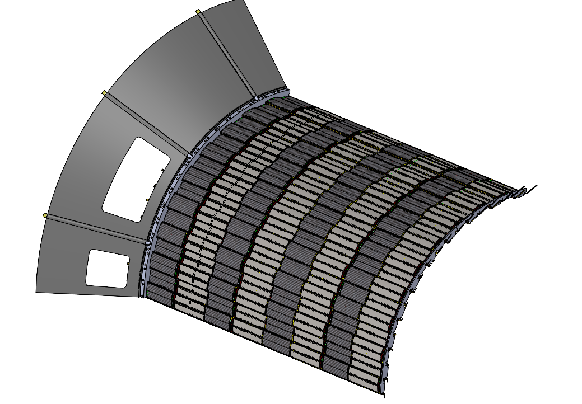
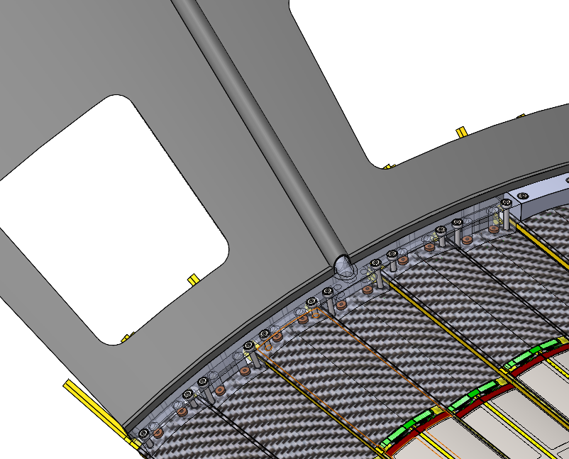
Half a Half Barrel

Slide 9
How to Achieve High Pressure Supply
Local pressure regulator looks to be impractical
  Too large/material heavy
Without pressure regulation there is a risk of over pressuring staves
  Stave flow resistance may increase over lifetime, without active flow monitoring/control flow rate will drop
Proposal
  Digital regulator using stave inlet pressure as control variable, adjusting proportional flow valve
  Inlet pressure set point based on known stave flow vs. pressure curve
  Upstream flow meter for global flow measurement (per 6 staves)
  Comparison between flow meter reading and inlet pressure can be used to monitor stave health.

Slide 10
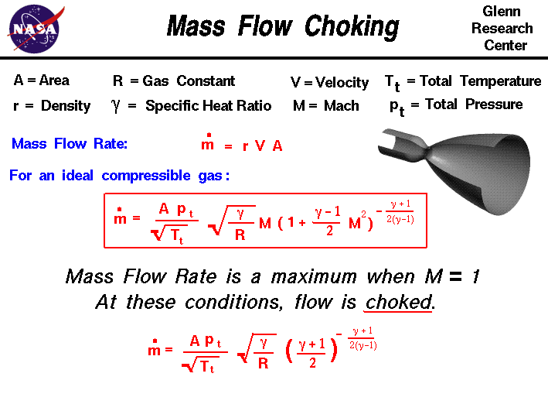
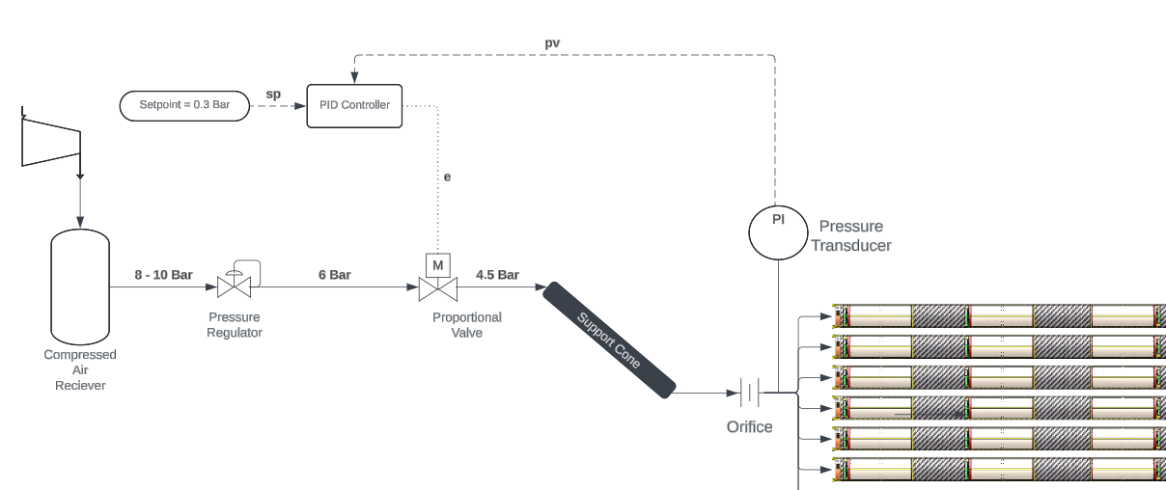
High Pressure Supply

Slide 11
Testing Plans – Work in Progress
As part of the Oxford test setup, we need a method to allow the DAQ System to control stave coolant flow rates
We achieve this with:
  Using a proportional solenoid control valve to manage upstream pressure
  PID controller drives valve position (and outlet pressure) based on measurement from flow controller
  Flow controller measurement could be replaced with a pressure transducer.
Robustness of system will require extensive testing & the intention is there would be backup mechanical pressure relief devices.

