Slide 1
pfRICH mirror and sensor plane update
02 June 2026

Slide 2
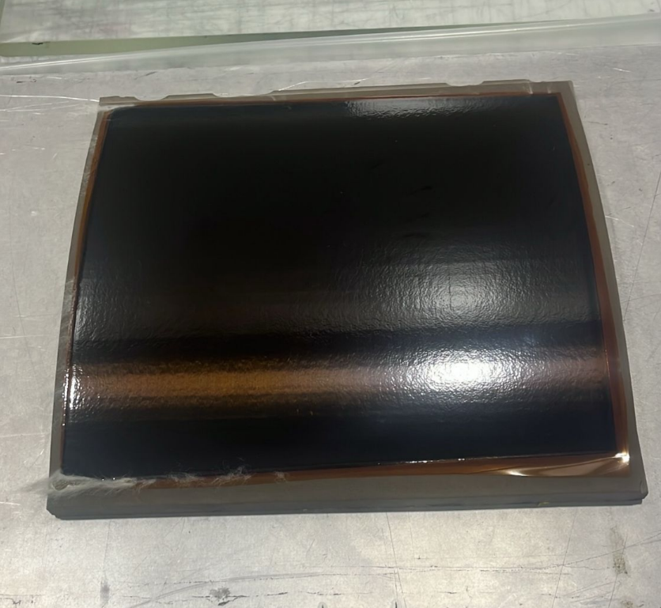
Curved Mirror full scale #2
The inner surface was co-bonded. This made us learn new lessons
Next co-bond in progress this week

Slide 3
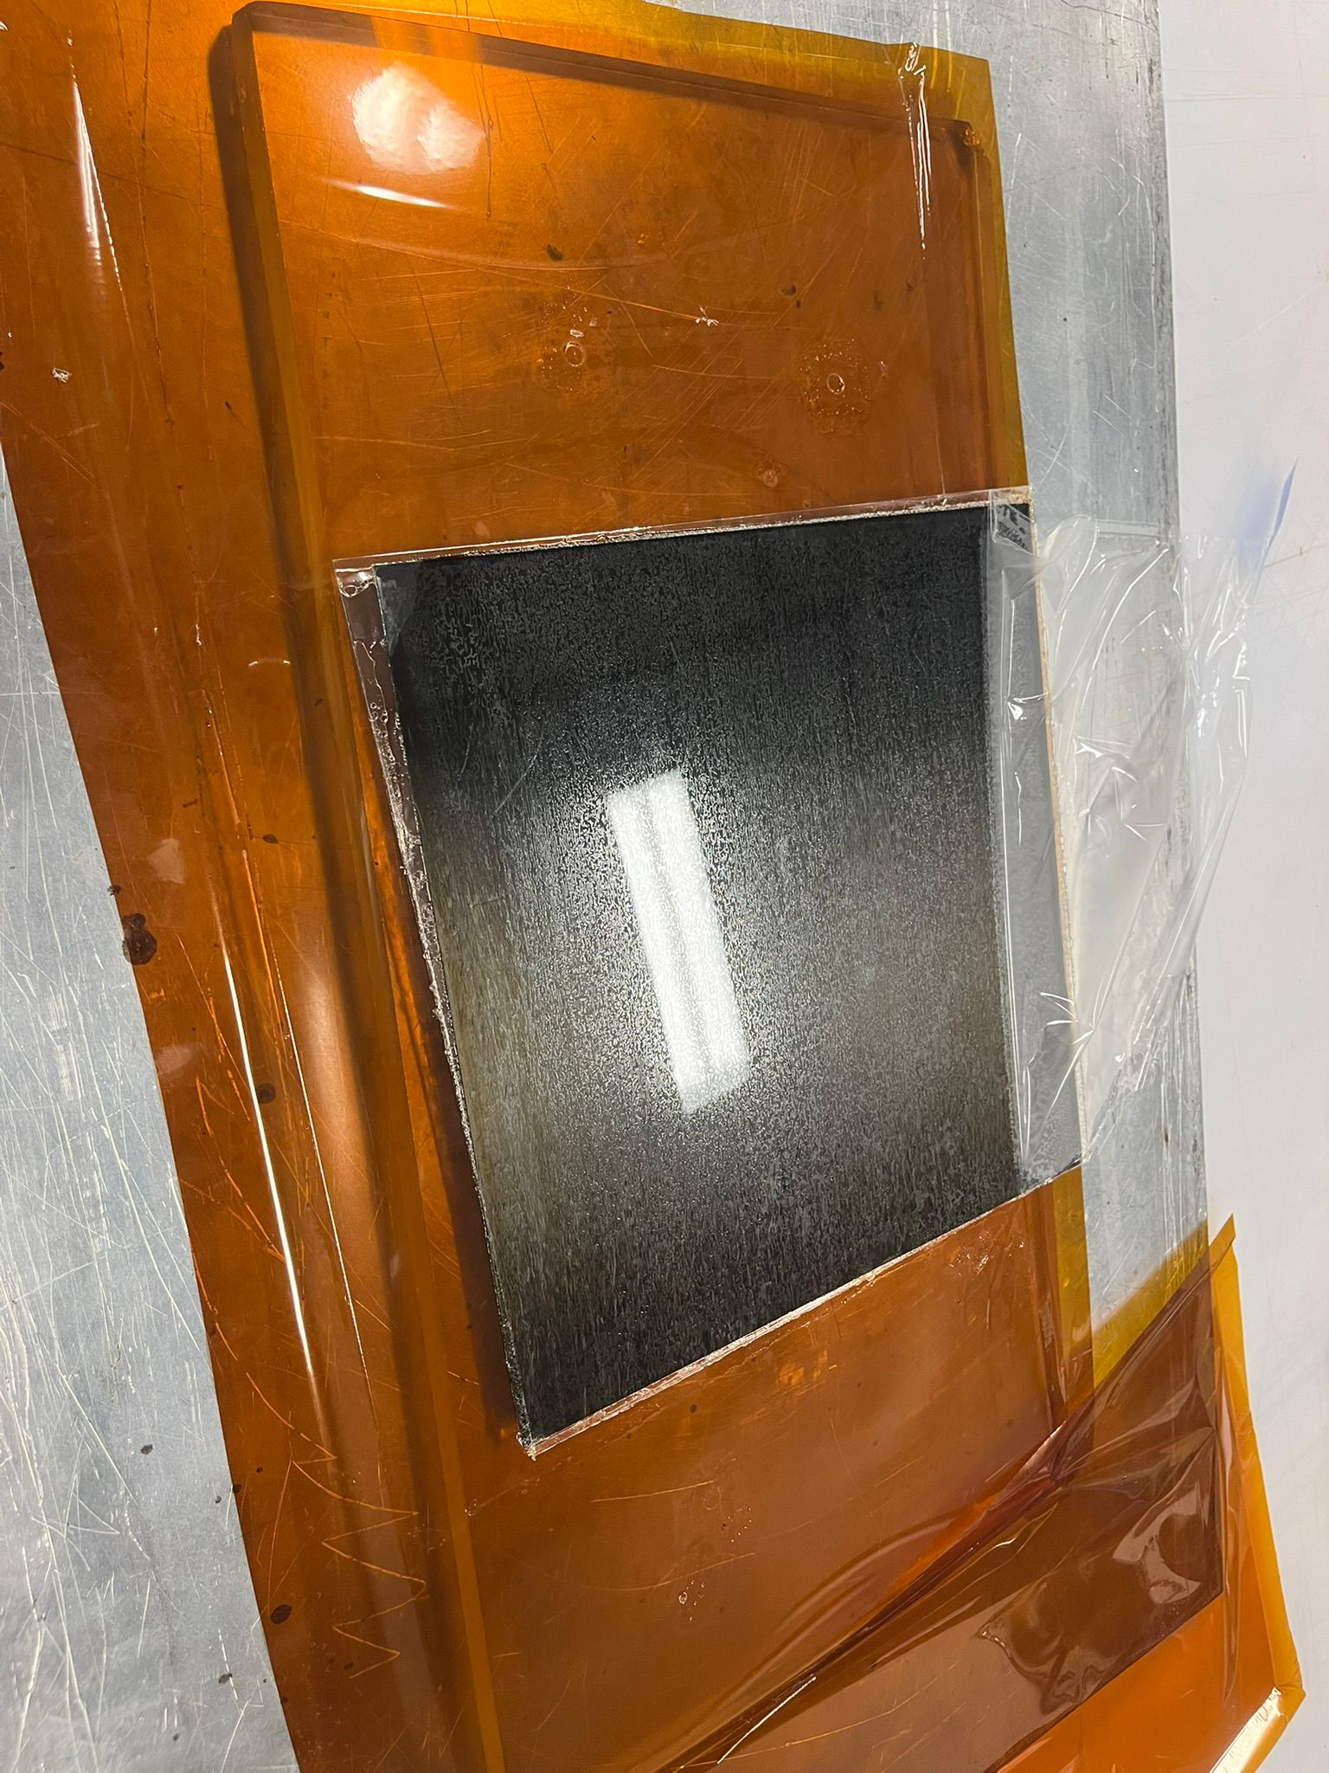
Flat sample looks great
Will ship to SBU upon trimming into 7cm x 7cm
I have 4 samples in the size 30 cm x 30 cm ready to ship to SBU –Kong told us to hold on the shipment and ship with the curved samples in a single shipment.

Slide 4
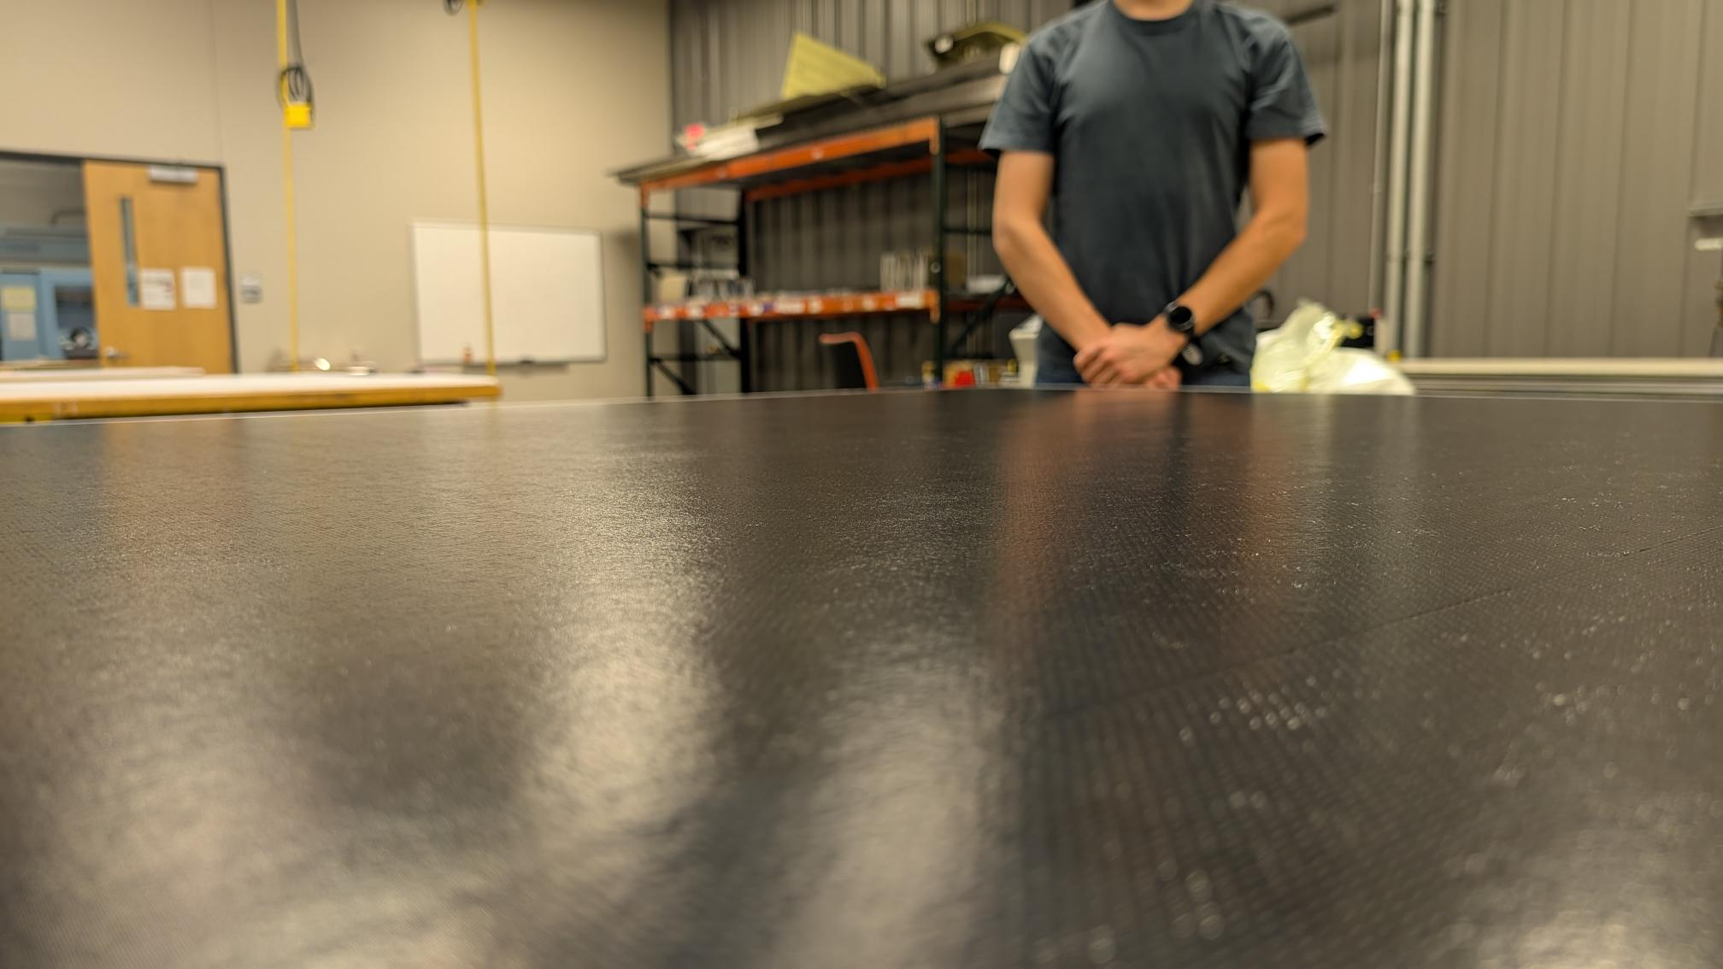
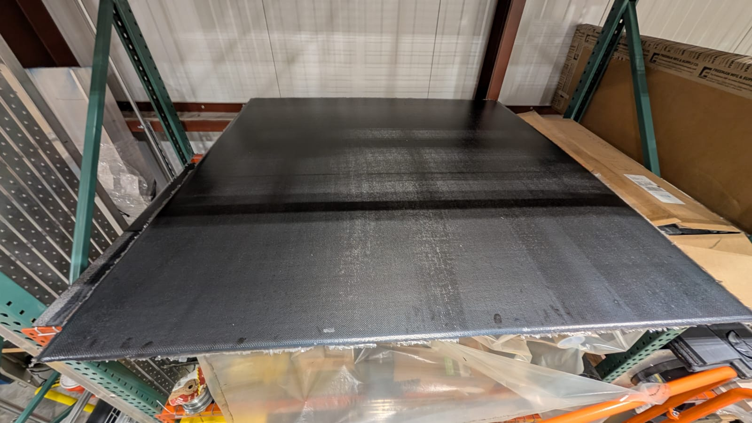
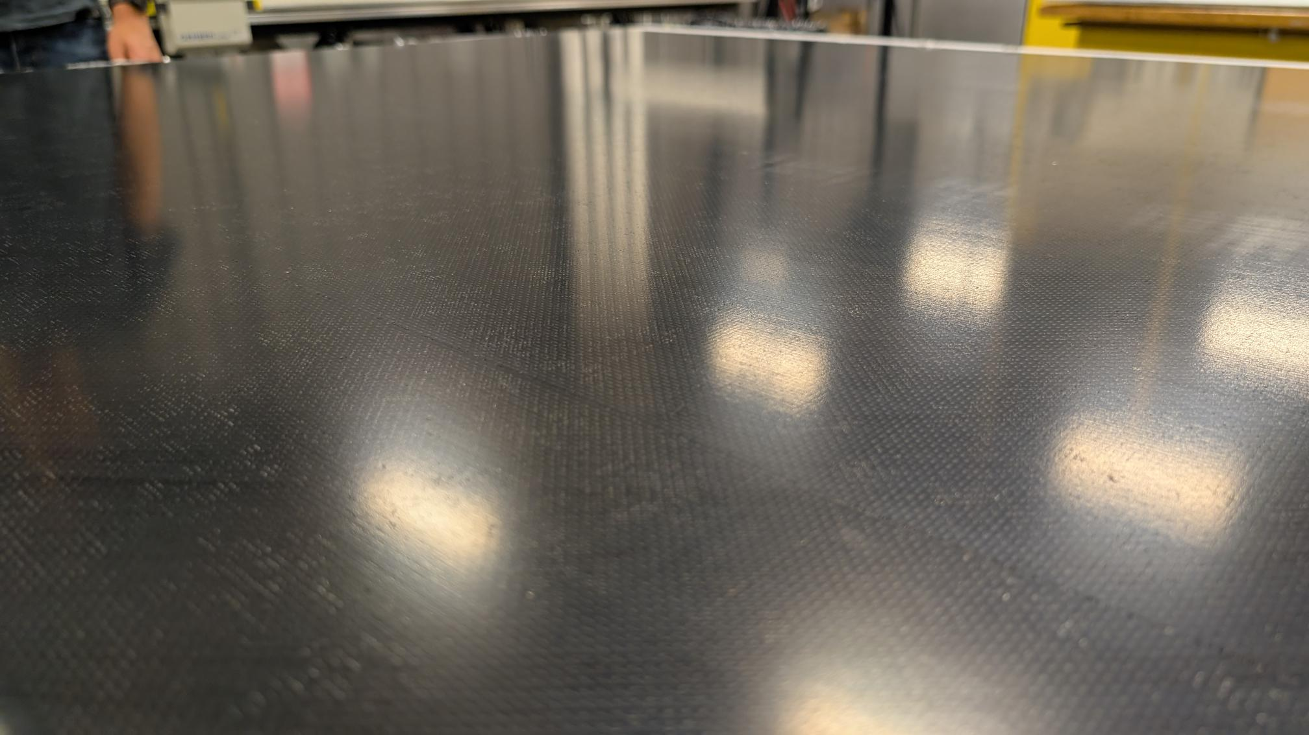
Sensor plane plate cured and flatness looks good
Really happy with the consolidation and flatness of the plate

Slide 5
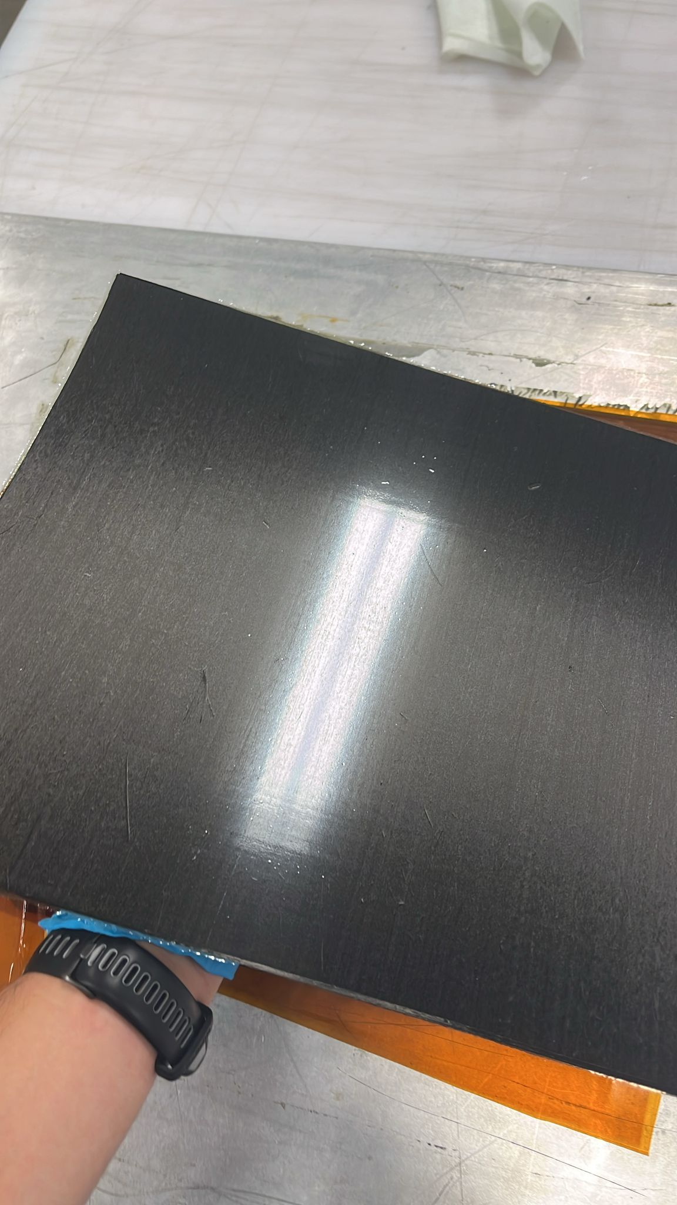
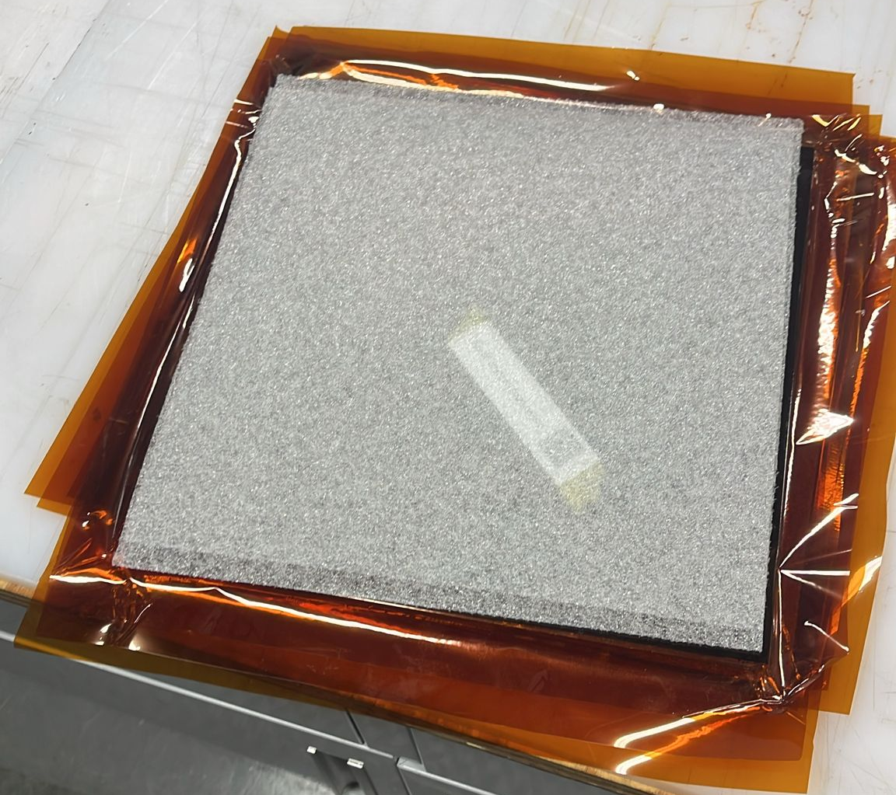
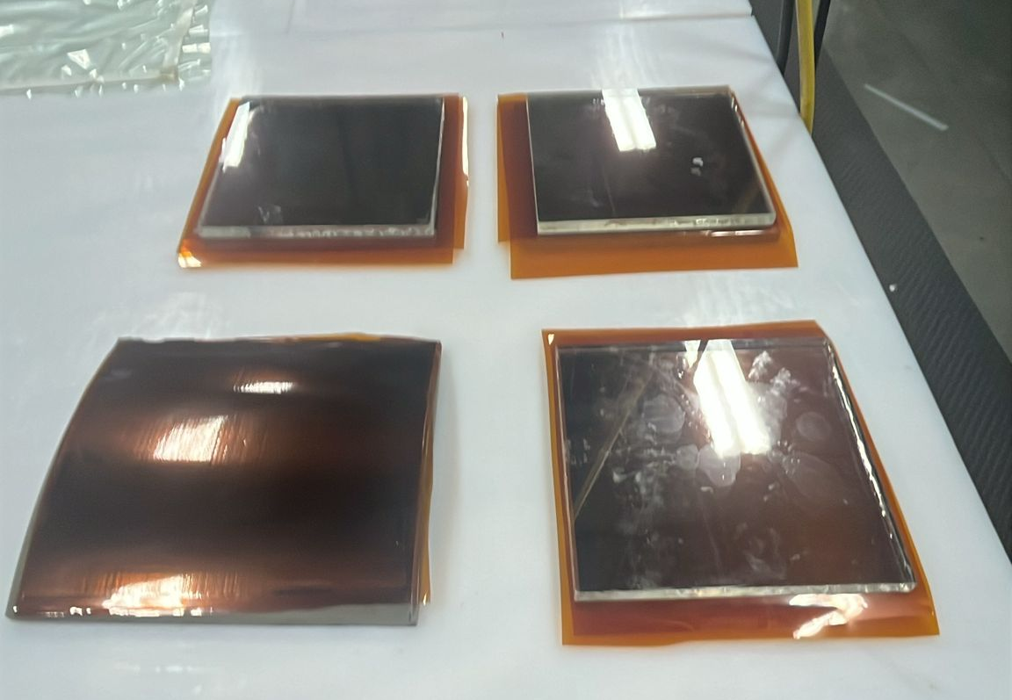
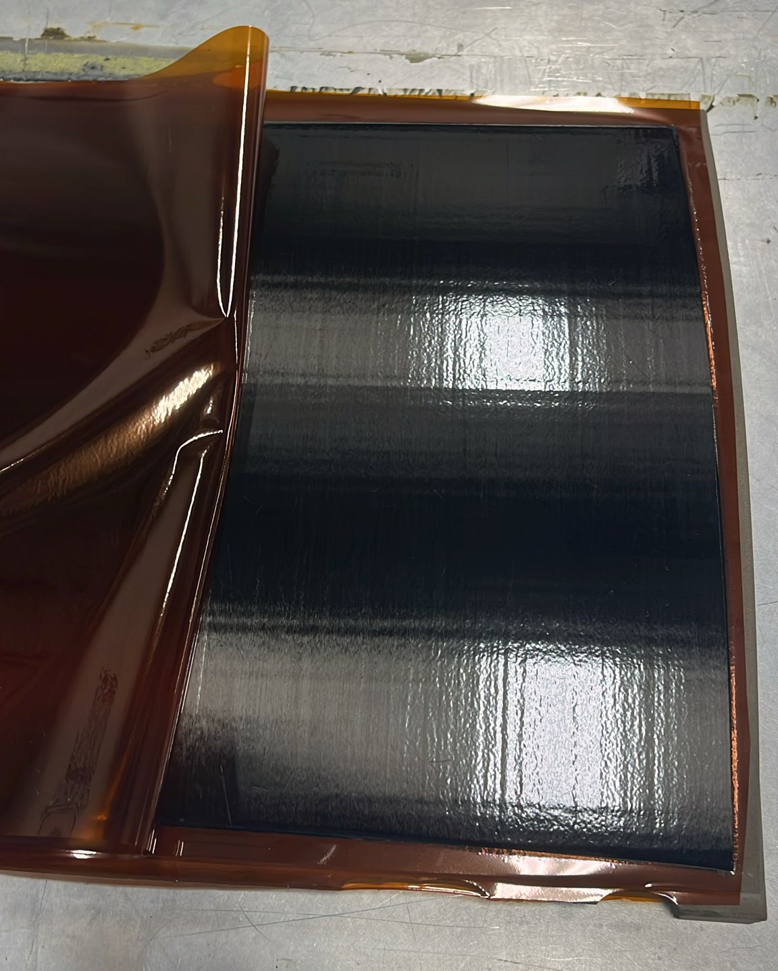
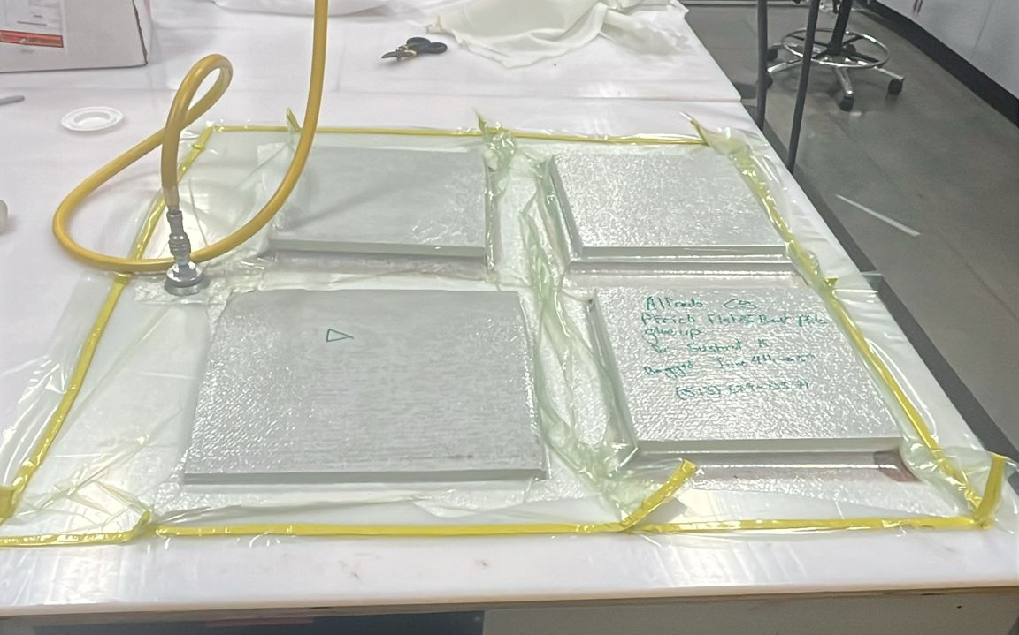
Mirror Co-bonding Updates

Slide 6
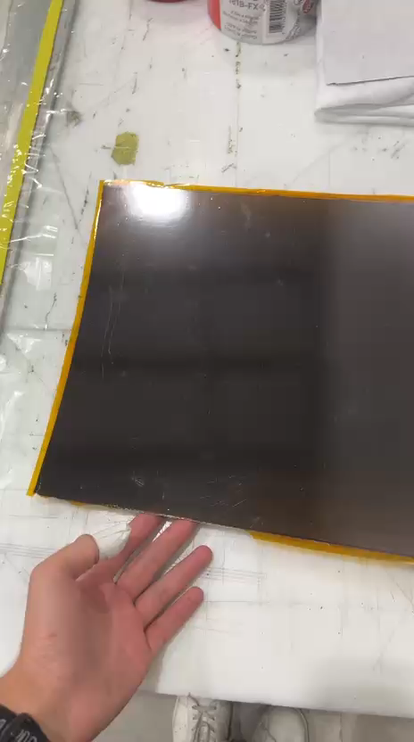
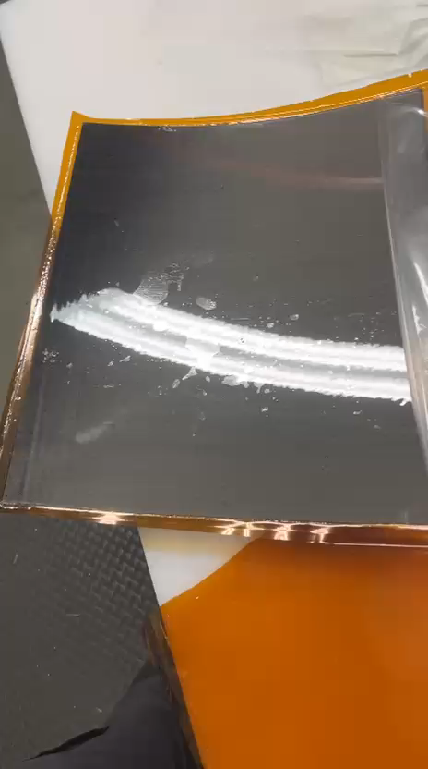
These are videos
Substrate 2 post lexan bonding
Substrate 1 before bonding the lexan

