Slide 1
Cradle, Barrel HCAL & Moving Mechanism
Triple I Engineering Meeting Update – 6/09/25
Nathaniel Speece-Moyer (BNL)

Slide 2
Cradle and Moving Mechanism Updates
Updates
Narrowed down design options and got cost estimates for the cradle moving and positioning system.
Ranked design options. Reached consensus with the mechanical engineers at BNL that the best path forward is with air bearings.
Need to present results to Elke and Rolf for a final decision.
Got clarity on positioning requirements for the cradle and detector.
+/- 1mm, +/- 1 mrad positioning accuracy for the detector and beampipe, including manufacturing tolerances.
Positioning with the GST will be difficult due to all the cables and services
Will need to build as much accuracy into the cradle moving and positioning mechanisms, but adjustability needs to be accounted for elsewhere in the detector (i.e. GST, beampipe, etc.).
Cradle positioning should be <1mm to account for manufacturing tolerances and other errors in the system.
Met with air bearing and air compressor companies to determine design options and cost.
Met with hydraulic piston and controls companies to get a rough cost estimate for the hydraulic positioning option.
Met with Tristan Loiseau who works with the CMS detector at CERN. They successfully use air casters with fixed stops to move and position the CMS detector. Very helpful meeting to give assurance that our design strategy should work.

Slide 3
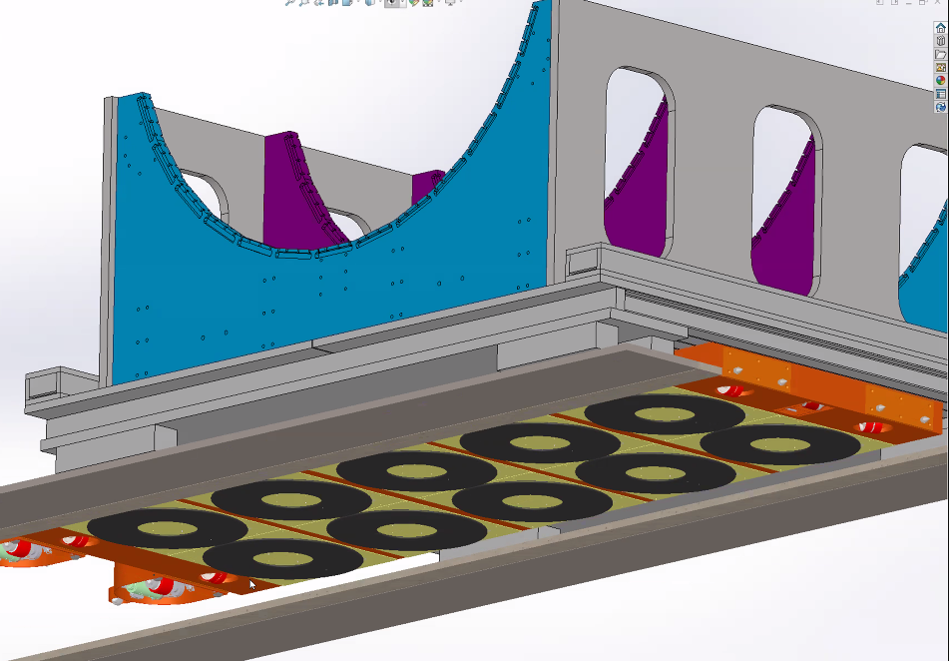
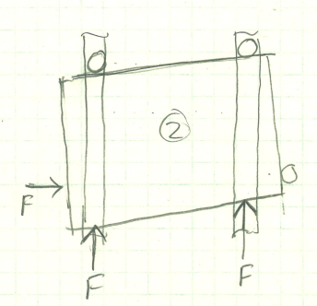
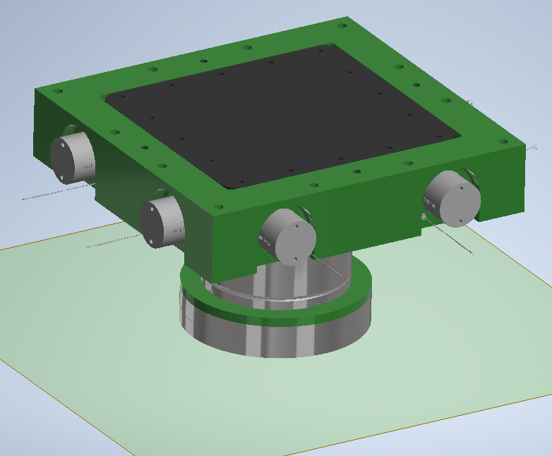
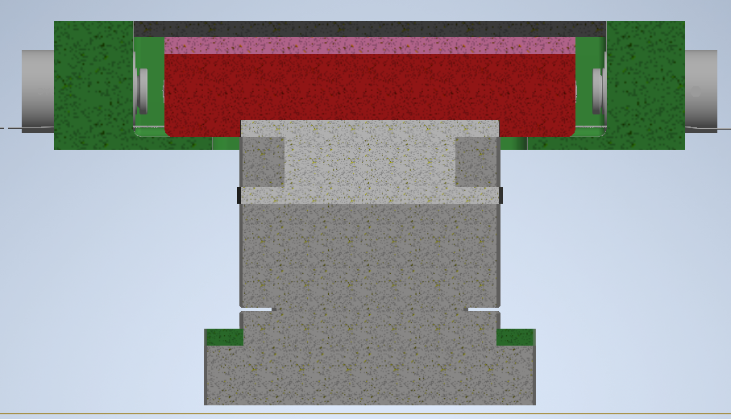
Design Strategies
Air bearings
Lift detector with air bearings, move into hall with STAR hydraulic actuators. Use fixed stops for precision positioning.
Pros: Allows translation and rotation in horizontal plane. Combined with fixed stops, this allows for ease of positioning and a high level of repeatability. Low profile requires least modification to cradle design and is easiest to integrate.
Cons: Additional equipment cost with air compressor, dryer, filter. Requires some floor modifications.
Rollers + hydraulic positioning assembly
Vertical lifting pistons + low friction assembly on top, adjusted with hydraulic cylinders. Use fixed stops for precision positioning.
Pros: Rollers are a known technology, and BNL has some experience with this design on the PHENIX detector.
Cons: Some uncertainty in system performance and positioning ability, accuracy. A similar design did not work on sPHENIX, though likely due to the location of hydraulic cylinders away from the low friction surfaces. Height and size of assembly make integration more difficult.
X-Z roller assembly
This concept is two roller assemblies stacked at 90 degrees to each other with a low friction surface in between. Use fixed stops for precision positioning.
Pros: Would give x-z (vertical) positioning and some control of rotation.
Cons: Design not proven at this weight. Height of assembly would require substantial cradle modifications and design effort.
Cradle concept with air bearings, repeatable positioning with adjustable stops
Vertical piston and low friction assembly with horizontal positioning pistons.

Slide 4
Design Ranking
Ranking Categories and Weights
Horizontal (x, z) positioning, y rotation accuracy, repeatability (Weight = 5)
Vertical (y) positioning, x rotation accuracy, repeatability (Weight = 5)
BNL design effort and ease of integration with existing cradle (Weight = 5)
R&D effort by external company (Weight = 1)
Design complexity of moving mechanism (Weight = 2)
Unknowns and risk with design (Weight = 5)
BNL Experience with design (Weight = 2)
Risk of operational delays due to equipment failure (Weight = 5)
Assembly and installation effort (Weight = 1)

Slide 5
Ranking Results
The table lists a summary of scores and cost estimates for each option.
We plan to proceed with using air bearings to move the cradle. Fine design details still need to be worked out.
Likely will use hydraulic pistons from STAR to move cradle in and out of the experimental hall. Use followers on the track to maintain position and control of detector as it is being moved.
For final positioning, use smaller pistons or winch system, in combination with fixed stops for positioning and control.

Slide 6
Plans Towards PDR
Next steps
Cradle: Need to review options with Elke and Rolf to get approval to proceed with the air bearing option.
Barrel HCAL: No updates or work done to modify design to accommodate the magnet phase separator.
Platform over cradle: No updates or design work done to modify/design new platform to accommodate magnet phase separator.
Path towards PDR
Substantial work remaining prior to PDR.
Latest scope needs to be added to the resource-loaded schedule to verify that timelines can be met with remaining hours and current workforce.

Slide 7
Question & Comments

