Slide 1
Far-Forward / Far-Backward
Detector Integration
Jonathan Smith (JLAB), Ron Lassiter (JLAB),
India Krehbiel (JLab), David Powell (JLAB)
June 16th, 2025

Slide 2
Primary Updates Outline
Far-Forward Region
B0 Detector Layer Resize
B0 Outside Tooling
ZDC Updates
Far-Backward Region
Low Q2 Tagger Calorimeter Updates
B0 3D Model
Upcoming Updates

Slide 3
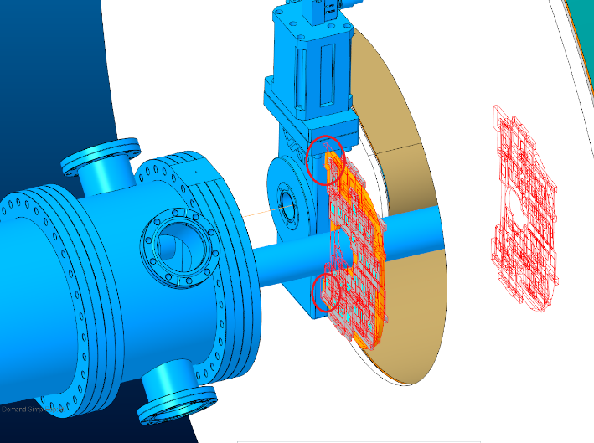
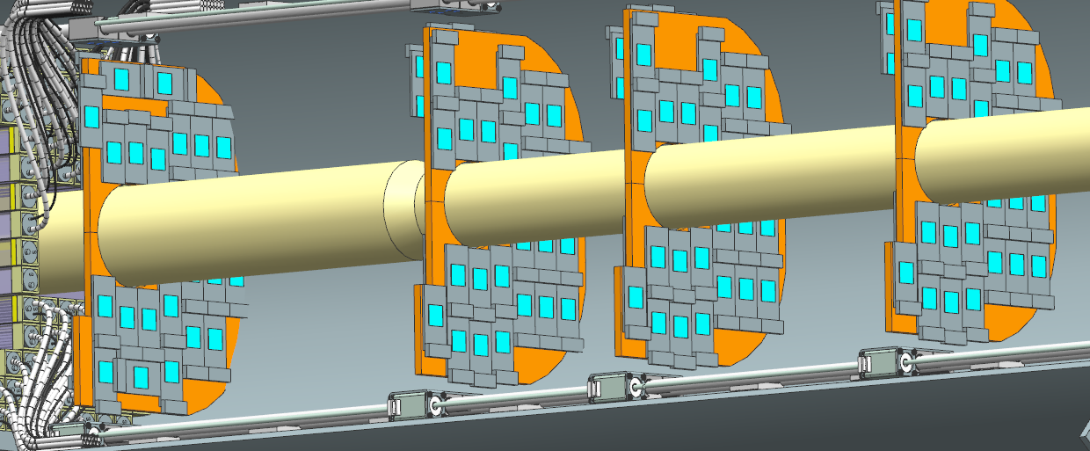
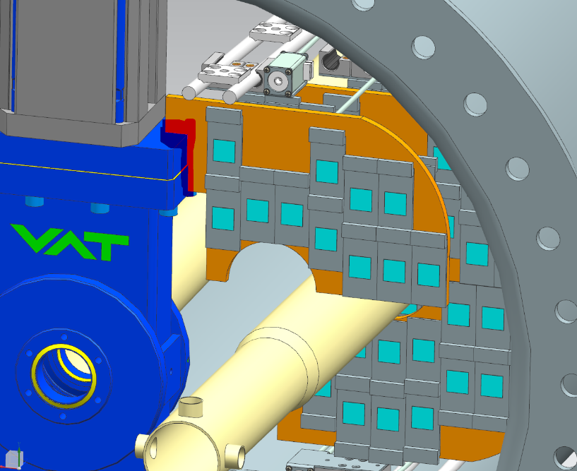
B0 Detector Layer Resize
Karim identified an interference between the detector layers and the latest valve in front of the B0 Magnet.
Updated the detector layer to remove the ‘wing’ portion to clear the foul.

Slide 4
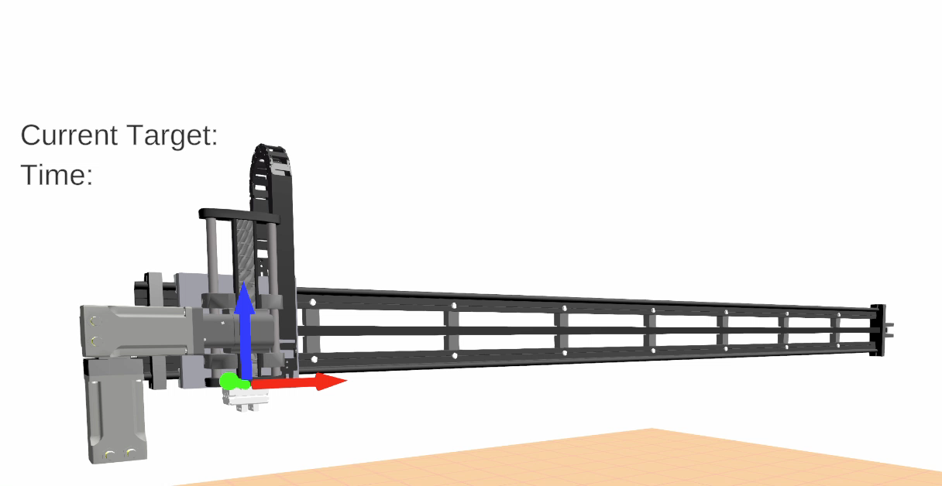
B0 Outside Tooling
Investigating hardware for the B0 tooling assembly.
Estimated cost ~$5,500 per rail, (2) needed for outside tooling totaling $11,000
Demo courtesy of IGUS

Slide 5
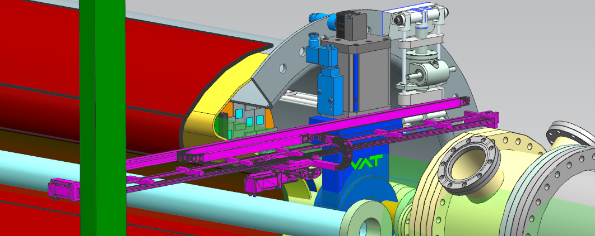
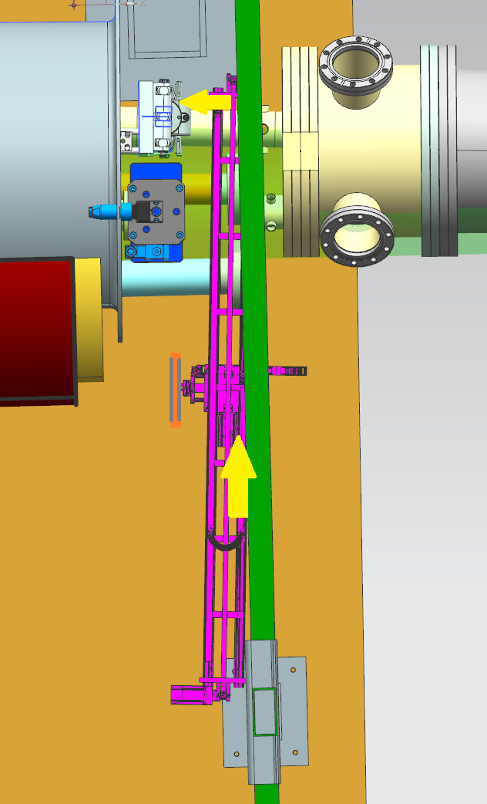
B0 Outside Tooling
Final assembly will consist of a top and bottom rail working independently, transferring the individual detector layers to the inside tooling
NOTE – Images are for demonstration purposes only at this time

Slide 6
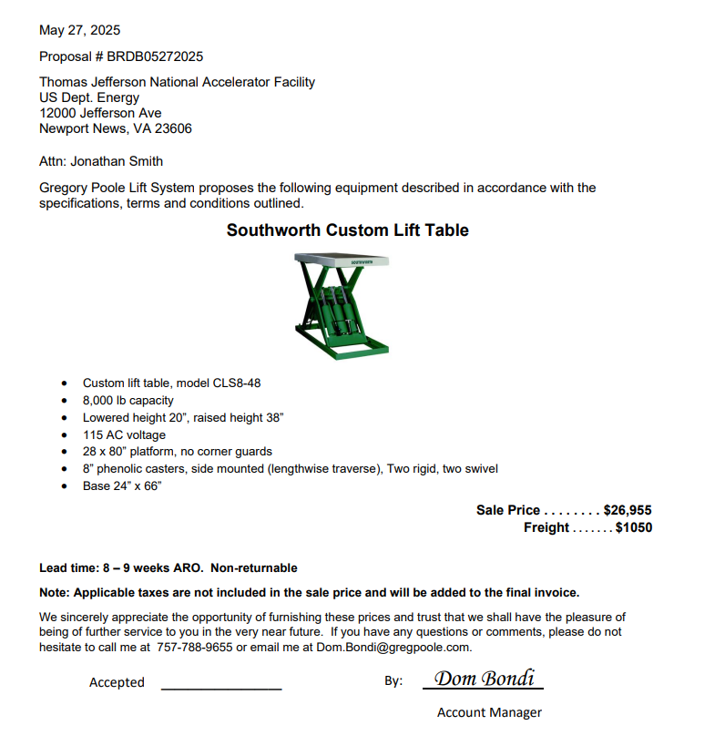
ZDC Updates
Updates on ZDC
Received a quote from a local Southworth supplier
Replied to vendor with the following questions, currently unanswered:
The intention of this table is to hold 2.5 tons of weight in the maximum lifted position for the lift table’s lifetime. The only time it will be lowered and rolled out of position is for maintenance. Will this table designed to withstand this kind of application?
We’re estimating the lifecycle for this equipment to last 30 years. Will the table be able to withstand this longevity with the necessary maintenance where required?

Slide 7
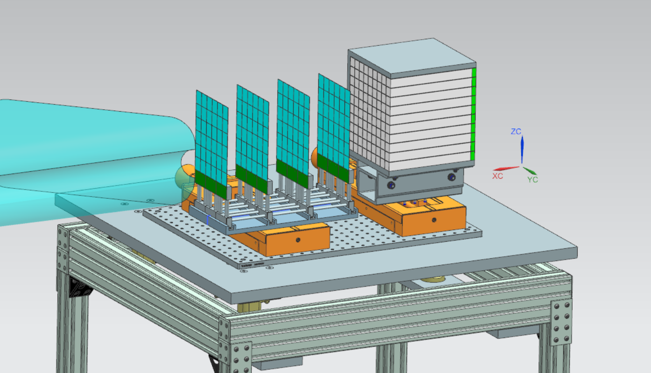
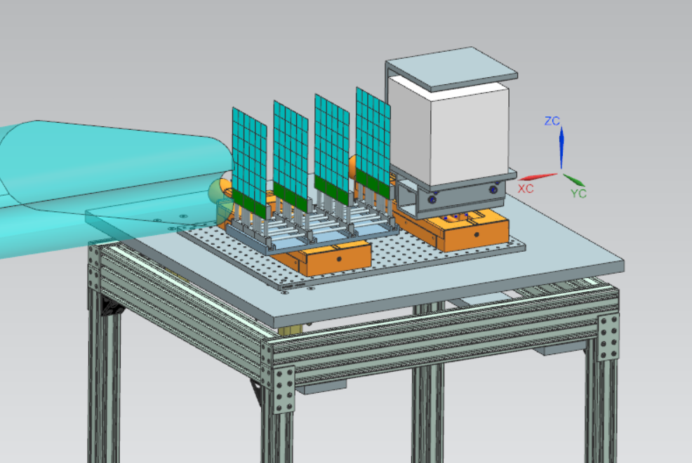
Low Q2 Tagger Calorimeter Update
Latest direction is to update the Low Q2 Tagger Calorimeter to match the Lumi Spectrometer Calorimeter
Existing
Update
Note: Additional information required prior to final model created

Slide 8
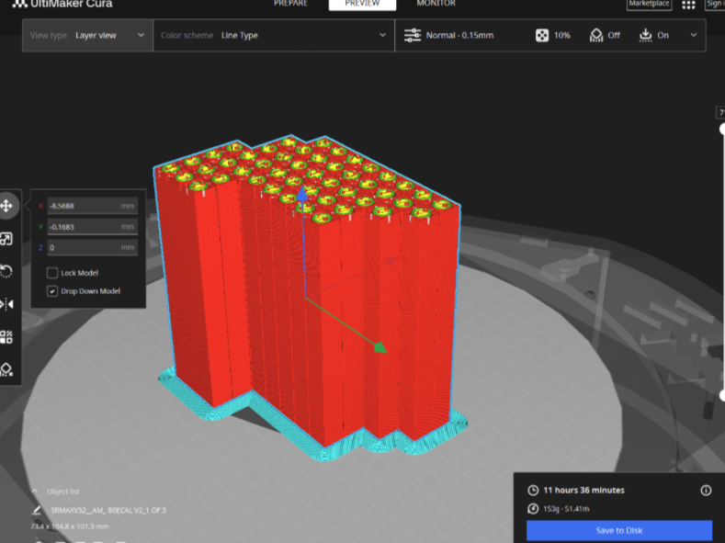
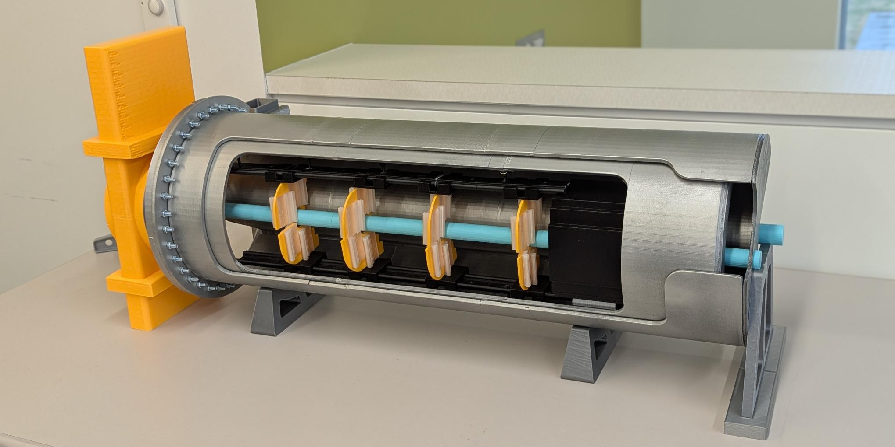
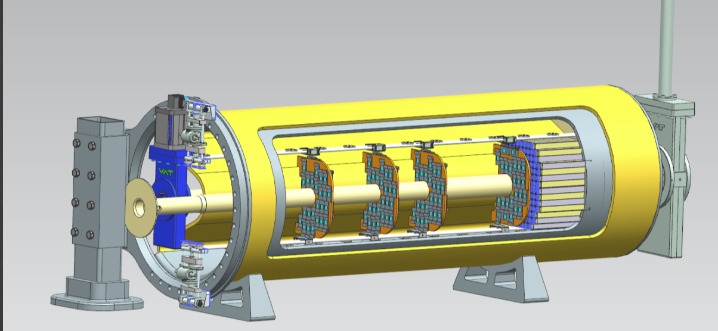
B0 3D Print Model Updating
With the latest updates to the beampipe, calorimeter, valve, and detector layer locations we are updating our onsite 3D Printed model to reflect the changes
Update 6/10/25 – Additional Filament ordered
(Estimated completion date: Mid August)

Slide 9
Current Work
B0 Tooling
Sourcing a Carriage ‘Gripper’ for holding detector layers
Method for transferring detector carriages from external tooling to the inner rail system
Cable management
(Estimated Completion Date: Tenatively Mid-July, ongoing as design matures)
Low Q2 Tagger Calorimeter
Additional information required:
Size requirements
Electronic readout(s)
Cabling
(Estimated Completion Date 6/18/2025)

