Slide 1
BIC Update
Triple I Engineering Meeting Update
Kevin Bailey & Tom O’Connor
June 23, 2025

Slide 2
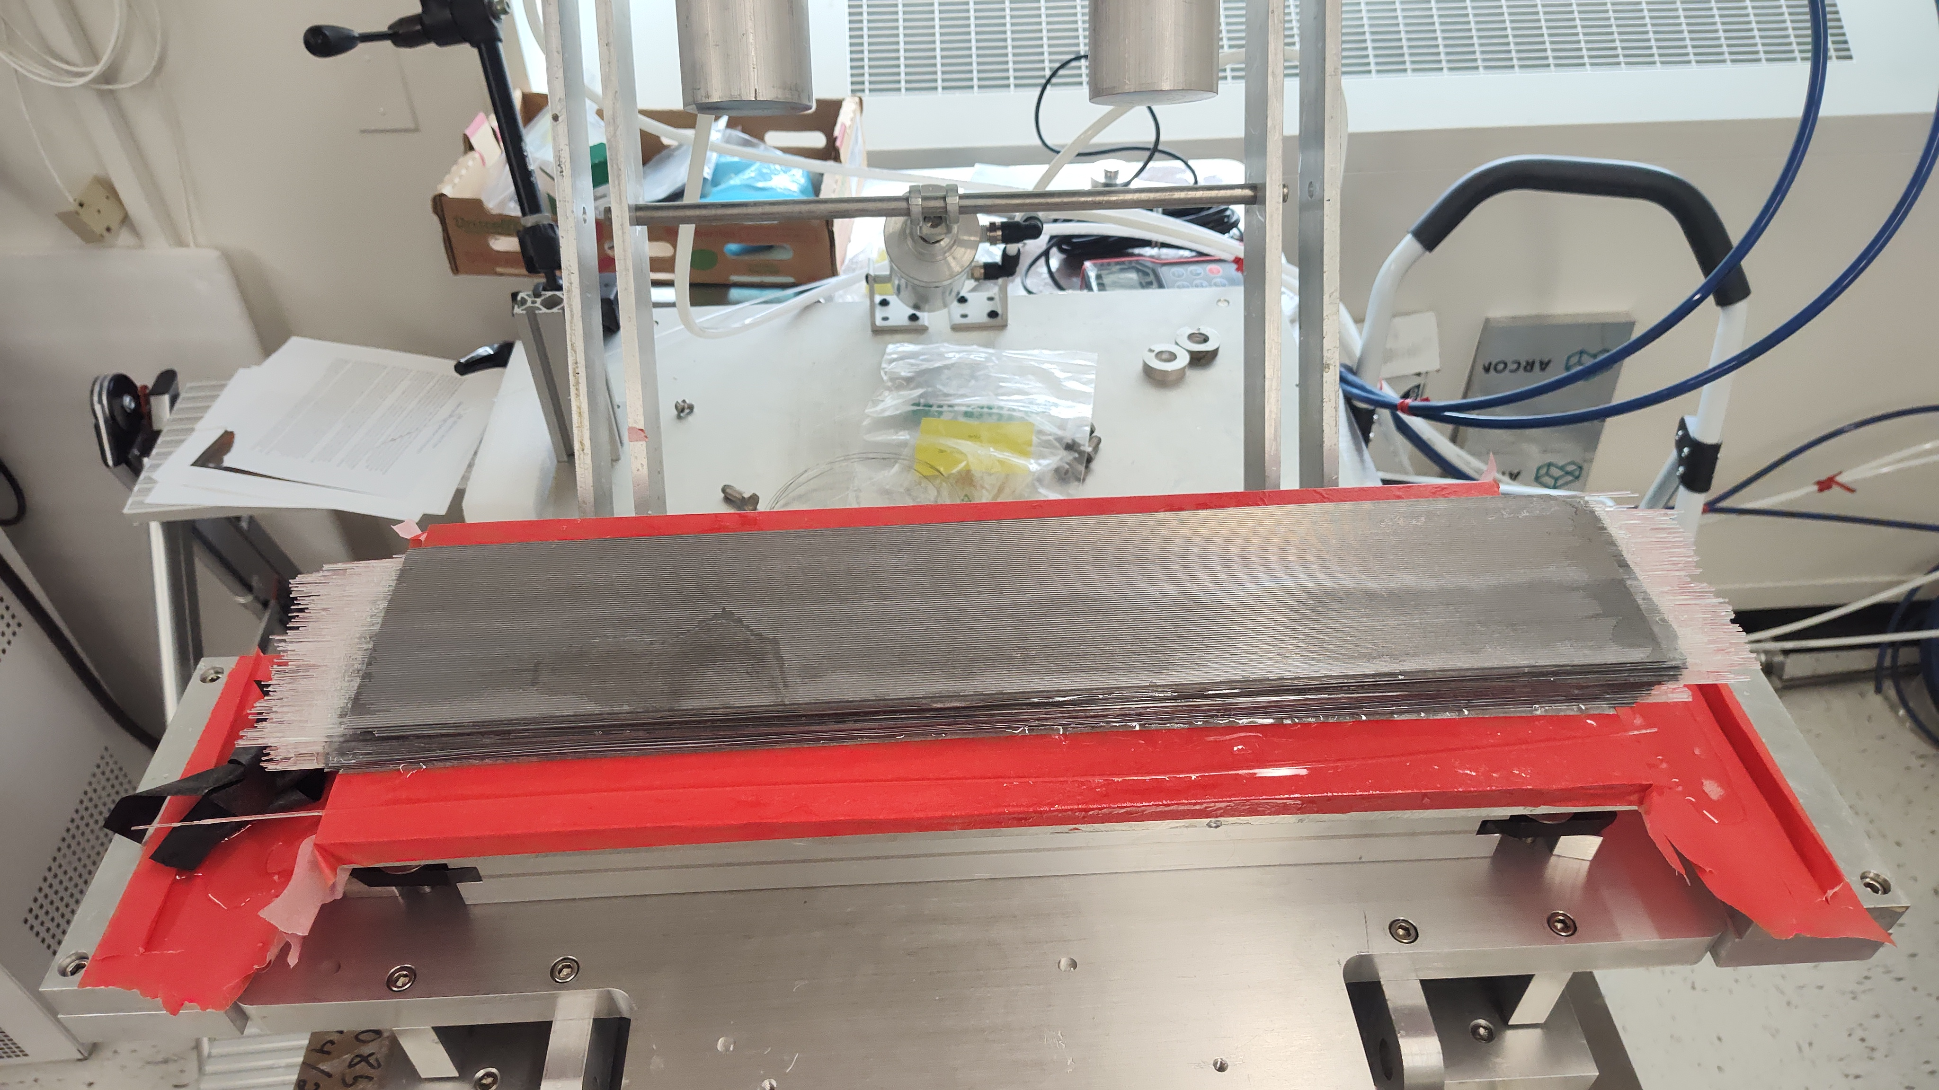
First Test Article
Using GlueX lead 11cm wide
Using dummy fiber
Non scintillating fiber
Relaxation problem solved
Assembly techniques evolving
Waiting on machining and evaluation

Slide 3
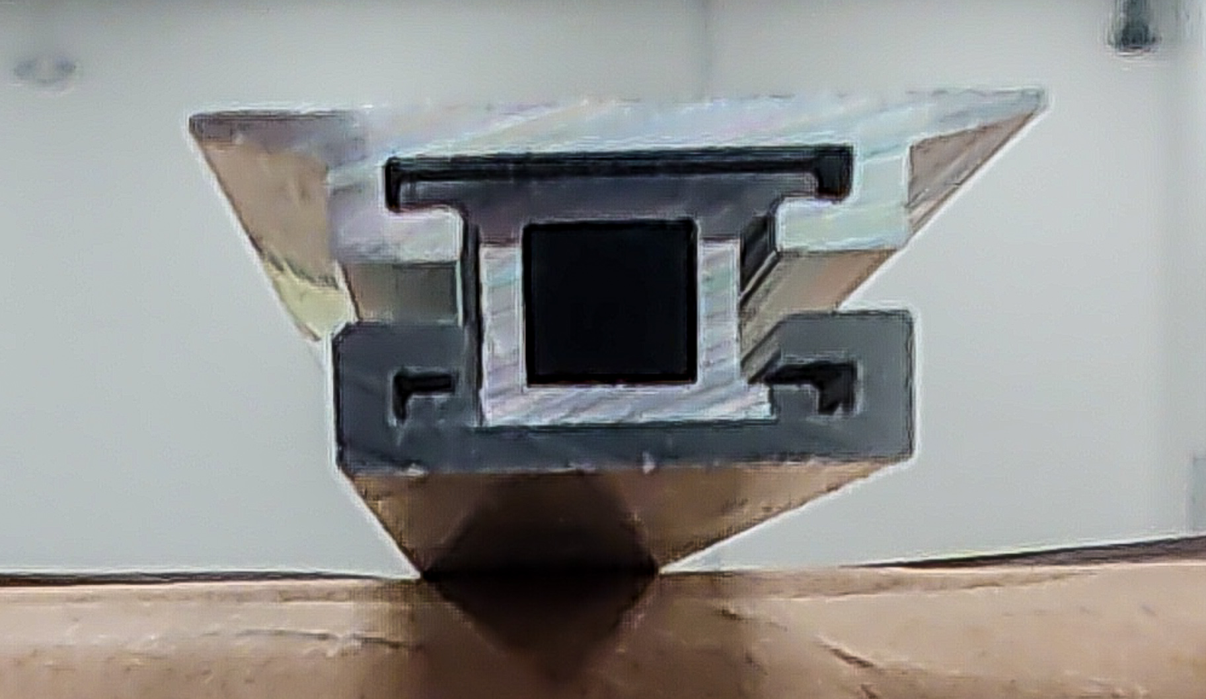
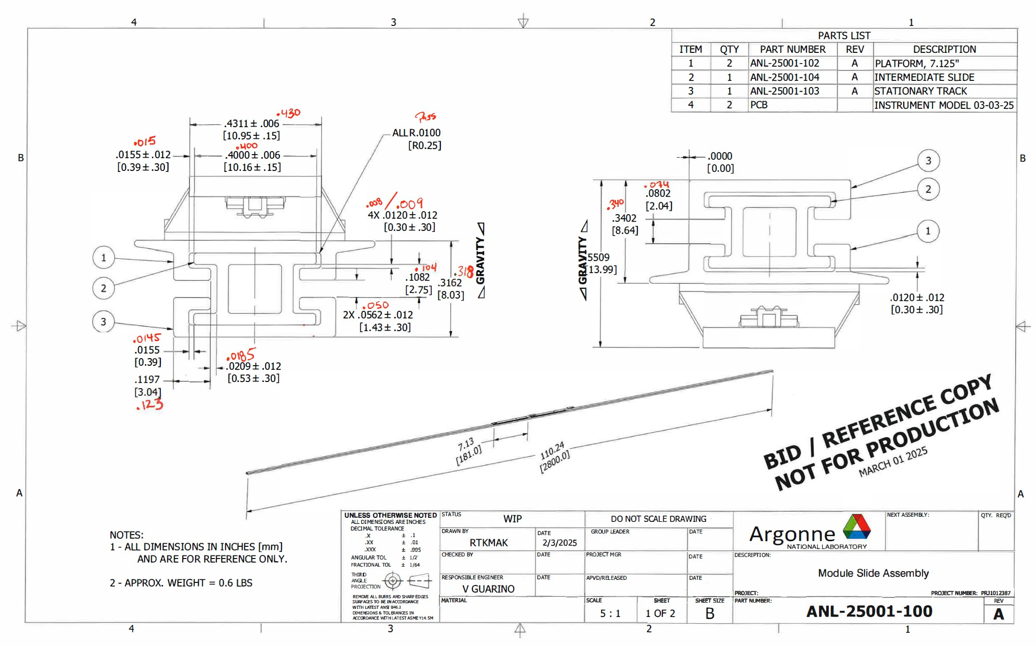
First Aluminum Extrusions
Pieces fit together
Slide smoothly @ 2.8m long
dddddd
Will use to test Astropix assembly tooling
Will iterate design

Slide 4
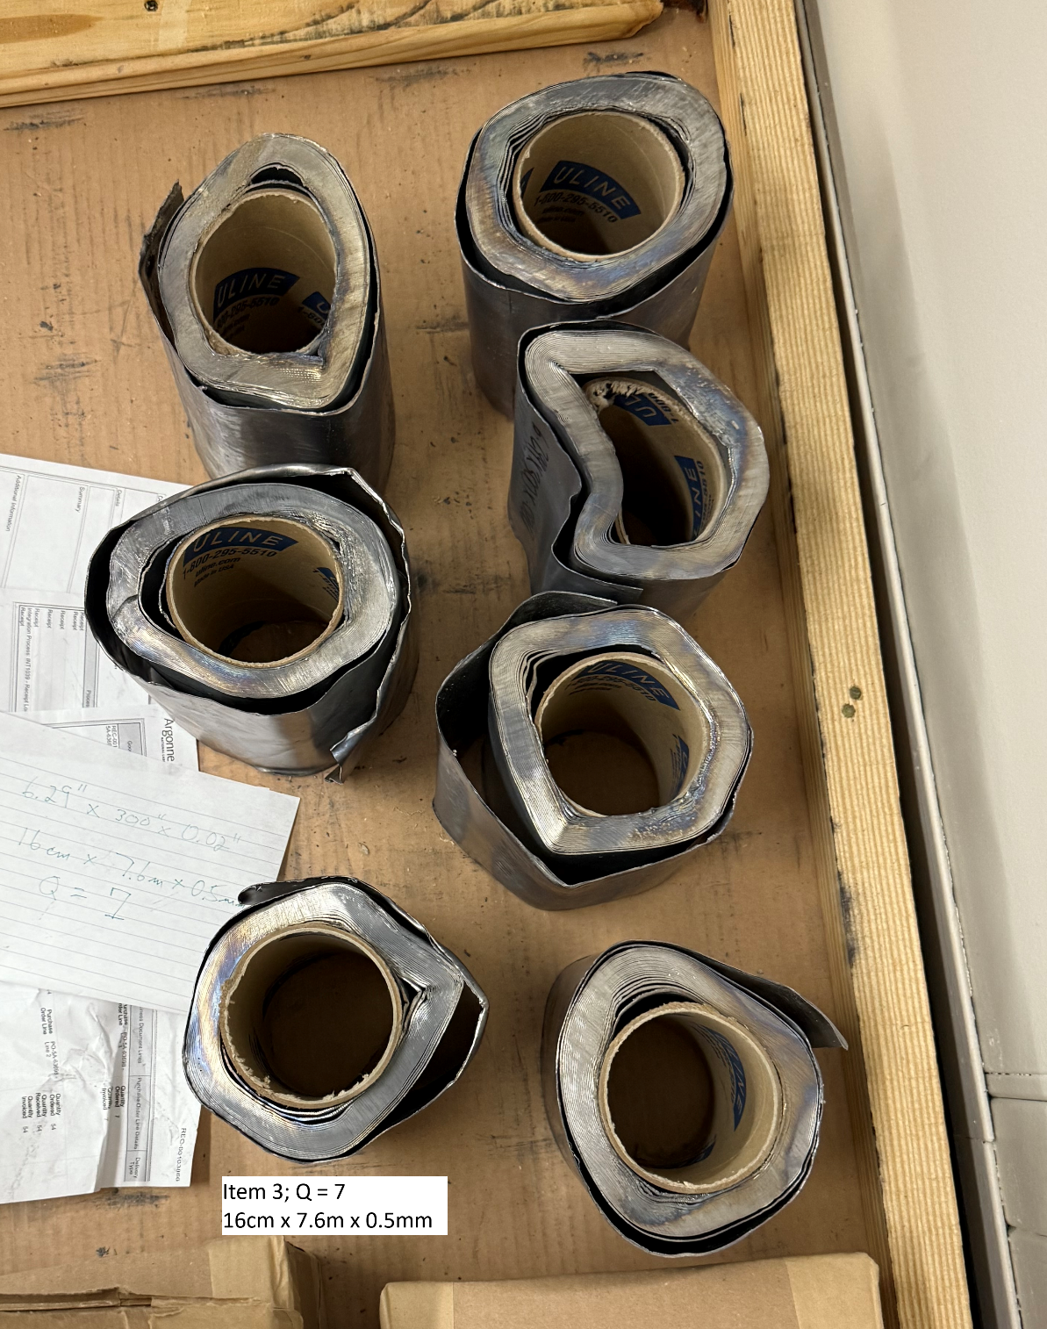
New Lead
Fresh lead arrived
Not in the best of shape
Not in tolerance
Ordered 0.5mm
Received 0.6mm
RMA in progress

