Slide 1
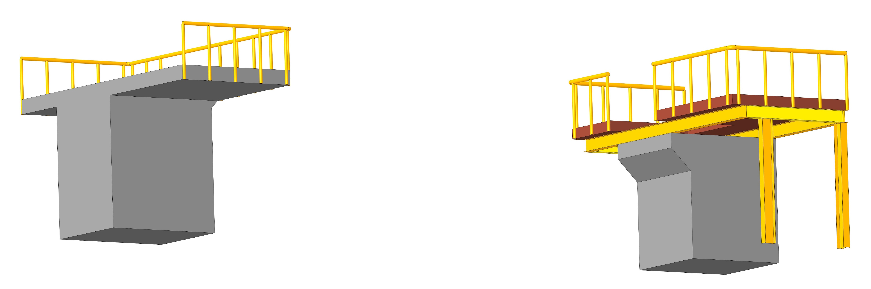
Platform Concept
Steel platform
Concrete stand
All Concrete stand

Slide 2
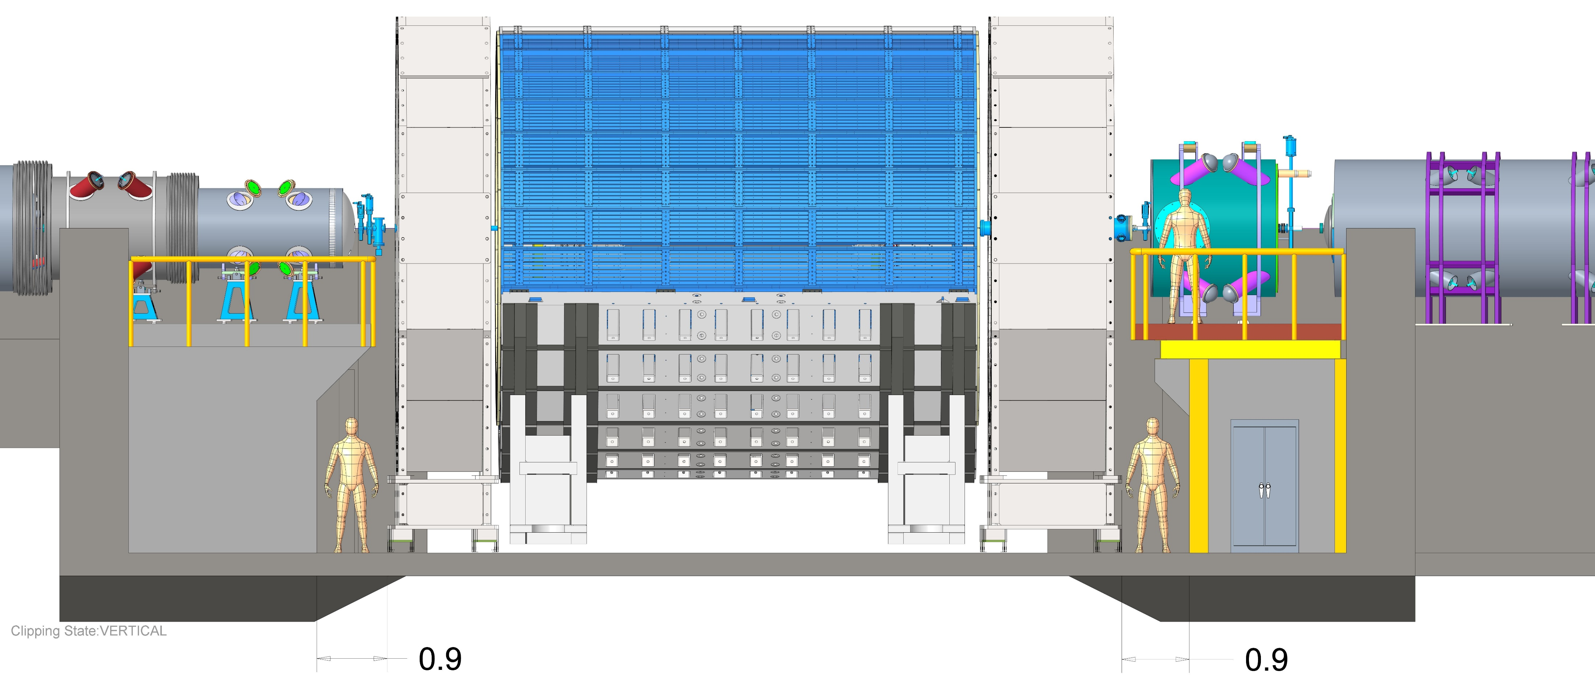
Seismic restraints
Steel platform
Concrete stand
Concrete stand
All Concrete stand
Egress
Electronics cabinet

Slide 3
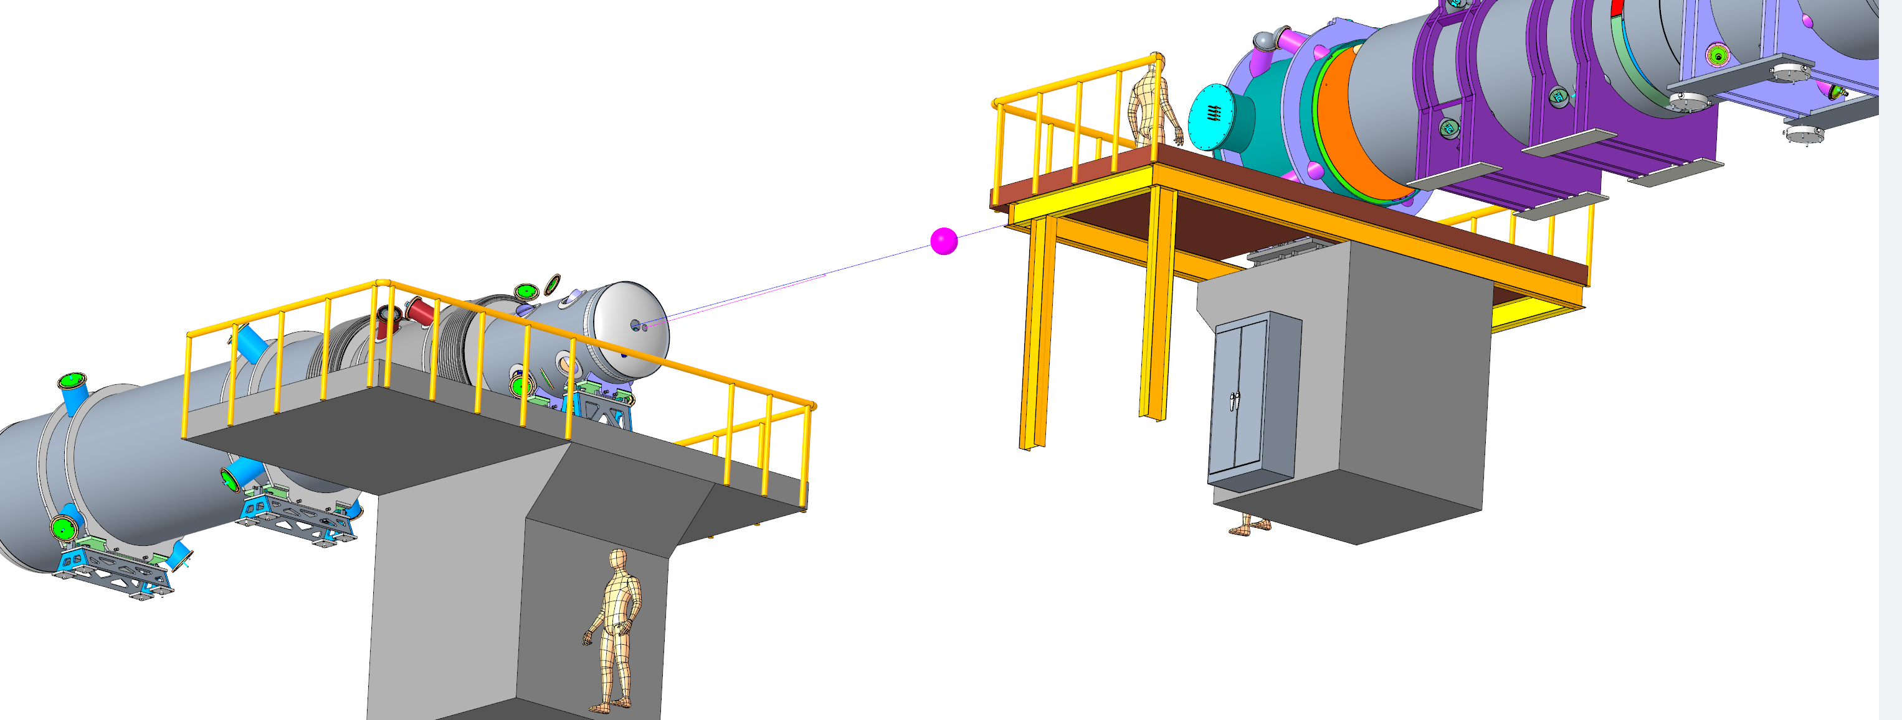
Extension
platform

