Slide 1
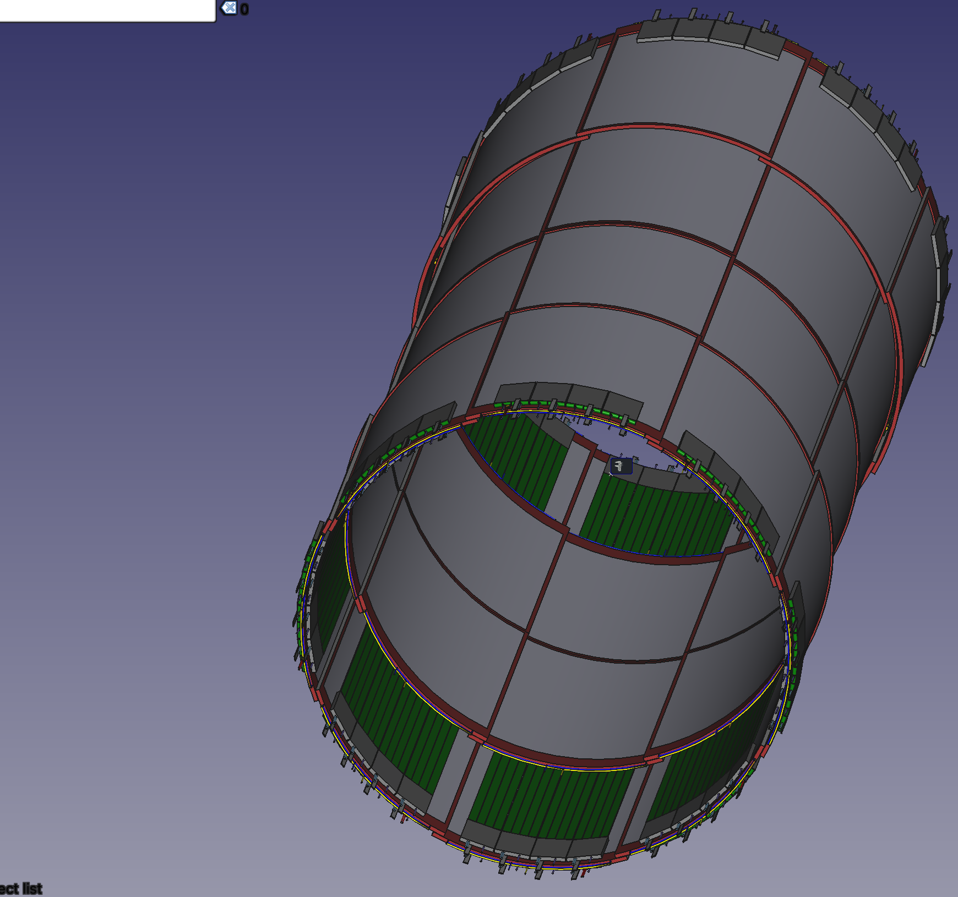

Inner MPGD CyMBaL Status
Fabien Jeanneau, for the CEA/Saclay IRFU team
EIC/EPIC 3I meeting, 30th june 2025

Slide 2
CyMBaL re-design in 12 sectors
Because of constraints on the EPIC detector installation and maintenance, CyMBaL is now suggested to move from a configuration of 8 to 12 independent sectors, supported on the external GST support, in order to make it more serviceable.
Global re-design which needs to be validated in terms of physics performances, readout electronics configuration and development plan.
From 32 to 48 modules of ~33 cm width: production plan changes (toolings, schedule, cost)
Cylindrical Vs flat tiles : estimated 0.5% to 1% X/X0 radiation length increase if flat
Change in width leads to a complete re-design of the detector readout with an increase of the number of electronics channels :
FEB: 128 → 144 (+12,5%)
SALSA: 512 → 576 (+12,5%)
Not enough room in 33 cm width to put 4 FEB (only 3)
Questions:
2D readout anode Vs independent x/y readouts ?
Strip pitch Vs track reconstruction?
Increase of electronics channels & FEBs Vs global ePIC DAQ readout (move back to RDO, more DAM cards ?)
Maintain hermeticity with active area overlaps, or if not possible, check global performances
New design : precision in Z | Z | Phi
External dimensions (cm) | 67 | 33
Active area (cm) | 59 | 31
# strips / pitch (mm) | 576 / 1,02 | 192 / 1,6
# SALSA | 9 | 3
# FEB | 3
New design : same ch number | Z | Phi
External dimensions (cm) | 67 | 33
Active area (cm) | 59 | 31
# strips / pitch (mm) | 512 / 1,15 | 256 / 1,2
# SALSA | 8 | 4
# FEB | 3
Precision in Z
Downgraded track reconstruction performances
Major change: inputs needed from performance and reconstruction requirements, simulation
and from global integration (3D CAD model – GST+TOF+rails)

Slide 3
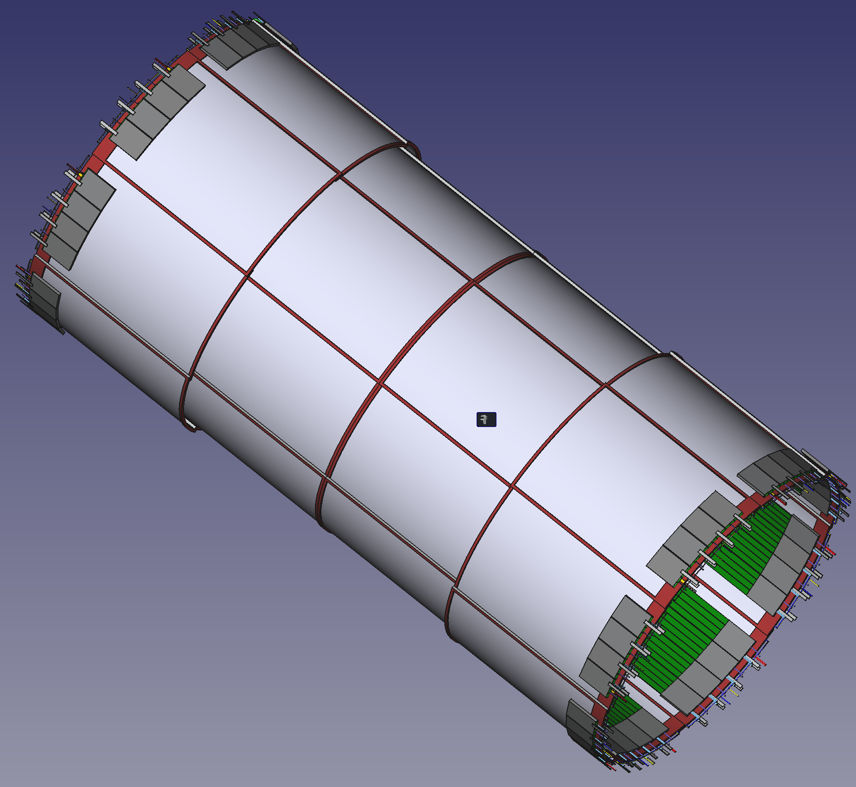
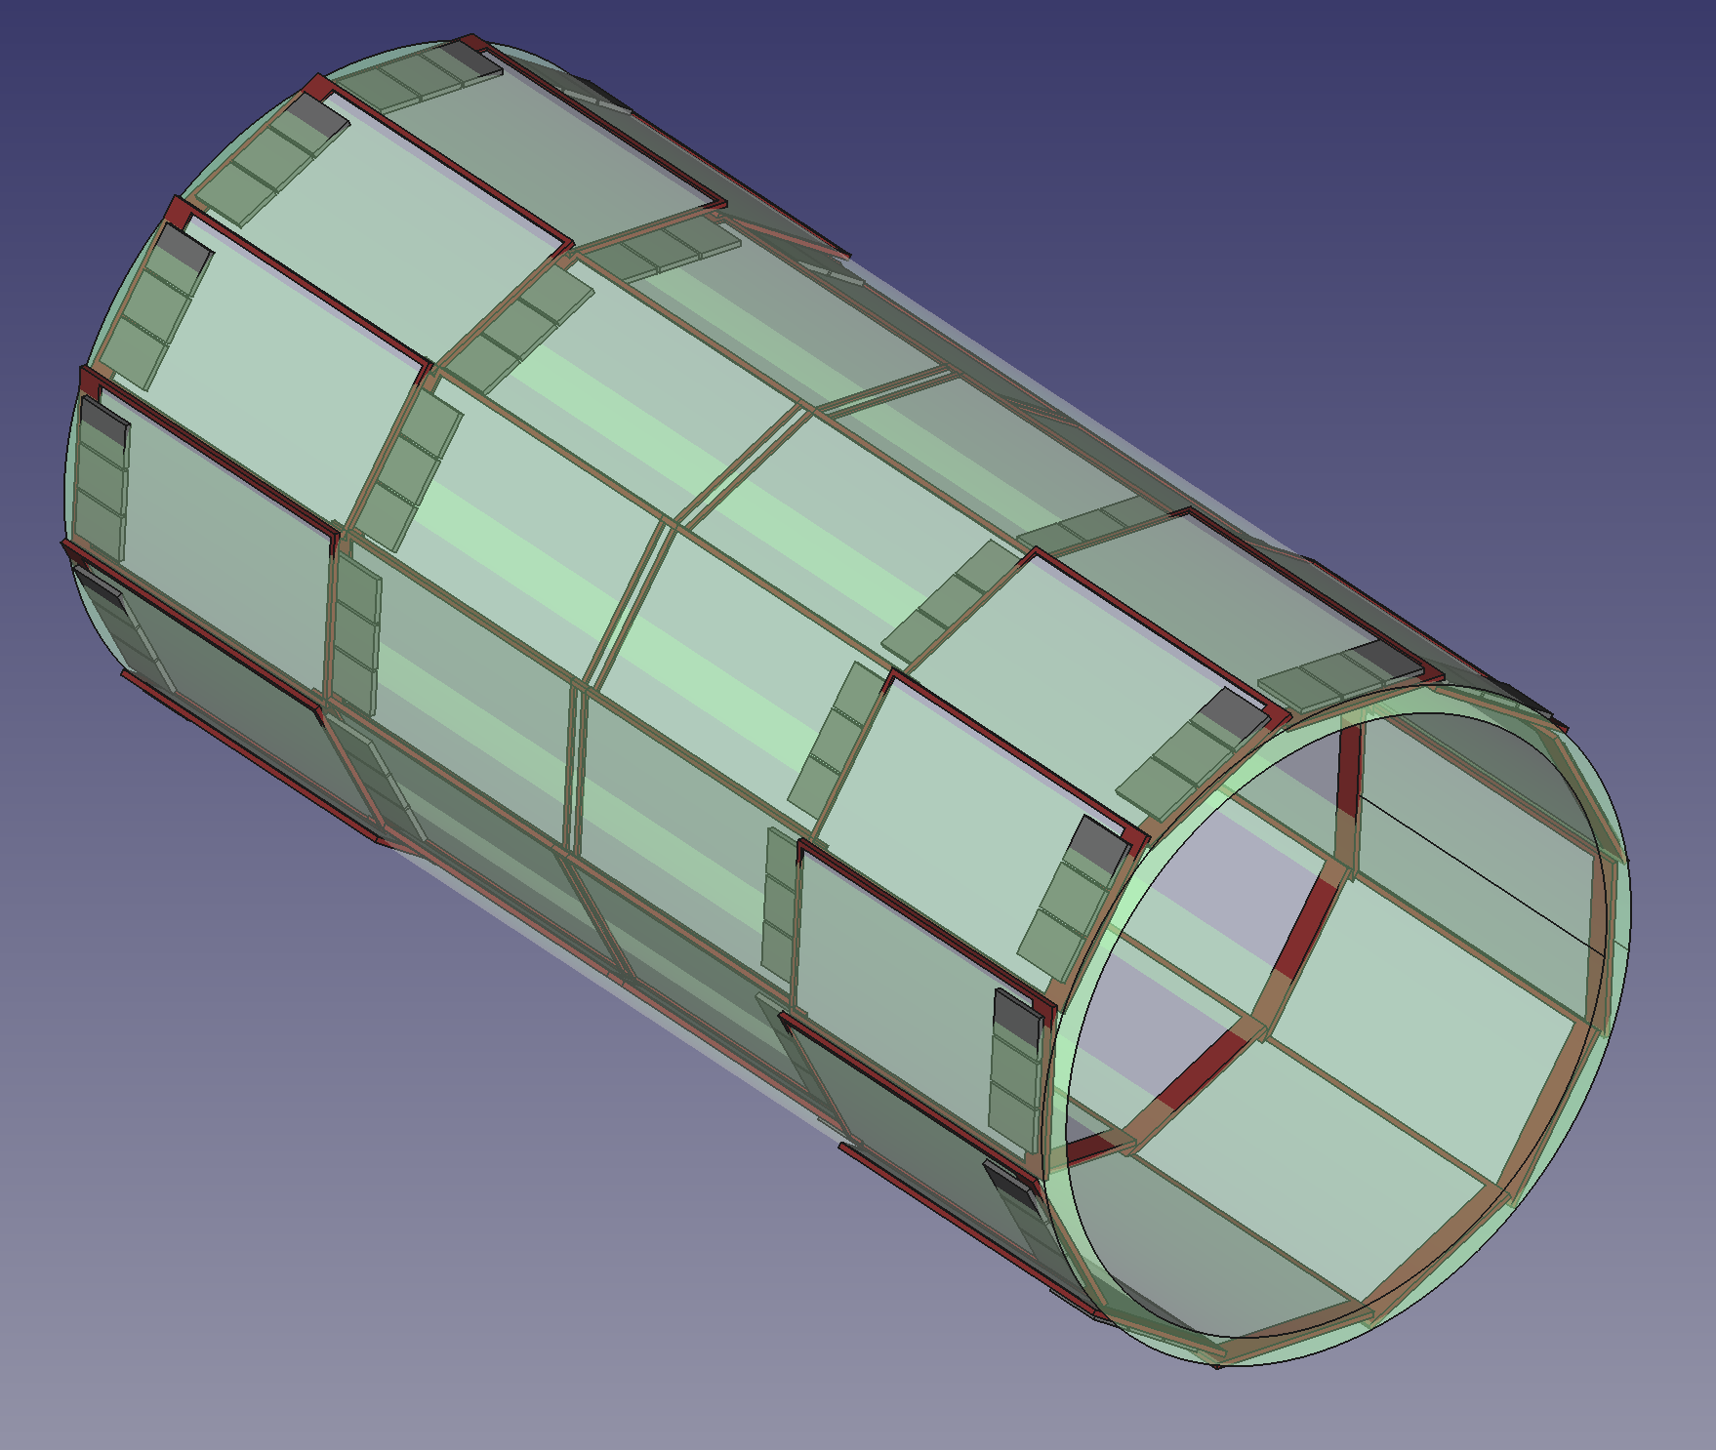
From 8 to 12 inner MPGD sectors …
Current design
32 Cylindrical Tiles
48x57 cm²
Pitch : ~1.1 mm
128 x 256 ch. FEBs
On-going study
re-design in 12 sectors
33x67 cm² flat tiles

Slide 4
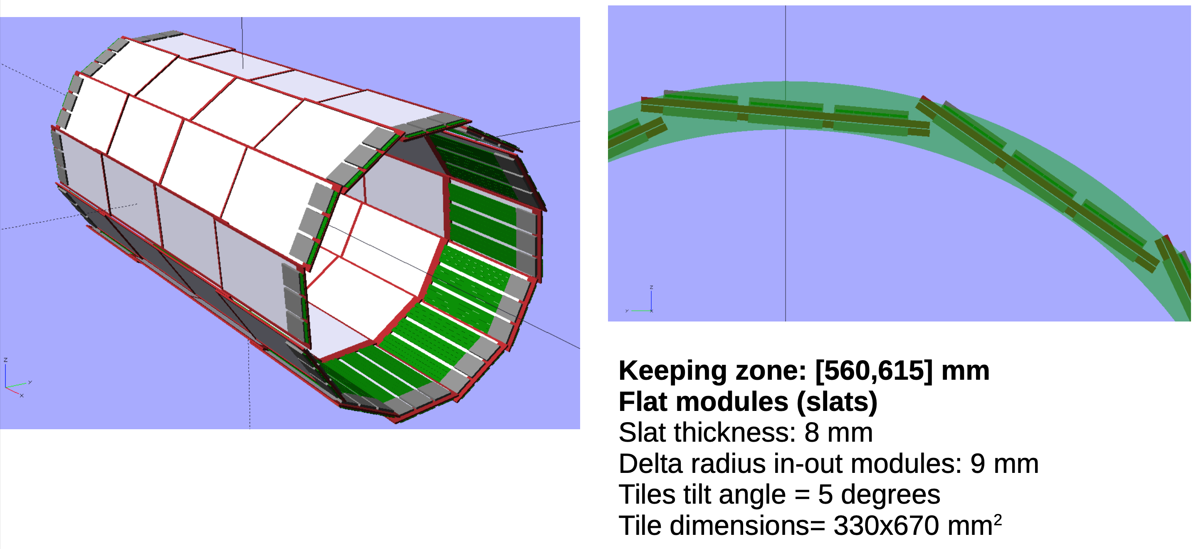
12 slats model
Difficult to maintain full hermeticity within the current Inner MPGD envelop …

Slide 5
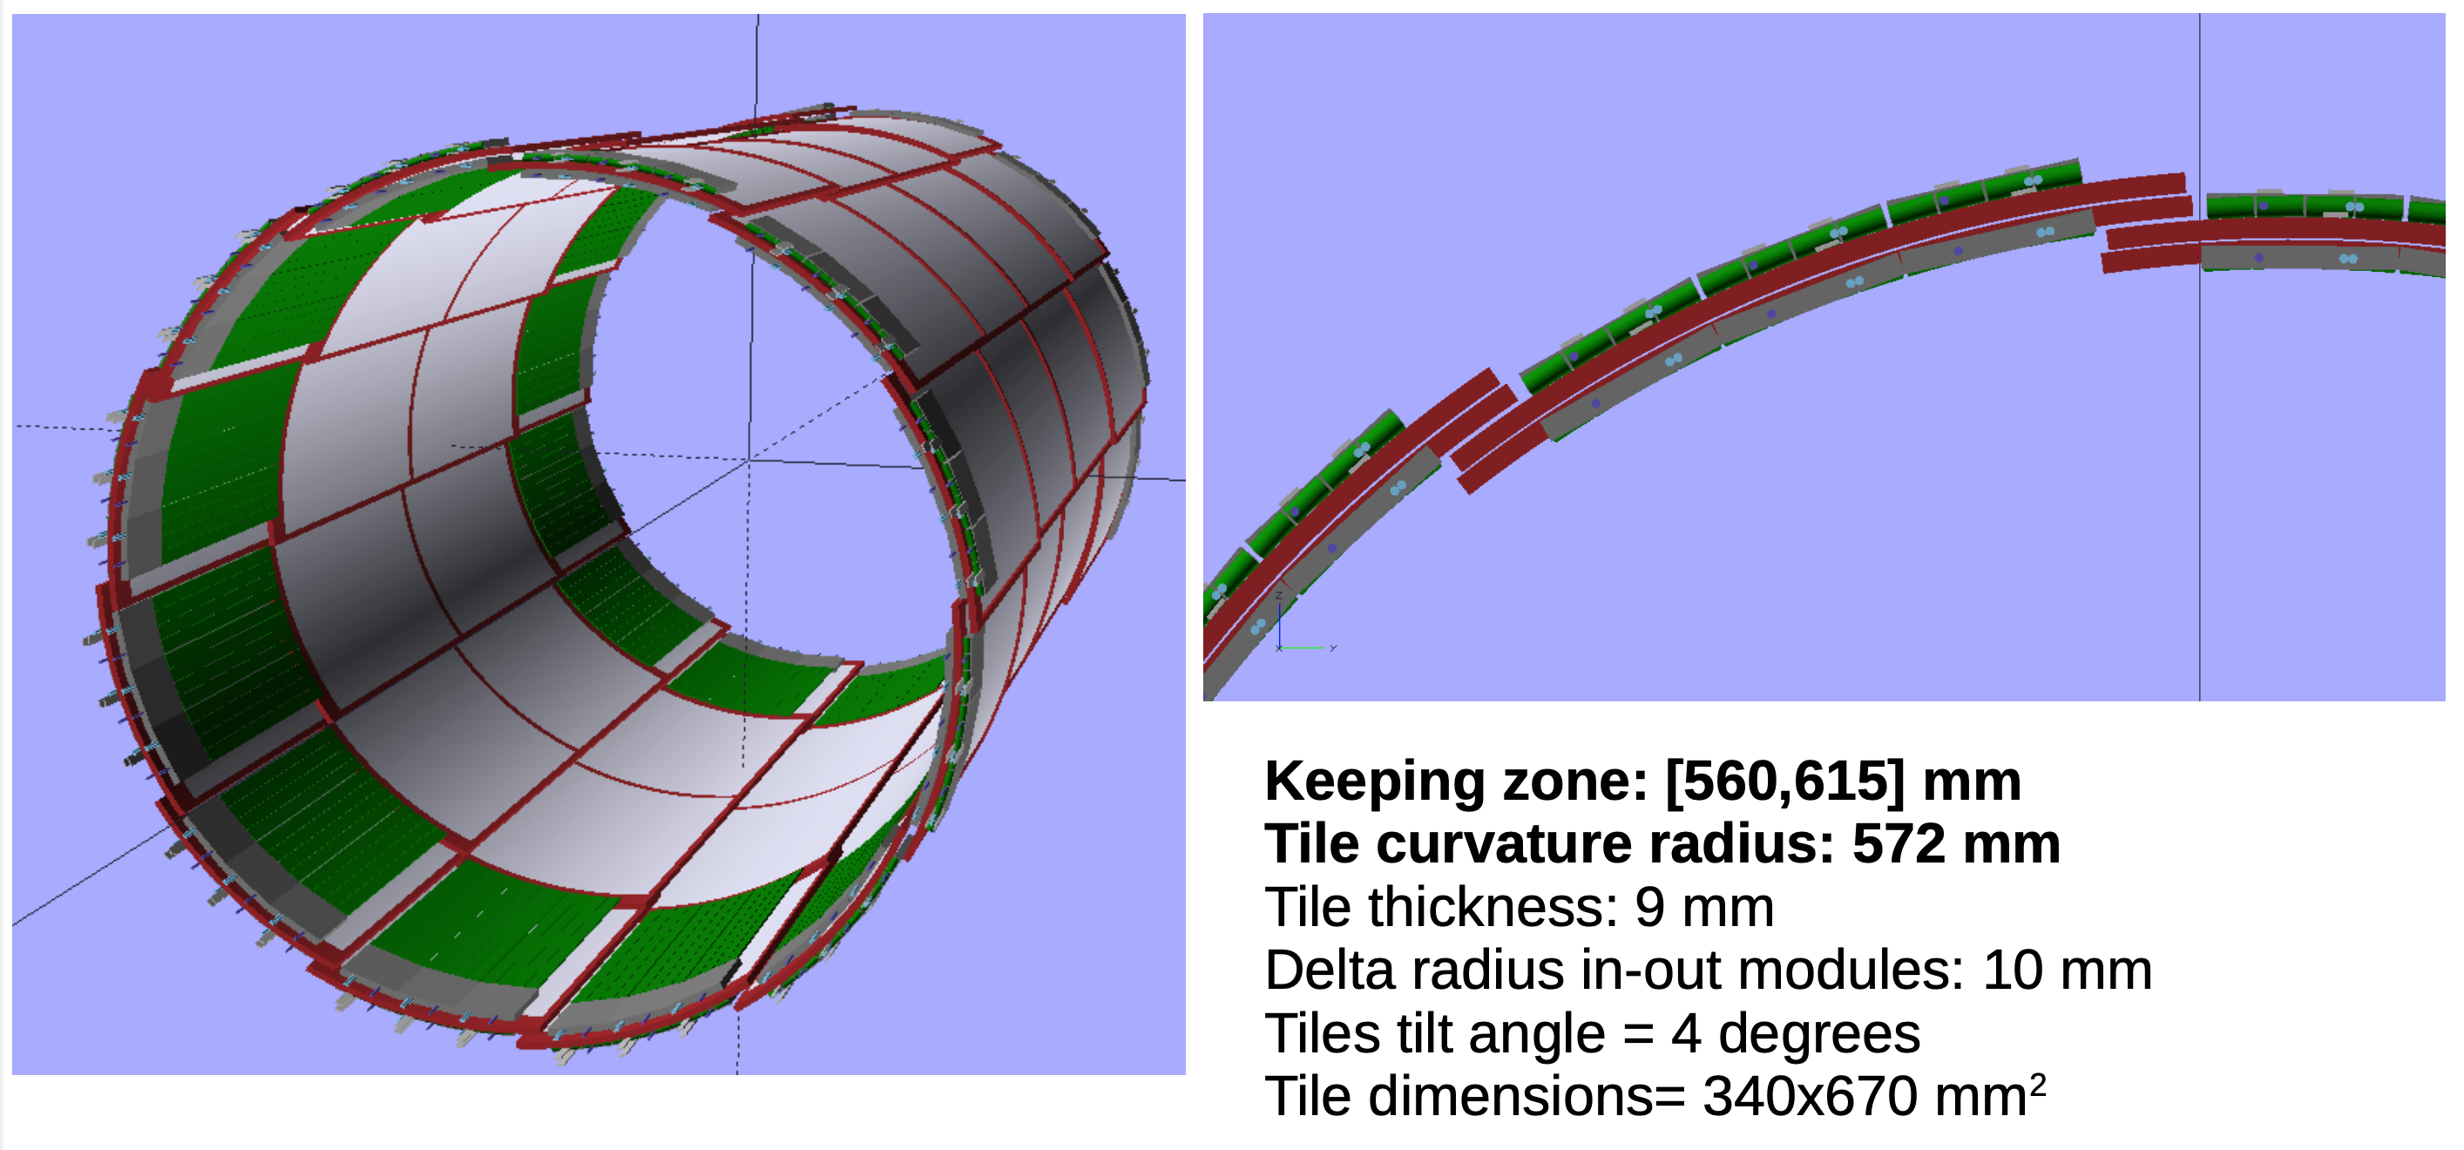
12 fish scales model

Slide 6
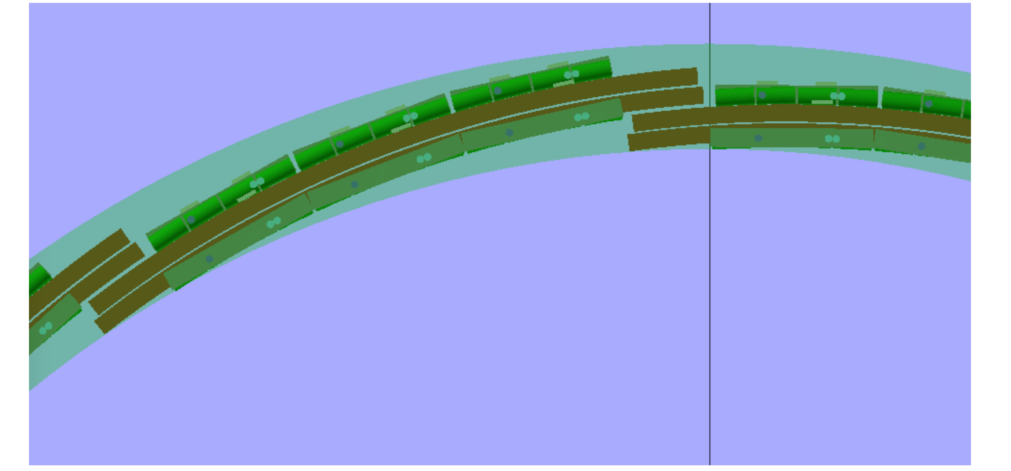
Check with keeping zones

Slide 7
Preliminary remarks
A larger envelope is needed: [560 ; 615] mm, thus 5 mm more than foreseen
Module feasibility study needed in terms of thickness, dimensions, etc.
Overlap in Phi seems ok
Overlap in Z must be studied, specially depending on the fixation system
3D model, and meeting with CAD engineer, needed to study fixation mechanics, services, etc. of a complete sector

Slide 8
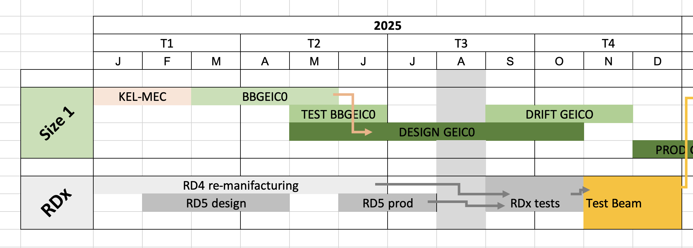
CyMBaL development timeline (under revision)
2025
2026
2027
2028
2030
R&D and design (RDx)
Scale 1 proto
GEICO
Pre-production
Production (+ 6 months ?)
Installation
Finalization of the 2D readout R&D
Choice of the r/o (test beam)
Design of scale 1 prototype
Production and tests of the proto scale 1
Validation of the tile design
Production and tests
Tests & Validation with SALSA2 FEB
Production of 32 (→48) tiles
Validation with cosmics and Fe55
Tests and production of SALSA3 FEB
Validation of the FEB→DAQ chain with detectors
Shipments to BNL
Commissioning at BNL
+ MPGD base material change to Dynamask
New 12 sectors
CyMBaL Design
Active area coverage
Planar Vs Cylindrical
Ch. Count Vs readout pitch
New FEB design & ch. Numbers
Vs ePIC DAQ ?
FEB cooling simulations expected in sept 2025
RD5 PCB delivery

