Slide 1


MPGD Endcap Tracker Interconnection Structures and Integration
Stefano Gramigna (sgramigna@roma2.infn.it) on behalf of the ECT group:
C. Ammendola, R. Ammendola, M. Bondì, A. D’Angelo, R. Di Salvo, A. Fantini, L. Lanza, S. J. Lee, G. Nobili, E. Sidoretti, L. Torlai
July 28th 2025 – Infrastructure and Integration Meeting

Slide 2
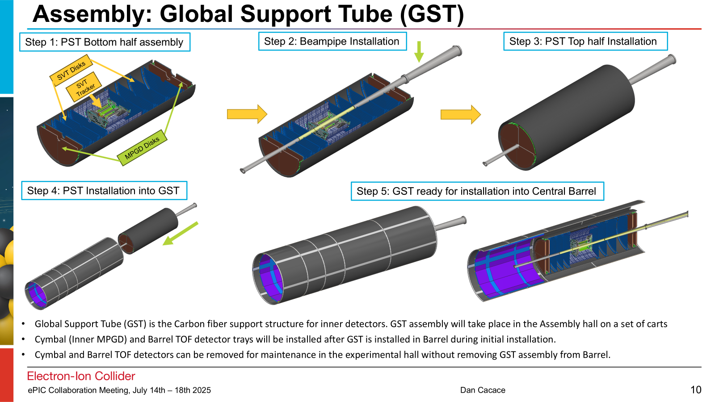
Issues with Current ECT Integration
ECT quadrants overlap, either internal clearance in Z (limiting for ECT) or precise alignment will be necessary for the installation of PST’s top half

Slide 3

Issues with Current ECT Integration
NOT HERE
BUT HERE
We can bypass the problem by installing the modules frontally, with the PST already closed and the beam pipe in place

Slide 4
Principles
Threaded standard
Through standard
Through low profile
Threaded spacer
Threaded spacer
reversed
Glued pins handle module to module interfaces
Possible materials are brass, SS 316, PEEK, and PERMAGLAS (+ SS HeliCoil)

Slide 5
Principles
The detector’s back panel acts as reference, pins are glued in a 1.5 mm deep counterbore, the head of the pin sticks out 0.5 mm (standard)

Slide 6
Principles
A nominal detector thickness of 16 mm is assumed
Actual thickness should be closer to 15.7 mm
Standard pins stick out 0.5 mm at each side w.r.t. the nominal detector thickness
Spacer pins add 2 mm in a chosen direction
Glued stack
SPACER PIN
This ensures that interfaces are not affected by errors accrued when gluing the detector stack

Slide 7
Principles
A second counterbore on the front panel provides a glue reservoir for epoxy sealing

Slide 8
Principles
FEBs and service inlets/outlets will not be accessible once all the modules are in position
Cables and service lines (up to the patch panels) must remain connected to the modules

Slide 9
Principles
No fine mechanical alignment is pursued
Software alignment with data from magnet-off runs should provide better results anyway
Golden tracks from the silicon tracker will be used as reference
Overlapping portions of the quadrants could be used for alignment if needed (4 points per track in these regions)

Slide 10
Starting Point
No. 4 mounting brackets already mounted on PST at 0°, 90°, 180°, 270°
(Nothing prevents a 45° rotation of the whole detector at present)

Slide 11
Mounting Brackets Preliminary Design
No. 2 designs for mounting brackets (mirrored across the vertical plane)
Just a placeholder proposal until PST design is frozen

Slide 12
Integration procedure
First quadrant installed is top-right

Slide 13
Integration procedure
Fixed to the mounting brackets with a single M4x16 screw at each corner
(M4 in Ø4.3 for the time being, subject to changes)

Slide 14
Integration procedure
The second quadrant installed is bottom-left, similarly fixed to the mounting brackets (temporary supports might be useful at this stage)

Slide 15
Integration procedure
A two-part interconnection ring (PERMAGLAS) is pre-assembled around the beam pipe and then fixed to the quadrants with M4 screws (brass, SS 316, or PEEK)

Slide 16
Integration procedure
The third quadrant installed is top-left, fixed first at the mounting brackets …

Slide 17
Integration procedure
… Then to the other quadrants near the central cavity …

Slide 18
Integration procedure
… and finally to the bottom level quadrants again where the spacer pins are located. 2 mm separate the two levels of modules

Slide 19
Integration procedure
Bottom-left quadrant is similarly installed to complete the first disk

Slide 20
Integration procedure
A two-part interconnection pipe (PERMAGLAS) is pre-assembled around the beam pipe

Slide 21
Integration procedure
A two-part interconnection pipe (PERMAGLAS) is pre-assembled around the beam pipe

Slide 22
Integration procedure
And then fixed to the interconnection ring and to the top-level quadrants with M4 screws

Slide 23
Integration procedure
The second row of mounting brackets can now be installed

Slide 24
Integration procedure
The module’s mounting sequence repeats itself. Top-right quadrant is secured to the mounting brackets and to the interconnection pipe with M4 screws

Slide 25
Integration procedure
The bottom-left module is similarly installed

Slide 26
Integration procedure
Then top-left

Slide 27
Integration procedure
Low-profile screws are used to secure the top-level modules of the second disk These are the only special screws in the assembly

Slide 28
Integration procedure
The installation of the bottom-right module follows next, concluding the assembly

Slide 29
Changes to FEB Form Factor
FEB PCBs had to be shrunk by 2 mm to accommodate the interconnection structures and maintain a 5 mm clearance between facing boards

Slide 30
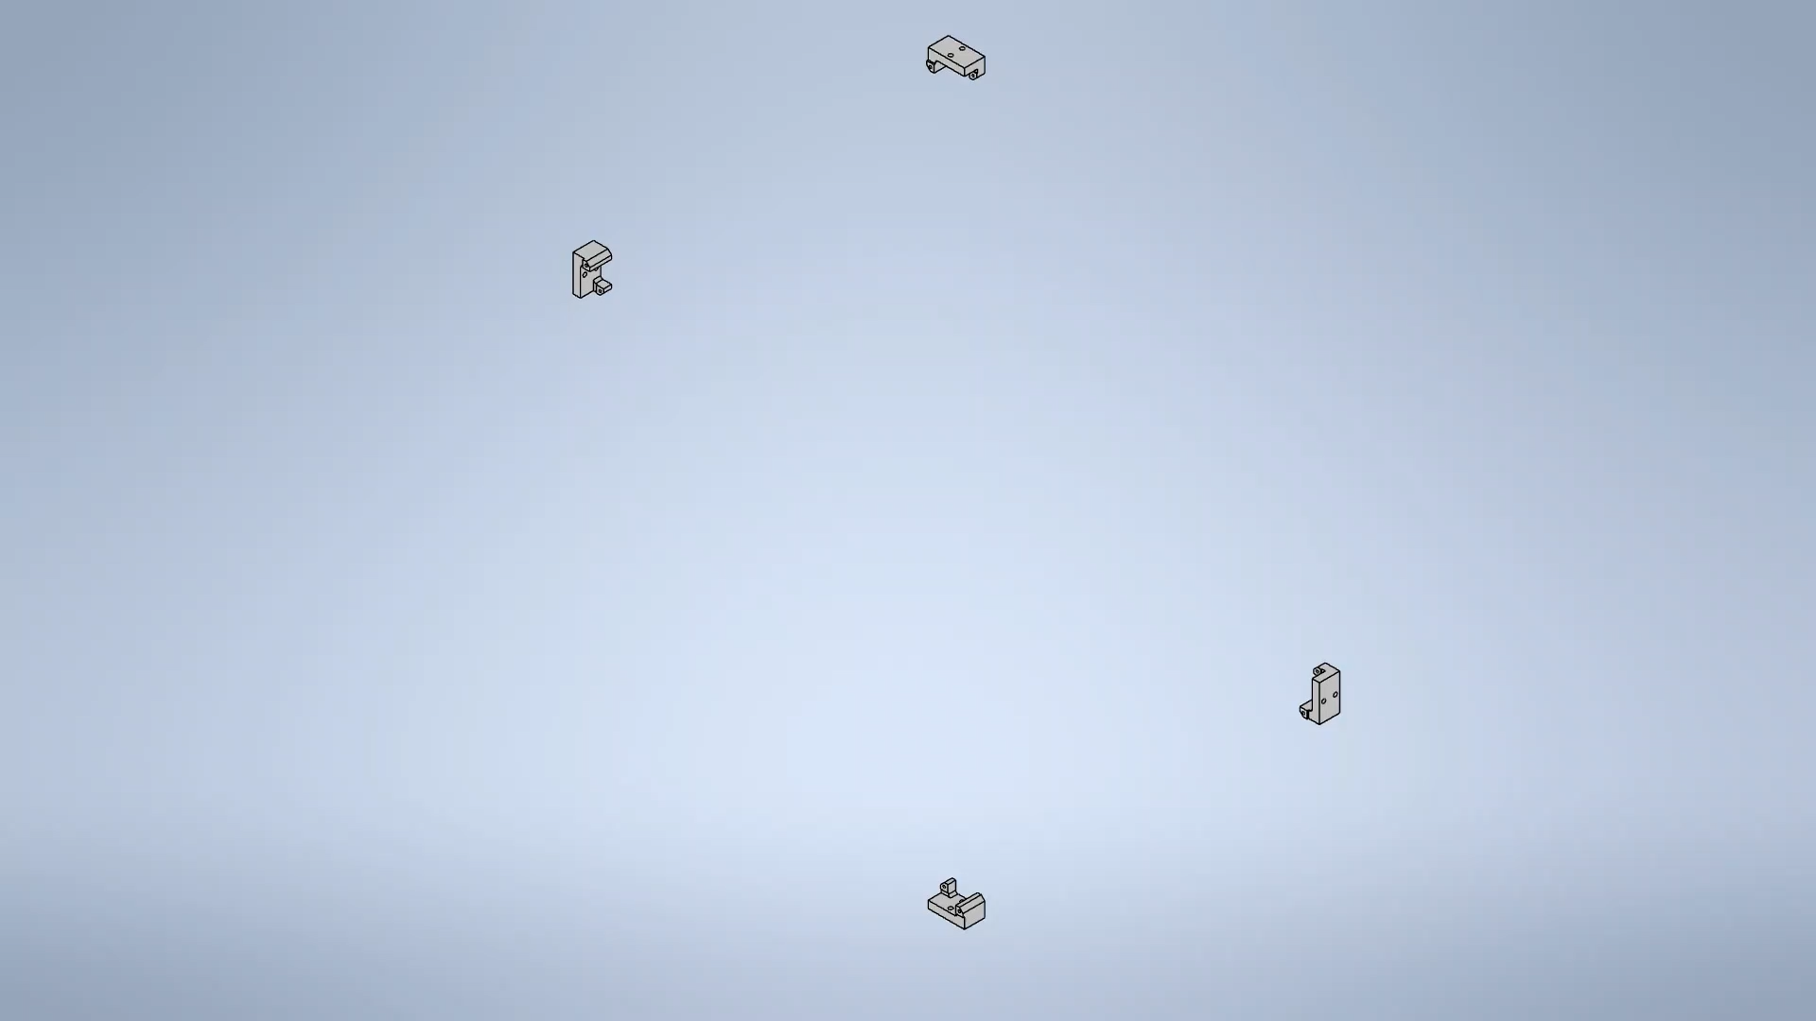
Screw-by-screw Video of the Procedure

Slide 31
Conclusions
A first proposal for structures interconnecting the ECT modules on the lepton side is presented
An integration sequence only requiring frontal access and applicable with the beam pipe already in place was developed in accordance
Mechanical interfaces are rendered independent from the glued detector stacks (which are prone to accumulating errors)
FEB form factor had to be adjusted, now consisting of two 110x52.5 mm² PCBs
Hadron side geometries are more complex due to the asymmetric central cavity, but the same solutions can be applied

