Slide 1
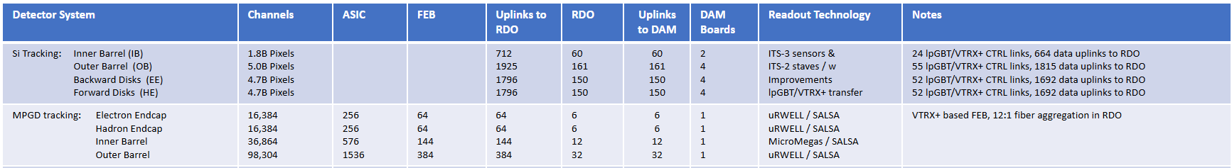
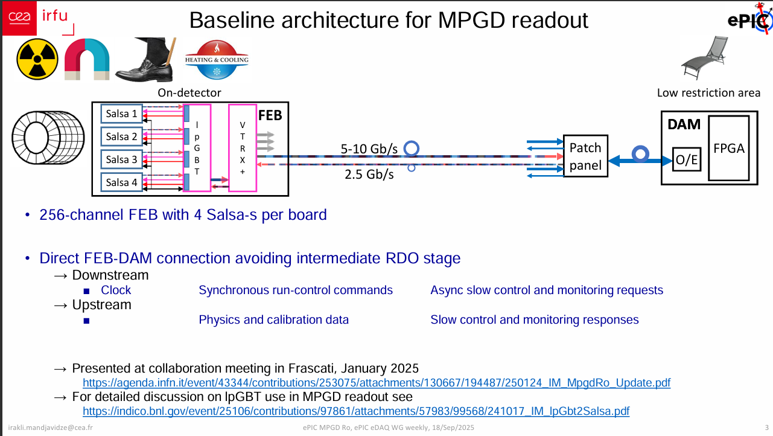
MPGD Readout Baseline
Sept, 2025
Irakli Made Request but not interpreted as a request to change the baseline by DAQ…
Recent discussions of RDO development brought this back to light

Slide 2
Expected Data Volume (2024)
These are the DAQ interpretation of 2024 Background Group Estimates – are there better ones?
BackwardMPGDEndcap DIS Electron Beam Proton Beam Gas Total
-------------------- --- -------------- --------------- -----
asic Max: 27.3 kHz 446.0 kHz 19.8 kHz 493.1 kHz
Sum Hits Sum: 600.3 kHz 2.8 MHz 161.5 kHz 3.5 MHz
asic data max: 8.7 Mbps 142.7 Mbps 6.3 Mbps 157.8 Mbps
Sum data sum: 192.1 Mbps 889.5 Mbps 51.7 Mbps 1.1 Gbps
ForwardMPGDEndcap DIS Electron Beam Proton Beam Gas Total
-------------------- --- -------------- --------------- -----
asic Max: 616.5 kHz 208.1 kHz 30.8 kHz 834.2 kHz
asic Sum: 5.4 MHz 1.4 MHz 318.7 kHz 7.1 MHz
asic data max: 197.3 Mbps 66.6 Mbps 9.9 Mbps 267.0 Mbps
rdo data sum: 1.7 Gbps 446.4 Mbps 102.0 Mbps 2.3 Gbps
OuterMPGDBarrel DIS Electron Beam Proton Beam Gas Total
-------------------- --- -------------- --------------- -----
asic Max: 2.3 kHz 378.0 Hz 135.3 Hz 2.6 kHz
rdo Sum: 1.4 MHz 319.4 kHz 78.5 kHz 1.8 MHz
asic data max: 751.6 kbps 121.0 kbps 43.3 kbps 832.7 kbps
rdo data sum: 433.3 Mbps 102.2 Mbps 25.1 Mbps 560.7 Mbps
MPGDBarrel DIS Electron Beam Proton Beam Total
-------------------- --- -------------- --------------- -----
asic Max: 7.4 kHz 1.5 kHz 371.5 Hz 8.4 kHz
asic Sum: 1.9 MHz 576.5 kHz 108.4 kHz 2.6 MHz
asic data max: 2.4 Mbps 469.5 kbps 118.9 kbps 2.7 Mbps
rdo data sum: 607.4 Mbps 184.5 Mbps 34.7 Mbps 826.5 Mbps
21% of a single 5.12 Gb/s fiber
44% of a single 5.12 Gb/s fiber
10% of a single 5.12 Gb/s fiber
16% of a single 5.12 Gb/s fiber
Link: https://brookhavenlab.sharepoint.com/:f:/s/EICPublicSharingDocs/IgAEJRLKoX47ToBgcph0XDrVAaxSr5ZwhhmL5UTmb5_hf1Y?e=7UwuQH

Slide 3
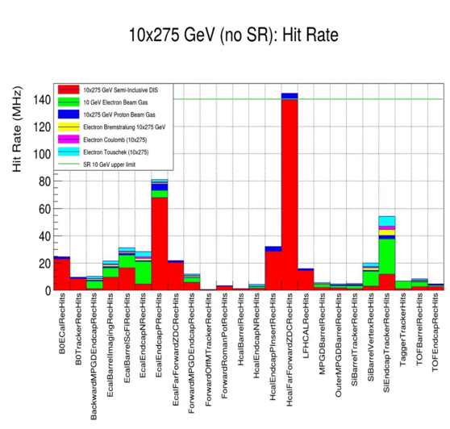
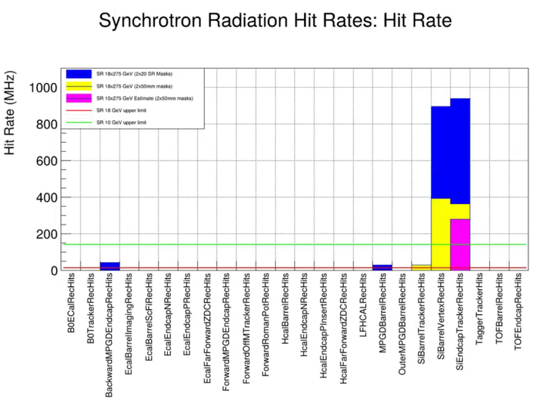
Expected Data Volume (2025)
Single Hits!
Detector | Synchrotron Hits (18x275) | Non-Sync (10x275) | Previous Hit Rate | 5.12 Gbps fibers
CYMBAL | 25 MHz | 5-10 Mhz | 1.8 MHz | 4
Outer Barrel | 0 | 5-10 MHz | 2.7 MHz | 37% of 1 fiber
Forward Endcap | 0 | 10 MHz | 7.1 MHz | 62% of 1 fiber
Backward Endcap | 50 MHz | 10 MHz | 1.1 MHz | 12
Synchrotron Radiation Inconclusive… but,
Might significantly affect Backward Endcap
Might minimally affect Cymbal

Slide 4
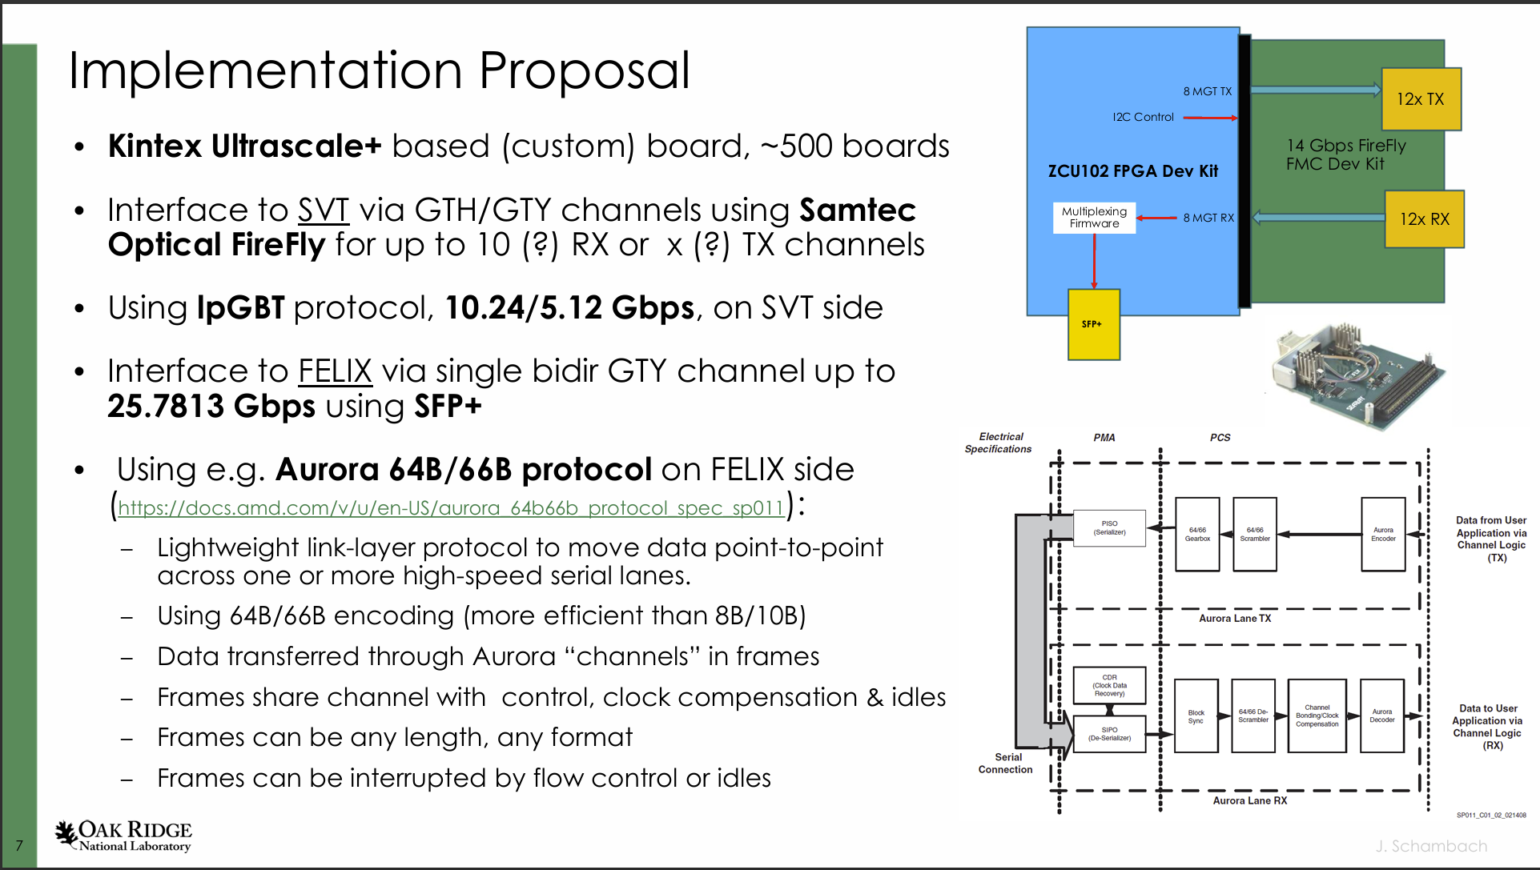
RDO Plans
Aggregates lpGBT
Data transfer path is transparent to user formats
Fast command / Slow Controls path must be capable of multiplexing data to lpGBT
An interface should be possible to make lpGBT multiplexing transparent to FEB / user DAQ software – (with reduced data throughput)
https://indico.bnl.gov/event/30532/contributions/118678/attachments/67569/116116/20260121_MVTX_Fiber_Aggregation.pdf

Slide 5
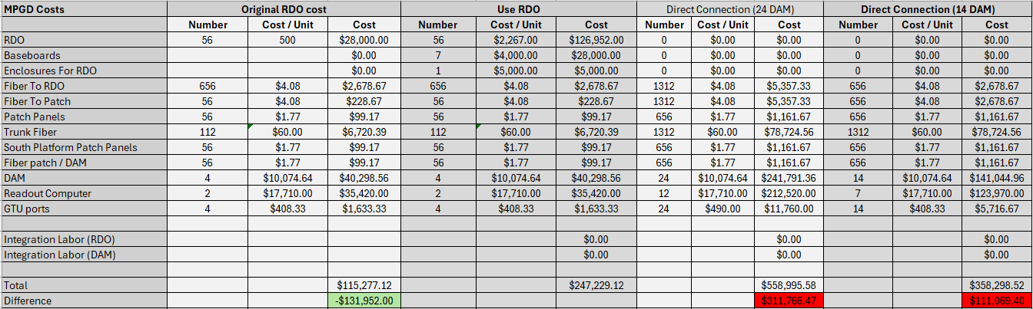
Cost Analysis
# DAM Needed: Electron Endcap 64 FEB / 48 = 1.33
Hadron Endcap: 64 FEB / 48 = 1.33
Cymbal: 144 FEB / 48 = 3
Outer Barrel: 384 FEB / 48 = 8
Total = 14
Readout Computers => # DAMS / 2
September Presentation requested 24 DAM

Slide 6
Summary
The Aggregating lpGBT RDO will be developed in any case for SVT
FEB protocol is identical whichever solution is chosen
Space on platform is plentiful and RDOs are physically small (expectation that all MPGD RDOs would fit in a single VME crate sized object)
Can choose either baseline, and “easily” change if necessary
There are negatives to direct connection:
Extra Fiber in confined / complex region
Extra DAM / Readout computer in DAQ Room (limited space / cooling)
Slightly higher cost for hardware
Main positive to direct connection is integration:
Aggregation Issue can likely follow SVT solution
Main issue is software for addressing slow controls
Backward Endcap may need direct connection (or less aggregation at RDO) due to Synchrotron Radiation)
Costs seem close enough that we can reduce integration labor to compensate for additional hardware
From DAQ/project perspective we can follow MPGD groups choice

