Slide 1
MPGD Gas System Discussion
May 7th, 2026 • MPGD-DSC General Meeting

Slide 2
Our Latest Interaction on the Matter
ePIC Collaboration Meeting @ BNL in Jan 2026

Slide 3
Preliminary/General Considerations
The cleanliness of components/piping in contact with the gases is a fundamental requirement for MPGDs:
Outgassing safe polymers/resins
Low wear metallic parts
Particulate Filters
Integration with slow-control (SC) / interlock (IL) is necessary to ensure the safe operation of the detectors
The MPGD Gas System will be common to all three subdetectors

Slide 4
Gas Storage and Supply
All three subdetectors will operate with the same gas mixture:
Ar:CO₂:iC₄H₁₀ (93:2:5) is the main candidate
To be validated in the coming 2026 test beam campaigns
Flushing with nitrogen will be required whenever the operating gas mixture is not circulating to prevent humidity from entering the detectors
The operating mixture should be as pure as realistically possible to achieve consistent gas gains and reduce aging:
Ar → Grade 6.0 (99.999%)
CO₂ → Grade 4.5 or better (99.995%)
iC₄H₁₀ → 99.5% or better
Grade 5.0 (99.999%) N₂ is sufficient for flushing
Isobutane requires warm storage and/or pre-heating to avoid transition to liquid phase in the colder months

Slide 5
Example Gas Storage and Supply Block Diagram
Ar, CO₂, N₂
Bottles
Pressure regulators
SS pipes
Pressure regulators
Pressure Regulators
To the Gas Mixer
Warm Storage
iC₄H₁₀
Bottle
Pre-heater
Pressure Regulator
Insulated SS pipe

Slide 6
Gas Mixer
O(1%) errors in mixing ratio can significantly change the detectors’ behavior
No. 3 Thermal Mass Flow Controllers (MFCs) required to ensure reliable mixing ratios
5 μm particulate filters upstream of MFCs to prevent clogging and ensure accurate readings
MFCs could be used for Nitrogen and distribution too but cheaper flow regulators are likely sufficient
Clean vessels:
- Mixing volume → Homogeneous gas mixing
- Sampling volume → Offsite gas analysis
- Buffer tank → Limit downtime during bottle changes/malfunctions
Could be replaced by a
system for switching between 2 bottles

Slide 7
Example Gas Mixer Block Diagram
Ar
CO₂
iC₄H₁₀
P
5μm Filter
MFCs
5μm Filter
MFCs
5μm Filter
MFC
Sampling volume
P
Buffer Tank
Pressure Regulator
Mixing Volume
T
H
Pressure Regulator
FLUSH
FLUSH
To Distribution
N₂
5μm Filter
MFC/Flow Regulator

Slide 8
Distribution
3 main lines, 1 per subdetector
Distribution to modules or groups of modules can be handled by flow regulators
The total number of distribution lines per subdetector is determined by operation requirements and service routing constraints:
Each subdetector group will address connection to the modules and local distribution

Slide 9
Example Distribution Block Diagram
MFC/Flow Regulator
To BOT Modules
MFC/Flow Regulator
To Cymbal Modules
Ar:CO₂:iC₄H₁₀
/
N₂
MFC/Flow Regulator
MFC/Flow Regulator
5μm Filter
MFC/Flow Regulator
5μm Filter
P
T
H
MFC/Flow Regulator
5μm Filter
P
T
H
MFC/Flow Regulator
5μm Filter
P
T
H
P
T
H
To ECT Modules

Slide 10
Exhaust Schemes
1)
1. Free exhaust
Risk of backflow → long lines
Susceptible to rapid pressure variations → outlet protection
2)
MFM
2. Monitored exhaust
Risk of backflow → long lines
Increases the modules internal pressure
Dangerous if clogged → regular maintenance
Easy leak quantification
3. Bubblers
No backflow
Risk of water contamination
Slightly increases the modules internal pressure
Requires periodic refilling
3)
4. Recirculation
High initial cost
Complex → more downtime due to failures
Independent from external pressure
Increases the modules internal pressure
If not mandated by unmanageable sustained costs or environmental concerns open circuit schemes are the preferred solution
4)

Slide 11
Hazards and Environmental Concerns
GAS SPECIFIC HAZARDS
iC₄H₁₀:
Flammable at 2-9% concentration
Liquifies around -12°C @ standard pressure
Not easily purified (99.99% max)
Heavy (relative density ~2) → might separate if it stagnates
Minor environmental concern (GWP = 3)
CO₂:
Corrosive → Requires SS piping, fittings, etc.
Minor environmental concern (GWP = 1)

Slide 12
Hazards and Environmental Concerns
SYSTEM SPECIFIC HAZARDS
Cleanliness:
Pipes, fittings, controllers, regulators, valves should be rated for high purity gas lines
Assembly of the system should be performed with particular care to dust formation
High flow nitrogen flushing recommended before connecting to the detectors
Pressure:
Pressure spikes can damage the detectors, safety measures and procedures should be implemented both at system design level and during operation
Rapid pressure variations at the outlets could affect the flow → exhausts should be protected
Contamination:
Residual humidity and leaks compromise detector performance
Potential outgassing from polymer components must be taken into consideration
Operational risks:
Flows in the distribution lines may depend on each other, procedures should be devised for safely varying flow rates to the modules

Slide 13
A Smaller Scale Example
Gas Mixer Unit Project for in-house Gas Optimization

Slide 14
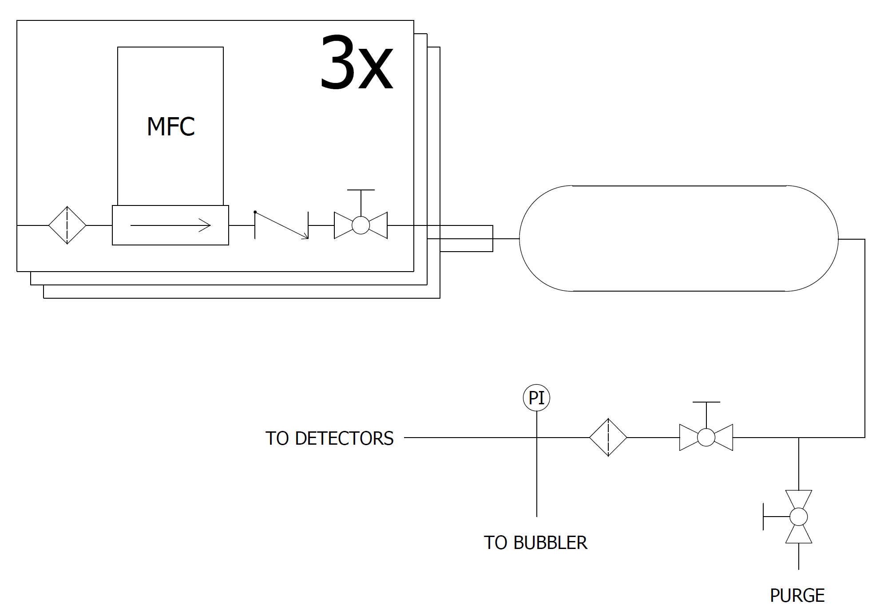
Simplified P&ID Diagram
X
$$$

Slide 15
Implementation
Color Legend
Mass flow controllers | Filters | Check valves | Control valves | Pipes | Fittings | Mixing volume | Pressure gauge | Electrical | Mechanics

Slide 16
Expected Performance
From the instruments’ datasheet:

Slide 17
Cost Breakdown (Relevant Items Only)
Item | Quantity | Cost (VAT excluded) to the nearest 50€
MFCs (MKS GM50A) | 3 | 7500 €
1000 cc tank | 1 | 550 €
Tubing (SS) | 6 (m) | 100 €
Pressure gauge (Swagelok) | 1 | 150 €
Fittings (Swagelok) | NA | 950 €
Filters (Swagelok) | 4 | 650 €
Valves (Swagelok) | 5 | 1400 €
PWR and COM | NA | 350 €
Total | 11'650 €

Slide 18
Backup Slides

Slide 19
The Role of CF₄
CF₄ might be necessary to boost timing performance but introduces additional environmental concerns
CF₄ Specific Hazards:
Major environmental concern (GWP ~6500) → might require recirculation system
Heavy (relative density ~3) → might separate if it stagnates
Very important to precisely define timing performance requirements to decide if CF₄ should be employed as a last resort

Slide 20
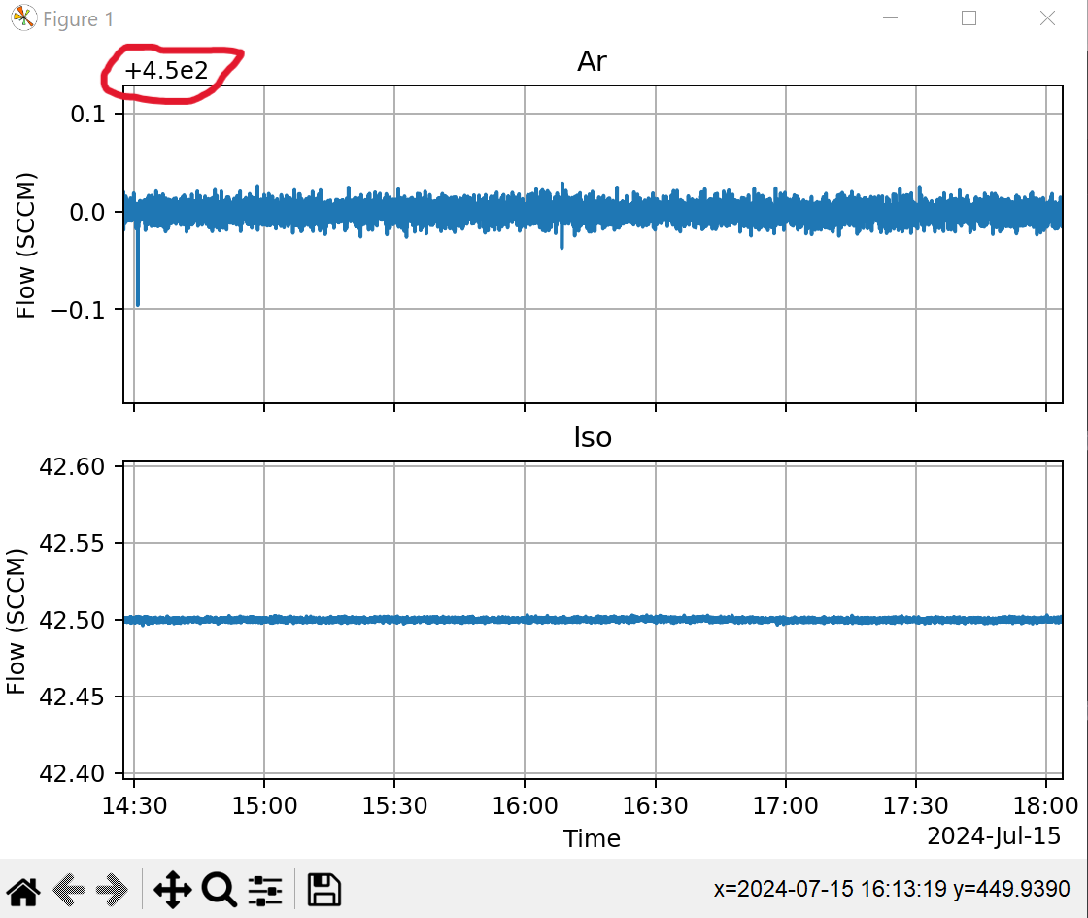
Typical Fluctuations in GM50A MKS MFCs
Example from BESIII
CGEM-IT Gas System
Running with:
Ar:iC₄H₁₀ (91.5:8.5)

Slide 21
Absolute Vs “Master-Slave” Approach
Premise
Typical fluctuations are of 2 kinds:
Environmental (relatively high amplitude but slow, tackled internally by MFC via gas-dependent corrections)
Electrical noise (very low amplitude but fast, ground dependent)
Atypical fluctuations can be fast and high amplitude, they usually can be traced back to external causes
Absolute Setting
Master Slave Setting
All setpoints for MFC-1, MFC-2, and MFC-3 are set independently
Error on Flow-1 depends on MFC-1 reading
Error on Flow-2 depends on MFC-2 reading
Error on Flow-3 depends on MFC-3 reading
Setpoints of MFC-2 and MFC-3 are set according to reading on MFC-1
Error on Flow-1 depends on MFC-1 reading
Error on Flow-2 depends on error on Flow-1 and on MFC-2 reading
Error on Flow-3 depends on error on Flow-1 and on MFC-3 reading

