Slide 1
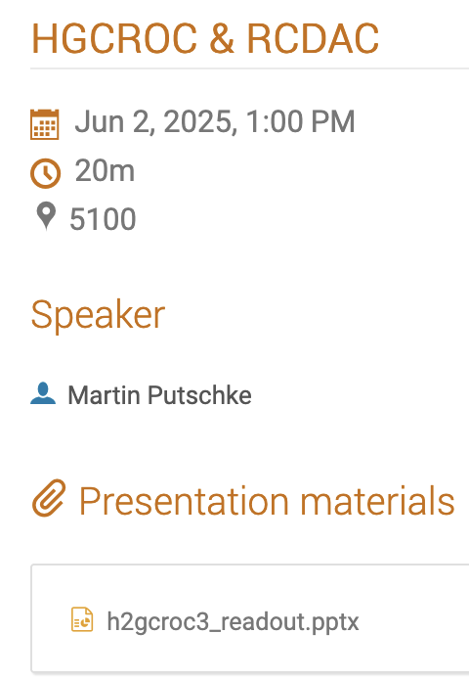
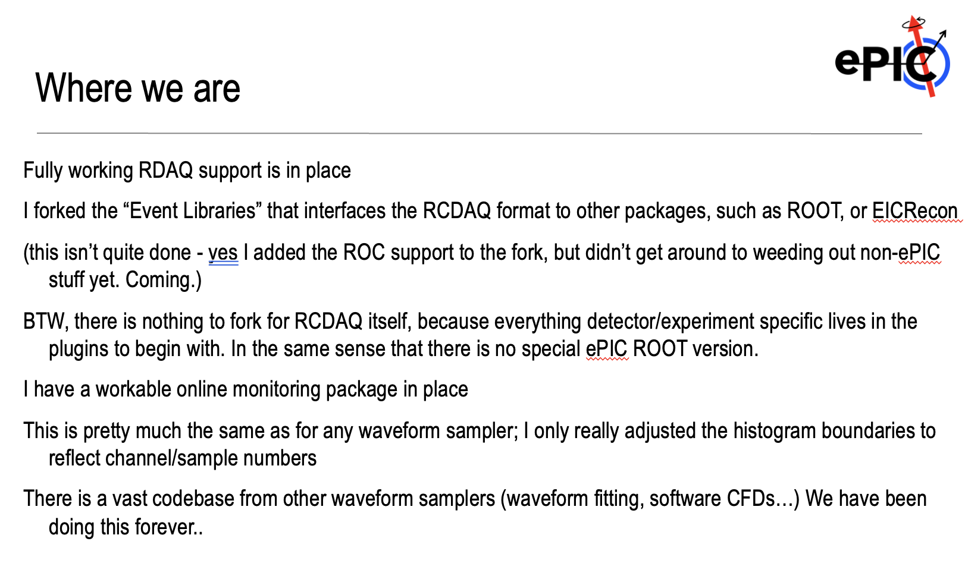
This week’s activities
This week saw the ORNL “Calorimeter Workfest”
https://indico.phy.ornl.gov/event/680/sessions/321/#20250602
I attended some of it remotely
I gave a long presentation with some “live” components on Tuesday
Some slides I show today are from that presentation
This is a screenshot of my summary

Slide 2
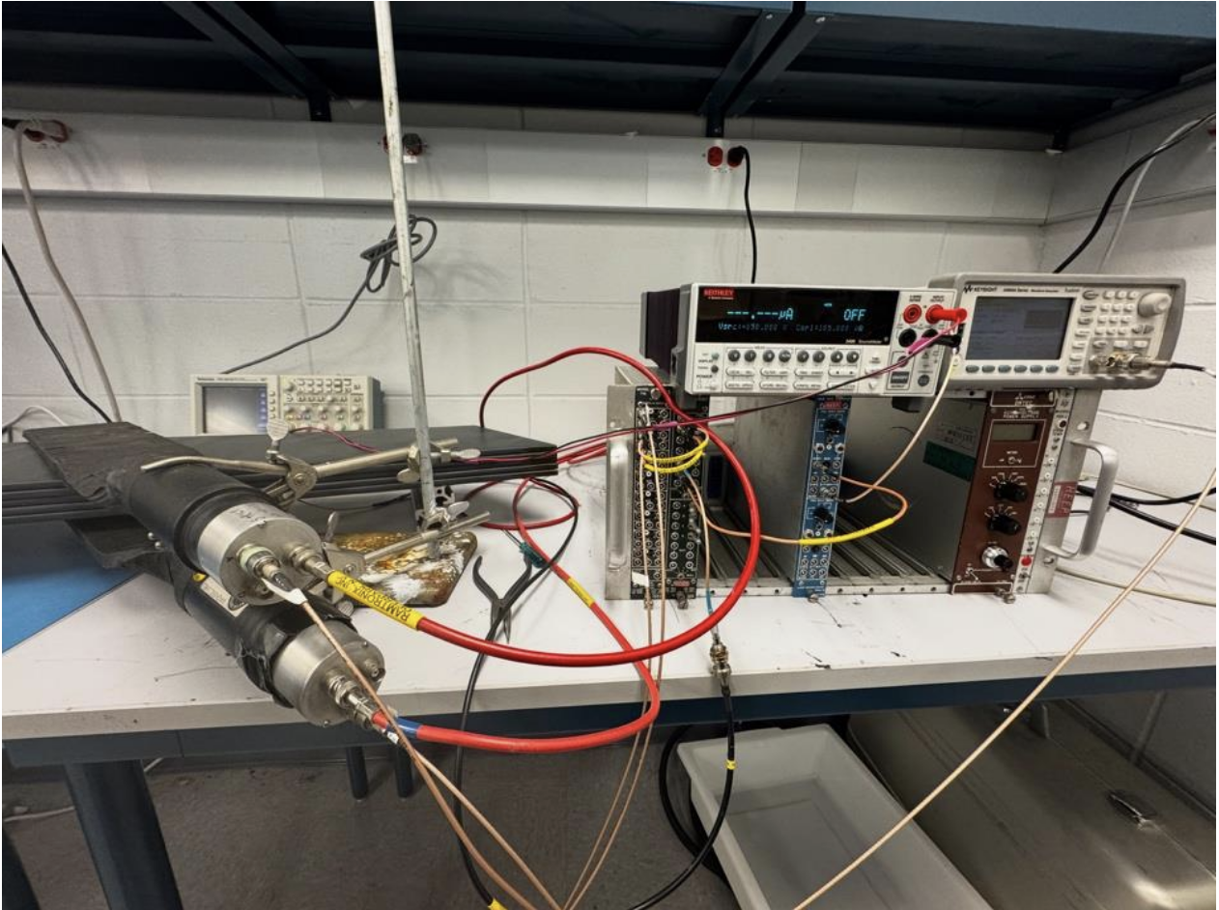
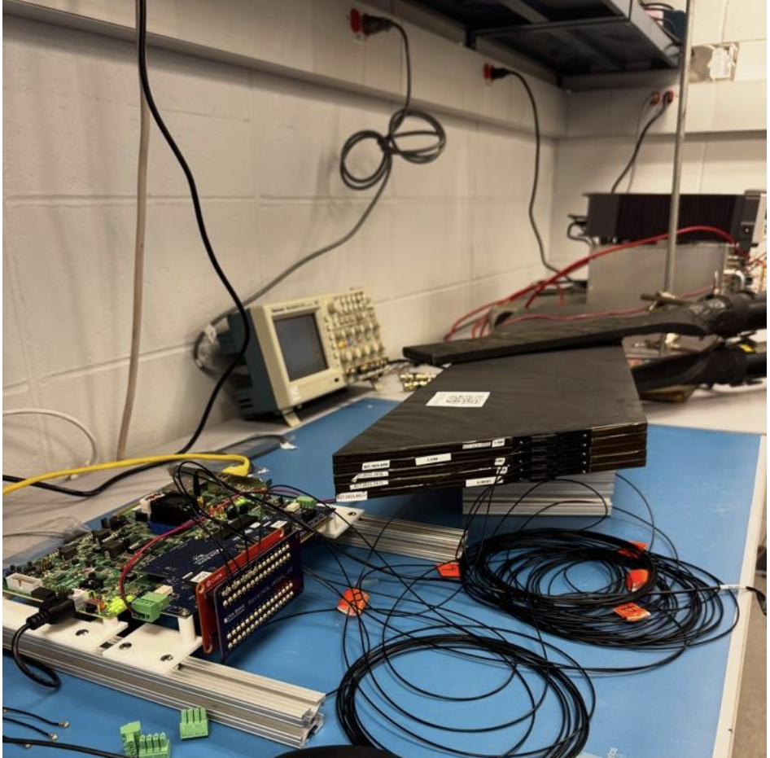
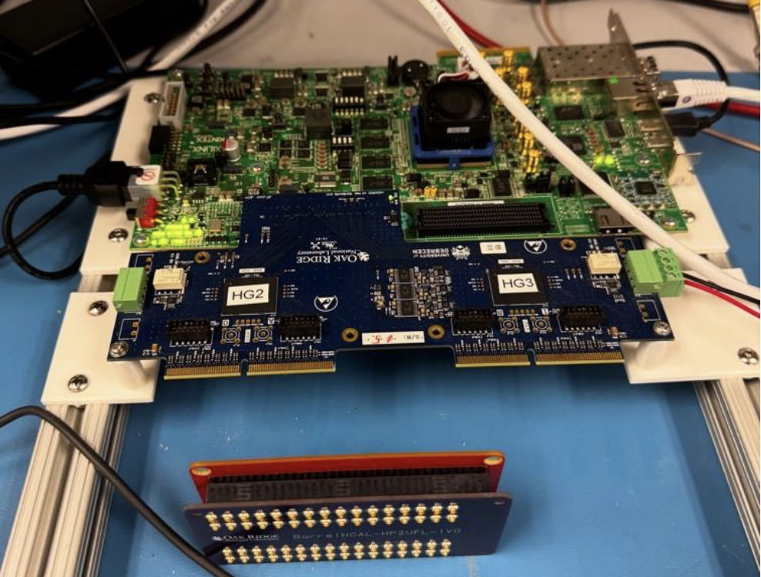
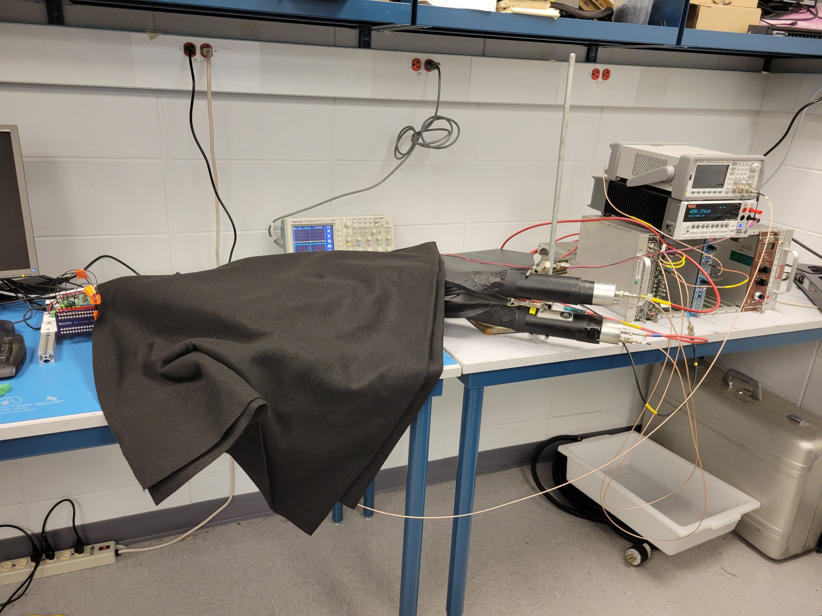
ROC readout in our Hcal Lab @BNL
5 BHcal tiles with the ePIC SiPMs connected to the H2GCROC3 card
Read out via the KCU105 FPGA board
Readout fully implemented in RCDAQ

Slide 3
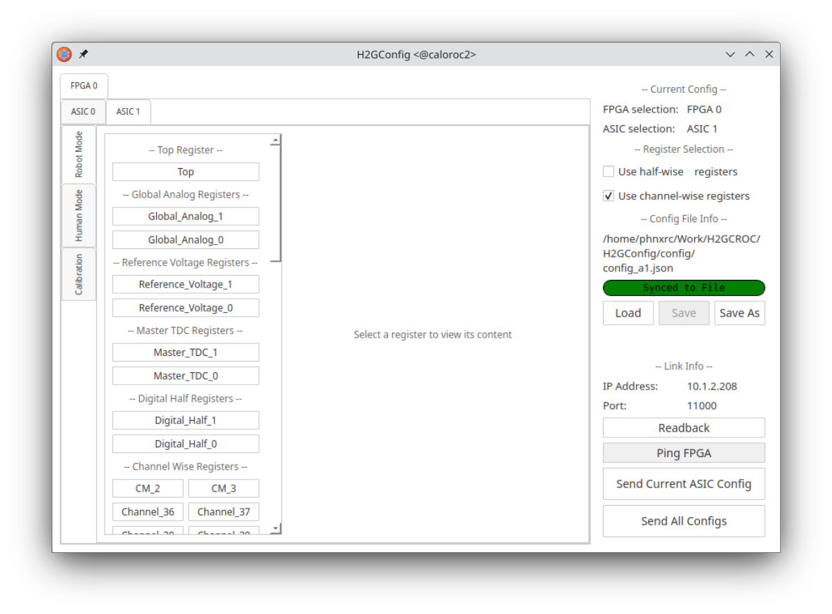
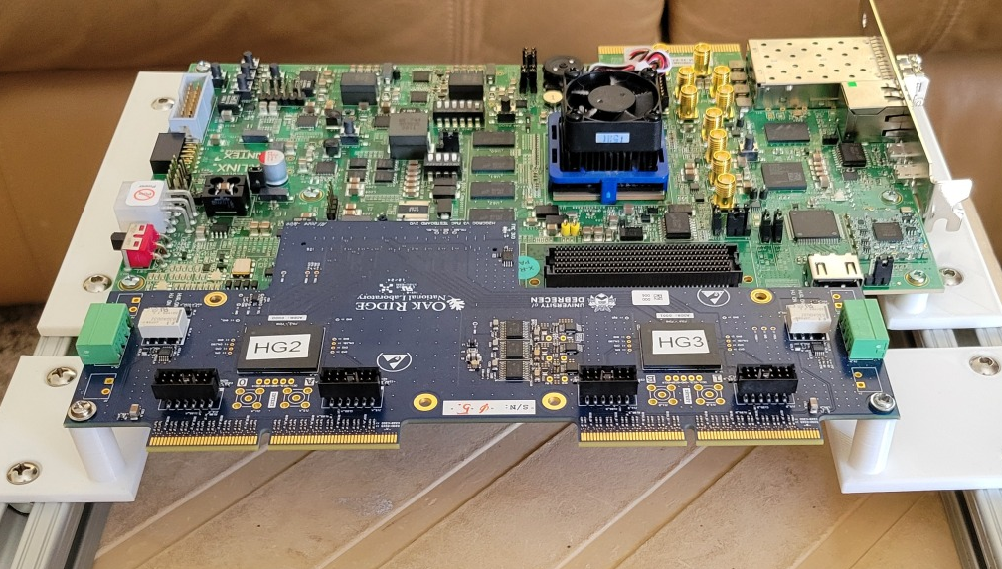
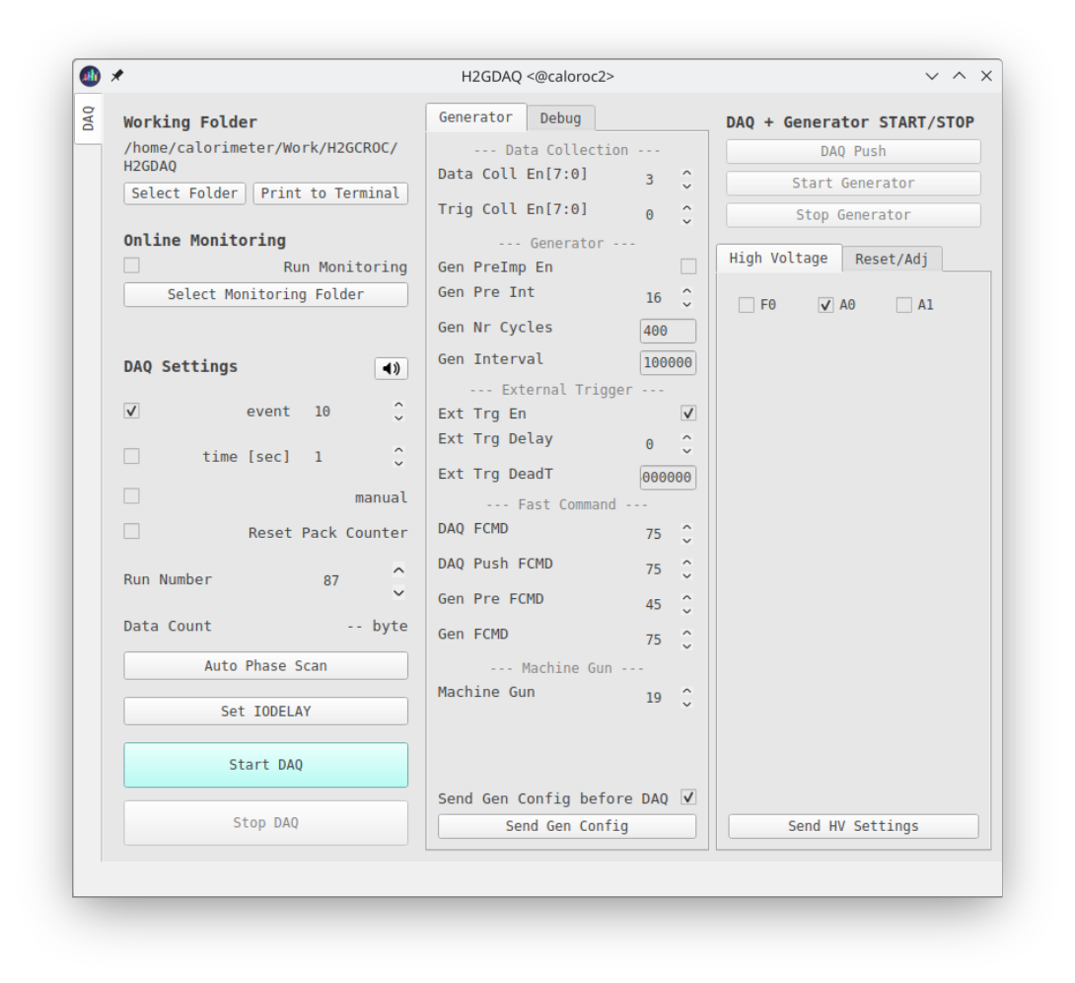
Front-end configuration vs RCDAQ configuration
Like many other devices with a vast configuration space (here: some 3000 parameters, most with reasonable defaults), the configuration of the front-end and the readout are two distinct tasks
The front-end is getting configured with two GUI-based processes (H2GConfig for the ASICs, H2GDAQ for the FPGA portion), and set up just the way we want it
RCDAQ is almost fully oblivious to the particulars of the front-end configuration, it reads whatever comes its way
It really only needs to know the IP address from which the data are coming; it also issues “start” and “stop” commands to the front-end to start or stop the flow of data – that’s all.
The standalone configuration process
We also support command based “canned” configs – GUIs are nice but can also be tedious.

Slide 4
The H2GCROC3 RCDAQ plugin
“All knowledge how to read out a device comes by way of a plugin that teaches RCDAQ how to do that.”
This shows the relevant portions of the RCDAQ setup file
It loads that plugin that teaches RCDAQ how to read the H2GCROC3 front-end
And then we create the device itself
rcdaq_client load librcdaqplugin_h2gcroc3.so
rcdaq_client create_device device_h2gcroc3 1 12001 10.1.2.208 1 128
This is all that the plugin needs to know
$ daq_status -ll
caloroc2 - Stopped
Filerule: /home/phnxrc/data/junk/junk_ROC-%08d-%04d.evt
Logging enabled
. . . Lines deleted
List of loaded Plugins:
- H2GCROC3 Plugin, provides -
- device_h2gcroc3 (evttype, subid, IP addr, trigger, nr_packets) - readout an H2GCROC3

Slide 5
Remember my script?
This is the (abridged) script that sets up the H2GCROC3 readout
rcdaq_client load librcdaqplugin_h2gcroc3.so
rcdaq_client create_device device_h2gcroc3 1 12001 10.1.2.208 1 128
I randomly assigned 12001 here – again, the number itself is meaningless as long as you know what it is
On the last slide you saw the “dlist” command that lists the packets present in one event.
Here is what we have in the H2GCROC3 data:
$ dlist /data/h2gcroc3/cosmics_ROC-00000022-0000.evt
Packet 12001 46724 -1 (ePIC Packet) 301 (IDH2GCROC3)

Slide 6
I said “the abridged” Script
The entire RCDAQ setup is usually scripted. Let me develop the full script here step by step
#! /bin/bash
# we need the $0 as absolute path b/c we pass it on to a "file" device further down
MYSELF=$(readlink -f $0)
# we add this script itself to the begin-run event
rcdaq_client create_device device_file 9 900 "$MYSELF"
rcdaq_client load librcdaqplugin_h2gcroc3.so
rcdaq_client create_device device_h2gcroc3 1 12001 10.1.2.208 1 1024

Slide 7
Begin-run what???
RCDAQ has the concept of different event types that have different readlists.
This allows you to read different things at different moments (I have a lengthy explanation in the backup)
When we begin a data taking run, a begin-run is generated, and an end-run event happens when we end
If nothing else, they are convenient markers that a new run has begun, or a run has ended (guaranteed to be the first and last events, respectively)
In the continuously running online monitoring, you might choose to clear all monitoring histograms on receipt of the begin-run, and on end-run you you could write the current ones out – preserve the run-by-run online monitoring history from your test beam
But they are events in their own right, and traverse their readlist like any other
The begin-run is THE place to store meta-info about that run –
The setup itself
Further configurations
Webcam pics if you are doing, say, a position scan in a test beam
Position info, bias info, whatever might be needed afterwards to streamline your analysis, or to do “forensics”
I have compared this to the “black box” on a plane

Slide 8
I said “the abridged” Script
The entire RCDAQ setup is usually scripted. Let me develop the full script here step by step
#! /bin/bash
# we need the $0 as absolute path b/c we pass it on to a "file" device further down
MYSELF=$(readlink -f $0)
rcdaq_client daq_clear_readlist
# Since we have plenty of CPU muscle, we enable the highest compression with 35 threads
rcdaq_client daq_set_nr_threads 35
rcdaq_client daq_set_compression 4
# and we roll over the files at 3GB
rcdaq_client daq_set_rolloverlimit 3
# we add this script itself to the begin-run event
rcdaq_client create_device device_file 9 900 "$MYSELF"
rcdaq_client create_device device_command 9 0 "RequestScript.py > /tmp/roc_setup.json"
rcdaq_client create_device device_file_delete 9 910 /tmp/roc_setup.json
rcdaq_client load librcdaqplugin_h2gcroc3.so
rcdaq_client create_device device_h2gcroc3 1 12001 10.1.2.208 1 1024
rcdaq_client daq_open

Slide 9
And here we are…
Here are the current contents of the begin-run event
Packet 900 is the setup script
Packet 910 is the snapshot of the actual configuration of the ASIC at this moment
It is for documentation purposes, and can be used to restore a given setup
$ dlist -t 9 data/cosmics/cosmics_ROC-00000050-0000.evt
Packet 900 382 -1 (ePIC Packet) 4 (IDCSTR)
Packet 910 7818 -1 (ePIC Packet) 4 (IDCSTR)
$ ddump -t 9 -p 910 data/cosmics/cosmics_ROC-00000050-0000.evt | more
['0xa0', '0x0', '0x10', '0x0', '0x0', '0x95', '0x5', '0xa0', '0x0', '0x0', '0x0', '0x0', '0x0', '0x0', '0x0', '0x0', '0x0', '0x0', '0x0', '0x0', '0x0'
, '0x0', '0x0', '0x0', '0x0', '0x0', '0x0', '0x0', '0x0', '0x0', '0x0', '0x0', '0x0', '0x0', '0x0', '0x0', '0x0', '0x0', '0x0', '0x0']
ASIC0 Register Top: 0xa0 0x00 0x10 0x00 0x00 0x95 0x05 0xb4 0x0b 0x0f 0x40 0x7f 0x00 0x07 0x85 0x00 0xff 0x00 0xff 0x00 0xff 0x00 0x7f 0x00 0x22 0x02
0x05 0x00 0x00 0x00 0x00 0x00 0x00 0x00 0x00 0x00 0x00 0x00 0x00 0x00
['0xa0', '0x0', '0x10', '0x0', '0x0', '0x8f', '0x0', '0x0', '0x0', '0x0', '0x0', '0x0', '0x0', '0x0', '0x0', '0x0', '0x0', '0x0', '0x0', '0x0', '0x0',
'0x0', '0x0', '0x0', '0x0', '0x0', '0x0', '0x0', '0x0', '0x0', '0x0', '0x0', '0x0', '0x0', '0x0', '0x0', '0x0', '0x0', '0x0', '0x0']
ASIC0 Register CM_2: 0xa0 0x00 0x10 0x00 0x00 0x8f 0x00 0x0e 0x00 0x00

Slide 10
Analysis API
The device generates a packet with hitformat 301 (mnemonic “IDH2GCROC3”)
Remember these numbers are a simple enumeration, and numbers are plentiful
This “hitformat” maps the packet to a “handler class” that is specific to this particular hitformat
$ dlist /home/phnxrc/data/cosmics/cosmics_ROC-00000012-0000.evt
Packet 12001 7304 -1 (ePIC Packet) 301 (IDH2GCROC3)
. . .
case (IDGL1V1):
return new
Packet_idgl1v1( sevt_ptr );
break;
case (IDH2GCROC3):
return new
Packet_idh2gcroc3( sevt_ptr );
break;
. . .

Slide 11
Analysis API
The data access APIs are exactly like those for any waveform sampler we support (CAEN V7142, DRS4, the (sPHENIX) Sampa (== ePIC’s Salsa) chips…).
If p is a pointer to the packet object from that device:
We we get away with (0,”SAMPLES”) b/c it’s the same for all channels. It supports different numbers of samples per channel
There are more APIs to ask the packet all kinds of other questions, but those are the most-often used ones here
p->iValue(0,"SAMPLES") tells you how many samples are present
p->iValue(0,”CHANNELS") tells you how many channels that device has (here:144)
p->iValue(c,s) gives you sample s from channel c (there are faster interfaces available)

Slide 12
Analysis API
I copied the online monitoring from one of the existing ones for a waveform sampler, here is the meat of it:
Packet *p = e->getPacket(12001);
if (p)
{
for ( int s = 0; s < p->iValue(0,"SAMPLES"); s++)
{
for (int c = 1; c < 35; c++) // we can ask iValue(0,”CHANNELS”) but we only want 35
{
h2->Fill(c,s, p->iValue(c,s));
}
}
delete p;
}

Slide 13
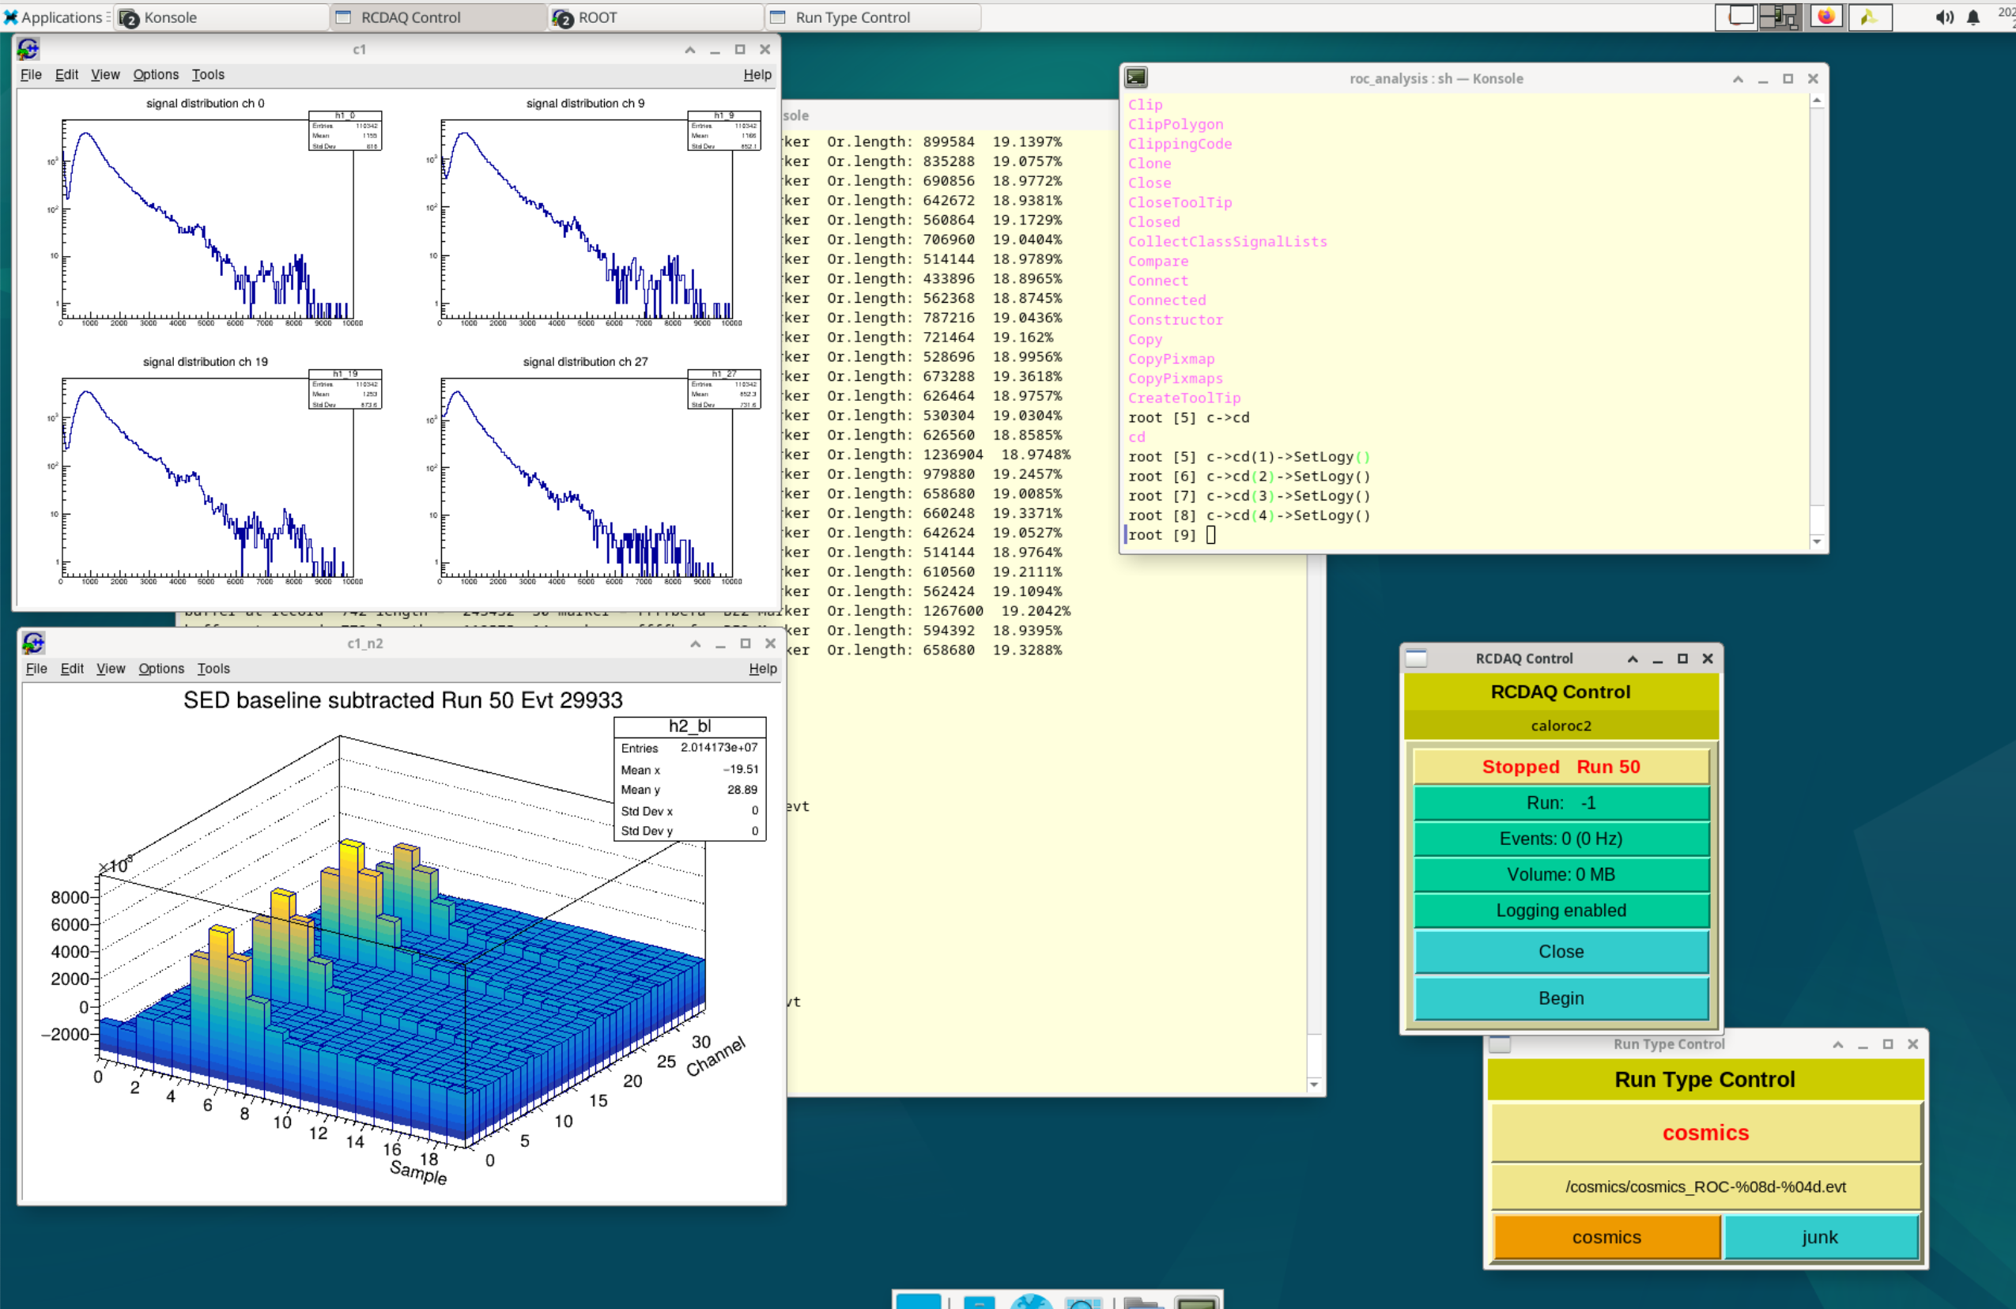
Online monitoring
After Norbert was done with the cable length tests, I took over and switched to RCDAQ readout
I made a for-real online monitoring and analysis package with waveform analysis to derive a signal, and made histograms and all
Remember that the online monitoring can also be used as-is for offline analysis (reading a file instead of the online stream)
I went all-out with the setup – the 2 panels you see here (I’ll show this live in the meeting) self-update every 30 and 60s, respectively (what I call “billboard monitoring” in the manual)
The signal distributions reset when a new run starts
Last week I mentioned that run the entire show in VNC

Slide 14
One final forward-looking statement
At the Frascati coll meeting I had put out the challenge (for me, mostly) to demonstrate a full analysis chain from RCDAQ to using eicrecon for the analysis in the eicshell
AFAIK no one has ever used the eicrecon framework for real data (test beam, or the ones we take)
Derek made a test setup but without being able to make the event libraries that we need
Working with Derek, Dmitry (K) and especially Wouter, we have an eicshell version in place that can support our event libraries:
My day job interfered with the final “eicrecon” step, but… RSN.
I can already do the “offline monitoring” (the online monitoring can replay files, obviously)
Then we will have a full native tool analysis chain
jug_dev> ddump -T -p 1002
Packet 1002 36 -1 (ePIC Packet) 5 (ID2EVT)
0 | 0000 0001 0002 0003 0004 0005 0006 0007
8 | 0008 0009 000a 000b 000c 000d 000e 000f
16 | 0010 0011 0012 0013 0014 0015 0016 0017
24 | 0018 0019 001a 001b 001c 001d 001e 001f
32 | 0020 0021 0022 0023 0024 0025 0026 0027
40 | 0028 0029 002a 002b 002c 002d 002e 002f
48 | 0030 0031 0032 0033 0034 0035 0036 0037
56 | 0038 0039 003a 003b 003c 003d 003e 003f

Slide 15
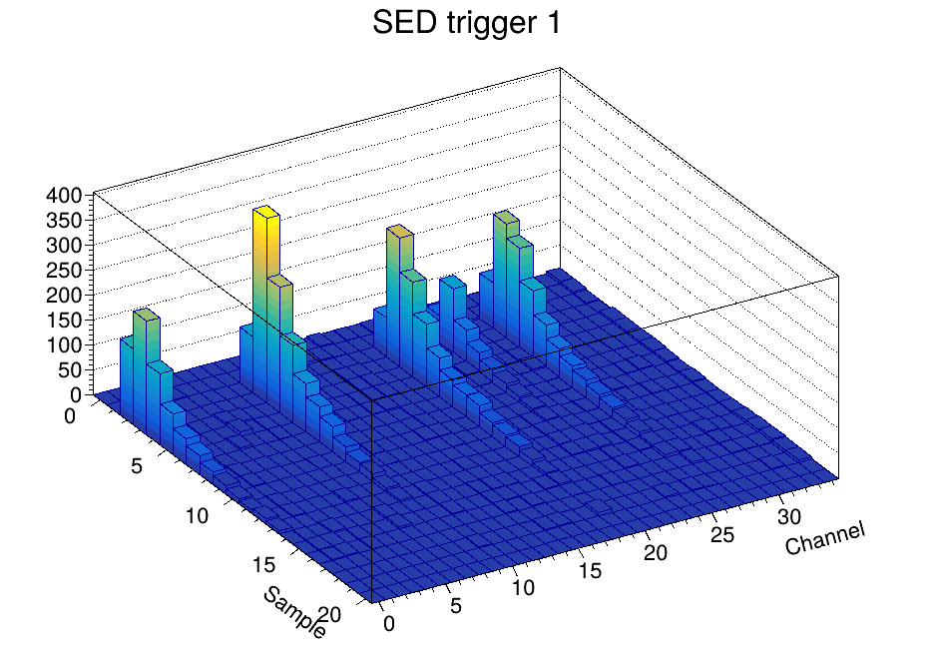
Some eye candy
A quick movie of the lego display of consecutive events…

Slide 16
Where we are
Fully working RDAQ support is in place
I forked the “Event Libraries” that interfaces the RCDAQ format to other packages, such as ROOT, or EICRecon
(this isn’t quite done - yes I added the ROC support to the fork, but didn’t get around to weeding out non-ePIC stuff yet. Coming.)
BTW, there is nothing to fork for RCDAQ itself, because everything detector/experiment specific lives in the plugins to begin with. In the same sense that there is no special ePIC ROOT version.
I have a workable online monitoring package in place
This is pretty much the same as for any waveform sampler; I only really adjusted the histogram boundaries to reflect channel/sample numbers
There is a vast codebase from other waveform samplers (waveform fitting, software CFDs…) We have been doing this forever..

