Slide 1
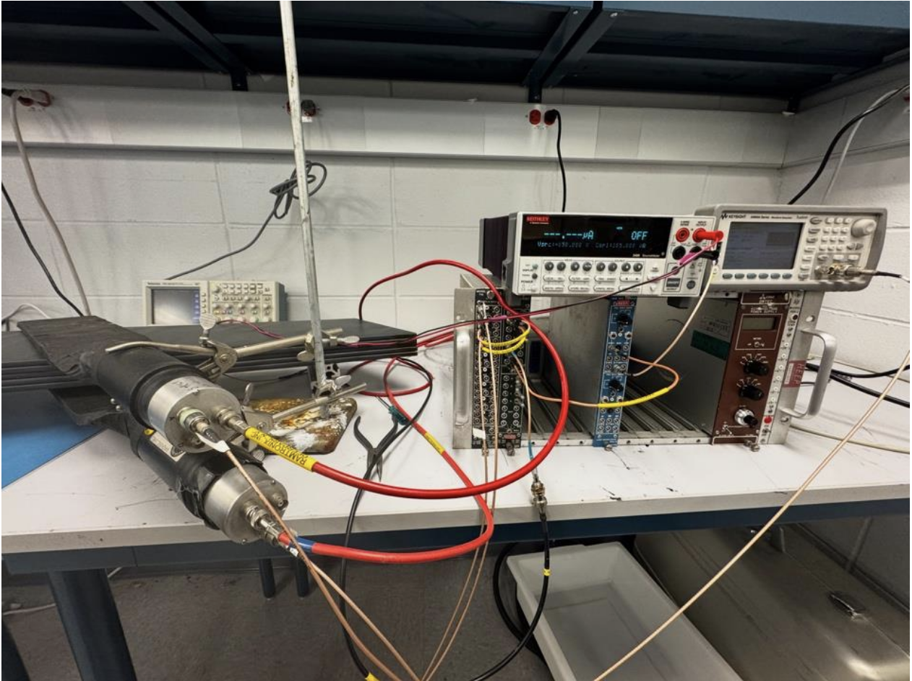
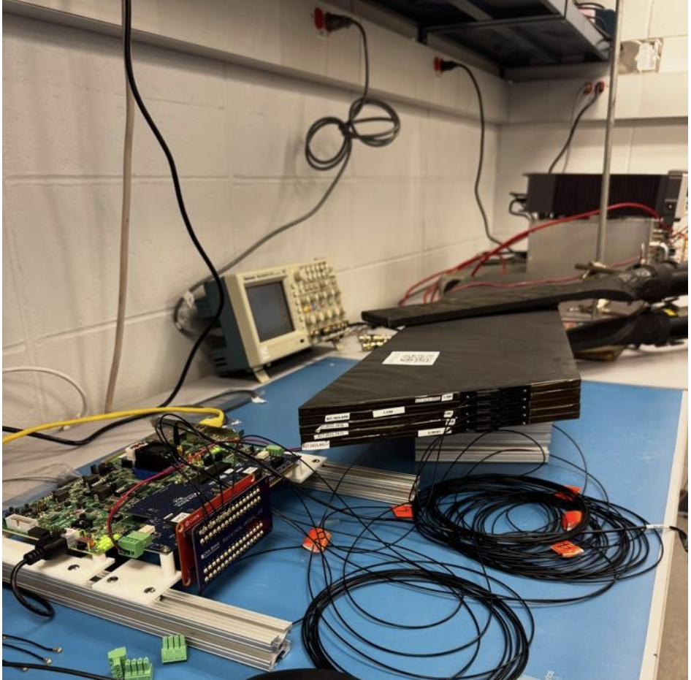
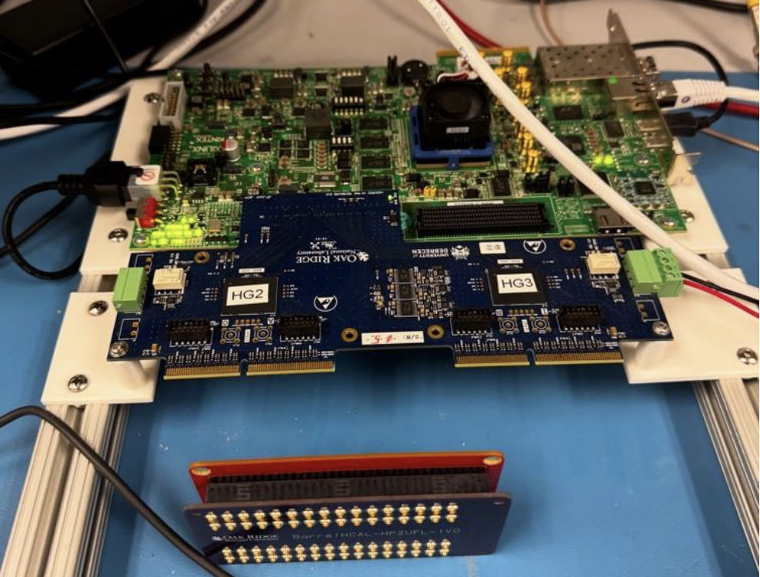
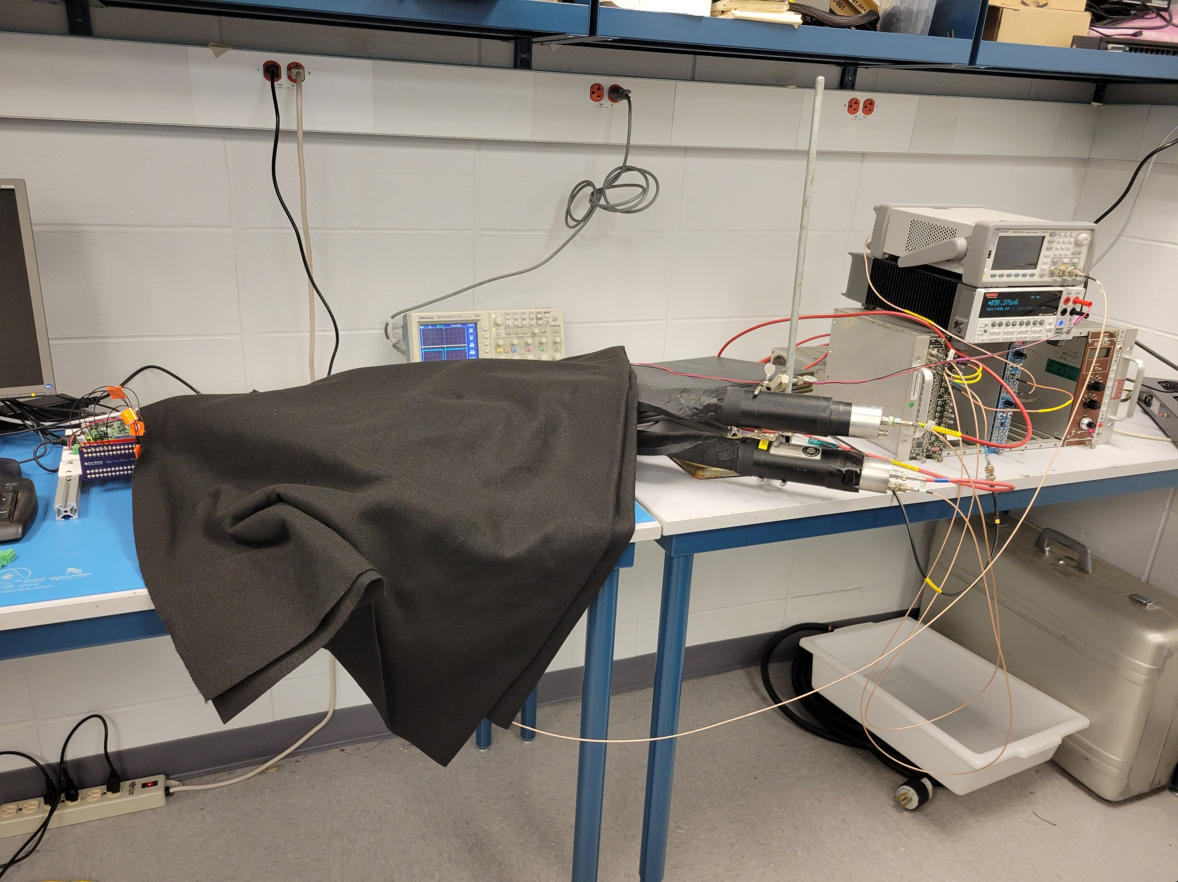
ROC readout in our Hcal Lab @BNL
5 BHcal tiles with the ePIC SiPMs connected to the H2GCROC3 card
Read out via the KCU105 FPGA board
Readout fully implemented in RCDAQ

Slide 2
RCDAQ - The High Points
Each interaction with RCDAQ is a shell command. There is no “starting an application and issuing internal commands” (think of your interaction with, say, root)
Of course you still have a rich set of GUIs. But it is guaranteed that any GUI isn’t doing anything that you cannot also do with a command
This makes everything inherently scriptable (which you really need for many bench tests or test beams – thing of bias voltage scans, position scans in a test beam, etc)
RCDAQ out of the box doesn’t know about any particular hardware. All knowledge how to read out something, say, a FELIX card, comes by way of a plugin that teaches RCDAQ how to do that.
Built-in support for standard online monitoring
Built-in support for electronic logbooks (Stefan Ritt’s Elog)
Network-transparent control interfaces

Slide 3
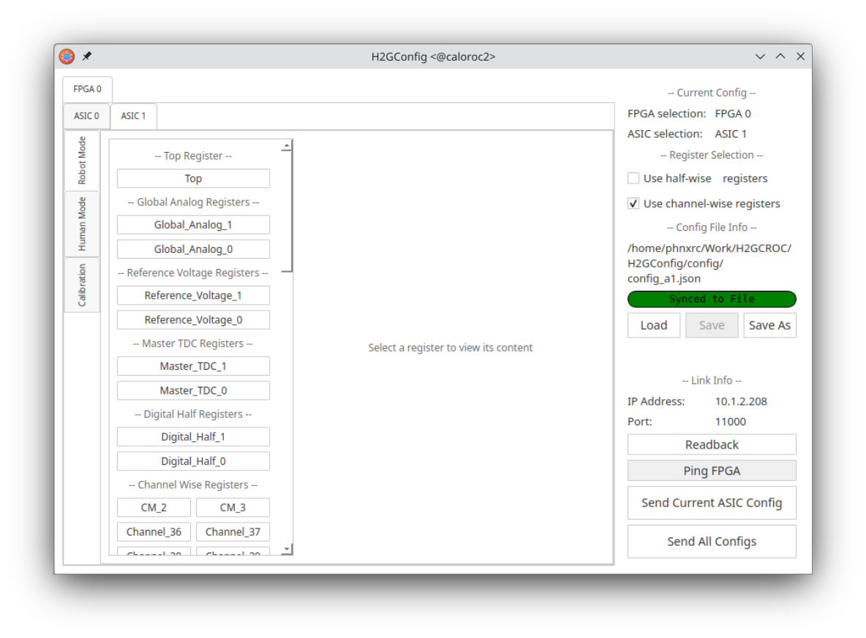
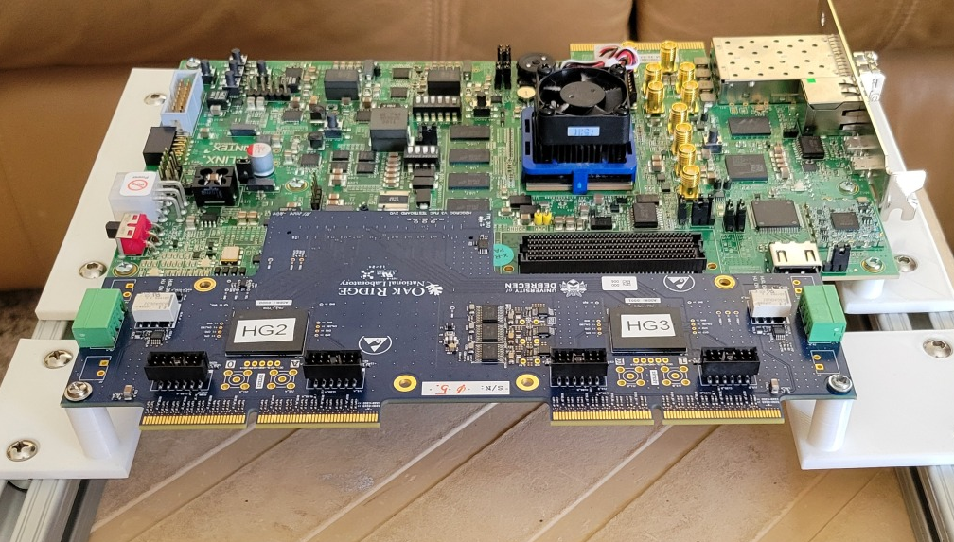
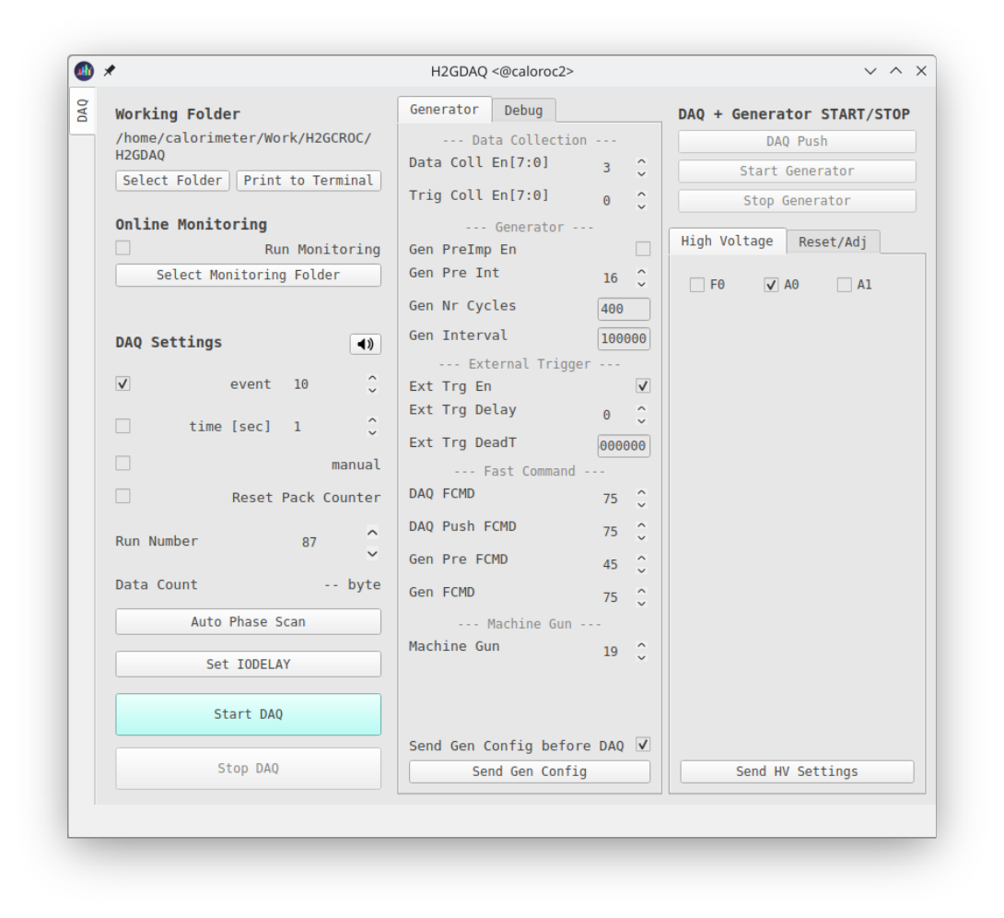
Front-end configuration vs RCDAQ configuration
Like many other devices with a vast configuration space (here: some 3000 parameters, most with reasonable defaults), the configuration of the front-end and the readout are two distinct tasks
The front-end is getting configured with two GUI-based processes (H2GConfig for the ASICs, H2GDAQ for the FPGA portion), and set up just the way we want it
RCDAQ is almost fully oblivious to the particulars of the front-end configuration, it reads whatever comes its way
It really only needs to know the IP address from which the data are coming; it also issues “start” and “stop” commands to the front-end to start or stop the flow of data – that’s all.
The standalone configuration process
We also support command based “canned” configs – GUIs are nice but can also be tedious.

Slide 4
The H2GCROC3 RCDAQ plugin
“All knowledge how to read out a device comes by way of a plugin that teaches RCDAQ how to do that.”
This shows the relevant portions of the RCDAQ setup file
It loads that plugin that teaches RCDAQ how to read the H2GCROC3 front-end
And then we create the device itself
rcdaq_client load librcdaqplugin_h2gcroc3.so
rcdaq_client create_device device_h2gcroc3 1 12001 10.1.2.208 1 128
This is all that the plugin needs to know
$ daq_status -ll
caloroc2 - Stopped
Filerule: /home/phnxrc/data/junk/junk_ROC-%08d-%04d.evt
Logging enabled
. . . Lines deleted
List of loaded Plugins:
- H2GCROC3 Plugin, provides -
- device_h2gcroc3 (evttype, subid, IP addr, trigger, nr_packets) - readout an H2GCROC3

Slide 5
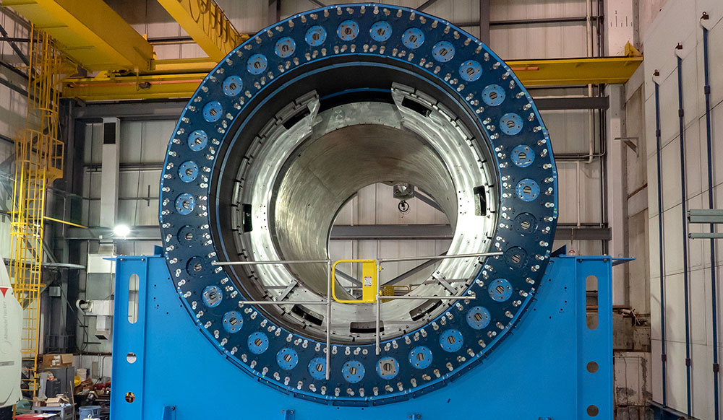
How RCDAQ works
After you have loaded the plugins you need, you create a list of devices that you read out in each event
This is known as the readlist
When the readout is kicked off, RCDAQ visits each device in the readlist and asks it for its contribution
Typically, each device contributes one data packet to the data structure of this event (some devices can contribute more than one packet, and sometimes they may have nothing to contribute)
Then the eventual data structure consists of a collection of such packets
Each packet is identified by a unique packet id that then identifies a piece of “detector real estate” – what that device reads out
The packet ids in themselves are just a number – you enumerate the packets in a way that makes sense
Example: the current sPHENIX / future ePIC Barrel Hcal
Every 2 (of 16) sectors are read out by one “device”
Makes 8 packets total, split across 2 readout PCs, East and West

Slide 6
PacketID assignment Example (BHCal)
In sPHENIX we assign each detector system a “Detector Number” – our Hcal happens to be #8
Each detector then can assign packet IDs in the d_nr * 1000 +1 …. d_nr * 1000 +999 range
8001… 8999 for the Hcal (the “even 1000” is reserved). Much more than we need
So we have 8001, 8002, 8007 and 8008 on the west side.
8003, 8004, 8005, 8006 on the east side
All 8 together constitute the data of the entire HCal
8003
8002
E
8004
8001
W
8005
8008
8006
8007
$ dlist /bbox/bbox6/W/HCal/cosmics/cosmics_seb16-064906-0000.prdf
Packet 8001 788 0 (Unformatted) 172 (IDDIGITIZERV3_12S)
Packet 8002 676 0 (Unformatted) 172 (IDDIGITIZERV3_12S)
Packet 8007 753 0 (Unformatted) 172 (IDDIGITIZERV3_12S)
Packet 8008 753 0 (Unformatted) 172 (IDDIGITIZERV3_12S)
The channel mapping for one device /packet repeats for each packet – super-easy to deal with
$ dlist /bbox/bbox7/W/HCal/cosmics/cosmics_seb17-064906-0000.prdf
Packet 8003 746 0 (Unformatted) 172 (IDDIGITIZERV3_12S)
Packet 8004 732 0 (Unformatted) 172 (IDDIGITIZERV3_12S)
Packet 8005 662 0 (Unformatted) 172 (IDDIGITIZERV3_12S)
Packet 8006 690 0 (Unformatted) 172 (IDDIGITIZERV3_12S))

Slide 7
Remember my script?
This is the (abridged) script that sets up the H2GCROC3 readout
rcdaq_client load librcdaqplugin_h2gcroc3.so
rcdaq_client create_device device_h2gcroc3 1 12001 10.1.2.208 1 128
I randomly assigned 12001 here – again, the number itself is meaningless as long as you know what it is
On the last slide you saw the “dlist” command that lists the packets present in one event.
Here is what we have in the H2GCROC3 data:
$ dlist /data/h2gcroc3/cosmics_ROC-00000022-0000.evt
Packet 12001 46724 -1 (ePIC Packet) 301 (IDH2GCROC3)

Slide 8
I said “the abridged” Script
The entire RCDAQ setup is usually scripted. Let me develop the full script here step by step
#! /bin/bash
# we need the $0 as absolute path b/c we pass it on to a "file" device further down
MYSELF=$(readlink -f $0)
rcdaq_client daq_clear_readlist
# Since we have plenty of CPU muscle, we enable the highest compression with 35 threads
rcdaq_client daq_set_nr_threads 35
rcdaq_client daq_set_compression 4
# and we roll over the files at 3GB
rcdaq_client daq_set_rolloverlimit 3
# we add this script itself to the begin-run event
rcdaq_client create_device device_file 9 900 "$MYSELF"
rcdaq_client create_device device_command 9 0 "RequestScript.py > /tmp/roc_setup.json"
rcdaq_client create_device device_file_delete 9 910 /tmp/roc_setup.json
rcdaq_client load librcdaqplugin_h2gcroc3.so
rcdaq_client create_device device_h2gcroc3 1 12001 10.1.2.208 1 1024
rcdaq_client daq_open

Slide 9
Begin-run what???
RCDAQ has the concept of different event types that have different readlists.
This allows you to read different things at different moments (I have a lengthy explanation in the backup)
When we begin a data taking run, a begin-run is generated, and an end-run event happens when we end
If nothing else, they are convenient markers that a new run has begun, or a run has ended (guaranteed to be the first and last events, respectively)
In the continuously running online monitoring, you might choose to clear all monitoring histograms on receipt of the begin-run, and on end-run you you could write the current ones out – preserve the run-by-run online monitoring history from your test beam
But they are events in their own right, and traverse their readlist like any other
The begin-run is THE place to store meta-info about that run –
The setup itself
Further configurations
Webcam pics if you are doing, say, a position scan in a test beam
Position info, bias info, whatever might be needed afterwards to streamline your analysis, or to do “forensics”
I have compared this to the “black box” on a plane

Slide 10
And here we are…
Here are the current contents of the begin-run event
Packet 900 is the setup script
Packet 910 is the snapshot of the actual configuration of the ASIC at this moment
$ dlist -i -t 9 /home/phnxrc/data/cosmics/cosmics_ROC-00000034-0000.evt
-- Event 1 Run: 34 length: 8208 type: 9 (Begin Run Event) 1748797433
Packet 900 382 -1 (ePIC Packet) 4 (IDCSTR)
Packet 910 7818 -1 (ePIC Packet) 4 (IDCSTR)

Slide 11
Analysis API
The device generates a packet with hitformat 301 (mnemonic “IDH2GCROC3”)
Remember these numbers are a simple enumeration, and numbers are plentiful
This “hitformat” maps the packet to a “handler class” that is specific to this particular hitformat
And what happens when (not if) we change the format, say, read it out through the FELIX eventually?
# this is the evolving data format for our TPC read through the FELIX card
case (IDTPCFEEV1):
return new
Packet_idtpcfeev1( sevt_ptr );
break;
case (IDTPCFEEV2):
return new
Packet_idtpcfeev2( sevt_ptr );
break;
case (IDTPCFEEV3):
return new
Packet_idtpcfeev3( sevt_ptr );
break;
case (IDTPCFEEV4):
return new
Packet_idtpcfeev4( sevt_ptr );
break;
$ dlist /home/phnxrc/data/cosmics/cosmics_ROC-00000012-0000.evt
Packet 12001 7304 -1 (ePIC Packet) 301 (IDH2GCROC3)
. . .
case (IDGL1V1):
return new
Packet_idgl1v1( sevt_ptr );
break;
case (IDH2GCROC3):
return new
Packet_idh2gcroc3( sevt_ptr );
break;
. . .

Slide 12
Analysis API
The data access APIs are exactly like those for any waveform sampler we support (CAEN V7142, DRS4, the (sPHENIX) Sampa (== ePIC’s Salsa) chips…).
If p is a pointer to the packet object from that device:
We we get away with (0,”SAMPLES”) b/c it’s the same for all channels. It supports different numbers of samples per channel
There are more APIs to ask the packet all kinds of other questions, but those are the most-often used ones here
p->iValue(0,"SAMPLES") tells you how many samples are present
p->iValue(0,”CHANNELS") tells you how many channels that device has (here:144)
p->iValue(c,s) gives you sample s from channel c (there are faster interfaces available)

Slide 13
Analysis API
I copied the online monitoring from one of the existing ones for a waveform sampler, here is the meat of it:
Packet *p = e->getPacket(12001);
if (p)
{
for ( int s = 0; s < p->iValue(0,"SAMPLES"); s++)
{
for (int c = 1; c < 35; c++) // we can ask iValue(0,”CHANNELS”) but we only want 35
{
h2->Fill(c,s, p->iValue(c,s));
}
}
delete p;
}

Slide 14
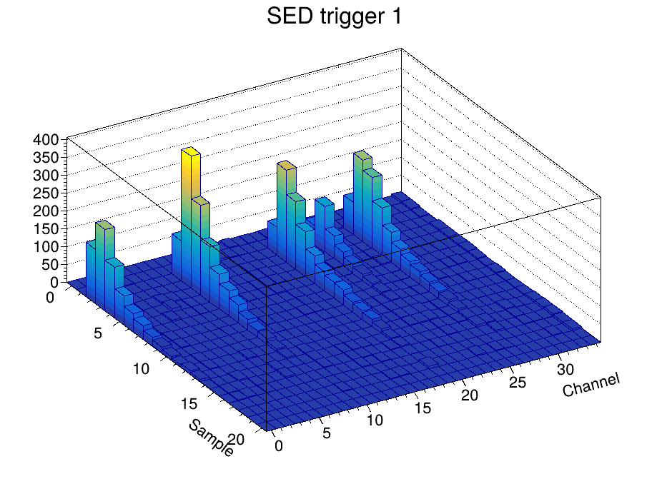
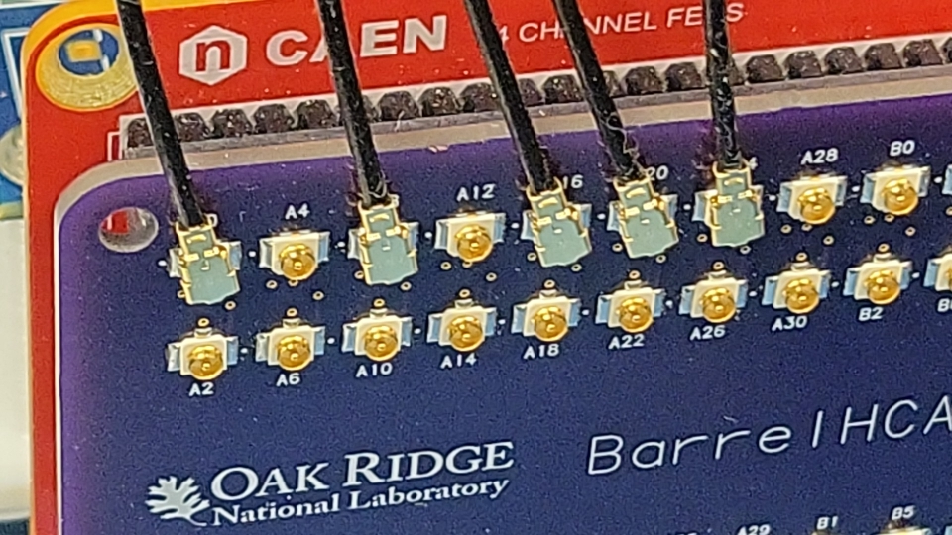
The “mlp standard plot”
Whenever I have data from a waveform sampler (that is, a device with a number of channels, and each channel provides a waveform) I make a Lego plot with Channel vs Sample, with z the sample value:
We see what we expect: Signals from 5 tiles, and with the right channel numbers
The waveforms are baseline-corrected. And we saw the first of those plots from online monitoring on Thursday
Connected channels

Slide 15
One final forward-looking statement
At the Frascati coll meeting I had put out the challenge (for me, mostly) to demonstrate a full analysis chain from RCDAQ to using EICRecon for the analysis
AFAIK (don’t take it the wrong way if I’m wrong), no one has ever used the EICRecon framework for real data (test beam, or the ones we take)
Derek made a test setup but without being able to make the event libraries that we need
Working with Derek, Dmitry (K) and especially Wouter, we have an eicshell version in place that can support our event libraries:
My day job interfered with the final “eicrecon” step, but… RSN
jug_dev> ddump -T -p 1002
Packet 1002 36 -1 (ePIC Packet) 5 (ID2EVT)
0 | 0000 0001 0002 0003 0004 0005 0006 0007
8 | 0008 0009 000a 000b 000c 000d 000e 000f
16 | 0010 0011 0012 0013 0014 0015 0016 0017
24 | 0018 0019 001a 001b 001c 001d 001e 001f
32 | 0020 0021 0022 0023 0024 0025 0026 0027
40 | 0028 0029 002a 002b 002c 002d 002e 002f
48 | 0030 0031 0032 0033 0034 0035 0036 0037
56 | 0038 0039 003a 003b 003c 003d 003e 003f

Slide 16
Some eye candy
A quick movie of the lego display of consecutive events…

Slide 17
Where we are
Fully working RDAQ support is in place
I forked the “Event Libraries” that interfaces the RCDAQ format to other packages, such as ROOT, or EICRecon
(this isn’t quite done - yes I added the ROC support to the fork, but didn’t get around to weeding out non-ePIC stuff yet. Coming.)
BTW, there is nothing to fork for RCDAQ itself, because everything detector/experiment specific lives in the plugins to begin with. In the same sense that there is no special ePIC ROOT version.
I have a workable online monitoring package in place
This is pretty much the same as for any waveform sampler; I only really adjusted the histogram boundaries to reflect channel/sample numbers
There is a vast codebase from other waveform samplers (waveform fitting, software CFDs…) We have been doing this forever..

Slide 18
Backup

Slide 19
Meta Data Capturing
In the “real” experiment that’s running for a few years (think sPHENIX, ATLAS, what have you) you are embedded in an environment that supports all sorts of record keeping
At a test beam or you in your lab needs a different kind of “record keeping support”
What was the temperature? Was the light on? What was the HV? What was the position of that X-Y positioning table?
We capture this information in the raw data file itself and the data cannot get lost
I often add a webcam picture to the data so we have a visual confirmation that the detector is in the right place, or something
A picture captures everything…
Let me show you how we always capture the RCDAQ setup itself

Slide 20
Reading different things with different Event Types
You would think of the DAQ as “reading your detector”
Very often, it is necessary to read different things at different times.
Let’s go to the CERN-SPS (or the Fermilab Test Beam) for an example:
Let’s recap here:
The red lines are events that you would expect (read your detector)
The blue and yellow lines are events that read something else
acceleration
SPS or FTBF
extraction
“spill”
Begin-run event
End-run event
Spill-On event
Read and clear scalers
Flush buffers
Data Events
Read your detector channels, ADCs, TDCs...
Spill-Off event
Read and clear scalers
(allows spill intensity-based corrections)
20
In addition to your data, you need information about the spill itself – each one is different
You need to make intensity-dependent corrections on a spill-by-spill basis
So you put some signals on scalers and get an idea about the intensity, dead times, microstructures, etc

Slide 21
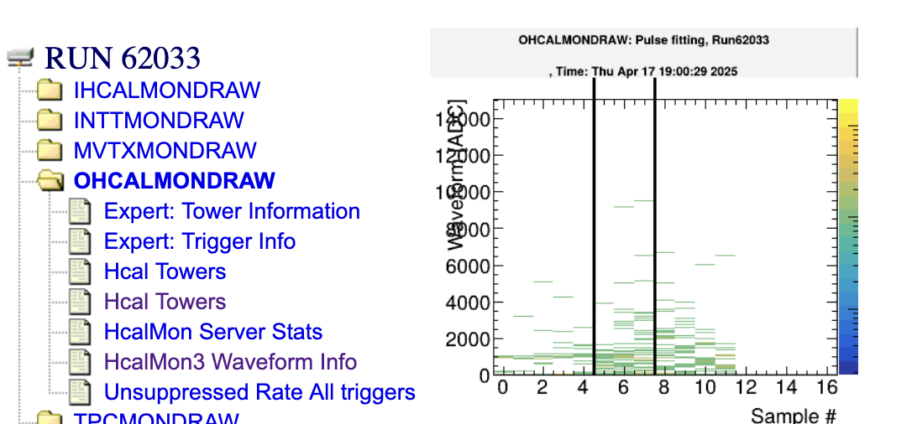
Why are begin- and endrun events so important?
In each run, they are generated exactly once
This is the place where you can keep information that is needed/valid for the entire run
Like the position information of the x/y motors that you saw before - they would get stored in the begin run.
Ditto for configuration information – we always make it so that we store it in the begin-run.
RCDAQ guarantees that the begin-run is the first, and the end-run is the last event in that run
If nothing else, if you treat your data as a stream (think online monitoring – doesn’t stop, sees many runs), these serve as convenient markers that a new run has begun, or a run has ended.
On receipt of the begin-run event, you typically clear all your monitoring histograms
On receipt of the end-run event, you save your histograms to a file
This is actually how all this online monitoring history is generated!

