Slide 1
Common scenarios for preTDR:
Backgrounds, Luminosity, and Radiation Doses
E.C. Aschenauer (BNL)
Great Thanks to Andrii, Alex and the EIC Accelerator Team for the all work
ePIC TIC Meeting
June 9th, 2025

Slide 2
Why do we need to take Backgrounds serious

Slide 3
Lessons from HERA II upgrade
HERA performed an upgrade to increase luminosity by a factor of 5
  Mainly by squeezing the beam more at the IP by redesign of the IR
The upgrade increased backgrounds dramatically → Several month shutdown to implement improvements
Electron beam polarization never reached HERA-I levels, H1 and Zeus solenoids (~1T) not well compensated
Main culprits:
  no careful simulations prior to the upgrade
  Proton beam-gas interactions most severe background
    Needed an extremely good vacuum to mitigate this
  Synchrotron radiation background
    Background to detectors
    Excess heating of beam pipe
      Can damage flanges, etc.
      Can heat beam pipe, decreasing vacuum
  Electron beam-gas

Slide 4
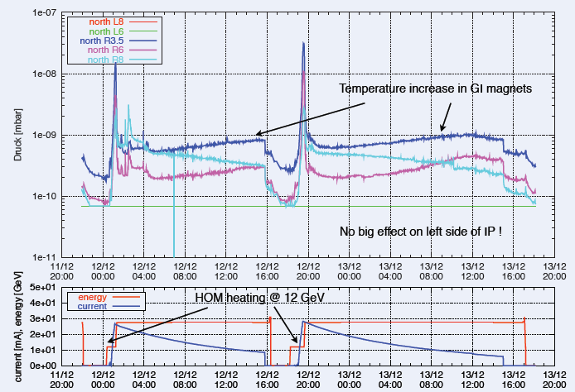
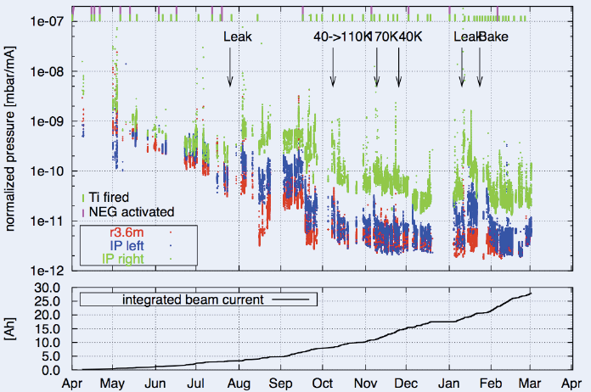
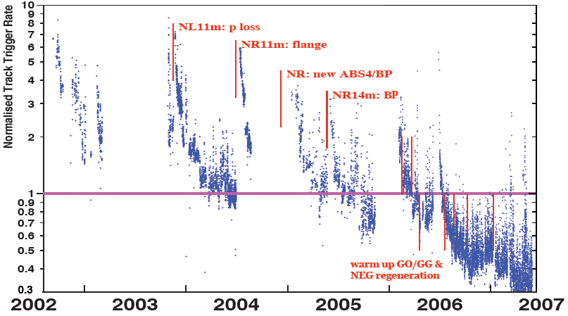
Lessons from HERA II upgrade
Dynamic pressure increase due
to thermal and photo desorption
Pressure vs. integrated electron
current 2002 - 03
Proton Beam Gas Background
Two time constants for vacuum
conditioning
Short term after leaks 20 – 30 days
Long term 600 days

Slide 5
What Backgrounds do we have

Slide 6
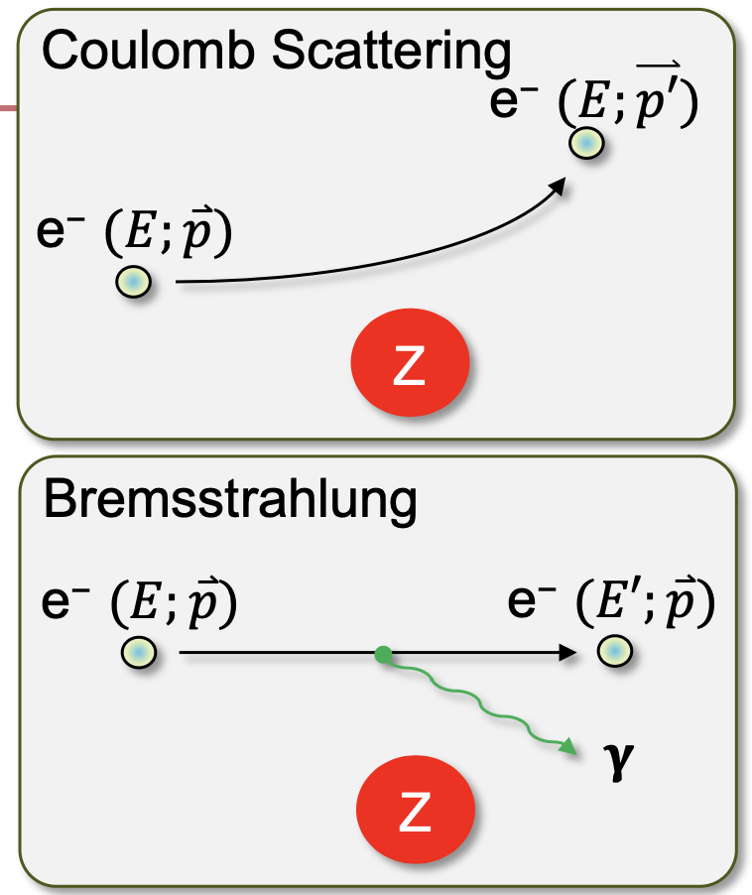
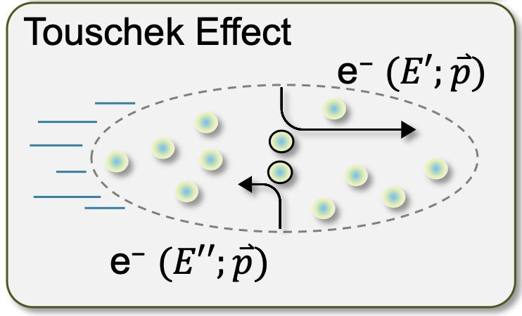
Beam Background Sources
Background/radiation sources : Different to hadron-hadron colliders beam related background cross-sections are larger than signal cross-section
Hadron Beam
  Low beam lifetime during injection and ramping
  → can be mitigated by collimation system → no impact on data taking
  Beam-gas scattering through Coulomb process.
  → can be mitigated by collimation system
  → see earlier talks by Zhengqiao
  Inelastic beam-gas interaction (producing showers of secondaries in the IR).
  We do not have yet any full particle tracking for hadrons
  → working on protons
  → heavy ions are especially difficult – LHC just finished full particle tracking for ions
Electron Beam
  background due to de-excitation of beam if bunches are replaced
  → can be mitigated by collimation system
  Beam-gas scattering through Coulomb and Bremsstrahlung (Bethe-Heitler) processes:
  → Elastic and inelastic beam particle scatterings on residual gas molecules and a hadron beam.
  Touschek effect:
  → Incoherent scattering of the particles in the same beam bunch.
a good vacuum is critical for all beam gas related backgrounds → need to limit how often we
break vacuum
collimation systems will minimize backgrounds, but not if the background is generated in IP-6

Slide 7
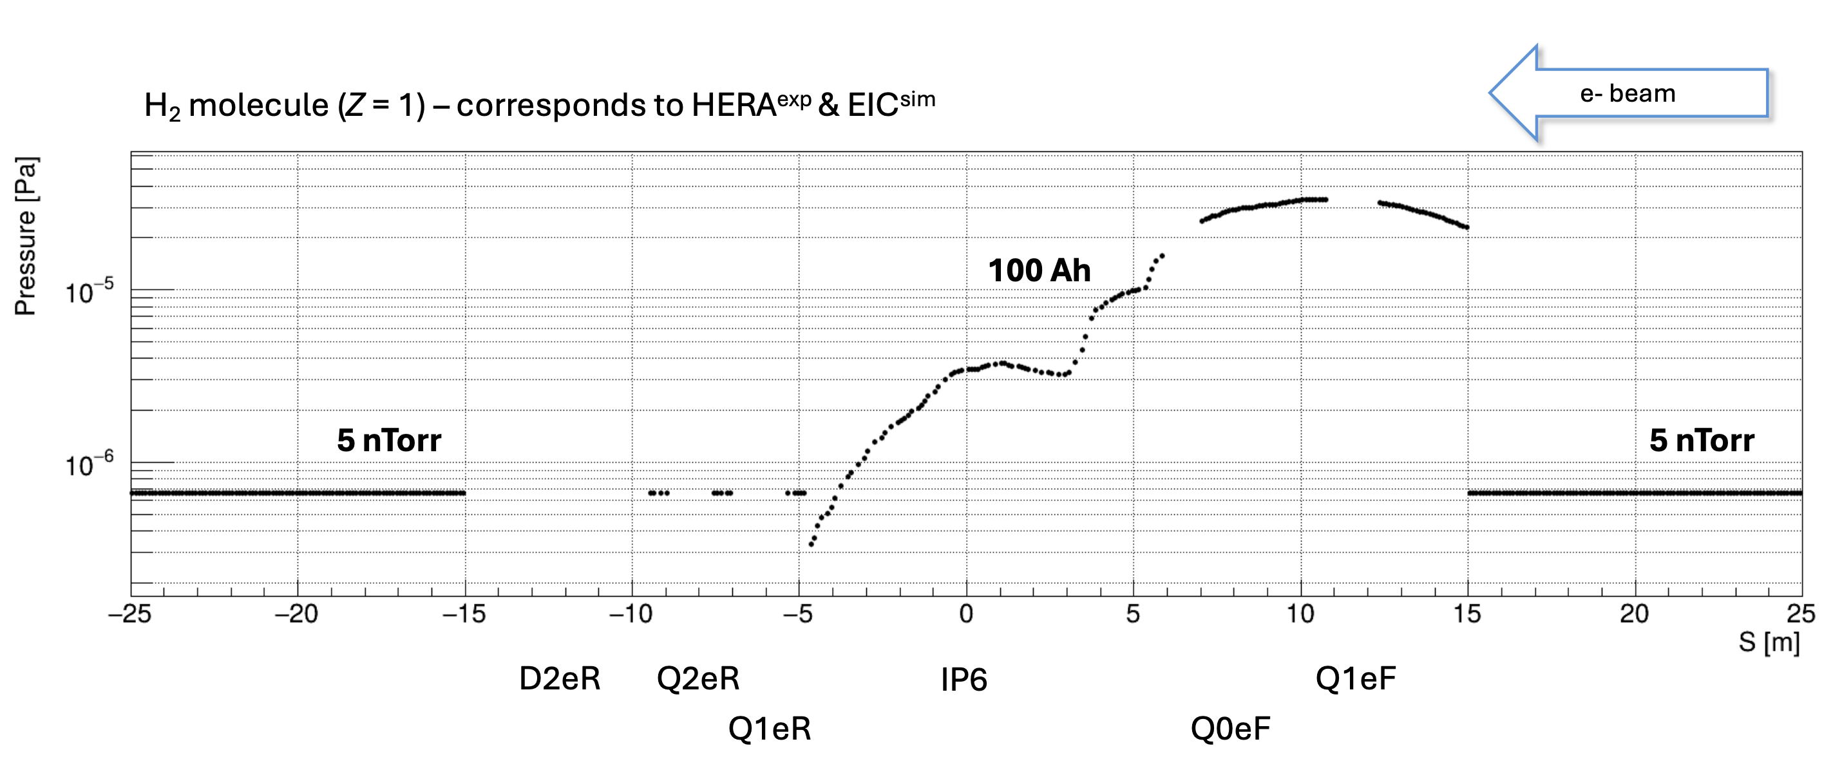
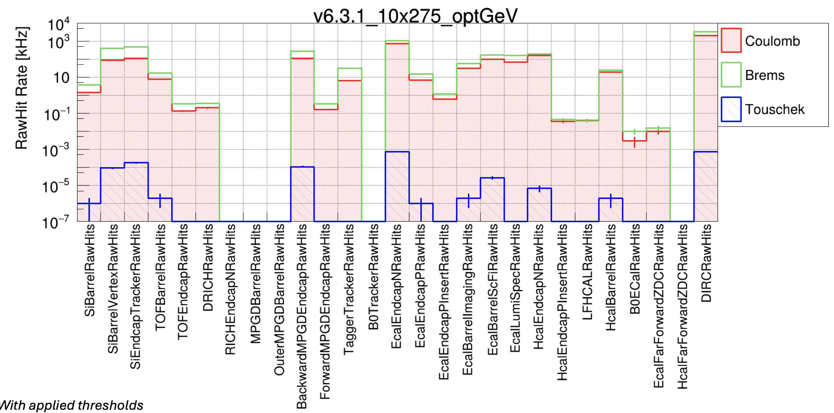
Electron Beam Gas Results
Example: 10 GeV x 275 GeV with Electron Current: 2.5 (A)
at 5 GeV: Touschek increases to rated close to Coulomb & Brems
at 18 GeV: Rates are lower as electron beam current is 0.2 A

Slide 8
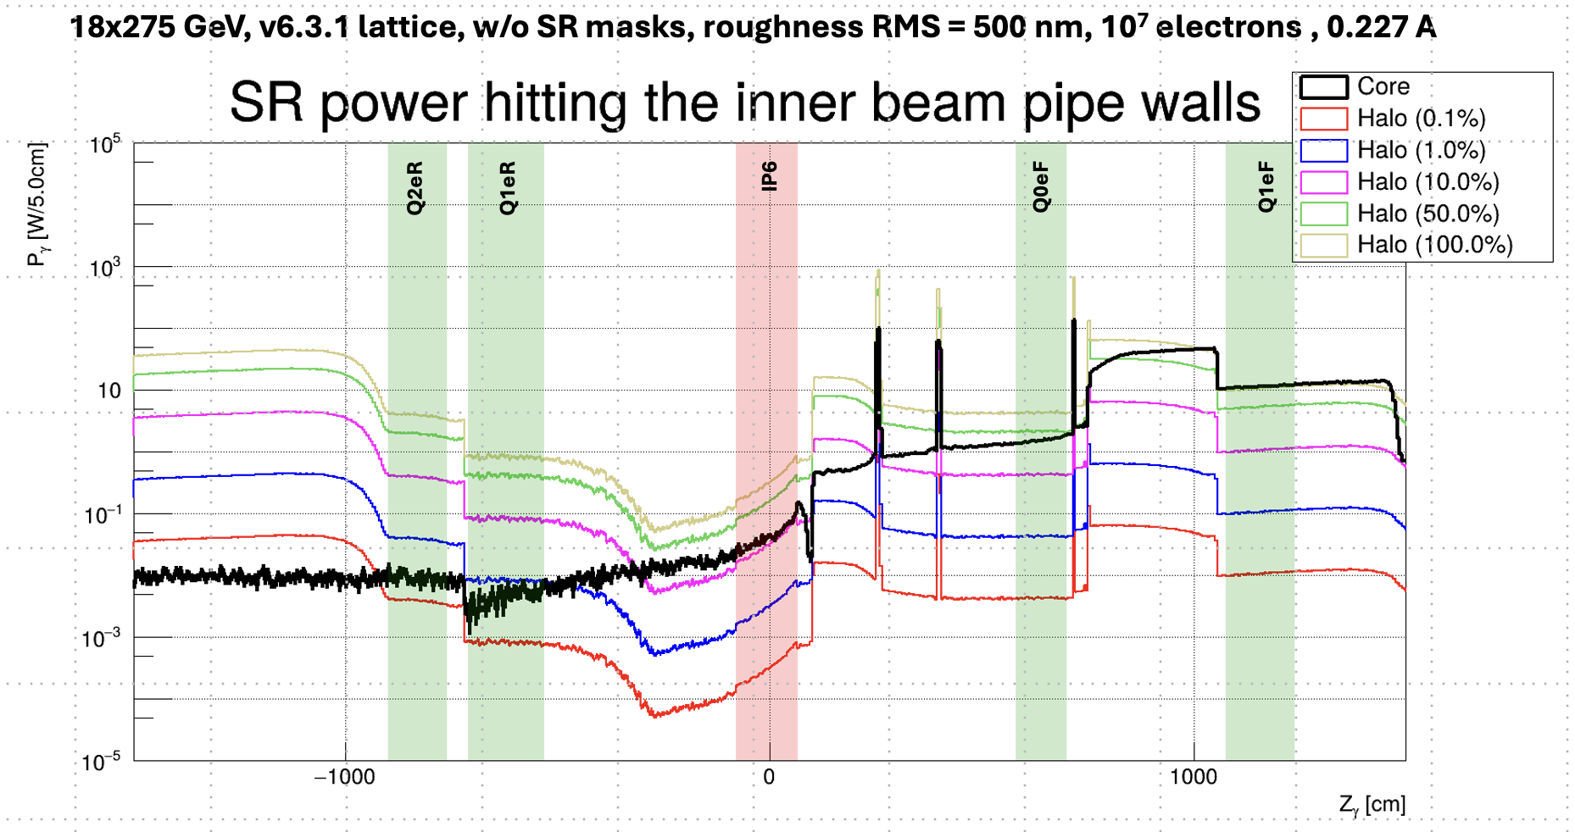
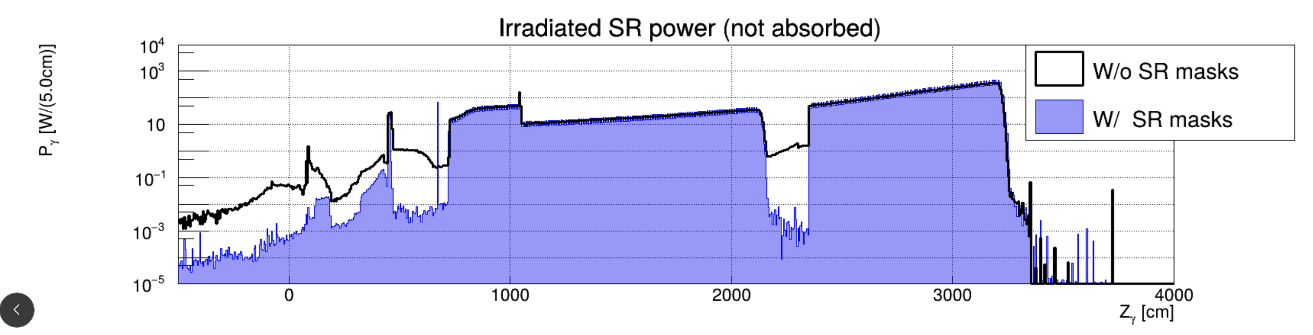
Beam Background Sources
Electron Beam
  Synchrotron Radiation
  → It is critical to keep the dipole strength closes to the IP low
  → SR largest at highest beam energy
  Key Findings:
  Highest SR load of ~0.1 kW and ~0.1 W on the superconducting (SC) quad cold mass is at 18 GeV (0.2 A) and 10 GeV (2.5 A), respectively
  The ePIC detector SR background rates are ~1 THz at 18 GeV (0.2 A)
  Counter measures:
  High-Z shielding can reduce the load on SC quads by a few orders of magnitude below the safety limit
  Dedicated SR masking significantly reduces detector rates down to ~0.1 GHz
The tails of the electron bunches are critical
for the SR: ~ few % realistic

Slide 9
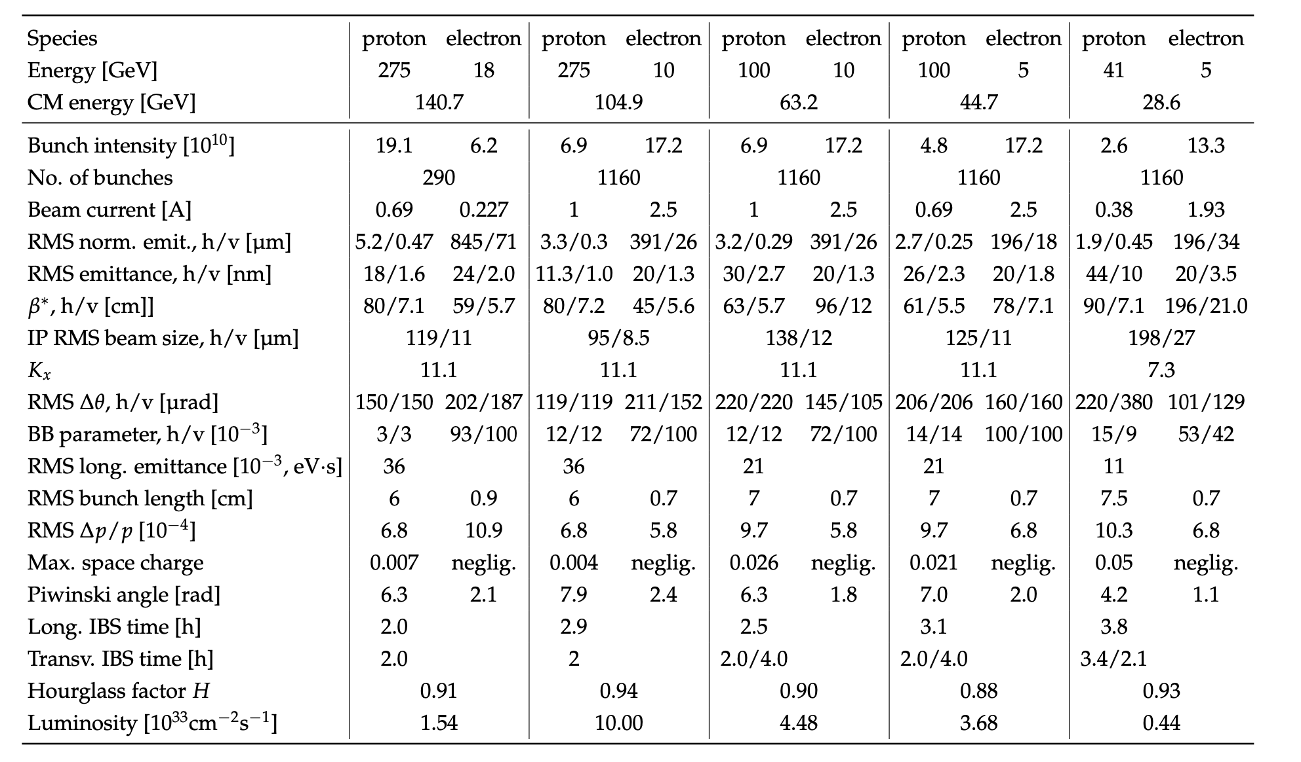
EIC Beam Parameters
electron beam current and energy impact electron beam gas background and synchrotron radiation
→ Radiated SR power: P(kW)=88.46 E_{B}(GeV)⁴ / r(m)² I (A)
hadron beam current impacts hadron beam gas
beam energies and luminosity impact the radiation and neutron fluence

Slide 10
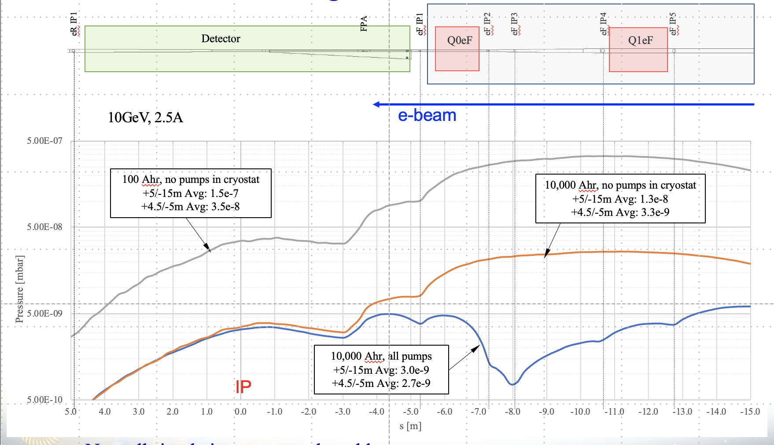
Proposal what to use for the pre-TDR
It is reasonable to assume a Run will be 30 weeks per year with a 80% uptime / running efficiency. In addition, we have a 2h store turnaround time and if one assumes 8h long stores, one gets 3024 h of operations per year.
→ 10 GeV: 2.5 A → 7500 Ah
→ 18 GeV: 0.2 A → 600 Ah
Do first simulations for ultimate EIC performance
parameters
→ Vacuum after 10000Ah
→ lepton beam energy 18 GeV
→ hadron beam energy 275 GeV
What is needed an update of the electron beam gas to have Coulomb & Brems and need to include Touschek → can be made available soon
It is critical that the background simulations and the ePIC simulation use the same beam pipe design
It is critical to have the IR magnet material well modeled in Geant → Andrii is working on this
Ultimately, we need to simulate different beam energy combinations and hadron beam types

Slide 11
Finding Correlation between Vacuum and Beam Current
Beam Currents:
$I^{ESR}=100 mA$, $\frac{I^{ESR}}{I^{HSR}}\sim \frac{5}{2}$
Beam Dose:
$$BD=100 Ah$$
Detector Limit:
$$DL=1 MHz$$
Acceptable Beam Lifetimes:
$τ_{acc}^{ESR}\sim 10 hr$, $τ_{acc}^{HSR}\sim 3 hr$
Loop Until: $I^{ESR}<I_{nominal}^{ESR}(2.5 A)$
Initial Parameters @ 10x275 GeV
Estimate Gas Pressure:
$P^{ESR}$,$P^{HSR}$
Calculate Detector Backgrounds and Beam Lifetimes (Beam-gas, Touschek, SR, Collision, IBS, etc.):
${BG}_{i}^{ESR}$,${BG}_{j}^{HSR}$,${BG}^{COL}$, $τ_{i}^{ESR}$,$τ_{j}^{HSR}$
$$\sum{BG\sim DL}$$
AND
$$\sum{\frac{1}{τ^{ESR/HSR}}≲}\frac{1}{τ_{acc}^{ESR/HSR}}$$
NO
YES
Increase Beam Dose:
$$BD+=I^{ESR}∙∆t(1 day or 1 week)$$
$$\sum{BG>DL}$$
OR
$$\sum{\frac{1}{τ^{ESR/HSR}}>}\frac{1}{τ_{acc}^{ESR/HSR}}$$
Log: $I^{ESR}=f(\sum{∆t})$, $L_{peak}=g\left(\sum{∆t}\right)$, etc.
NO
YES
Reduce Beam Current:
$$I^{ESR}−=∆I(10 mA)$$
Increase Beam Current:
$$I^{ESR}+=∆I(10 mA)$$

Slide 12
What Studies with Background are needed
Three “core” combinations to study:
Separating DIS events from background when both are present in the detector simultaneously.
  → study impact of background on subsystem performance, tracking, track – cluster matching, energy
  reconstruction in calorimeters, ….
  → study as function of Q² of DIS event
  → determine rates for DAQ (low Q² (~ 10⁻⁹) DIS + background
  → what does the background do to to ePIC detection efficiency for rare events, e.g. DVCS, TCS, …
  Mix: DIS events with full Q² range with all hadron and electron beam backgrounds
Identifying events where a “real” low-Q2 event is present (electron misses ePIC), but electron beam+gas background ”tricks” you into thinking you have a higer-Q2 event (beam+gas scattered electron hits ePIC in region where your electron finder ”thinks” a moderate Q2 electron would be)
  Mix: DIS events with Q² <1 with all hadron and electron beam backgrounds
How often do we mistake “pure” background for a DIS event, when NO DIS event is present?
  Mix: all hadron and electron beam backgrounds no DIS events needed

Slide 13
Luminosity

Slide 14
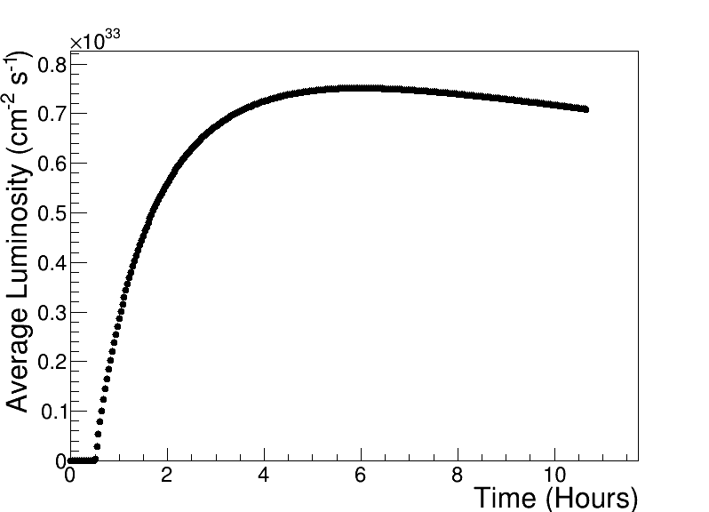
Assumptions and Luminosity Calculation
7 nC electron bunch charge compared to 28 nC (CDR)
Constant proton beam IP divergencies are maintained throughout the store by gradual increase of proton IP beta-functions as the beam emittance increases.
The electron IP beta-functions are adjusted accordingly to match electron and proton transverse beam size.
Ion beam is cooled at low energy (24 GeV/u) but no stochastic cooling is used in the store
1 Run is 30 weeks of operation at 80% uptime
2 h store turnaround time
30 min at the beginning of the store is taken by the ESR fill and detector turn-on
250 GeV x 10 GeV
Luminosities for 30 weeks are updated to better take into account cycle time

Slide 15
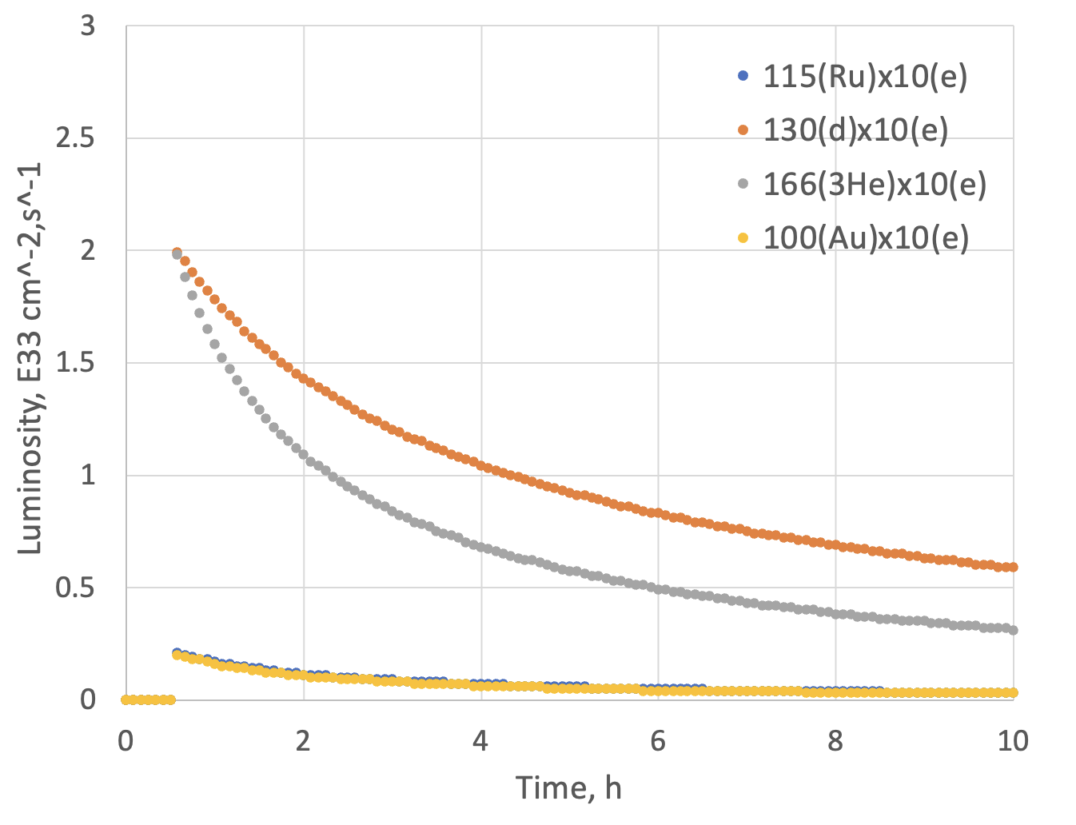
Assumptions and Luminosity
Possible Beam energies:
electron: 5 GeV, 10 GeV and ultimately 18 GeV
proton: 41 GeV, 100 GeV to 255 GeV ultimately 275 GeV
Au: 41 GeV, 100 GeV to 110 GeV ultimately
A: 41 GeV, 100 GeV to Max ~255 / (A/Z) ultimately ~275 / (A/Z)
eA luminosities for Phase-I
 | Lumi per Day | Lumi per Year
10 GeV e x 115 GeV Ru | 6.1 pb⁻¹ | 1.0 fb⁻¹
10 GeV e x 100 GeV Au | 5.6 pb⁻¹ | 0.95 fb⁻¹
10 GeV e x 130 GeV d | 78 pb⁻¹ | 13.1 fb⁻¹
10 GeV e x 166 GeV ³He | 58.5 pb⁻¹ | 9.8 fb⁻¹
Note:
eA luminosity is per nucleon

Slide 16
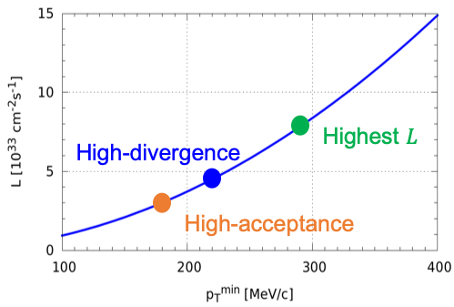
ep Luminosity for Early Years
High Divergence | Lumi per Day | Lumi per Year
5 GeV e x 250 GeV p | 44.7 pb⁻¹ | 7.5 fb⁻¹
10 GeV e x 250 GeV p | 62.9 pb⁻¹ | 10.6 fb⁻¹
5 GeV e x 130 GeV p | 29.8 pb⁻¹ | 5.0 fb-1
10 GeV e x 130 GeV p | 36.2 pb⁻¹ | 6.09 fb⁻¹
Low Divergence | Lumi per Day | Lumi per Year
5 GeV e x 250 GeV p | 32.7 pb⁻¹ | 5.5 fb⁻¹
10 GeV e x 250 GeV p | 42.1 pb⁻¹ | 7.07 fb⁻¹
5 GeV e x 130 GeV p | 27.9 pb⁻¹ | 4.7 fb⁻¹
10 GeV e x 130 GeV p | 33.6 pb⁻¹ | 5.6 fb⁻¹
Compare to HERA integrated luminosity 1992 – 2007: 0.6 fb⁻¹
Remember:
high divergence: higher lumi, but reduced acceptance
for low forward particle p_{T}^{min}
low divergence: lower lumi, but increased acceptance
for low forward particle p_{T}^{min}
→ important for exclusive processes
Illustration
Low-divergence

Slide 17
Accelerator at Day One and at full Capability
EIC commissioning and Ramp Up
Full EIC Capabilities
RCS:
7nC / bunch
5 – 10 GeV polarized e-
Add an accumulation ring to reach 28 nC / bunch and add RF to accelerate to 18 GeV electrons
ESR:
7nC / bunch
5 – 10 GeV polarized e-
Add more RF cavities to operate at 18 GeV electrons and 28 nC / bunch
HSR:
100 – 250 GeV polarized p
100 GeV/u nuclear beams
cooling at injection energy
Update PS to reach 275 GeV protons and 110 GeV/u nuclei add 41 GeV bypass to get full HSR beam
Increasing the bunch current for electrons from 7nC to 28 nC
→ increase in luminosity ~4
need to re-calculate the luminosities at full capability as things change a bit without cooling at store
for the pre-TDR one should use 10 GeV x 275 GeV as it will be the highest luminosity combination and will impact occupancy, radiation and so on

Slide 18
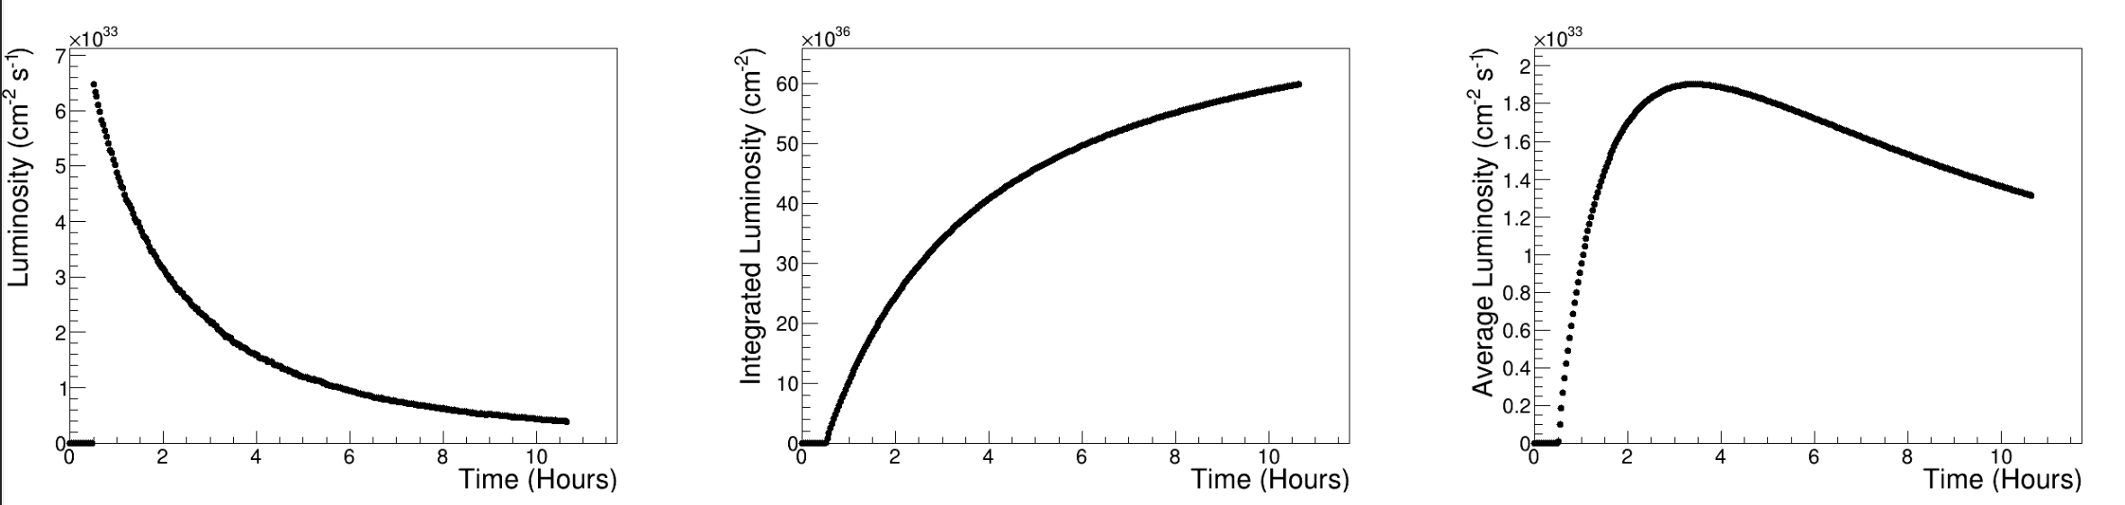
First Luminosity Numbers at full Capability
No SHC -- ep | Lumi per Day (pb⁻¹) | Lumi per Year (fb⁻¹)
18 GeV x 275 GeV | 24.2 | 4.1
10 GeV x 275 GeV | 164.2 | 27.6
10 GeV x 100 GeV | 64.8 | 10.9
5 GeV x 100 GeV | 55.3 | 9.3
5 GeV x 41 GeV | 6.9 | 1.2
No SHC -- eAu | Lumi per Day (pb⁻¹) | Lumi per Year (fb⁻¹)
18 GeV x 110 GeV | 5.2 | 0.87
10 GeV x 100 GeV | 54.4 | 9.1
5 GeV x 110 GeV | 53.6 | 9.0
5 GeV x 41 GeV | 11.2 | 1.9
ep 10 GeV x 275 GeV
1.9 10³³ cm⁻²s⁻¹

Slide 19
Radiation Doses

Slide 20
Facility Lifetime
For EIC we define a 30 y lifetime, to define radiation doses one needs to have a rough split between the beam energies over this 30 years here is assumption
EIC is built to run the following beam energy combinations:
5 GeV x 41 GeV, 5 GeV x 100 GeV, 10 GeV x 100 GeV, 10 GeV x 275 GeV and 18 GeV x 275 GeV
For simplicity all hadrons are treated as protons, which should be okay for radiation purposes.
Based on this, one gets the following:
Electron Energy |  |  | Hadron Energy
5 GeV | 10 GeV | 18 GeV | 41 GeV | 100 GeV | 275 GeV
10 years | 10 years | 10 years | 5 years | 12 years | 13 years
For ePIC 30 y lifetime for radiation will be too long so my suggestion is to use 15 years with 5 years
a the EIC commissioning and ramp up luminosities ( ∫L = 40 fb⁻¹) and 10 years at full EIC capabilities
Electron Energy |  |  | Hadron Energy
5 GeV | 10 GeV | 18 GeV | 41 GeV | 100 GeV | 275 GeV
3 years | 3 4 years | 4 years | 2 years | 4 3 years | 4 5 years
5 x 41 GeV --> 2 years
5 x 100 GeV --> 1 year
10 x 100 GeV --> 2 years
10 x 275 GeV --> 2 years
18 x 275 GeV --> 3 years
∫L = 100 fb⁻¹

Slide 21
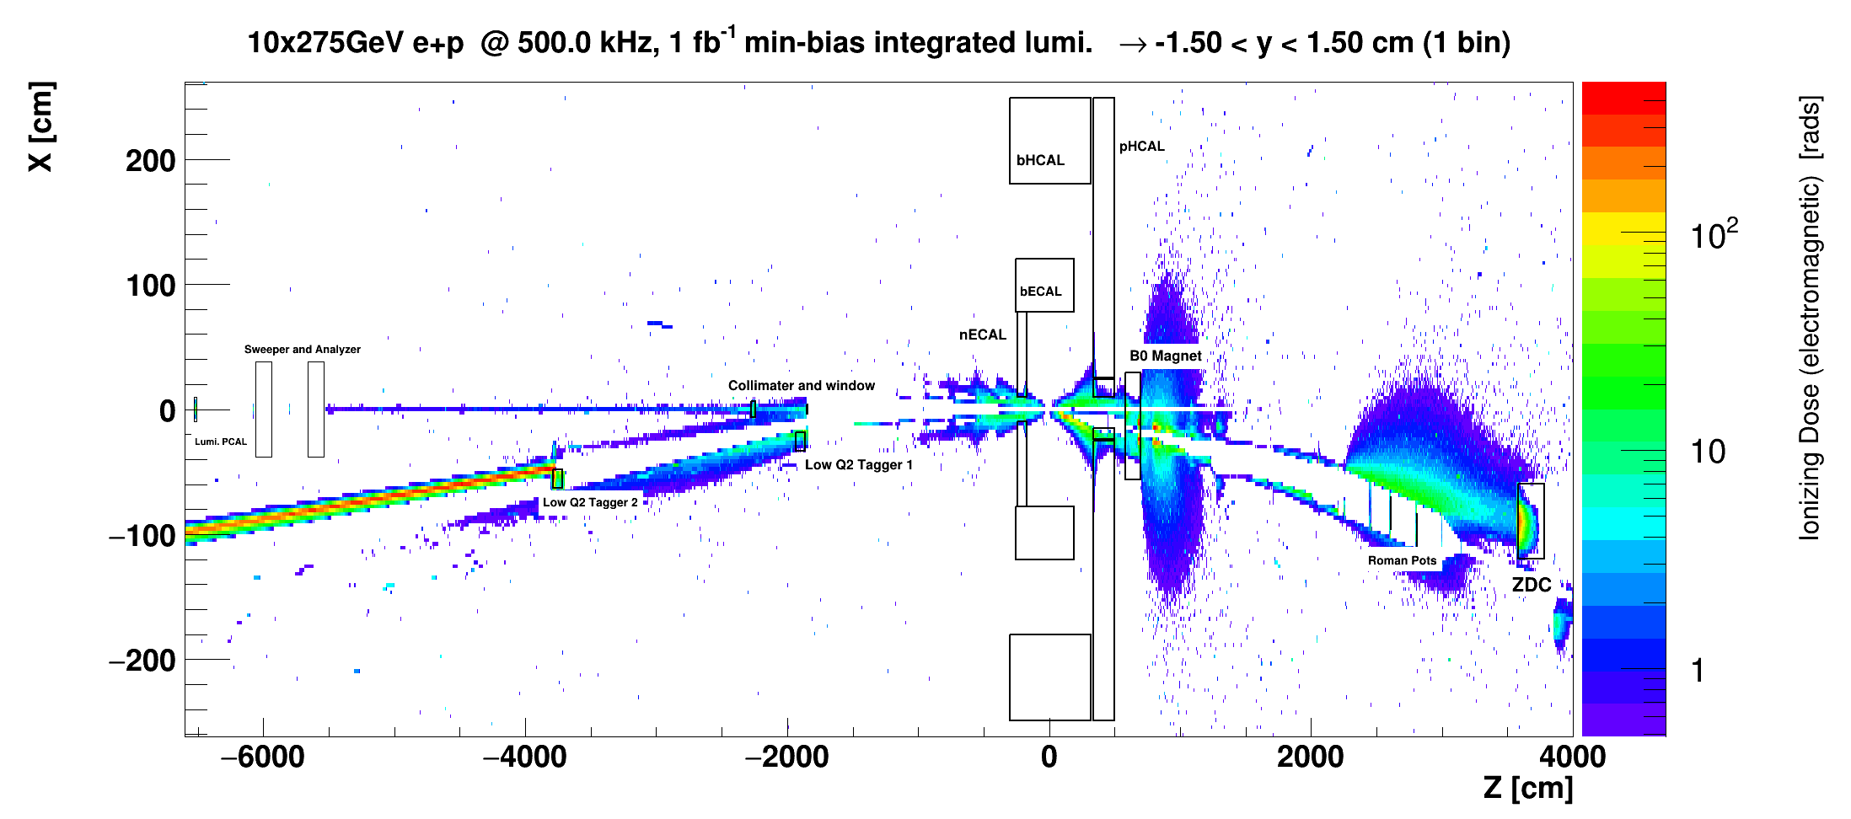
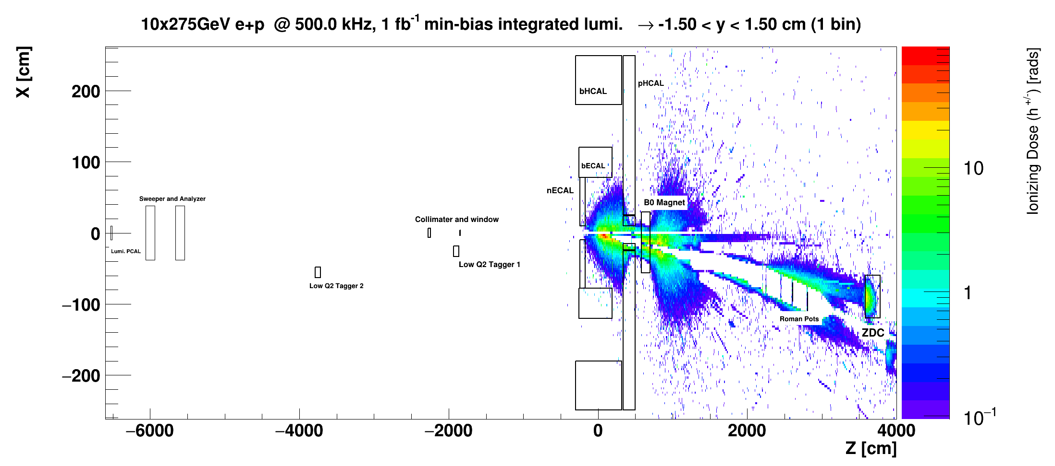
Radiation Doses
All the information is posted at https://wiki.bnl.gov/EPIC/index.php?title=Radiation_Doses
To obtain the full radiation dose one needs to add the radiation dose due to
electron-nucleon scattering + electron beam backgrounds and hadron beam backgrounds
The figures are for an integrated lumi of 1 fb⁻¹, so one needs to scale to the total integrated luminosity
for the 15 years as described earlier.
It is very important to have the material budget correct also along the beam pipe, like the SC magnets
Electromagnetic radiation doses
Charged hadron radiation doses

Slide 22
Summary
All information is there to proceed
  beam pipe has been updated
  background files exist
    need to update electron beam gas to include Coulomb and to include Touschek → done
    potential more hadron beam backgrounds needs to wait till full particle tracking is complete, especially for Ions
    need to integrate realistic model of the IR magnets, especially material budget, into the ePIC simulation → model exist
  Luminosity numbers for EIC commissioning and ramp up phase are known
    will recalculate numbers at full capability → done
    for the pre-TDR one should use 10 GeV x 275 GeV as it will have the highest luminosities
      → impacts occupancy, radiation and so on
  Radiation Doses
    Simulations exist since a long time for DIS + beam backgrounds
      need to update for electron and hadron beam backgrounds as soon as the realistic model of the IR magnets is integrated
      need to make this radiation simulation possible in the ePIC framework → resolve problem to access stepping information
If you have a question, ask the experts, email to eic-ir-bckgr-l@lists.bnl.gov
personal emails will not get the same attention

Slide 23


Slide 24


Slide 25
First Luminosity Numbers at full Capability
With SHC | Lumi per Day | Lumi per Year
10 GeV e x 100 GeV p | 354.2 pb⁻¹ | 21.8 fb⁻¹
10 GeV e x 275 GeV p | 129.6 pb⁻¹ | 59.5 fb⁻¹

