Slide 1
Summary of the Paris ASIC Meeting 2-3 June 2025
TIC Meeting
Fernando Barbosa (JLab)
23 June 2025

Slide 2
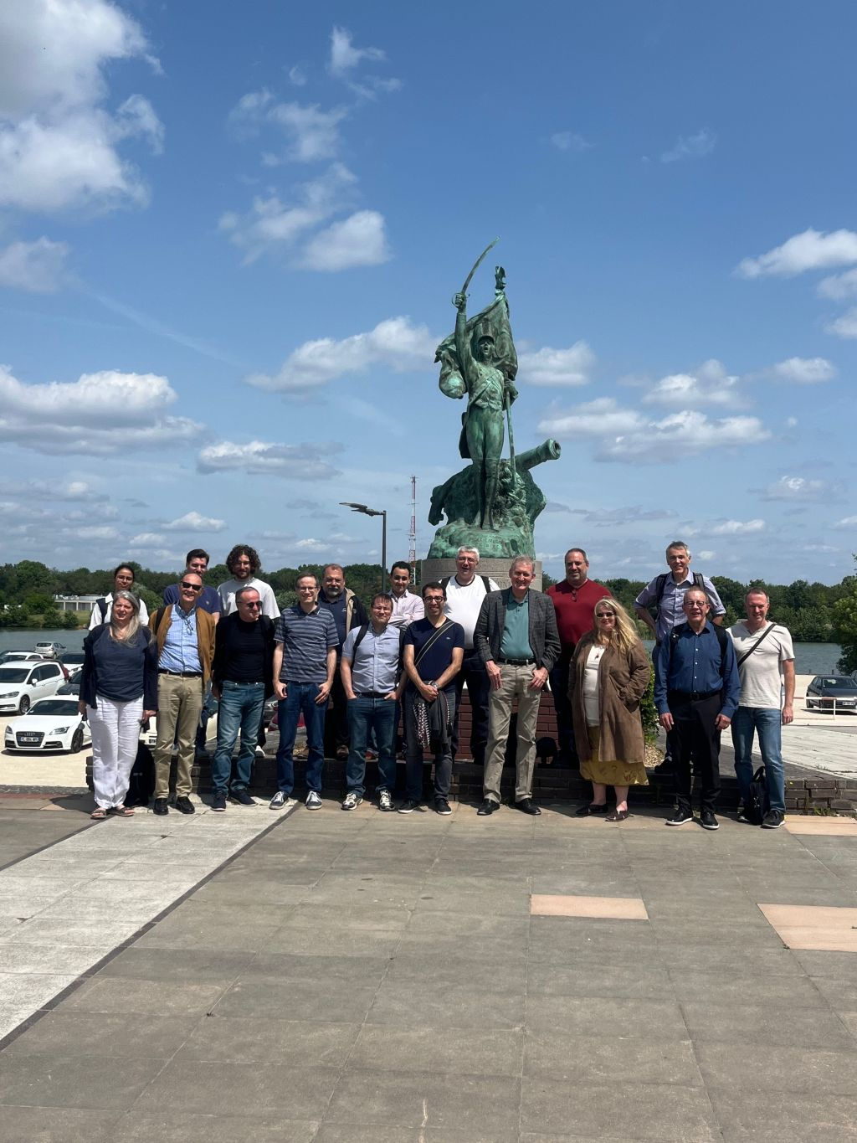
ASIC Meeting in France
Where: Ecole Polytechnique (+ Omega) and Saclay
When: 2-3 June 2025
Topics & Goals: Full assessment of ASICs’ developments through production
Reference: https://indico.bnl.gov/event/28161/
A very big thank you to Dominique Marchand, Christophe De La Taille, Damien Neyret and everyone at Ecole Polytechnique and Saclay for the great organization and tours.

Slide 3
Topics & Goals
  EICROC
  CALOROC
  FCFD – AC-LGAD Strips
  FCFD Variant – HRPPD/MCP-PMT for pfRICH & hpDIRC
  SALSA
  ALCOR (via Zoom)
  Status
  Review of specifications, requirements, nice-to-have requests. Includes frontend and backend with interfaces and packaging
  Steps to completion with anticipated schedule, including testing
  Production outlook, including QA/QC and testing
  Synergies. Possibly sharing of designs, architectures and infrastructure (e.g. power implementation, distribution)
  Documentation. Functionality (e.g. User’s Manual/Spec sheets) and approvals needed (e.g. CERN, import/export, etc.)
  Digital Interfaces

Slide 4
  Status
    Provide a brief description of the current status in the development of the ASIC and what steps remain to finalize the design.
  Review of specifications, requirements, nice-to-have requests. Includes frontend and backend with interfaces and packaging
    Are the frontend specifications and requirements complete?
      Functionality
      Number of channels
      Coupling, termination
    Are the backend specifications and requirements complete?
      Are the interfaces and links well defined?
        Data format, digital interface definitions and development plans
        Number of links
        Link rates – fixed, programmable or settable
    Is the technology node fixed?
      130 nm (EICROC, CALOROC), 65 nm (FCFD, SALSA), 110 nm (ALCOR)
    Is the nominal power consumption per channel or ASIC well understood?
      Voltage and current requirements
      Special considerations or recommendations for distribution
      Temperature limits, cooling

Slide 5
  Review of specifications, … (cont.)
    When is the packaging and pinout of the ASIC expected to be finalized?
      Timeline – planning for FEB PCB design, routing
      Package (wire bonding, BGA, …) and pinout
        Special considerations or recommendations for PCB layout
  c) Steps to completion with anticipated schedule, including testing
    Provide a brief description of the steps needed until production
      Steps with timelines
      Tests
        Bench, validation with sensor, beam
        Distribution to a limited number of users
    Production Readiness Review
      This is a major milestone prior to start of production
  Production outlook, including QA/QC and testing
    Provide a brief description of the steps needed to start production
    Packaging & shipping
    Provide a preliminary plan for QA/QC and testing

Slide 6
Synergies. Possibly sharing of designs, architectures and infrastructure (e.g. power implementation, distribution)
  We would like to explore the feasibility of sharing designs, architectures and infrastructure among the various ASIC designs, including IP blocks and benefitting the streaming readout approach at the EIC
  Discuss the support needed towards the first “release” of the ePIC DAQ (picoDAQ) for the readout of the various ASICs in a standardized manner
  Are there benefits and efficiencies to be attained, considering the same or different technology nodes?
Documentation. Functionality (e.g. User’s Manual/Spec sheets) and approvals needed (e.g. CERN, import/export, etc.)
  As designs mature, it would be advantageous to group each of the ASIC capabilities via a User’s Manual and a Specifications sheet. A preliminary version would be desirable well in advance of the Readiness Review.
  We would like to discuss the need for documentation, agreements and/or approvals anticipated prior to production as these can take considerable time.

Slide 7
g) Digital interfaces for streaming? (for each ASIC)
We want to understand the zero suppression/self triggering. Importantly, what data volume do we expect for a single hit? If there are multiple channels hit during the same clock cycle, how does this affect the data volume?
Many detectors have hot regions and cold regions and it would be beneficial to use more ASICs per FEB than other regions. Can the link speed be configured slower than the maximum rate? E.g. to allow more asics to be read from a single lpGBT in colder regions?
Error handling
  We want to positively ensure that the clocks stay synchronized. There are at least two possibilities? Which works, or are there other plans?
    We intend to send a revtic (one signal every 1260 bunches associated with the 0 bunch). This allows the ASIC to expect a the revtic every 1260 clocks (for 98.5MHz digitization) and 504 clocks (for 40MHz digitization clocks). The ASIC itself can determine whether this signal comes when expected. If it does not, a signal should be sent.
    Alternatively (or in addition) we can issue a trigger on an arbitrary bunch crossing, that responds with the appropriate clock counter.
      If this method is used, can there be a trigger that ONLY responds with the clock counter?
      If not, how do we determine whether the output is generated by the trigger or by the self-triggering?
  Is it possible for the amount of data generated to overflow the ability of the serial outputs of the ASIC to transfer data to the FEBs?
    If so, is there a error mechanism to communicate this to the FEB? What is it?
Calibration:
  Are there pedestals/gains or other calibrations required?
  Are they automatically generated, or loaded from DAQ?
  How are they to be generated? We can not read black events for long through the DAQ, is there a way to trigger zero-threshold readouts for short periods of time?
How long is the deadtime between two hits? What is the granularity at which deadtime would be applied?

Slide 8
ASICs – Path to Completion
 | Status & Development Summary | Next Steps | Production | Institution
CALOROC | Interface design FY23- FY24, CALOROC1A/B designed FY24-FY25 CALOROC1A: ADC/TOT + TOA, full SRO interface CALOROC1B: Switched gain (4) + ADC + TDC, full SRO interface Tests: Oct 2025 | CALOROC2 (64 ch) – FY25-FY26 Select version and increase channels from 32 ch to 64 ch. | FY27 | OMEGA/IN2P3/IJCL, ORNL
EICROC (32x32) | EICROC0A (4x4) designed FY24-FY25, EICROC1 (32x32) FY25 EICROC0A: ADC + TOA, improved testability EICROC0B: Replaced ADC with peak sensing, Wilkinson ADC, lower power EICROC1: added full SRO interface | EICROC2 (32x32) FY26 Add Derandomizer and ZS. Digital on Top design for lower power (~1 mW/ch). | FY27 | OMEGA/IN2P3/IJCL/CEA-Saclay, AGH
FCFD (128) | Front end characterized, FCFDv1 (6 ch) FY23-FY24 characterized, FCFDv1.1 FY25 Optimized for HPK sensor characteristics | FCFDv2 (32 ch) FY25-FY26 Add ADC, TDC, interfaces from ETROC, ECON CERN. FCFDv3 (128 ch) FY26 | FY27 | FNAL
FCFD Variant (64) | FCFDv1.1 FY25 Preliminary tests with sensors | Harmonize sensor/ASIC specifications, adapt FCFD for 64 ch. | TBD | FNAL
ALCOR | ALCORv2.1 (32 ch) beam tests FY24, ALCOR v3 (64 ch) FY24-FY26 Full specification, SRO interface, BGA | ALCOR-64 – FY26 Final iteration for production | FY26 – FY27 | INFN
SALSA | SALSA0/1 FY24, SALSA2 (32 ch) designed FY23-FY25 Full SRO interface, most DSP features, Submission October 2025 | SALSA3 (64 ch) FY25-FY27 full DSP, 64 ch | FY27 – FY28 | CEA-Saclay, U Sao Paulo
ASIC production is ~1 Year: Fab, Packaging, Test. Additional information in the following slides. PED is expected to be completed in FY26.
Complete.
Fab submission is imminent.

Slide 9
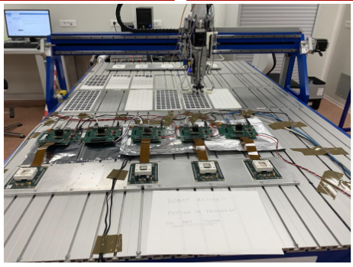
ASIC Meeting in France - Summary
ASIC designs are progressing well, including QA/QC plans
A list of action items will be requested (Elke/Rolf) from the collaboration:
  Timing precision, dynamic range (e.g. pfRICH)
  Radiation dose, fluence per chip location
  Occupancy
    Validation, cross-checks prior to finalizing designs
Administrative steps take longer than anticipated (approvals, institutes, contracts, etc.)
Europractice/IMEC/TSMC – agreements are with CERN and ePIC recognized experiment is not enough
  We have ~2 years to production – need to clarify agreements (CERN/ePIC/EIC/BNL/JLAB/institutions, …)
eRD109 monthly updates during E&DAQ meetings will transition to internal mini-reviews per ASIC/Discrete – PED, construction phases.
Readiness reviews for each ASIC/Discrete prior to start of production
Expect devices for tests with sub-detectors in FY26
  More details at the upcoming collaboration meeting
Testing @ Omega (~100/hour).

