Slide 1
Accelerating the Development of Fusion with AI and HPC Shantenu Jha, Princeton Plasma Physics Laboratory
Contributions from M Churchill, T Powis, A Sanchez, R Hager, D Rivera, N Ferraro and several others PPPL/Princeton University

Slide 2



Fusion Fundamentals
… the process of combining two light atomic nuclei to form a heavier nucleus, releasing a significant amount of energy. It has the potential to provide a nearly limitless, clean, and safe source of energy.
When small hot atoms (usually hydrogen) combine….
ENERGY produced
E=mc²

Slide 3
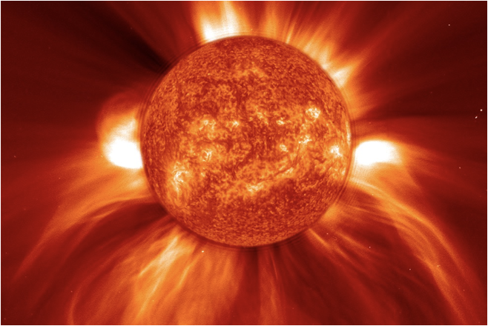
Fusion is the energy source of all stars
The core of the sun: ~15M K
When small hot atoms (usually hydrogen) combine….
ENERGY produced
E=mc²

Slide 4
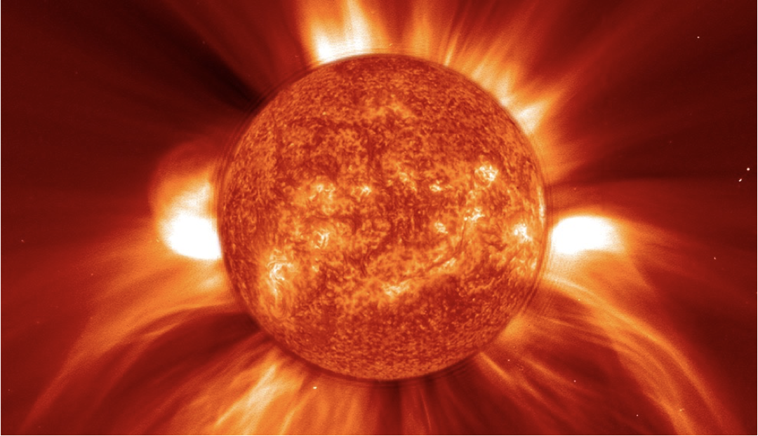
The sun uses gravity …

Slide 5

…but we don’t have enough mass in a lab

Slide 6
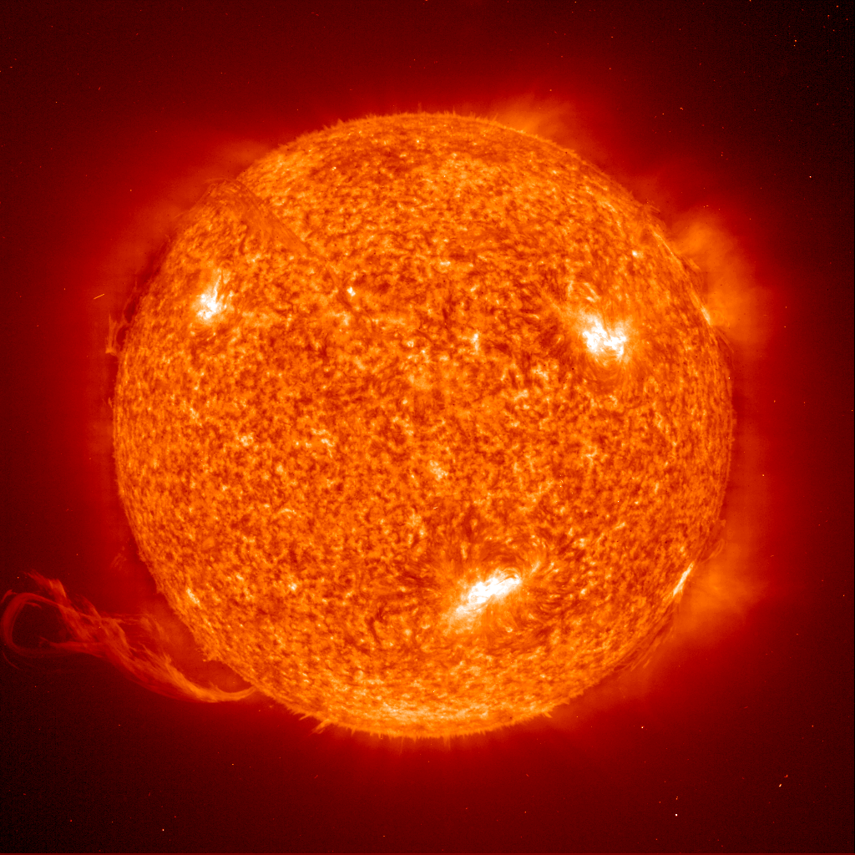
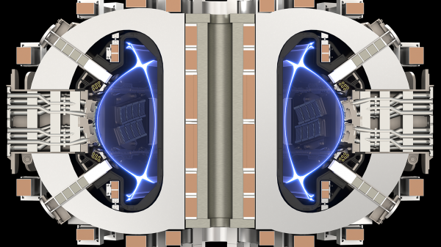
Sun in a Box
In a reactor, temperatures 10x hotter than the center of the sun are needed (~150M K) and technology to confine & control the plasma.

Slide 7
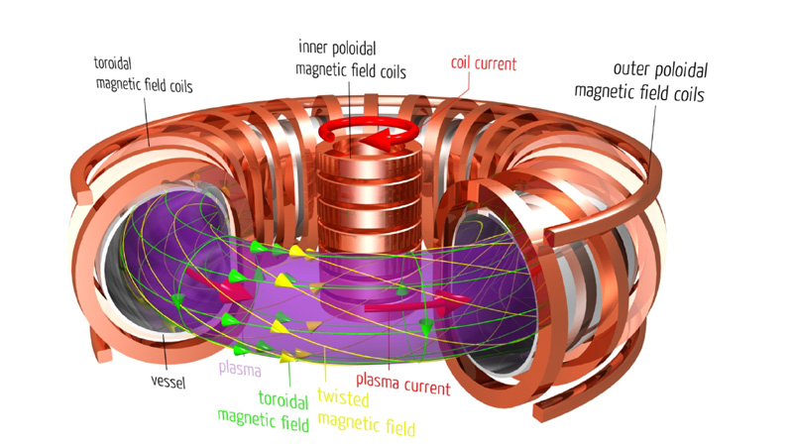
The main confinement method we study at PPPL is magnets

Slide 8
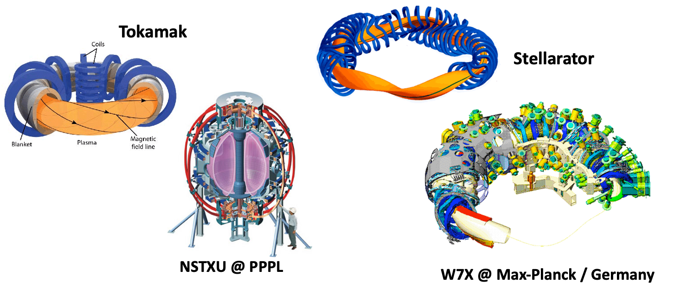
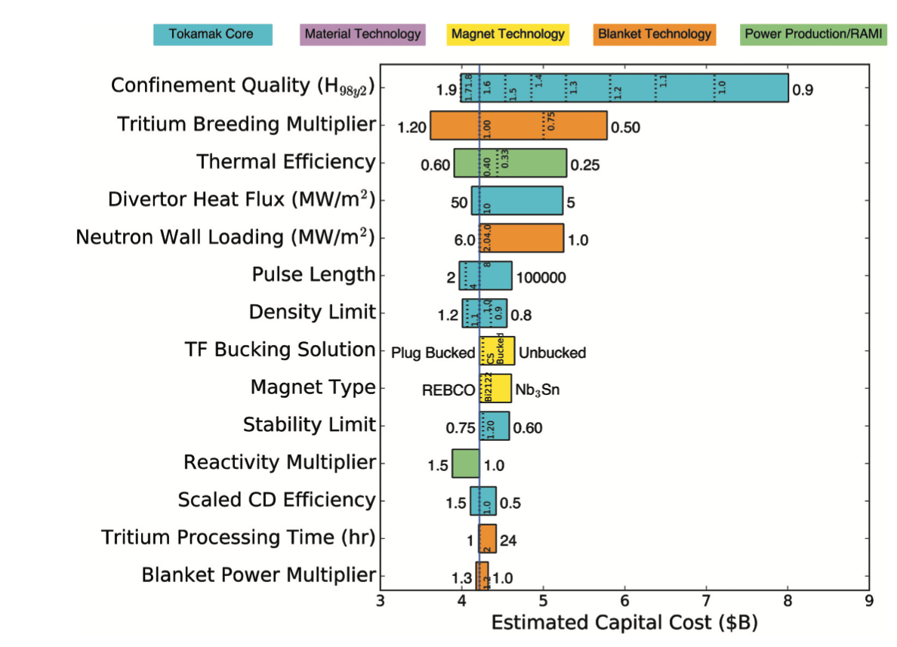
Magnetic confinement devices are often tori
Which tori is most promising (cost, engineering feasibility, operating control, ..)?

Slide 9
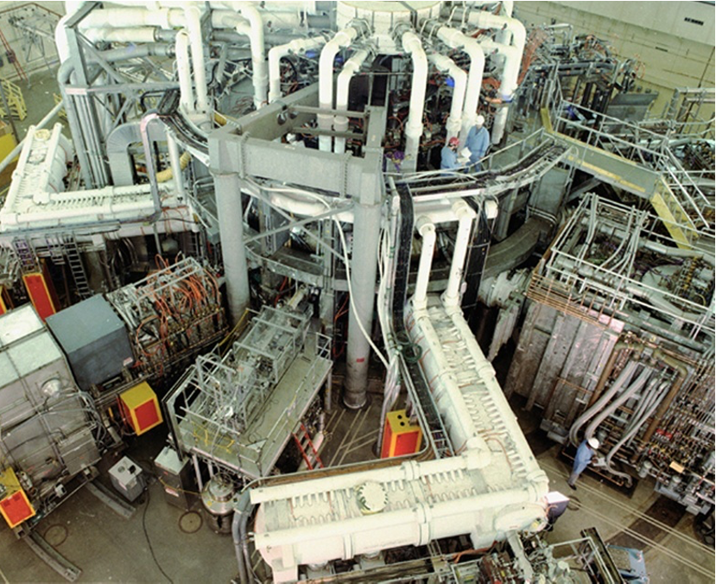
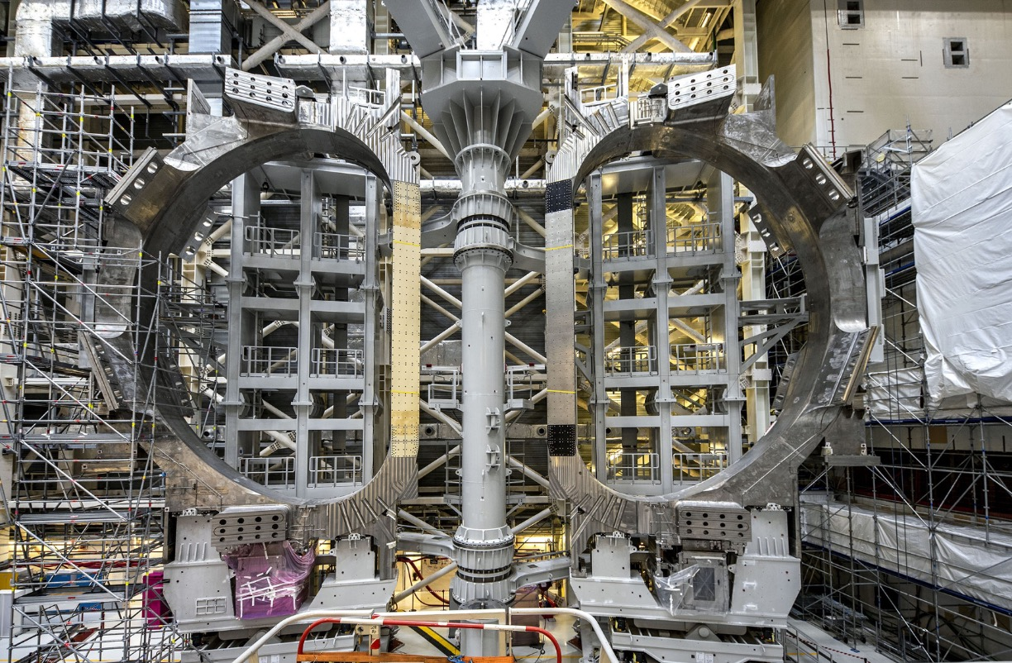
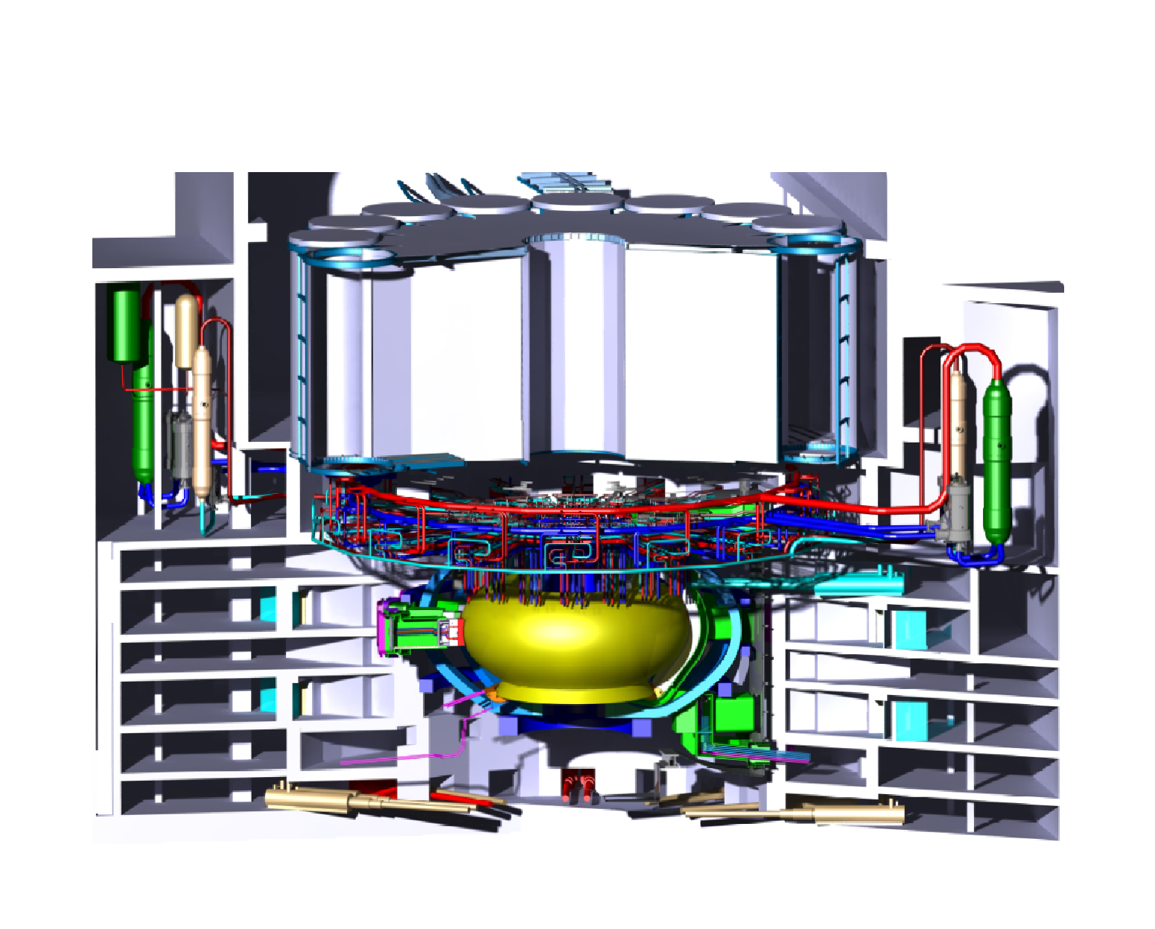
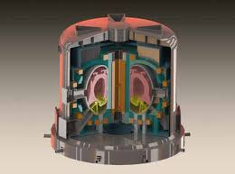
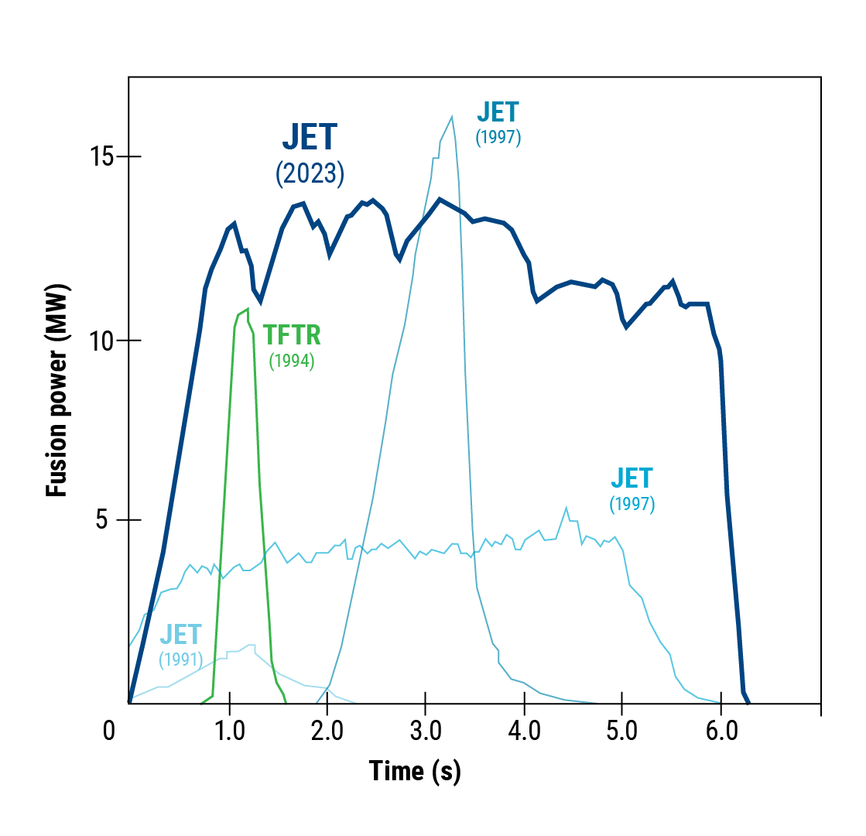
The Mainline to Fusion
Condition for Fusion Ignition
DEMO
European Demonstration Fusion Energy Power Plant – 2045
“Confinement Factor”
Turbulence Suppression
Cost of fusion plant:
H ³ B ⁴ R ³ ≥ constant ∝1/H³
CFETR
Chinese Fusion Engineering
Test Reactor — 2030s
TFTR | fusion conditions — 1994
ITER | fusion burn — 2035?
EU DEMO: Logical next step for the conventional tokamak but faces major challenges — especially power handling — and projected to be very large and costly.
PPPL Innovation: Developing advanced configurations enabling practical, attractive reactor solutions.
ITER: H = 1, R = 6.2m, B = 5.3T BR3/4 = 20.8
MIT + COMMONWEALTH FUSION SYSTEMS — SPARC: H = 1, R = 1.78m B = 12.5T BR3/4 = 19.2
Notes:
“We can do fusion but can we do commercial fusion”
Achievement of the mainline have been impressive but – not
A route to commercial fusion - too expensive and not robust
China investing ~$1.7B/year on the main line – wouldn’t be our choice
PPPL is convinced that we can make it smaller cheaper faster H>1.8
The answer lies in the plasma physics

Slide 10
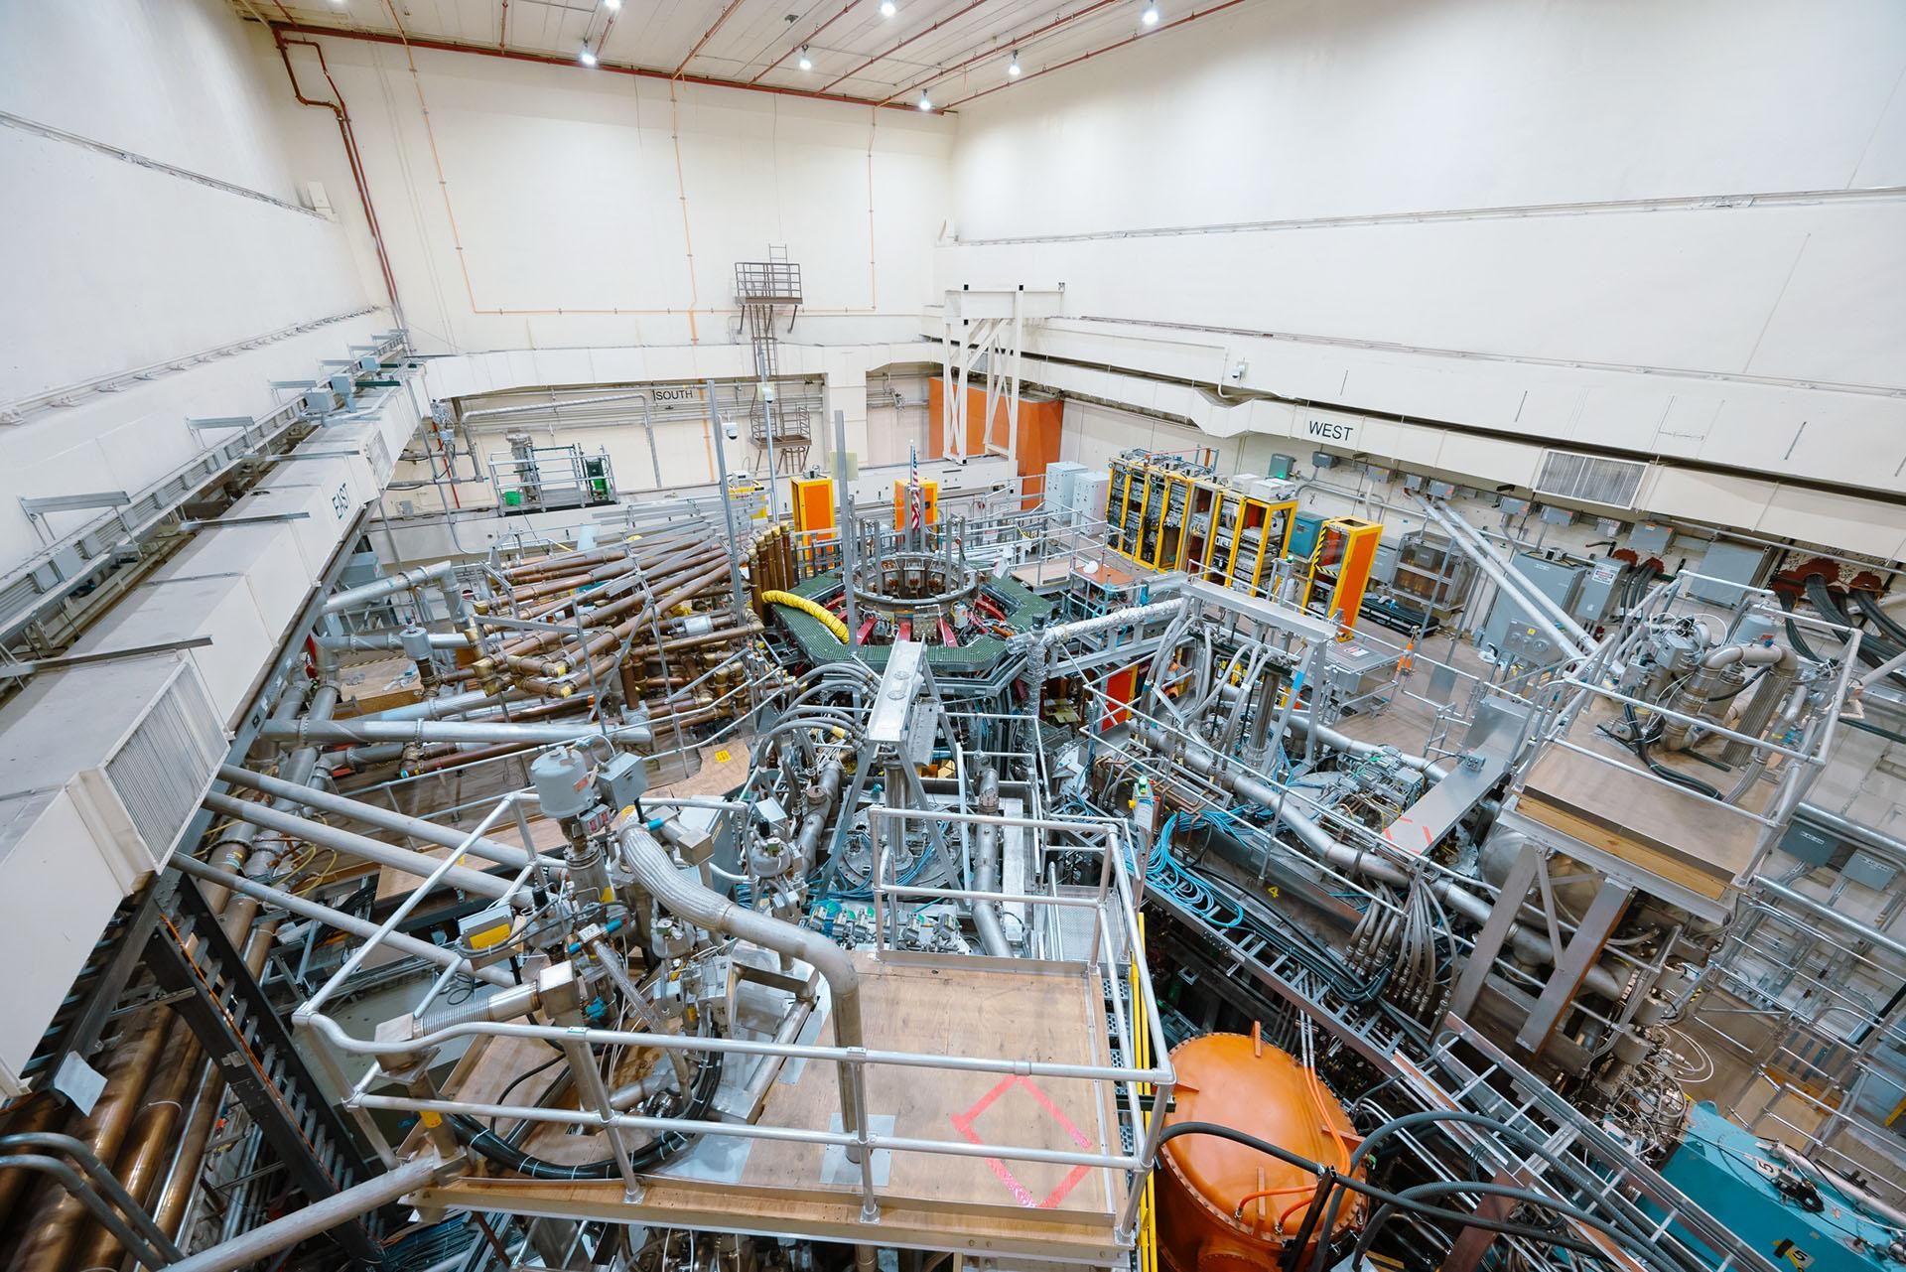
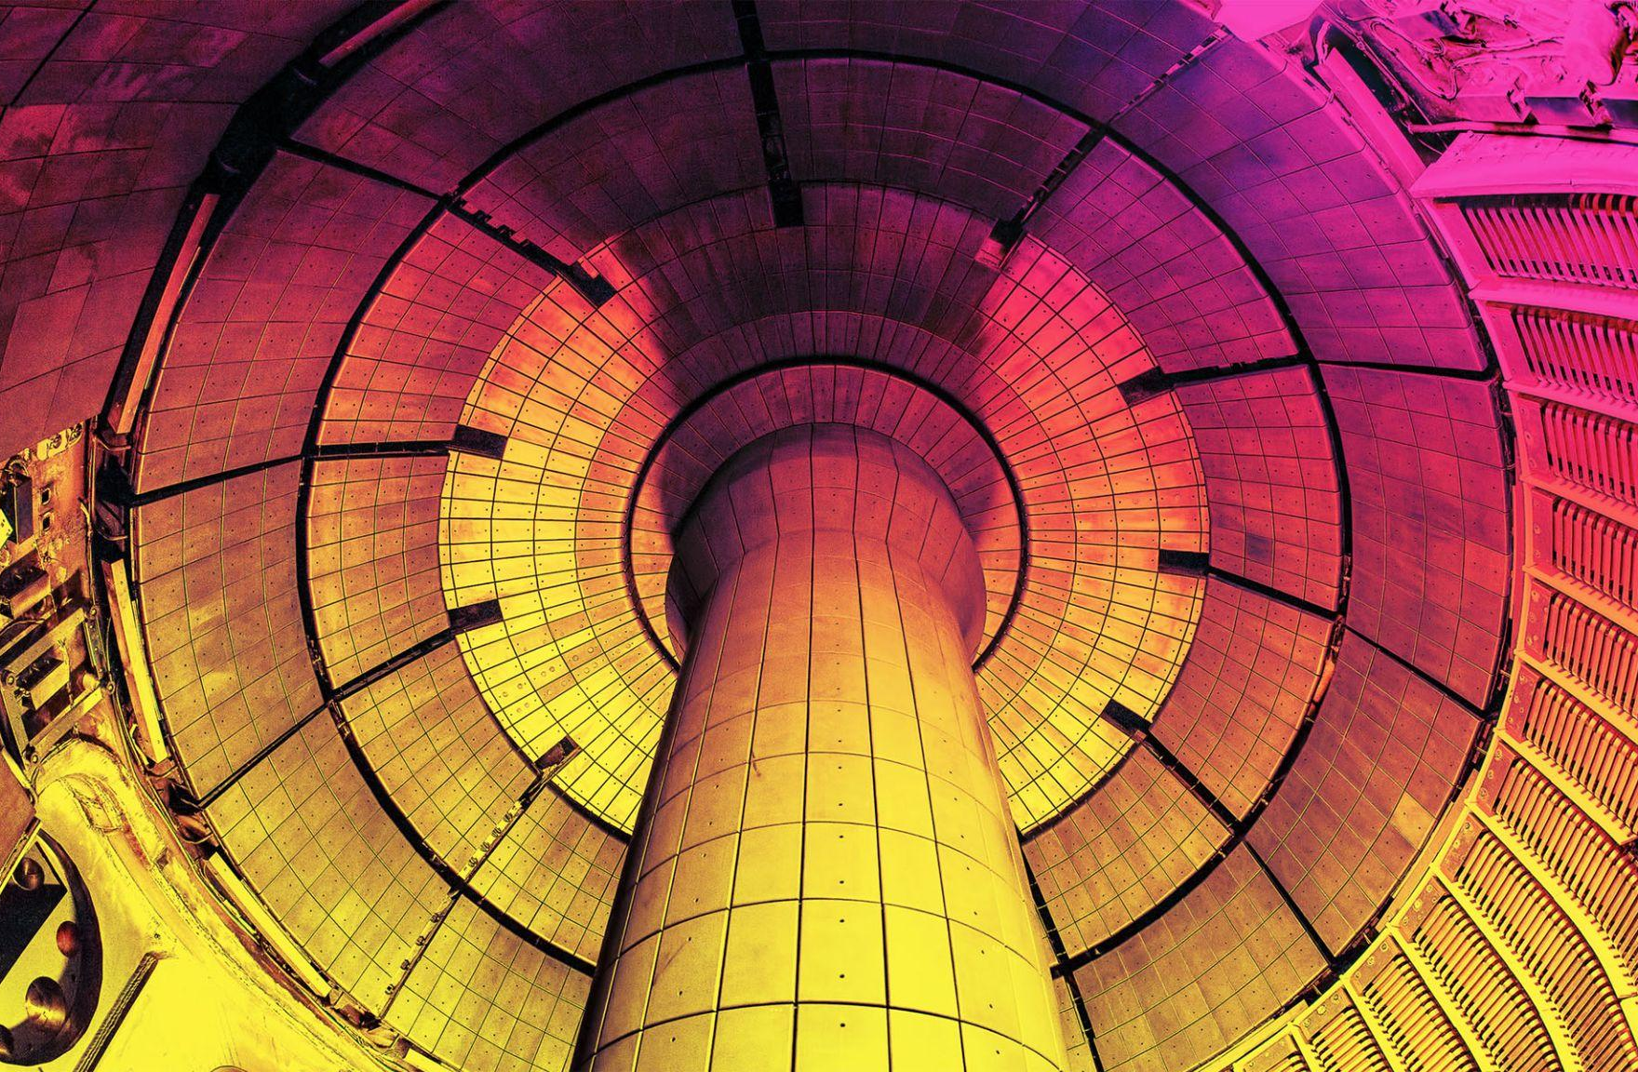
NSTX-U Spherical Tokamak
Better Confinement …
2026
First plasma
2031
Fusion pilot plant design
Validate the physics of the spherical tokamak H~1.8?
Liquid lithium campaign
Notes:
Experimental results and some calculation suggest that the ST is a route to a smaller cheaper better reactor
Four major and three minor companies are betting that it is the answer
NSTX-U is epsilon away from complete The final component should arrive in weeks from Spain
Used the best suppliers in the world

Slide 11
NSTX-U Spherical Tokamak
Better Confinement … AI-Enabled Progress
NSTX-U: Optimized reactor design.
STAR
PPPL
ST-E1
Tokamak Energy (U.K.)
Commercial
reactors
204X…?
STEP
U.K. Atomic Energy Authority
FAST
Japan
2026
First plasma
2031
Fusion pilot plant design
2035
Fusion pilot plant operation
2040
2045
Validate the physics of the spherical tokamak H~1.8?
Liquid lithium campaign
Notes:
NSTX-U provides the decisive data to validate spending billions to build a ST pilot plant
NSTX-U is being configured to train the AI along with HPC of the ST
PPPL working with UK and TE to optimize.
Liquid metal program to produce a robust power handling solution

Slide 12
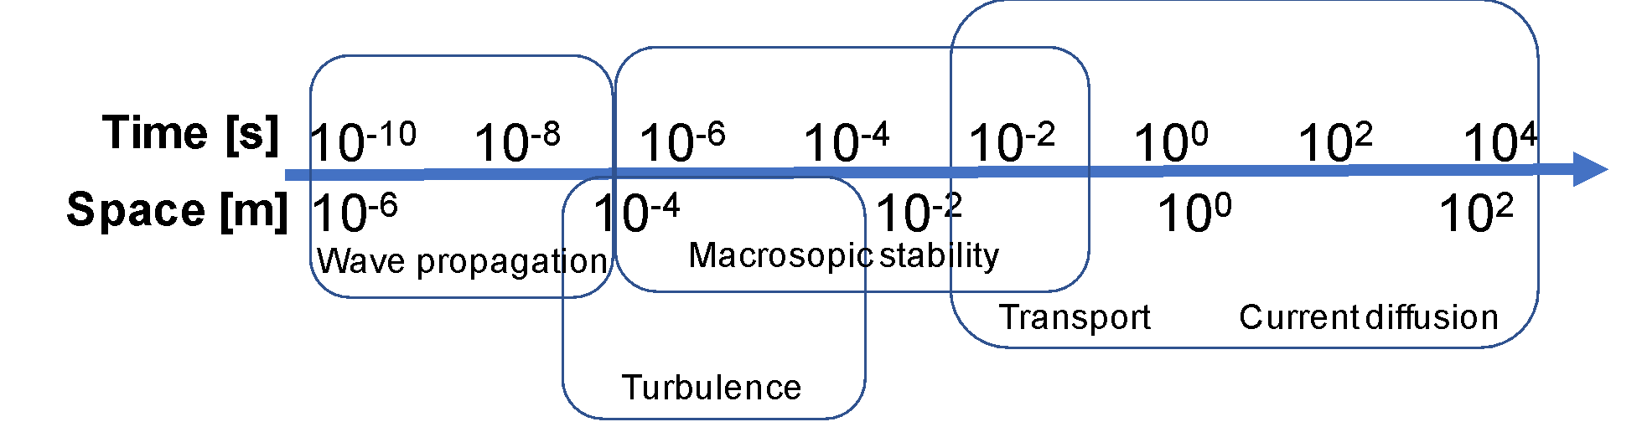
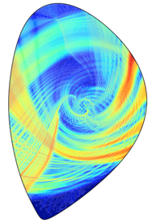
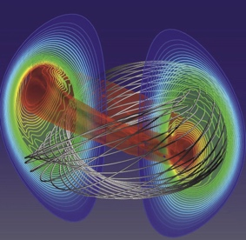
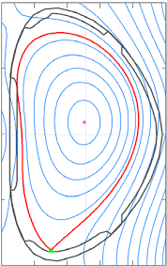
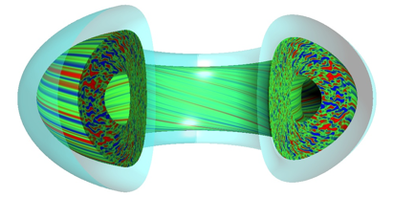
Fusion systems have a range of phenomena, manifest over multiple time and spatial scales
How do you design the magnets?
What materials prevent the walls from melting?
Full-wave solvers
MHD codes
How do you predict plasma dynamics?
Full plasma and plant evolution and control
How do you control the plasma in real time?
Gyrokinetic codes
What are robust designs for the next generation machines?

Slide 13
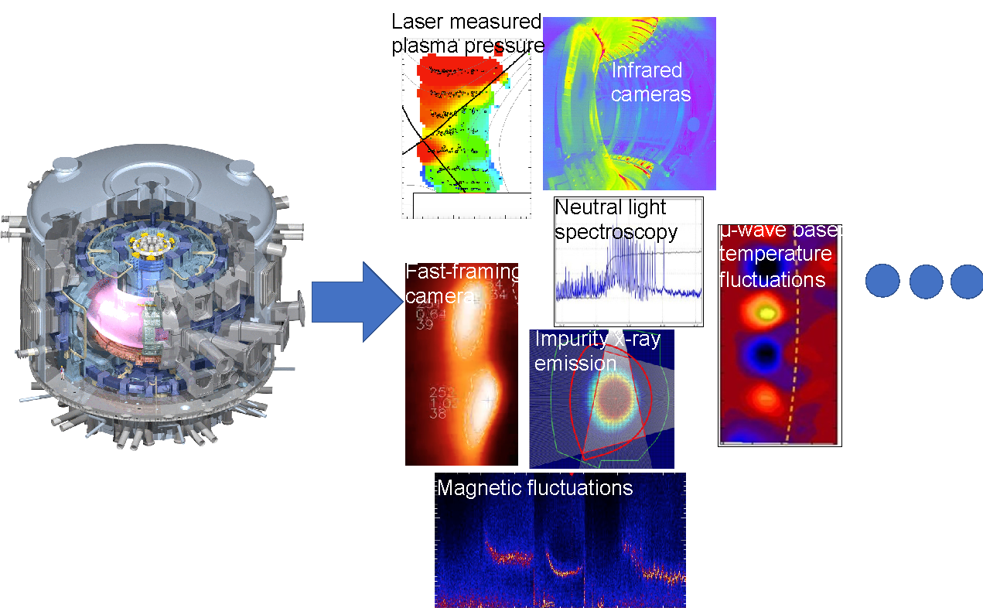
Understanding fusion plasmas requires extracting information from multiple diagnostics and simulations at these wide ranges of time and spatial scales
As we approach pilot plants, less diagnostics, more reliance on simulation
PPPL’s codes are validated, predictive, accurate — and the world depends on them
Fusion is beyond current capabilities of “traditional” high-performance computing

Slide 14
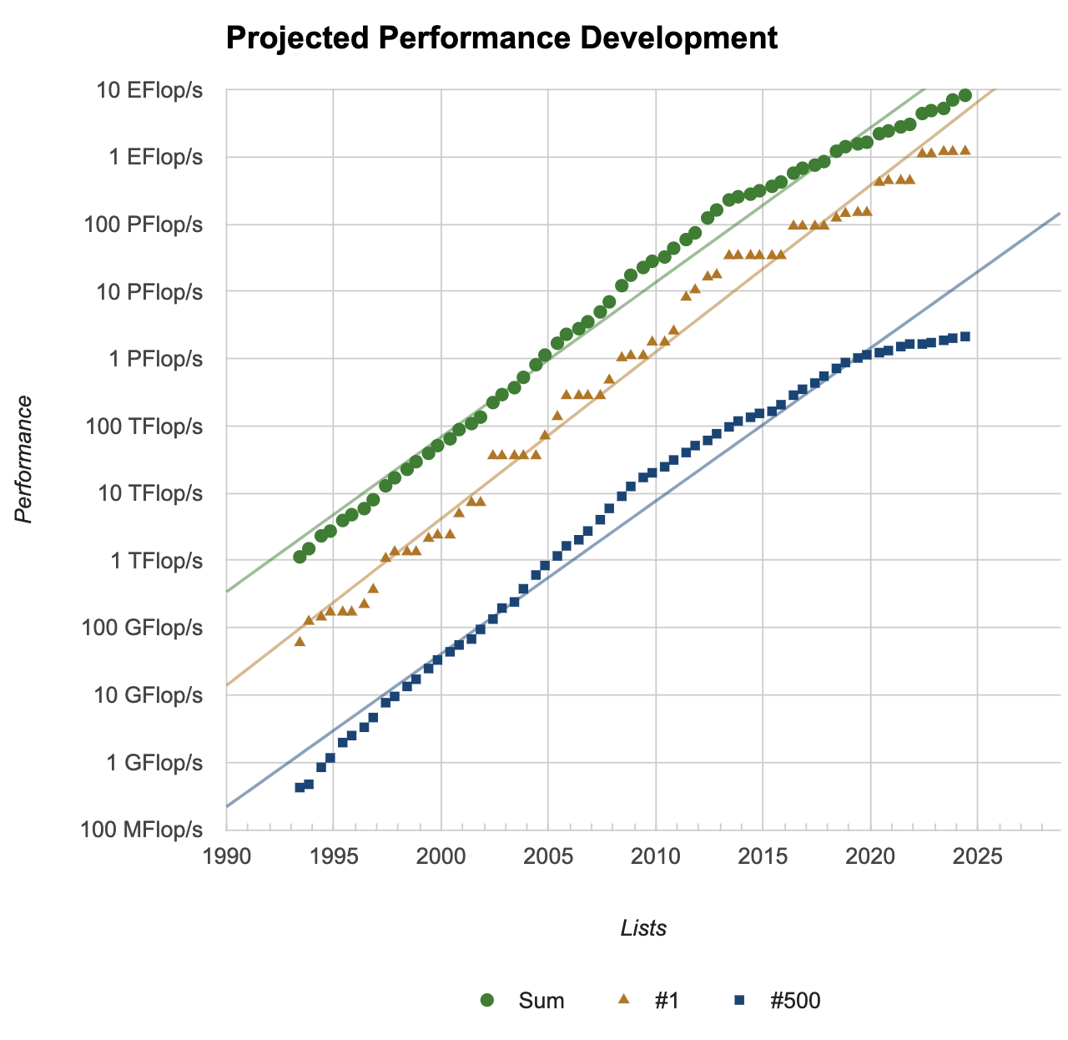
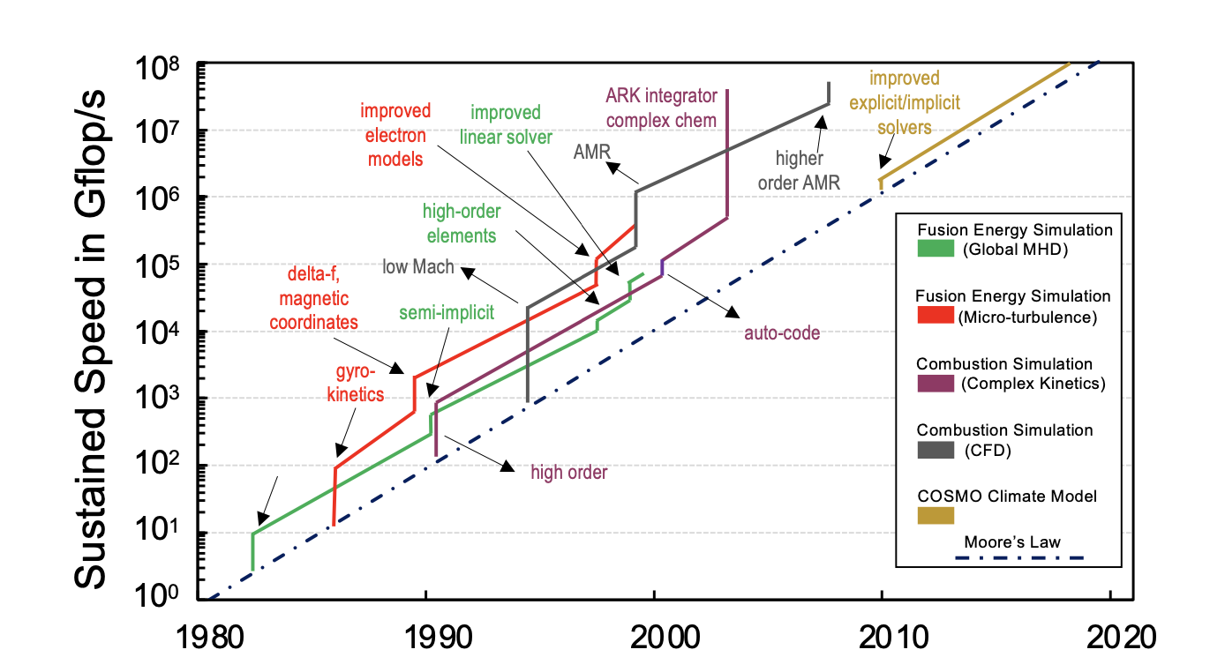
HPC is dead! Long live HPC!
Traditional HPC for modeling & simulations reaching limits
Architecture (micro, macro) trends, economics
Limitations of weak scaling
Supercomputers have tracked 100-1000x per decade
Fewer applications use large fraction at a high cost
Divergence in computer vs scientific performance
Next ten orders of magnitude (OOM) in “performance” not like last ten OOM!
Hybrid AI-HPC workflows: Online concurrent and coupled execution of AI and HPC, not offline AI
AI-HPC applications grow algorithmic Moore’s Law
Fusion energy and combustion simulations data by Keyes (2022) and climate simulation data by Schulthess (2016). From Matsuoka: https://doi.org/10.1177/10943420231166
Notes:
Past performance is no guarantee of future returns
What it means to be “performant” will be different

Slide 15
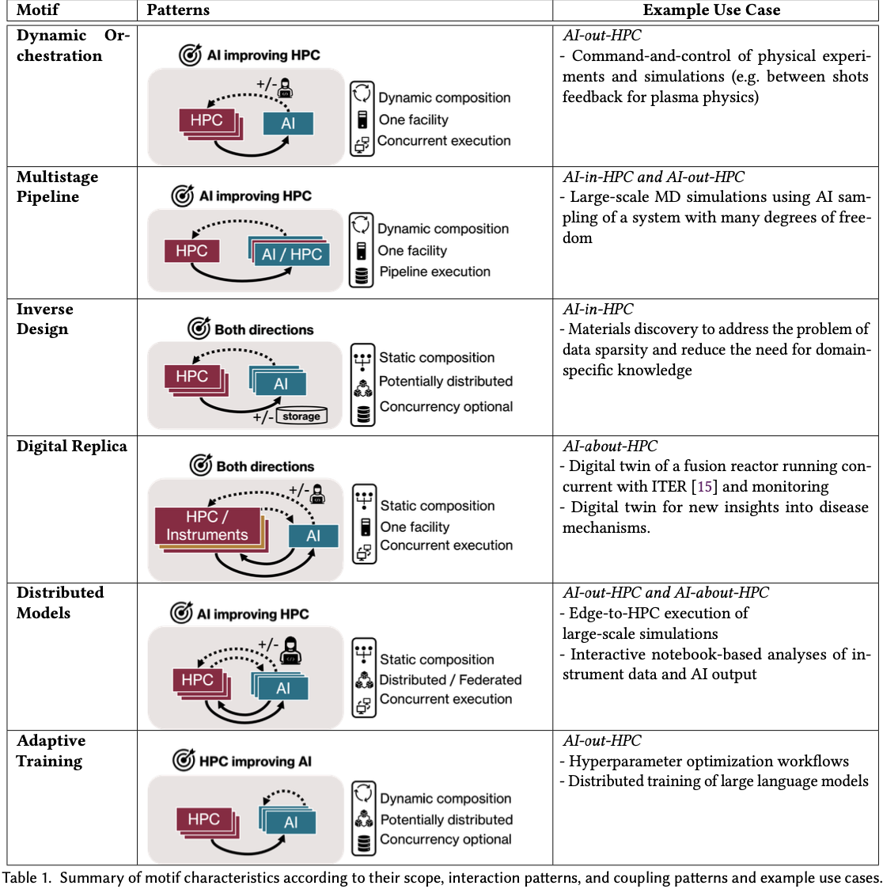

Hybrid AI-HPC Workflows: Algorithmic Moore’s Law ?
Three AI-x-HPC modes^{1,2} (not mutually exclusive)
AI-in-HPC is learning and replacing traditional simulations, or parts thereof
AI-out-HPC when AI is distributed from HPC
AI-about-HPC is AI running synergistically and interacting w/ simulations
Where will the next ten orders of magnitude (OOM) scientific performance?
4-6 OOM: surrogates of high-fidelity simulations
4-6 OOM: neural operators for high-fidelity simulations
2-4 OOM: steering and outer loop (reinforcement learning, Bayesian optimization)
…
^{1,2} https://arxiv.org/abs/2208.11745 and https://arxiv.org/abs/1909.13340

Slide 16
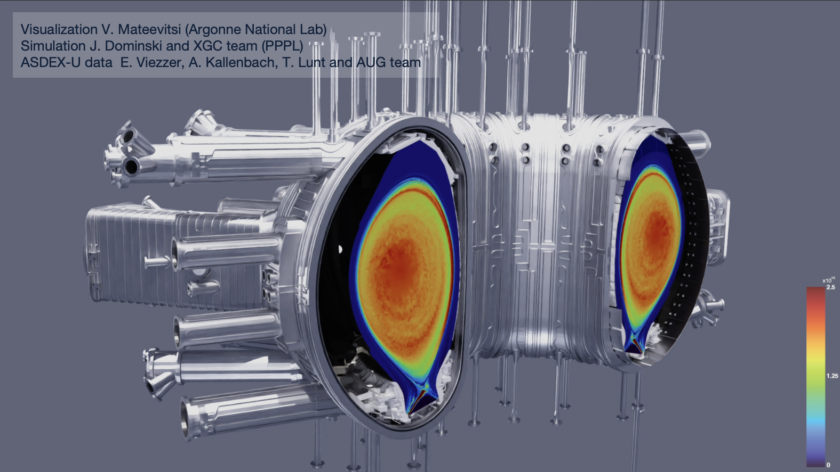
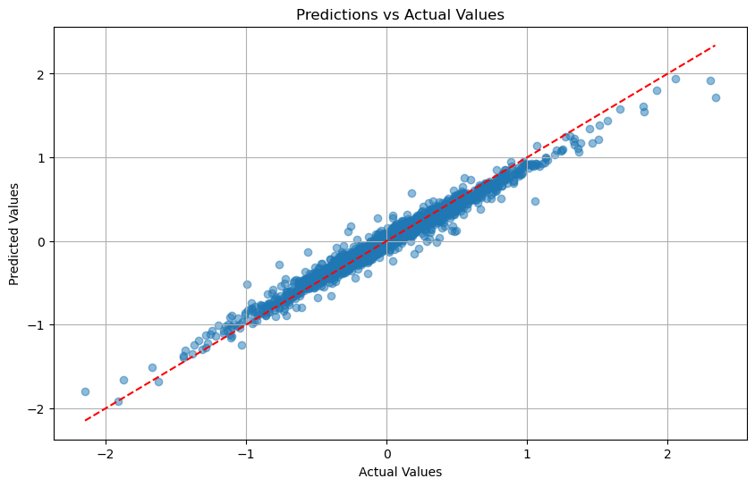
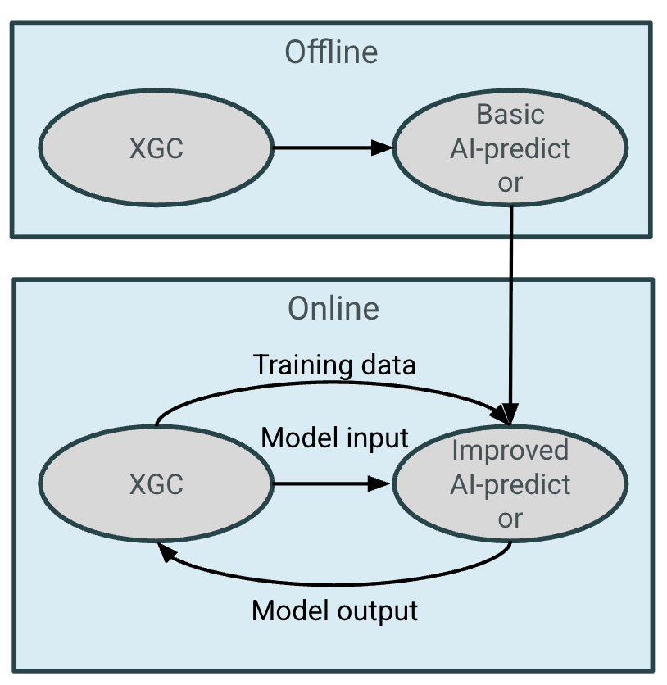
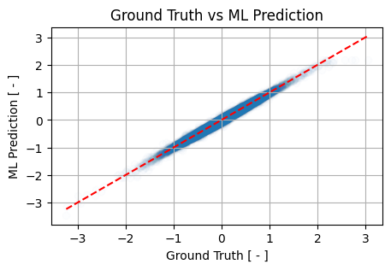
Surrogates for X-point Gyrokinetic Code (XGC)
Particle-in-Cell gyrokinetic code for simulating fusion plasma in magnetic confinement devices
Turbulence & transport in tokamak edge; critical for predicting heat loads to the wall
High-fidelity makes it computationally expensive
Improve performance and accuracy: replace analytical closures for collision operator with AI/ML predictor
Predictor for the magnetic vector potential
Online coupling permits significant improvement in A_{II} through larger training data sets and model
In-situ surrogate for sympletic vector potential boosts stability and timestep size
↑ Δt → Reduced code runtime

Slide 17
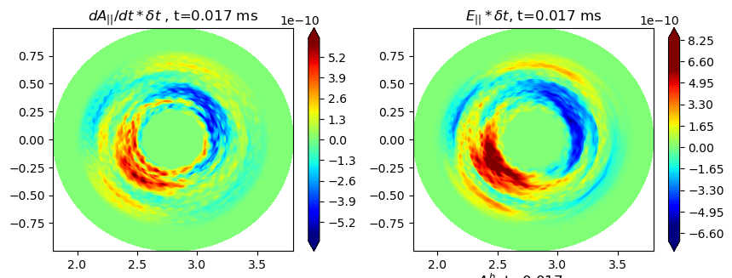

Surrogates for X-point Gyrokinetic Code (XGC)
Particle-in-Cell gyrokinetic code for simulating fusion plasma in magnetic confinement devices
Turbulence & transport in tokamak edge; critical for predicting heat loads to the wall
High-fidelity makes it computationally expensive
Improve performance and accuracy: replace analytical closures for collision operator with AI/ML predictor
Predictor for the magnetic vector potential
Online coupling permits significant improvement in A_{II} through larger training data sets and model
In-situ surrogate for sympletic vector potential boosts stability and timestep size
↑ Δt → Reduced code runtime
Predictor

Slide 18
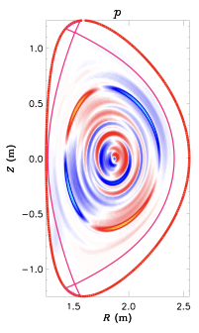
Surrogate Model for Tokamak Stability Analysis
Tokamak stability is typically calculated with a linear magnetohydrodynamic (MHD) model
Input: a tokamak equilibrium
Output: fastest-growing MHD eigenmode and growth rate
M3D-C1 is a high-fidelity MHD model for calculating MHD stability
Linear M3D-C1 calculations take ~10—20 min, which is too slow for real-time control, analysis during experiments, or use in whole-discharge modeling
A surrogate using thousands of M3D-C1 calculations using publicly available predicted equilibria for the SPARC tokamak
Expand to include equilibria from NSTX-U, and other tokamaks

Slide 19
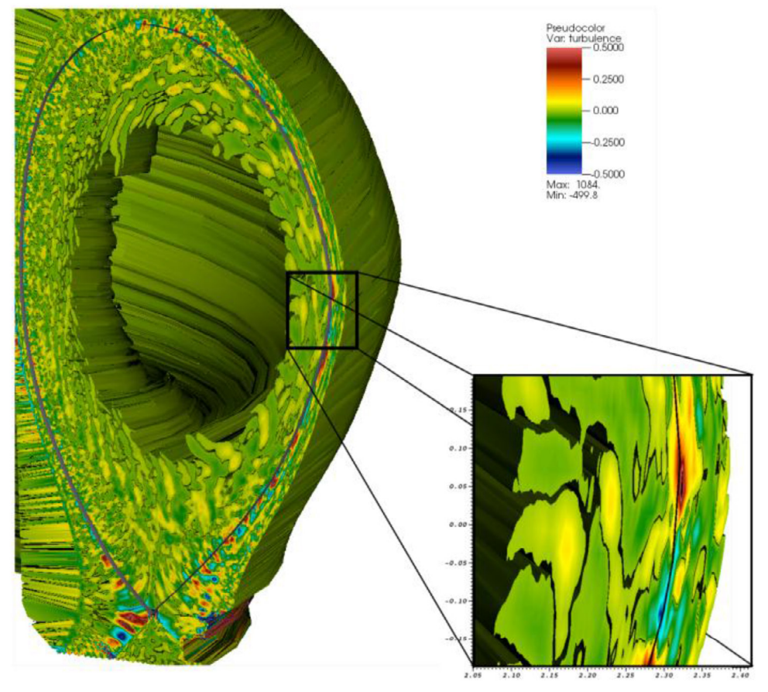
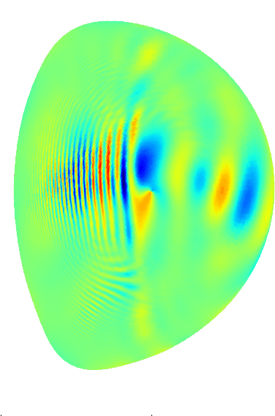
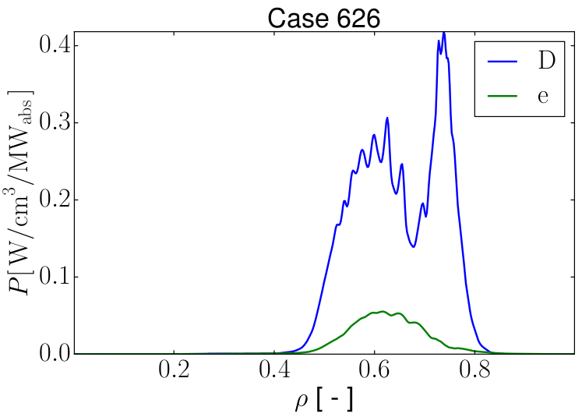
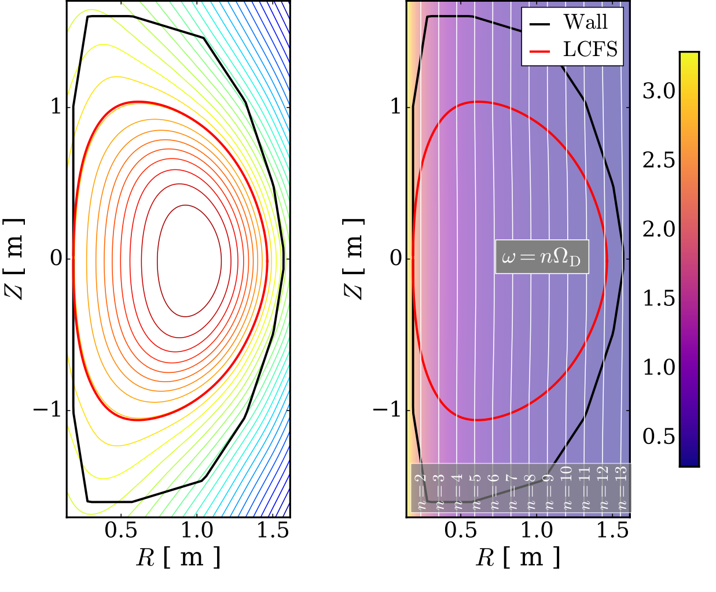
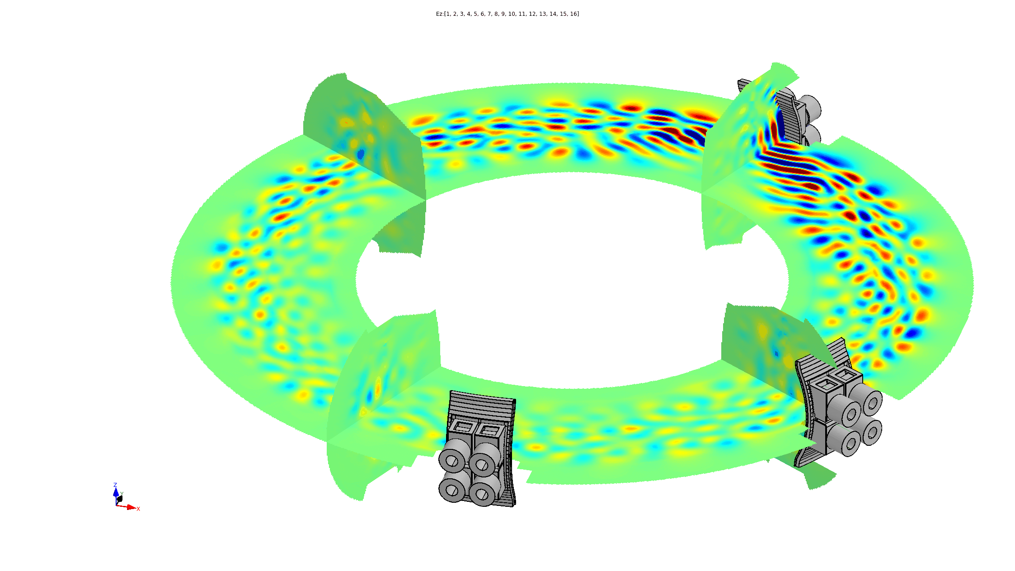

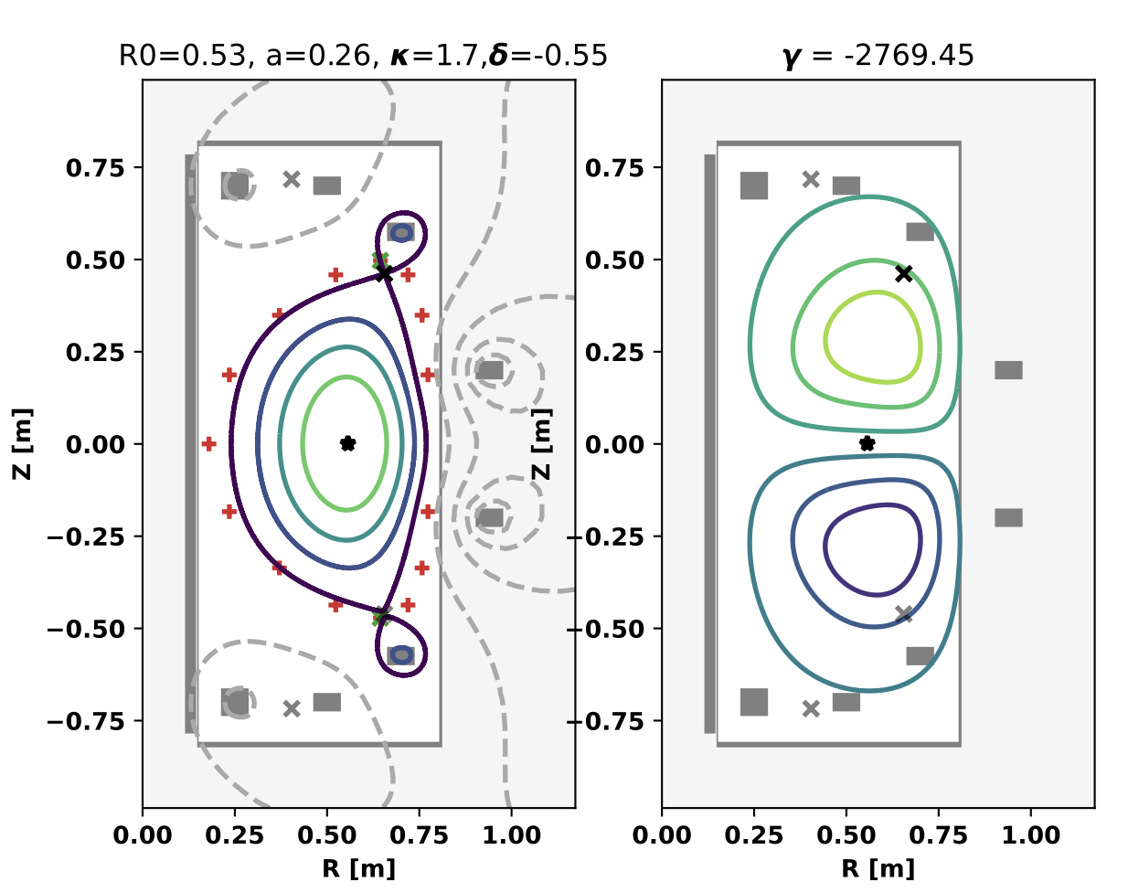
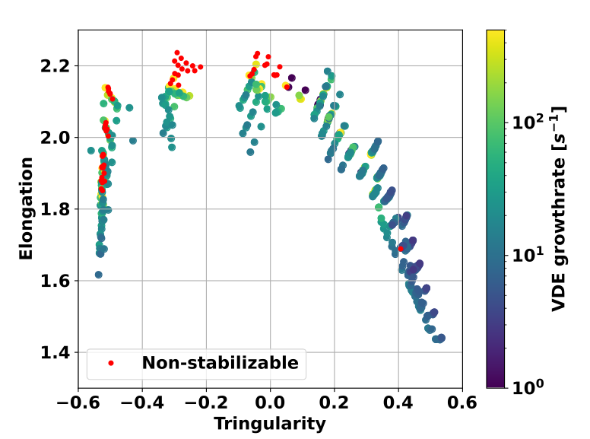


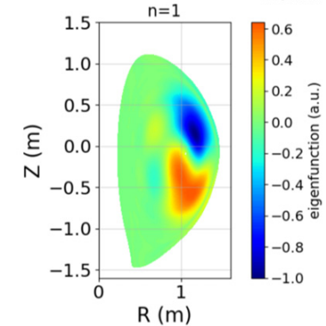
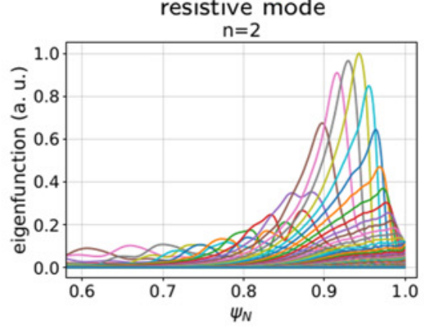
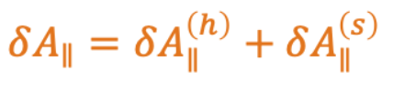
Surrogates address limitations of high-fidelity simulations
AI-in-HPC Surrogate
AI-about-HPC Surrogate
Accelerate bottlenecks in Gyrokinetics code
Inputs
RF Physics code
Outputs
Geometry, magnetic conf./equilibria, physical parameters, etc…
Particle Scatter
Calculate charge and current densities
Mesh-to-particle Interpolation
Project updated distribution function data back to particles
Field Solve
Calculate electrostatic and magnetic vector potentials
Plasma Heating via EM waves
5D Grid Operations
Collision operator, neutral particle recycling, external particle, heat and torque sources, etc.
Time step loop
Particle Push
Evaluate equations of motion and update particle positions in phase space
Particle-to-mesh Interpolation
Project particle information on 5D phase space mesh
Plasma Turbulence
Chang (2017) NF
Inputs
MHD code
Outputs
Pull-back optimization via ML to improve algorithmic stability with higher timesteps
Plasma Stability
Court. Fuentes del Pozo
Geometry, magnetic conf./equilibria, physical parameters, etc…
Court. Hager
…
A. Kleiner NF 22
Seeking broader access to gold-standard data
Access to extensive synthetic data
Notes:
Robust real-time capable inference
Traits include:
Robust
fast inference,
uncertainty quantification
generalizability
Applications include:
AI-around-HPC (e.g. forward problem inference): significant acceleration where full accuracy is not required.
AI-in-HPC (e.g. operator replacement): broader access to high-fidelity, physics informed data

Slide 20
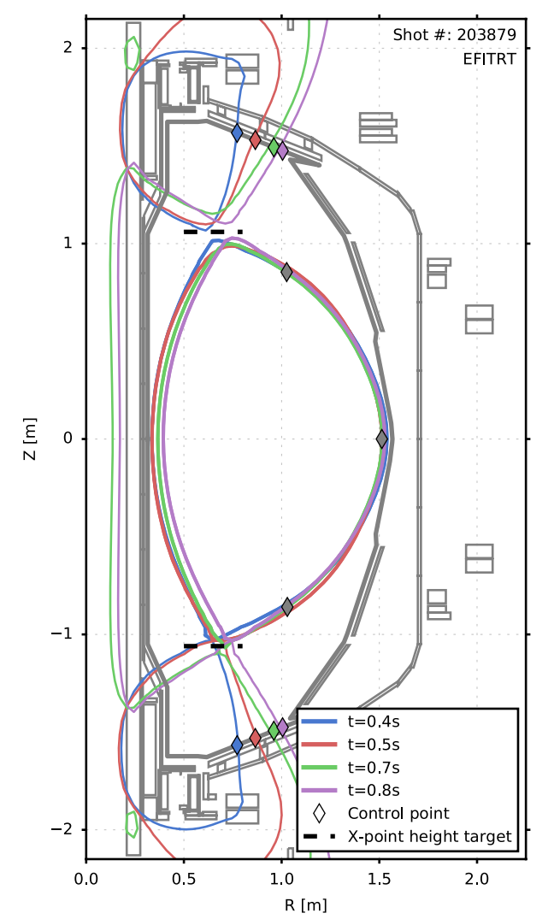
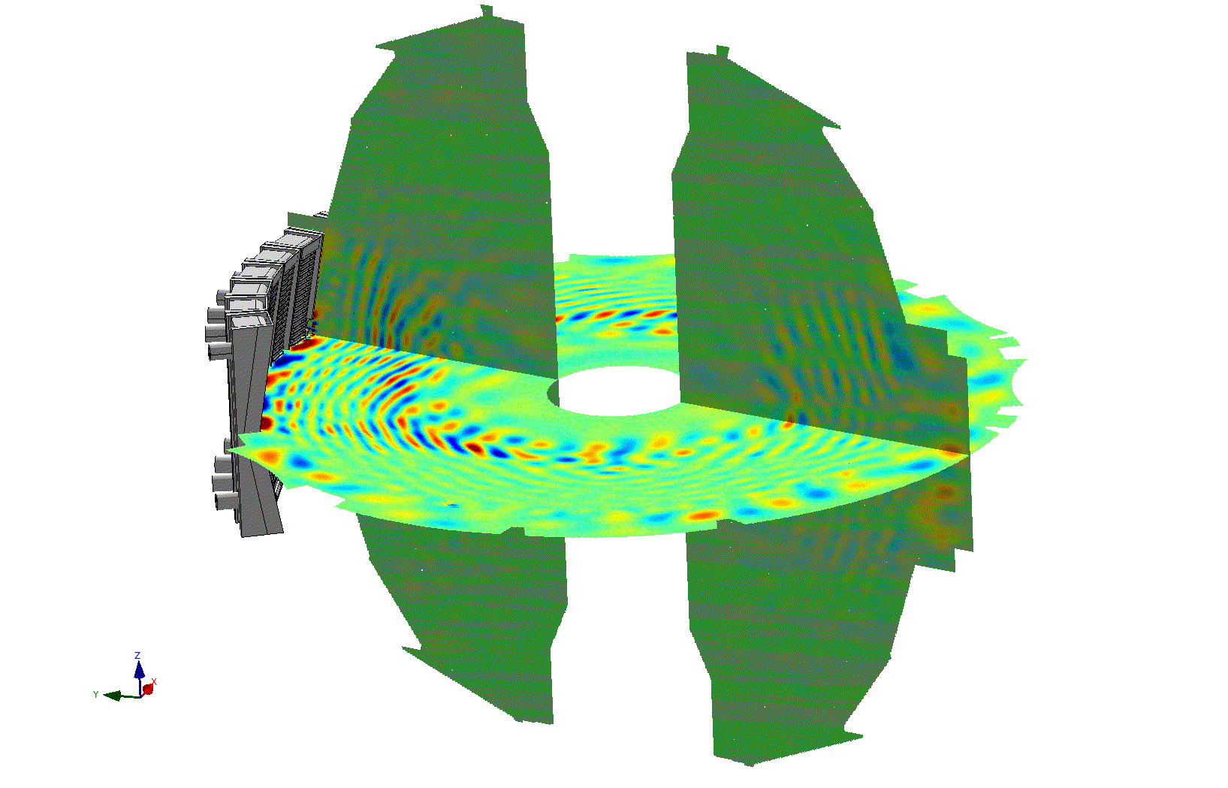
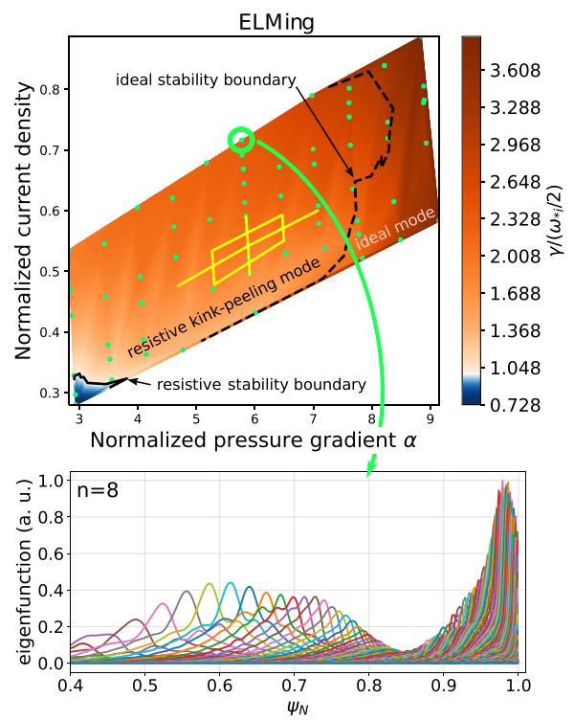
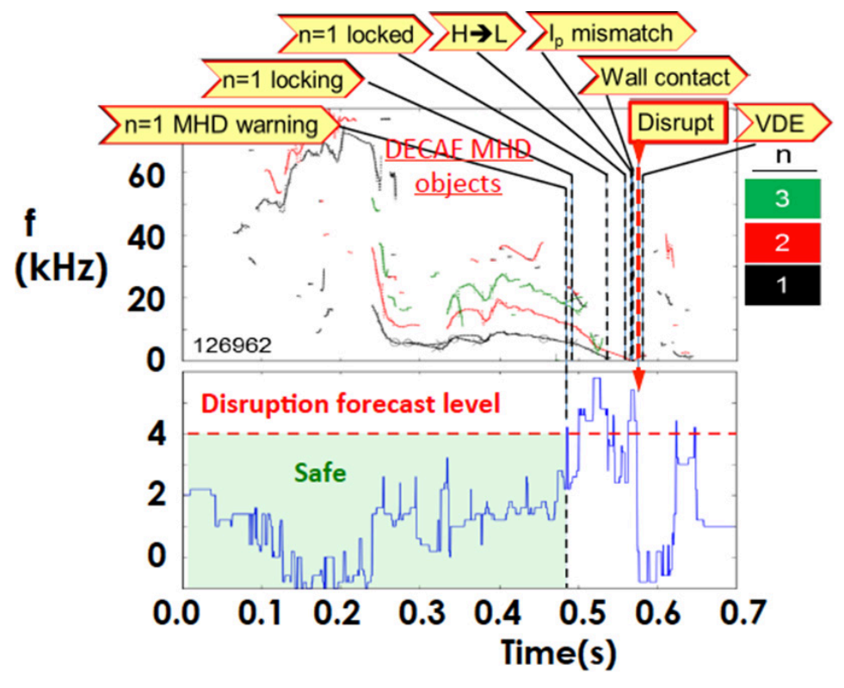
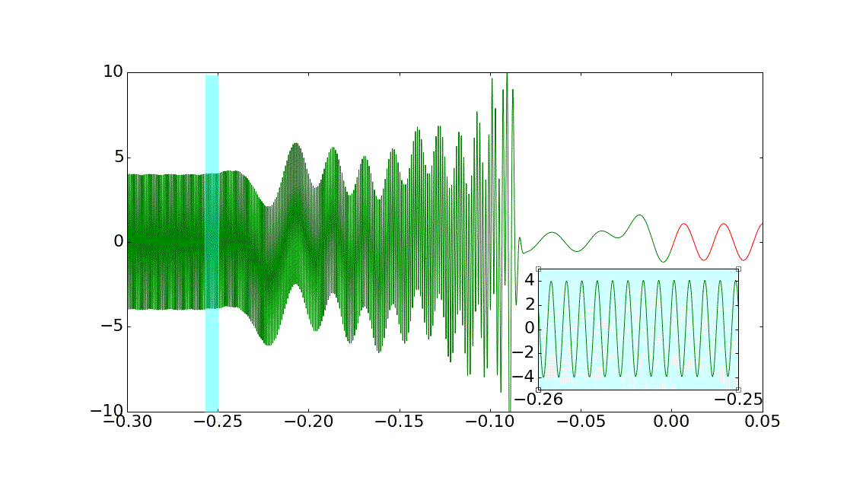
Fusion Foundation Models (FFM)
Kinetic Equilibrium
Reconstruction
Particle and Energy Source Prediction
Disruption Forecasting
MHD Stability
Gyrokinetics
FFM tackle analysis, reconstruction, forecasting/prediction, and inverse control tasks
Notes:
FM are trained on massive and diverse / multimodal datasets in order to learn general-purpose patterns and representations. Because of this broad training, it can be adapted (via fine-tuning, prompting, or other techniques) to a wide range of downstream tasks without being retrained from scratch.

Slide 21
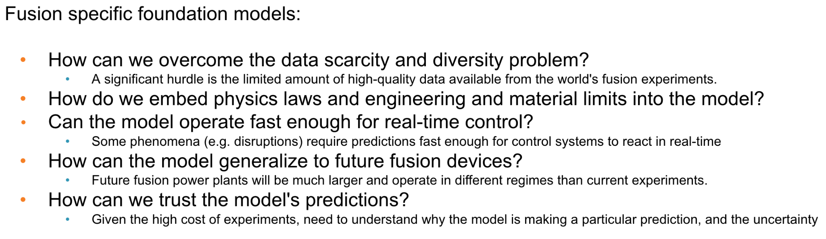
Fusion Foundation Models (FFM)
Kinetic Equilibrium
Reconstruction
Particle and Energy Source Prediction
Disruption Forecasting
MHD Stability
Gyrokinetics
FFM tackle analysis, reconstruction, forecasting/prediction, and inverse control tasks
FFM require generating and leveraging multimodal and diverse data
Notes:
Surrogate models are key building blocks for data generation:
Both AI-about-HPC and AI-in-HPC surrogates for synthetic data generation
AI-in-HPC surrogates potentially enable broader access to gold standard datasets

Slide 22
Fusion Foundation Models (FFM)
Kinetic Equilibrium
Reconstruction
Particle and Energy Source Prediction
Disruption Forecasting
MHD Stability
Gyrokinetics
FFM tackle analysis, reconstruction, forecasting/prediction, and inverse control tasks
FFM require generating and leveraging multimodal and diverse data
Surrogate models are key building blocks for data generation
Notes:
Surrogate models are key building blocks for data generation:
Both AI-about-HPC and AI-in-HPC surrogates for synthetic data generation
AI-in-HPC surrogates potentially enable broader access to gold standard datasets

Slide 23

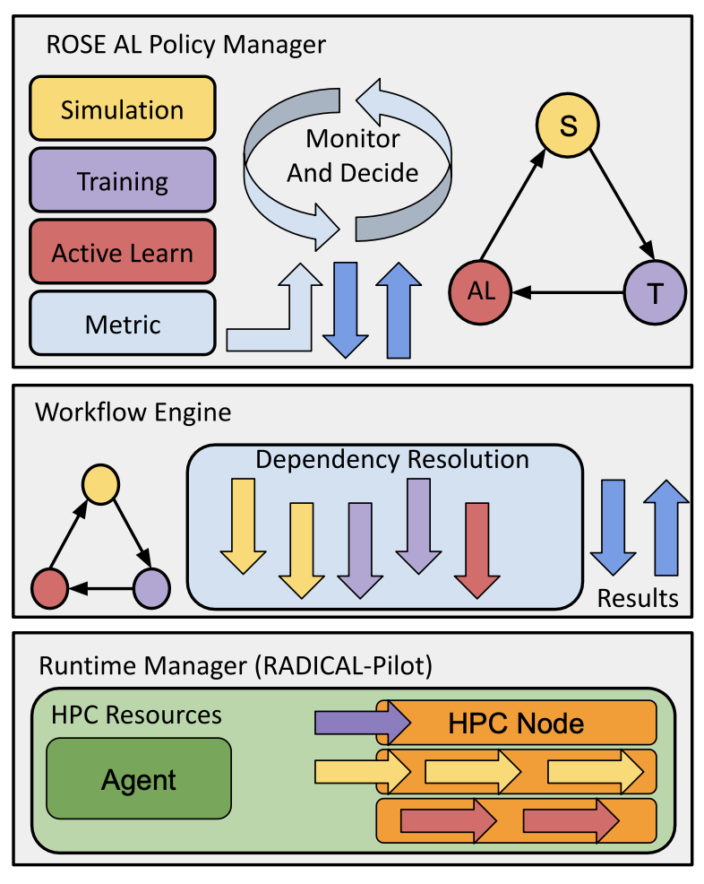

AI to improve HPC and HPC to improve AI
Need active learning algorithms and policies to build (multiple) surrogates online efficiently
RADICAL Orchestrator for Surrogate Exploration (ROSE) to manage HPC campaigns to build surrogates: https://github.com/radical-cybertools/rose
(to appear AI4S Workshop at SC’25):
Specifically 75% reduction in training data without loss of accuracy ⇒ saving O(10000) node hours
https://arxiv.org/abs/2506.11100
The maximally performing computation is the one you didn’t need to execute!
Sequential Policy
Parallel Policy
User Defined Policy
Stop Criterion
Stop Criterion
Stop Criterion
Simulation
Task
Simulation
Utility Task
Sim
Sim
Sim
Training
Task
Training
1
…..
Training
N
Utility Task
Training
Active Learn
Task
Active Learn
1
…..
Active Learn
N
Active Learn

Slide 24
Conclusion
Fusion is a promising solution for clean, reliable, and safe energy generation.
Production fusion has many engineering challenges; fusion is beyond current capabilities of high-performance computing
Next ten orders of magnitude (OOM) scientific performance will rely on the ability to effectively integrate AI and HPC (algorithmic Moore’s Law)
Build surrogates of high-fidelity simulations online is critical
Surrogate models are critical data generators for foundation models
Critical to efficiently build surrogates on HPC (ROSE)

Slide 25
Thank you!

