Slide 1
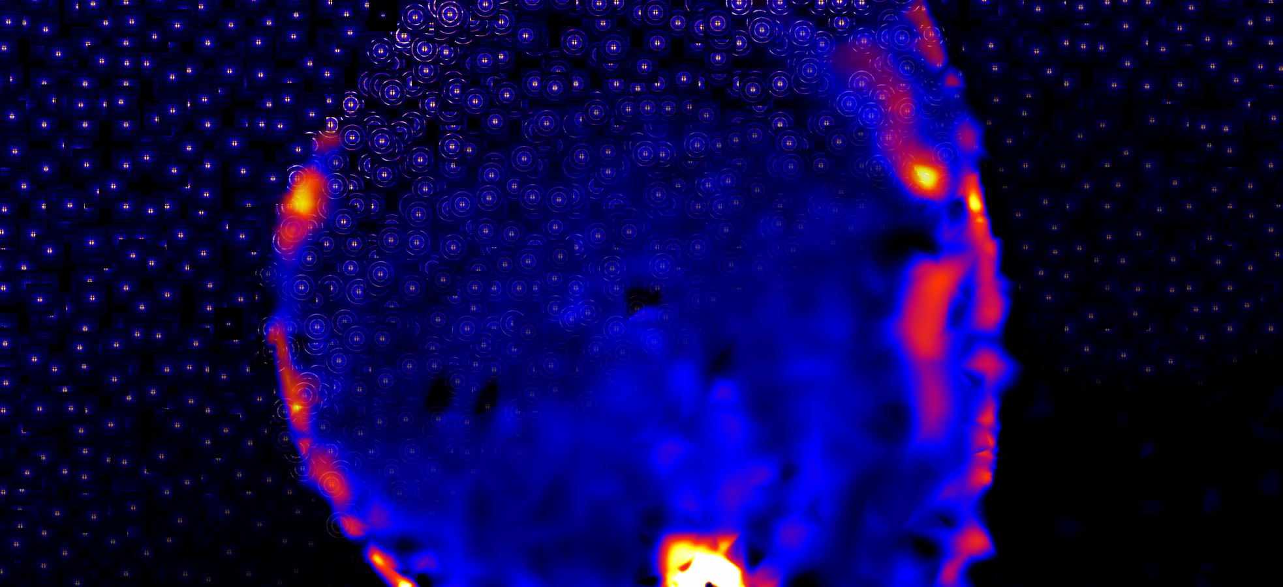

The Future of AI-Accelerated Physical Science
Kevin G. Yager (kyager@bnl.gov) Interim Director (CFN) & Group Leader (AI-Accelerated Nanoscience)

Slide 2
Frontier AI (LLMs)

Slide 3
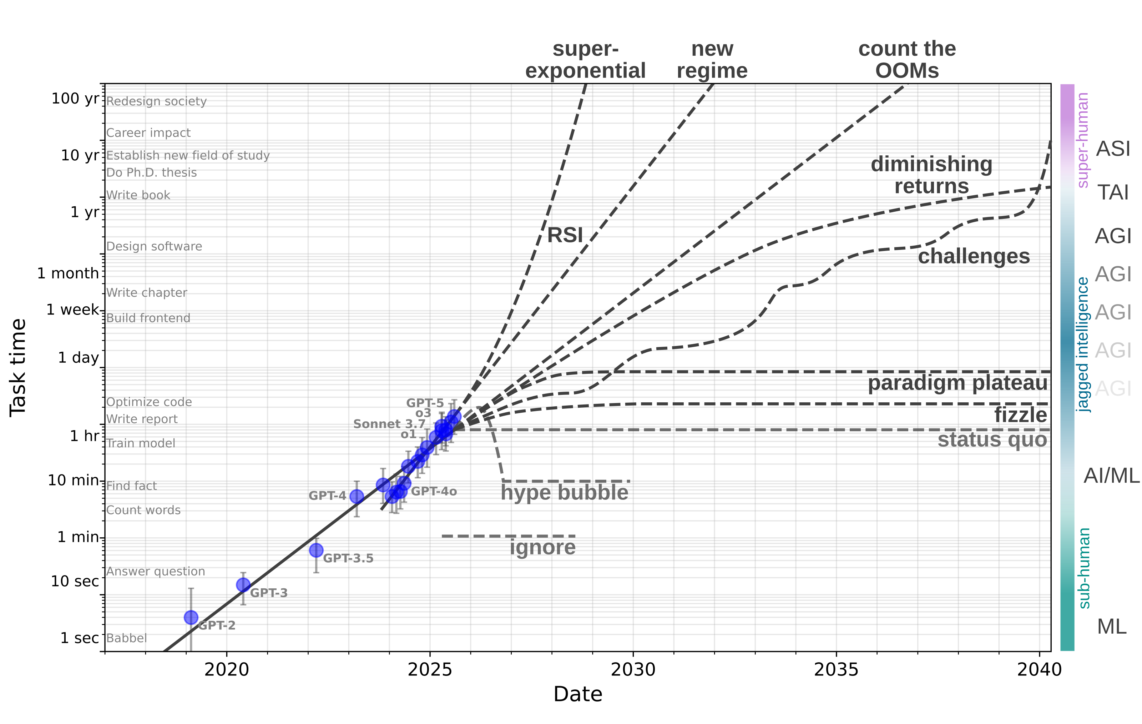
Future of AI
Progress of LLMs hard to predict
But, impact is large across a wide range of scenarios
How to leverage for physical sciences?
Data points from METR: arXiv 2025, 2503.14499
yager-research.ca

Slide 4
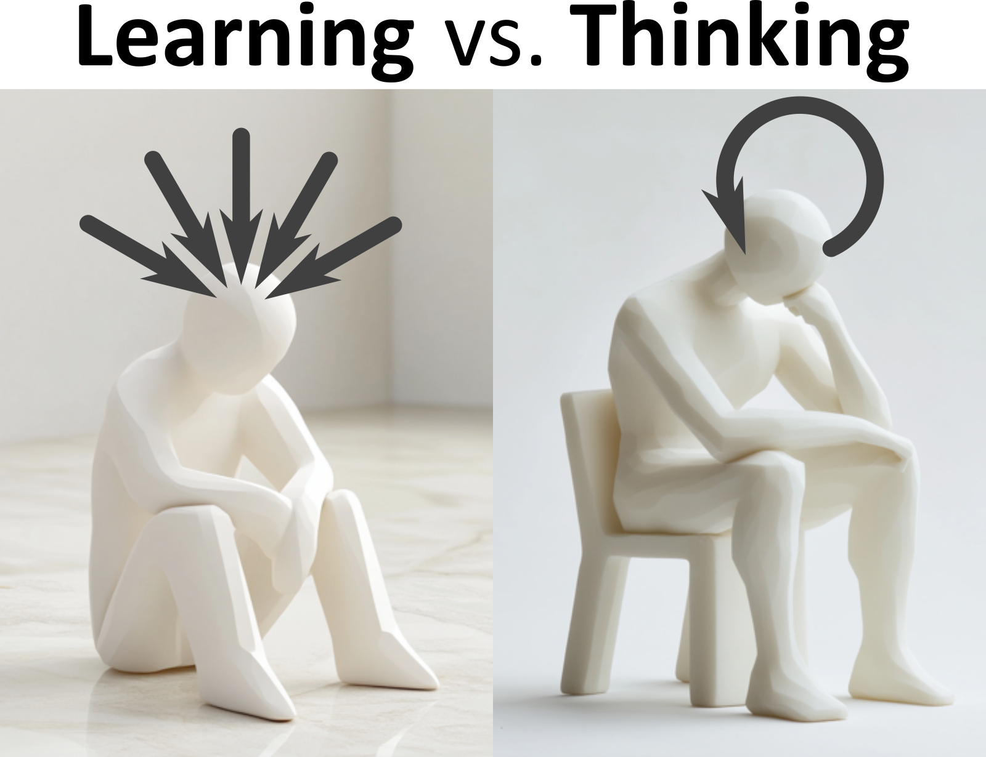
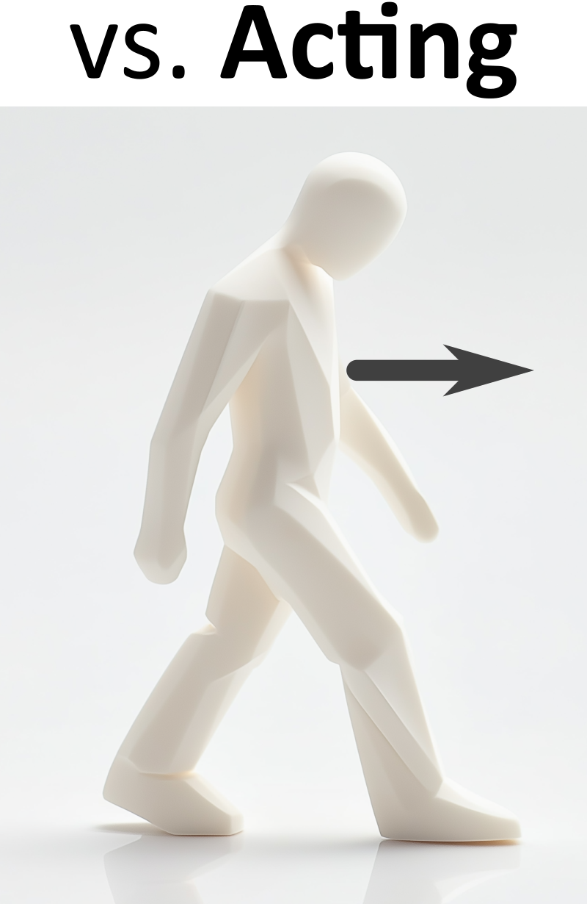
Future of AI for Science
Large Language Models (LLM) are poised to revolutionize intellectual work
AI is suited to science: Science is a sequence of cognitive tasks
AI advancements can apply to science:
Learning: Models trained on science data
Thinking: Reasoning for coding, math, problem solving, etc.
Acting: Operate instruments, conduct experiments, etc.
Science is suited to AI: physical sciences are ideal proving ground
Metrics of success, etc.
People | Reflexive response “system 1” | Iterative deliberation “system 2”
Observe, make changes
Use tools (search, software, etc.) “agentic”
AI | Train a giant model “training-time compute” | Iteration/ reasoning “inference-time compute”

Slide 5
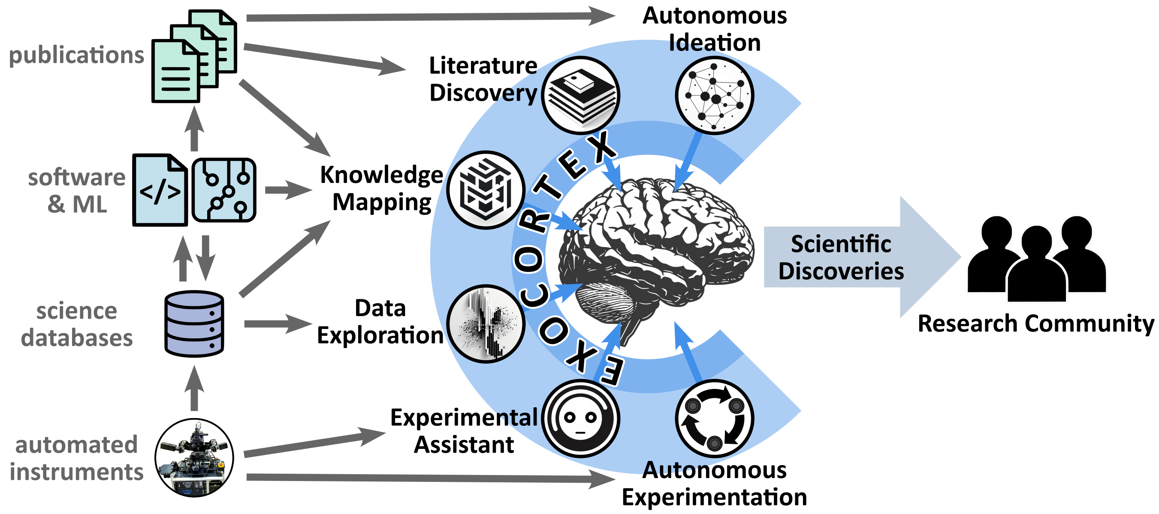
Vision: Science Exocortex
Imagine a science exocortex: a persistent swarm of AI agents that extend a researcher’s cognition and volition
Exocortex enables:
AI agents that think and reason
Emergent intelligence of swarm
AI that works on hard problems for long time periods
Give scientists “eureka” insights
Expands human cognition
Accelerates Scientific Discovery
Yager Digital Discovery 2024, 3, 1933

Slide 6
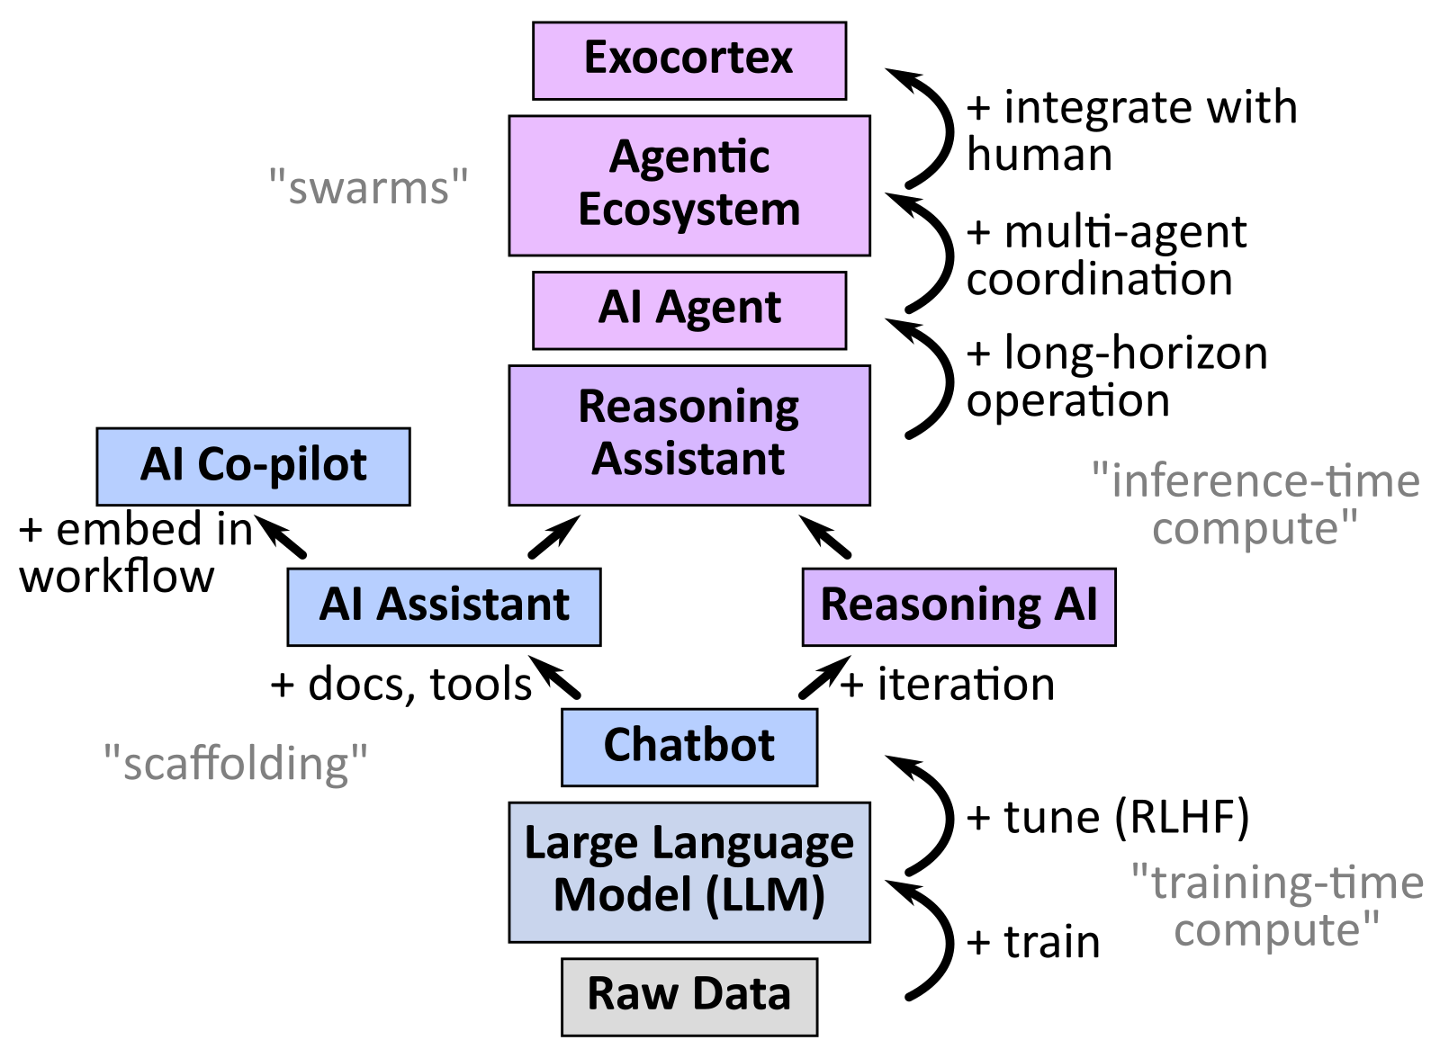
Agentic Swarms
AI Agent: A persistent AI system that autonomously and adaptively completes open-ended tasks through iterative planning, tool-use, and reasoning.
Tool-use ✔
Iteration ✔
Long-range coherence ✘
Agentic Ecosystem: A swarm of specialized agents that collaborate to complete complex tasks.
Coordination ✘

Slide 7
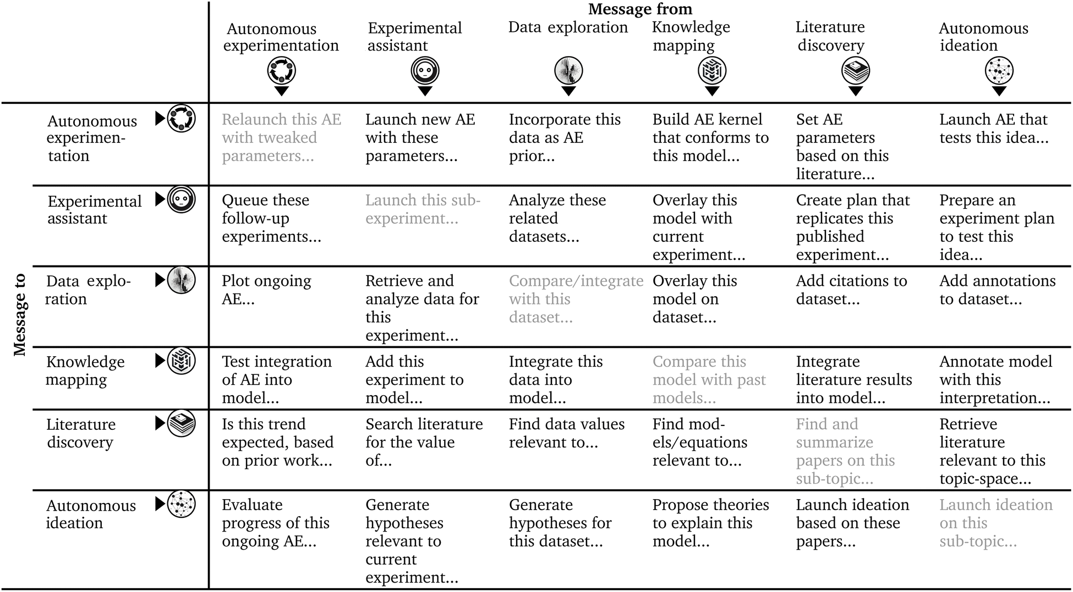
Agent inter-communication
Agents work on tasks together, messaging each other (in English!) as required
Only high-value results or decisions are brought to human attention
Emergent intelligence exceeds components
Yager Digital Discovery 2024, 3, 1933

Slide 8
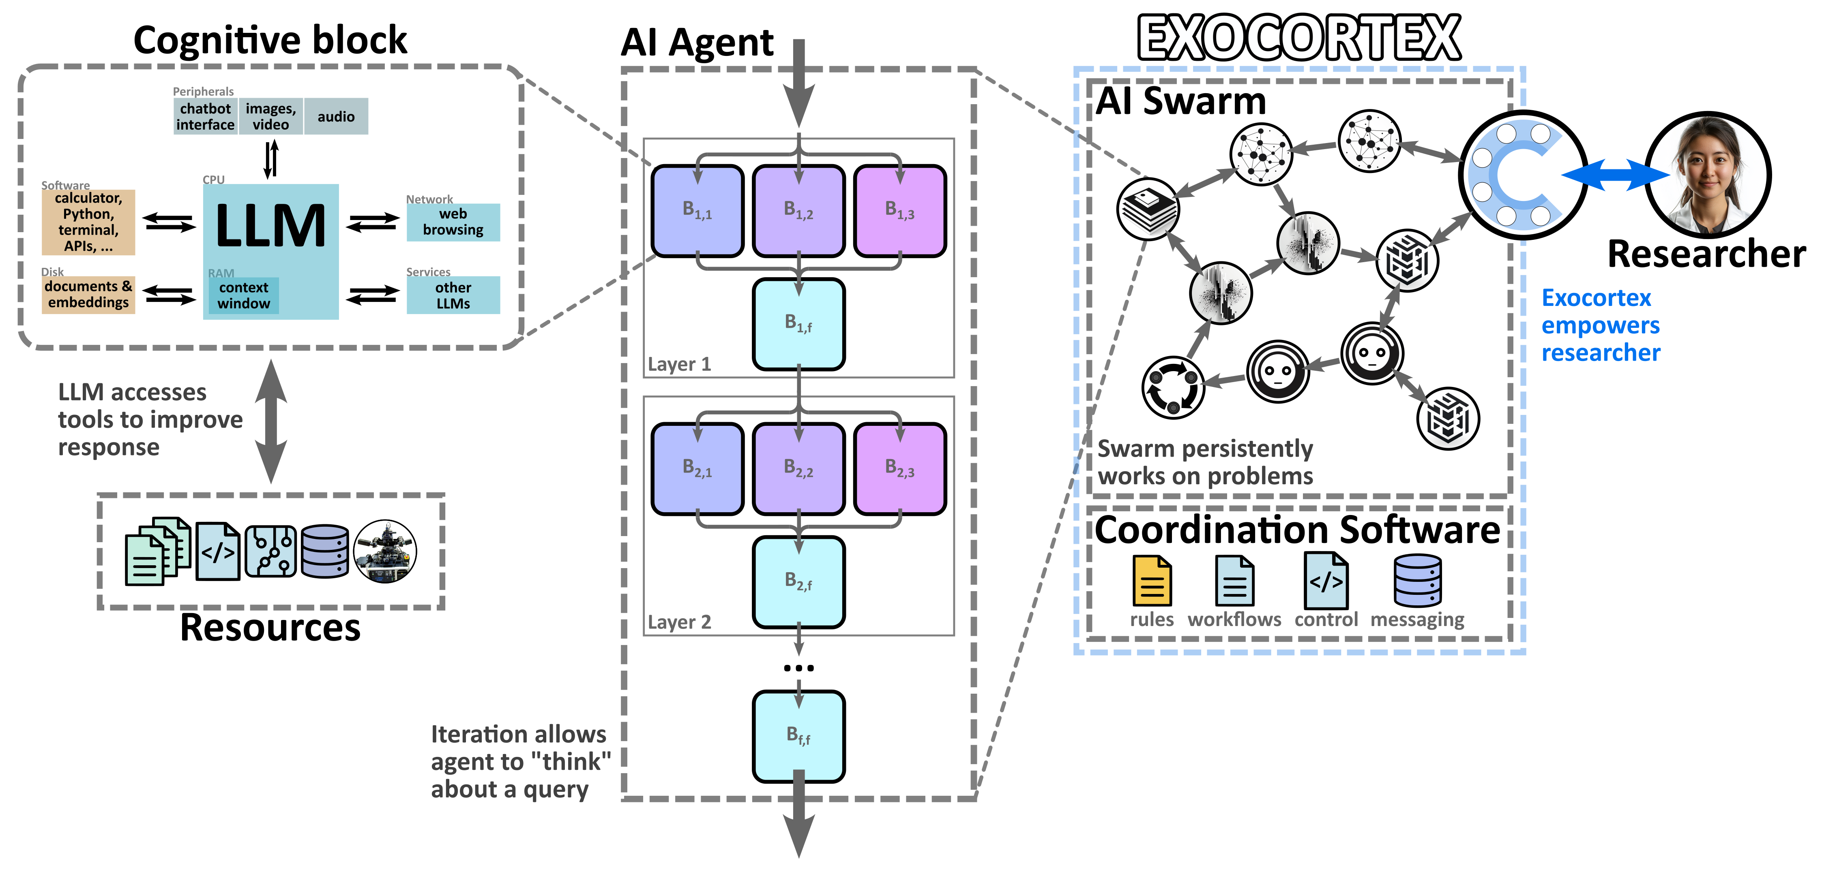
Swarm Safety & Verifiability
Interpretability: “Understand what the AI is thinking”
Legible (English) messages in swarm make it easier to understand, and intervene
Alignment: “AI should do what we intend”
“Discordant Alignment”: In humans, decisions arise from competition between drives (instincts, emotions, values, deliberation); Exocortex behavior is emergent from agents voting
Mitigates over-optimization
Tune behavior by weighting agents
Guardrails: “Stop AI from doing wrong thing”
Layered architecture allows defense-in-depth
Self-reflection allows AI to block bad outputs
Human is at center, always in control
Exocortex unlocks new ways to increase AI capabilities and safety
Use optimized system as teacher model

Slide 9
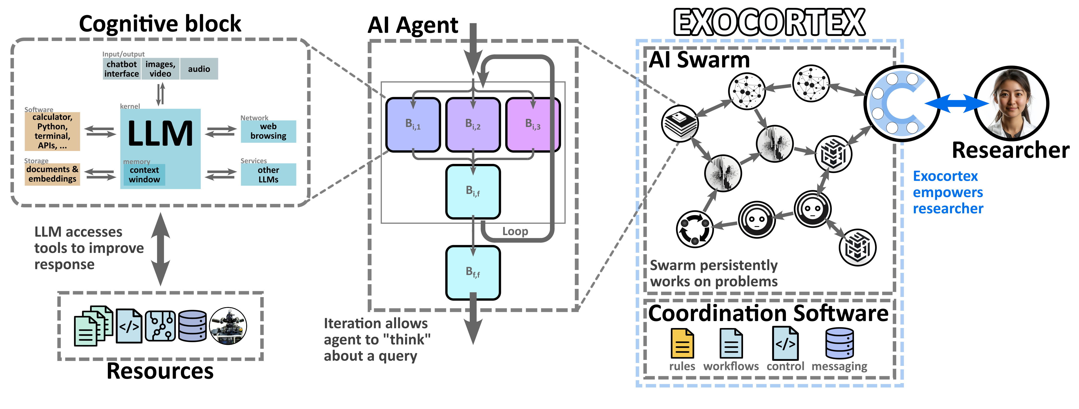
Architecture

Slide 10
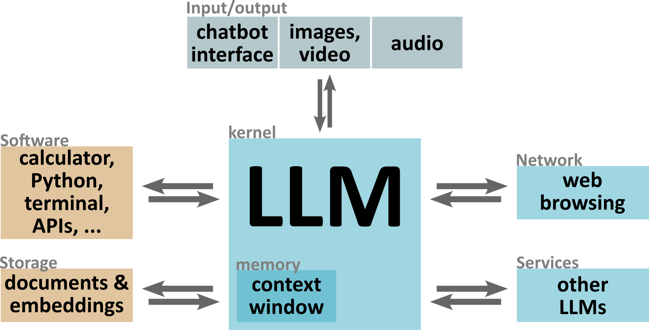

Cognitive Block Architecture
How to adapt LLMs to science?
Connect existing LLMs to various tools and services (“scaffolding”)

Slide 11
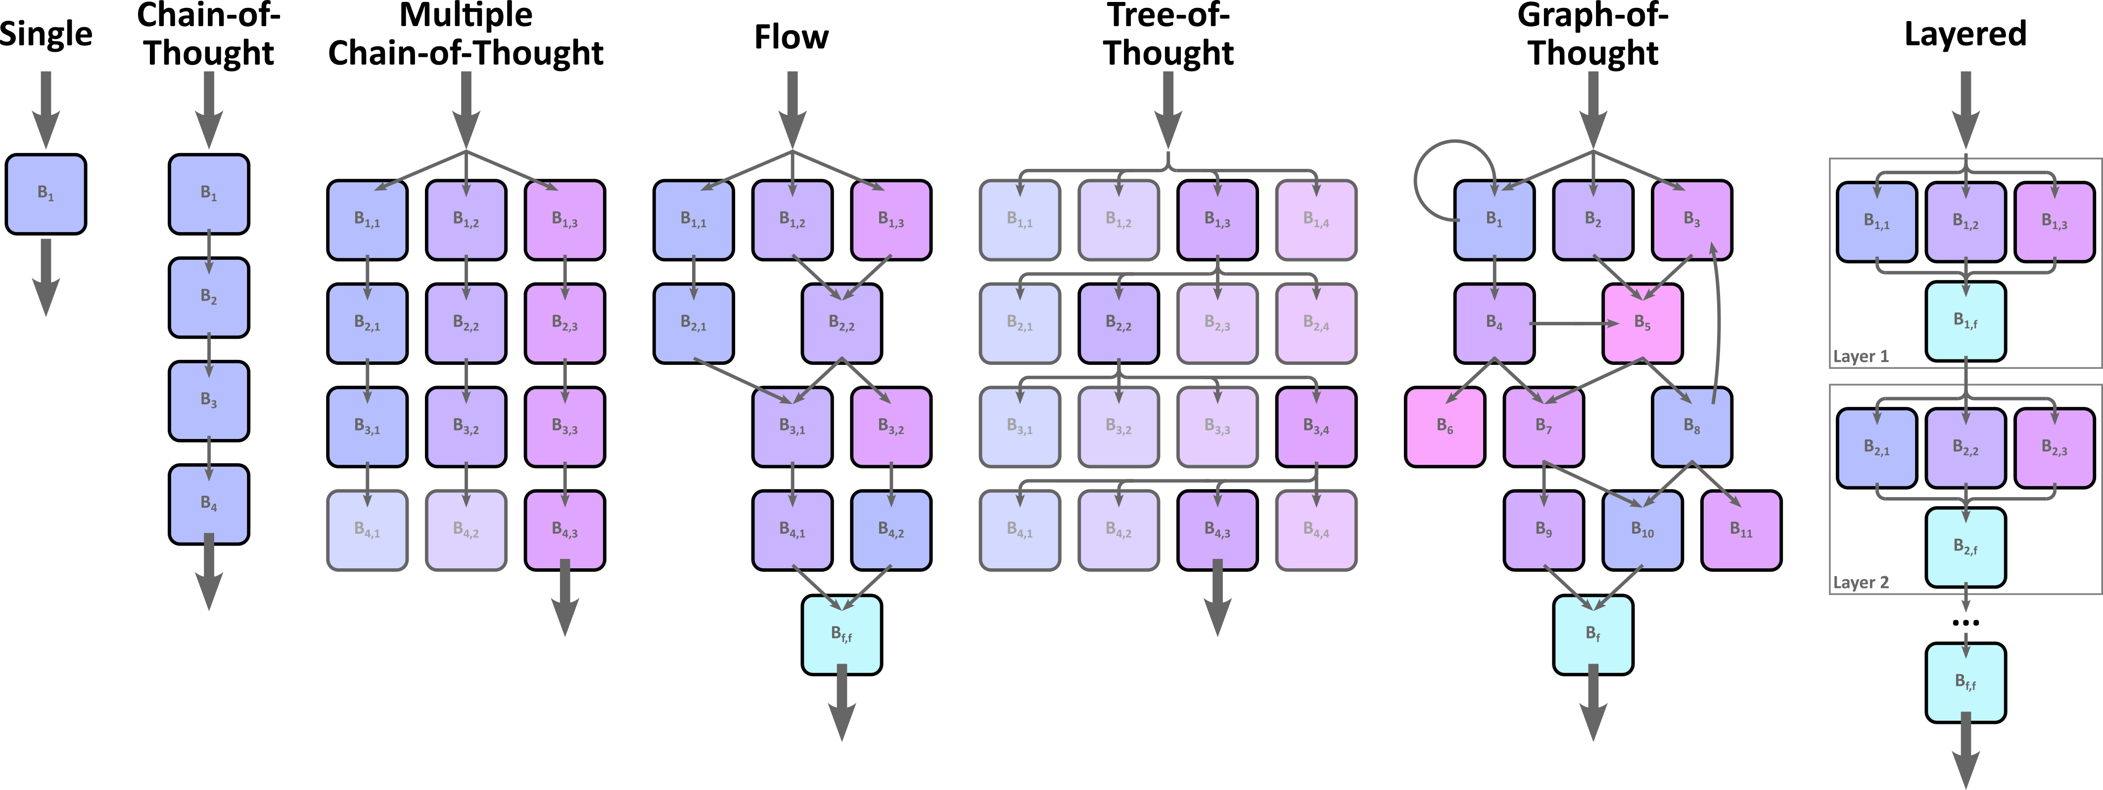
Agent Architecture

Slide 12
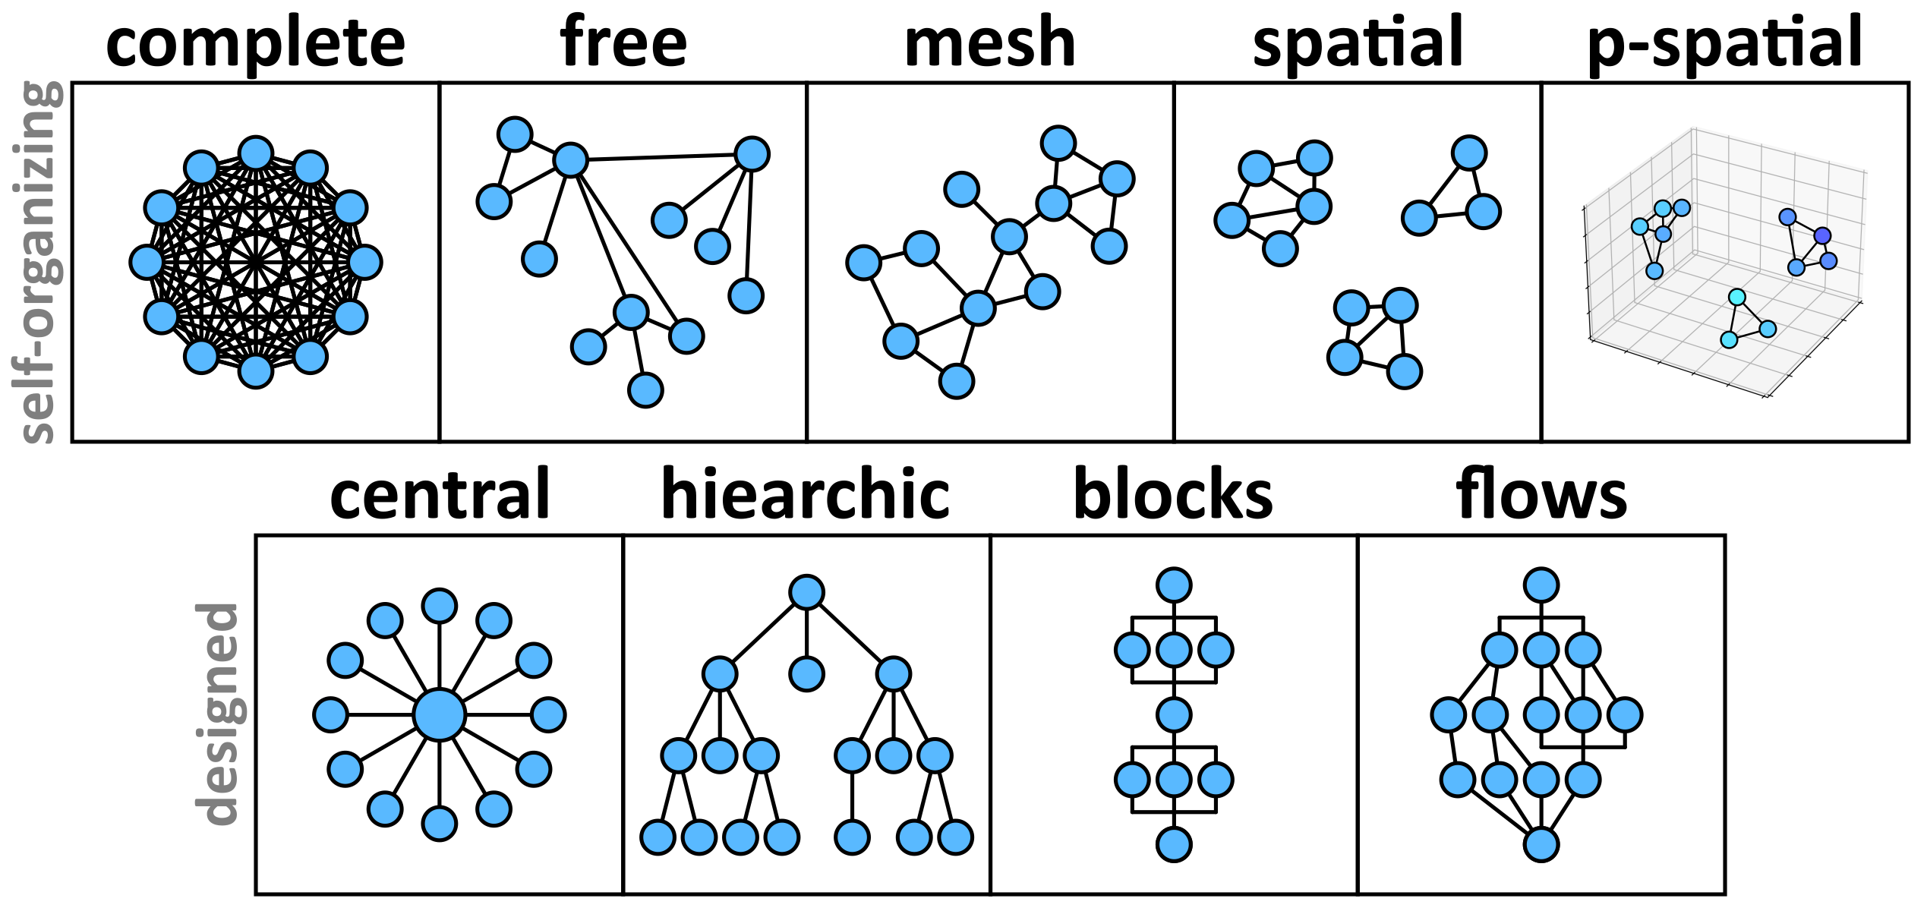
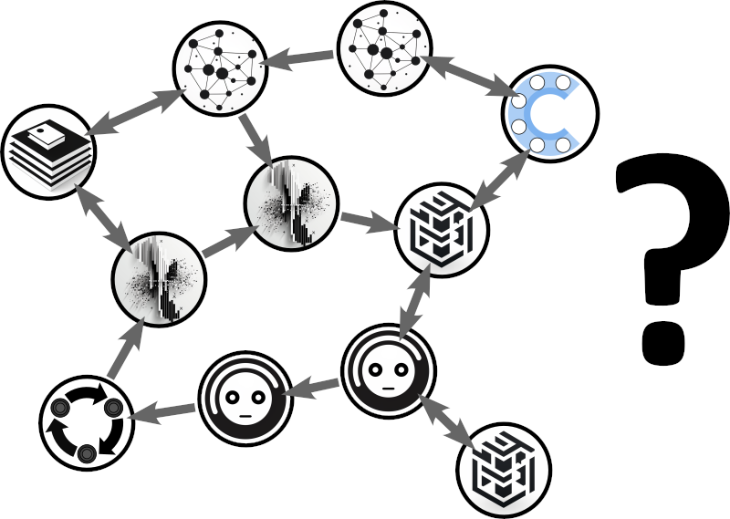
Swarm Architecture
How to coordinate agents?
Deep research problem
Research multi-agent interactions
Treat it as an ML optimization problem
Identify schemes tailored to different science tasks

Slide 13
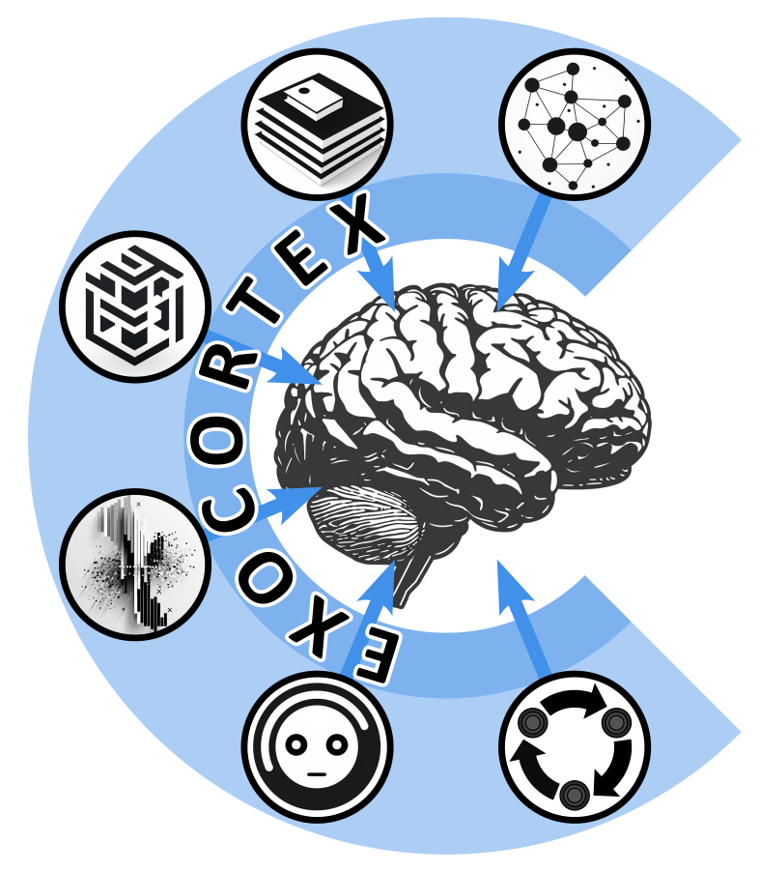
How do we achieve this?
Exocortex
Swarm of “reasoning AI agents” that cooperate on complex tasks
Community
This is a huge project, requiring community-scale research!
Modular and scalable architecture (agents), allows community to work on components in parallel
BNL
We are working on components:
Autonomous experimentation
Chatbots
AI assistants

Slide 14
Autonomous Experimentation

Slide 15
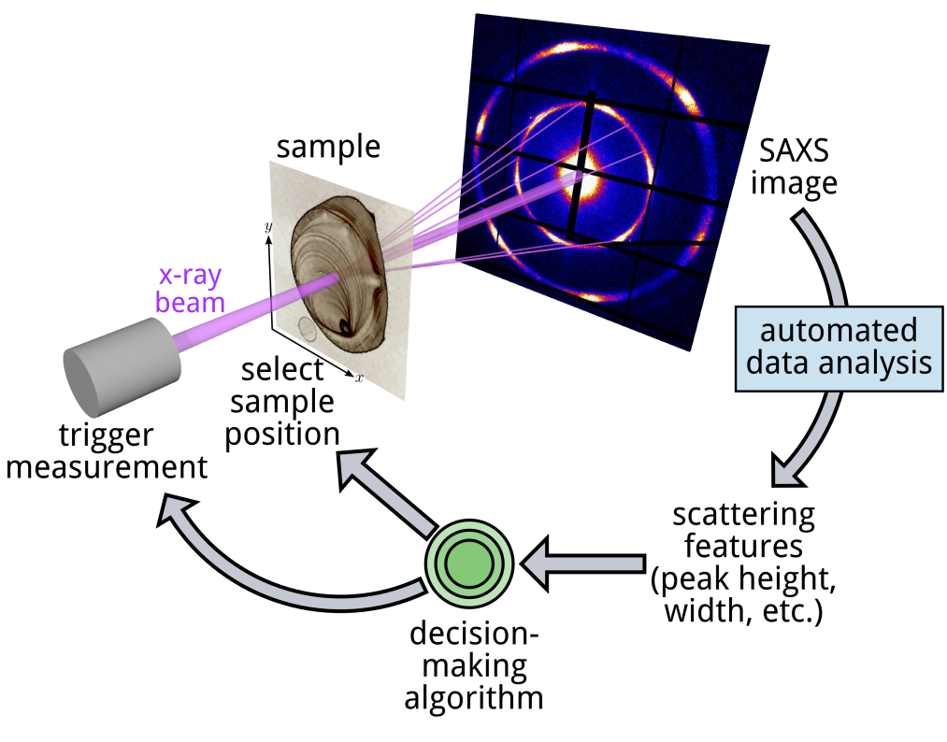
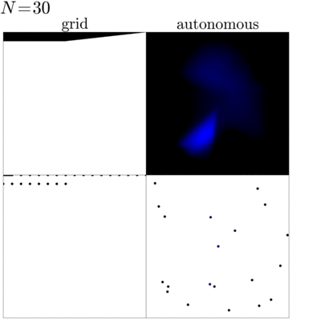
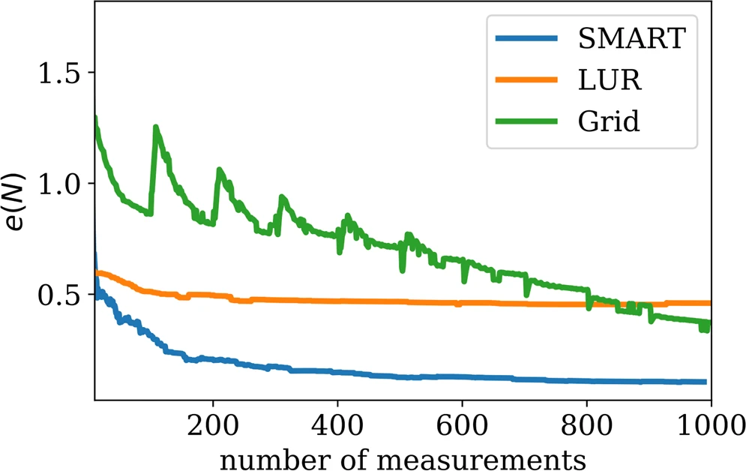


Autonomous Experimentation
Construct surrogate model using Gaussian Process (gpCAM software)
Fit/interpolate data
Select kernel to match physics
Learns parameters to match data
Calculate uncertainty surface
Construct objective function
Search for maximum in objective
Control behavior: gradients, cost, etc.
As we iterate, errors decrease and surrogate model improves
Noack et al. Scientific Reports 2019, 9, 11809; 2020, 10, 1325; 2020, 10, 17663 Noack et al. Nature Reviews Physics 2021, 3, 685 Yager et al. Nanotechnology 2023, 34, 322001
Marcus Noack (LBNL)

Slide 16
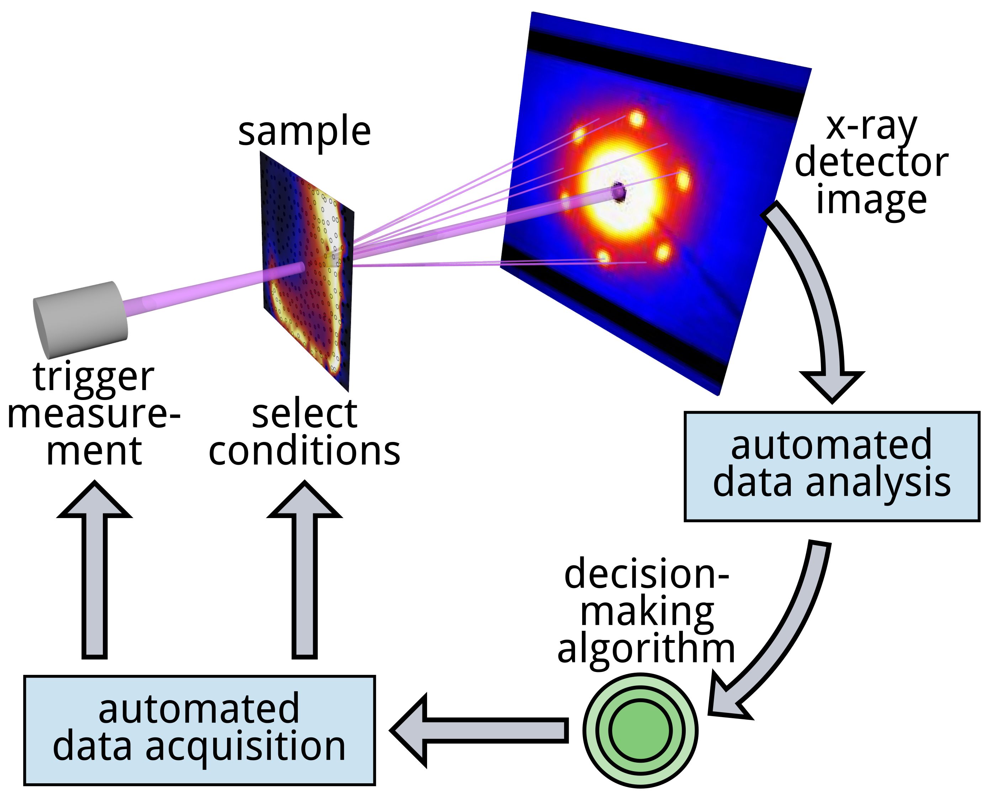
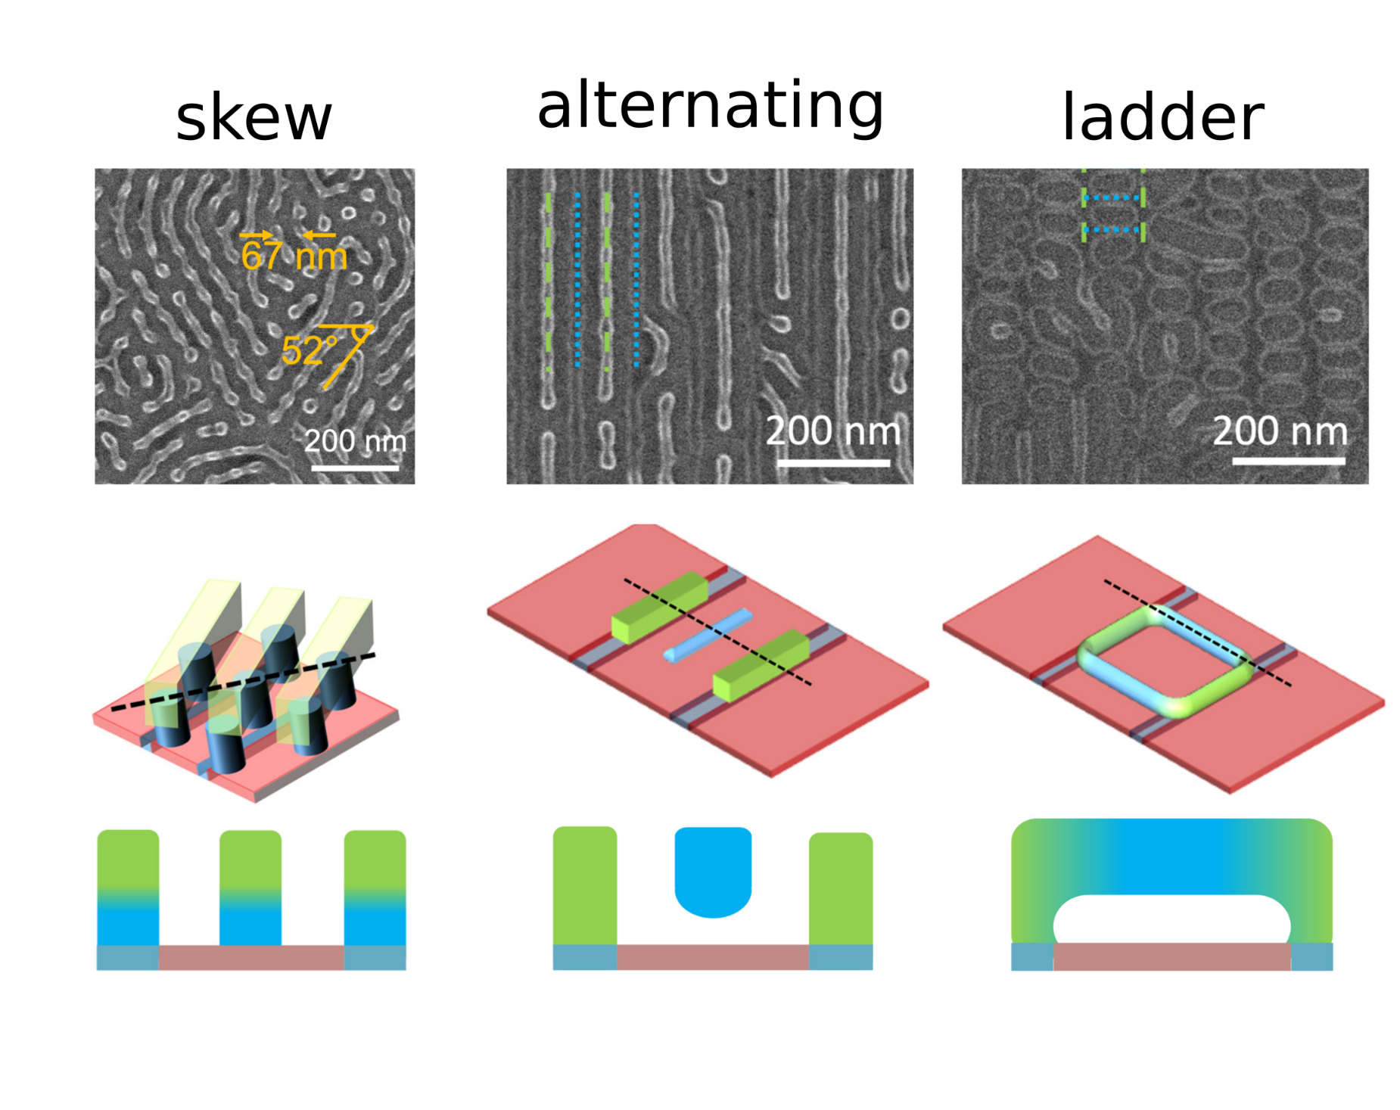
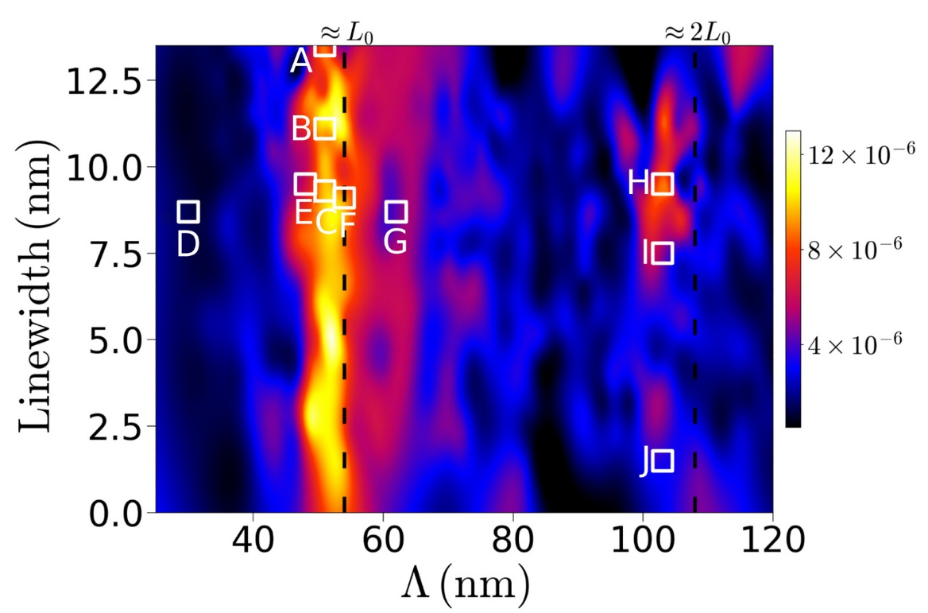
Example: Autonomous Material Discovery
Doerk, Stein, Bae, Noack, Fukuto, Yager Science Advances 2023, 9, eadd3687

Slide 17
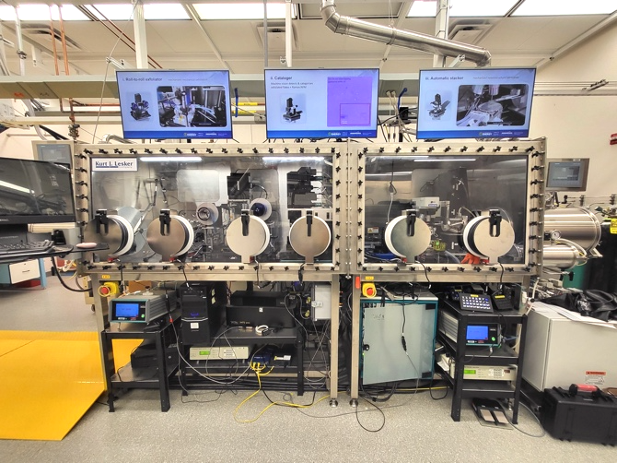
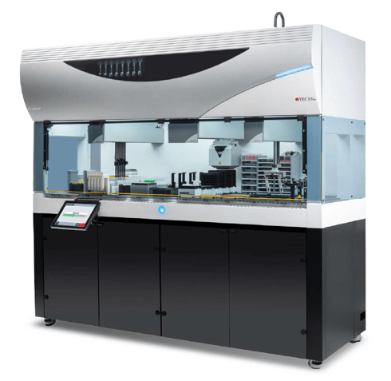
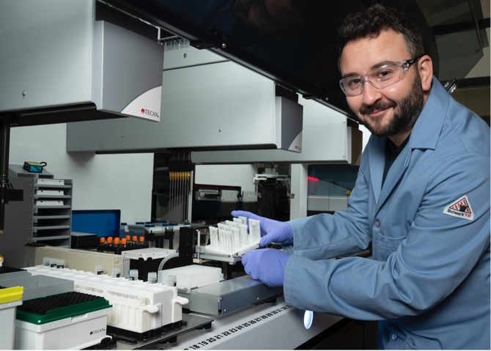
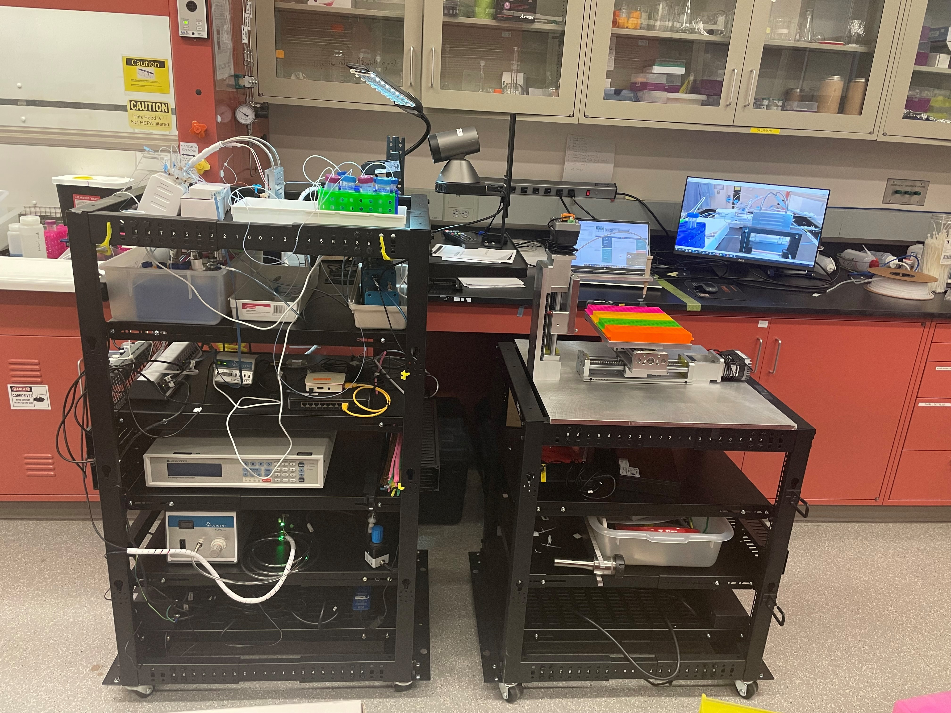
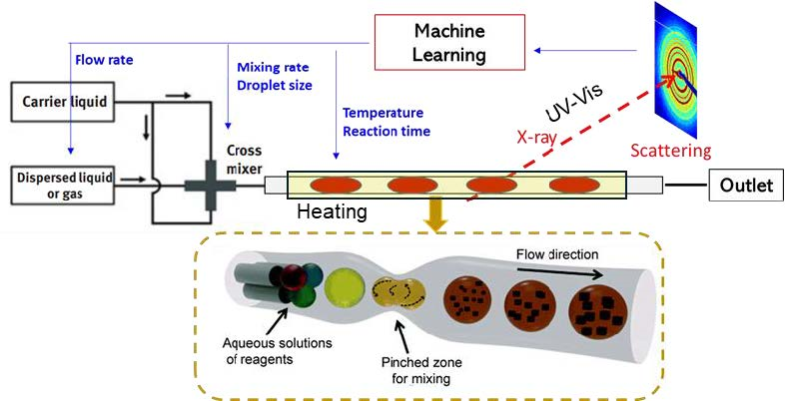
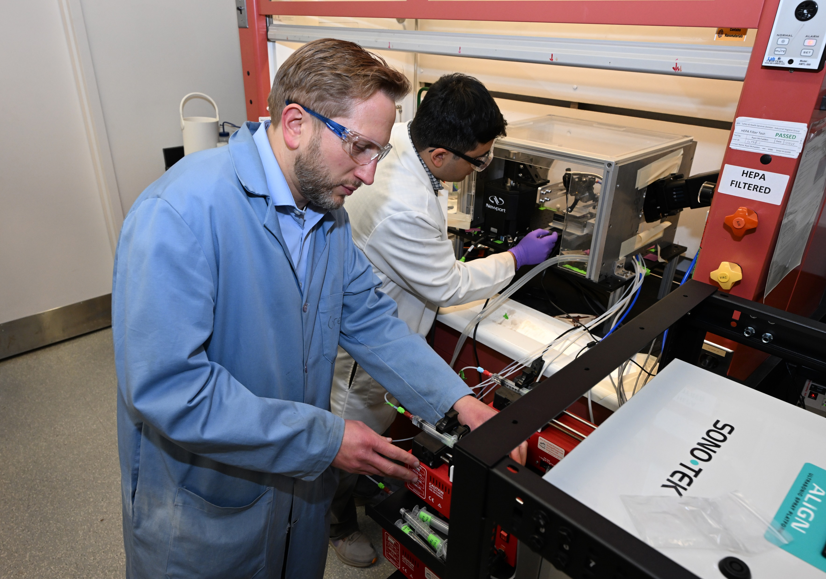
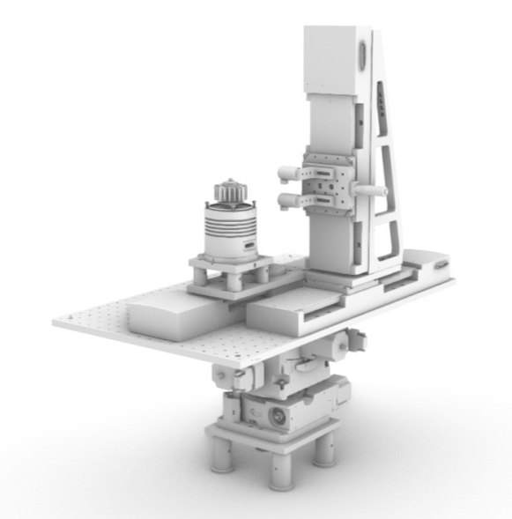
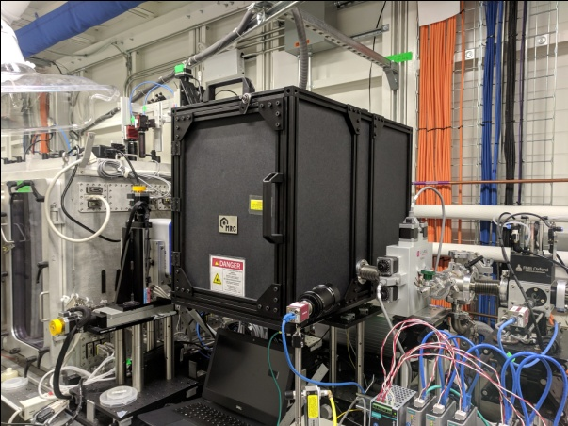
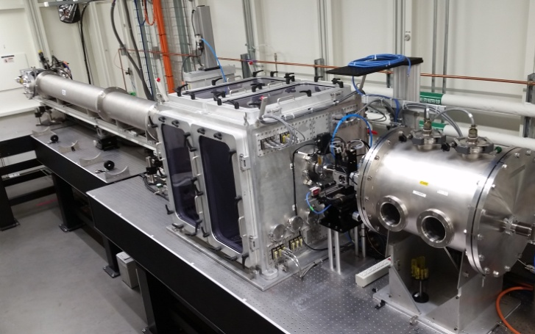
Synthesis Platforms
Liquid Synthesis Robot: Pipetting robot w/ customizable processing & characterization, for arbitrary liquid-phase assembly (DNA, nanoparticles, etc.)
Flow Synthesis: Automated droplet-reactor synthesis of nanoparticles
QPress: Layering of 2D materials into quantum heterostructures
Spray Platform: Ultrasonic spray for control of coating/processing, including generating combinatorial libraries
Photo-thermal Annealer: Focused IR laser for computer-control of spatio-temporal thermal profiles
X-ray Beamlines: Frontier instruments that can combine synth platforms with autonomous control

Slide 18
LLMs & Chatbots

Slide 19
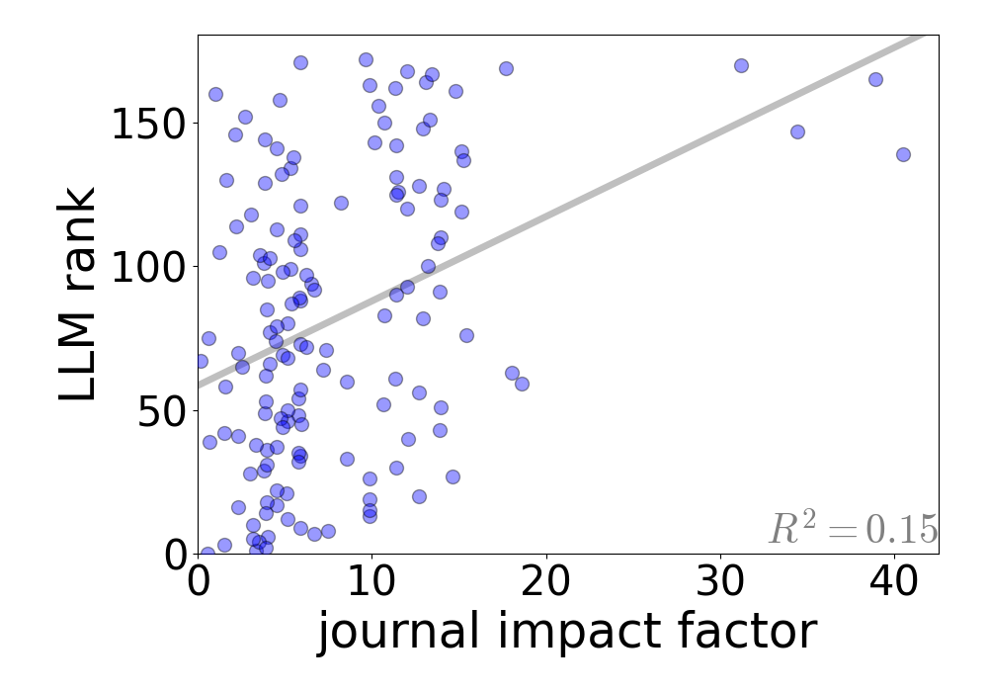
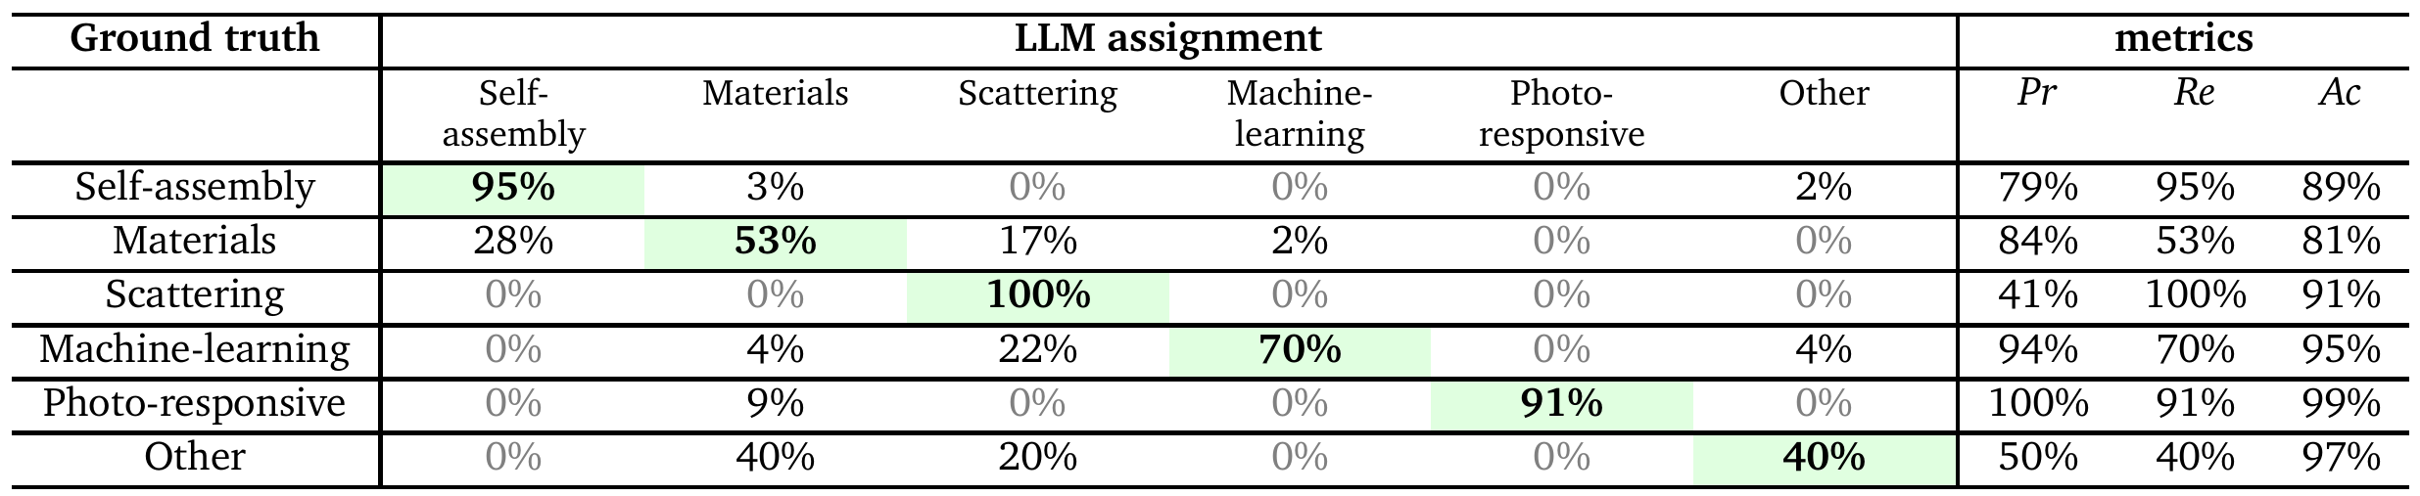
Adapt LLMs to Science Tasks
Science Tasks
LLMs can be adapted to “fuzzy” tasks (ranking, classification)
LLMs can help with learning, translating, coding
LLMs can do ideation
Yager Digital Discovery 2023, 2, 1850

Slide 20
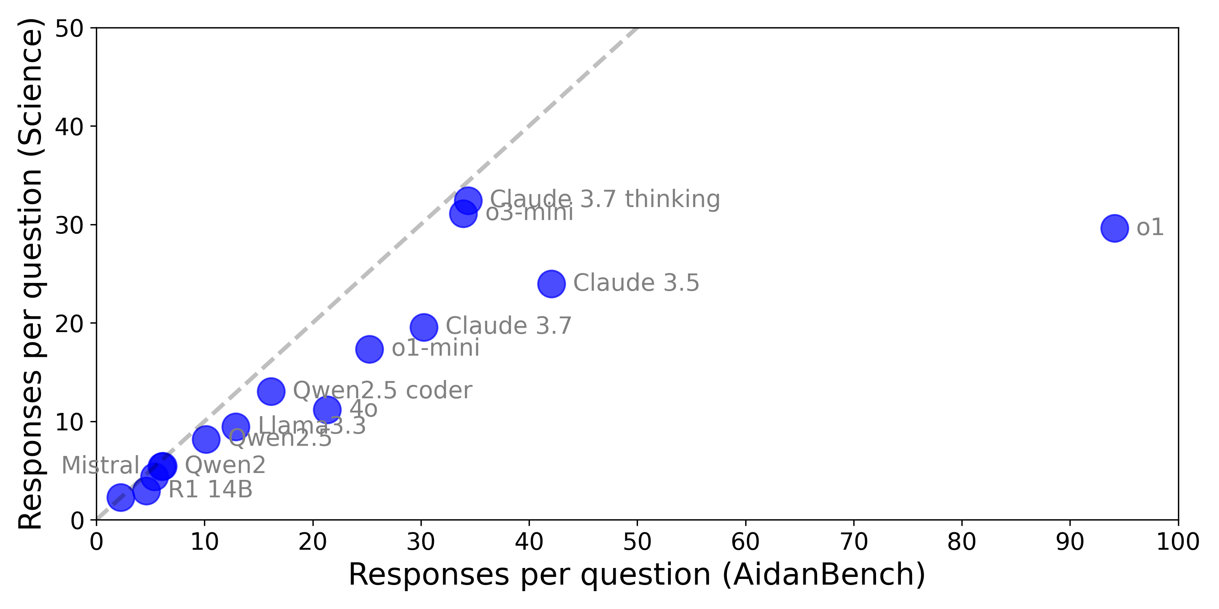
Ideation
LLMs for ideation, hypothesis generation, planning
Benchmark measures ability to generate diverse (but coherent) science ideas

Slide 21
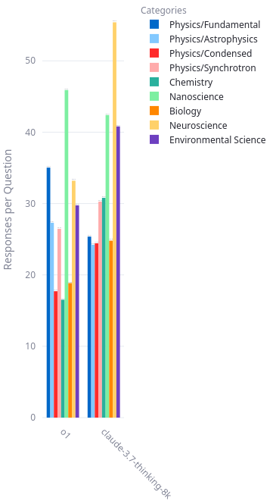
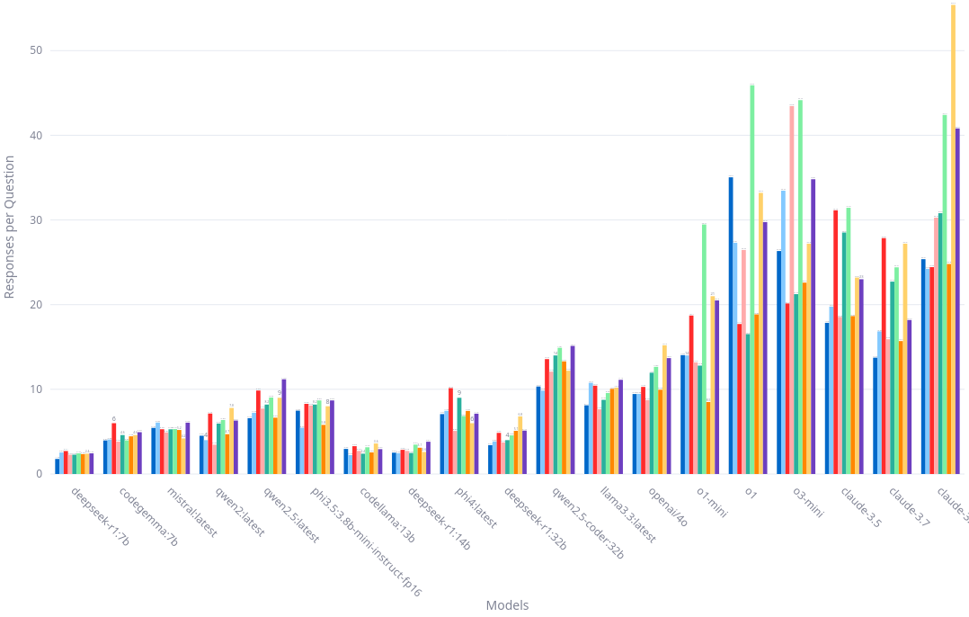
Ideation
LLMs for ideation, hypothesis generation, planning
Benchmark measures ability to generate diverse (but coherent) science ideas
We find evidence for “jagged intelligence”
Models have strengths and weaknesses

Slide 22
AI Assistants

Slide 23
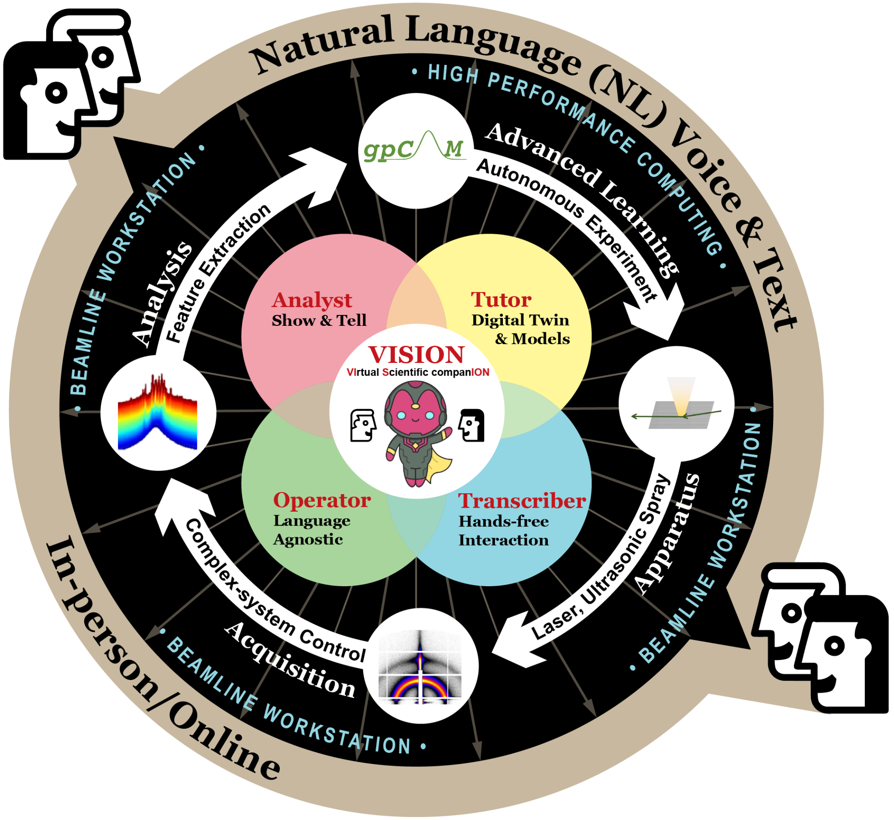


Beamline Assistant
Virtual Scientific Companion (VISION)
Natural language (typing or voice)
Scientists can ask questions or describe
LLM retrieves docs, refines plans, generates Python code to execute at beamline
Dialog with data and analysis pipelines
Esther Tsai
Video demo
Potemkin, Soto, Li, Yager, Tsai arXiv 2023, 2312.17180 Mathur, van der Vleuten, Yager, Tsai MLST 2025, 6, 025051

Slide 24
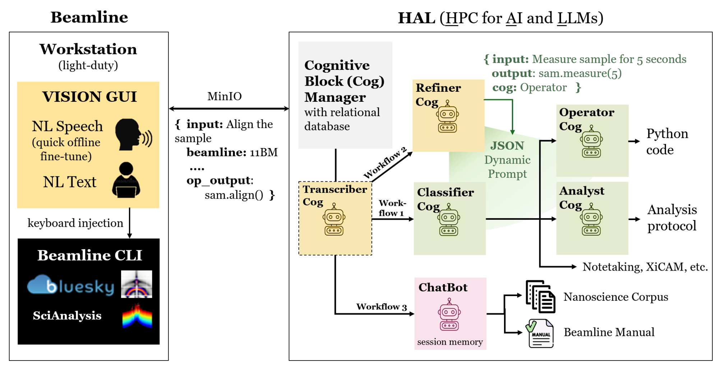
Beamline Assistant
Prompt engineering to enable capabilities
Access documents (beamline manual, papers, etc.)
Output code for beamline control, analysis, etc.
Potemkin, Soto, Li, Yager, Tsai arXiv 2023, 2312.17180 Mathur, van der Vleuten, Yager, Tsai arXiv 2024, 2412.18161

Slide 25
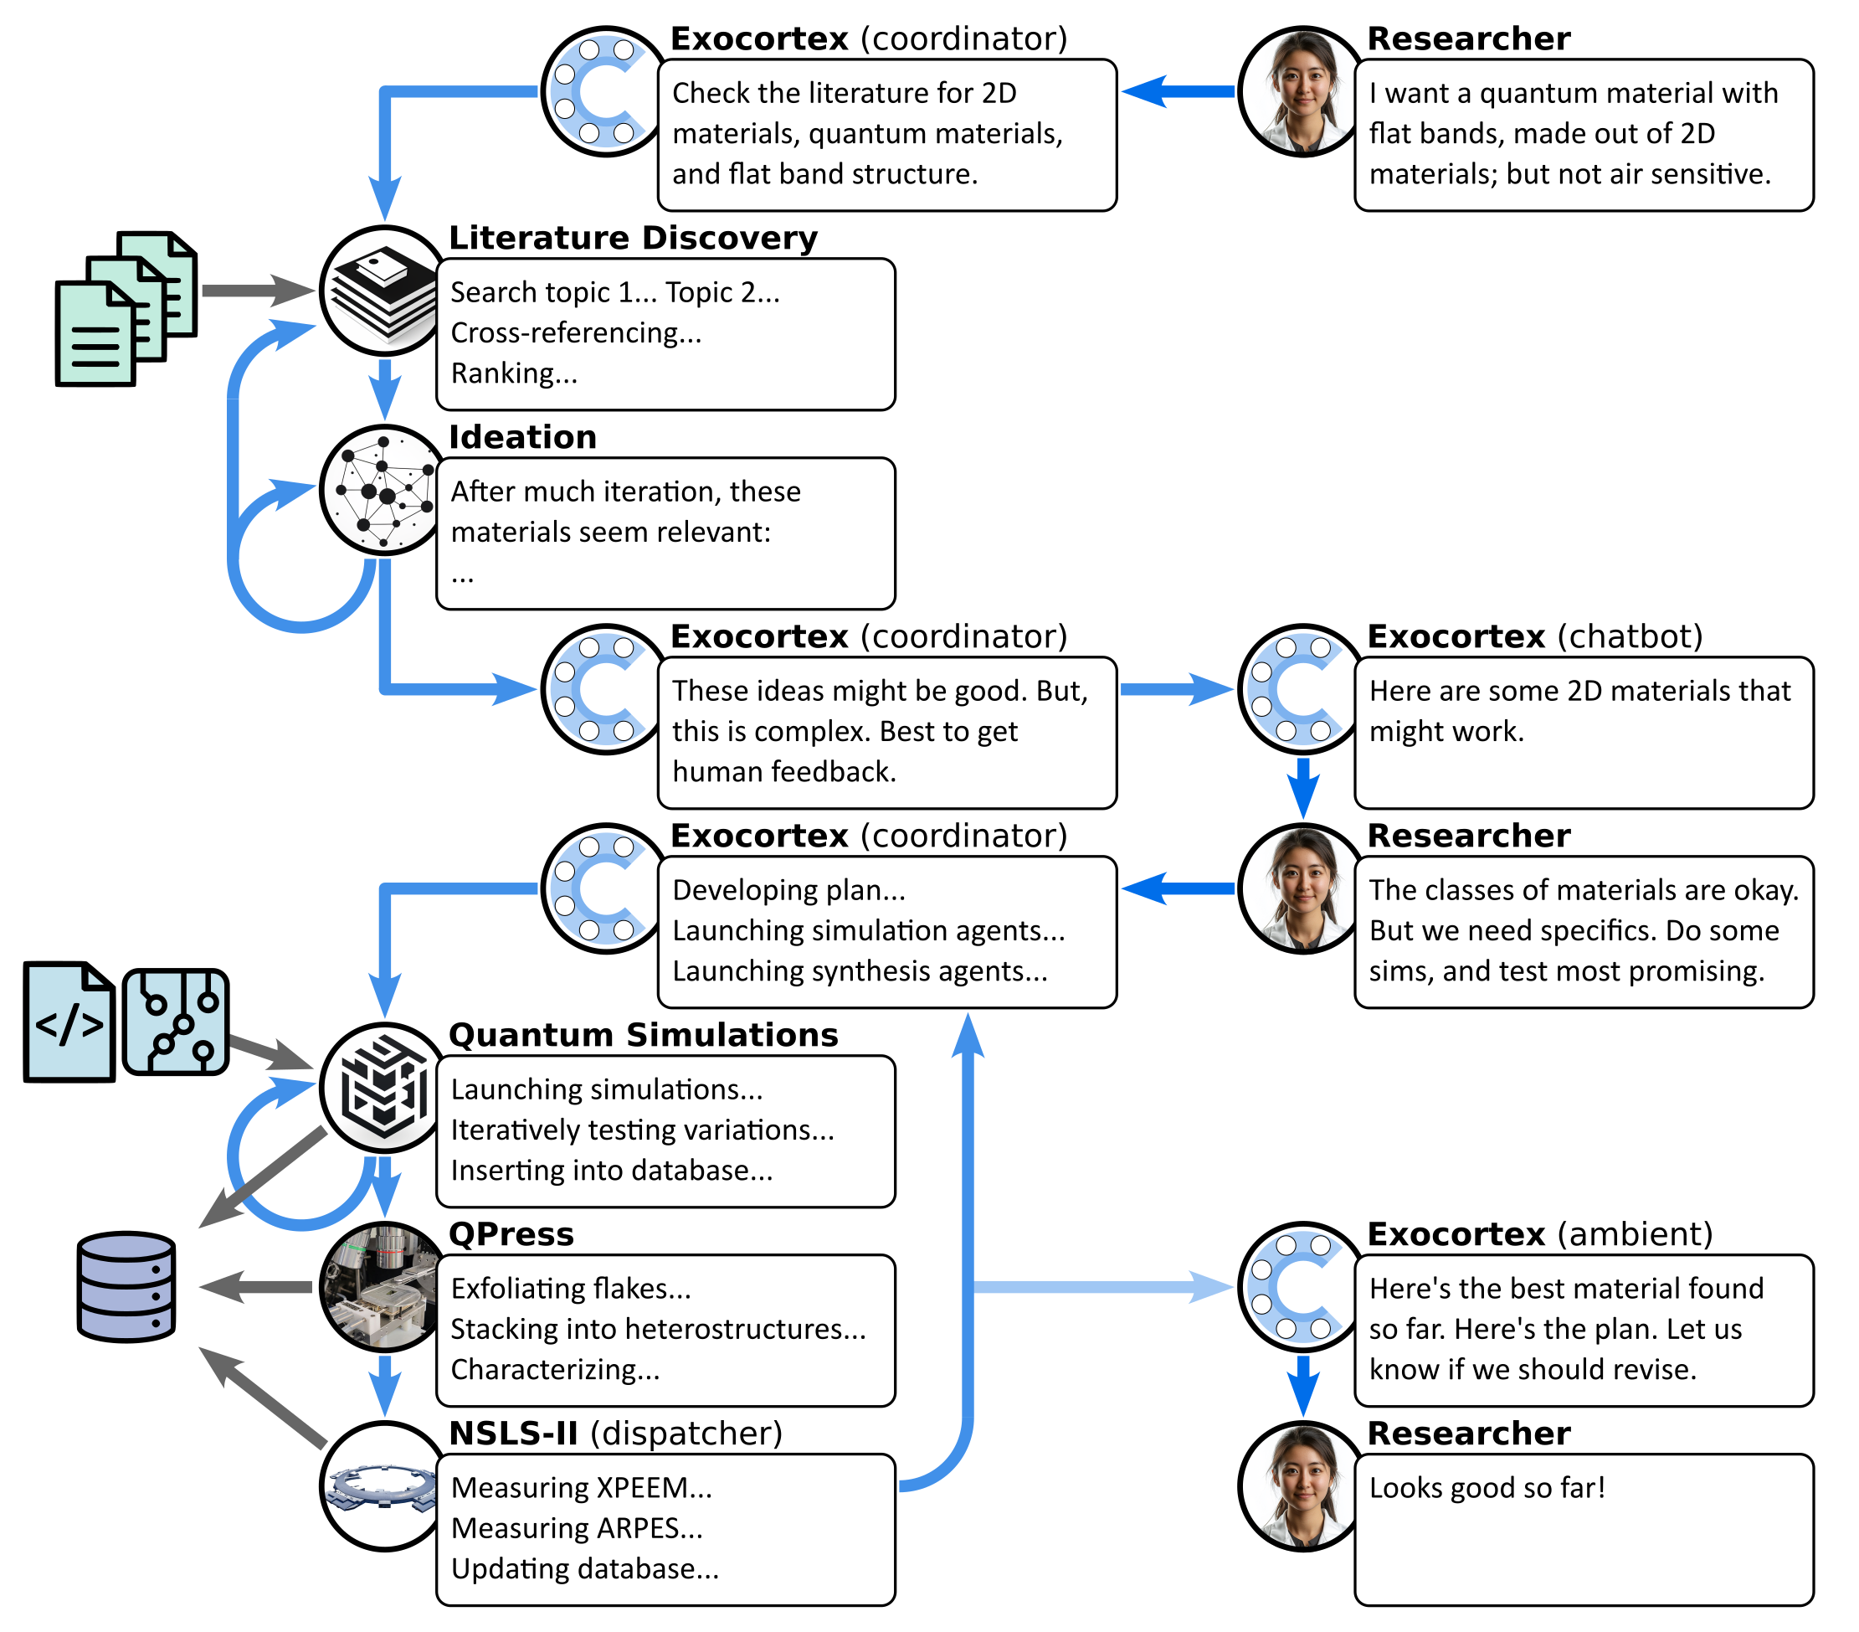
Future
Develop more AI assistants
Nanoscience publications chatbot
Data navigator
X-ray beamline operator
Materials simulation (DFT) software operator
Ideation bot
…
Test multi-AI workflows

Slide 26
Conclusion

Slide 27
Vision: Science Exocortex
Imagine a science exocortex: a persistent swarm of AI agents that extend a researcher’s cognition and volition
Yager Digital Discovery 2024, 3, 1933

Slide 28
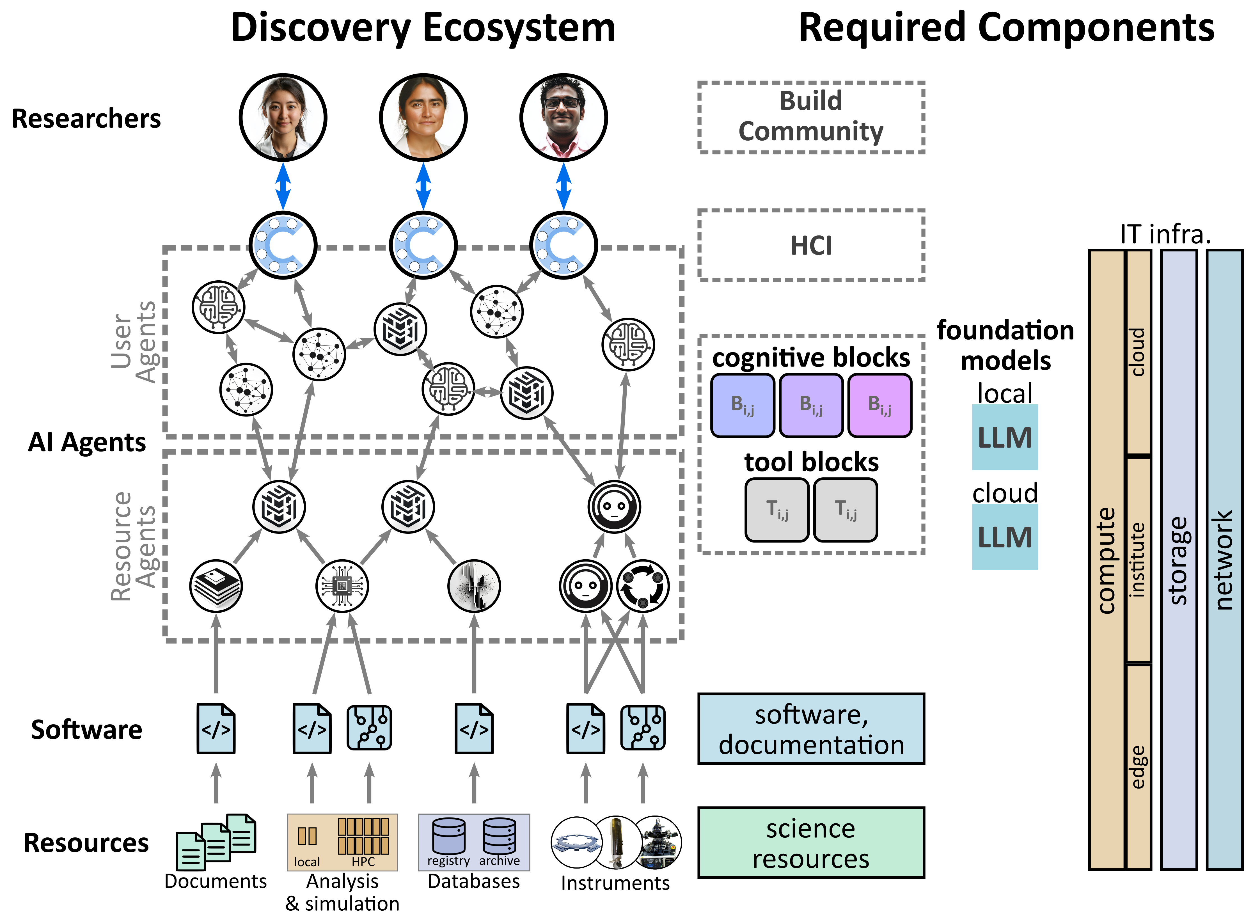
Vision: Science Exocortex
Exocortex
Swarm of “reasoning AI agents” that cooperate on complex tasks
Physical Scientists
AI-accessible instruments
Build AI agent workflows
Datasets, benchmarks, etc.
AI/ML Scientists
FMs for science (interpretable?)
LLMs suitable for science (tool-use, agents, etc.)
Connect science data to LLMs
Swarm architectures

Slide 29

Acknowledgments
Autonomous implementation
Masa Fukuto (BNL, NSLS-II)
Marcus Noack (CAMERA)
Ruipeng Li (BNL, NSLS-II)
Directed assembly (BNL, CFN)
Greg Doerk
Sebastian Russell
AI assistants
Esther Tsai (BNL, CFN)
Shray Mathur (BNL, CFN)
Noah van der Vleuten (BNL, CFN)
Max Rakitin (BNL, NSLS-II)
Carlos Soto (BNL, CDS)

Slide 30
Questions?

